Slide 1
PSAM 16 – 2022
Steven Prescott
Steven.Prescott@inl.gov
James Knudsen
Stephen Ted Wood
Coauthors
Automated Fire PRA Scenario Modeling in SAPHIRE Using FRI3D

Slide 2
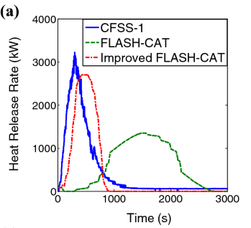
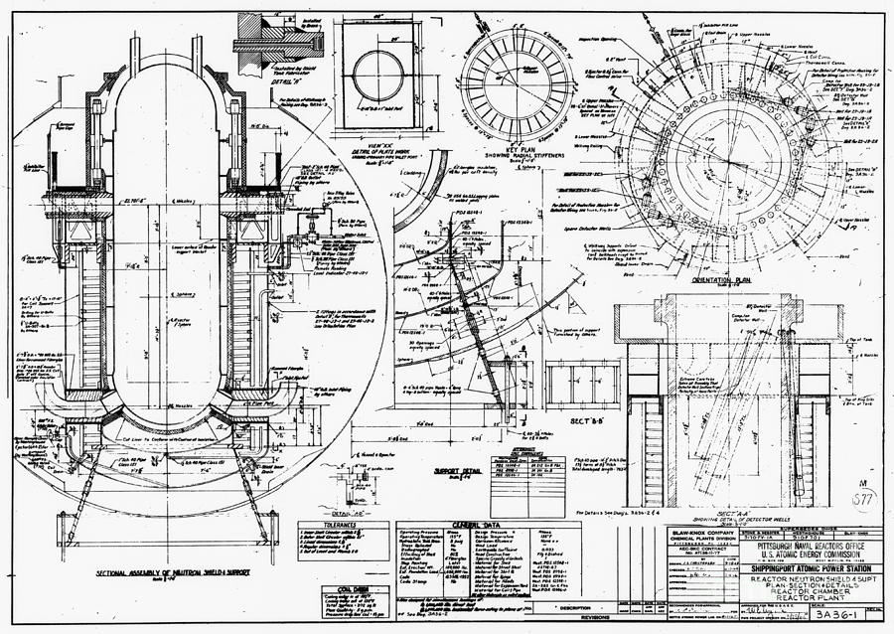
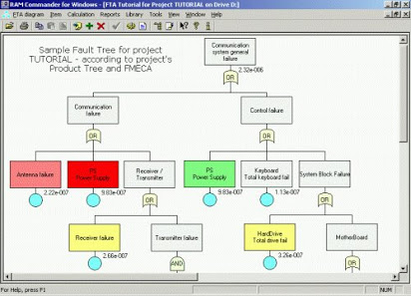
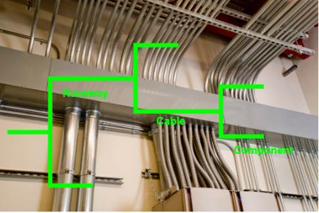
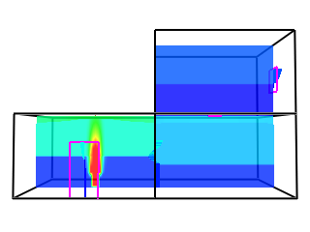
Fire Risk Analysis
Spatial Information
Calculation Methods
Plant Database
Operator Procedures
Walkdown Notes
PRA Model
Cable Tracing
(Logic Model)
Fire Simulation Models

Slide 3
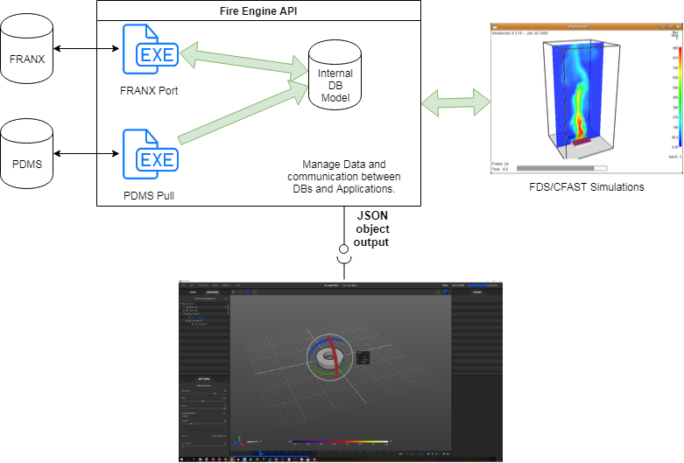
Fire Risk Investigation in 3D (FRI3D)
Combine multiple tools and methods to automate many fire PRA tasks
Import existing models/data
Link 3D spatial information
FLASH-CATS
CFAST fire simulation
Calculate component failures
Generate scenarios
Run PRA model

Slide 4
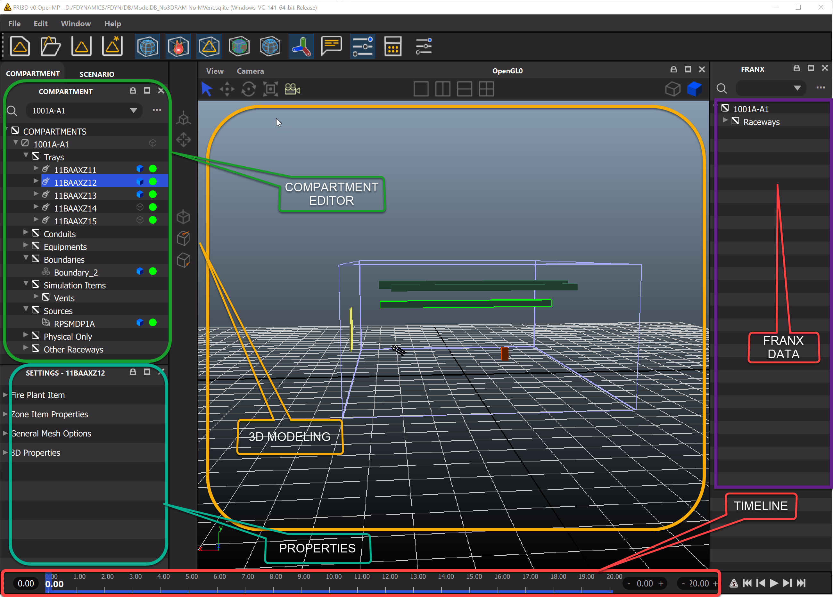
FRI3D User Interface
Left – Current compartment data
Center – 3D
Right – Trace logic
Bottom – Failure timeline

Slide 5
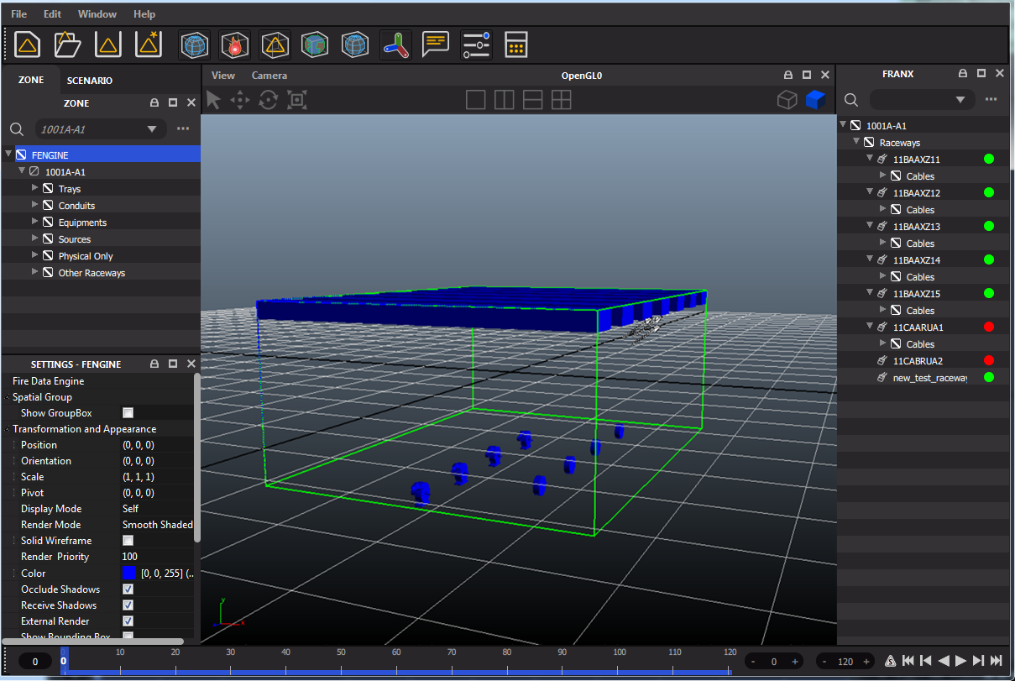
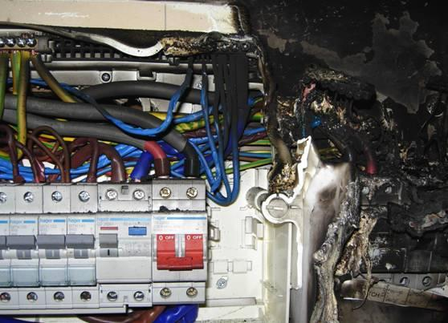
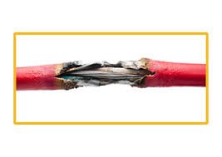
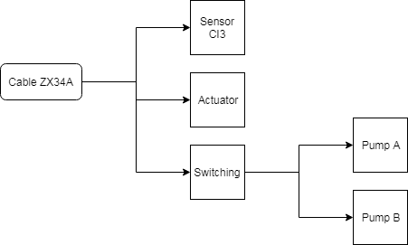
FRI3D Automated Scenario Generation
Physics Sim
(CFAST)
1
Secondary
Combustibles
(FLASH-CATS)
2
4
5
New Scenario
3
Determine Failures
(Heat Soak or THIEF calcs.)
Result Probability
Logic for Disabling Components

Slide 6
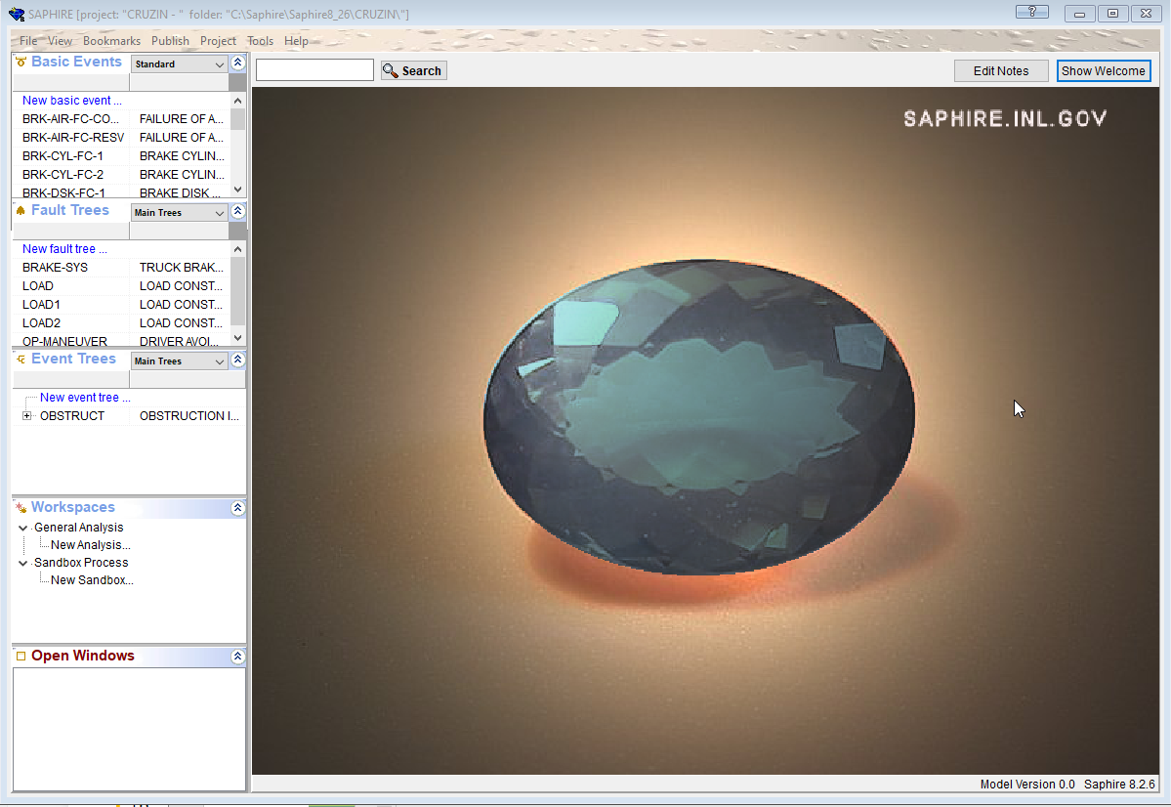
How to Do Fire Modeling in SAPHIRE
Initiating Events
Event Trees
Flag Sets
Linkage Rules

Slide 7
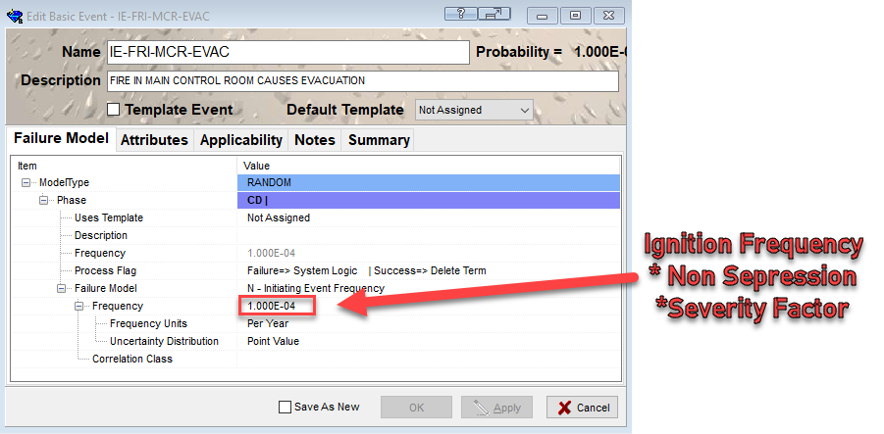
SAPHIRE Fire PRA (Initiating Event)
Step 1 – Create an initiating event for each scenario
Frequency is set to (ignition frequency * non-suppression probability * severity factor)

Slide 8
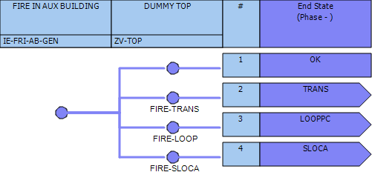
SAPHIRE Fire PRA (Event Trees)
Step 2 – Create an event tree for each fire scenario

Slide 9
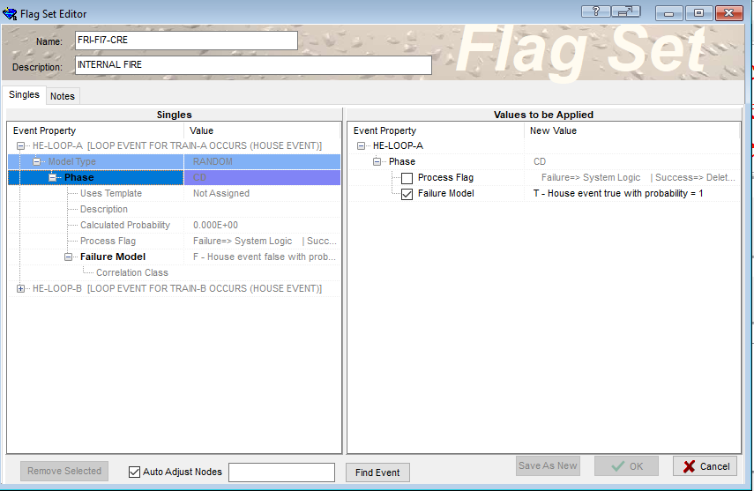
SAPHIRE Fire PRA (Target Sets)
Step 3 – Create a flag set for each scenario containing all the scenarios failed basic events being set to a true house event

Slide 10
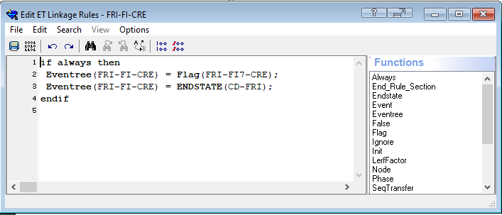
SAPHIRE Fire PRA (Linkage Rules)
Step 4 – Add a linkage rule for the even tree to apply the associated Flag set

Slide 11
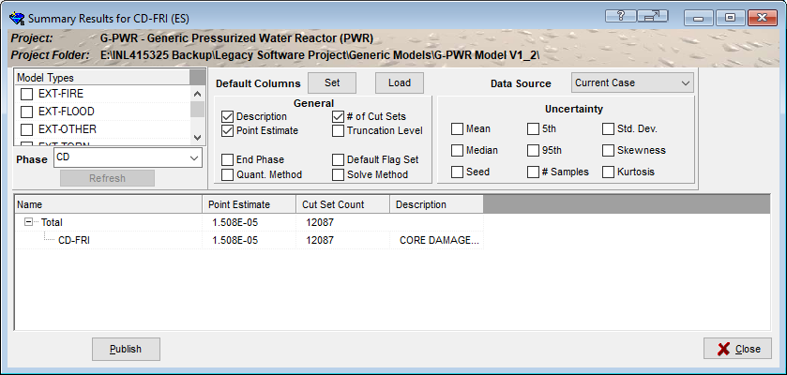
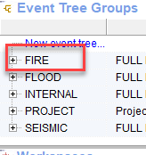
SAPHIRE Fire PRA (Solving)
Step 5 – Quantify to fire core damage end state (group under an event tree group for easy access)

Slide 12
Auto Generating Fire PRA
SAPHIRE MARD
SAPHIRE Macro execution

Slide 13
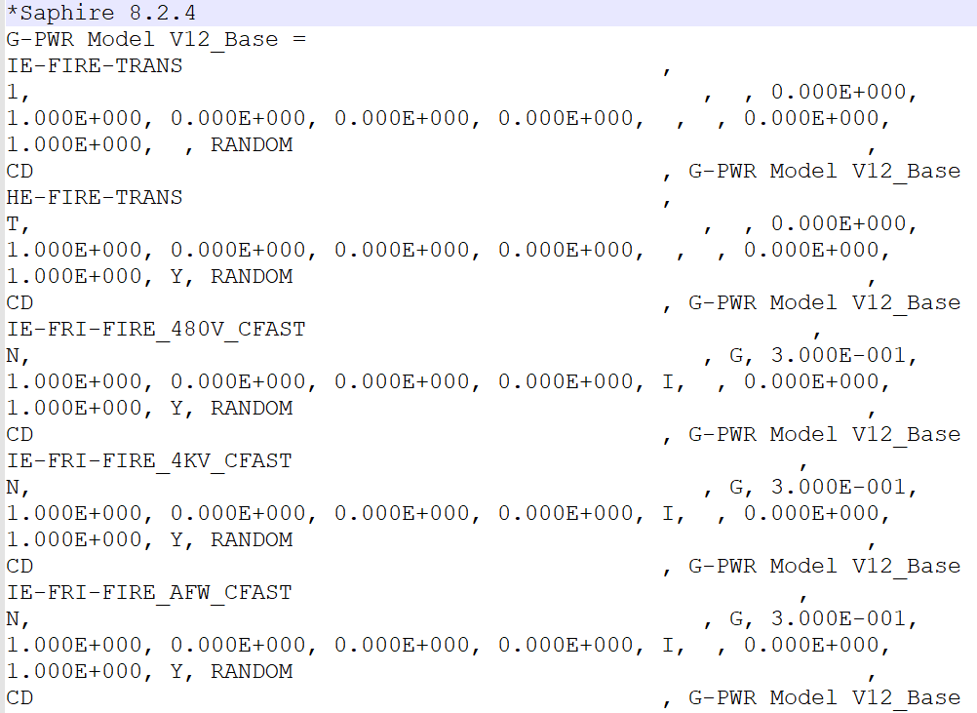
SAPHIRE MARD Input
Text-based version of the model
Allows for manual search and replace or software modification
Update new rates for basic events
Comparison

Slide 14
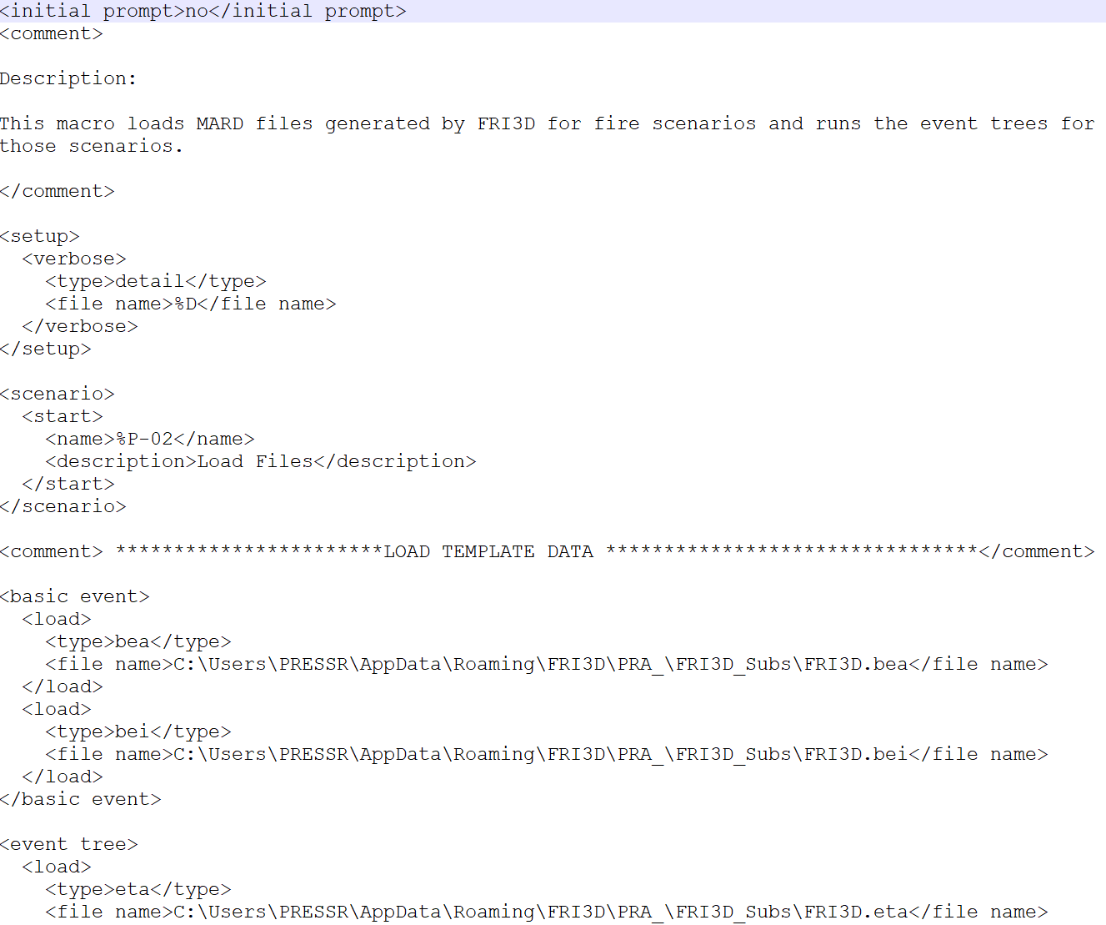
SAPHIRE Macro Input
Scripts that can be run in SAPHIRE
XML based
Import MARD
Quantify
Generate reports

Slide 15
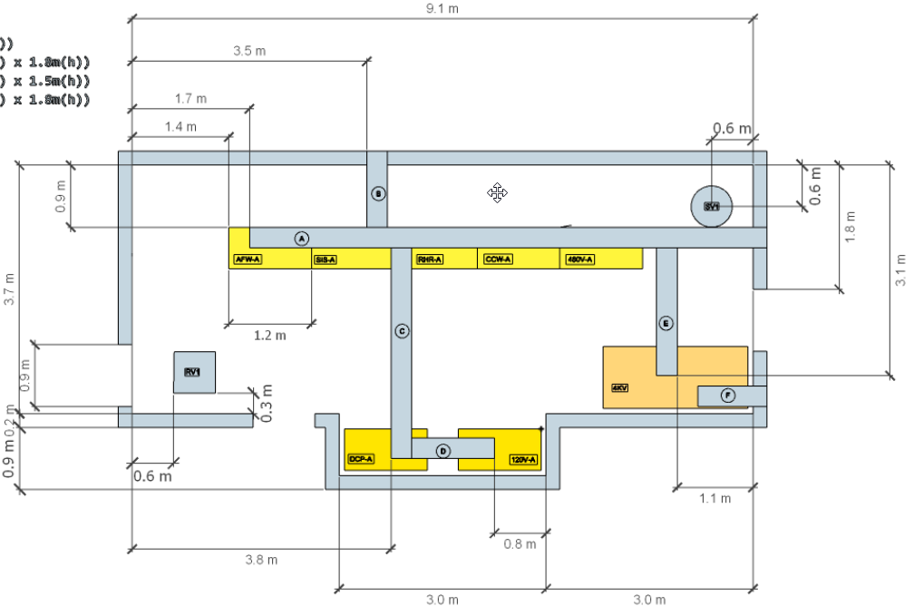
FRI3D Demo – Generic PWR Model
Layout for generic PWR
Switch gear room
AFW, SIS, RHR, CCW, 480v cabinets
4KV power
DC power
Cables logic to components

Slide 16
Video

