Slide 1
PSAM 16 – 2022
Steven Prescott
Steven.Prescott@inl.gov
Daniel Nevius
Zhegang Ma
Svetlana Lawrence
Coauthors
Using EMRALD to Simplify and Perform Dynamic Analysis with MAAP

Slide 2
Thermal Dynamics in PRA
Model representing the heat transfer and fluid flow of a reactor
Modeling requires expert knowledge
Difficult learning curve (Script based)
Used to identify hazardous conditions of a plant
Evaluate mitigation strategies
Typically bins or conservative bounds for parameters are determined (Static)
Nuclear Power Examples: MAAP, RELAP, MELCOR

Slide 3
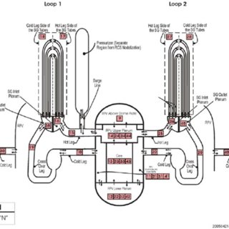
MAAP
Modular Accident Analysis Program (MAAP)
Commonly used by industry
EPRI code to evaluate PWR and BWR reactors
Custom input files
Main plant model - .INP file
Modification file for a scenario - .PAR
Fast compared to other TH codes
How to make it easier for a typical analyst to use the models for common tasks including statistical or dynamic analysis?
Nuclear Engineering and Technology 10.1016/j.net.2015.06.010
Notes:
Input files reminiscent of Fortran code.

Slide 4
EMRALD
Dynamic PRA based on a three-phased discrete event simulation
Initialization – Start states added to initial states
While there are States in the New States list, for each State - Add the Events to the Time Queue or Conditional List - Execute any Immediate Actions
If any Conditional Events criteria is met - Execute that events action/s - (Go to Step 1)
Jump to the next chronological event - Process that event’s actions - (Go to Step 1)
https://emrald.inl.gov

Slide 5
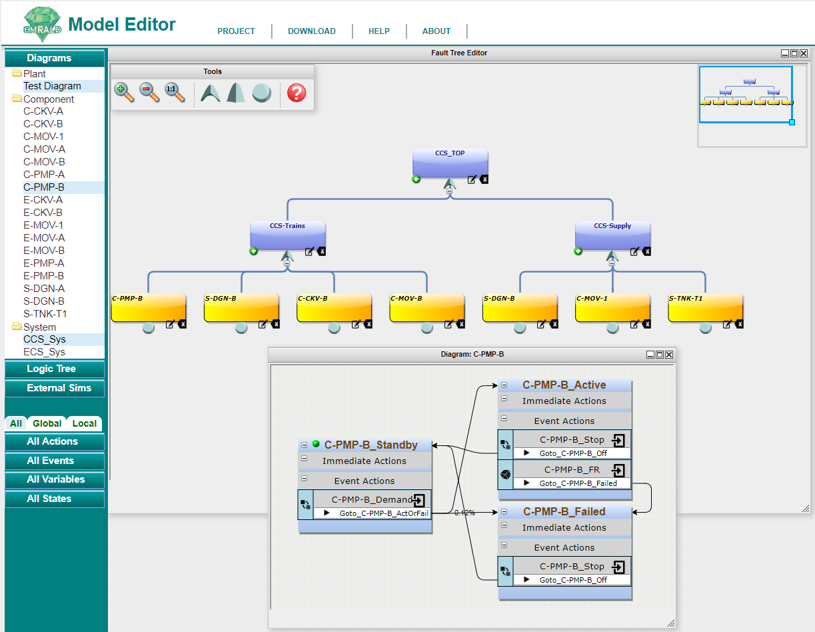
EMRALD User Interface
Web Model Editor
Drag & Drop
State Based Model
Open Source

Slide 6
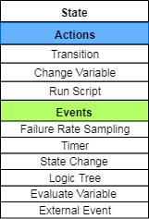
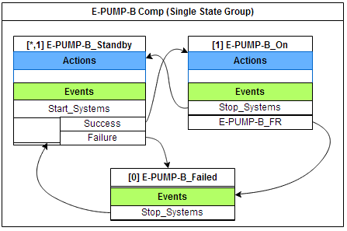
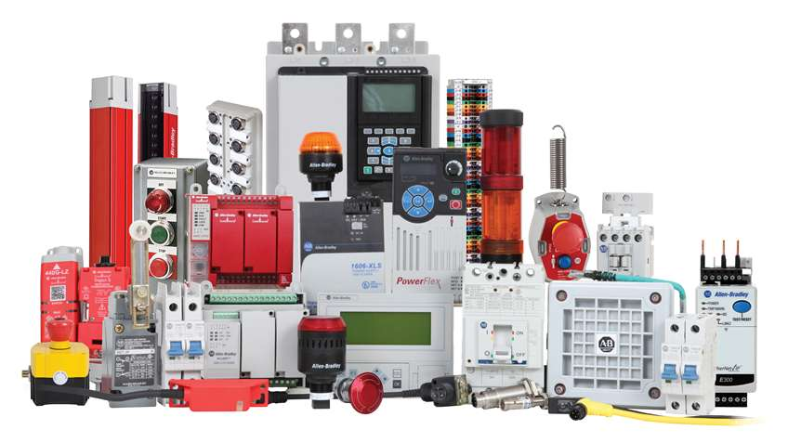
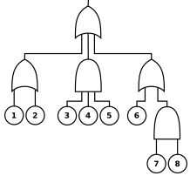
EMRALD Modeling
States
Actions (transition, change variables, run script)
Events -> Action (sampling, conditions, time, etc.)
Diagrams
Components
Systems
Plant response
Logic Trees
Variables
External Links

Slide 7
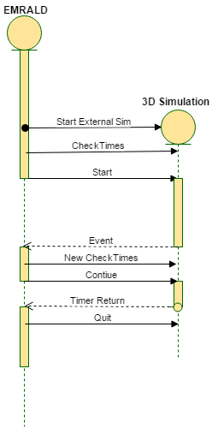
Coupling in EMRALD
EMRALD
One Way Coupling
User Defined Pre-Script
Assigned Exe
User Defined Post-Script movement
Start Exe
On Exit
Two Way Coupling
Message Passing
Requires open code or API
Event times
Feedback loops

Slide 8
EMRALD Custom Form
Designed to read in data and setup input for a specific application
Simplifies one way coupling
Do not need to know how the other application works
Retrieve and set EMRALD data with library of functions
Created by a software developer in one to a few days

Slide 9
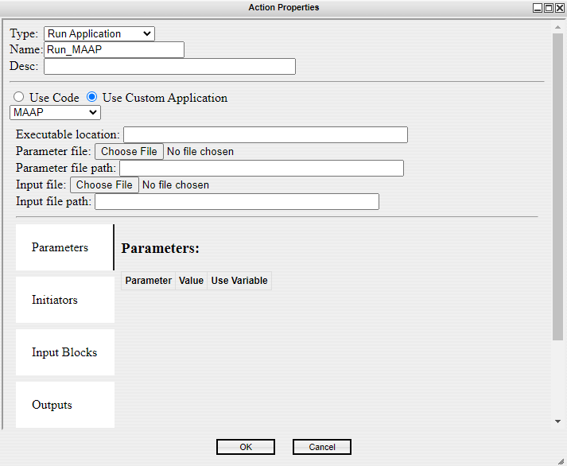
MAAP Form in EMRALD
Select custom application
MAAP Option
Assign parameters
Files are parsed and data loaded in the tabs.

Slide 10
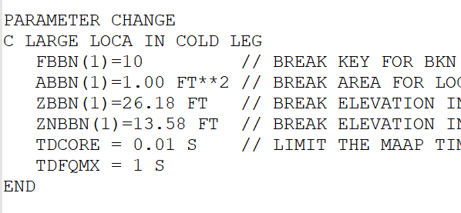
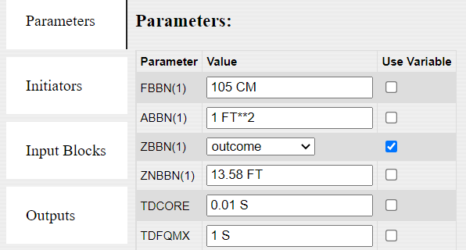
MAAP Parameters in EMRALD
Lists parameters and allows you reassign or set to EMRALD variables

Slide 11
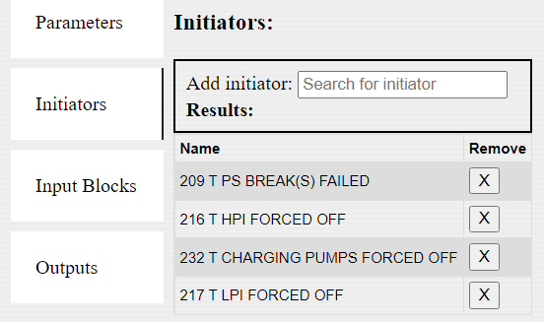
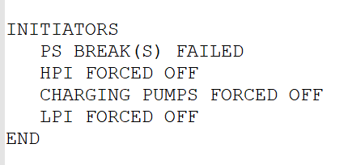
MAAP Initiators in EMRALD
Lists current initiators and allows you to search for new ones or remove existing

Slide 12
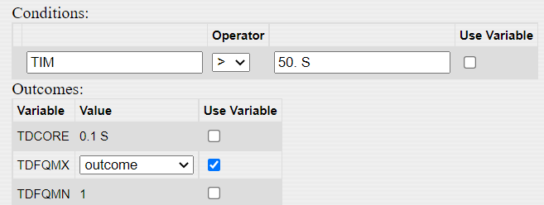
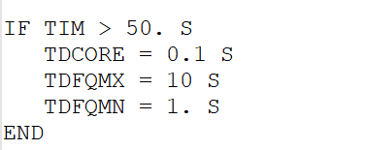
MAAP Condition Blocks in EMRALD
Lists conditions and lets you assign EMRALD variables to parameters

Slide 13
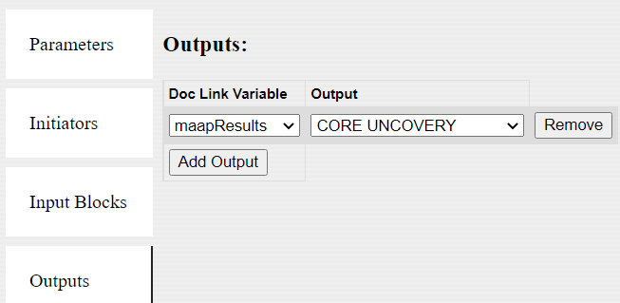
MAAP Output in EMRALD
Link result variable to desired data from .INP output file

Slide 14
Test Cases (MAAP 5.0.4)
Demo Model (CRA1AI.INP & WICE.PAR)
Hand results run using PWR5DOS with command options
PWR5DOS Input_Deck_Name (e.g., WIC-LOCA.INP) <Parameter_File> (e.g., WICE.PAR)
MAAP Input Deck | LOCA (inch) | LOCA Area (ft²) | MAAP Code
WIC-LOCA | 2 | 0.0218 | ABBN(1) = 0.0218 FT**2
WIC-LOCA-1 | 3 | 0.0491 | ABBN(1) = 0.0491 FT**2
WIC-LOCA-2 | 4 | 0.0873 | ABBN(1) = 0.0873 FT**2
WIC-LOCA-3 | 5 | 0.1364 | ABBN(1) = 0.1364 FT**2
WIC-LOCA-4 | 6 | 0.1963 | ABBN(1) = 0.1963 FT**3
WIC-LOCA-5 | 7 | 0.2673 | ABBN(1) = 0.2673 FT**4
WIC-LOCA-6 | 8 | 0.3491 | ABBN(1) = 0.3491 FT**5
WIC-LOCA-7 | 10 | 0.5454 | ABBN(1) = 0.5454 FT**6
WIC-LOCA-8 | 12 | 0.7854 | ABBN(1) = 0.7854 FT**7
WIC-LOCA-9 | 14 | 1.0690 | ABBN(1) = 1.0690 FT**8
MAAP Input Deck | LOCA (in.) | SCRAM | PZR EMPTY | MAIN COOLANT PUMPS OFF | CORE UNCOVER | CORE > 2499 K
WIC-LOCA | 2 | 55 | 90 | 1706 | 2513 | NA
WIC-LOCA-1 | 3 | 23 | 45 | 769 | 1610 | NA
WIC-LOCA-2 | 4 | 11 | 28 | 431 | 948 | NA
WIC-LOCA-3 | 5 | 7.3 | 20 | 279 | 713 | NA
WIC-LOCA-4 | 6 | 5.1 | 16 | 197 | 260 | NA
WIC-LOCA-5 | 7 | 3.8 | 13 | 144 | 197 | NA
WIC-LOCA-6 | 8 | 2.9 | 12 | 110 | 158 | NA
WIC-LOCA-7 | 10 | 1.9 | 10 | 70 | 112 | 2890
WIC-LOCA-8 | 12 | 1.2 | 9.6 | 48 | 90 | 2230
WIC-LOCA-9 | 14 | 0.9 | 9 | 35 | 71 | 1793

Slide 15
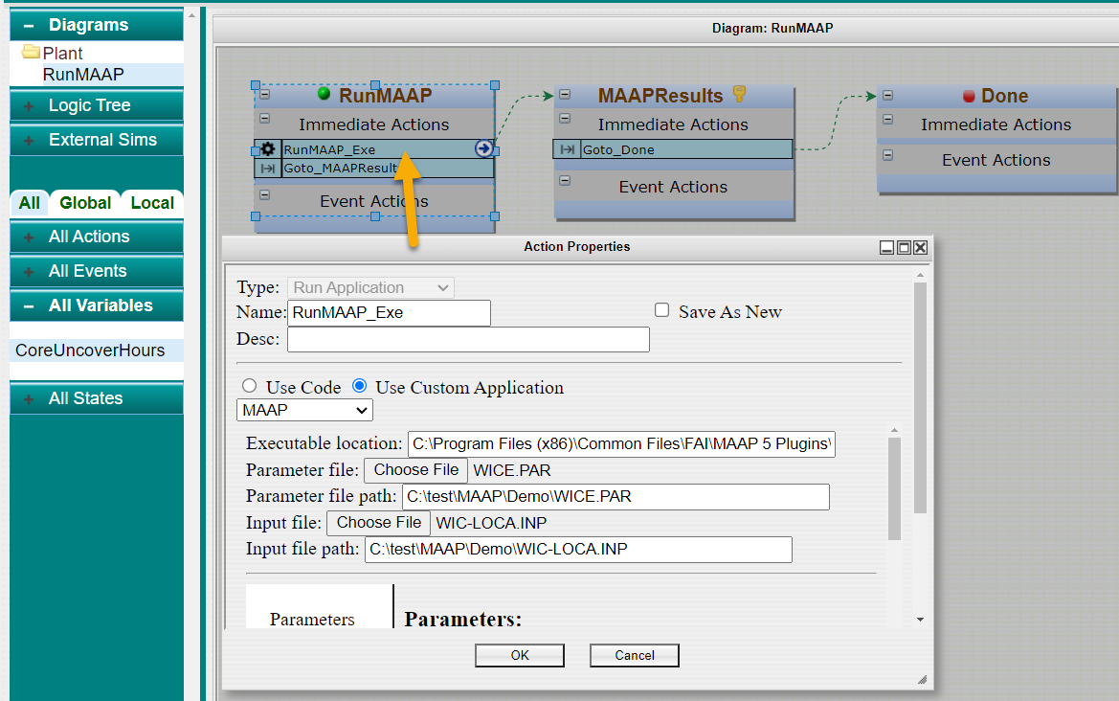
Simple Use Case
1. Load the .INP and .PAR files

Slide 16
Simple Use Case (Continued)
2. Assign the ABBN(1) parameter (hover over showed item comments)
3. Assign the result to analyze

Slide 17
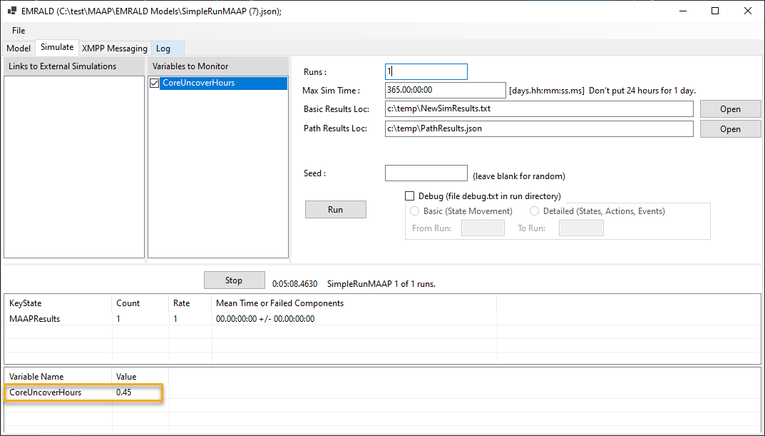
Simple Use Case Results
CoreUncoveryHours 0.45

Slide 18
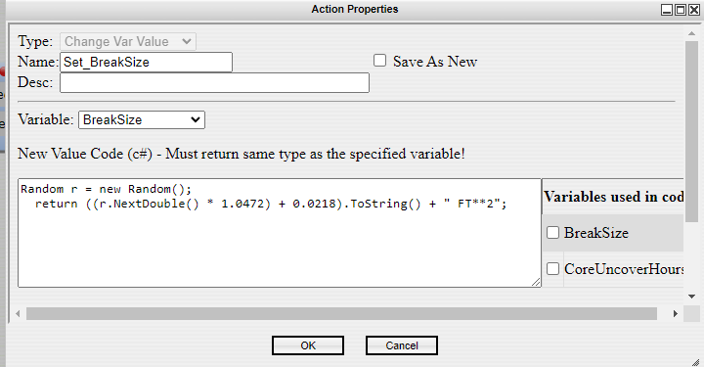
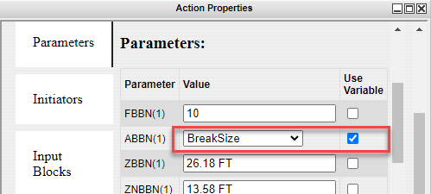
Dynamic Simulation Use Case
Operator procedure to identify and isolate LOCA
Task has a normal distribution for time to perform 5 min with 3 min standard deviation
Evaluate probability of success

Slide 19
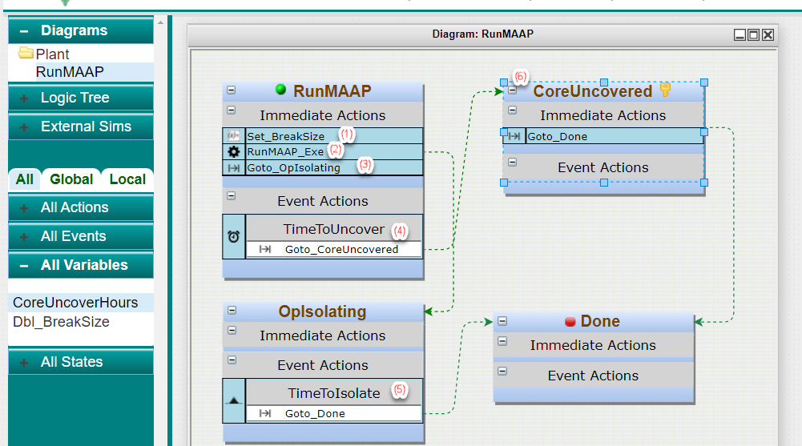
Dynamic Simulation Use Case (Continued)
1. Sample the size of break
2. Run MAAP
3. Start Operator procedure
4. Timer assigned by MAAP results
5. The time for operator to isolate
6. If operator is to slow then core is uncovered
Results
25 runs
15 “CoreUncovered”
0.60

Slide 20
Conclusion
TH analysis provides critical data for dynamic PRA
EMRALD custom forms simplifies the coupling with complex TH applications such as MAAP
With a custom UI, EMRALD could be used to run one-off TH runs
EMRALD enables dynamic analysis of TH models

