Slide 1
A modeling framework for assessing resilience of urban infrastructure systems considering multiple interdependency and uncertainty
Sotaro Kawanishi¹, Kazuo Furuta¹, and Taro Kanno¹
¹ School of Engineering, The University of Tokyo, Japan
The Probabilistic Safety Assessment and Management Conference
June 26, 2022
Notes:
Hello everyone.
I’m Sotaro Kawanishi, from the University of Tokyo.
The title of the presentation is “A modeling framework for assessing resilience of urban infrastructure systems considering multiple interdependency and uncertainty”.

Slide 2
Background
Resilience has become an important concept in maintaining the functionality of the society in recent years.
Resilience assessment considering the uncertainty of disaster scenario is necessary to deal with unexpected disasters.
Most studies that consider uncertainty focus on assessing the risk of failure of the target system, and few studies assess the resilience of the entire social system.
Kanno et al.^{[1]} developed a model that considers various types of interdependencies underlying urban systems to assess urban resilience for a fixed disaster scenario (hereinafter referred to as previous study).
We extended the model used in the previous study and applied the Monte Carlo method to assess resilience considering uncertainty
[1] T. Kanno, T. Suzuki, S. Koike, and K. Furuta, “Human centered modeling framework of multiple interdependency in urban systems for simulation of post disaster recovery processes,” Cognition, Technology & Work, 21(6), pp. 301-316, 2019.
Notes:
First, I will talk about the background of our research.
Damage to infrastructure during disasters is a major challenge for countries around the world, and extensive damage is inevitable in certain cases such as the Great East Japan Earthquake.
Against this background, the concept of resilience has become more important compared to the traditional risk management in recent years.
In order to deal with unexpected disasters, resilience assessment considering the uncertainty of disaster damage is necessary.
However, most studies that consider uncertainty focus on assessing the risk of failure of the target system, and there are few studies that assess the resilience of the entire social system.
Therefore, we aimed to introduce the concept of uncertainty to a model that assesses the resilience of the entire social system.
Kanno et al. developed a human-centered modeling framework of urban systems that captures various types of interdependency underlying urban sociotechnical and socioeconomic systems to assess urban resilience for a fixed disaster scenario.
Fixing the disaster scenario has been a common approach in resilience researches.
We extended this model and applied the Monte Carlo method to assess the resilience of the entire social system considering uncertainty

Slide 3
Objective
Develop a resilience assessment method for urban infrastructure
Considering uncertainty of disaster damage by applying the Monte Carlo method
Considering multiple interdependencies of a city
Apply to the water distribution network
Compare the distribution of resilience for different cases
Notes:
Next, I will talk about the objective.
As I said earlier, the main objective of this research is to develop a resilience assessment method for urban infrastructure.
We considered uncertainty of disaster damage by applying the Monte Carlo method, and considered multiple interdependencies of a city by extending the model used in the previous research.
Then, we aimed to verify the effectiveness of the method.
In this research, we applied the modeling framework to the water distribution network, assuming that random water pipes will break in each simulation.
Then, we compared the distribution of resilience for 2 different cases: one is having a restoration plan, and the other is restoring in a random order.
We believe that these simulation results could be used to support the development of disaster prevention measures, by evaluating the effectiveness of those measures.

Slide 4
Flowchart of the method
Main parameters
Number of simulation runs (N)
Timesteps for each simulation (T)
Each simulation uses the same model structure
The distribution of the damage is given randomly when a disaster occurs
The distribution of resilience is obtained as the output
Set parameters
Initialize model structure
Start simulation
Disaster occurrence
Simulation
Model
No
Restoration
Calculate resilience
Reach N
Yes
Distribution of resilience
Notes:
This is the flowchart of the resilience assessment method.
First, the simulation parameters such as the number of simulation runs N and timesteps for each simulation T are set.
Then, the model structure, for example, the lifeline network, is initialized.
After that, the simulation will start.
The distribution of damage is given randomly when a disaster occurs, and the recovery process is simulated.
When the timestep reaches T, the simulation ends, and the resilience of the run will be calculated.
The distribution of resilience will be obtained after repeating the simulation N times.

Slide 5
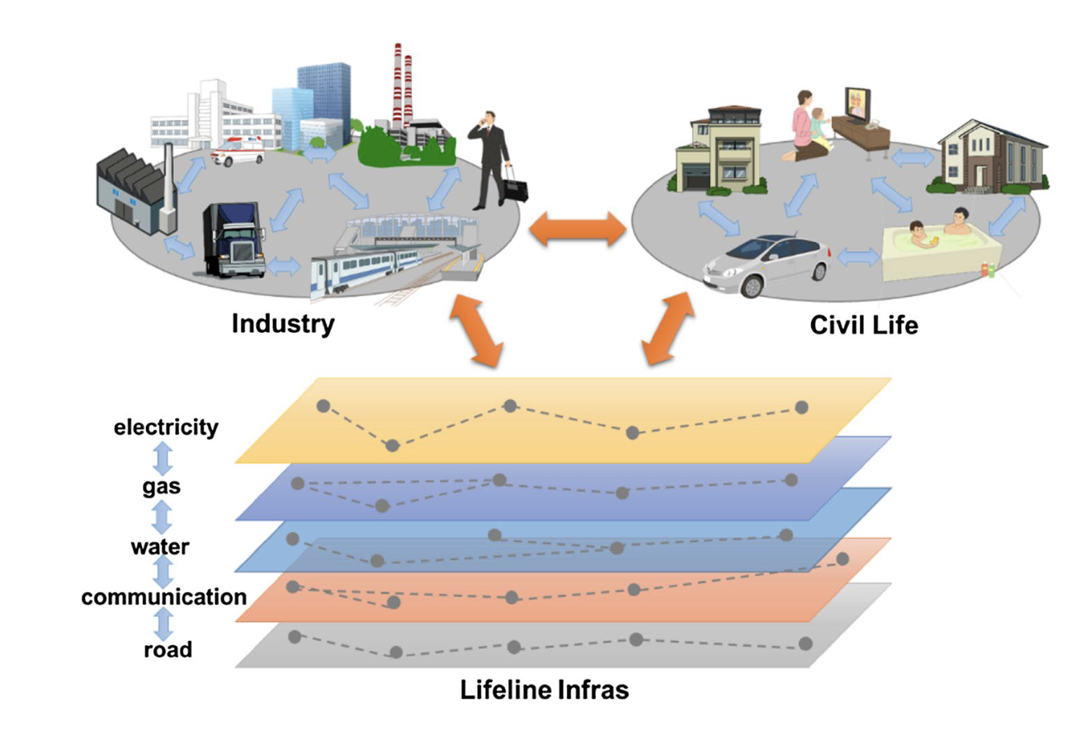
Overview of the simulation model
Simulate the recovery process of a local city from a disaster
[1] T. Kanno, T. Suzuki, S. Koike, and K. Furuta, “Human centered modeling framework of multiple interdependency in urban systems for simulation of post disaster recovery processes,” Cognition, Technology & Work, 21(6), pp. 301-316, 2019.
Notes:
Then, I will explain the overview of the simulation model.
The model consists of three subsystems: civil life, manufacturing/service industry, and lifeline infrastructure, and interdependencies existing within and between these subsystems are considered.
The lifeline infrastructures are represented as multi-layered networks of links and nodes, with each link having parameters that represent the connection and length.
Citizens and facilities such as company factories are represented as agents and are placed on the road network.
It is assumed that lifeline links get damaged when a disaster strikes, and the recovery process of a local city from a disaster is simulated in each simulation run.
5

Slide 6
Interdependency
 |  | On
 |  | Civil Life | Industry | Lifeline
Dependency of | Civil Life | Resource conflict Geographical | Supply Geographical | Supply Geographical
 | Industry | Demand Labor supply Geographical | Demand/supply Alternative Geographical | Supply Geographical
 | Lifeline | Demand Labor supply Geographical | Demand/Supply Repair Geographical | Demand/Supply Alternative Geographical
Notes:
Next, I will talk about the interdependencies that are taken into account.
Nine different types of interdependencies existing within and between the three subsystems are considered.
First, I will explain the interdependencies within the subsystems.
A typical dependency within civil life is resource-sharing and conflict among different daily activities or other persons.
Within Industry and lifeline, there are transactional relationships, such as those involving demand and supply or customer and provider relationships, and there are alternative or competitive relationships.
Then, I will explain the interdependencies between the subsystems.
Civil life depends heavily on lifelines and services that industries provide.
Industry depends on civil life for labor supply and depends on lifeline for lifeline supply. Also, the demand is determined by civil life.
Lifeline is dependent on civil life and industry, because the demand is determined by them.
In addition, various companies and organizations are involved in restoring the damaged lifelines, which can also be regarded as a dependency.

Slide 7
Agent-based model
Citizen
4 types of citizens: non-workers, industry workers, lifeline workers, and repair workers
Performs daily life activities to satisfy quality of life
Company
Manufactures products and provides services by accomplishing company tasks
Restoration Squad
Repairs damaged lifeline links after a disaster occurs
Notes:
Next, I will explain the agent-based model.
These are the main agents that exist in the model.
There are 4 types of citizen agents: non-workers, industry workers, lifeline workers, and repair workers.
Workers commute to their workplaces, and supplies labor to them.
Each citizen agent performs daily life activities such as consuming water and purchasing daily necessities, to satisfy their quality of life.
Company agents manufactures products by accomplishing company tasks, and provides the products to the citizen agents.
Restoration squads are agents that repair the damaged lifeline links after the disaster occurs.
They are constrained by distance, time, and resources, so it will take some time for the lifeline infrastructures to fully recover.

Slide 8
Evaluation
The total performance is the average performance of the three subsystems
Civil life: Average quality of life of each citizen agent
Quality of life is the percentage of daily life activities achieved
Industry: Percentage of company tasks achieved
Lifeline: Percentage of links with access to lifeline facilities
The resilience of the city is assessed by the area of the resilience triangle in the post disaster simulation
Performance
Disaster Occurrence
Time
Notes:
Next, I will explain the evaluation criteria.
The total performance of the social system is calculated by the average performance of the three subsystems.
The performance of civil life is the average quality of life of each citizen agent, while the quality of life is the percentage of daily life activities achieved.
The performance of industry is the percentage of company tasks achieved, and the performance of lifeline is the percentage of links with access to lifeline facilities.
These performance values are calculated on a 100-point scale, day by day.
Then, the resilience of the city is assessed by the area of the resilience triangle in the post disaster recovery simulation.

Slide 9
Application to the water distribution network
Company
Main pipe
Randomly damaged when a disaster strikes
Reservoir
Branch pipe
Residence
Notes:
Next, I will explain how we applied the modeling framework to the water distribution network.
Wakayama et al. applied the model used in the pervious study to the evaluation of water pipe repair plans, and reproduced the water distribution network of a real city.
Attributes were set to each water pipe, for example, whether the pipe is a main pipe with larger diameter or not.
We used the network structure of this research.
Since we focused on the water distribution network, we assumed that only water pipes would randomly get damaged when a disaster strikes.
Any water pipe that cannot reach any reservoirs by following undamaged water pipes are regarded as unavailable pipes, and buildings that are tied with unavailable pipes will not be able to access to water.
10

Slide 10
Test run
Parameter | Value
Citizens | 6,990
Companies | 628
Nodes | 2,310
Road links | 1,951
Water pipes | 4,910
Repair squads | 13
Pipes damaged when disaster strikes | 100
Simulation days | 20
Disaster date | 5
Number of simulations | 100,000
Apply to two cases
Case 1: Prioritize upstream main pipes
Case 2: Random order
Notes:
Next, I will explain how I conducted the test run.
The table on the left shows the main simulation settings.
The road network model consists of 2310 nodes and 1951 links, and 6990 citizen agents (each representing 4 people) and 628 enterprises are placed on the network.
As for the water distribution network, 4910 pipes are placed, and 13 water repair squads work to repair the pipes after a disaster occurs.
100,000 simulations were conducted, with each simulation lasting 20 days, with a disaster occurring on the fifth day, when 100 water pipes are randomly destroyed.
Then, we applied the method to 2 cases: with and without having a repair plan.
In case of having a repair plan, main pipes were prioritized, and when the pipes are the same type, priority was given to the pipe closer to upstream.
In case of no repair plans, the repair order was selected randomly.
After that, compared the distribution of resilience to evaluate the impact of having a repair plan to urban resilience.

Slide 11
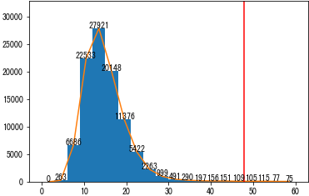
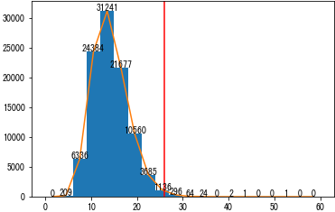
Results
Histogram of resilience index
Case 1: Without repair plan
Average: 16.1
Maximum: 758.2
99 percentile: 47.9
Frequency
Case 2: With repair plan
Average: 14.4
Maximum: 82.5
99 percentile: 25.9
Frequency
Resilience Index
Notes:
These are the results.
The graphs show the histogram of the resilience index in each case.
The upper graph shows that of the case without any repair plans, and the lower graph shows that of the case when upstream main pipes are prioritized.
The horizontal axis represents the resilience value, and the vertical axis represents the frequency.
The red vertical line in the graph represents the 99 percentile.
First of all, by comparing the average value, we can observe that the implementation of the recovery plan slightly improves the system resilience, 1.5 on average.
Next, comparing the maximum resilience value, there is a large difference between 758.2 and 82.5, indicating that the implementation of a repair plan has a significant effect on improving the worst-case scenario.
In addition, there is a significant difference in the 99 percentile values, which is 47.9 for the random case and 25.9 with the repair plan, so it can be said that the possibility of high impact cases will significantly decrease by introducing a repair plan.
Although there is not much difference in the approximate shape of the graph, these results could be visually confirmed by focusing on the tail of the graph where the resilience value is higher than 35.
From these results, it can be said that the Monte Carlo method can be applied to simulations to evaluate disaster prevention strategies from a more multidimensional perspective.

Slide 12
Conclusion
We developed a resilience assessment method considering uncertainty and multiple interdependency
Results showed that disaster prevention strategies can be evaluated more accurately for high impact/low frequency disasters by applying the Monte Carlo method
Future perspective
Consideration of uncertainties of disaster scale and timing
Application of variance reduction methods to reduce computational effort
Implementation of realistic pre and post disaster prevention measures
Notes:
Finally, I will conclude my presentation.
We developed a modeling framework based on previous research to enable resilience assessment of urban infrastructure systems considering multiple interdependency and uncertainty.
Simulation results showed that disaster prevention strategies can be evaluated more accurately for high impact/low frequency disasters compared than when disaster scenarios are fixed.
The next step will be randomizing the scale and occurrence timing of the disaster, and adding attributes that affect the failure probability to the pipes.
As the number of random factors increases, the variance of the simulation results will increase, and more simulation runs will be needed, so we will apply variance reduction methods to reduce computational effort.
After that, we will implement more reality-based pre-disaster and post-disaster measures and compare the results of their effectiveness, so that the model could be put to practical use.
Thank you for listening.

