Slide 1
A novel approach for quantitative importance analysis of DI&C systems in NPP
June 27. 2022
KAERI, Risk Assessment Team
Sung-Min Shin, Sang Hun Lee, Seung Ki Shin

Slide 2
Contents
Introduction
Main part
  DI&C system modeling
  Weight assignment
  Importance evaluation
Case study
Concluding remarks

Slide 3


Introduction | Ideal goal
The defence in depth (DiD) concept is applied to all safety related activities, whether organizational, behavioral or design related, and whether in full power, low power or various shutdown states.
This is to ensure that all safety related activities are subject to independent layers of provisions, so that if a failure were to occur, it would be detected and compensated for or corrected by appropriate measures.
An approach to designing and operating nuclear facilities that prevents and mitigates accidents that release radiation or hazardous materials.
The key is creating multiple independent and redundant layers of defense to compensate for potential human and mechanical failures so that no single layer, no matter how robust, is exclusively relied upon.
DiD includes the use of access controls, physical barriers, redundant and diverse key safety functions, and emergency response measures.

Slide 4
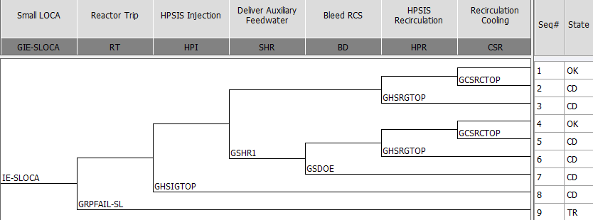
Introduction | In reality
SLOCA ET on OPR-1000
For the I&C systems, in fact, they are not possible to be completely independent of the paths of “instrumentation – decision making – control” required for each mitigation procedure.
➔ We need to evaluate the suitability of redundancy and diversity in the I&C functions for accident mitigation.

Slide 5
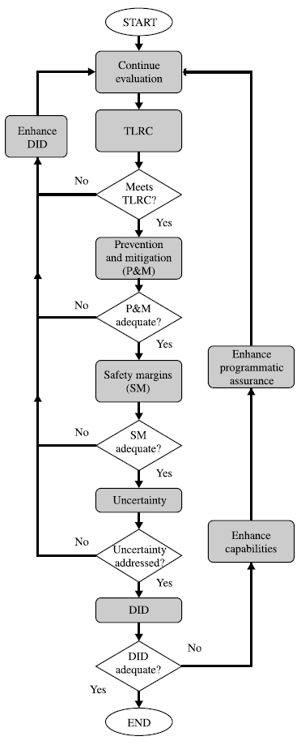
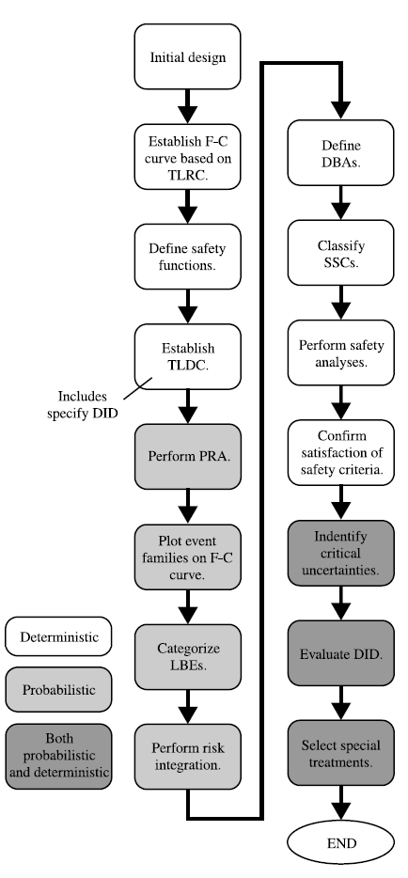
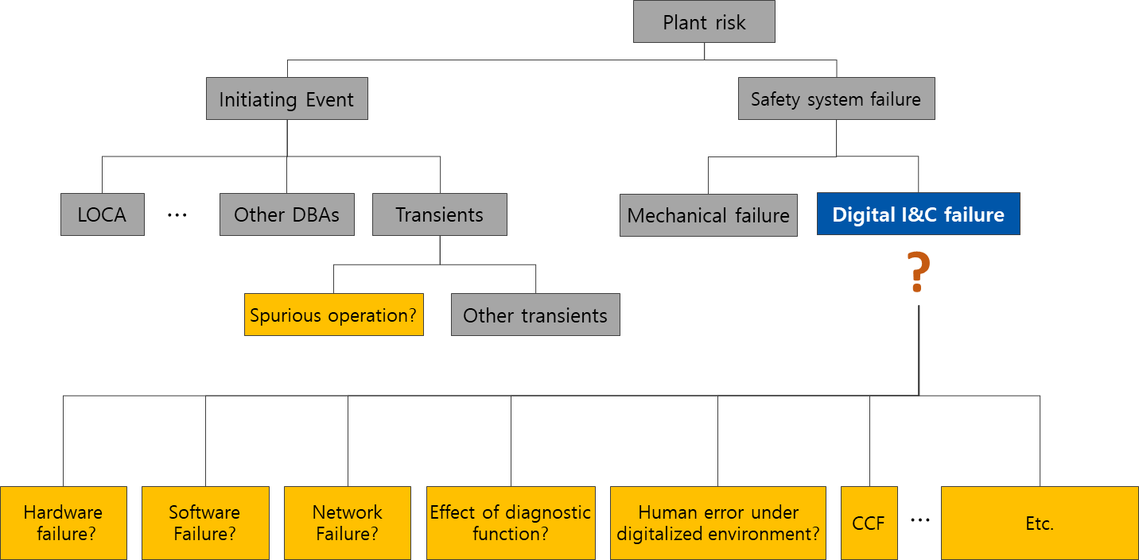
Introduction | In reality
Approximate configuration of DI&C fault tree
Basically, it seems that the evaluation of DID is based on the PSA, but in the case of digital I&C(DI&C), It is difficult to model the correlation of DI&C components according to the FT framework, and it is even more difficult to secure failure information of them.
Logic for implementing
evaluation of DID
Safety desing process overview¹⁾²⁾
➔ Can we derive quantitative evaluation results of DI&C systems without failure information or FT framework.
Andrea Maioli, David J. Finnicum, Robert H. Lichtenstein, Stephanie Y. Harsche, “Use of PSA in the Development of SMRs”, NEA/CSNI/R(2012)2
nuclear safety design process for modular helium-cooled reactor plants(ANSI/ANS-53.1-2011)

Slide 6

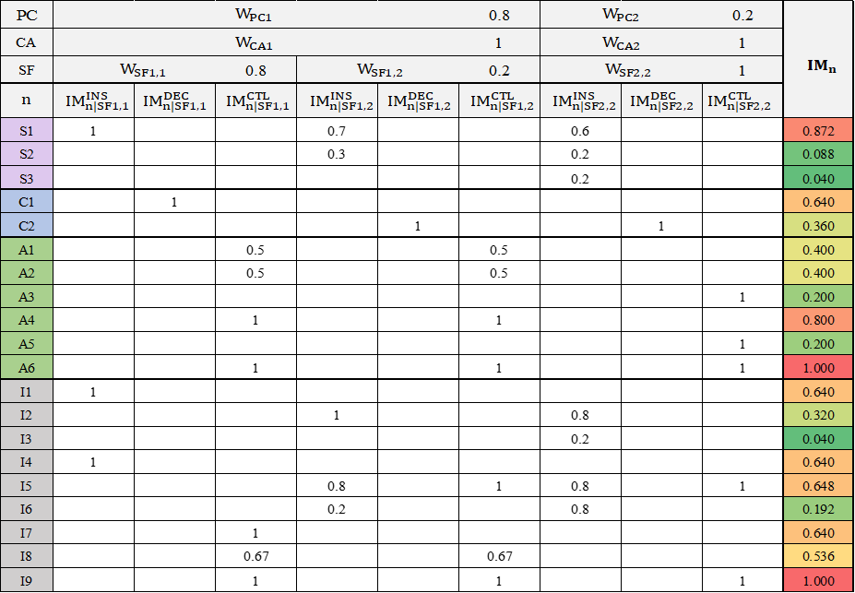
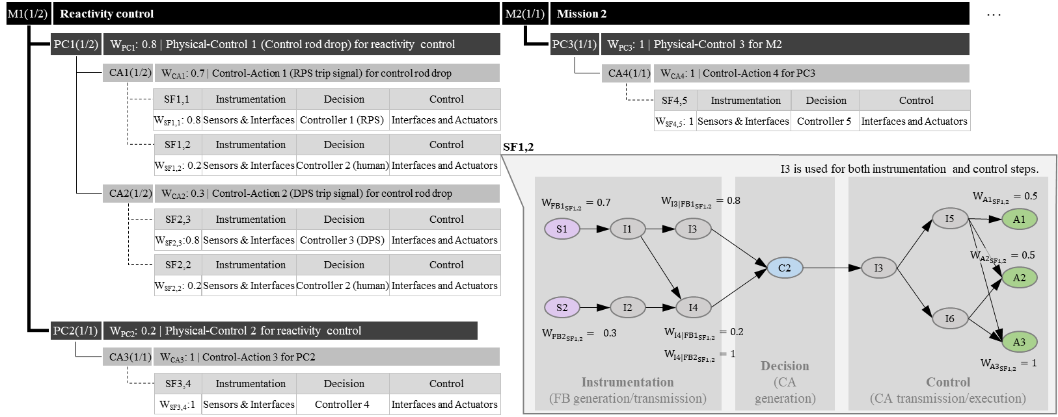

Introduction | Overview of the approach
Develop equations to calculate the importance of each component
DI&C systems have complex interactions that are difficult to clearly analyze without a separate model.
Importance of each component
Modeling of DI&C system
Functional requrirements
Conceptual design
Operational strategies
.
.
.
Related Information
Assign weights according to the information of system design and operation strategies instead of failure information.
A component is important if it is used for an important functioning and it is used often.

Slide 7
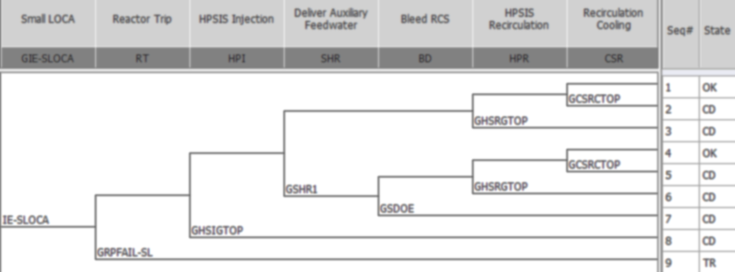
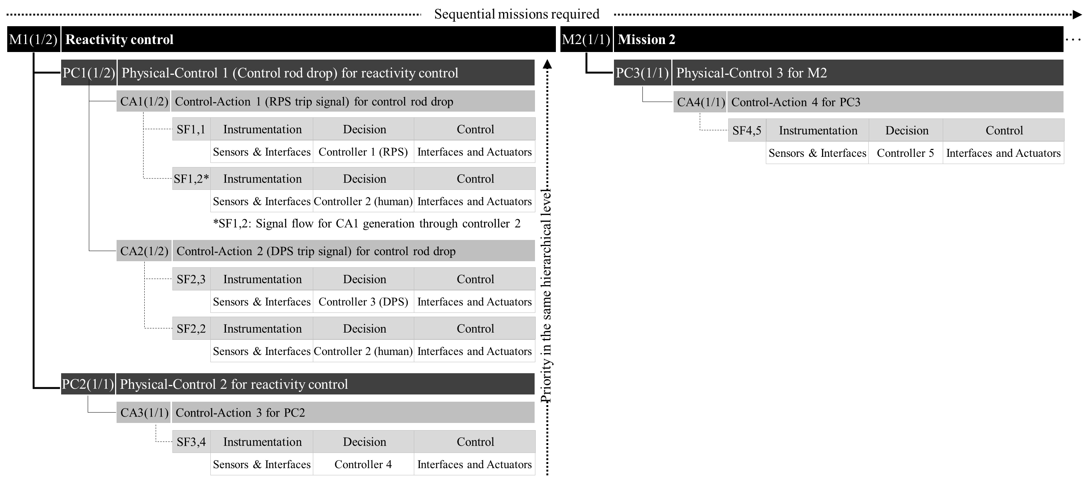
DI&C system modeling | Macro model for functional redundancy and diversity
Review the functional redundancy and diversity relevant to the DI&C system at each heading in an ET and re-organize it according to a specific hierarchal form: Mission(M) – Physical control(PC) – Control Action(CA) – Signal Flow(SF)
. . .
▶ Hierarchical structure is as follows:
Mission (M): Role required for I&C system in a specific heading.
Physical Control (PC): Sub-role to fulfill the upper mission.
Control Action (CA): The same physical control can be activated by various control actions, which is a kind of safety signal that needs to be generated.
Signal Flow (SF): The same CA may also be generated by different paths. SF is signal transfer path between related components from measurement to control.
▶ Clarify the success criteria for the parent hierarchy.

Slide 8
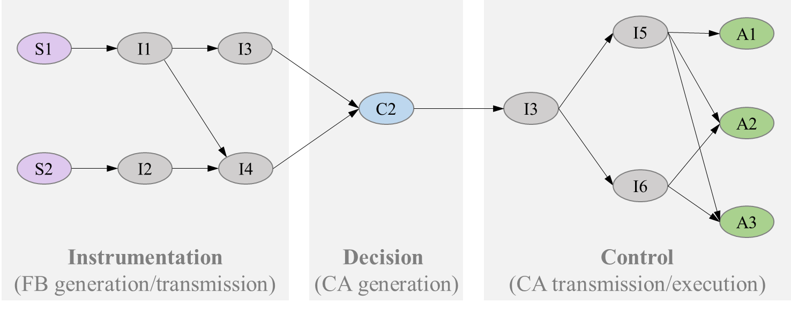
DI&C system modeling | Micro model for redundancy and diversity in a SF
Review all the signal transfer paths (instrumentation – decision making – control) in an SF and organize interactions between components used according to a specific form.
  Three steps in a SF
    Instrumentation: Generation/transmission of Feedback (FB; sensing signal)
    Decision: Decision on whether or not to generate a CA
    Control: Transmission/execution of the CA generated
  The three steps consists of some of the following four types of components
    Sensor (S): a component that generates FB
    Actuator (A): a component that receives a CA and performs corresponding physical actions.
    Controller (C): a component that determines whether a CA is generated or not, and which CA should be generated
    Interface (I): a component that transmits FB from a sensor to a controller or a CA from a controller to an actuator
→ It is assumed that each step has a one-way serial signal connection, and that the complete failure of one step leads to the failure of the corresponding SF.

Slide 9
Weight assignment | Functional redundancy and diversity
M1(1/2)
Reactivity control
M2(1/1)
Mission 2
. . .
PC1(1/2)
W_{PC1}: 0.8 | Physical-Control 1 (Control rod drop) for reactivity control
PC3(1/1)
W_{PC3}: 1 | Physical-Control 3 for M2
CA1(1/2)
W_{CA1}: 0.7 | Control-Action 1 (RPS trip signal) for control rod drop
CA4(1/1)
W_{CA4}: 1 | Control-Action 4 for PC3
SF1,1
Instrumentation
Decision
Control
SF4,5
Instrumentation
Decision
Control
W_{SF1,1}: 0.8
Sensors & Interfaces
Controller 1 (RPS)
Interfaces and Actuators
W_{SF4,5}: 1
Sensors & Interfaces
Controller 5
Interfaces and Actuators
SF1,2
Instrumentation
Decision
Control
W_{SF1,2}: 0.2
Sensors & Interfaces
Controller 2 (human)
Interfaces and Actuators
CA2(1/2)
W_{CA2}: 0.3 | Control-Action 2 (DPS trip signal) for control rod drop
SF2,3
Instrumentation
Decision
Control
W_{SF2,3}:0.8
Sensors & Interfaces
Controller 3 (DPS)
Interfaces and Actuators
SF2,2
Instrumentation
Decision
Control
Weights are assigned to the elements in the same functional hierarchy level.
According to the relative importance in achieving the needs of the parent hierarchy, the weights are assigned between 0 and 1.
Sum of the weights of the elements that cause the failure of the parent hierarchy needs (i.e. minimal cut set: MCS) should be equal to 1.
W_{SF2,2}: 0.2
Sensors & Interfaces
Controller 2 (human)
Interfaces and Actuators
PC2(1/1)
W_{PC2}: 0.2 | Physical-Control 2 for reactivity control
CA3(1/1)
W_{CA3}: 1 | Control-Action 3 for PC2
SF3,4
Instrumentation
Decision
Control
W_{SF3,4}:1
Sensors & Interfaces
Controller 4
Interfaces and Actuators

Slide 10
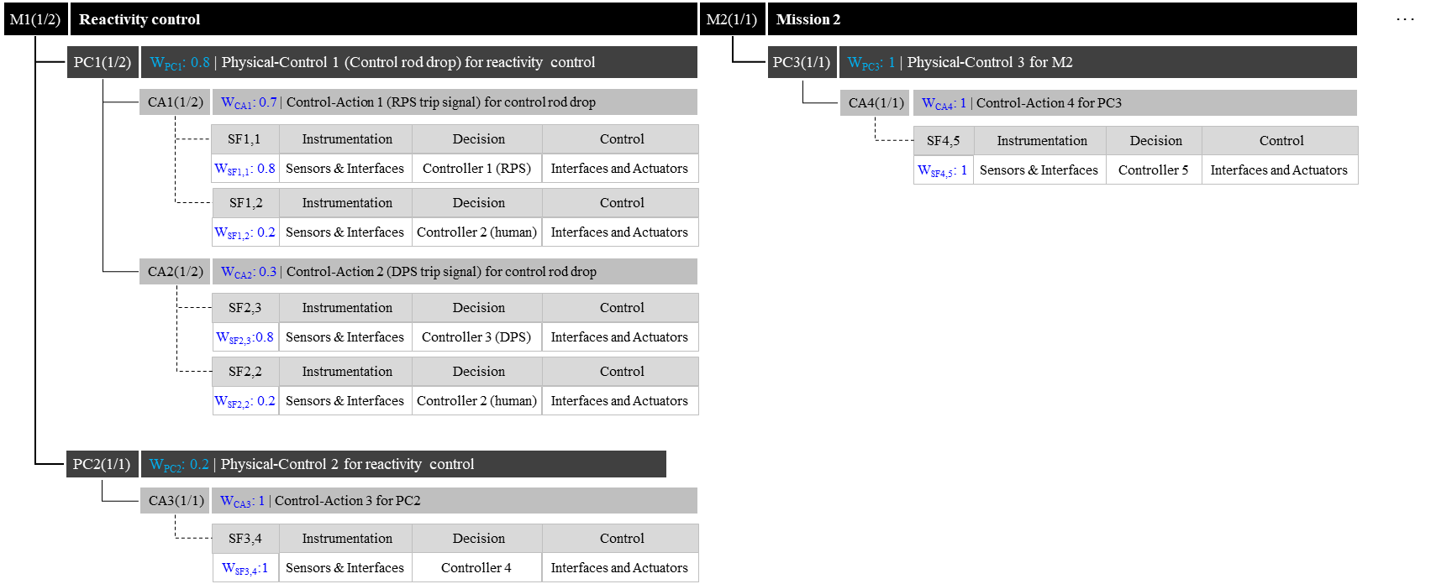
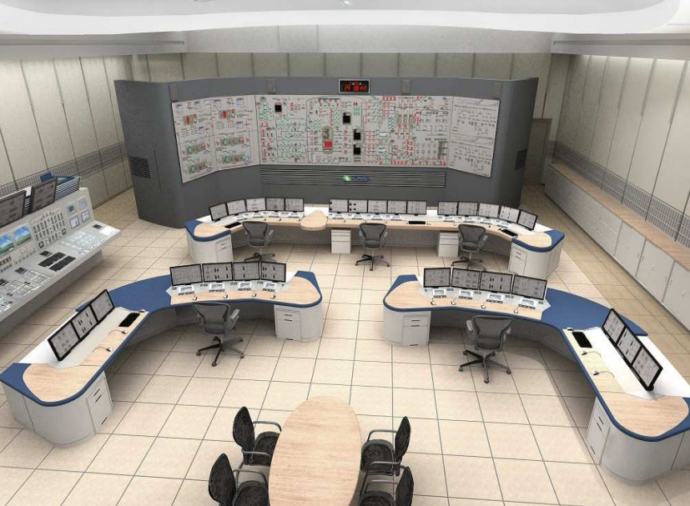








Weight assignment | SF
A1
A3
A2
SF1,2
I3 is used for both instrumentation and control steps.
Instrumentation
(FB generation/transmission)
Decision
(CA generation)
Control
(CA transmission/execution)
$$W_{{FB1}_{SF1,2}}=0.7$$
$$W_{I3|{FB1}_{SF1,2}}=0.8$$
$W_{{A1}_{SF1,2}}=0.$5
S1
I1
I3
I5
A1
C2
I3
$W_{{A2}_{SF1,2}}=0.$5
A2
S2
I2
I4
I6
$$W_{{FB2}_{SF1,2}}= 0.3$$
$$W_{I4|{FB1}_{SF1,2}}=0.2$$
A3
$$W_{I4|{FB2}_{SF1,2}}=1$$
$$W_{{A3}_{SF1,2}}=1$$
▶In a single SF, weights are assigned to some components (Sensors, front-end interface, which transfers FBs to the controller, and actuators)in accordance with the following general logic.
  Some components which transfer a FB significant on decision-making through an effectively recognizable path to the controller are important.
  Minimal set of actuators to complete the control step are important.

Slide 11
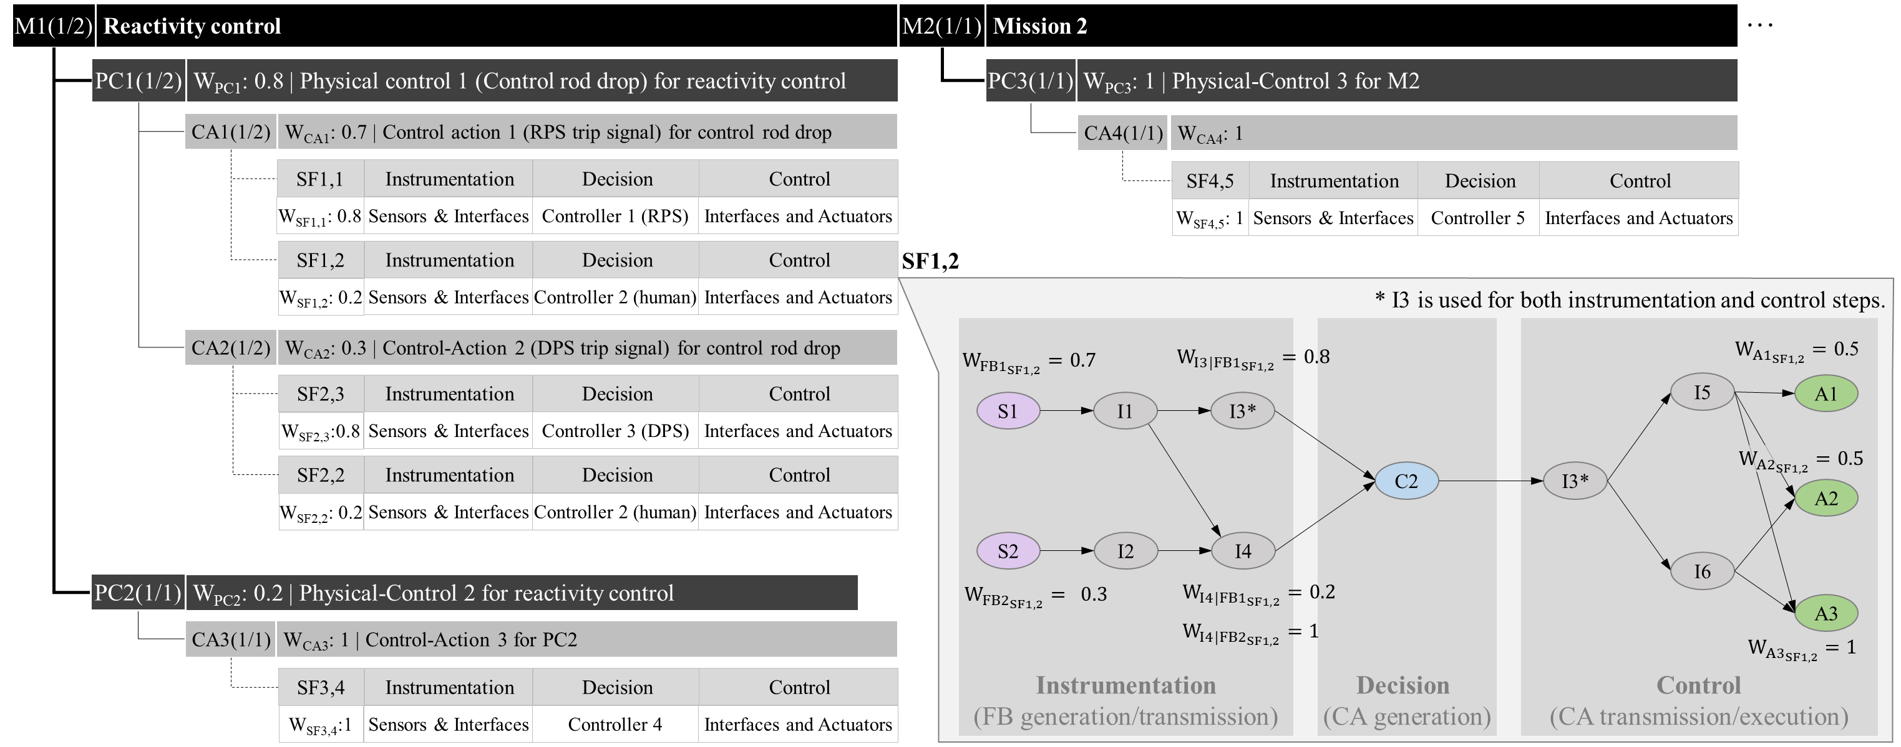
Importance evaluation

Slide 12




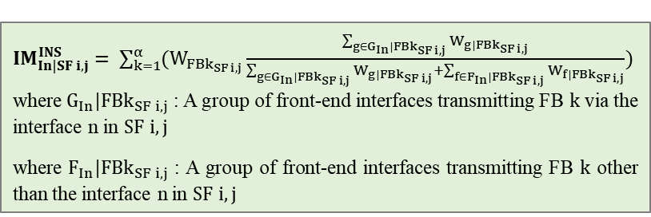

Importance evaluation | in an SF
$$∝$$
Importance of a component (IM) in an SF extent to which a particular component impairs the soundness of each step when that component is unavailable
A SF degraded/failure
Instrumentation
(FB generatio/transmission)
degraded/failed
Decision
(CA generation)
degraded/failed
Control
CA (transmission/execution)
degraded/failed
${IM}_{Cn|SF i,j}^{DEC}=1$ ($n=j$)
${IM}_{In|SF i,j}^{CTL}=\max\left\{{IM}_{ln|SF i,j}\left(z\right) :z=1..γ\right\}$
where $γ$ is the number of MCS of actuators in SF i,j
${IM}_{ln|SF i,j}\left(z\right)=\frac{\sum_{g∈G_{In}|{MCSz}_{SF i,j}}{W_{g_{SF i,j}}}}{\sum_{g∈G_{In}|{MCSz}_{SF i,j}}{W_{g_{SF i,j}}}+\sum_{f∈F_{In}|{MCSz}_{SF i,j}}{W_{f_{SF i,j}}}}$
where $G_{In}|{MCSz}_{SF i,j}$ : A group of actuators receiving CA i via the interface n in the MCSz in $SF i,j$
where $F_{In}|{MCSz}_{SF i,j}$ : A group of actuators receiving CA i other than the interface n in the MCSz in $SF i,j$
${IM}_{Sn|SF i,j}^{INS}=W_{{FBk}_{SF i,j}}$ ($n=k$)
${IM}_{In|SF i,j}^{INS}= \sum_{k=1}^{α}{(W_{{FBk}_{SF i,j}}}\frac{\sum_{g∈G_{In}|{FBk}_{SF i,j}}{W_{g|{FBk}_{SF i,j}}}}{\sum_{g∈G_{In}|{FBk}_{SF i,j}}{W_{g|{FBk}_{SF i,j}}}+\sum_{f∈F_{In}|{FBk}_{SF i,j}}{W_{f|{FBk}_{SF i,j}}}})$ where $G_{In}|{FBk}_{SF i,j}$ : A group of front-end interfaces transmitting FB $k$ via the interface n in $SF i,j$
where $F_{In}|{FBk}_{SF i,j}$ : A group of front-end interfaces transmitting FB $k$ other than the interface n in $SF i,j$
${IM}_{An|SF i,j}^{CTL}=W_{{Ay}_{SF i,j}}$ ($n=y$)

Slide 13
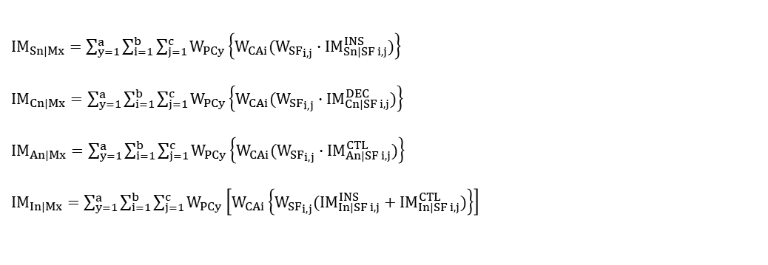
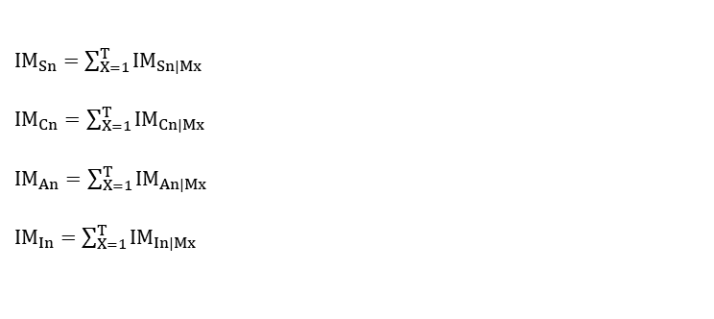
Importance evaluation | in a mission & entire mitigation procedure
IM of a component integrated with weights of related SF, CA and PC for a mission
IM of a component in a mission → integrated over the entire mitigation scenario
${IM}_{Sn|Mx}=\sum_{y=1}^{a}{\sum_{i=1}^{b}{\sum_{j=1}^{c}{W_{PCy}\left\{W_{CAi}({W_{SF}}_{i,j}∙{IM}_{Sn|SF i,j}^{INS})\right\}}}}$
${IM}_{Cn|Mx}=\sum_{y=1}^{a}{\sum_{i=1}^{b}{\sum_{j=1}^{c}{W_{PCy}\left\{W_{CAi}({W_{SF}}_{i,j}∙{IM}_{Cn|SF i,j}^{DEC})\right\}}}}$
${IM}_{An|Mx}=\sum_{y=1}^{a}{\sum_{i=1}^{b}{\sum_{j=1}^{c}{W_{PCy}\left\{W_{CAi}({W_{SF}}_{i,j}∙{IM}_{An|SF i,j}^{CTL})\right\}}}}$
${IM}_{In|Mx}=\sum_{y=1}^{a}{\sum_{i=1}^{b}{\sum_{j=1}^{c}{W_{PCy}\left[W_{CAi}\left\{{W_{SF}}_{i,j}({{IM}_{In|SF i,j}^{INS}+IM}_{In|SF i,j}^{CTL})\right\}\right]}}}$
${IM}_{Sn}=\sum_{X=1}^{T}{{IM}_{Sn|Mx}}$
${IM}_{Cn}=\sum_{X=1}^{T}{{IM}_{Cn|Mx}}$
${IM}_{An}=\sum_{X=1}^{T}{{IM}_{An|Mx}}$
${IM}_{In}=\sum_{X=1}^{T}{{IM}_{In|Mx}}$

Slide 14
Case study | Protection I&C systems for a 5MW open-pool type research reactor
AC: Actuation Circuit
APS: Alternate Protection System
BP: Bistable Processor
CC: Coincidence Circuit
IC: Initiation Circuit
IPS: Information Processing System
LDP: Large Display Panel
MTP: Maintenance and Test Panel
MTS: Manual Trip Switch
OWS: Operator Workstation
PAMS: Post Accident Monitoring System
RPS: Reactor Protection System
SSP: Signal Splitter Panel
* To simplify the system, components connected in series to each other without branching were combined as one component.

Slide 15
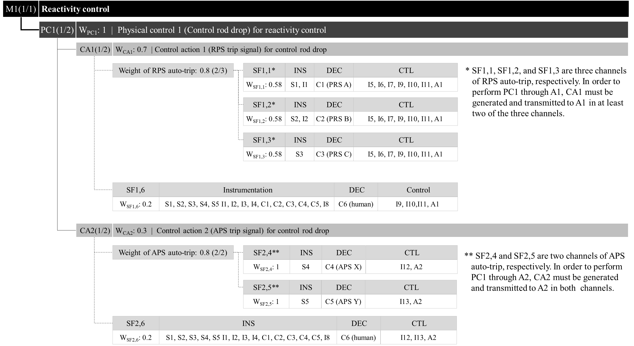
Case study | Protection I&C systems for a 5MW open-pool type research reactor

Slide 16
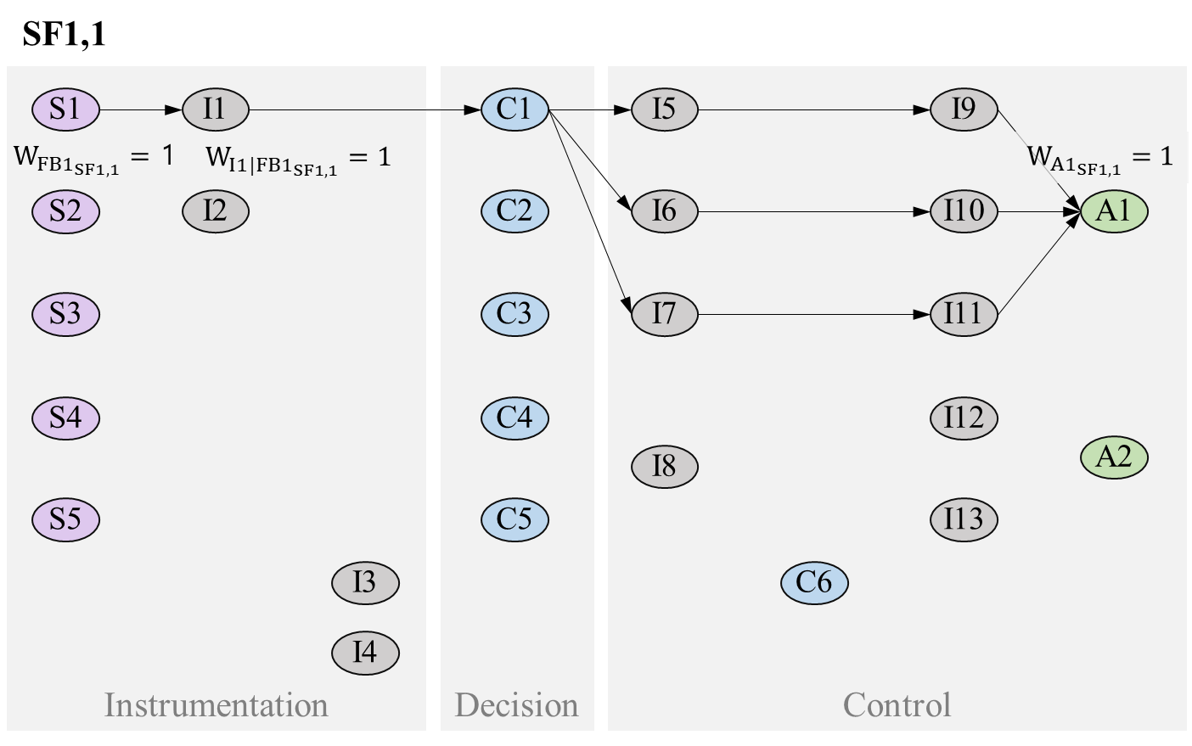
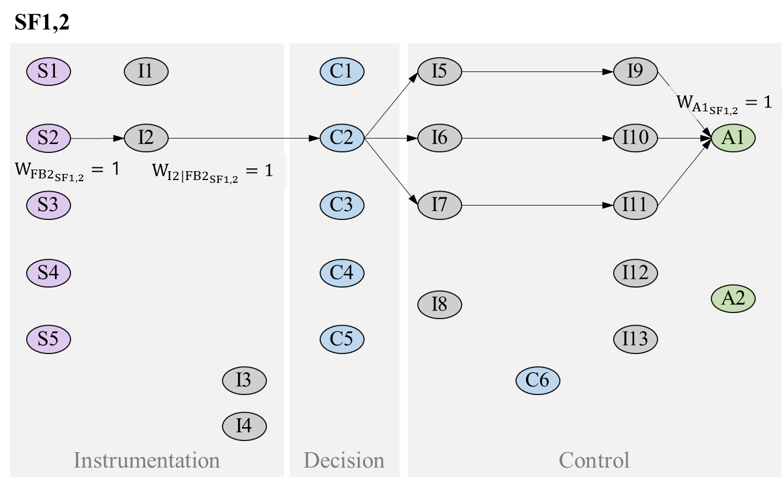
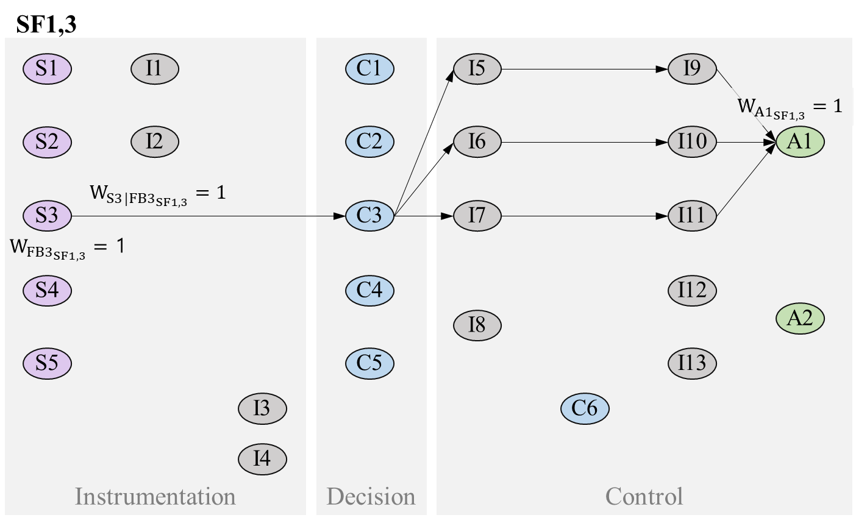
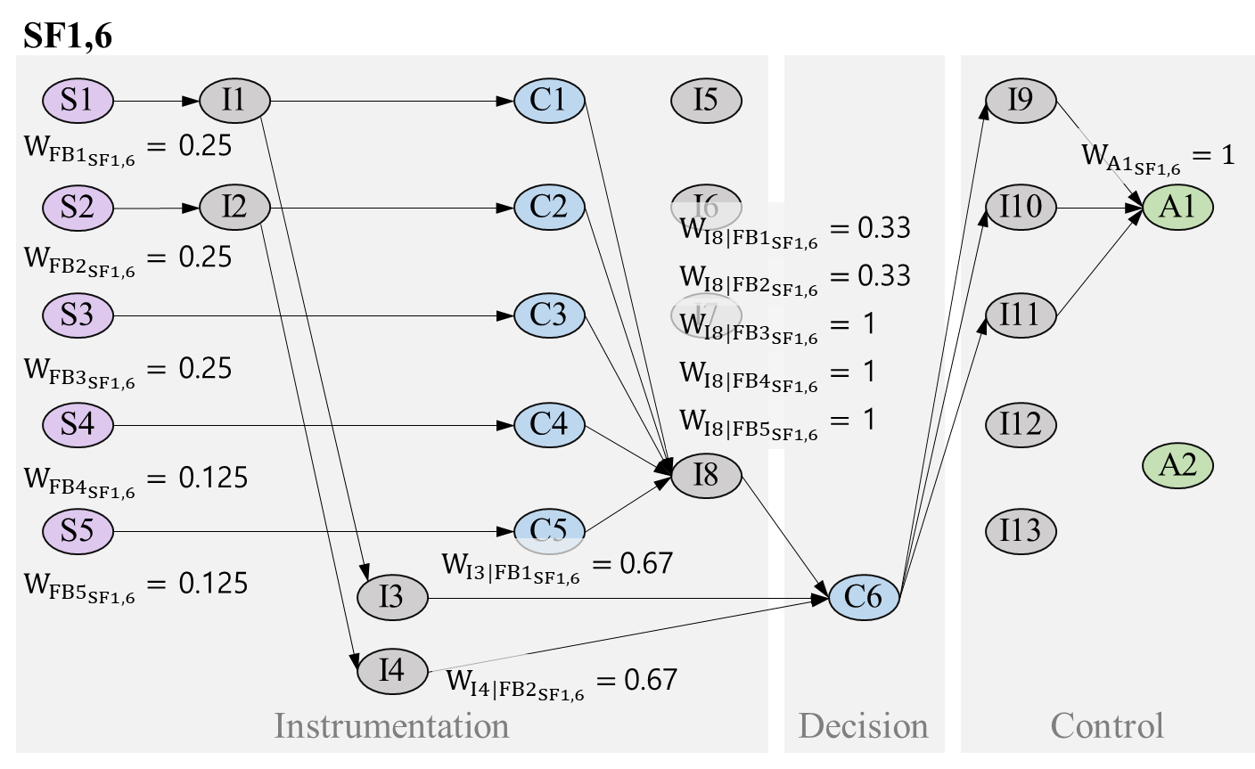
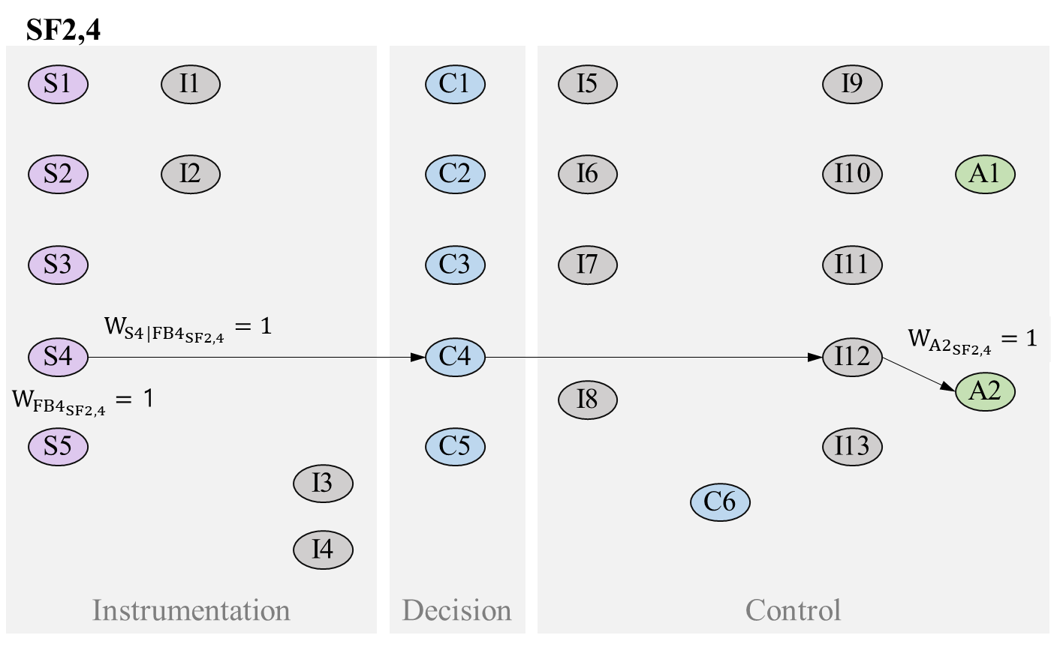
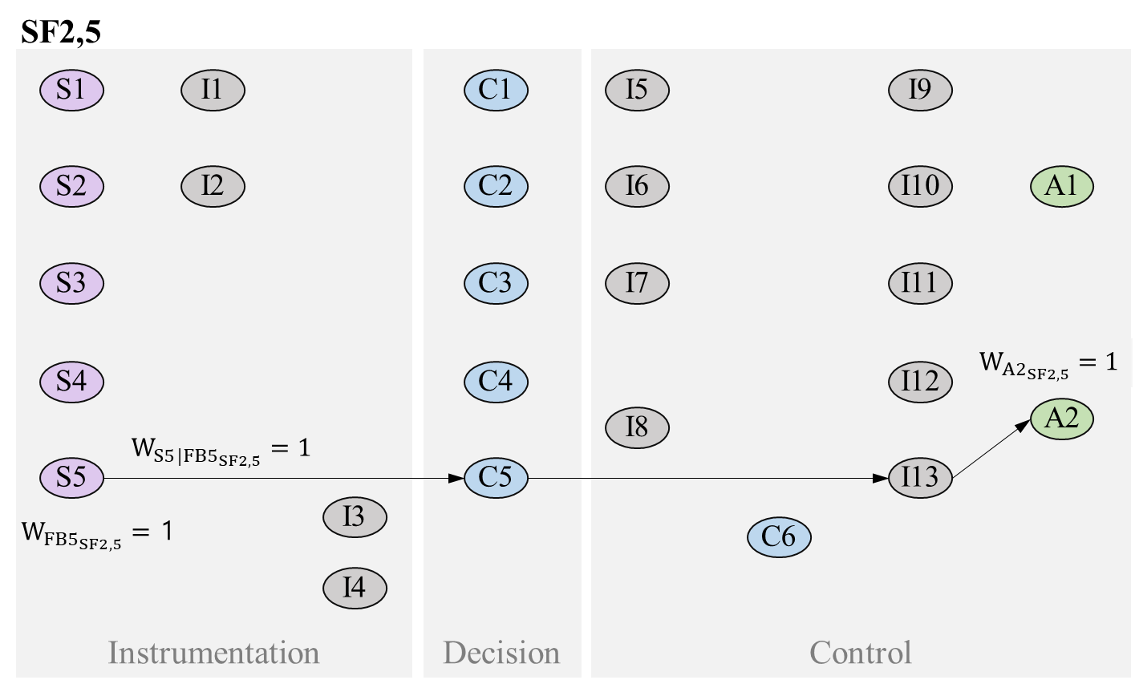
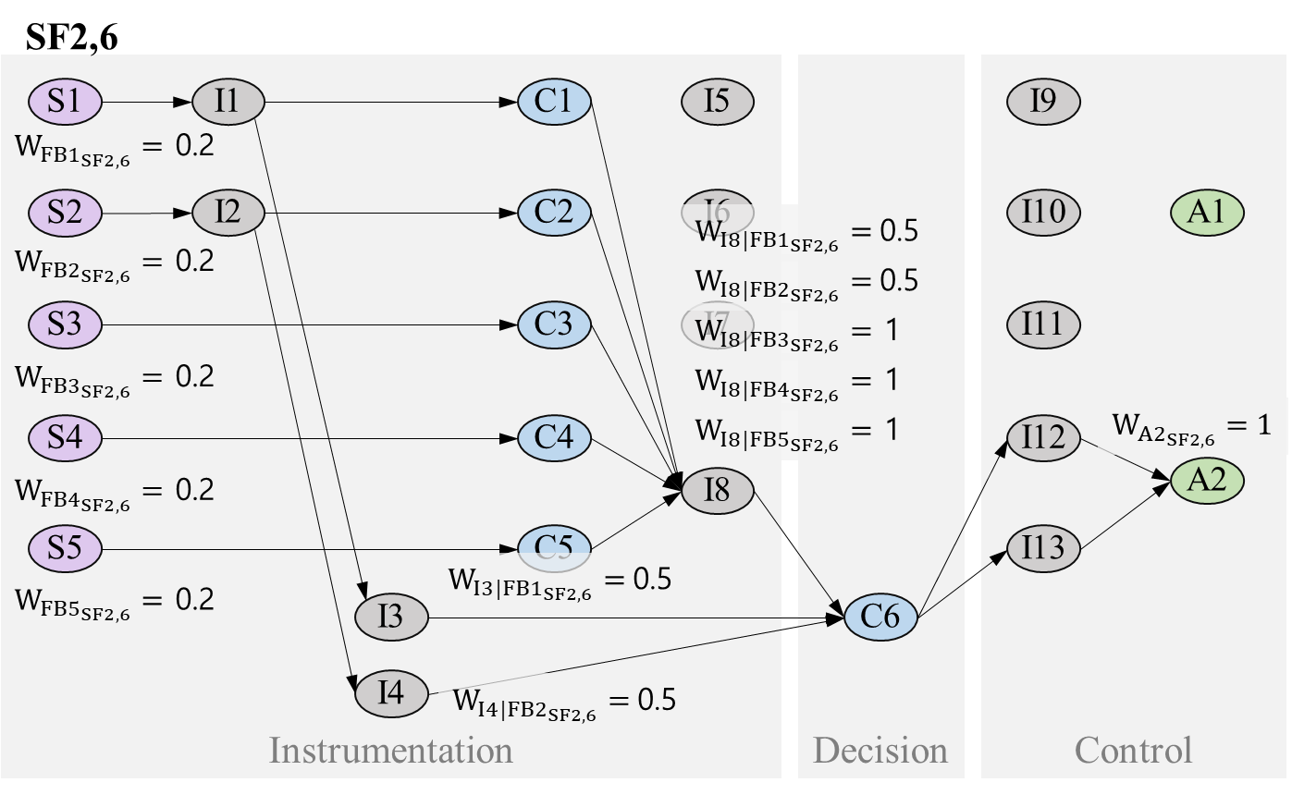
Case study | Protection I&C systems for a 5MW open-pool type research reactor
RPS auto trip
RPS manual trip
APS auto trip
APS manual trip

Slide 17
Case study | Protection I&C systems for a 5MW open-pool type research reactor
The actuators are the most important components. Especially, A1 is the remarkably important as it is used in the high-weighted CA (RPS auto-trip).
S1, S2, S3, C3, I1, and I2 are important, for the same reason as that of A1. Regarding the controllers, C3 has a little higher importance than C1 and C2 because FB1 and FB2 can be transmitted to the human operator via I3 and I4 even if C1 and C2 fail, while FB3 cannot be transmitted to the human operator at all when C3 fails.
In terms of the interfaces, I9, I10, and I11 are slightly more important than I5, I6, and I7 because the former are additionally used to transmit the RPS manual-trip signal in SF1,6 as well as in the transmission of the RPS auto-trip signal.
Otherwise, the importance of most components excluding the actuators (A1 and A2) and some interfaces (I3, I4, and I8) are distributed evenly between 0.200 and 0.370. In this regard, it can be said that the I&C system for reactivity control is well-balanced.

Slide 18
Concluding remarks
The new approach to evaluate the quantitative importance of components in I&C systems has been proposed
The method can provide quantified analysis results without failure information.
It is necessary to consider the following prerequisites and precautions in utilizing this method
  It is assumed that signals (FBs or CAs) do not deteriorate or changed in the process of transmission.
  It is assumed that one CA is created by only one controller.
  The results of analysis vary depending on the assigned weights.
  The boundary and balance between components should be properly considered and defined.
Based on the analysis results, the safety of the control system might be achieved
  by modifying the system design to do not concentrate the importance on a few components, or
  by forcing the implementation of high reliability for certain components with high importance.
In order to ensure the validity of the approach, a method that objectively and systematically assigning weights must be supported. (*Regarding this subject, the authors plan to conduct a follow-up study)

Slide 19
smshin@kaeri.re.kr

