Slide 1
Development of Operator Response Time Model for DICE(Dynamic Integrated Consequence Evaluation)
29. 06. 2022
PSAM 16 (June ${26}^{th} through \text{July} 1^{st}$)
Kyung Hee University
Department of Nuclear Engineering
Speaker: Dohun Kwon
Author: Dohun Kwon, Gyunyoung Heo
Notes:
Hello, everyone. I am Dohun Kwon and I’m studying for a master’s degree at Kyung Hee University in South Korea.
My presentation is “Development of operator response time model for DICE’
This research is being conducted with the support of the Nuclear Safety Commission.
Currently, a project to cross-check the branch probability in Level 2 PSA with IDPSA is being carried out.
The project is being conducted by Kyung Hee University, Incheon University, Chosun University, and Sentch company in Korea

Slide 2
Contents
Motivation
Introduction to DICE
Development of Operator Response Time Model
Results
Conclusions
Notes:
These are the contents.

Slide 3
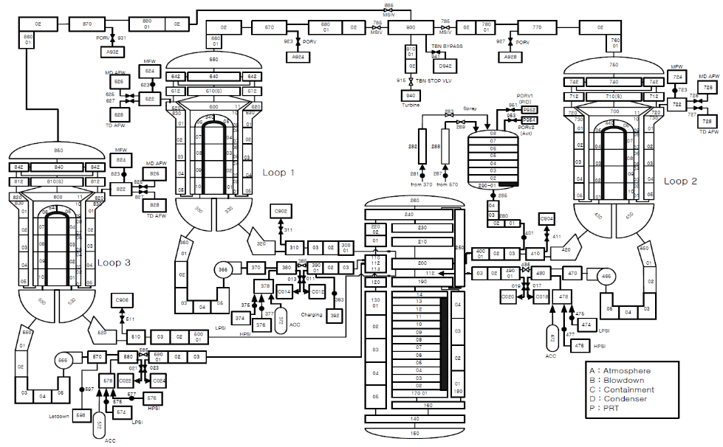
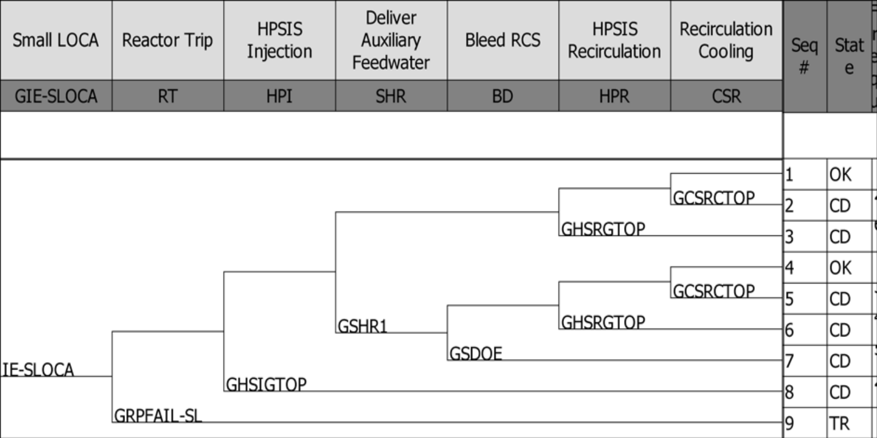
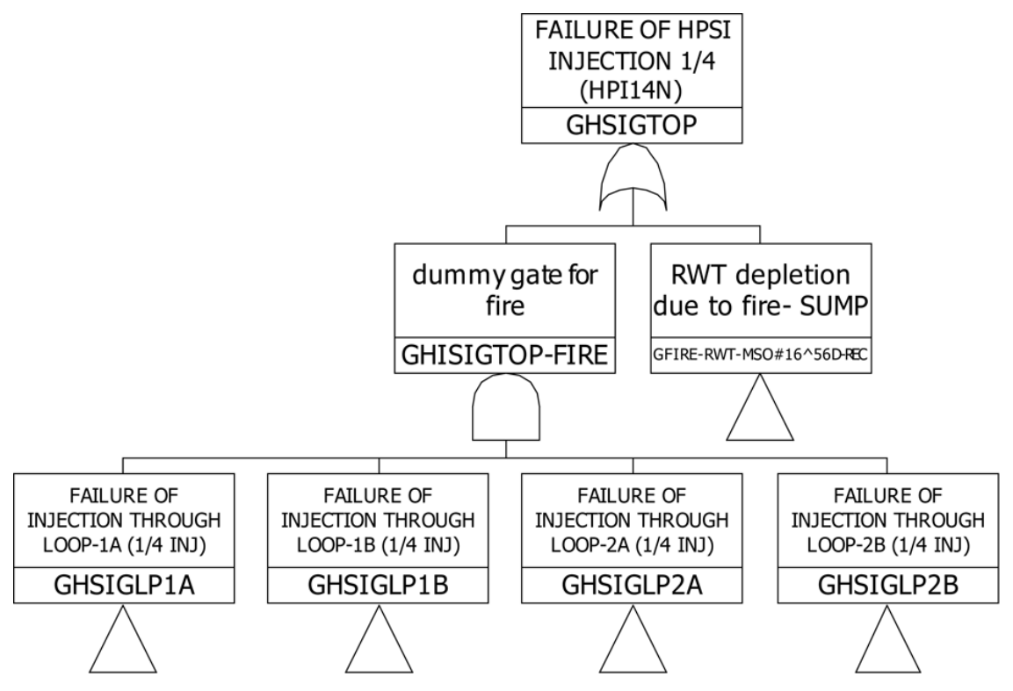
Motivation
Success
Fail
PSA
DSA
IDPSA(Integrated Deterministic-Probabilistic Safety Assessment)
… is a methodology that analyzes the metric related to the system’s safety by reflecting probabilistic (or stochastic) situational changes in the deterministic simulation process of a physical model.
* IDPSA is also called DPSA(Dynamic PSA), DPRA(Dynamic PRA), ISA(Integrated Safety Assessment), etc.
Notes:
There is an IDPSA methodology that reflects and interprets both a probabilistic method of evaluating risk for nuclear power plants and a deterministic method that is a physical analysis.
This method is a methodology that considers the plant safety every time step by reflecting the physical state of the plant with a probabilistic safety evaluation.
IDPSA is also called in by several terms such as Dynamic PSA or Dynamic PRA.
In this presentation, I will use the term IDPSA.

Slide 4
Motivation
J. Devooghy, C. Smidts (1992)
P. C Cacciabue, A. Amendola, G. Cojazzi(1986)
P. E. Labeau, J. M. Izquierdo (2005)
1980s
1990s
2000s
2010s
T. Aldemir (1987)
M. Marsequerra, E. Zio(1996)
Development of IDPSA Theoretical Background
ADAPT(2008)
DICE(2018)
GO-FLOW(1988)
ISA(1994)
MCDET(2002)
RAVEN(2012)
1980s
1990s
2000s
2010s
SCAIS(2005)
PyCATSHOO(2013)
DYLAM(1984)
DETAM(1989)
ADS(1998)
RAPID(2018)
Dynamic Fault-Tree (1999)
Development of IDPSA Method/Tool
Notes:
Here is the current state of IDPSA research, tool, and methodology over time.
The theoretical background and methodology have been studied since the 1980s, and various tools have been outgoingly developed since the 2000s.
Theoretical research on IDPSA has been conducted in Korea, and in 2018, Kyung Hee University developed DICE, the first IDPSA tool in Korea.

Slide 5
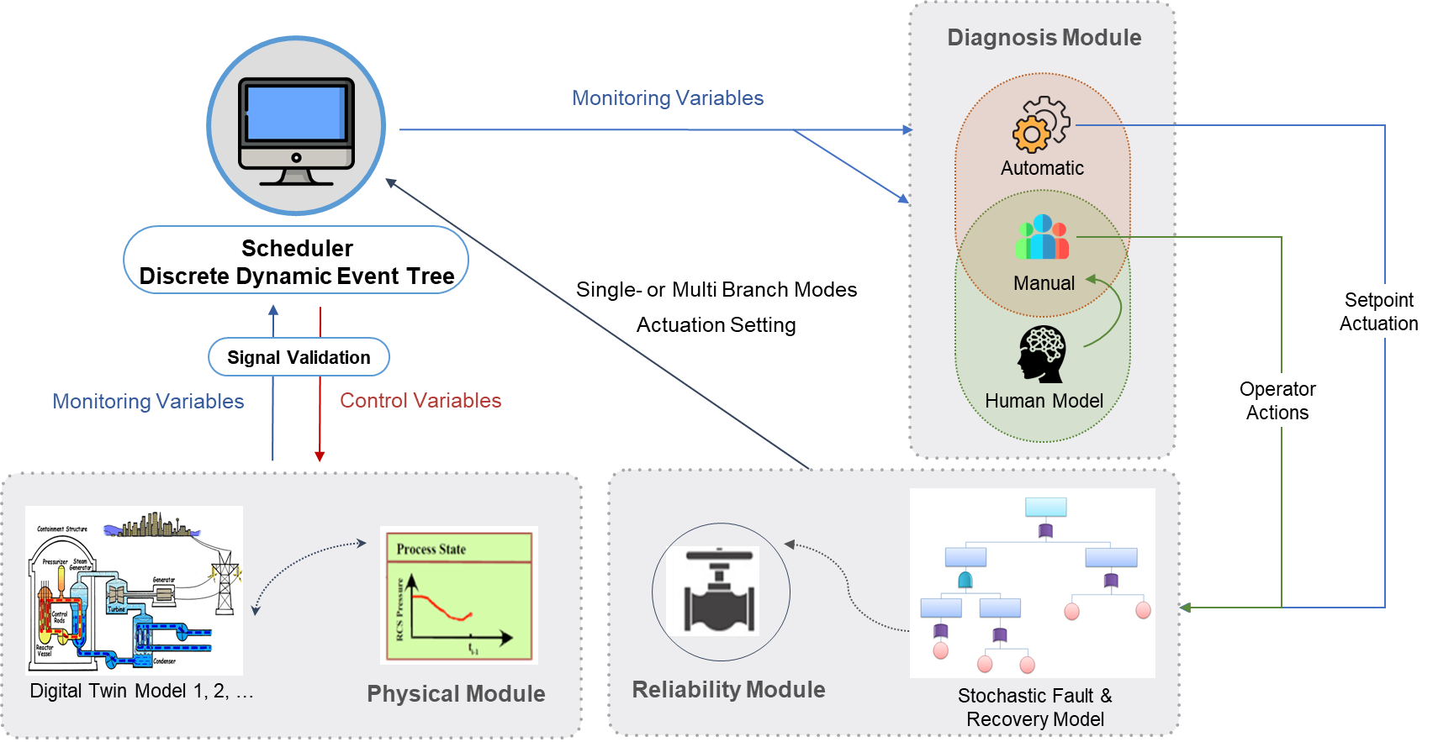
Introduction to DICE(www.mainformatics.com)
Schematic diagram of DICE
Notes:
I will briefly explain DICE. DICE composes of four components.
A physical module that analyzes the thermo-hydraulic behavior of a nuclear power plant,
A diagnosis module that reads the variable for the physical module at every time-step and changes the state of the plant,
A reliability module is in charge of equipment failure and quantification.
A scheduler generates branches based on the DDET method and transfers information among the modules.
The DDET method has a similar mechanism to the event tree.
However, a branch is generated based on various conditions, such as physical variable combinations, and evaluation over time
Differently from the conventional event tree created a branch by assuming that the analyst is conservative.
DICE has two calculation methods. One is called the multi-branch mode, the other is the single-branch mode
Multi-branch mode is to perform sensitivity analysis and uncertainty analysis with a large number of simulations at once.
The other method aims to explore an unknown scenario.
Today, I will talk about single branch mode,
and for a detailed description of DICE,
please visit our website mainformatics.com.

Slide 6
Introduction to DICE
Reliability Module
Diagnosis Module
(Auto Action)
Physical Module
Simulation
Starts
Auto Task
Module ?
dt
dt
dt
dt
Scheduler
Single Fail?
Manual Task
Module ?
Reliability Module
Double Fail!
dt
dt
dt
All Fail?
Notes:
The following introduces the calculation process of DICE at present.
When the simulation starts, the physical module analyzes every time step, and at the same time, the reliability module also evaluates the reliability of the equipment.
Then, when the combination of physical variables satisfies the branch conditions, the diagnosis module creates the branches.
At this time, the branch is created taking into account the availability of the evaluated equipment for every time step.

Slide 7
Introduction to DICE
Reliability Module
Diagnosis Module
(Auto Action)
Physical Module
Reliability Module
Simulation
Starts
Diagnosis Module
(Manual Action)
Auto Task
Module ?
dt
dt
dt
dt
Scheduler
Single Fail?
Manual Task
Module ?
Manual Task
Module ?
Double Fail!
dt
dt
dt
All Fail?
$$CDF=\sum_{i}{Damage_{i}}$$
In an hour?
In two hour?
dt
dt
dt
Reliability Module
at 1:00!
OK? or Damage?
Notes:
The method of creating such a branch is divided into branch types depending on whether or not an operator action.
In the case of a branch for equipment that operates automatically such as Rx Trip signal, or Safety Injection signal, a branch is created for available equipment by judging whether they are a failure.
Failure or not is determined by the reliability module based on the failure rate and time of the exponential distribution.
However, if an operator intervenes, not only the failure of the equipment but also the time taken by the operator's performance time.
In other words, the time for the operator to take action according to whether the equipment is operating or not should be considered together.

Slide 8
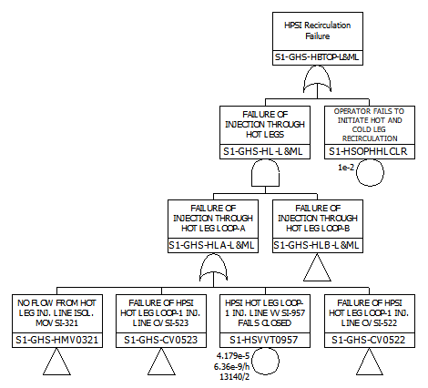
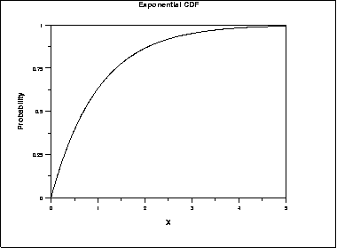
Introduction to DICE
?
$$t_{1}<t_{2}<t_{3}$$
Exponential Distribution
λ: Failure rate
$$t_{1}$$
$$t_{2}$$
$$t_{3}$$
Time
Time
Notes:
Equipment failure and recovery can check the equipment status at a specific time by using the exponential distribution as failure rate lambda and time.
However, there is only HEP in which a human judges the or failure of performance.
success
Currently, The HRA, which assesses the impact on humans focuses on calculating the human error probability that an operator will fail to perform a specific duty.
Looking at the figure on the right, the human error probability is used as a basic event in the fault tree to quantify the accident scenario.
However, the existing HRA is impossible to derive the operator action time required by the DICE.

Slide 9
Motivation
Needs
With the DICE, unknown scenarios that have not been conventional PSA can be seen.
The human effects such as delayed operator response time are essential in the DICE.
The conventional HRA is not suitable for the DICE.
Therefore, to apply it to DDET, developing a model calculated operator response time is necessary.
Consideration for Development
The HRA for DDET should be equivalent to the conventional HRA in terms of methodology for verification and validation.
Development of a model for providing operator response time model needs to be driven from a conventional HRA such as SPAR-H, which is currently used to satisfy regulatory requirements.
Notes:
As I told before, the existing HRA has limitations for application to DICE
The DICE has the advantage of being able to explore unknown scenarios
However, in order to take advantage of these strong points, it is essential to consider the impact on humans, that is, the variability in operator response time.
So, an operator response time model suitable for the DICE should be developed.
There are several points to consider in developing the operator model.
The model applicable to DICE should be made into a model that has the equivalent results with the existing HRA results for verification and validation.
And we consider that DICE will be used in the regulation.
The operator model should be developed conventional HRA method in order to satisfy regulatory requirements.

Slide 10
Motivation
Research Objective
Development of the operator model that can effectively use the advantages of IDPSA and DDET method
The developed operator model should be the equal result for conventional HRA methodology.
Notes:
Here is the motivation for this research.
We developed the operator model that can effectively use the advantages of DICE.
And It should be developed with an equal result to conventional HRA methodology.

Slide 11
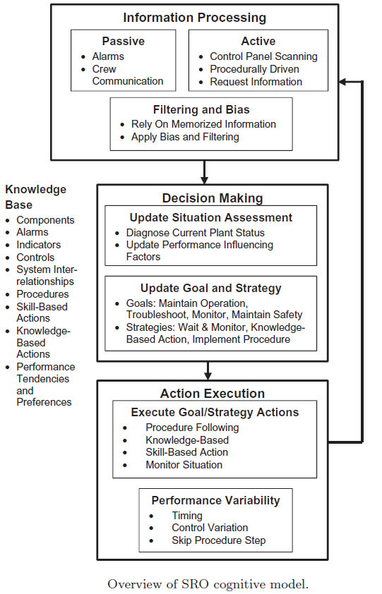
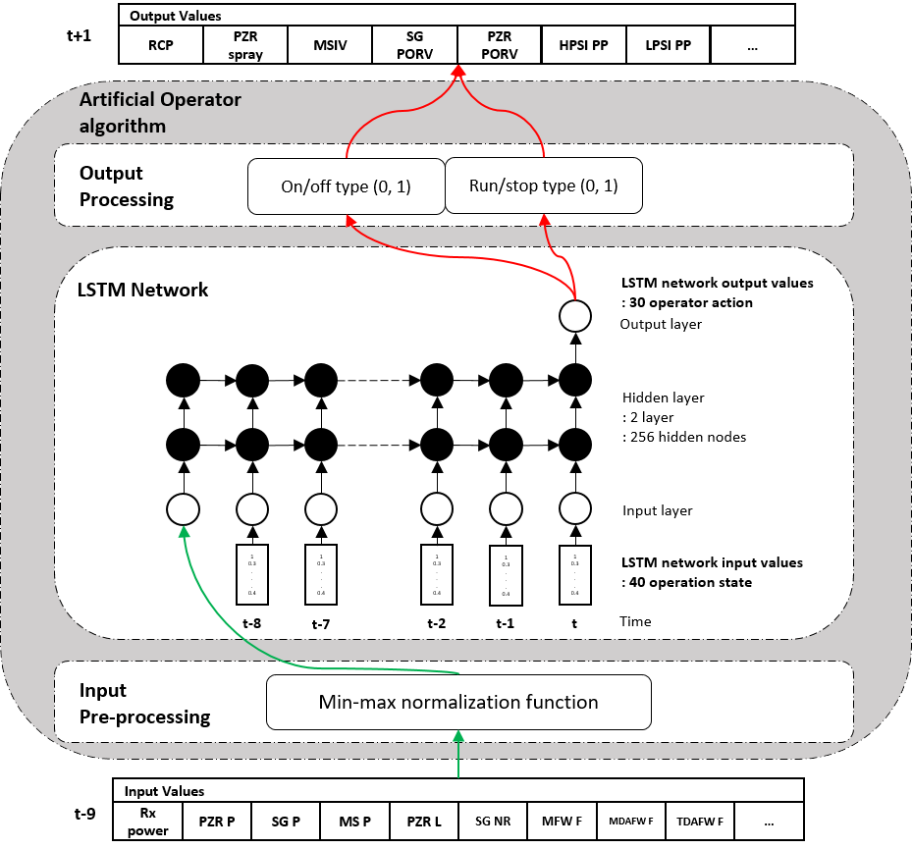
Operator Response Time Model
**
*
LSTM (Long Short-Term Memory) algorithm
ADS-IDAC Crew Model
CSU Operator Model
*G. Yoon, et.al., 2019, Feasibility Study on the Application of Artificial Operator to Estimation of HEPs, Asian Symposium on Risk Assessment and Management, Gyeongju, 2019
** Advanced Concepts in Nuclear Energy Risk Assessment and Management “CHAPTER 2: Dynamic Probabilistic Risk Assessment
Model Validation and Application — Experience with ADS-IDAC, Version 2.0”
Notes:
Such studies have previously been conducted.
In 2018, Chosun University, which is conducting a project with us, developed an operator model.
A model was developed to derive operator action time, success/failure, and probability using machine learning.
However, this model is challenging to verify HEP.
The other is the popular IPDSA tool, ADS-IDAC.
IDAC is a great model, but I haven't had a chance to install it to DICE.

Slide 12
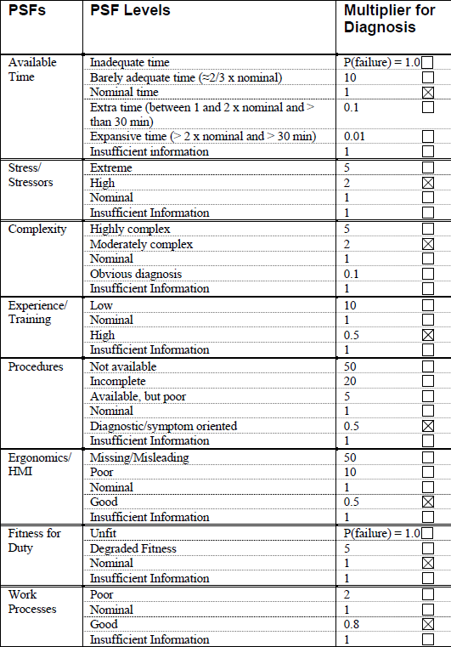
Operator Response Time Model
Human Reliability Assessment(HRA) is a method of human effect such as error. (e. g., K-HRA, THERP/ASEP, CBDT/HCR+THERP, etc.)
SPAR-H is one of the HRA methods recently developed U.S. NRC
It assesses the expert judgment and gives the HEP by calculating each Performance Shaping Factor (PSF) such as ‘Available time,’ ‘Stress,’ etc.
$${HEP}_{Execution}={Nomianl HEP}_{Execution}×\prod_{i=1}^{8}{{PSF}_{Execution, i}} \\ {HEP}_{Diagnosis}={Nominal HEP}_{Diagnosis}×\prod_{i=1}^{8}{{PSF}_{Diagnosis, i}}$$
$${HEP}_{}={HEP}_{Execution}+{HEP}_{Diagnosis}$$
Example) Event Name: Operator Fails to Diagnose SGTR
${Nominal HEP}_{Diagnosis}$= ${10}^{−2}$
$${HEP}_{Diagnosis}={10}^{−2} x 1x 2 x 2 x 0.5 x 0.5 x 1 x 1 x 0. 8$$
Notes:
The operator model for DICE was developed using the SPAR-H and will be briefly described here.
Currently, HRA methods have been developed a lot around the world.
We developed the operator response time model based on the SPAR-H method, which is widely used in many methodologies.
SPAR-H is developed by U, S, NRC that evaluates a total of 8 performance shaping factors to calculate the human error probability.

Slide 13
Operator Response Time Model
Conventional
HRA
Operator Response Time Model
Input: PSF
Input: HEP, PSF(Available Time)
Output: HEP
Output: Operator Response Time
Notes:
The HRA calculates the HEP as an evaluated PSF.
Conversely, we calculate the operator response time from the existing results.
The operator response time will be calculated with information on the HEP and the available time, which is the PSF.
The obtained operator response time becomes the box in the left bottom figure, and the state of the power plant will be changed at this time.

Slide 14
Operator Response Time Model
When the monitoring variable of the physical module satisfies, the diagnosis module start.
HEP_d is already provided by expert judgment.
When the manual diagnosis module operates, the user judges whether the diagnosis is normal or not by comparing random number with HEP_d
2-1. If the generated random number is less than the set HEP_d, the operator determines that the diagnosis has failed
A maximum time (Max(A.T_d)) of the operator response time for diagnosis is set as a maximum value using the available time level and its multiplier
The operator response time for diagnosis is to determine the time(Time_d) by utilizing the random number reproduced based on the specific probability distribution for the range set in Step 3
Time_d
Algorithm for Developed Model(1/2)
Notes:
Next, It is an algorithm for the operator response time model.
First, we have information which is HEP for diagnosis and execution, and expert judgment of available time level.
Step 1, When the monitoring variable of the physical module satisfies, the diagnosis module start.
Step 2, When the manual diagnosis module operates, the user judges whether the diagnosis is normal or not by comparing a random number with HEP_d
If the generated random number is less than the set HEP_d, the operator determines that the diagnosis has failed.
Ant then, A maximum time (Max(A.T_d)) of the operator response time for diagnosis is set as a maximum value using the available time level and its multiplier
The operator response time for diagnosis is to determine the time(Time_d) by utilizing the random number reproduced based on the specific probability distribution for the range set in Step 3

Slide 15
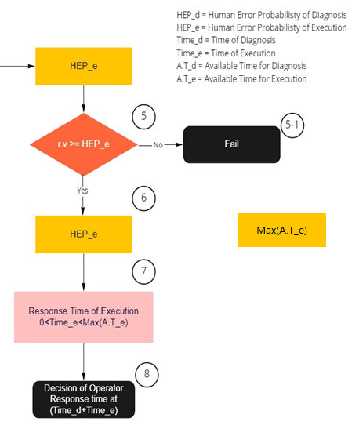
Operator Response Time Model
After determining the diagnosis time, if the random number generated by comparing it with the random number is greater than or equal to the execution HEP
HEP_e is already provided by expert judgment
5-1. If the generated random number is less than the HEP for the set execution, the operator
determines that the execution has failed.
After successful execution, the operator response time for the execution shall be determined using the same method such as 3 Step.
operator’s response time is within the operator’s available time; the operator response time for execution must be within the value that is available time minus the operator response time for diagnosis.
The operator response time for execution determines the time(Time_e) by utilizing the regenerated random number based on the specific probability distribution for the range.
The final operator response time is transmitted to the physical module by combining the operator response time for diagnosis and execution determined in Step 4 with Step 7.
Time_e
Algorithm for Developed Model(2/2)
Notes:
Execution is also calculated by the same method.
But, we need some considerations for deriving the execution response time.
When we succeed in step five, it means that the operator’s response time is within the operator’s available time
For this reason, the operator response time for execution must be within the value that is available time minus the operator response time for diagnosis.
The operator response time for execution determines the time(Time_e) by utilizing the regenerated random number based on the specific probability distribution for the range.
Finally, The final operator response time is transmitted to the physical module by combining the operator response time for diagnosis and execution determined in Step 4 with Step 7.

Slide 16
Results
Example: Primary cooling and decompression failure using low-pressure safety injection in a small loss of coolant accident(SLOCA)
Example 1 of Model Results
Example 2 of Model Results
 | Value | Result
Available Time | 23 min(1,380 s)
Diagnosis HEP | 6.20E-01
Diagnosis Available Time Level | Nominal
Diagnosis Nominal Time | 19 min(1,140 s)
Success or Fail by comparing for Diagnosis |  | Success
Operator Response Time for Diagnosis |  | 512 sec
Execution HEP | 2.90E-02
Execution Available Time Level | Nominal
Execution Nominal Time | 3min(180 s)
Success or Fail by comparing for Execution |  | Success
Operator Response Time for Execution |  | 123 sec
Operator response time |  | 635 sec
 | Value | Result
Available Time | 23 min(1,380 s)
Diagnosis HEP | 6.20E-01
Diagnosis Available Time Level | Nominal
Diagnosis Nominal Time | 19 min(1,140 s)
Success or Fail by comparing for Diagnosis |  | Success
Operator Response Time for Diagnosis |  | 1,021 sec
Execution HEP | 2.90E-02
Execution Available Time Level | Nominal
Execution Nominal Time | 3min(180 s)
Success or Fail by comparing for Execution |  | Fail
Operator Response Time for Execution |  | -
Operator response time |  | No Action
Notes:
This operator action is only considered in cases that already exist in the EOP.
It is a calculation result for a specific operator action event with the algorithm.
An example is Primary cooling and decompression failure using low-pressure safety injection in a small loss of coolant accident.
In shown example 1, both diagnosis and execution are successful, and the operator response time is calculated at 635 and changes the plant state at this time.
However, in the case of the second example, even if the diagnosis is satisfied, the result is that operator couldn’t take any action due to his failure to execute.
As such, even in the same accident scenario, the results are different at each simulation, providing variability in the operator response time and success or failure.

Slide 17
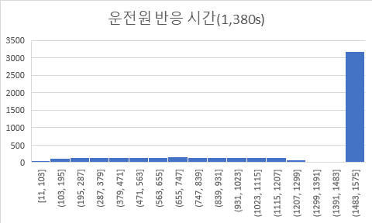
Results
Operator Response Time
(5,000 iterations)
Existing SPAR-H Result | Model Result
6.49e-1 | 6.40e-1
Error Prob.
1.3%
Frequency
Failure
Time
Notes:
In DICE, if the model fails, it is treated as an omission, and the physical module proceeds without changing the state of the plant.
This is the result of 5,000 iterations.
3,201 failed out of a total of 5,000 calculations.
The operator response time is too rapid or too late shown to have low frequency compared to the other times.
For the other times, it appeared to have a uniform frequency.
The HEP of SPAR-H used in this calculation is 0.649, but the HEP of this model is 0.64, which has an error of 1.3%.

Slide 18
Conclusions
Completed the development of the Operator Response Time Model for DICE, one of the IDPSA methods
It is developed using SPAR-H
The operator response time model code develops completed
Expected Outcomes
Unknown scenarios can be found by increasing the degree of freedom for scenarios due to changes in operator response time.
Various versions of the human models can be installed to reflect error of omission, commission, and even malicious actions.
Notes:
This is the conclusion.
Through this research, we have developed the operator response time model using SPAR-H
This model was developed to consider with installed in DICE.
In addition, it was made to calculate the equal human error probability as the existing methodology to enable verification and validation.
The expected effects in the future are as follows.
DICE, which is installed and operated with the operator model, can discover unknown scenarios that were not considered by increasing the degree of freedom for scenarios.
It can also be installed with a variety of human reliability analysis methods, which can reflect error of omission and error of commission, furthermore, malicious behavior can also be reflected.

Slide 19
Thank you for your attention
Contact: skdmlclsrn11@gmail.com

