Slide 1
Modelling and Quantification of Correlated Failures of Multiple Components due to Asymmetries of the Electrical Power Supply System of Nuclear Power Plants in PSA
J. C. Stiller
Gesellschaft für Anlagen- und Reaktorsicherheit (GRS) gGmbH, Germany
PSAM 16
Honolulu, Hawaii, USA

Slide 2
Introduction
  Faults simultaneously impairing multiple trains of the electrical power supply system may pose serious threats to the safety of NPPs.
  Such faults may have different causes like open phase conditions.
  Events with such faults have recently occurred in several NPPs, e.g.
    Byron 2012-01-30
    Forsmark 2013-05-30
  Such faults are generally not modelled in PSAs.
  Therefore, GRS has initiated research projects to analyze such faults and develop methods to model and quantify them in PSAs.

Slide 3
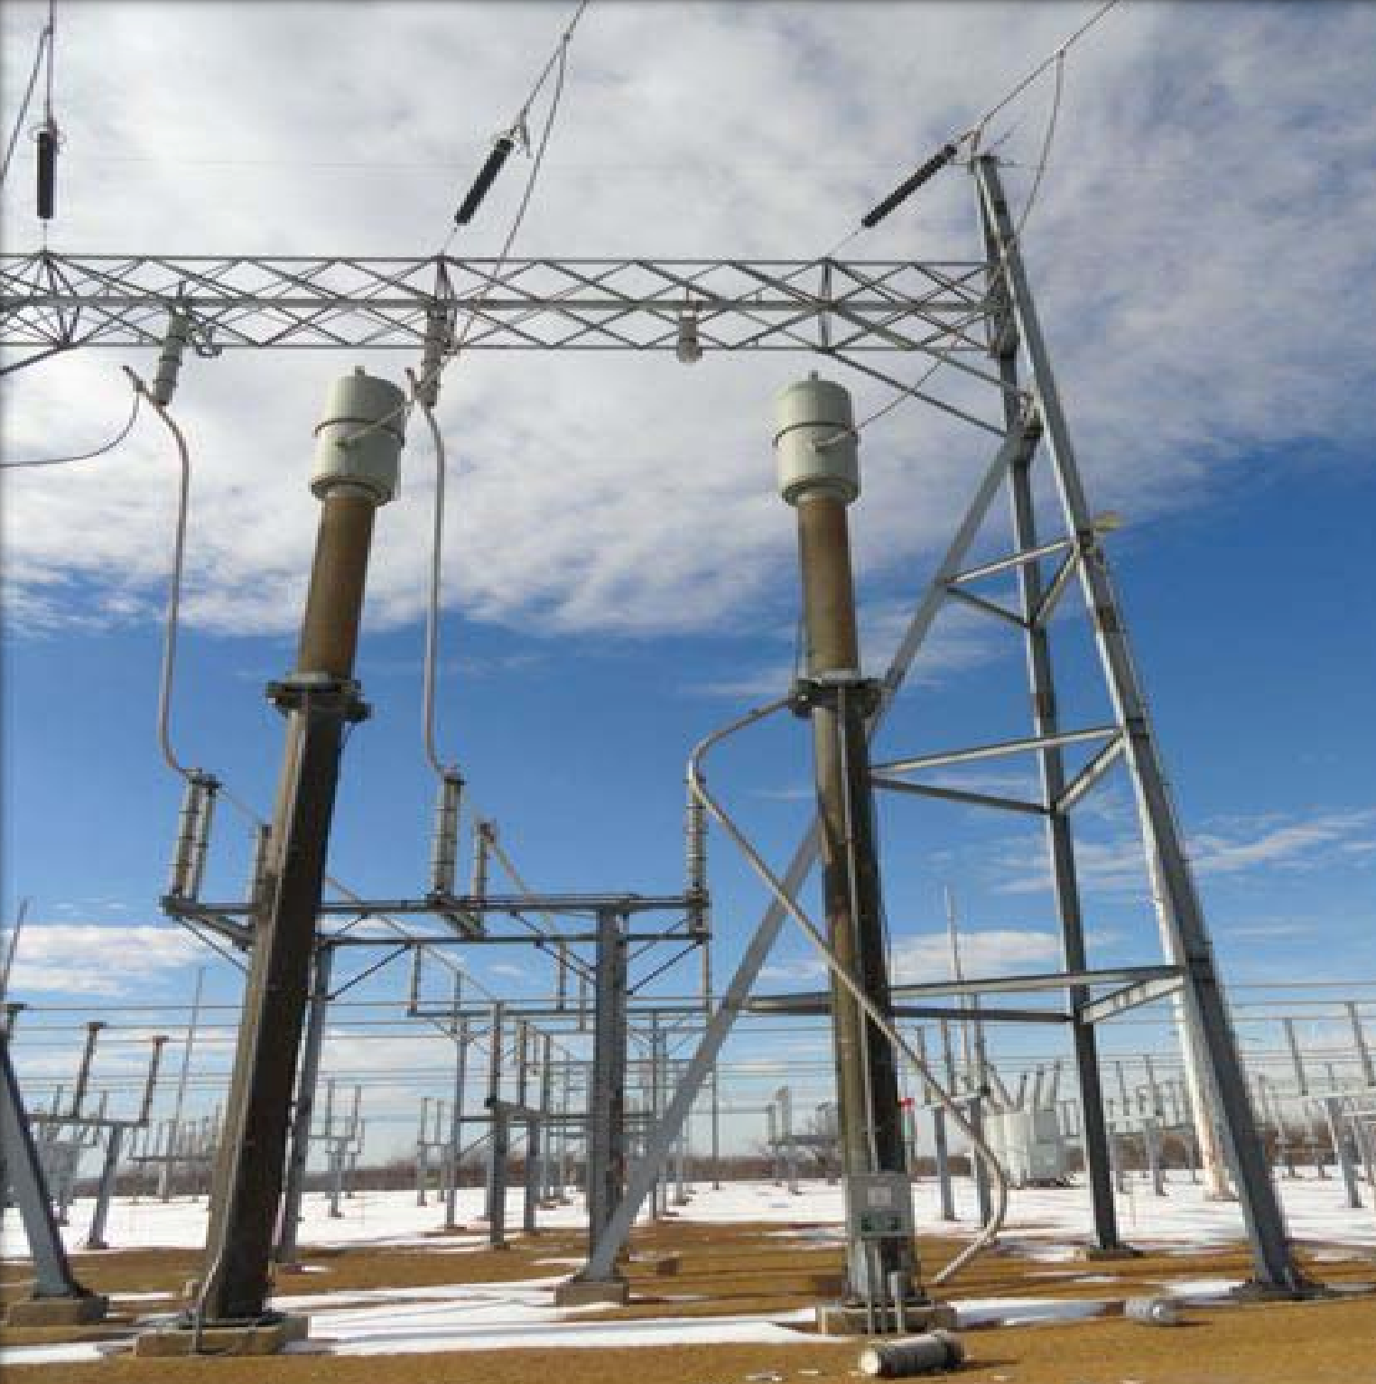
    Example Event: Byron 2012-01-30 (1)
  Collapse of a porcelain insulator on the high-voltage side of the auxiliary transformer in the switchyard of the plant
    Interruption of one phase
    No ground fault
    Open phase condition
Collapsed insulator
Uninterrupted Phase
Open Phase

Slide 4
Example Event: Byron 2012-01-30 (2)
  Within the next seconds, multiple pumps failed due to overcurrent protection:
    Essential service water (ESW) pumps
    Motor driven auxiliary feedwater (AFW) pump
    Component cooling water pumps (CCW)
    All reactor coolant pumps (RCP)
    …
  The monitoring of the onsite power system was not able to detect and handle the fault.
    No automatic actions of the reactor protection system.
    8 minutes after the collapse of the insulator the fault was isolated by manual action.

Slide 5
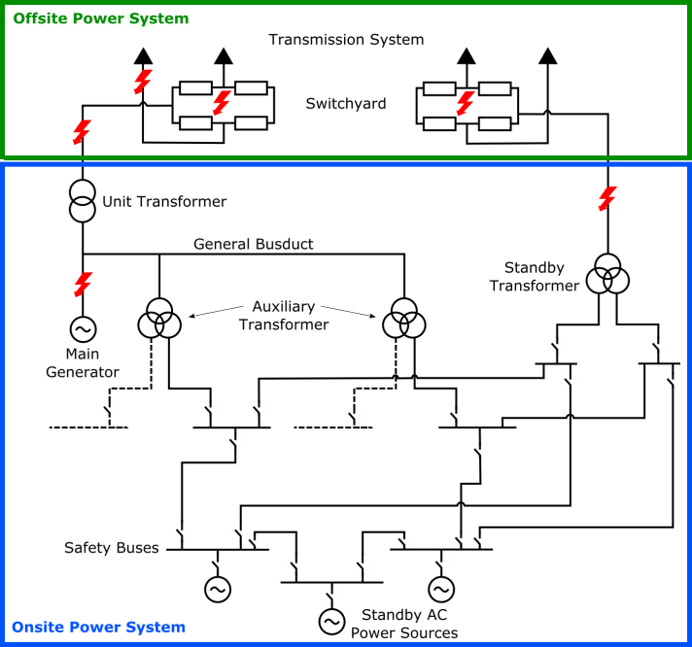
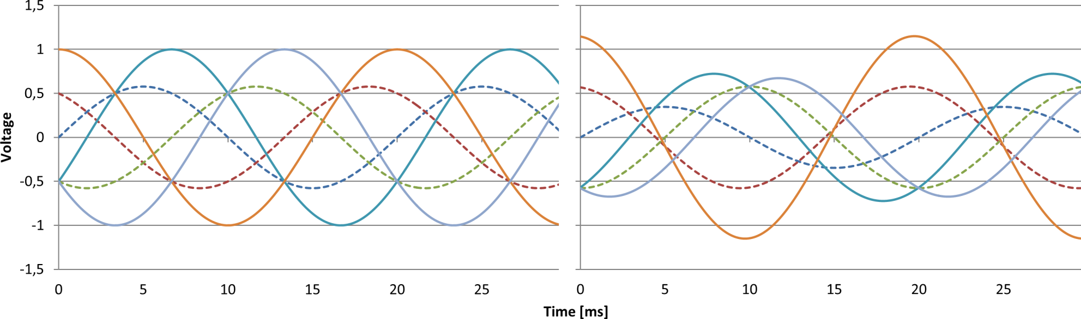
Safety relevance (1)
  No separation between the redundant electrical bus bars during normal operation.
    All trains are connected via the generator bus duct or the high voltage side of the standby transformer.
  Any open phase condition “above” the connections will affect all redundant trains simultaneously.
Voltage [ratio to amplitude]
uninterrupted
open phase
Notes:
Dashed: Voltage to ground, solid: Voltage between phases

Slide 6
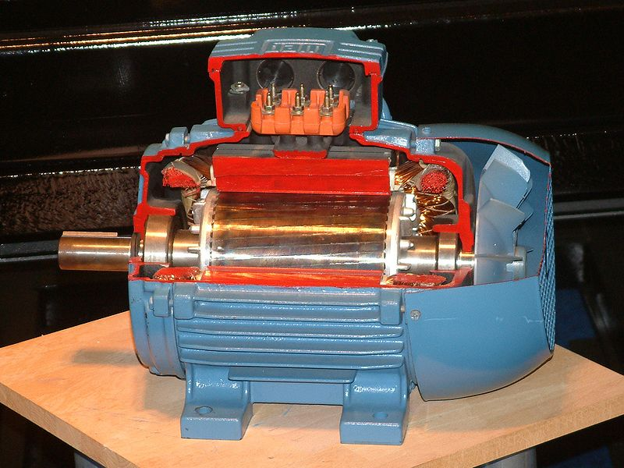
Safety relevance (2)
  Operational and safety relevant pumps, fans and valves in NPP are usually driven by asynchronous (induction) motors.
  Effects of open phase conditions may be:
    Reduced torque of the motors
      Operation or startup of the motors
      may get impossible
    Increased current intake
      May trigger overcurrent-protection
      devices of the motors
      Resetting requires manual action
    Thermal destruction of the motors

Slide 7
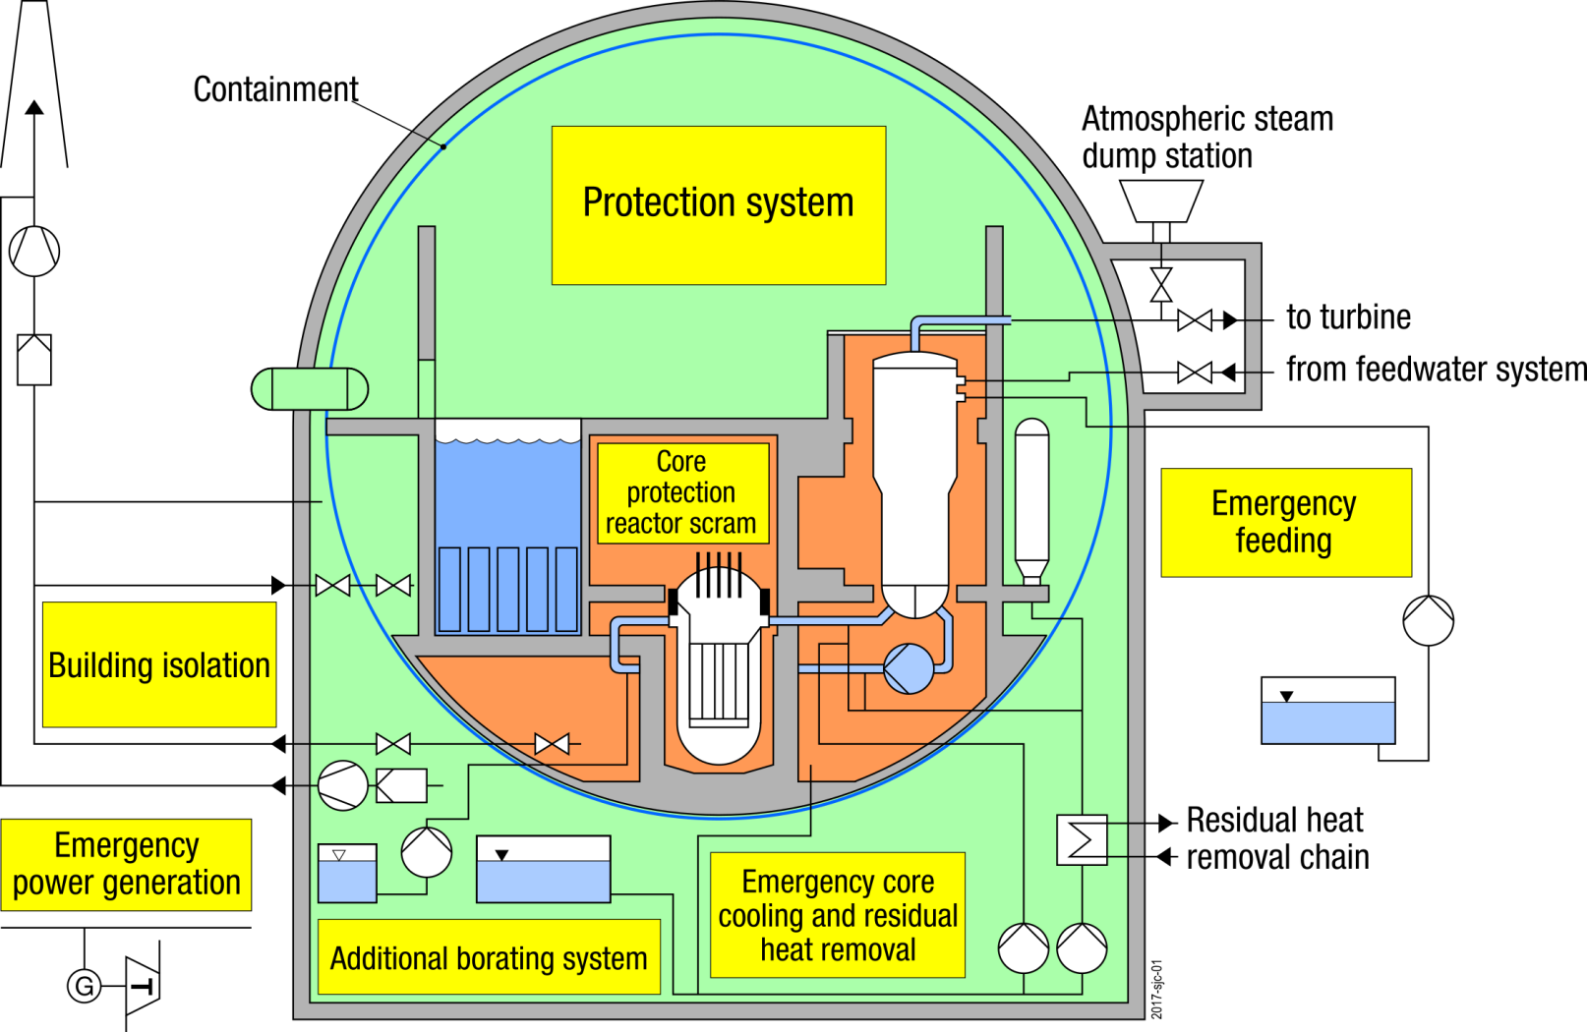
Safety relevance (3)
  Aim of the project: Include such phenomena in PSA

Slide 8
Structure of the Project
  Assessment of possible causes of faults affecting multiple trains of the electrical power supply system and their consequences from an operating and modeling perspective
    Detailed analysis of international operating experience with respect to actual and potential faults affecting multiple trains of the electrical power supply system
    Development of a detailed dynamic model of the electrical power supply system of a generic modern German PWR and the investigation of the causes and the propagation of such faults.
  Extension of a PSA model of a German PWR to allow for the modeling of the phenomena identified in the previous steps, adding
    Additional relevant equipment,
    New failure modes of equipment already modeled.
  Estimation of frequencies of initiating events (→Rate comparable to small LOCA)
  Estimation of additional reliability parameters describing component failures due to an asymmetry
  Quantification of the PSA model

Slide 9








Failure probability of components due to asymmetry: first modelling approach:
  Failure probability of individual components as function of asymmetry $a=\frac{V_{inverse}}{V_{direct}}$.
  Model parameters $α_{0}, α_{1}$are estimated using selected
  operating experience:
    failures,
    asymmetries $a$at individual components (calculated using a NEPLAN model of the plant).
  Result: Uncertainty distribution of model parameters.
$$P_{fail}$$
$$α_{1}$$
$$P$$
$$α_{0}$$
$$α_{0}$$
$$α_{1}$$
$$a$$

Slide 10
First modelling approach: Results
  Generally, the asymmetry at different bus bars is different due to the effect of transformers and loads.
  Redundant bus bars usually have similar asymmetry values since they have similar loads and similar connections to other parts of the electrical energy supply system.
  This causes a correlation of failures of components on redundant bus bars, which generally includes the groups of identical and redundant components.
  The analysis of international operating experience, however, showed that the observed correlation of failures of identical components with similar loads is much stronger than predicted by this model
    Identical components with similar loads fail while other components at the same bus bars are unaffected.
  This is of high importance to PSA results since redundant components are likely to be affected by such correlated failures.
  Explicit modelling of correlated failures necessary.
    Correlations estimated from operating experience.

Slide 11
Analysis of operating experience (1)
  To asses the failure of components during an asymmetry, national and international operating experience was considered.
  Available sources included:
    Licensee event reports,
    Event reports of the IAEA International Reporting System for Operating Experience (IRS),
    GRS internal reports, and
    Documents and reports published by
      regulators and
      other organizations like IAEA.

Slide 12
Analysis of operating experience (2)
  For the following ten events, quantitative information on component failures during asymmetries of the electrical energy supply system could be researched:
    Kalinin Unit 1, 1994,
    Balakowo Unit 1 und 3, 1997,
    South Texas Unit 2, 2001,
    Vandellòs Unit 2, 2006,
    Dungeness-B, 2007,
    Bruce A-1, 2012,
    Byron Unit 2, 2012,
    Forsmark Unit 3, 2013,
    Dungeness-B-2, 2014, and
    Biblis Unit A, 2014.

Slide 13
Analysis of operating experience (3)
  In total, 63 groups of identical components with similar loads that were exposed to the asymmetry and where components failed have been identified.
    For 18 groups, the number of exposed and of failed components could be researched
    For 3 additional groups:
      All failed.
      Group size unknown.
  Only actually exposed components and actual component failures were considered.
    The results of technical analyses about further component failures that would have occurred if additional components operated or were started were not included.

Slide 14
Analysis of operating experience (4)
  9 groups (identical components with similar loads) of size 2:
    In all instances, all components failed.
  5 groups of size 3:
    In all instances, all components failed.
  4 groups of size 4:
    In 2 instances, all components failed.
    In 1 instance, 2 components failed.
    In 1 instance, 1 component failed.
  3 groups whose size could not be determined:
    All components failed.

Slide 15
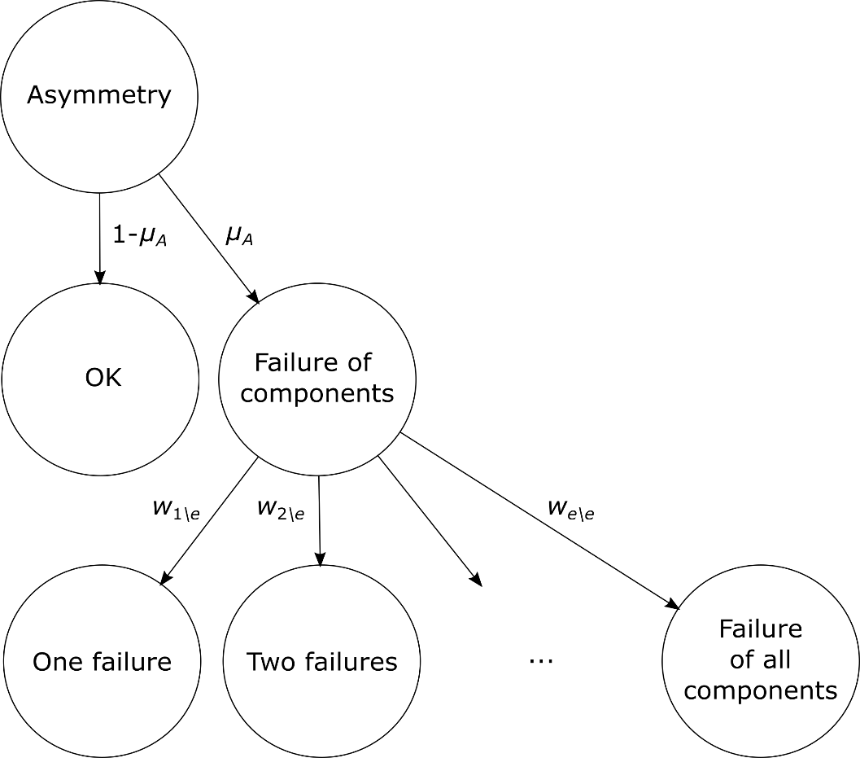
Improved Model
Stage 1
Stage 2
Notes:
transients due to plant internal faults and quasi-static grid disturbances

Slide 16

Stage 1 (1)
  Probability $μ_{A}$that failures occur in a specific group of similar components with similar loads.
  Estimates* for different events:
  → Different $μ_{A}$ for different events (different asymmetries)
*In cases where the exact number of exposed groups could not be assessed, a generic estimate (typical NPP/power operation) was used (see paper).

Slide 17
Stage 1 (2)
  Model: Mixture distribution of a uniform distribution on the unit interval and a Beta distribution
  Identical mean and standard deviation
  Very similar 5%, 50% and 95% quantiles

Slide 18
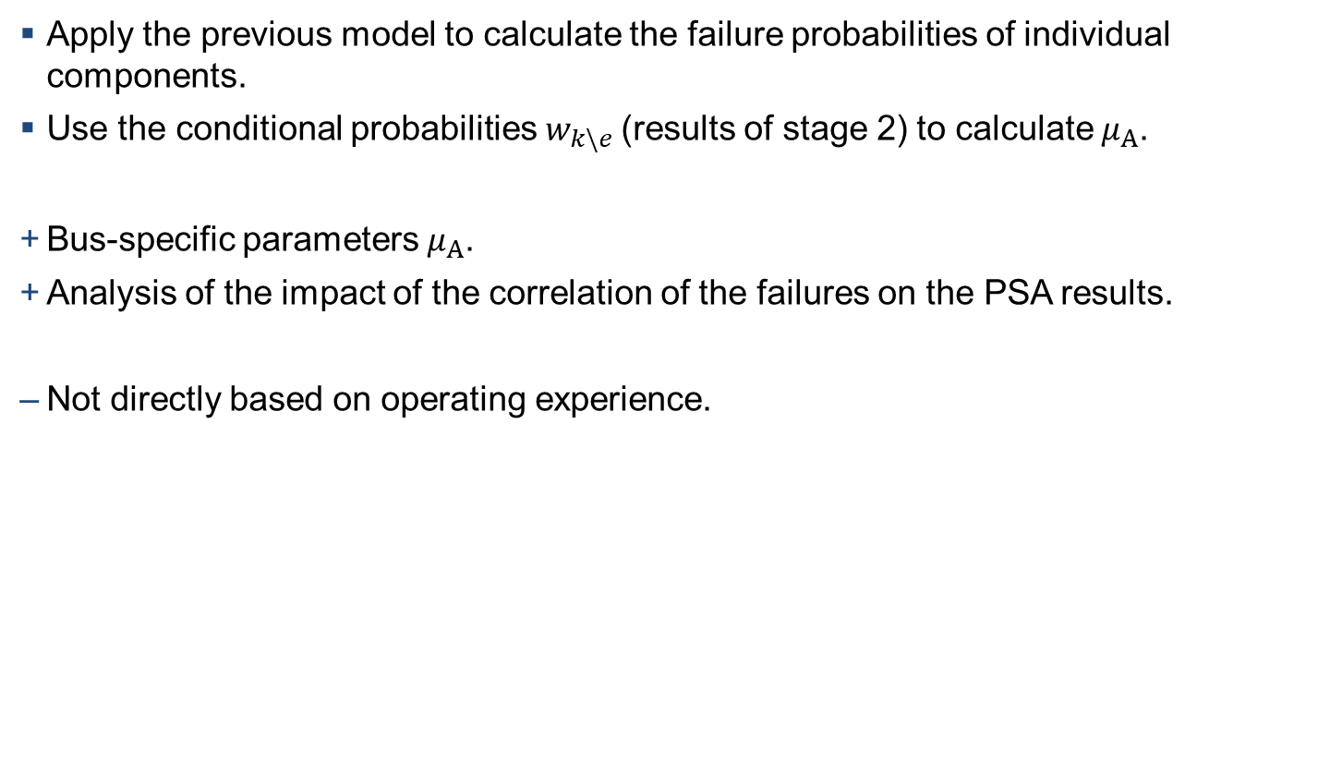
Stage 1 - Alternative approach
  Apply the previous model to calculate the failure probabilities of individual components.
  Use the conditional probabilities $w_{k\backslash e}$(results of stage 2) to calculate $μ_{A}$.
  Bus-specific parameters $μ_{A}$.
  Analysis of the impact of the correlation of the failures on the PSA results.
  Not directly based on operating experience.

Slide 19
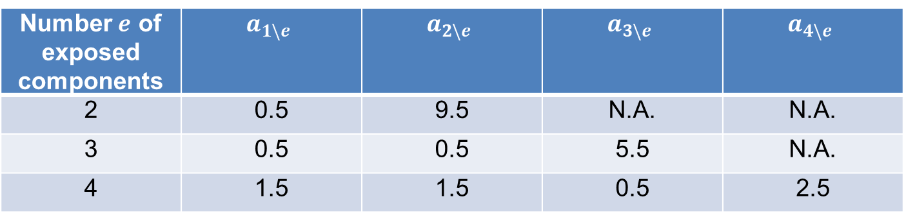

Stage 2 – Approach 1
  Directly model conditional probabilities $w_{k\backslash e}$ that $k$ out of $e$ exposed components fail (similar to Alpha-factor model)
  Noninformative prior according to Jeffreys
  $w_{k\backslash e}$ distributed according to a Dirichlet distribution with parameters:
Number $e$ of exposed components | $$a_{1\backslash e}$$ | $$a_{2\backslash e}$$ | $$a_{3\backslash e}$$ | $$a_{4\backslash e}$$
2 | 0.5 | 9.5 | N.A. | N.A.
3 | 0.5 | 0.5 | 5.5 | N.A.
4 | 1.5 | 1.5 | 0.5 | 2.5

Slide 20
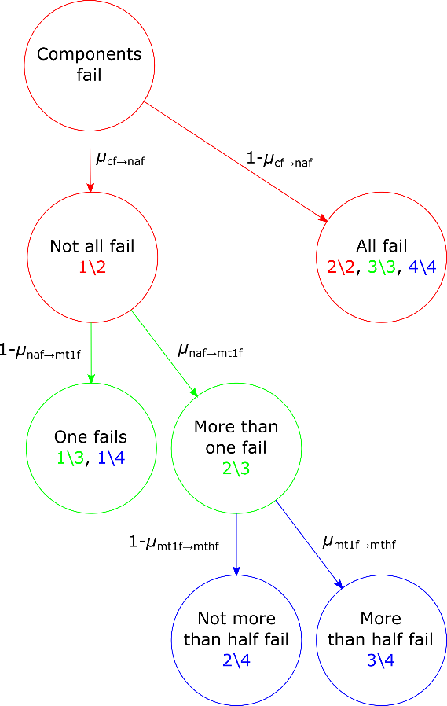
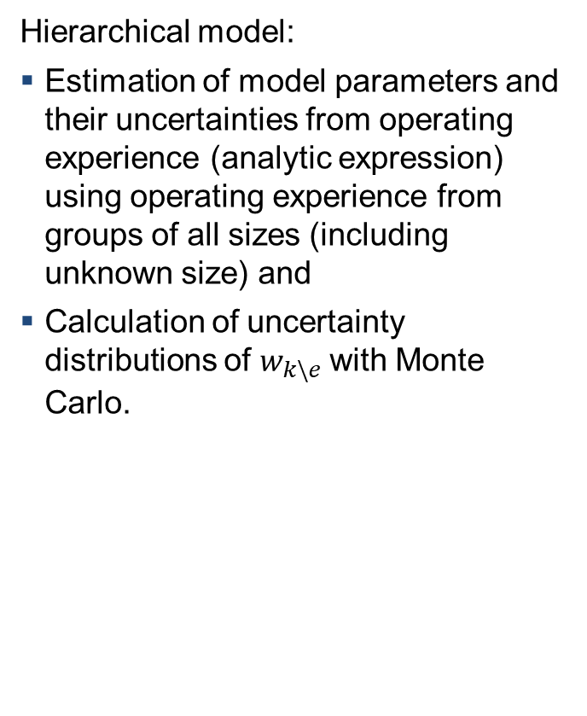
Stage 2 – Approach 2
Hierarchical model:
  Estimation of model parameters and their uncertainties from operating experience (analytic expression) using operating experience from groups of all sizes (including unknown size) and
  Calculation of uncertainty distributions of $w_{k\backslash e}$with Monte Carlo.
  Advantages:
    Estimation and quantification for component groups of different sizes.
    Extension of the model for larger groups possible (even without operating experience for groups of that size).

Slide 21
Results
Model |  | 1\2 | 2\2 | 1\3 | 2\3 | 3\3 | 1\4 | 2\4 | 3\4 | 4\4
1 | Mean | 0.009 | 0.174 | 0.014 | 0.014 | 0.155 | 0.046 | 0.046 | 0.015 | 0.076
2 | Mean | 0.029 | 0.153 | 0.018 | 0.011 | 0.153 | 0.018 | 0.008 | 0.003 | 0.154
1 | SD | 0.026 | 0.272 | 0.040 | 0.040 | 0.246 | 0.090 | 0.090 | 0.042 | 0.135
2 | SD | 0.052 | 0.241 | 0.035 | 0.024 | 0.241 | 0.035 | 0.019 | 0.009 | 0.241
  Quite similar, but deviations in the mean of up to
    0.078 absolutely
    a factor of 5.6

Slide 22
Next steps
  Extend the PSA model to include correlated failures.
  Quantify the PSA model (using results of the different approaches).
  Quantitative assessment of the risk associated with asymmetries of the electrical energy supply system.
Further research
  Modeling and quantification of detection and management (manual actions) of asymmetries by operators.

Slide 23
Summary
  Faults simultaneously impairing multiple trains of the electrical power supply system – including but not limited to open phase conditions – may pose serious threats to the safety of nuclear power plants.
  Such events have been repeatedly observed but are not generally modelled in PSA.
    Rate similar to a small break LOCA.
  On-going research initiative by GRS to model such events in PSA:
    Identification of different scenarios
    Detailed dynamic model of the electrical power supply system
      Simulation of scenarios, calculation of asymmetries
    Extension and modifications of existing PSA model
    Estimation of rates of initiating events and reliability parameters
    Estimation of the probability of correlated failures of components
    Quantitative assessment of the risk associated with asymmetries of the electrical energy supply system
23

Slide 24

Thanks for your attention!
Questions, remarks,
suggestions?
jan.stiller@grs.de
This research has been funded by the German
Ministry for the Environment, Nature Conservation, Nuclear Safety and
Consumer Protection (BMUV)

Slide 25
  Extra slides

Slide 26
Extra: Failure probability of components due to asymmetry - initial model

Slide 27
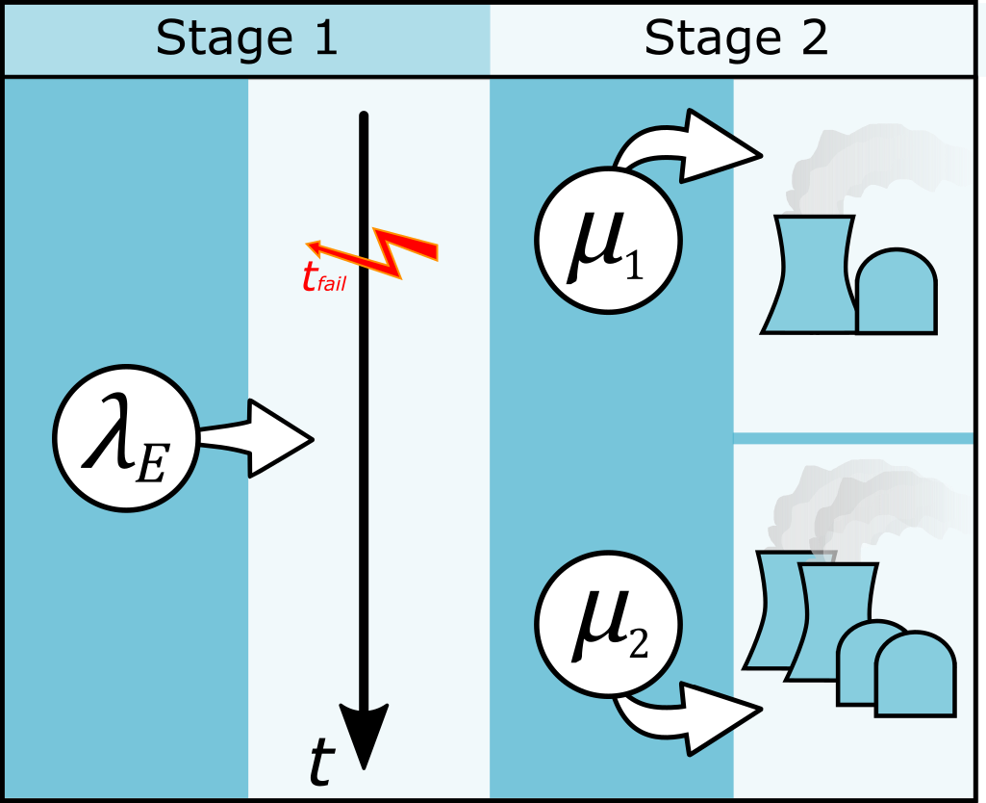
Quantification: Rate of Initiating Event “Asymmetry of the active grid”
  Rate comparable to small break loss of coolant accidents (LOCA)
2-phase
1-phase
1 or 2-phase
1/a

Slide 28
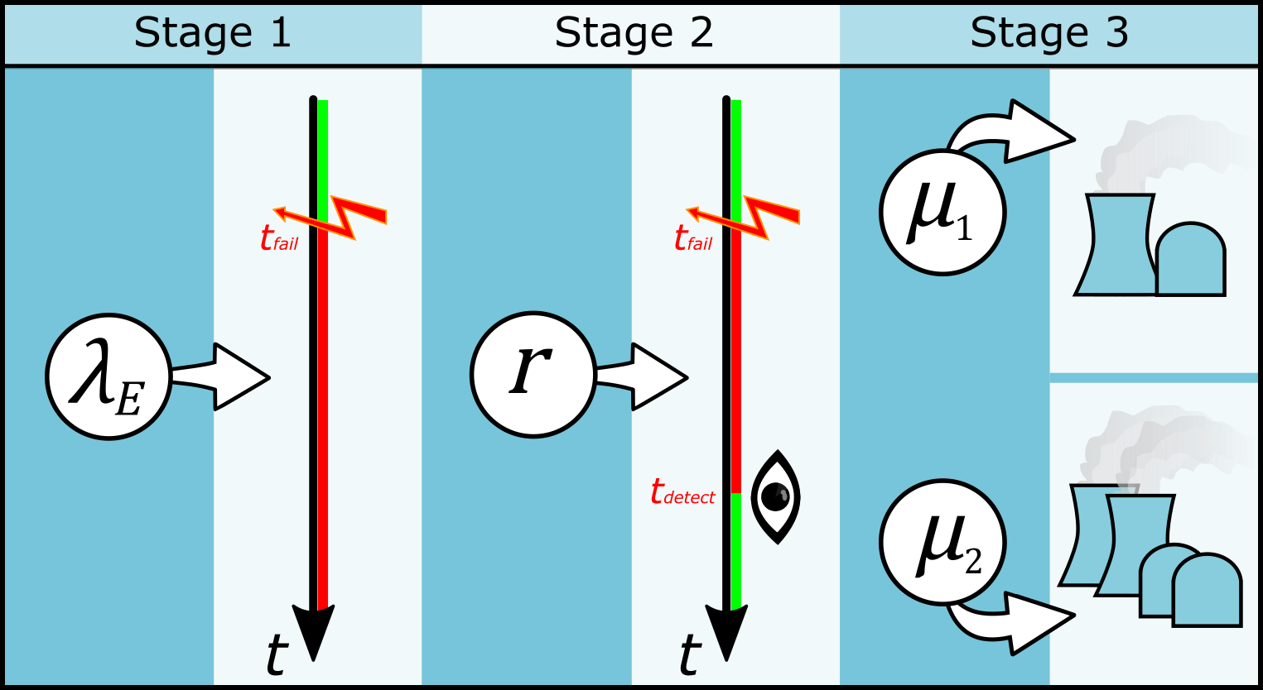
Quantification: Unavailability of the Non-Active Grid due to Asymmetry
2-phase
1-phase/1 or 2-phase

Slide 29
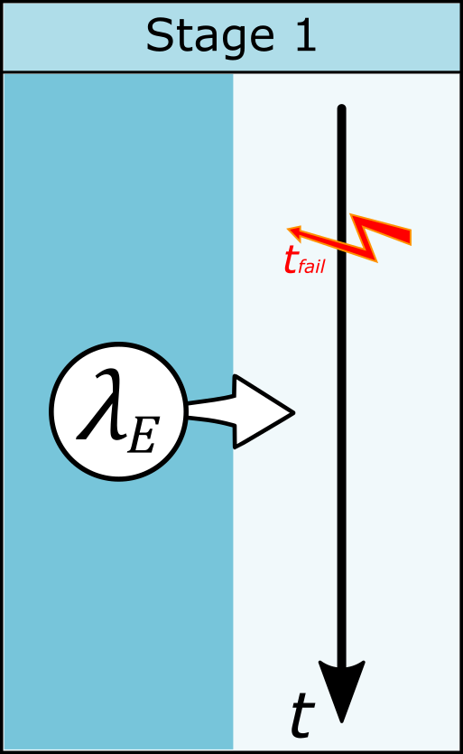
Extra: Quantification: Effect of the 2nd Stage of the Model
→ Gamma distribution
  Comparison with 1-stage model
    Example: 1-phase failure
  significantly broader distribution
1-stage
2-stage
1/a

