Slide 1
Assessing the Impact of Combined External Events on the Safety of NPP Paks
Tamas Siklossy, Attila Bareith, Bence Burjan, Barnabas Toth
siklossyt@nubiki.hu
PSAM16
Honolulu, Hawaii, USA, June 26 – July 1, 2022

Slide 2
Content
Introduction
Objectives
Types of External Hazard Combinations
Major Analysis Steps
Findings
Conclusions

Slide 3
Introduction
Mostly single external hazards were considered in the definition of the design basis for the Paks NPP in Hungary
Motivation of assessing the impact of hazard combinations on NPP safety
Hungarian Nuclear Safety Codes and international recommendations
Lessons learnt from the Fukusima Dai-ichi accident
Finding of the Periodic Safety Review of the Paks NPP in 2017
Preparatory study in 2018:
the regulations and recommendations have been looked at
the available methodologies have been studied and evaluated
analysis practices applied in Hungary have been reviewed
a proposal has been developed for the technical tasks and the schedule thereof to identify combinations of external hazards and assess the effects of such hazards on NPP safety (including high level methodology of each analysis steps)

Slide 4
Objectives
Identify combinations of external hazards and assess the effects of such combinations on NPP safety
identification and characterization of load combinations
assess the effects of hazard combinations on NPP safety:
justification of the adequacy of protection against hazard combinations to be included in the design basis
quantification of the residual risk due to beyond design basis load combinations and identification of the main risk contributors
Identify important safety concerns
Transients in full power operation and in LPSD states

Slide 5
Types of Combined External Hazards
Combination of dependent hazards – causal connection
Consequential hazards – cause-effect relation:
A may cause B (e.g. explosion – forest fire)
A is a prerequisite of B (e.g. earthquake – soil liquefaction)
Non-consequential connected hazards (correlated hazards) – common root cause (e.g. a meteorological condition triggers many hazards)
Combination of independent hazards (coincidental hazards) – no causal connection
independent events have a high occurrence frequency,
at least one of the events is long-lasting and usually rare.

Slide 6
Major Analysis Steps
PSA:
Selection of combined external hazards
Screening of combined external hazards
Detailed assessment of screened-in event combinations:
Hazard assessment
Plant response and fragility analysis
Event logic modeling and risk quantification
Design basis (identification and justification of protection):
Selection of combined external hazards
Screening of combined external hazards
Definition of design basis load combinations
Evaluation of plant protection and specification of protective measures

Slide 7
Selection of Combined External Hazards
Development of a comprehensive list of potential single external hazards
Screening of single hazards with respect to hazard combinations
screening by relevance (cannot occur at the site)
frequency based screening (10⁻⁷/a for Paks NPP)
Evaluation of the dependence among the hazards
a table („matrix”) form – cross-correlation chart
for all the possible hazard combinations, the possible relation type has to be identified and marked with a predefined symbol
identification of hazard combinations including 3 or more hazards:
mapping of root causes that may trigger such combinations
studying the dependence in rows and columns of the cross-corr. chart

Slide 8
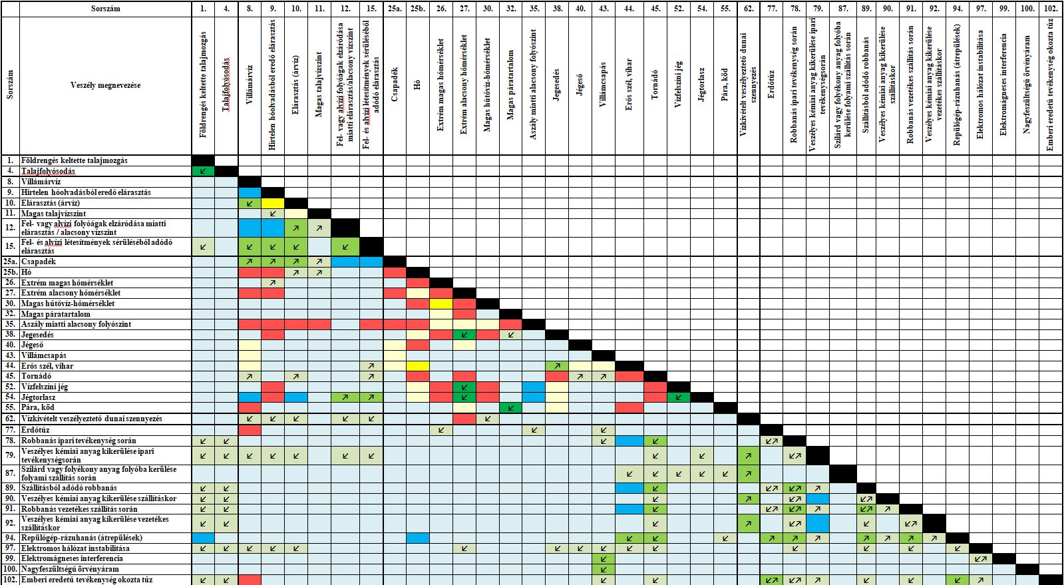

Slide 9
Selection of Combined External Hazards – Possible relation types
↗↙ | one hazard is a prerequisite of the other hazard
↙↗ | one hazard may cause the other hazard, the impact mechanisms of the single hazards are similar or the same
↙↗ | one hazard may cause the other hazard, the impact mechanisms of the single hazards are different
 | correlated hazards, the impact mechanisms of the single hazards are similar or the same
 | correlated hazards, the impact mechanisms of the single hazards are different
 | independent hazards, the impact mechanisms of the single hazards are similar or the same
 | independent hazards, the impact mechanisms of the single hazards are different
 | mutually exclusive hazards

Slide 10
Screening of Combined External Hazards
666 hazard combinations were mapped, consisting of 2 hazards
In general, the same screening criteria as for single hazards
Relation between the impact mechanisms of the single hazards:
similar or the same (e.g. wind & snow to structures):
hazards affect the same SSCs amplifying one another’s effects
resistance against the combined load has to be assessed
different (e.g. wind & high temperature)
hazards do not affect the same SSCs or not with the same mechanisms
Hazard combination specific screening criteria:
hazards are mutually exclusive
definition of a single hazard covers the other single hazard
the impact of the hazard combination is not more severe than the effect of the more powerful hazard

Slide 11
Screening of Combined External Hazards
Detailed screening of hazard combinations was performed considering the following hazard categories:
hydrological hazards;
man-made external hazards;
riverine events endangering the water intake facility;
hazards related to the relevant areas of geosciences;
meteorological hazards.
For the sake of traceability and transparency screening not on a case-by-case basis, but looking at hazards within a group and then hazards related to different categories

Slide 12
Screened-in Combined External Hazards
handling of dangerous substances in severe weather conditions
multiple accidents in nearby industrial facilities due to a common initiator of natural origin
earthquake occurring when the ambient temperature is extreme (independent hazards)
storm: high wind, extreme precipitation and thunder
snowstorm and accumulated snow and strong wind: extreme wind and snow
extreme warm weather: extremely high air temperature and high Danube temperature
extreme cold weather: extremely low air temperature and surface ice on the Danube (and icing and snow)
(geoscience related hazards, e.g. earthquake and soil liquefaction)
(possible combinations of single hydrological events)
(external hazards endangering the blockage of water intake from the river Danube – combinations of single endangering events)

Slide 13
Hazard Assessment – Man Made Hazards
A large number of dedicated deterministic analyses to determine the effects of an accident during handling dangerous substances in severe weather conditions -> do not pose more significant impact on the NPP safety than in moderate conditions – screened out from further assessment
Multiple accidents in nearby industrial facilities do not pose a significant challenge to the NPP safety due to
the distance between the hazard sources and the NPP
the direction of the sources relative to the NPP
and the different types of effects of the various sources

Slide 14
Hazard Assessment – Natural Hazards
Snowstorm: relative frequency of strong winds during intensive snowfalls
Full correlation was conservatively assumed between the extreme (return) values of instantaneous, daily and weekly air temperatures, and cooling water temperature
Earthquake occurring when the ambient temperature is extreme (independent hazards – dedicated approach)
$P=N·λ_{1}{·λ}_{2}·\left(t_{1}+t_{2}\right)$
$λ_{i}$ occurrence frequency of event i [1/a]
$t_{i}$ duration of event i [year]
N duration (in a year) when both events may occur simultaneously [year]
Storm; Accumulated snow and strong wind:
collected site specific data
joint distribution function – bivariate extreme value distribution
logistic dependence model
extreme value distribution functions of single hazards as marginal distributions

Slide 15
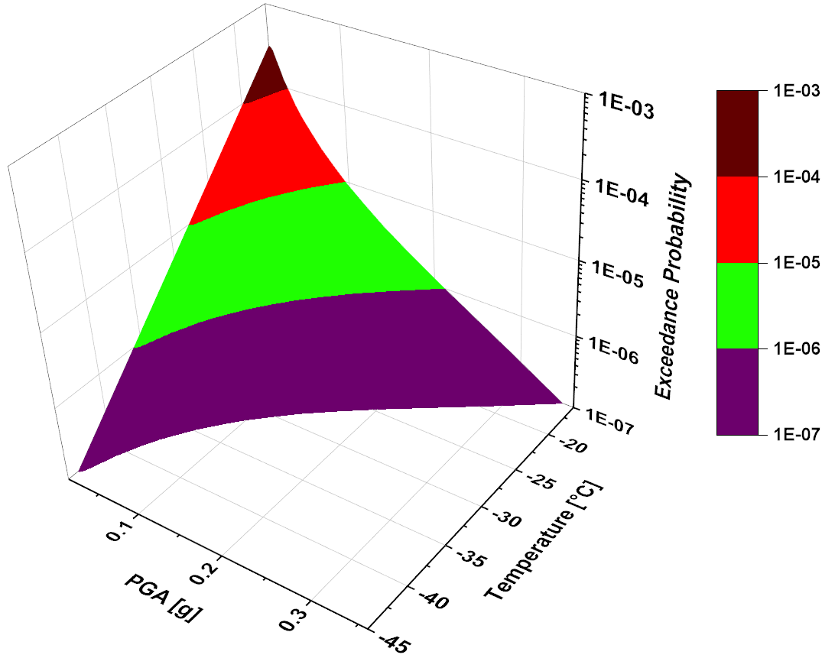
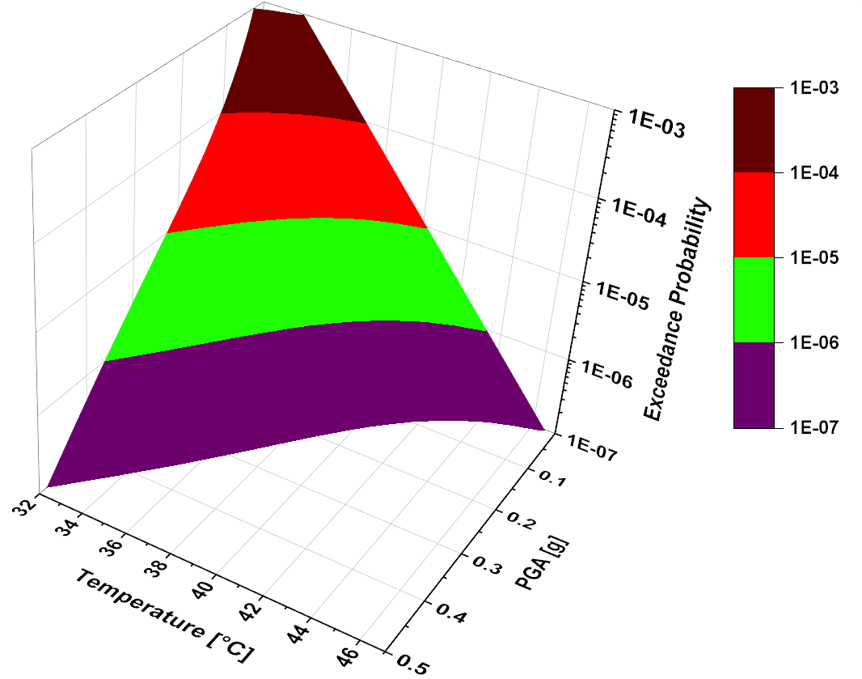
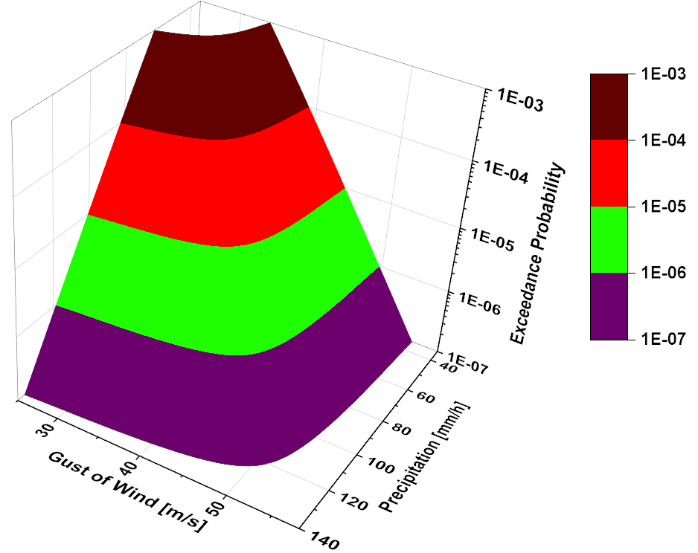
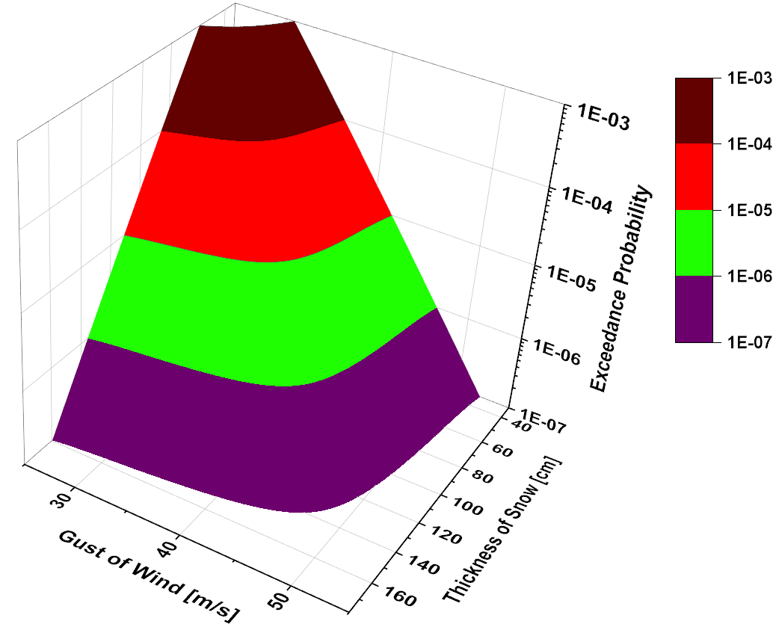

Slide 16
Plant Response and Fragility Analysis
Earthquake occurring when the ambient temperature is extreme:
failure of the HVAC system induced by below design basis seismic events during moderately extreme air temperature
the potential processes and the corresponding fragility curves
plant is sufficiently protected against low air temperature
Storm: LOOP induced by high wind or lightning and simultaneously extreme precipitation
cooling water of diesel generators are discharged to the same canalization system that is used for rainwater discharge
plant is sufficiently protected against such scenarios
Extreme warm and cold weather – plant response is almost the same to these events as to single hazards, not assessed further

Slide 17
Plant Response and Fragility Analysis
Accumulated snow and strong wind:
thorough review of the already available structural analyses -> the fragilities assessed for single hazards are bounding
some combinations were already considered
dominant structural components in the fragilities do not coincide
new scenario: LOOP (with wind fragility) during heavy snowfall
Snowstorm – conservative expert judgement
the conditional blockage probability of the air intake system to the diesel generators in case of a heavy snowfall is 0.1 (if no operator action is assumed)

Slide 18
Event Logic Modelling
Earthquake occurring in extreme warm weather
Identification of event sequences leading to core damage (seismic failures leading to loss of HVAC system)
Single hazard fragility curves could be used in the assessment
CCDP for extreme warm weather situations when HVAC is not available was estimated based on conservative expert judgement
No detailed PSA model, spreadsheet application to determine cut set frequencies, overall CDF, perform sensitivity analysis
Extreme wind and snow
New events:
wind induced loss of off-site power during extreme snowfall
wind induced switchyard failures leading to LNPS during extreme snowfall
loss of the diesel generators due to snowstorm (blockage of air intake systems)
Scenarios:
wind induced LOOP AND snow induced failure
snow induced switchyard failures AND blockage of the air intake filters to the DGs
Event tree for extreme snow was utilized, quantification similar to single hazards

Slide 19
Findings
Earthquake occurring in warm weather
CDF 1.74·10⁻⁷ /a
same failures in full power operation and in LPSD (constant risk)
considerable uncertainties, hence regarded as an upper bound
fans and heat exchangers of the HVAC system and the seismically unqualified relays and cabinets are the dominant risk contributions
Extreme wind and snow
CDF 2.06·10⁻⁸ /a
Dominant event sequences:
LOOP due to high wind and the blockage of the air intake system of the DGs
wind induced failure of the switchyard, subsequent failure of plant operation in island mode and the blockage of the air intake system of the DGs
limited scope of uncertainty assessment showed remarkable uncertainties
Several safety enhancement measures were proposed

Slide 20
Conclusions
An assessment of combined external hazards for the Paks NPP has lately been completed.
The relevant load combinations have been identified and characterized
The adequacy of protection against hazard combinations has been justified.
The residual risk due to beyond design basis load combinations has been quantified and the main risk contributors have been identified.
The assessment followed the commonly exercised steps in this domain:
hazard selection and screening,
hazard assessment,
evaluation of plant protection,
plant response and fragility analysis,
development of event sequence models for hazard initiated plant transients
risk quantification and evaluation of results.
The Paks NPP is sufficiently protected against the combined external hazards.

Slide 21
Thank you for your attention!

