Slide 1
A Risk-Informed Approach to Linked Safety-Security Modeling
Shawn St. Germain
June 2022
Notes:
Remember … amy attending will not be aware of the physical security work.
Meet NRC reequipment and be more cost effective.

Slide 2
Overall Proposed Approach
Develop and demonstrate tools for a risk-informed physical security method by integrating dynamic risk methods, physics-based modeling and simulation, operator actions, and flex equipment, which should extend the adversarial timeline for response force success.
These tools will enable commercial utilities to incorporate increased realism in their force-on-force (FOF) models, take credit for operator actions and flex equipment, and move towards greater use of quantitative measures of performance in security postures and the technical basis for physical security at power plants.

Slide 3



FY 2020 Reports

Slide 4

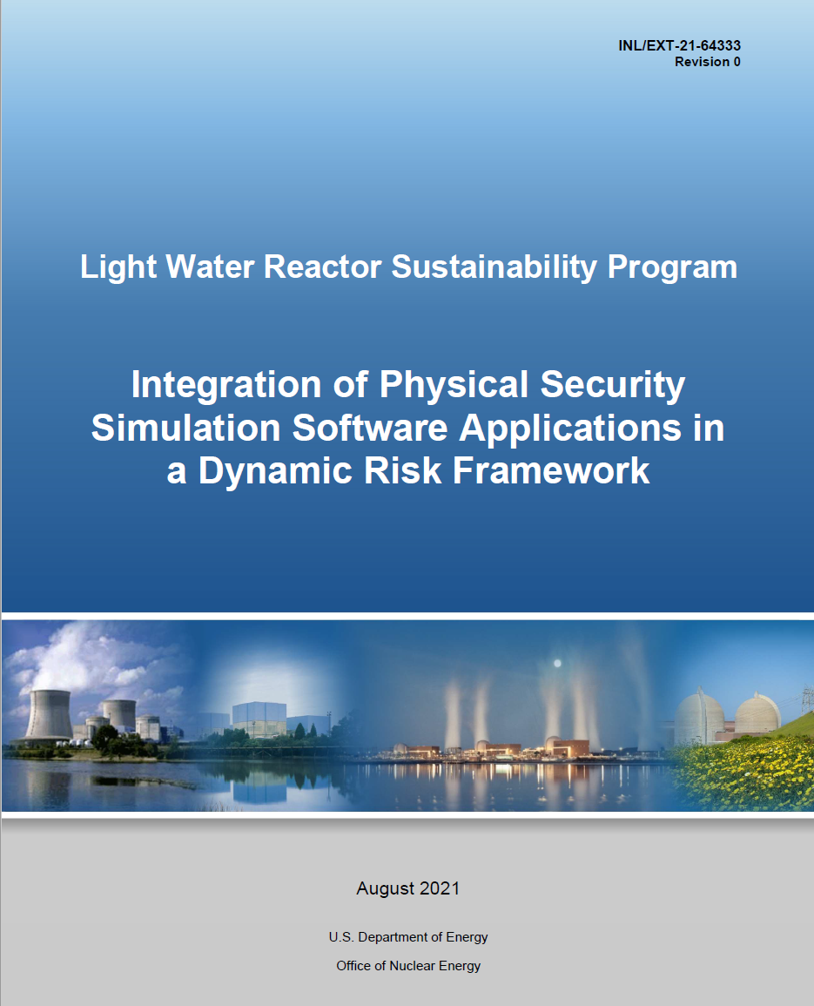
FY 2021 Reports

Slide 5
FY 2021 Reports
Integration of Physical Security Simulation Software Applications in a Dynamic Risk Framework
  Describes integration of Simajin simulation application into the Dynamic Risk Framework
  Includes refined treatment of Defense-in-Depth (DID) Analysis
  Includes refined treatment of post-effectiveness evaluation
  Includes refined treatment of human action modeling
Guidance Document for Using Dynamic FOF Tools to Support Physical Security Optimization
  Provides instructions for physical security modelers to implement the Dynamic Risk Framework
  Describes the various tools that may be used
  Describes how to set up Event Modeling Risk Assessment using Linked Diagrams (EMRALD) to support dynamic physical security risk modeling
  Describes integration of common physical security simulation software applications in the Dynamic Risk Framework
  Describes methods for evaluating and interpreting results

Slide 6
FY 2021-2022 Tasks
Develop guidance documents in collaboration with stakeholders to support the use of the dynamic risk tools by industry security staff with support of nuclear utility Probabilistic Risk Assessment (PRA) staff.
Integrate additional A simulation software platforms and refine metrics for evaluation of effectiveness.
Document the Physical Security Pathway human reliability needs for the Risk-Informed Systems Analysis (RISA) pathway's work package.
Develop dynamic modeling tools to incorporate FOF and nuclear utility site operator actions into static and dynamic risk assessment models.
Support the LWRS Program Physical Security Pathway Program Manager in providing input to the Physical Security Pathway program plan and support program meetings including stakeholder meetings.
Demonstrate methodology with actual plant data to refine methods and validate assumptions.

Slide 7
Proposed Framework

Slide 8
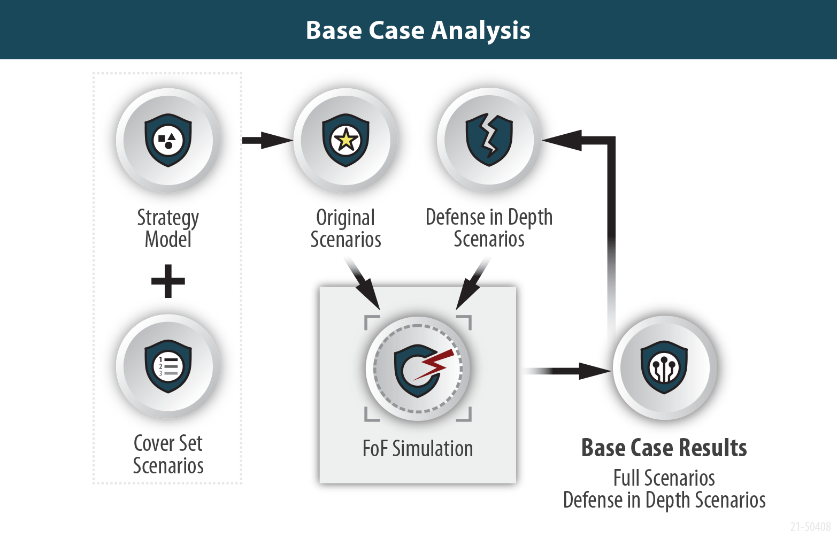
Initial Plant Modeling

Slide 9
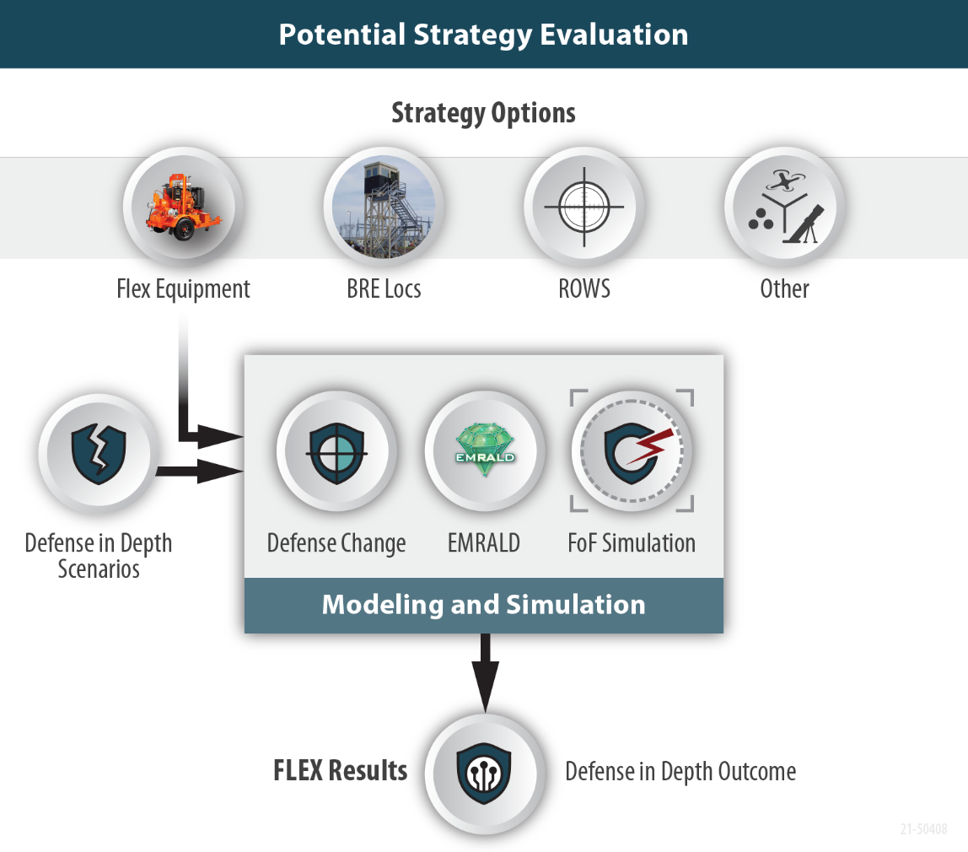
Modeling Potential Alternative Strategies

Slide 10
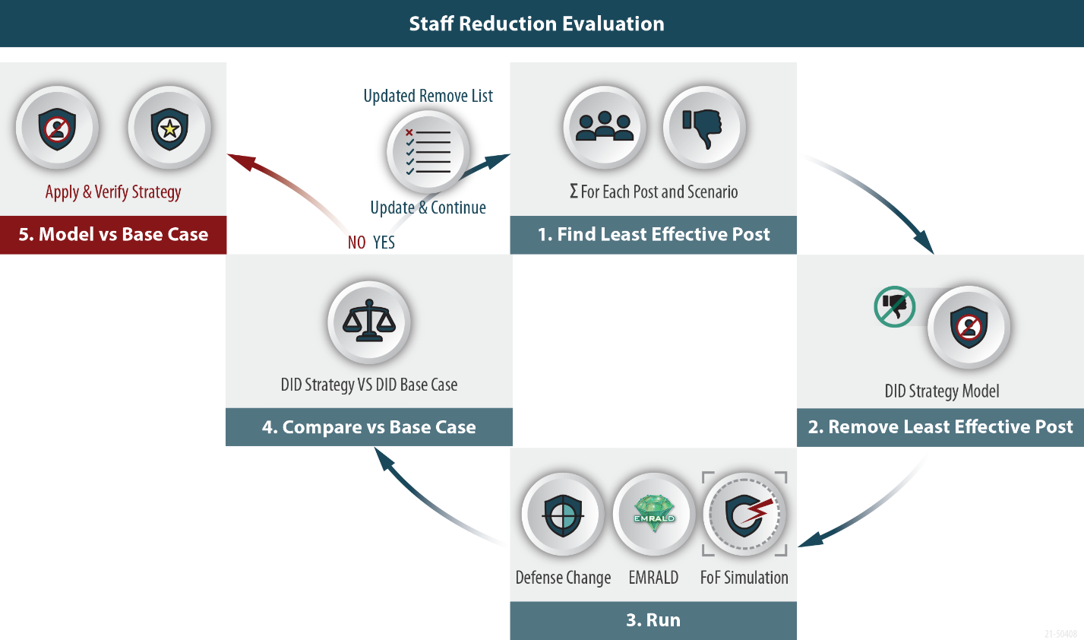
Evaluate Potential Cost Savings

Slide 11
EMRALD
(Event Model Risk Assessment using Linked Diagrams)
Dynamic PRA model based on a three-phased discrete event simulation.
  To begin, add initial start states to Current and New States List.
  While there are States in the New States list, for each State:
  - Add the Events to the Time Queue or Conditional List
  - Execute any Immediate Actions
  If any Conditional Events criteria are met:
  - Execute that events action/s
  - (Go to Step 1)
  Jump to the next chronological event:
  - Process that event’s actions
  - (Go to Step 1).

Slide 12
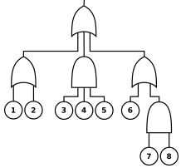
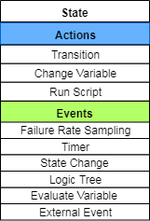
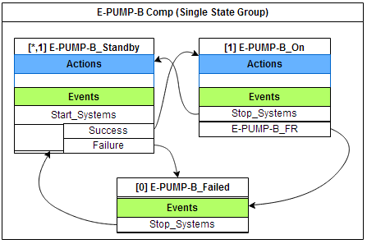
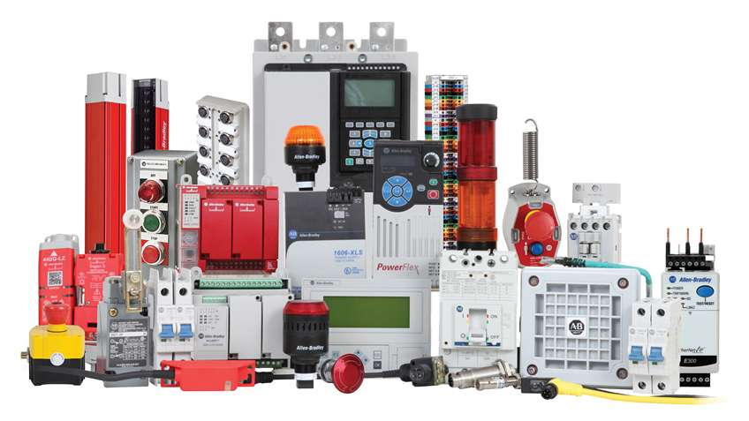
EMRALD Modeling
States
Actions (transition, change variables, run script)
Events → Action (sampling, conditions, time, etc.)
Logic Trees​
Diagrams
Components
Systems
Plant response
Variables
External Links
Notes:
An EMALD model is built out of a few basic components.
States are a logical representation for a current condition and are made of immediate actions and Events that trigger actions.
States are used to build different types of diagrams these diagrams relate directly to traditional PRA Modelling.
The user can also define Logic Trees of components, variables and external links.

Slide 13
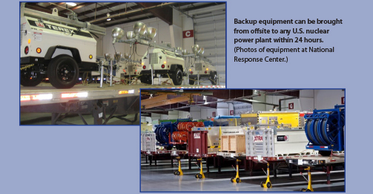
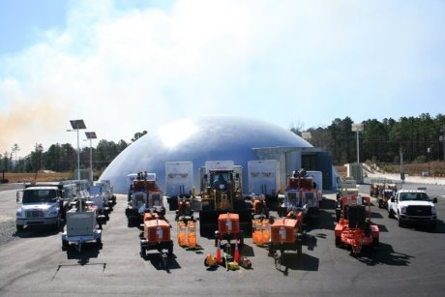
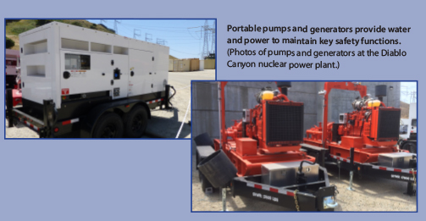
Case Study: Crediting FLEX Equipment
Diverse and Flexible Mitigation Strategy (FLEX)

Slide 14
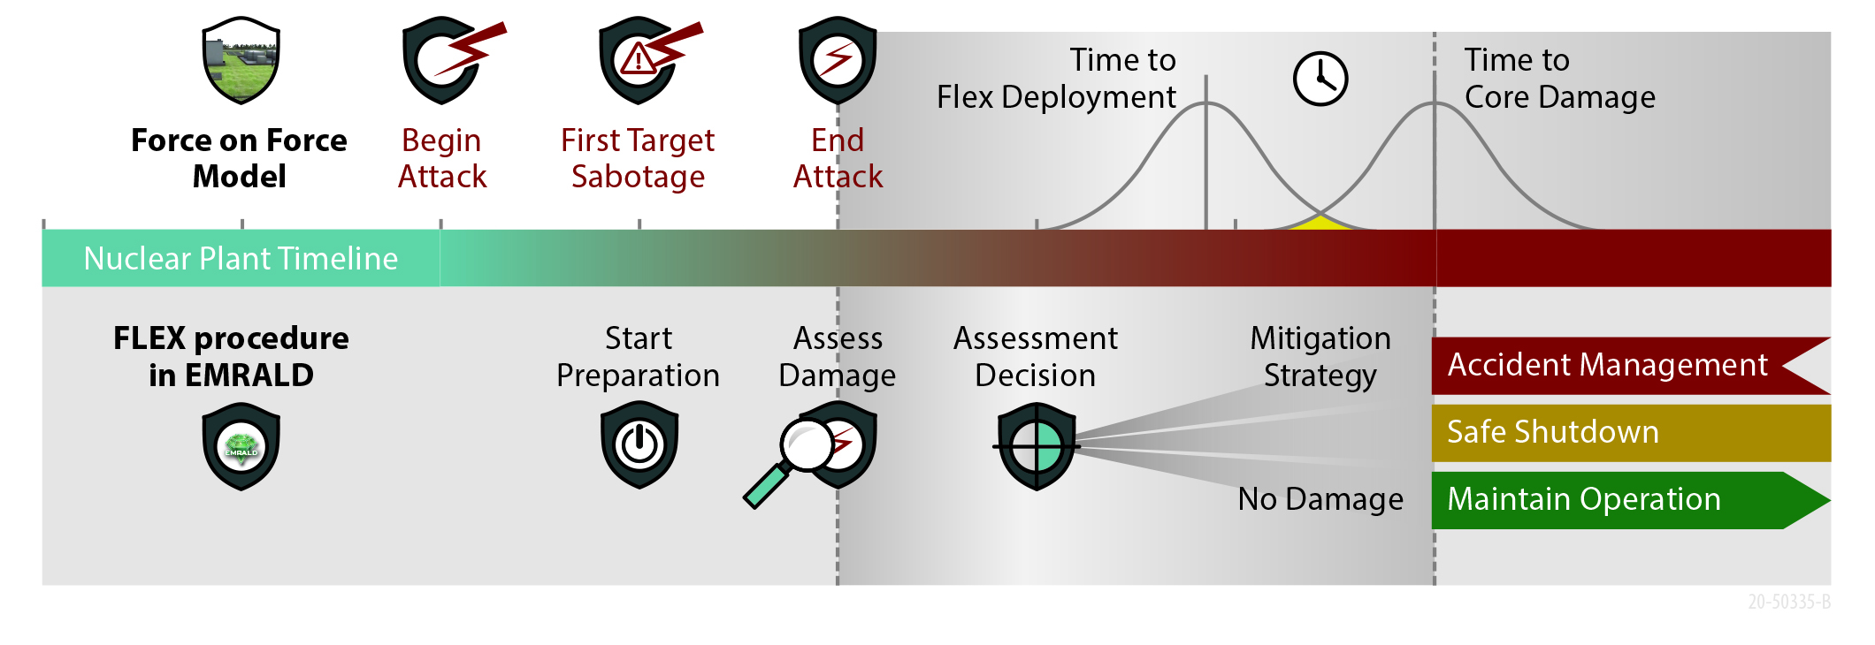
FoF-FLEX Timeline Model

Slide 15
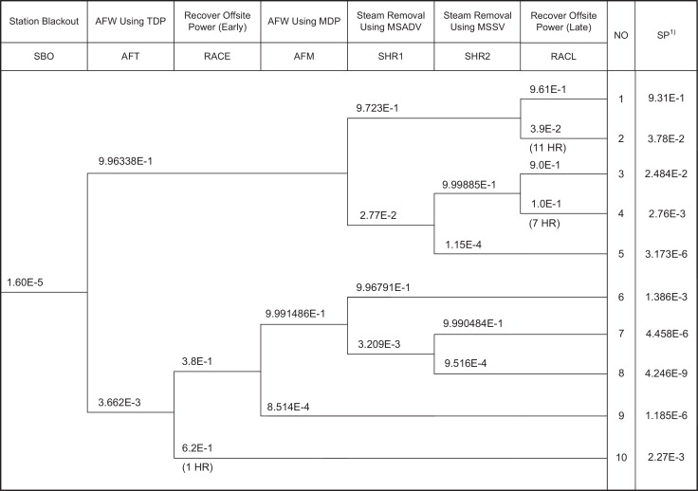
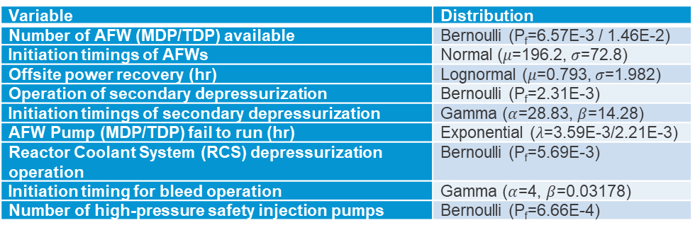
Time Window to Execute FLEX Strategy
RELAP5 TH analysis with uncertainties*:
  Operator action timing:
  Component failures:
Task | Average(s) | Std dev (s)
Average performance time of standard post-trip actions | 196.2 | 72.8
Event diagnosis time data for SBO | 251.7 | 78.6
Minimizing the leakage from RCS | 395.4 | 61.0
Preventing the over pressurization of main condensers | 410.8 | 76.5
Restoring AC power | 515.6 | 89.7
Variable | Distribution
Number of AFW (MDP/TDP) available | Bernoulli (P_{f}=6.57E-3 / 1.46E-2)
Initiation timings of AFWs | Normal ($μ$=196.2, $σ$=72.8)
Offsite power recovery (hr) | Lognormal ($μ$=0.793, $σ$=1.982)
Operation of secondary depressurization | Bernoulli (P_{f}=2.31E-3)
Initiation timings of secondary depressurization | Gamma ($α$=28.83, $β$=14.28)
AFW Pump (MDP/TDP) fail to run (hr) | Exponential ($λ$=3.59E-3/2.21E-3)
Reactor Coolant System (RCS) depressurization operation | Bernoulli (P_{f}=5.69E-3)
Initiation timing for bleed operation | Gamma ($α$=4, $β$=0.03178)
Number of high-pressure safety injection pumps | Bernoulli (P_{f}=6.66E-4)
CD in 1 hour
Conservative time limit
(Realistic time limit > 1 hour)
* A. U. A. Shah, R. Christian, J. Kim, H. G. Kang. “Coping Time Analysis for Chromium coated Zircaloy for Station Blackout Scenario based on Dynamic Risk Assessment.” Proceedings of The 15th Probabilistic Safety Assessment and Management Conference. Venice, Italy. November 2020.

Slide 16
Realistic Core Damage Time
Force-on-Force Thermal Hydraulics (FOF-TH) coupled simulations show that there is enough time to actuate the FLEX strategy following the attack scenario
Realistic time-to-core-damage > 1 hr

Slide 17
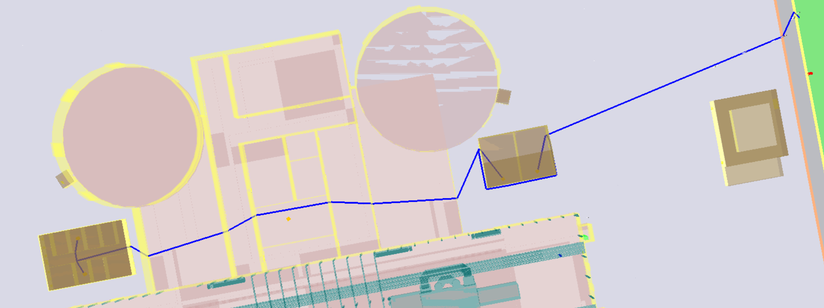
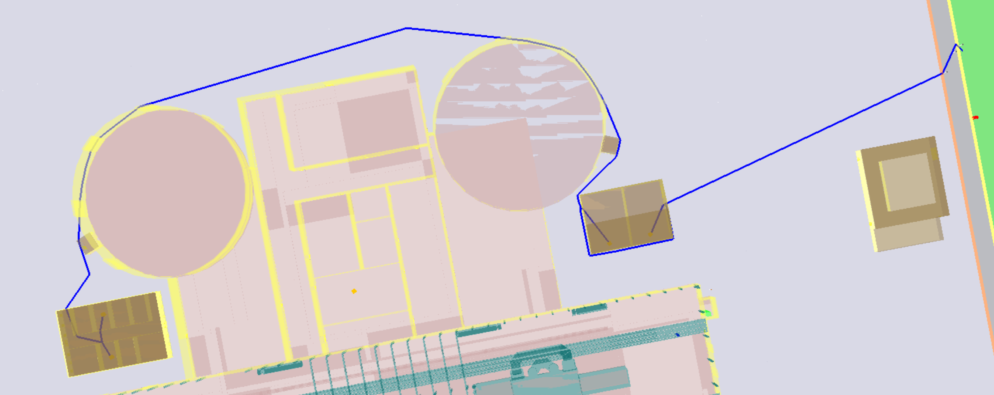
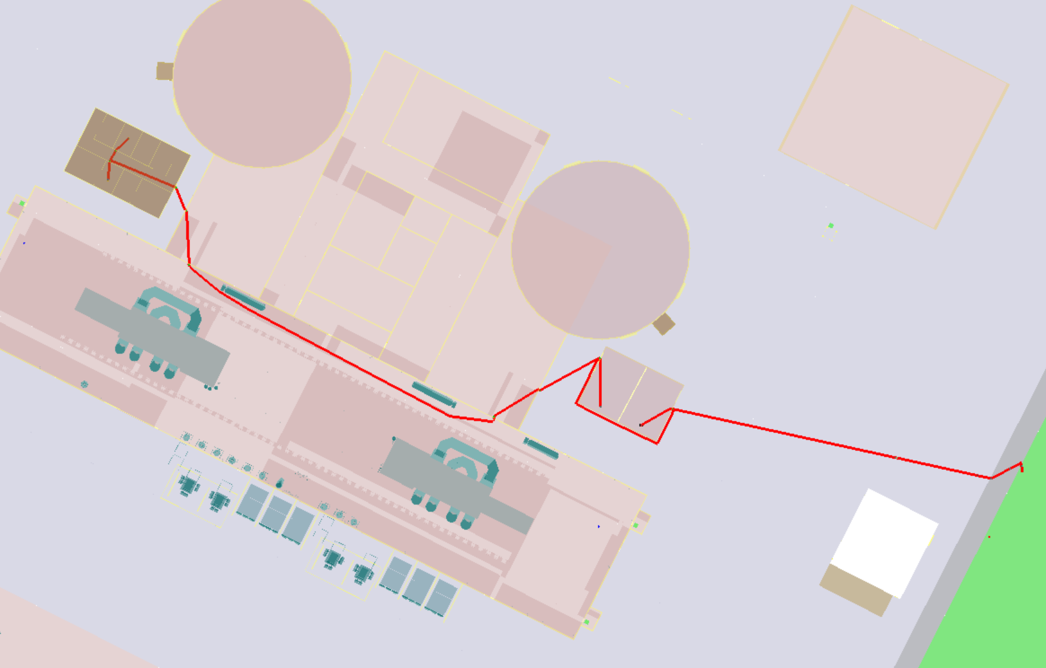
Results Comparison
1
Simulated three attack paths @ 100 runs
No. | System Availability |  |  | Mitigation strategy | Probability | P(CD) without FLEX | P(CD) with FLEX
 | Offsite power | EDG | TDP
1 | ✓ | ✓ | ✓ | N/A (Continue operation) | 0 | 0
2 | ✓ | ✓ | X | Non-transient shutdown | 0 | 0
3 | ✓ | X | ✓ | Non-transient shutdown | 0 | 0
4 | ✓ | X | X | Non-transient shutdown | 0 | 0
5 | X | ✓ | ✓ | Loss-of-Offsite-Power Event Tree | 280/300 = 0.933 | 0.933 * 1E-3
6 | X | ✓ | X | Loss-of-Offsite-Power Event Tree | 0 | 0
7 | X | X | ✓ | DG FLEX Strategy | 17/300 = 5.67E-2 | 5.67E-2 * 1 | 5.67E-2 * 0.1
8 | X | X | X | DG & Pump FLEX Strategy | 3/300 = 0.01 | 0.01 * 1 | 0.01 * 0.2
Total |  |  |  |  | 1 | 6.76E-2 | 8.6E-3
2
3
Assumption: Failure probability for each FLEX equipment is 0.1
FLEX strategy reduces Core Damage Probability

Slide 18
Modeling Human Action Time Distributions
Collaborated with the LWRS Risk Informed Systems Analysis Pathway Team to create a method for assigning time distributions to human actions for modeling flex procedures
Created a simple worksheet and method that allows security risk analyst to interview flex implementation SME to assign a time distribution to key actions
  The worksheet guides the analyst to collect information about the task location, challenges, average time to complete, best case time to complete and worst-case time to complete
  The method then assigns a log-normal distribution with associated uncertainty parameters to use in EMRALD
Developed the capability to combine the input from several SMEs
Established plans to collect and provide representative time values for common FLEX actions based on industry data collection in the future.

Slide 19
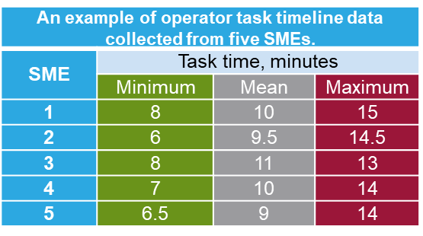
Collecting Timeline Data
For an average operator performing this task and working as quickly and efficiently as possible under ideal conditions, please provide the minimum amount of time in which this task could be performed.
For an average operator performing this task and working as quickly and efficiently as possible under normal conditions, please provide the average amount of time necessary to perform this task.
For an average operator performing this task and working as quickly and efficiently as possible under challenging conditions, please provide the maximum amount of time necessary to perform this task.
Gather additional information about the nature of the task (can inform estimating a shaping or weighting function for the time distribution).
  Will FLEX equipment require relocation? If yes,
    How will the equipment be moved? (e.g., forklift, truck, by hand)
    How far will the equipment be moved? (e.g., distance in yards)
    Over or through what terrain and barriers?
  Is this an individual or team task? If a team task,
    How many are on the team?
    What are the typical challenges the team will face?
  How physically challenging is this task?
    High exertion (e.g., lifting heavy equipment, climbing ladders or stairs, etc.)
    Medium exertion (e.g., moving or repositioning valves, electrical connections, etc.)
    Low exertion (e.g., manipulating switches, opening doors, etc.)

Slide 20
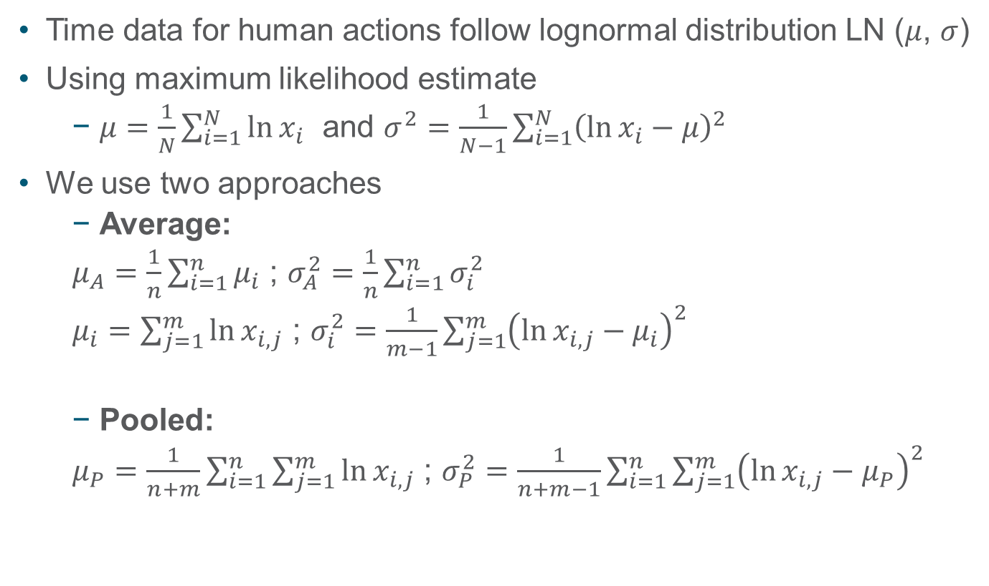
Statistical Distribution from Collected Data
Time data for human actions follow lognormal distribution LN ($μ$, $σ$)
Using maximum likelihood estimate
  $μ=\frac{1}{N}\sum_{i=1}^{N}{\ln{x_{i}}}$ and $σ^{2}=\frac{1}{N−1}\sum_{i=1}^{N}{{\left(\ln{x_{i}}−μ\right)}^{2}}$
We use two approaches
  Average:
  $μ_{A}=\frac{1}{n}\sum_{i=1}^{n}{μ_{i}}$ ; $σ_{A}^{2}=\frac{1}{n}\sum_{i=1}^{n}{σ_{i}^{2}}$
  $μ_{i}=\sum_{j=1}^{m}{\ln{x_{i,j}}}$ ; $σ_{i}^{2}=\frac{1}{m−1}\sum_{j=1}^{m}{{\left(\ln{x_{i,j}}−μ_{i}\right)}^{2}}$
  Pooled:
  $μ_{P}=\frac{1}{n+m}\sum_{i=1}^{n}{\sum_{j=1}^{m}{\ln{x_{i,j}}}}$ ; $σ_{P}^{2}=\frac{1}{n+m−1}\sum_{i=1}^{n}{\sum_{j=1}^{m}{{\left(\ln{x_{i,j}}−μ_{P}\right)}^{2}}}$

Slide 21
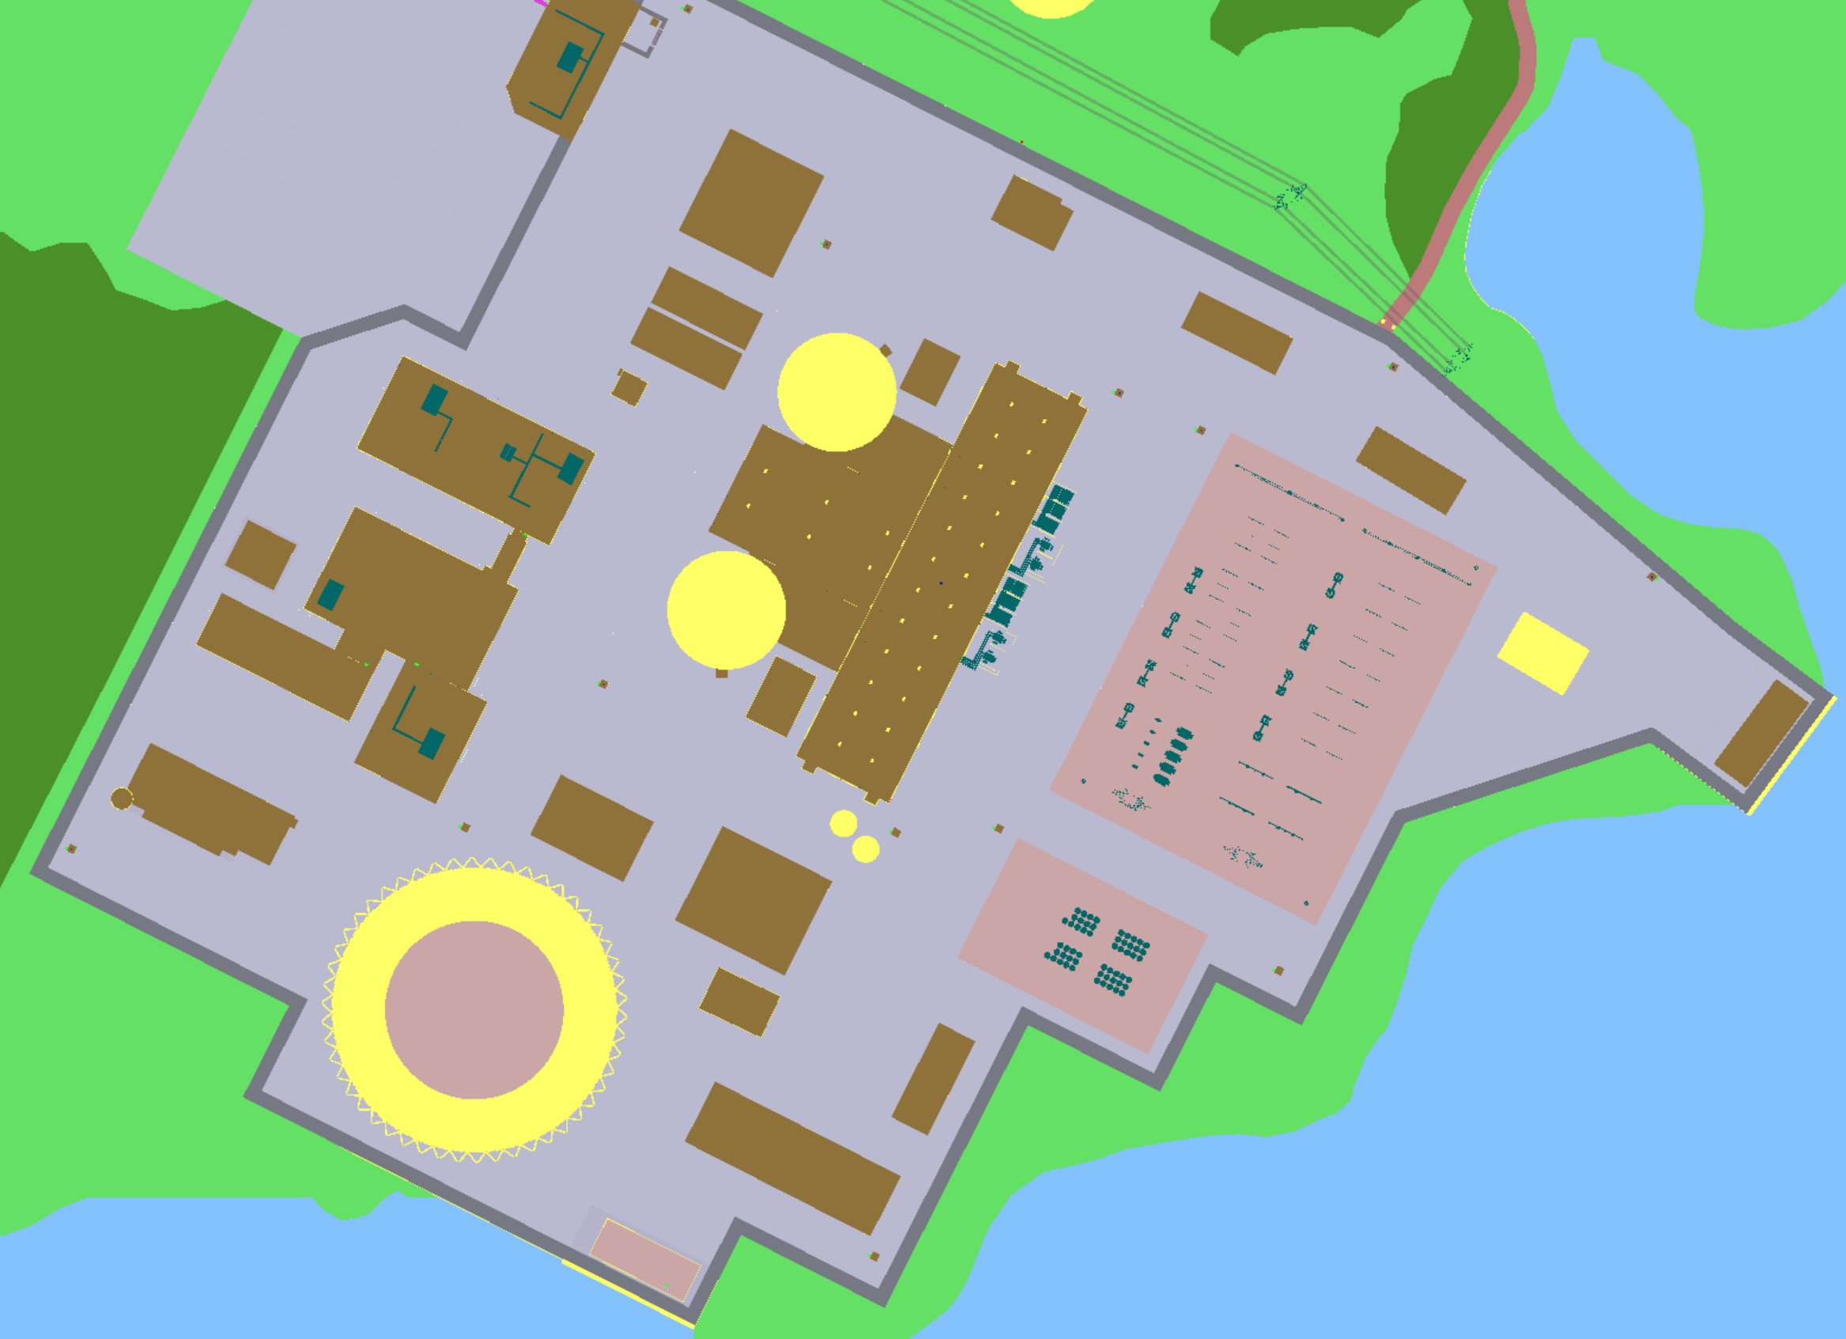
Other Case Studies
Optimizing the location of guard towers
EMRALD controls FOF simulations with various tower locations, and post-processes the results.
A
3
B
1
2
C
5
E
6
F
4
7
D

Slide 22
Summary
Current physical protection evaluation method is static and conservative
The dynamic modeling method using INL’s EMRALD may reduce Physical Protection Systems (PPS) design conservatism and cost
Existing measures (FLEX and Design Basis safety actions) nuclear power plant (NPP) takes may be credited toward the NPP’s compliance on the physical protection’s objective. This approach provides more flexibility to optimize a plant’s PPS design.

Slide 23
Thank You
Research team:
Shawn St. Germain
Vaibhav Yadav
Steven Prescott
Pralhad Burli
Robby Christian
Chris Chwasz

