Slide 1
Conceptual Design, Application and Risk Assessment of Forced-SI for Station Blackout Accident Mitigation
Asad Ullah Amin Shah, Junyung Kim, and Hyun Gook Kang
Rensselaer Polytechnic Institute
Dept. of Mechanical, Aerospace and Nuclear Engineering (MANE)
Probabilistic Safety Assessment and Management (PSAM), June 26th- July 1st, 2022

Slide 2
Background
Following the Fukushima Daiichi accident, USNRC issued order ES-12-049¹ requiring nuclear plants to implement mitigation strategies to cope with BDBAs.
Under SBO circumstance: Turbine-driven auxiliary feedwater pumps
Early failure/Fail to start of these pumps may lead to the core damage.
Diverse and flexible coping strategy (FLEX)
FLEX can be useful but the deployment and startup time is expected to be more than 2 hrs².
Quick response at the primary inventory loss is required.
SITs inventory can be useful but they are at low pressure of 4 MPa.
Depressurizing will lead to early core damage because of excessive inventory loss.
→ A new device ‘Forced SITs’ can fulfil this purpose, but they have their own pros/cons.
US NRC order EA-12-049,” Issuance of Order to Modify Licenses with Regards to Requirement for Mitigation Strategies for BDBAs events”, March 12, 2012.
Suh, Young A., Jaewhan Kim, and Mee-Jeong Hwang. "Sensitivity Analysis via Modelling FLEX/MACST Equipment into a PSA Model."

Slide 3
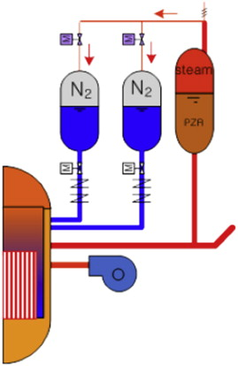
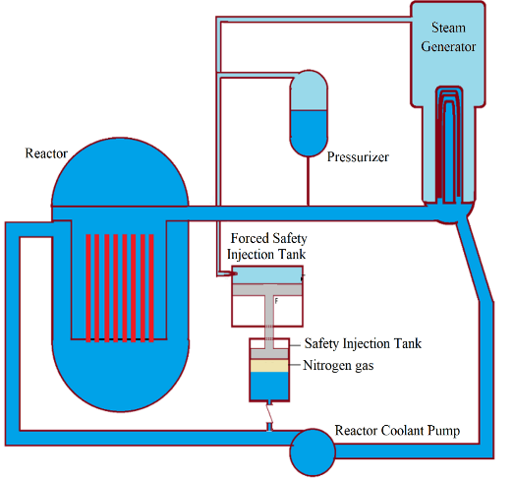
HSITs vs FSITs
Plant configuration with Hybrid SITs ³
Plant configuration with Forced SITs
Hybrid SITs are actuated by creating the equilibrium between the pressure inside the SITs and pressurizer. It takes time.
The hot water is injected into the SITs decreasing its cooling capacity.
Operation of relief valve affect the operation of HSITs by diverting its inventory to the atmosphere.
Feed and bleed strategy requires RCGVV operation.
FSIT will be actuated by a valve operation.
The hot water is isolated from SITs inventory by a piston assembly.
It can be operated at least in 2 modes: via SG and via Pressurizer
SG connected mode
Operation of relief valve does not affect the operation of FSITs
Feed and bleed strategy can be performed without RCGVV operation
3 Jeon, In Seop, Sun Heo, and Hyun Gook Kang. "Optimal operation of hybrid-SITs under a SBO accident." Nuclear Engineering and Design 297 (2016): 136-147.

Slide 4
Target plant and scenario
Four SITs in the target plant that is generic 1000MWe PWR
Each SIT contains about 55000 kg of borated water
In an accident such as SBO in coincidence with loss of turbine driven pumps, the core inventory gets depleted well before FLEX available
FSITs can be used to supply inventory before FLEX activation

Slide 5
Why we need FSIT?
The nominal pressure
RCS 15.5 MPa
SG steam outlet 7-8 MPa
SIT 4 MPa
The pressurizer relief valve action point is around 16.5 MPa.
FSIT can
provide core inventory makeup at high pressure.
extend mitigation time before core damage (additional ~ 1.5 hrs.)
improve FLEX chances of success .
be used for F&B operation for about ~ 1.5 hrs.

Slide 6
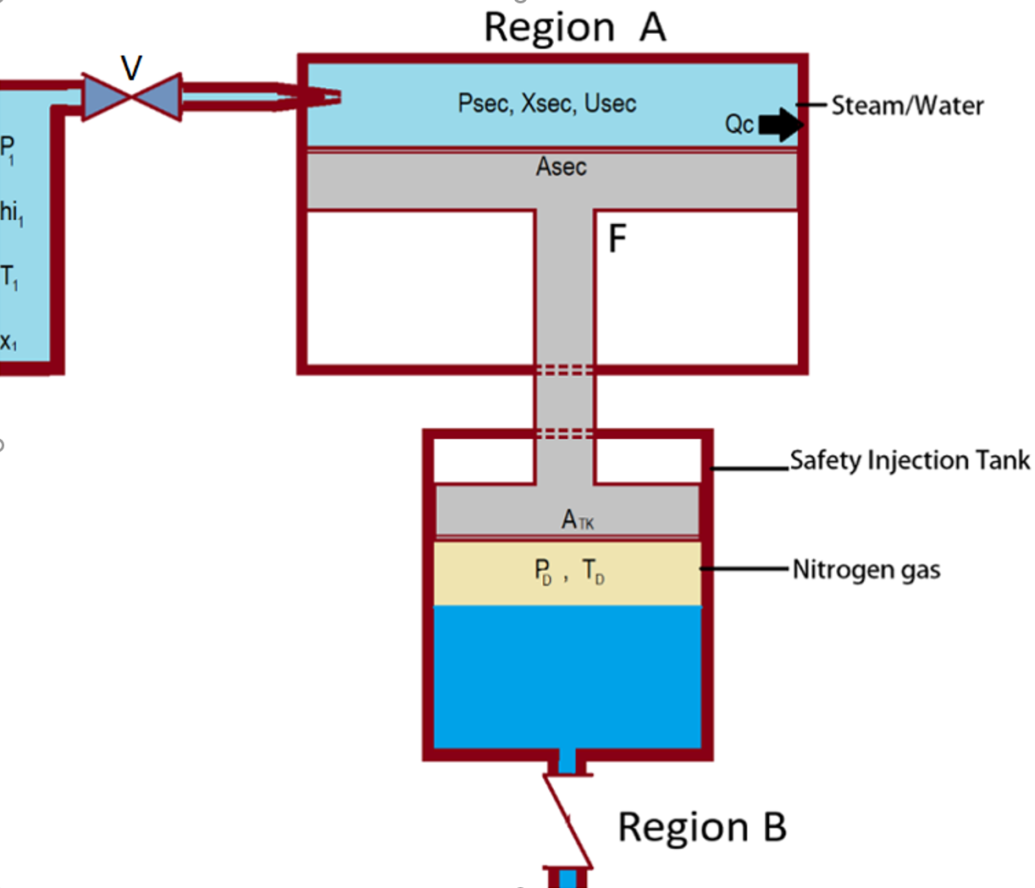
Working Principles
There are two regions in FSIT: Region A and Region B.
The pressure inside the region A is increased by opening a valve and connect it to the PRZ or SG.
Due to the difference of force (Equation 1) at each side on the piston assembly, the piston will start to move with an acceleration a (Equation 2), compressing the nitrogen gas in Region B.
The decrease in the volume in Region B will increase its pressure depending on the ratio of the areas of the piston assembly.
$$M_{p}a= P_{sec}A_{sec}−P_{D}A_{TK}+(M_{p}+m_{t})g$$ | (1)
$$a= \frac{1}{M_{p}}\left(P_{sec}A_{sec}−P_{D}A_{TK}+(M_{p}+m_{t})g \right)$$ | (2)
$$a=\frac{du}{dt}$$ | (3)
Modification of SIT to FSIT
$M_{p}$ is the mass of the piston assembly , $m_{t}$ is the mass of steam/water mixture in Region A, $a$ is the acceleration and u is the velocity of the piston assembly.

Slide 7
FSITs and plant configurations
Possible configurations
A: Operation using pressurizer pressure
B: Operation using steam line pressure.
In this research, we will demonstrate a case study for configuration B.
If FSIT can be operated with secondary pressure, the primary pressure is much higher than secondary, but there would be more operational limitations
Plant configurations A and B

Slide 8
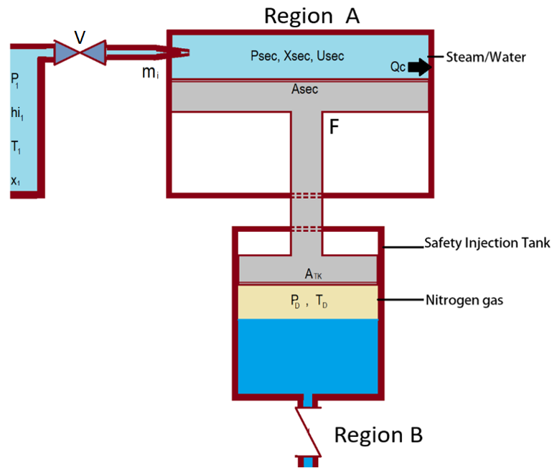
FSIT modeling
The modeling of FSIT is divided into two parts:
Region A Modeling
Inlet Nozzle Flow modeling
Pressure inside the region A
Region B Modeling
Downward piston motion will increase the pressure to the primary pressure.
Forced Safety Injection Tank

Slide 9
Region A modeling
The Inlet flow:
Depends on the area and downstream pressure
Either be choked or non-choked
And can be calculated by three equations as given below:
$$\left(\frac{P_{crit}}{P_{1}}\right)={\left(\frac{2}{γ+1}\right)}^{\frac{γ}{γ−1}}$$ | (4)
(If P₁ < P_{crit}, Choked) $m_{i}={C_{d}A}_{i}\sqrt{{γP}_{1}{rho}_{1}{\left(\frac{2}{γ+1}\right)}^{\frac{γ+1}{γ−1}}}$ | (5)
(if P₁ > P_{crit}, Non-choked) $m_{i}=C_{d}A_{i}\sqrt{{2P}_{1}{rho}_{1}\left(\frac{γ}{γ−1}\right)\left[{\left(\frac{P_{sec}}{P_{1}}\right)}^{\frac{2}{γ}}−{\left(\frac{P_{sec}}{P_{1}}\right)}^{\frac{γ+1}{γ}}\right]}$ | (6)
where, $P_{crit}$ is the critical value of downstream pressure for choked flow, $P_{1}$is the upstream pressure, $m_{i}$ is the inlet mass flow, $C_{d}$is the discharge coefficient, ${rho}_{1}$ is the density of the steam at the inlet, $A_{i}$ is the Nozzle area and $γ$ is the specific heat ratio.

Slide 10
Region A Modeling
The mass $m_{i}$ flows into the region A, the total mass at time t is given by Equation 7.
$$\frac{{dm}_{t}}{dt}=m_{i}$$ | (7)
The energy balance in Region A is given by Equation 8.
$$\frac{dU_{sec}}{dt}=m_{i}\left(\frac{{V_{ei}}^{2}}{2}+h_{i}\right)−P_{sec}A_{sec}u−{Q_{c}}^{′}$$ | (8)
where,
$m_{t}$ = total mass in region A
$U_{sec }$= Total internal energy of region A
$V_{ei}$ = Inlet velocity of steam
$h_{i}$ = Inlet specific enthalpy of the mixture
$T_{sec}$ = Temperature of the bulk in region A
${Q_{c}}^{′}$ = Heat transfer to the container A
$α_{w}$ = Heat transfer coefficient to the wall inner surface
$c_{steel}$= Specific heat capacity of the steel
$u_{sec}$ = specific
$ρ_{sec}$ = Density of the fluid in region A
$V_{sec}$ = Volume of the region A
The inlet velocity is given by Equation 9 and the velocity of the piston is in Equation 10
$$V_{ei}= \frac{m_{i}}{A_{i}ρ_{1}}$$ | (9)
$$\frac{dV_{sec}}{dt}=A_{sec}u$$ | (10)
$${Q_{c}}^{′}\text{= }α_{w}(A_{wall})(T_{sec}−T_{wall})$$ | (11)
Equation 13 and Equation 14 give the two thermodynamic properties and parameters like pressure, temperature and quality can be calculated from them.
$$u_{sec}=\frac{U_{sec}}{m_{t}}$$ | (13)
$$ρ_{sec}=\frac{m_{t}}{V_{sec}}$$ | (14)

Slide 11
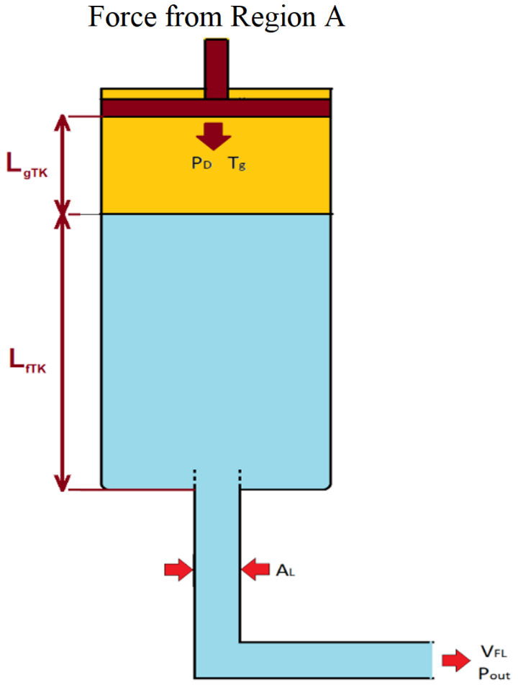
Region B Modeling
The mass and momentum balance model is the same as described by Zhao et al.⁴ and can be describe by following equations:
where,
$P_{D}$ = Pressure in the SIT
$L_{TK}$= Length of the SIT
$L_{gTK}$ = Length of the nitrogen blanket in SIT
$L_{fTK}$= Height of the liquid in SIT
$V_{g}$ = Volume of Nitrogen
$T_{g}$ = Temperature of Nitrogen
$M_{n}$ = Mass of Nitrogen
$R_{n}$ = Universal gas constant
$A_{L}$ = Area of the pipe at the exit
$A_{TK}$ = Area of SIT
$C_{vn}$ = Heat capacity of nitrogen
$u_{i}$ = Interface velocity
$P_{out}$= Downstream pressure at the exit
$ρ_{f}$ = Density of the liquid inside SIT
$ρ_{L}$ = Density of the liquid at the exit
$V_{FL}$ = Velocity of the fluid at the exit
$g_{x}$ = Gravitational acceleration
$$M_{n}−ρ_{n}(P_{D},T_{g})V_{g}=\text{0}$$ | (15)
$$ρ_{f}L_{fTK}\frac{du_{i}}{dt}+\frac{1}{2}ρ_{f}\left({V_{FL}}^{2}−{u_{i}}^{2}\right)+\left(P_{out}−P_{D}\right)−ρ_{L}g_{x}L_{fTK}+\frac{1}{2}Kρ_{L}{V_{FL}}^{2}=\text{0}$$ | (16)
While $u_{i}$ is the interface velocity and is calculated by Equations 17 and 18.
$$u_{i}−\frac{dL_{fTK}}{dt}\text{= 0}$$ | (17)
$$A_{TK}\frac{dL_{fTK}}{dt}−A_{L}V_{FL}=\text{0}$$ | (18)
The governing equation of the gas energy conservation at $T_{g}$
$$M_{n}C_{vn}\frac{dT_{g}}{dt}+P_{D}\frac{dV_{g}}{dt}−Q_{D}=\text{0}$$ | (19)
where $V_{g}$term can be replaced by Equation 20 and Pressure change is given by Equation 21.
$$\frac{dV_{g}}{dt}−A_{L}V_{FL}+A_{TK}u=\text{0}$$ | (20)
$$P_{D}V_{g}=M_{n}R_{n}T_{g}$$ | (21)
4 Bang, H. Zhao, L. Zou, H. Zhang, and R. C. Martineau, “Implementation and validation of a fully implicit accumulator model in RELAP-7,” Idaho National Lab.(INL), Idaho Falls, ID (United States), 2016.

Slide 12
Case Studies
All the Equations that has been shown previously has been implemented in the RELAP5 model using the control variables, general tables and trip logic options and the results were benchmarked with the similar module build in python.
This model is then implemented into the RELAP5 input for generic 1000 MWe PWR based NPP.
Two cases were simulated with and without FSITs and their risk assessment was performed.
The initial conditions for the referenced plant is given below:
Initial condition for SBO accident scenario
Parameters | Initial Values
Reactor power | 2815 MWth
Primary pressure | 15.51 MPa
Secondary side pressure | 8.0 MPa
Hot-leg temperature | 332 ºC
Cold-leg temperature | 302 ºC
Feed water flow rate | 807.63 kg/s per loop
Steam water flow rate | 807.63 kg/s per loop
Feedwater temperature | 232 ºC
Reactor coolant pump flow rate | 3759.1 kg/s

Slide 13
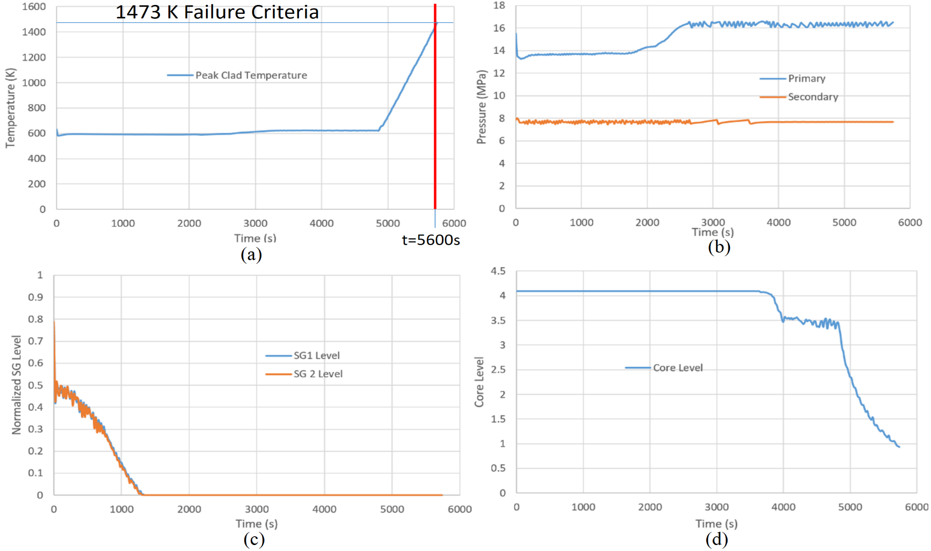
Case 1: SBO without FSIT
An SBO case study was performed with an assumption that TDAFW pumps fail to start.
Core damage timing < 1.5 hr.
Pressure rises after SG depletes
Peak cladding temperature increases after core uncovery
Core uncovery
Both SG depletes at around 1400 s

Slide 14
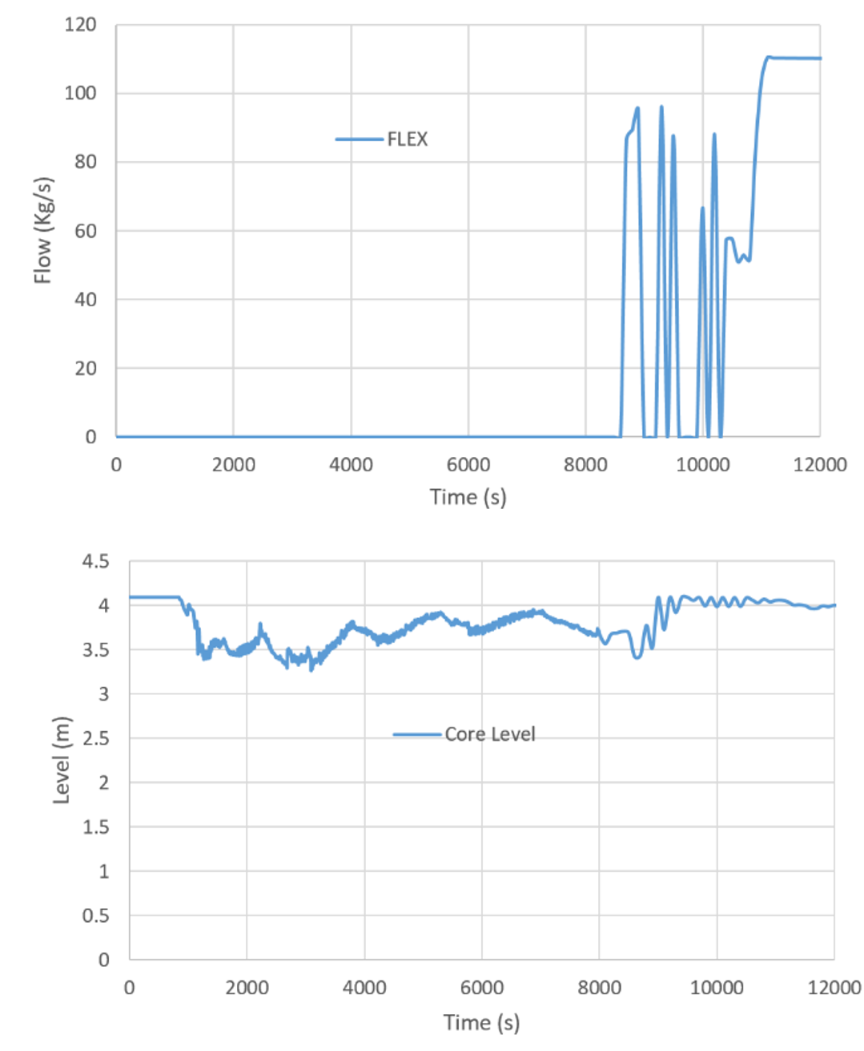
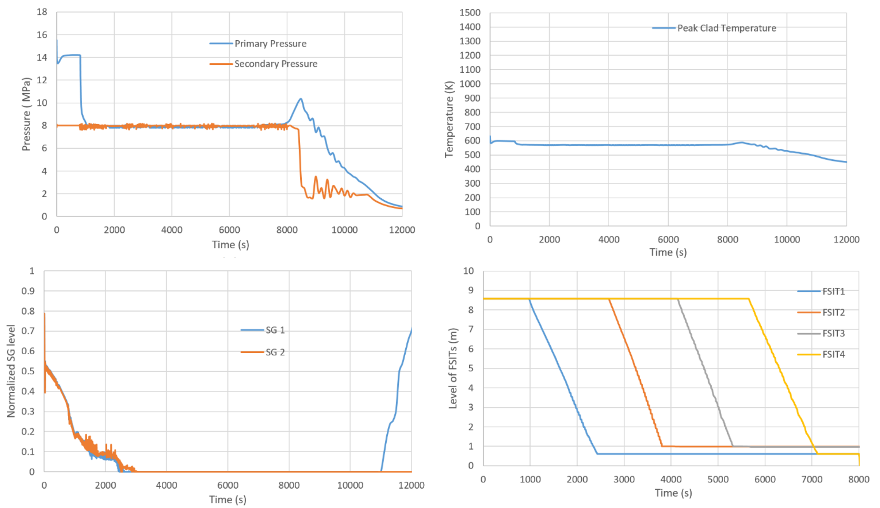
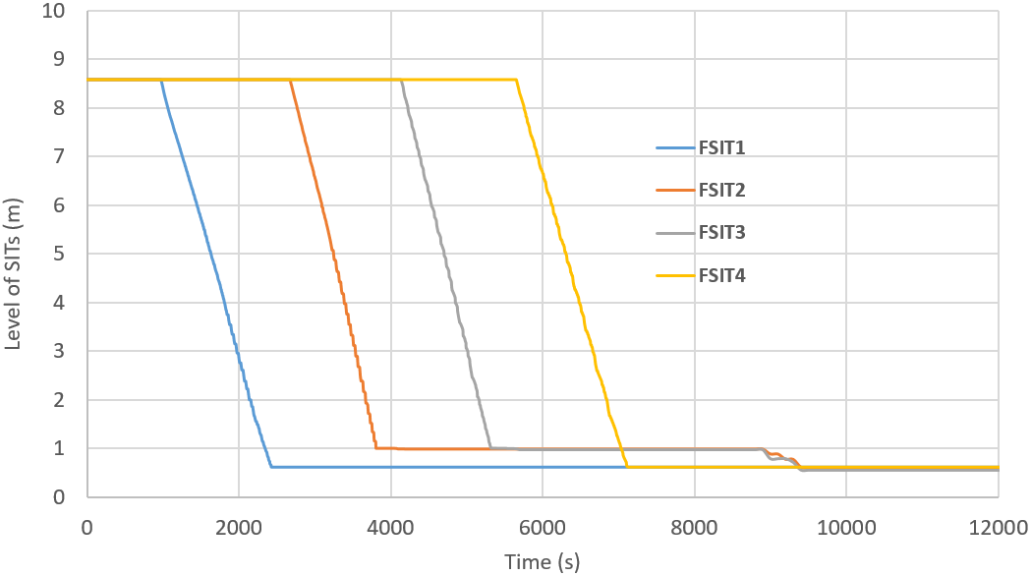
Case 2: SBO with FSIT – Rx saved!
FLEX injected at 8400 s
Without FLEX, the core damage happens ~ 2.8 hrs.
Set-point for relief valve
Sequential operation of FSITs
FSIT activation: SG levels drops to 20%
**The pressure will increase and will reach the Pressurizer Relief/Safety valves set-points and then there will be loss of inventory and core damage.
Notes:
Here you can see that the FLEX injected at around 8400 s, saved the core. There are four SITs on the plant site, so there will be 4 FSITs. The operation of FSIT is shown on the right bottom of the slide. All four FSITs operates in series to give around 1200s of extra time per FSIT and can last upto 10000s. So about 4000 – 5000s additional time margin.

Slide 15
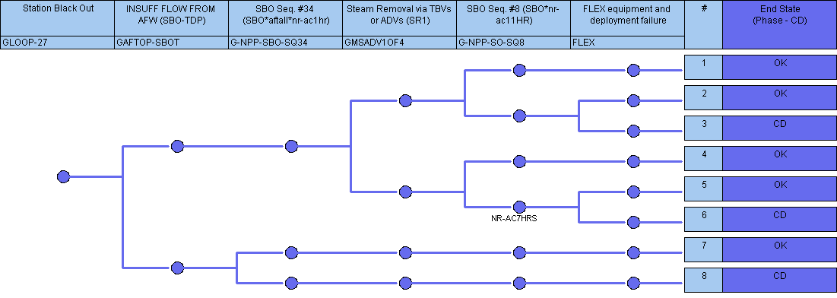
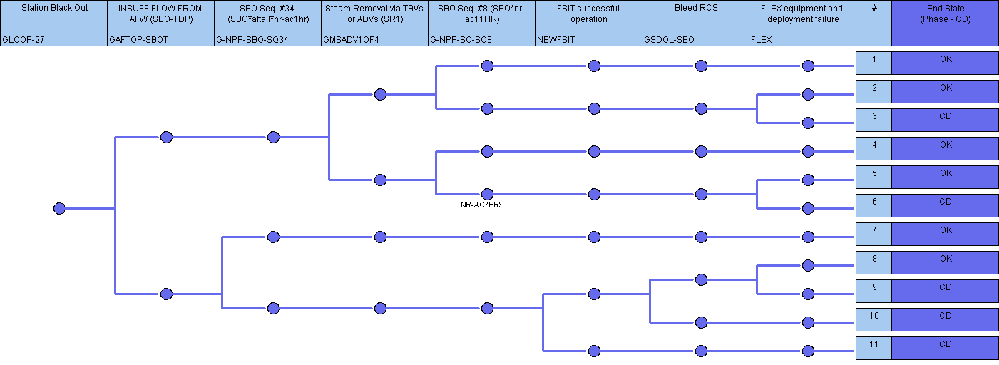
Risk Assessment
Simplified event tree for SBO without FSIT
Cases | CDF
Case 1: Simplified SBO without FSIT | 2.88e-8
Case 2: Simplified SBO with FSIT | 5.02e-9
CDF reduction | ~82%
with FSIT operation
Notes:
HEP was taken to be 0.026 based on the assumptions in the diagnostic and execution probability. Swain curve was used and for execution timing information were used and type of task were assumed to be complex and extremely stressful.
The failure of valve and piston assembly were also assumed to be 4x10⁻³ and 0.01 for piston assembly (From course materials).
There was a minimum time of 2 hrs for FLEX after which swain curve was used based on available time. That’s why in the first case it was not considered and in the second case there was enough time after 2 hrs to consider it.

Slide 16
Conclusion
A conceptual design of new Forced SIT was suggested
A case study was performed to demonstrate the merit of this system and how it can be used with recently developed FLEX strategies.
It can reduce the CDF under SBO by 82%.
The purpose of this study is to share the idea that we can utilize the back pressure for quick inventory makeup with available borated water.

Slide 17
Thank You

