Slide 1
An Enhanced Model for Evaluating Failure Propagation in Launch Vehicle Engine Sections
Susie Go
Scott Lawrence
Amir Levine
Probabilistic Safety and Management Conference, PSAM16
Honolulu, Hawaii
June 28, 2022

Slide 2
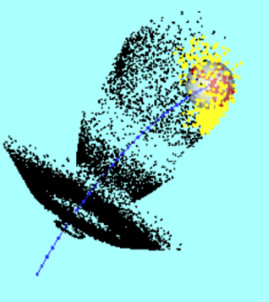
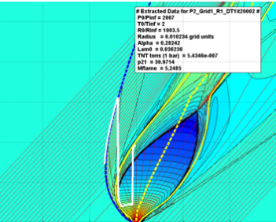
SARA and ERA: Physics-Based Modeling History
Pre-Constellation/Constellation: Simulation-Assisted Risk Assessment (SARA)
  Primary focus on characterization of explosion environments and their impact on crew risks
SLS/Artemis: Engineering Risk Assessment (ERA)
  Supported by SLS Induced Environments (was Structures & Environments)
  discipline: Sub-discipline - Abort Environments
  Primary product: Abortability Tables
MACH 2

Slide 3
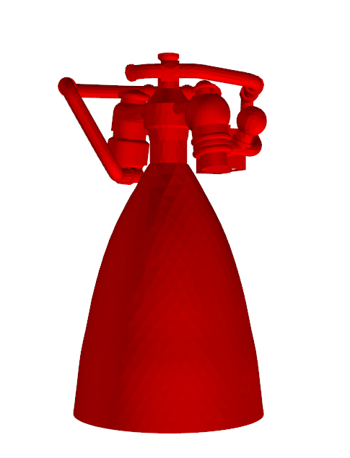
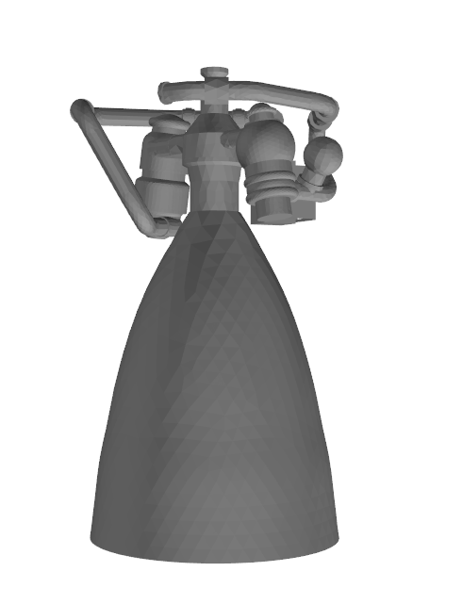
An Example: Abortability Defined
Initiating Failure
(Low pressure to FTP)
Benign Engine Shutdown
Multiple Engine Shutdown
Turbopump Burst
Local “explosion”
Failure Propagation
No Propagation
Other Engine Shutdown
Stage Explosion
Large scale explosion
Continue Mission
Nominal Abort
Nominal Abort
Off-Nominal Abort
Loss of Crew (LOC)
Explosion Characterization
Combined effects of failure propagation and explosion characterization produce “abortability”, the likelihood the crew escapes/survives effects of launch vehicle failure environments

Slide 4

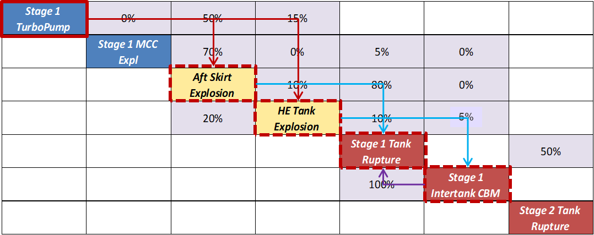
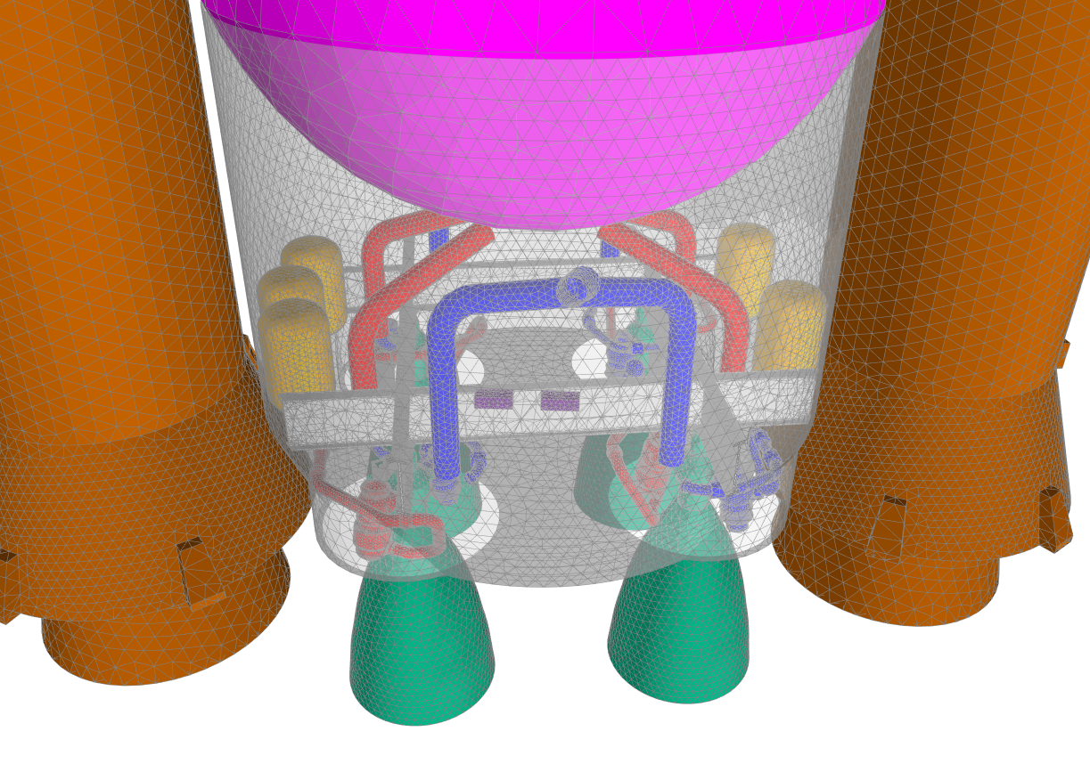
Evolution of Failure Propagation Analysis for SLS
0.37
Lawrence, et al. (2014)
Mathias, D., & Motiwala, S. (2015). Simulation of Liquid Rocket Engine Failure Propagation Using Self-Evolving Scenarios.
Static Model
Physics-Based Simulation
Engineering Judgment
Transition probabilities populated by
  Engineering judgment
  Off-line analysis/simulation
Holy Grail: inputs would consist only of:
Component geometric information
Component engineering information
Some important functional relationships (component A depends on inputs from component B)
Less judgment
More engineering

Slide 5
Failure Propagation Simulation
Approach: C++ code for Monte Carlo simulations and self-evolving failure scenarios
Captures propagation of debris field and blast wave environments
Process
  Failure initiated at a source component at the start of each realization
  Energetic components generate debris fields
  and blast waves
  Components act as shields until they fail: UPDATE
  Failure occurs when a component failure
  threshold is violated
  Propagation occurs if another energetic
  component has failed
  Energetic components are removed on
  failure
  Failure events and states are time-resolved
  globally before moving on to the next failure event
  A realization ends when there are no more failure
  events on the timeline – components have either
  failed or survived failure environments
Implemented within Monte Carlo iterative process
miss
T4
Blast
T2
T3
miss
Source
ok
T1
miss

Slide 6
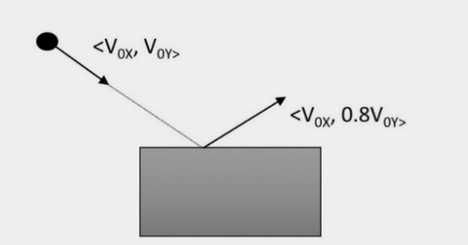




Explosion Modeling: Debris Propagation Updates
Failure Criteria
  Ballistic Limit Equation (new option to KE threshold)
  Can be interpreted as a fragment
  perimeter-dependent KE threshold
    $L$ fragment perimeter
    $t$ is target thickness
    $C_{s}$ is target material dynamic shear modulus
    $θ$ is impact angle, relative to perpendicular
Ricochet
  Energy removed from normal velocity component
    Coefficient of restitution, $C_{R}$
  Fragment re-released from impacted triangle center
  Ricochet count limited to avoid “ringing”
$V_{50}=\sqrt{\frac{2∙L∙C_{s}∙t^{2}}{m∙\cos^{2}{θ}}}⇒KE_{lim}=\frac{1}{2}mV_{50}^{2}=$ $LC_{s}{\overline{t}}^{2}$
$$\overline{t}=t/\cos{θ}$$
$$V= V_{0}−\left(1+C_{R}\right)∗\left(V_{0}∘ P\right)\hat{P}$$
Triangle-specific relative orientation

Slide 7
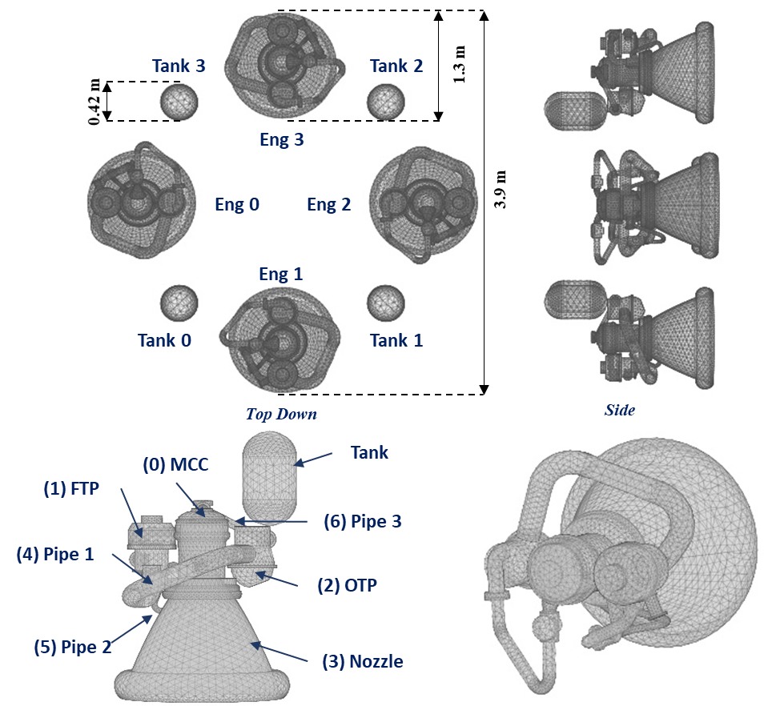
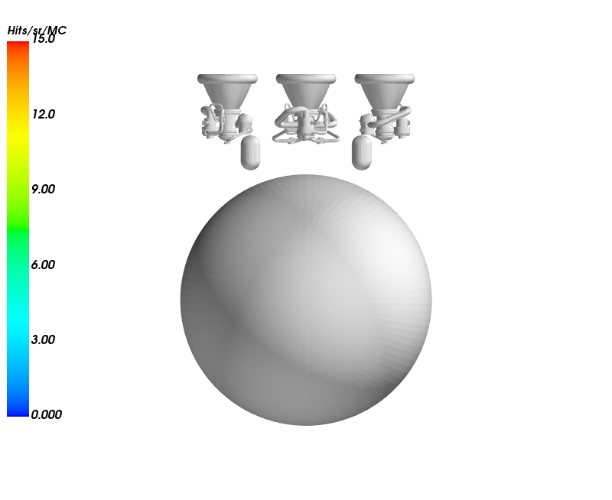
Core Engine Section Modeling Process
Geometry (32-33 components)
  4 engines (J2X-ish)
    7 components each
  4 composite overwrapped pressure vessels
    COPVs
  Fuel tank
Component Definition
  Design parameters
    Mass, material, thicknesses, spin rates, etc
  Failure parameters
    Generated environment characterization (distributions)
      Fragment count, velocities, etc
      Blast energy
    Failure criteria
      Fragment penetration
      Blast overpressure capability
Run Definition
  Altitude @ failure
  Initiating component
  Monte Carlo sample count & seed value
  Ricochet parameters (Coef Restitution, max count)
Individual Engine View
Full Model
+ Fuel Tank

Slide 8
Data Generated
For each sample:
  For each component failure event:
    Source: Component causing the failure
    Target: Component failed
    Mode: Energy transfer mode (blast or debris, for now)
    Time increment: Time between source failure and target failure
    Global time: Time between initial failure and target failure
    Ricochet count: Number of ricochet’s between source and target failure (for debris)
Challenge: Extracting useful information from the mass of simulation data generated
  Python and Matlab used liberally in pre-processing, post-processing, and plotting
Time
Symbols indicate failure mode (OP vs. FR)
  All fragments in this example
Colors
  Grey: component on initiating engine
  Red: LOC environment,
  (special potential for causing stage explosion)

Slide 9
Sample Cases: Sensitivities
Initiating component
  Look for symmetric in results, reflective of geometric symmetry of the model
Monte Carlo samples
  Look for convergence with increasing sample size
Ricochet effects
  Look for
    Effects of increased number of ricochet’s allowed (level required for convergence?)
    Effects of variations in coefficient of restitution
Overpressure failure threshold
  Look for effects of variations and sensitivity to failure altitude

Slide 10
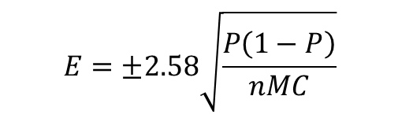
Component Failure Probabilities
Initiator: Engine 0 main combustion chamber (MCC)
Error bars based on standard central limit theorem:
Monte Carlo Sample Size (nMC) Sensitivity
$$E=±2.58\sqrt{\frac{P\left(1−P\right)}{nMC}}$$
Sensitivity to Maximum Number of Ricochet’s Allowed (n)

Slide 11
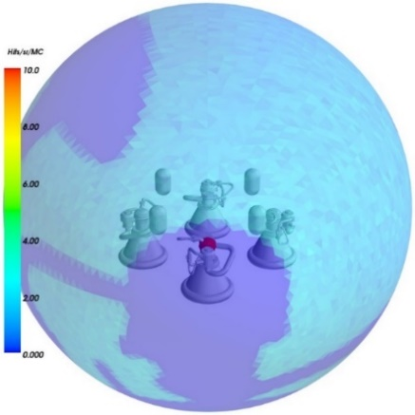
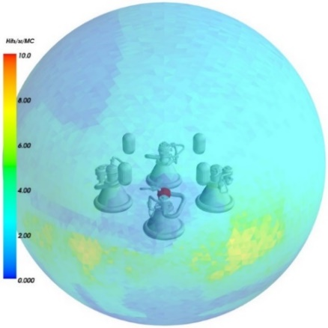
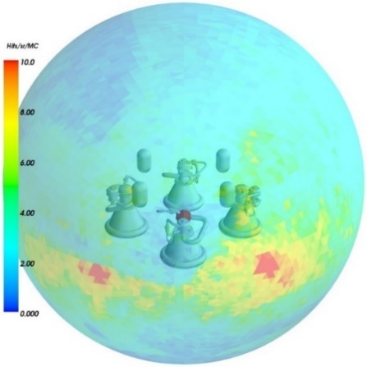
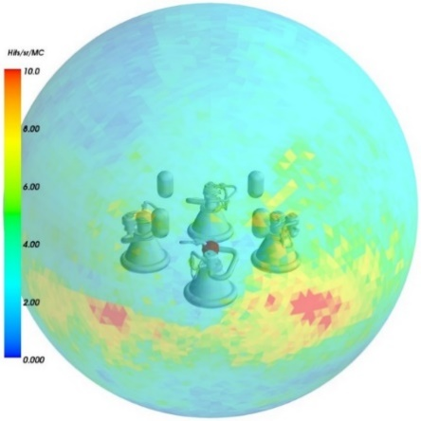
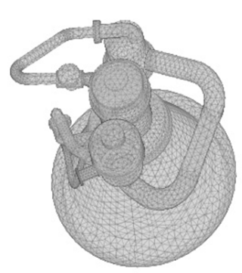
Debris Exit Patterns: Sensitivity to Debris Assumptions
Virtual component: spherical debris catcher
  Debris strike counts on each triangle (accumulated over all samples)
  Colored by strikes/area
No propagation
No ricochet
1 ricochet
3 ricochets
Impacting fragments cause no failure and stick
Impacting fragments cause failure or stick
Impacting fragments cause failure or ricochet once
Impacting fragments cause failure or ricochet up to 3 times
Initiator
Engine close-up

Slide 12
Other
Compute Requirements
  Cases attempted to date generally require < 15 mins for 10K sample run
    Single processor laptop
  Depends on:
    Component surface resolutions
      Current problem included O(40K) triangles
    Component vulnerabilities (# of failures)
Recent Updates & Future Work
  Functional dependencies included
    Also enables more general non-explosion propagation modes: requires transition probability specification
  “Container” failure modes (volume burst & explosion)
    Coupled leak modeling for container volumes: In work
  Various debris initiation refinements
    Surface release (vs. component center release), Grady-Kipp mass distribution, Specified debris catalogs
  First-principles hydrocode (ALE3D) and CFD (LOCI/Chem) simulations
    Insight into reasonable failure thresholds for pressure vessels: blast and debris
    Insight into failure environments generated by failing pressure vessels
    Insight into flame propagation behavior

