Slide 1
Physics-Informed Neural Networks for Remaining Useful Life Estimation of a Vapor Recovery Unit System

Slide 2
PROGNOSTICS AND HEALTH MANAGEMENT
Prognostics and health management (PHM) frameworks:
Diagnostics: health-state, anomaly detection
Prognostics: remaining useful life (RUL) estimation
System health management framework:
Goals: identify, predict, optimize
Steps: data processing, diagnostics & prognostics, assessment
Notes:
PHM are end-to-end frameworks which involve everything from acquiring sensor data to the decision-making process based on the collected operational data.
PHM has become one of the most important topics of research in reliability.
A typicall PHM framework consists of 4 main stages, which are illustrated in the figure below. And for the last 10 year, research focus has gone into the diagnostics and prognostic stage, which seek to create metric to assess the health state of the system or its remaining useful life (RUL)
It is in this context where PHM was born, where the objective is to develop a framework to provide a diagnosis and prognosis on the health state of a system.
Nowadays the most research efforts are focus on developing PHM frameworks to real complex system. The objective is to take advantage of the data collected from monitoring sensors,
which is expected to have information regarding the behavior of the system and its health state.

Slide 3
PROGNOSTICS AND HEALTH MANAGEMENT
Approaches in diagnostic & prognostic stage:
Physics-based models (PBMs)
Data-driven models (DDMs)
Hybrid methods
Deep learning (DL):
Deal with big data sets
Analysis of complex data
Obtain abstract information for diagnostics & prognostics
Complex engineering systems (CESs):
Multi-component systems
Monitoring sensor networks
Notes:
So, what exactly is PHM?
PHM is a framework that seeks to analyze data collected from monitoring networks in complex systems.
As I mentioned before, It focuses on obtaining a diagnosis and prognosis of the health state of the system, where the remaining useful life estimation is one of the most critical tasks to be performed.
Estimating the RUL has commonly been done through three different methods, namely: Physics of failure models, Data Driven approaches, and hybrid methods which are a combination of the other two
Regarding DDAs, many DL techniques have been implemented in PHM. This is mostly due to many advantages that DL models present when compared to PoF, which is that they don’t need expert knowledge on the data in order to interpret it.
However, this comes with a disadvantage, which is that these models are commonly looked as black-boxes and thus they are hard to implement in real system due to their lack of interpretability.
Further, all DL models so far applied to PHM do not consider time as input variables and rely solely on the structure of the data for the health assessment.
And, since degradation models are only available for local phenomena and small systems, creating hybrid models for large complex systems is a difficult task.

Slide 4
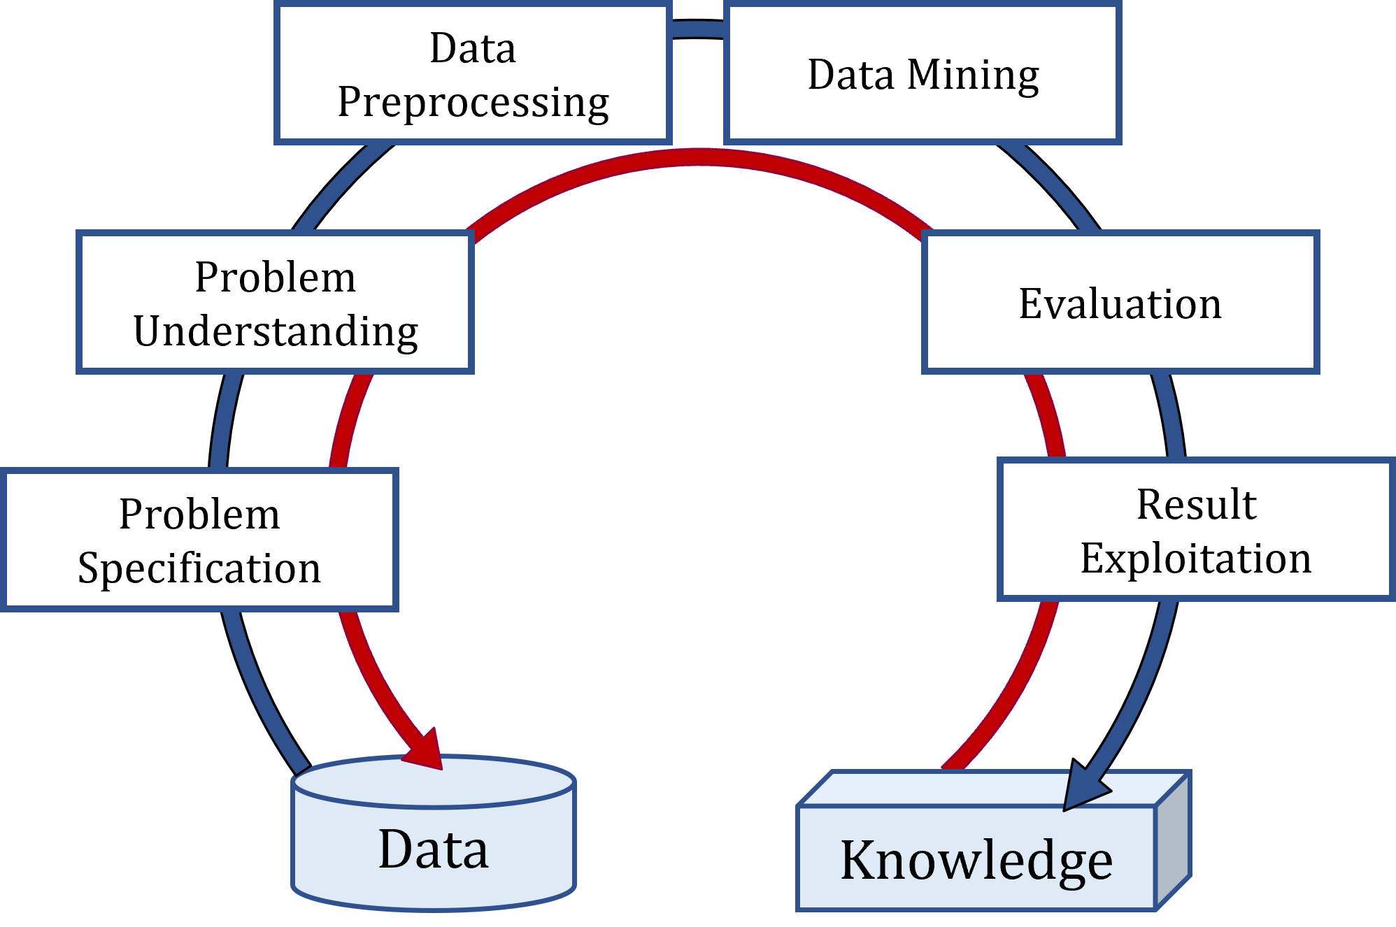
CHALLENGES IN PREPROCESSING DATA
Data preprocessing is essential to build reliable models
Can take up to 90% of the work time
Its role is often understated in DL-PHM research:
Lack of guidance on proper procedures
Many works do not report it
Inconsistencies for the same dataset and techniques
Notes:
Figure on the left shows how data analysis to create or obtain knowledge is an iterative process, and thus requires time and effort.

Slide 5
CHALLENGES IN DL APPLICATIONS TO PHM
Develop interpretable models:
Integrate domain and dynamics knowledge into the learning process
Understand a complex system’s degradation dynamics
Effective and efficient composition training data sets:
Integrate expert knowledge
Develop comprehensive data preprocessing protocols to manipulate machinery data
Develop models that use time as input variable:
Time is an essential variable in all reliability models
This could enable to fuse traditional reliability statistics with PHM (e.g., MTTF, MTBF)
Notes:
Despite all the new and exciting DL applications to PHM that has been developed in recent years, there are still many challenges to be addressed.
The first, and perhaps most important subject, is to create DL models that can be interpreted by the user. Switching from a black-box behavior to an open-box behavior. Once this is accomplished, engineers will be able to trust the models and understand its output, particularly when estimating the system’s RUL and using it to optimize maintenance policies.
Another ongoing challenge is the incorporation of expert knowledge to the training of the model. This can be either during the preprocessing of the data, or on the combination of DL models with other models that are specific to the system under study to create hybrid models. Expert knowledge can also be used to select and separate healthy from degraded states.
And a third challenge comes from using time as an input variable to the DL model. The degradation of a system is dynamic in its nature and thus it strongly depends on the time variable. Nevertheless, none of the DL models apply to PHM include this variable, since these were created to extract information from the structure of the data, and not to understand the system’s degradation dynamics

Slide 6
OBJECTIVES
Develop a preprocessing framework for sensor monitoring data collected from CESs for PHM-DDMs:
RUL label generation
Develop a DL-RUL framework that can either incorporate or discover a system’s underlying physics-related degradation behaviors:
Implement a physics-informed neural network (PINN)
Provide means for model interpretability
Validate framework with a data set from a CES

Slide 7
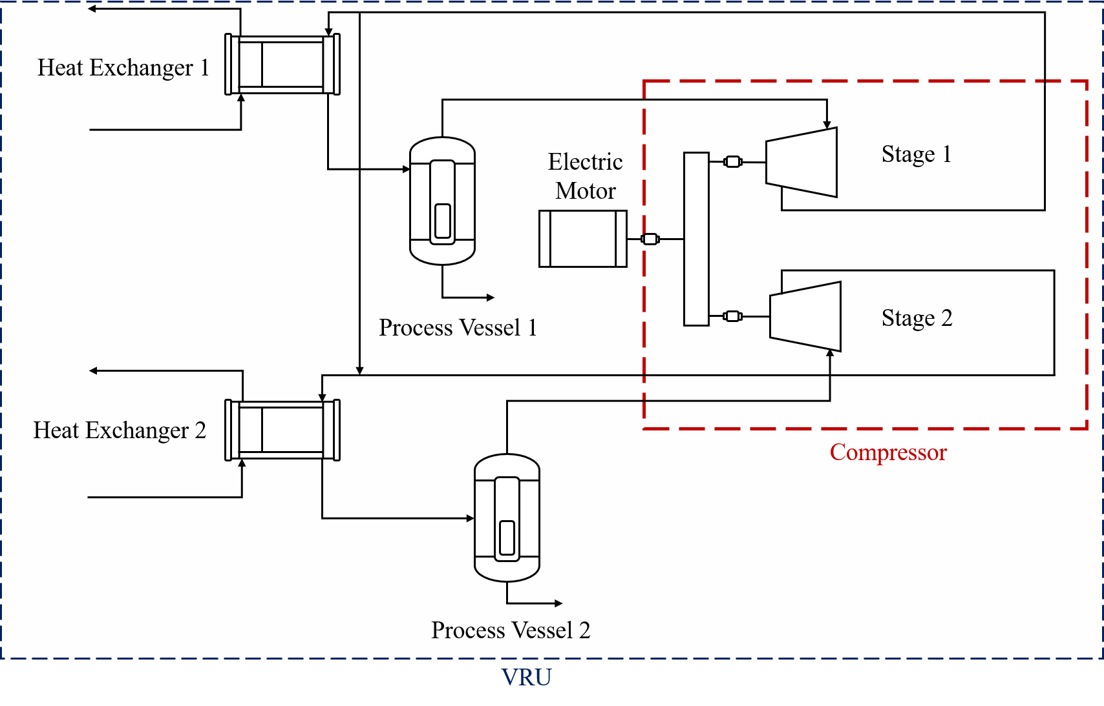
CASE STUDY: VAPOR RECOVERY UNIT
Offshore Vapor Recovery Unit (VRU)
Over 150 sensors and 2.3M data logs recorded over 15 months
Sensor readings are acquired every 15 seconds
Operational ranges for sensors are provided
Maintenance logs with failures and stoppages are provided
FIT | Flux | SDY | Valve position
FT | Flux | TE | Temperature
KT | Frequency / Rotation | TIT | Temperature
KY, KI | Frequency / Rotation | TT | Temperature
LIT | Level | TV | Valve position
SI, SX | Speed | VE, VI | Vibration
PDIT | Pressure | XT | Vibration
PT | Pressure | ZSH | Valve position
PIT | Pressure | ZSL | Valve position
PV | Valve position | ZT | Vibration
Notes:
The case study upon which we build the preprocessing pipeline comes from a Vapor Recovery Unit located at an offshore oil-production platform
Data for two identical and independent units are provided.
Data consists of sensor readings acquired every 15 seconds for a period of 15 months.
2,384,640 log entries.
Data is provided in separate files for two units:
VRU - A contains 189 sensors.
VRU - B contains 174 sensors.
This dataset presents a challenge given it multiple features, missing values, redundant features and few failure events.

Slide 8
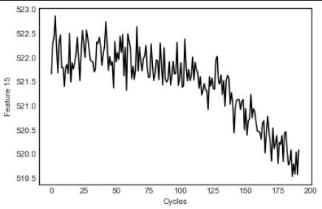
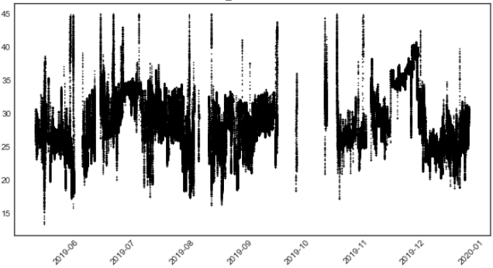
SIMULATED VS REAL MEASUREMENTS
Sensor reading from C-MAPSS (benchmark)
Sensor reading from VRU
(real CES)
Notes:
On the left is a pressure reading from the C-MAPSS benchmark dataset. One of the most common datasets used to test RUL models, as we will see later on this presentation.
On the right we can see a temperature sensor from a Vapor Recovery Unit.
Tendencies, variability, background noise and simplicity are clearly different for both observed variables.
These negatives effects are magnified when we have dozens of sensors reading, as we will see in the VRU system dataset
Including expert knowledge in the preprocessing can help to improve models’ performance
Can we preprocess both datasets equally?

Slide 9
PREPROCESSING FRAMEWORK
Preprocessing methodology for big machinery data aimed at DL-PHM models
Include expert knowledge:
Field reliability engineers
System operation
Notes:
This is an iterative process. For instance, after identifying redundant sensors the data should be read again without considering those sensors and performing the outlier detection once more.
This way the discarded featured don’t have any influence on the discarded outlier points.

Slide 10
NON-INFORMATIVE COLUMNS: VRU
Considering a data frame where columns are the sensor features and rows are the data points collected in time
% of NaN elements
% of NaN elements
Original NaN distribution
Filtered NaN distribution

Slide 11
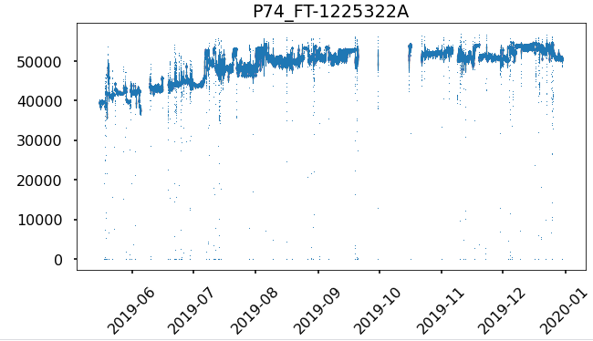
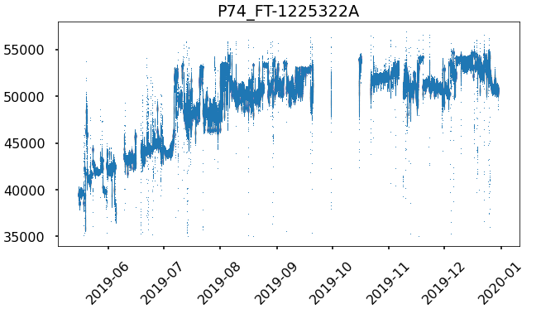
TEMPORAL & STATISTICAL CRITERIA: VRU
VRU Differential Pressure (kPad)
Unfiltered data and outlier behavior
Filtered data through temporal criteria

Slide 12
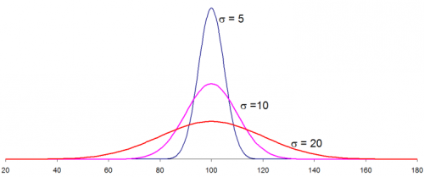
FEATURE SELECTION
Variables with no statistically significant variation do not provide information
Variables with $cv<0.05$are discarded
Highly correlated features can bias DL models
If ${|ρ}_{XY}|>0.95 ,$ one of the features is randomly discarded
$$cv=\left|\frac{σ}{μ}\right|$$
$$ρ_{XY}=\frac{Cov\left(X,Y\right)}{σ_{x}σ_{Y}}$$
Notes:
The third step correspond to statistical analysis.
Here non informative features are discarded. These variables correspond to those whom their standard deviation is small when compared with their mean value.
In the case that the std is zero, the variable would be constant, and thus is does not provide any information on the dynamical behavior of the variable and the system.
A threshold of 5% or lower is considered to discard a variable.
This can be either replaced or complemented with packages such as scikit-learn preprocessing SelectKbest.

Slide 13
PROBLEM STATEMENT
DDMs in PHM lack interpretability and compatibility with available physics of degradation models.
DL-PHM models are usually treated as black boxes:
Non-feasible outputs are common to be encountered
Lack of interpretability
Models need to account for the degradation dynamics of the system:
How to embed physics of degradation models into a DL architecture?
How to generate reliable RUL labels?
Notes:
Interpretability is needed to build trust in DL-PHM models.
DL is a set of ML techniques that allow us to analyze complex datasets and extract abstract information and features that otherwise would take expert knowledge and time to obtain.
The main structure behind DL are NNs. NN are non-lineal functions applied in sequence to an input data to yield and output variable.
With today’s technology, NN are flexible, easy to train, and easy to implement in many tasks. However, in their raw nature, NNs work as black boxes that cannot be interpreted and do not consider any constraint on the problem under study.
As such, one of the most recent research efforts have gone into how we can implement previous knowledge of a system to these powerful models. In engineering, this can be summarized in using physics models.
So the question is, how can we embed physics to a NN architecture?

Slide 14
PARTIAL DIFFERENTIAL EQUATIONS IN DEEP LEARNING
DL networks have recently been used to study Partial Differential Equations (PDEs):
Solve a PDE given initial and boundary conditions
Obtain PDE parameters given data
Discover PDEs based on data
A PDE representation for a variable $u(t,z)$ [Raissi et al., 2019]:
$$u_{t}−g\left(x,u,u_{x},u_{xx},…\right)=0$$
$$u_{t}+NN\left(x,u\right)=0$$
Notes:
Raissi et al. take advantage of automatic differentiation [31] to formulate a PDE-like penalization function:
Consider the target value to estimate (e.g., velocity field, temperature, RUL) as the output of a NN expressed by 𝑢 ( 𝑧 , 𝑡 )
One can use automatic differentiation to calculate the exact derivative of the NN representing 𝑢 with respect to any of its input variables (e.g., 𝑢_{𝑧} , 𝑢_{𝑡} ).
This allows the creation of a PDE in the form of Equation 6, where 𝑢_{𝑡} is the time derivative of the output variable, and the function g on the right-hand side is represented by a second NN, which takes the spatial variables and their corresponding 𝑢 derivatives as input
What we do:
Adding a PDE-like penalization to the loss function of the model would create a relationship among the input features of the model and the derivatives of the output value with respect to its independent variables
This effect can be boosted if the framework is given time as an input feature, rather than implicitly extracting it from a sequence, since for metrics such as the RUL, the penalization function adds information on the degradation rate if temporal derivatives are considered.

Slide 15
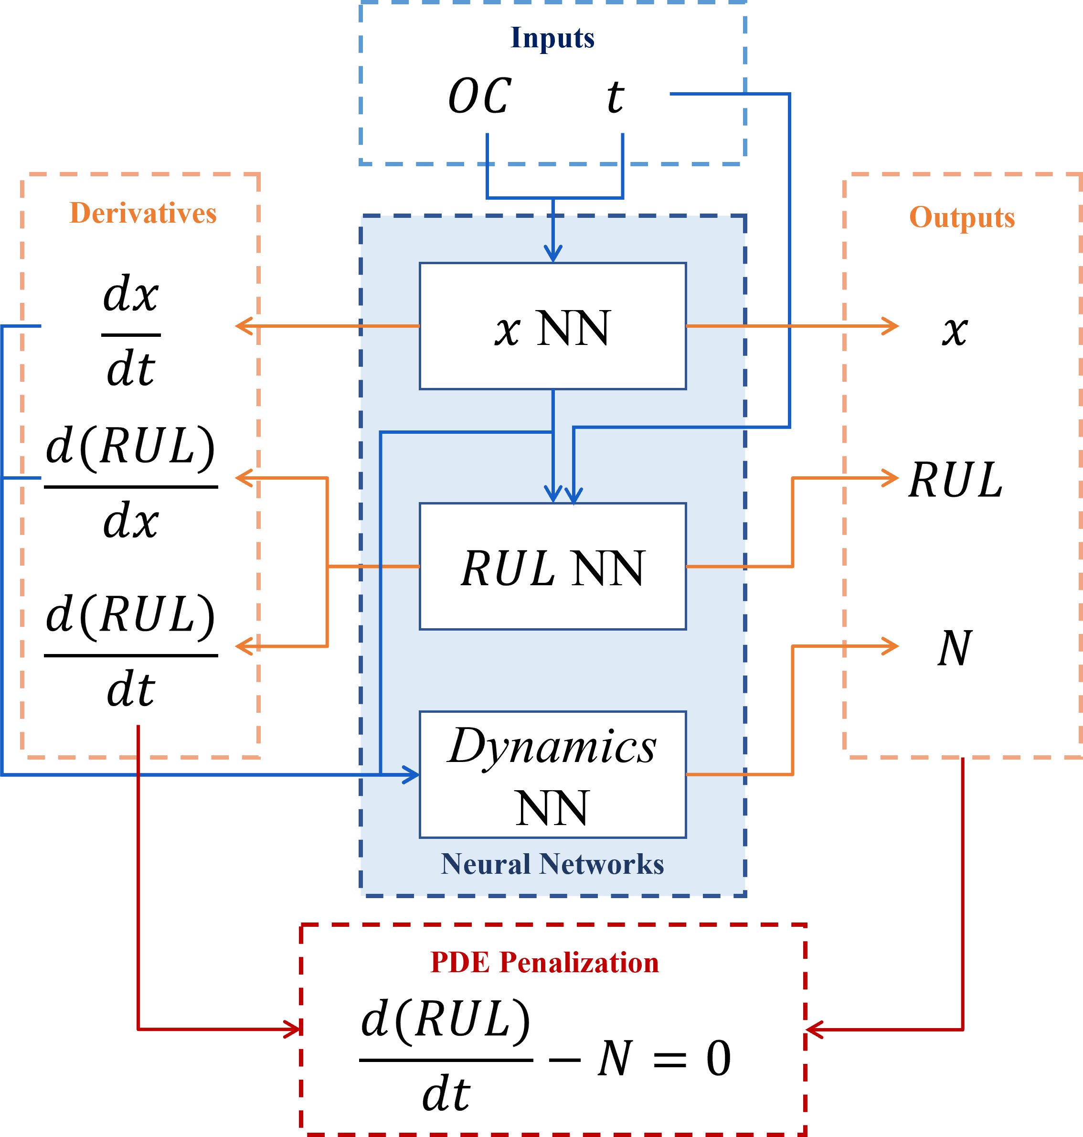
PROPOSED PINN-RUL FRAMEWORK
DL-PDE Framework Description.
Neural Network | Inputs | Outputs
$x$ NN | Operational conditions time | $x$ $dx/dt$
RUL NN | $x$ time | $RUL$ $d(RUL)/dx$
Dynamics NN | $x$ $dx/dt$ $d(RUL)/dx$ | $d(RUL)/dt$
$$f:\frac{∂RUL}{∂t}−N=0$$
$$MSE=\frac{1}{M}\sum_{i=1}^{N}{{\left(RUL_{i}−\hat{RUL_{i}}\right)}^{2}}$$
$$Cost=MSE+\frac{λ}{M}\sum_{j}{f_{j}^{2}}$$
Proposed DL-PDE Framework.
Notes:
The PDE has a penalization weight associated to it which is a hyperparameter to be determined

Slide 16
PROPOSED PINN-RUL FRAMEWORK
Main outputs are the RUL estimation and the latent space
Latent space’s dimension is one of the main hyperparameters to be selected:
2D is selected
Another important hyperparameter is the penalty weight on the PDE penalization:
100 is selected
Proposed DL-PDE Framework.

Slide 17
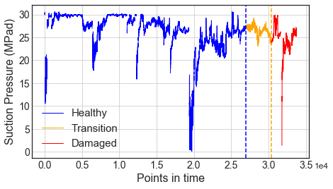
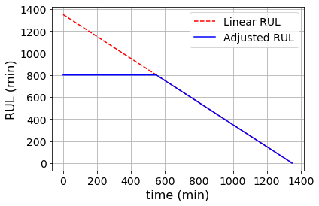
VRU: RUL LABEL GENERATION
Failure time is considered as $RUL=0$
A time window of $Δt=1400$min is defined to generate the RUL labels
Notes:
The case study upon which we build the preprocessing pipeline comes from a Vapor Recovery Unit located at an offshore oil-production platform
Data for two identical and independent units are provided.
Data consists of sensor readings acquired every 15 seconds for a period of 15 months.
2,384,640 log entries.
Data is provided in separate files for two units:
VRU - A contains 189 sensors.
VRU - B contains 174 sensors.
This dataset presents a challenge given it multiple features, missing values, redundant features and few failure events.

Slide 18
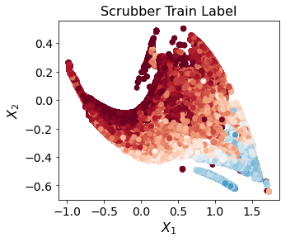
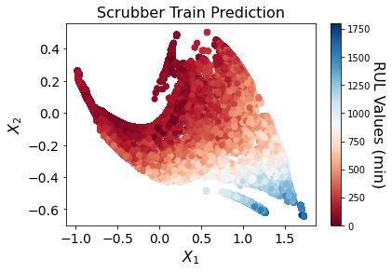
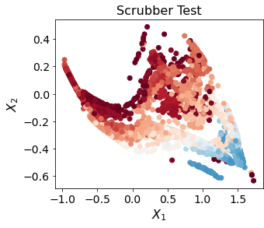
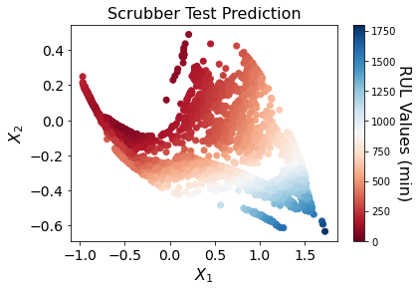
VRU: LATENT VARIABLE VISUALIZATION
10-fold cross validation for the selecting hyperparameters:
Number of layers and neurons in each NN
Activation functions
PDE penalization weigh
Learning rate
10 different models are trained:
Average RMSE of 2.19 hrs. for the test set

Slide 19
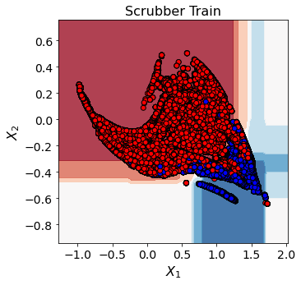
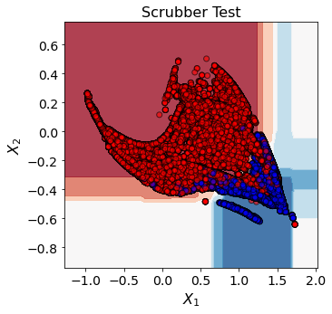
VRU: HEALTH-STATE CLASSIFIER
Train accuracy: | 88.5% | Test accuracy: | 88.6%
FP: | 5.6% | FN: | 5.8%
F1-score: | 90.3% | Precision-score: | 90.5%
Recall-score: | 90.1% | TH RUL: | 800min

Slide 20
CONCLUSIONS
A PHM prognostic framework implementing PINN was presented.
Allows the use of time as input variable
Maps sensor reading to latent space:
RUL estimation
Health state classifier
Interpretability
Flexibility to incorporate previous knowledge:
E.g., Paris’ Law

Slide 21
RELATED ARTICLES
Cofre-Martel, S.; Lopez Droguett, E; et al. “Big Machinery Data Preprocessing Methodology for Data-Driven Models in Prognostics and Health Management” (2021). Sensors, 21(20), 6841. https://doi.org/10.3390/s21206841.
Cofre-Martel, S.; Lopez Droguett, E; et al. “Remaining Useful Life Estimation through Deep Learning Partial Differential Equation Models: A Framework for Degradation Dynamics Interpretation Using Latent Variables” (2021). Shock and Vibration, 2021: https://doi.org/10.1155/2021/9937846.
Moradi, et al. “Integration of Deep Learning and Bayesian Networks for Condition and Operation Risk Monitoring of Complex Engineering Systems.” (2022) Reliability Engineering & System Safety, 108433. https://doi.org/10.1016/j.ress.2022.108433

