Slide 1
PSAM 16
Probabilistic Safety Assessment and Management
A New Simplified Methodology for Quantitative Risk Assessment of Carbon Capture and Storage Plant
Honolulu, O’ahu, Hawaii, USA
June, 30th, 2022

Slide 2
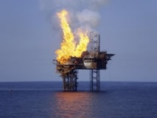
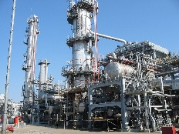
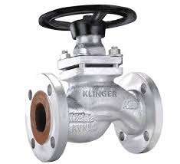
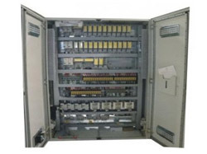
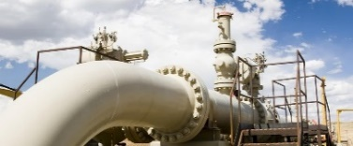
Auriga Consulting S.p.A.
DESIGN PHASE:
P&IDs and Instruments Lists;
Material Requisition for Instrumentation
Field and Automation Systems;
Technical Bid Evaluations;
Detailed Field and Automation
Engineering;
Design of Telecommunication Systems
INSTALLATION and COSTRUCTION
Supervision
TESTING and START-UP
Loss Prevention and HSE
DESIGN PHASE:
Risk Analyses (Hazard Identification, Frequency Assessment, Consequences Evaluation);
Reliability, Availability and Maintenance Analyses;
Design of Prevention and Protection Systems against Accidental Scenarios;
CFD Analyses;
Environmental, Social and Health Impact Assessment;
HSE Management Activities.
Electro-Instrumentation, Automation and Telecommunication

Slide 3
Contents
1
Introduction
2
CO₂ Characteristics and Peculiarity
3
Application on a Case Study
5
4
Quantitative Risk Assessment Methodology
Conclusions

Slide 4
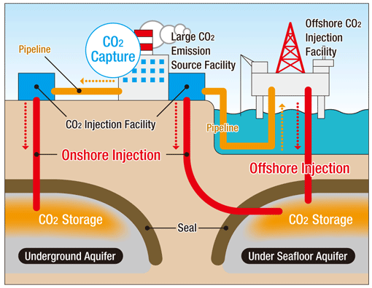
Introduction
Limitation of GHG emissions is one of the most important challenge for Industries to fight the global warming
During the last years the need to design and build Carbon Capture and Storage (CCS) plant is rising
Consequentially, it is crucial to accurately evaluate the risk for asset, personnel and people on CCS plants
The aim of the paper is to report a simplified methodology to consider all safety aspects related to CO₂ risks which could impact the analyses

Slide 5
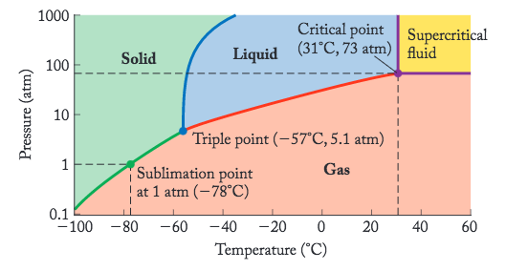
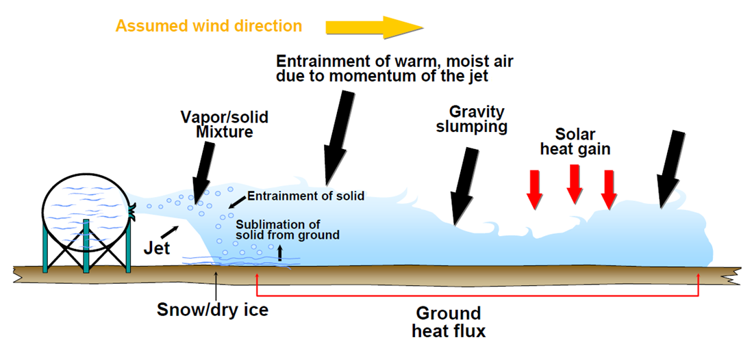
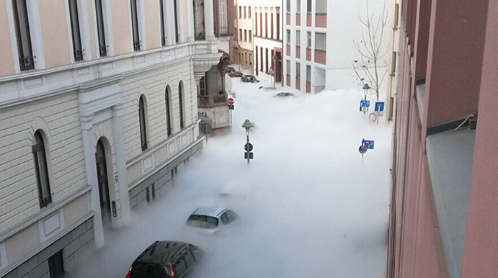
CO₂ Characteristics and Peculiarity
Asphyxiant
Toxic
Cryogenic effect
Visibility issue

Slide 6
QRA – Workflow
1. Identification of potential Loss of Primary Containments (LOPCs)
2. Assessment of the Frequencies related to the different loss of containment events
3. Development of the Loss of Containment events into incident scenarios and assessment of the related probabilities (Event Tree Analysis)
4. Assessment of the consequences of the accidental scenarios on assets
5. Calculation of the risk for asset personnel and people
6. Recommendation of risk reduction measures
(if needed)

Slide 7
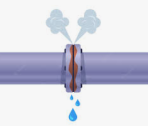
QRA – Identification of LOPCs
Random rupture analysis (e.g. fabrication defects, corrosion, dropped objects, etc.)
For the present Analysis following hole sizes are considered:
Medium release: 1 inch diameter, representative of the hole sizes lower than 50 mm;
Large release: 4 inches diameter, representative of hole sizes higher than 50 mm.

Slide 8
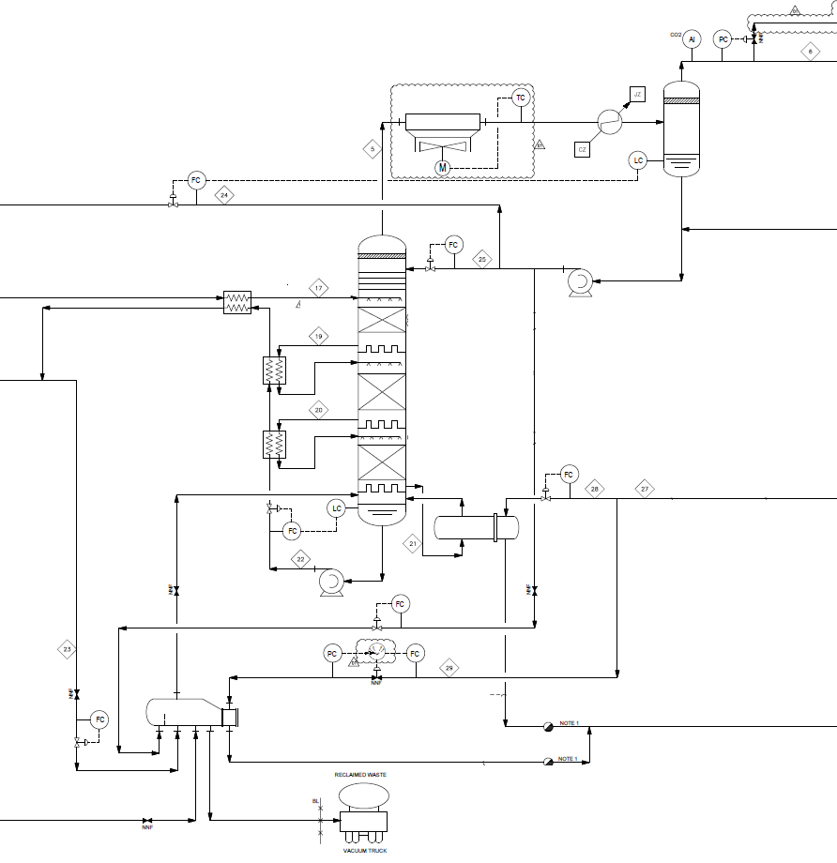
QRA – Leak Frequency Assessment
Parts Count Techniques based on project documentations:
Process Flow Diagrams (PFDs);
Utility Flow Diagrams (UFDs);
P&IDs.
Heat and Material Balances (H&MBs);
Layout;
Frequencies Database: IOGP Risk Assessment Data Directory
“Process Release Frequencies”

Slide 9
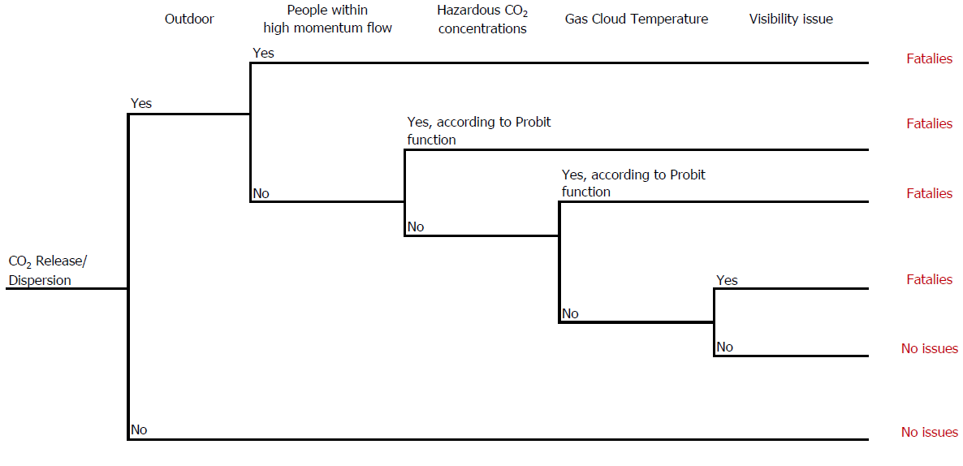
 | Toxic Effect |  |  | Cryogenic Effect |  |  | Visibility Effect
Threshold | 169.000 ppm | 115.000 ppm | 86.000 ppm | - 30 °C | - 20 °C | - 10 °C | 0 °C
Vulnerability (%) | 100% | 50% | 1% | 100% | 50% | 1% | 10%
QRA – ETA & Vulnerability

Slide 10
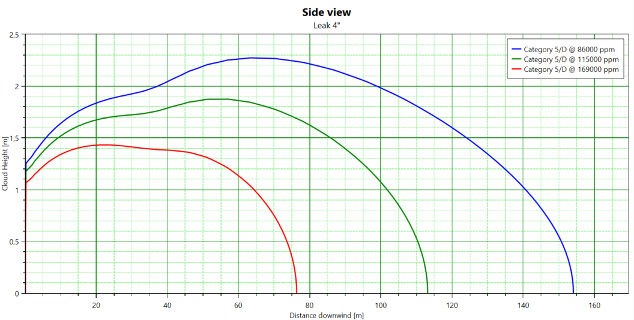
QRA – Evaluation of Consequences
Based on Process parameters (Pressure, Temperature and Fluid Composition), the consequences are modelled with software PHAST 8.61 (Process Hazard Analysis Software Tool) by DNV
Consequences modelling are at peak conditions (corresponding to the initial time of release)
The distances from the release sources characterized by high momentum are representative of possible carbon dioxide solid phase formation, if temperature values reached during the expansion to atmospheric conditions are below the sublimation point at 1 atm (-78.5°C)

Slide 11
QRA – Risk Criteria
Risk Level | Risk Range | Description
Low Risk | Risk < 1.00E-06 | Continuous monitoring to prevent deterioration
Medium Risk | ALARP region, 1.00E-06 ≤ Risk < 1.00E-04 | Generic control measures are required, provided that is demonstrated that the implementation of such measures is not disproportionate to the benefits
Medium-High Risk | ALARP region, 1.00E-04 ≤ Risk < 1.00E-03 | Suitable corrective measures are mandatory, provided that is demonstrated that the implementation of such measures is not disproportionate to the benefits
Intolerable Risk | Risk ≥ 1.00E-03 | Risk control measures are required to move the risk to lower risk regions

Slide 12
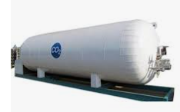
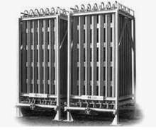
Case Study - Description
Equipment processing CO₂ in liquid phase of a Carbon Capture and Storage (CCS) plant, including:
Storage Vessel;
Pumps;
Evaporators;
Valves, Instrumentation, Piping.
Phase | Item | Temperature [°C] | Pressure [barg]
Liquid | Storage tank (Low pressure) | -26 | 17
 | Pump Discharge (High pressure) | 22 | 60
Relative Humidity [%] | Ambient Temperature [°C] | Solar radiation [kW/m²]
80 % | 22.5 | 0.5

Slide 13
Case Study - Results
Item | Hole [inch] | Distance related to Toxic Effect [m] |  |  | Distance related to Cryogenic Effect [m] |  |  | Distance related to Visibility Effect [m]
 |  | 169.000 ppm | 115.000 ppm | 86.000 ppm | - 30 °C | - 20 °C | - 10 °C | 0 °C
 |  | 100% | 50% | 1% | 100% | 50% | 1% | 10%
Storage Tank (Low pressure) | 1 | 27 | 38 | 45 | 33 | 37 | 44 | 59
 | 4 | 90 | 135 | 170 | 110 | 128 | 150 | 230
Pump Discharge (High pressure) | 1 | 22 | 33 | 46 | 24 | 32 | 43 | 100
 | 4 | 77 | 114 | 155 | 84 | 103 | 140 | 240
Damage distances _{cryogenic effects, 100%} > Damage distances _{toxic effects, 100%}
Damage distances _{cryogenic effects, ≤ 50%} < Damage distances _{toxic effects, ≤ 50%}
Damage distances _{visibility effects} > Damage distances _{toxic and cryogenic effects}

Slide 14
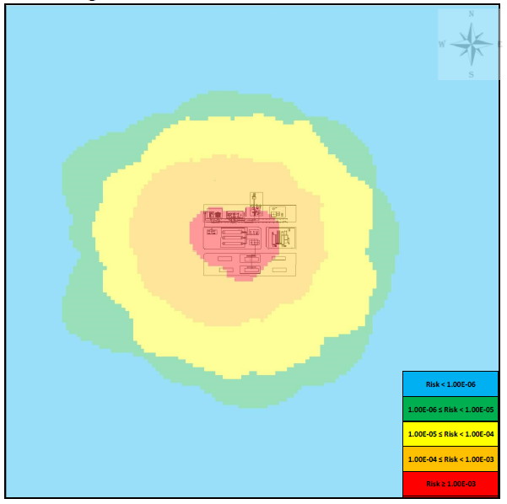
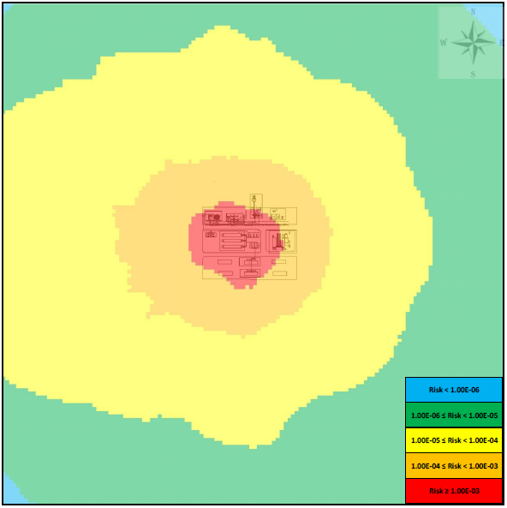
Case Study - Results
LSIR Contour – Toxic, Cryogenic and Visibility Effects
LSIR Contour – Toxic Effects
Visibility Effect
Cryogenic Effect
Worker/ People group | IRPA Toxic Effect | IRPA Toxic, Cryogenic and visibility Effects | Incremental Risk (Cryogenic and Visibility Effects, %)
Plant personnel | 3.23E-04 | 3.63E-04 | 12
External People | 3.40E-05 | 5.25E-05 | 55

Slide 15
Conclusions
The most QRAs performed for CCS plants available on the web take into account only toxicological effects of carbon dioxide, and not the cryogenic effects and visibility issues capable to lead to personnel injuries, domino effects on neighbouring assets, and to impair escape ways, as well.
From the results of the application of the new simplified methodology, that considered dedicated event trees, Probit functions and threshold values to the case study, it is possible to note that there is a not negligible incremental risk due to cryogenic and visibility effects for both personnel and external people, at least in case of liquid carbon dioxide releases.
Asset damage can be expected in case of CO₂ impairment, especially in the area where the “high momentum jet” is possible, due to snow-out effect.
FURTHER SUGGESTIONS/ADVICES:
Proper investigations should be carried out to set in a more accurate way the vulnerabilities associated to the cryogenic effects and visibility issues, since they can significantly change the results of a Quantitative Risk Assessment of a CCS plant.

Slide 16
THANK YOU FOR YOUR ATTENTION
Prepared by:
Stefania Benucci (sbenucci@aurigaconsulting.it)
Enrico Casu (ecasu@aurigaconsulting.it)
Andrea Mancini (amancini@aurigaconsulting.it)

