Slide 1
June 30, 2022
Presenter: Sai Zhang, Ph.D.
Probabilistic Risk and Reliability Analyst
Nuclear Safety and Regulatory Research Division
Idaho National Laboratory, USA
Natural Language Processing-Enhanced Nuclear Industry Operating Experience Data Analysis to Support Risk Model Parameter Estimations
Sai Zhang, Fei Xu, Zhegang Ma
Idaho National Laboratory, USA
Sai.Zhang@inl.gov, Fei.Xu@inl.gov, Zhegang.Ma@inl.gov
Notes:
Introduce myself.
Acknowledge co-authors.
Next step of a previous NRC project.
Mention funding status. Acknowledge Curtis/Mike for seed funding.

Slide 2
Presentation Outline
Background
Nuclear power plant operating experience data sources
Research motivation and focus
Analyzing free-text operating experience data: Now and future
To develop an automated natural language processing-based tool
Research method
Input
Methodological steps
Output
Conclusions and next steps

Slide 3
Background
Nuclear power plant operating experience (OpE) data
The data observed and harvested as nuclear power plants operate (including during maintenance activities)
Ma et al. (2022) Exploring Advanced Computational Tools and Techniques with Artificial Intelligence and Machine Learning in Operating Nuclear Plants, NUREG/CR-7294, INL/EXT-21-61117. U.S. Nuclear Regulatory Commission.
Notes:
Experimental data produced by lab or field experiments. Experimental data and OpE data could overlap if an experiment is conducted as part of plant operations, such as surveillance testing.
Synthetic/simulated data, which are artificially generated from running computational models to simulate processes or systems using computer programs (such as physics simulation codes) or digital twins (such as plant simulators).

Slide 4
Background (cont.)
OpE Data
1 Plant-specific
2 Generic (national)
3 Generic (international)
1.1 Operational data
1.2 Maintenance data
1.3 Regulatory data
1.4 Miscellaneous
2.1 United States
2.2 Other countries
3.1 International Atomic Energy Agency
3.2 Organisation for Economic Co-operation and Development Nuclear Energy Agency
3.3 World Association of Nuclear Operators
3.4 European Committee Joint Research Centre
3.5 Others
Nuclear power plant OpE data can be further categorized using multiple characteristics including:
Data (or file) format
e.g., free-text data
Data structure
Data velocity
Data accessibility
Relevancy to probabilistic risk assessment (PRA)
Ma et al. (2022) Exploring Advanced Computational Tools and Techniques with Artificial Intelligence and Machine Learning in Operating Nuclear Plants, NUREG/CR-7294, INL/EXT-21-61117. U.S. Nuclear Regulatory Commission.
Notes:
Category 1.1.1: Operational data are defined in this report as the data accumulated as a plant operates and are usually proprietary to the plant. Examples of this category include process instrumentation and control (I&C) data, plant logs, and internal plant failure reports.
Category 1.1.2: Maintenance data refer to the records (including plans, actions, results, and all relevant documents) of plant maintenance activities.
Category 1.1.3: Regulatory data are defined in this report as the data that a plant prepares or receives to comply with regulatory requirements.
Category 1.1.4: Miscellaneous data refer to all other plant-specific OpE data that are not captured by the previous three subcategories. Examples include plant design and license-related documents, plant operating guidance documents (such as technical specifications, procedures, and guidelines), and plant business data (such as data associated with enterprise asset management, procurement and logistics, project scheduling and management, human resources, finance, etc.).
Relevancy to PRA, which specifies if the data could be used to support PRA. Formulated in 1970s, PRA is a well-established technique to systematically develop accident scenarios and generate probabilistic, system- and plant-level risk estimates. This report defines four levels of relevancy to PRA, including (1) direct relevancy, (2) indirect relevancy, (3) potential relevancy, and (4) no relevancy.

Slide 5
Research Focus and Motivation
Analyzing free-text OpE data for risk model parameter estimates
What we are doing now
Part of U.S. nuclear industry OpE data are stored and coded by Nuclear Regulatory Commission (NRC) and Idaho National Laboratory (INL) in the NRC Reactor Operational Experience Results and Database (https://nrcoe.inl.gov/ParamEstSpar/) to update and maintain parameter estimates for standardized plant analysis risk (SPAR) models
Current challenges
“Iceberg”
“Cherry-picking”
Small number of observed failures (i.e., n values)
Difficulty to justify and generalize data applications, e.g., to advanced reactors
Failure
An event record
Categorization
(by experts)
$$p=\frac{n}{n+(N−n)}$$
Not Failure
Notes:
Highly simplified illustration. Realistic estimation much more complicated.
Just take failure probability as an example. Failure rate has a different estimating equation.

Slide 6
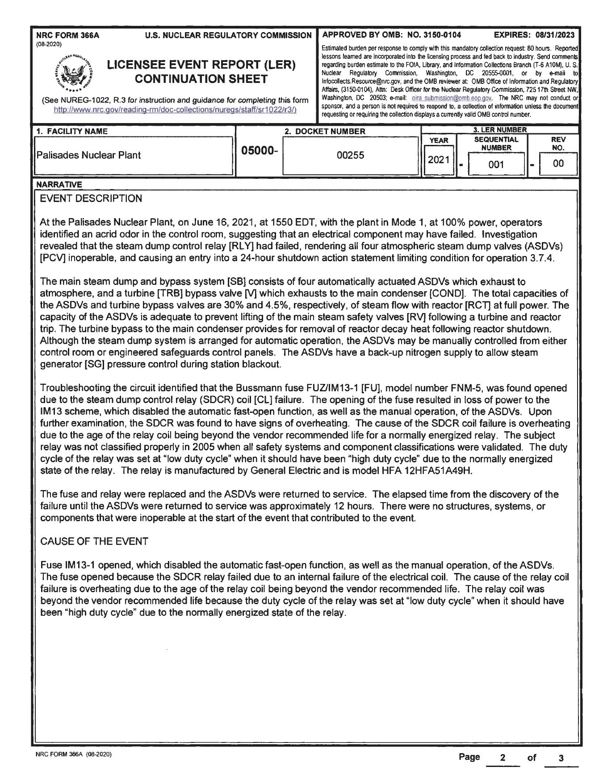
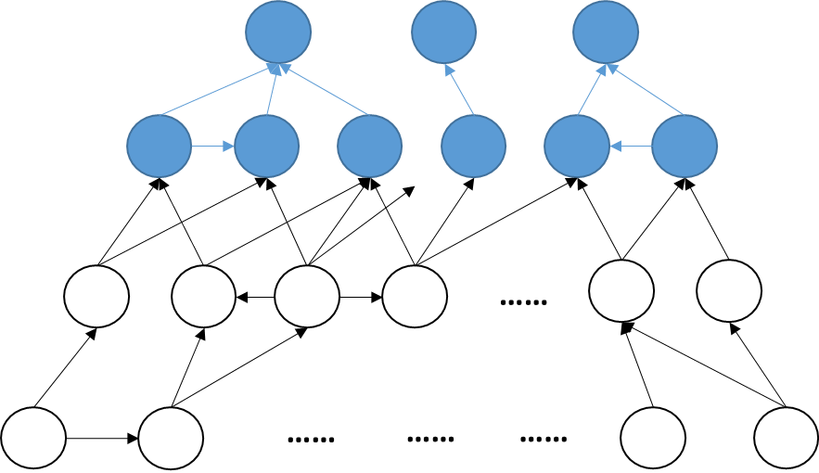
Research Focus and Motivation (cont.)
Analyzing free-text OpE data for risk model parameter estimates
What we might consider to do in future
By leveraging advanced techniques and tools such as natural language processing (NLP)
Research focus of this study
To develop a fully automated NLP tool to analyze free-text event report
Automated NLP Tool
Output: directed acyclic graph
Input: free-text event report
Notes:
Mention existing NLP studies: (1) classification, (2) causal reasoning (e.g., for a different application purpose)
Clarify benefits of using this method: better learn from past, and better use past to inform future

Slide 7
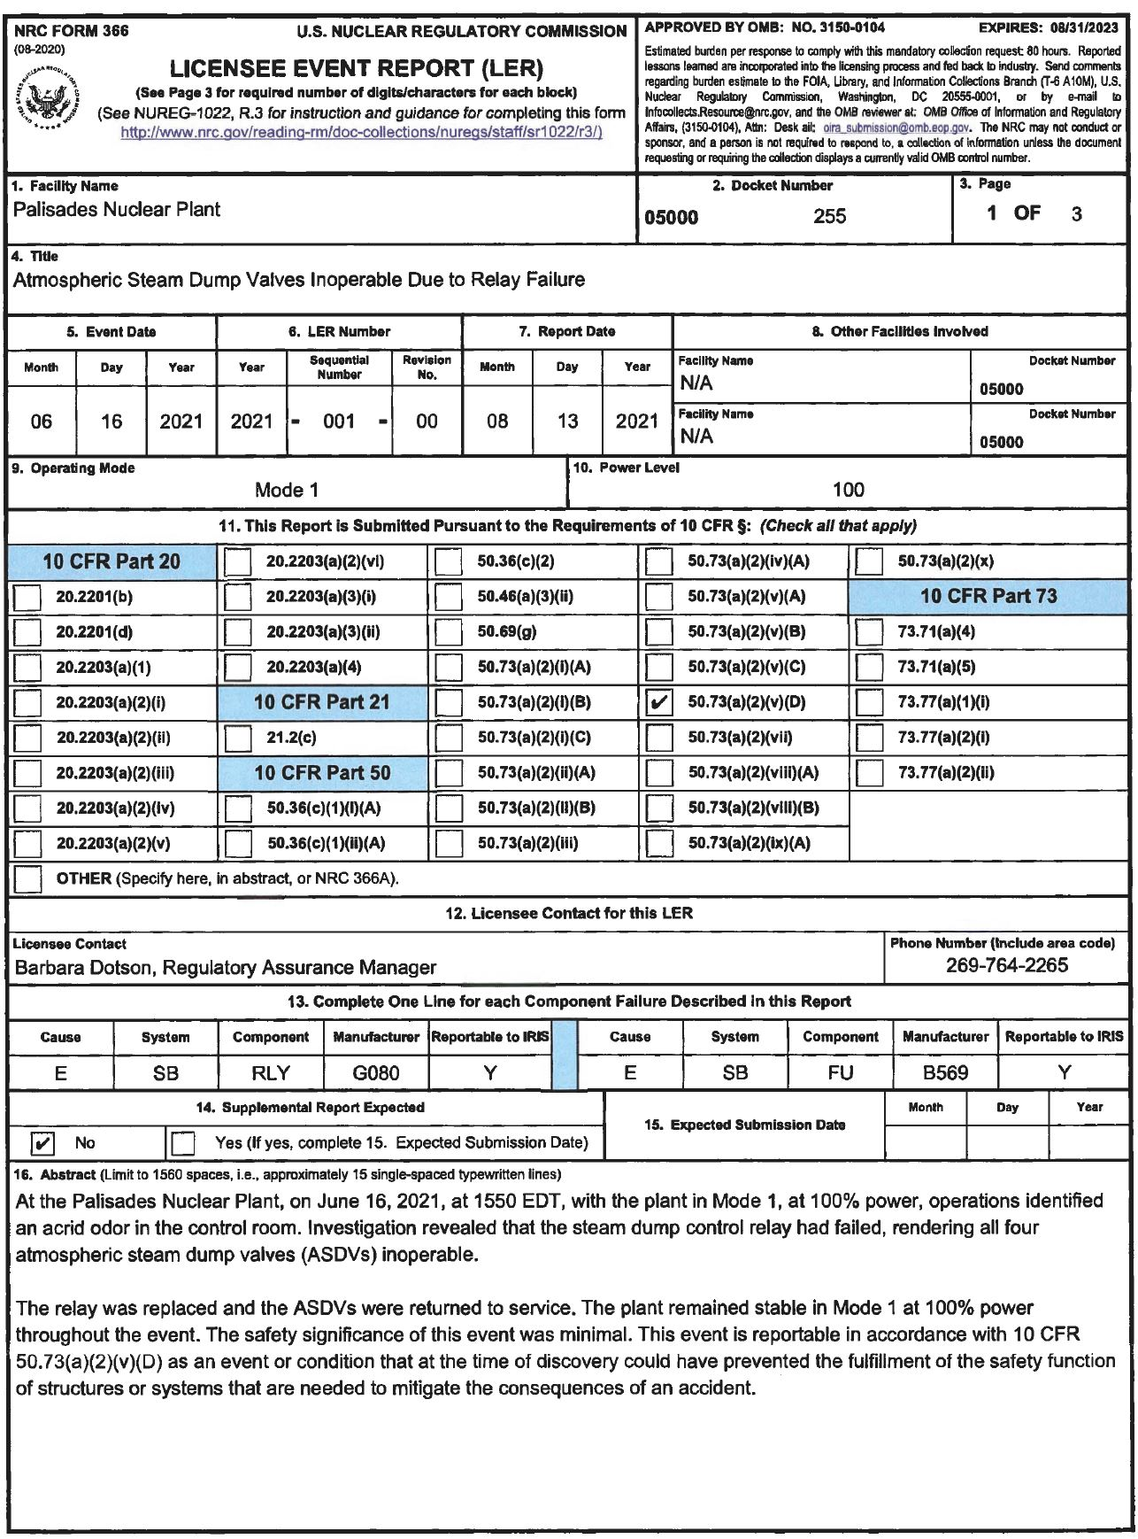
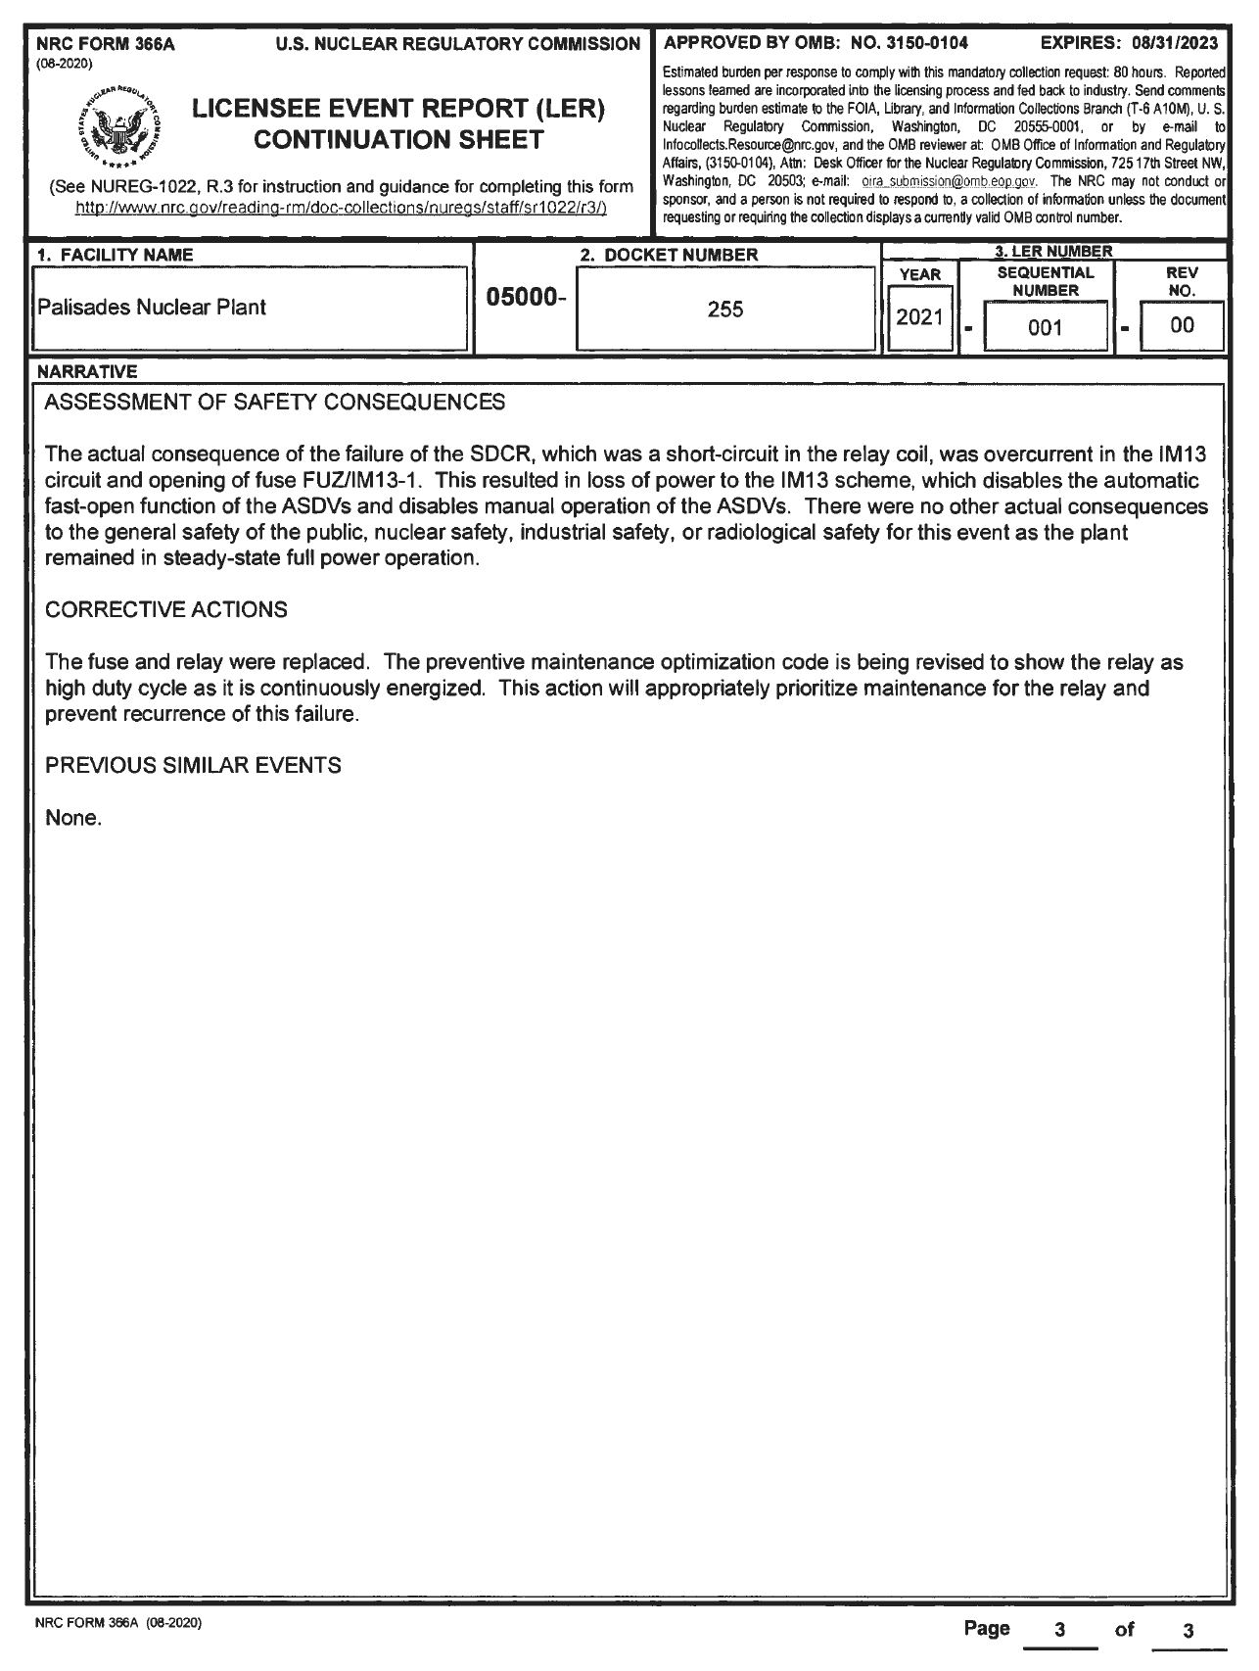
Input to Automated NLP Tool
Selected a publicly available data source (i.e., licensee event report [LER]) for this study
Notes:
This report in the case study describes a common cause failure. Occurred in 2021. Four valves inoperable.

Slide 8
Methodological Steps to Analyze a Single Event Report
Step 1: Identify sentences containing causal relationships
Prepare keywords list
Extract causal sentences
Step 2: Process single sentence
Create the cause-and-effect nodes
Step 3: Combine/process relationships from multiple sentences
Calculate the similarity between the causes and effects
Replace the similar causes or effects by using consistent phrases
Keyword tuples
Remove the duplicate relationships
Step 4: Generate the visualized relationship graph
Extract dependencies
Parts of 45 nodes (in this case study)
Reduce to 13 refined nodes (in this case study)

Slide 9
Identifying Causal Relationships
a) Keyword filter result
b) Tuple information for each sentence
c) Dependencies and relationship extraction for a single sentence

Slide 10
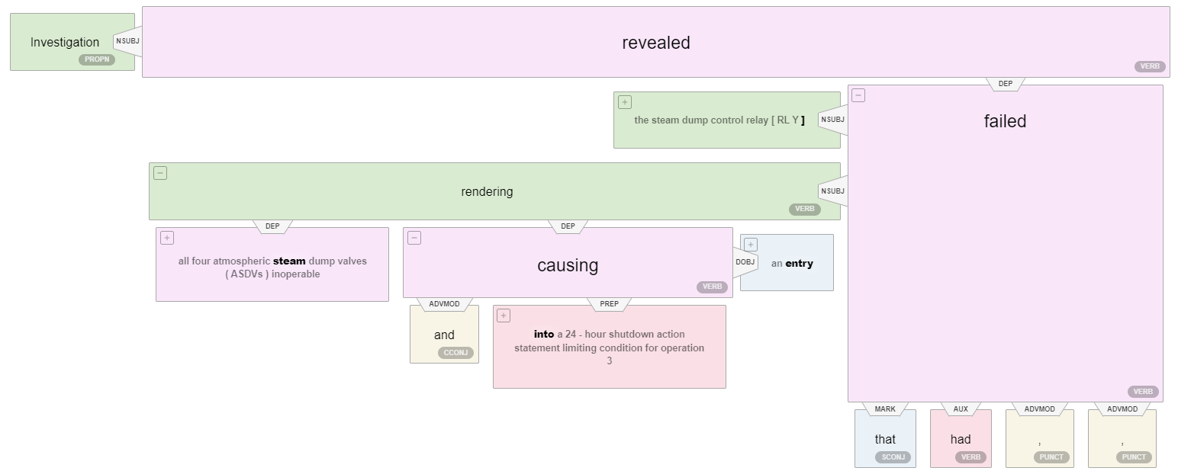
Commercial Tool Selection
S₁: Investigation revealed that the steam dump control relay had failed, rendering all four atmospheric steam dump valves (ASDVs) inoperable
S₂: The opening of the fuse resulted in loss of power to the IM13 scheme, which disabled the automatic fast-open function, as well as the manual operation, of the ASDVs
Stanford CoreNLP
Stanford CoreNLP
Allen NLP
Allen NLP
Notes:
Clarify none of tools can provide full set of functions that we want.
We applied two types of natural language processing applications to extract the dependencies, Stanford CoreNLP and Allen NLP. Both applications will obtain accurate results on simple sentences. However, as shown in Fig. , Allen NLP cannot process well complex sentences, e.g., dealing with ‘as well as’ conjunct. In the sentence S₂, Allen NLP process tagged ‘as well as ’ wrong and generated the dependencies was ‘function’, which should be tagged as punctuation, and its dependency was ‘disabled’ as shown on Standford CoreNLP’s result. Therefore, we adopted the Stanford CoreNLP application python package to implement the part of speech tagging and dependency parsing in this research.

Slide 11
Identifying and Combining Duplicated Entities
a) Original single sentence relationships
b) Refined multiple sentences’ relationships

Slide 12
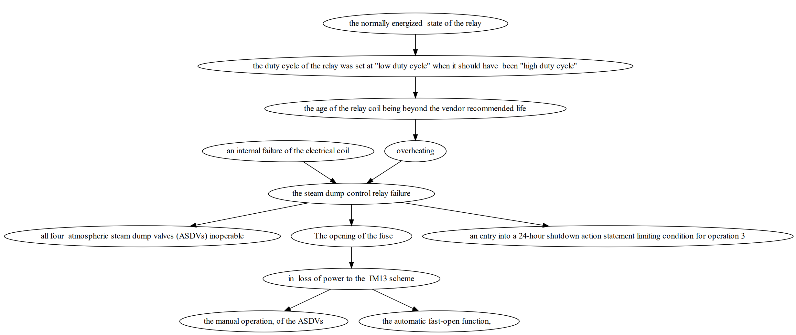
Output from Automated NLP Tool

Slide 13
Conclusions and Next Steps
Conclusions
Developed a fully automated NLP tool to analyze a single report
Input: a free-text, event-describing report
Output: a causal network representing event initiation and propagation
Next steps – A long way to go
Make full use of “past”
Expand tool capability to analyze multiple reports and aggregate results
Use “past” to inform “future”
Utilize results to inform risk model parameter estimations
Enhance physical understanding of failure initiation and propagation
What exactly occurred?
Compliment limited data pool of failure events by analyzing non-failure events (e.g., near misses, failure precursors, or even success data)
How likely is it to evolve into a failure? How close is it to a failure?
Support evaluation of applicability of existing data to, e.g., advanced reactors
How similar is it to a new situation?

