Slide 1
June 27, 2022
Presenter: Sai Zhang, Ph.D.
Probabilistic Risk and Reliability Analyst
Nuclear Safety and Regulatory Research Division
Idaho National Laboratory
Developing Component-Specific Prior Distributions for Common Cause Failure Alpha Factors
Sai Zhang, Zhegang Ma, Idaho National Laboratory, USA
Christopher Hunter, United States Nuclear Regulatory Commission, USA

Slide 2
Presentation Outline
Background
Research focus and motivation
Method
  General steps
  Case study
Results and discussions
  Component-specific priors
  Posteriors using component-specific priors
Conclusions and next steps

Slide 3
Background on CCF Modeling
Common Cause Failures (CCF)
  A specific category of dependent failure
  Stemming from shared root cause(s) AND coupling factor(s)
  Recognized as significant risk contributors from probabilistic risk assessments (PRA) for nuclear power plants
CCF models
  Parametric (e.g., alpha factor model)
  Non-parametric (e.g., failure-mechanism-simulation-based)
CCF parameter estimations for U.S. commercial nuclear power plants
  Raw data stored in a CCF database system maintained by Nuclear Regulatory Commission (NRC) and Idaho National Laboratory (INL)
  CCF parameter estimations periodically updated and published on the NRC Reactor Operational Experience Results and Database website (https://nrcoe.inl.gov/ParamEstSpar/)

Slide 4
Research Focus and Motivation
CCF parameters are estimated using a Bayesian update method
  Due to sparsity of new evidences, prior selection can have a strong influence on CCF parameter posteriors
  Generic priors vs. pool-specific priors
    To partition raw data into smaller pools (by component type, failure cause, failure mode, etc.)
    To better represent pool-specific performance
    To eliminate uncertainties in priors due to pool-to-pool variabilities
This study, which is an exploratory study, focuses on developing component (type) -specific prior distributions for CCF alpha factors
Prior
New Evidence
Posterior
AND
=
Developed based on historical CCF events
Newly-occurred CCF events, usually rare at nuclear power plants
CCF parameter estimates

Slide 5
Research Focus and Motivation (cont.)
Five component types
  Pump
  Valve
  Strainer
  Generator
  All else
Component Type for Component-Specific Prior Development | Number of CCF Events | Component Type Used in the NRC CCF Database
 |  | Broad Type | Detailed Type
Pump | 47 | Pump | MDP | motor-driven pump
 |  |  | TDP | turbine-driven pump
Valve | 123 | Valve | AOV | air-operated valve
 |  |  | CKV | check valve
 |  |  | HOV | hydraulic-operated valve
 |  |  | MOV | motor-operated valve
 |  |  | MSV | main-steam stop valve
 |  |  | PRV | power-operated relief valve
 |  |  | RVL | low-capacity relief valve
 |  |  | SRV | safety relief valve (dual activation)
 |  |  | SVV | safety valve (single acting)
Strainer | 51 | Filter | STR | strainer
Generator | 15 | Emergency power | GEN | generator
All else | 33 | Electrical | BAT | battery
 |  |  | BCH | battery charger
 |  |  | CRB | circuit breaker
 |  |  | TFM | transformer
 |  | Other | CMP | compressor
 |  |  | HTX | heat exchanger
 |  |  | VAC | vacuum breaker valve
Total Number of CCF Events (occurred between 1997 and 2015): 269

Slide 6
Method to Develop CCF Parameter Prior Distributions
Accessing CCF raw data
Treating complete CCF events
Estimating prior distributions
Complete
A CCF event
Categorization
Generalization
Partial
A complete CCF event is a “perfect” CCF event meeting all three conditions:
  Component degradation factor = 1.0
  Timing factor = 1.0
  Shared cause factor = 1.0
Generalization is to create “synthetic” CCF events of all common-cause component group sizes (e.g., 2 to 16)
  For partial events: mapping method
  For complete events: regression method

Slide 7
Method to Develop CCF Parameter Prior Distributions (cont.)
Accessing CCF raw data
Treating complete CCF events
Estimating prior distributions
For each common cause component group (CCCG) size, tabulate the number of all (i.e., complete and partial) CCF events and complete CCF events. Code each CCF event as an impact vector.
Map up and down impact vectors and calculate the n_{k} values for each group size (2–16), using all partial (i.e., incomplete) CCF events.
Using the information obtained in Step 1, perform a binomial regression to obtain the probability of complete CCF events for a given group size.
Using the results from Step 3, obtain the estimated number of complete CCF events. Add this number to the final n_{k} for each group size.
Using the final n_{k} values, estimate (1) maximum likelihood estimators (MLEs) of alpha factors and (2) beta prior distributions for each group size. The beta distribution is denoted by Beta(α, β). A computer code, CalcPrior.exe, was developed by INL to estimate the beta prior distributions.
As a check, calculate the mean of each prior distribution and compare them with the values obtained in Step 5. The mean value is obtained via the formula μ = α / (α+β).

Slide 8
Pump Example – Accessing CCF Data
Group Size | No. Partial CCF Events | No. Complete CCF Events | Total No. CCF Events
2 | 9 | 11 | 20
3 | 12 | 5 | 17
4 | 28 | 2 | 30
5 | 3 | 0 | 3
6 | 10 | 0 | 10
7 | 2 | 0 | 2
8 | 28 | 1 | 29
9 | 0 | 0 | 0
10 | 0 | 0 | 0
11 | 5 | 0 | 5
12 | 2 | 0 | 2
13 | 0 | 0 | 0
14 | 1 | 0 | 1
15 | 0 | 0 | 0
16 | 4 | 0 | 4
Total | 104 | 19 | 123

Slide 9
Pump Example – Accessing CCF Data (cont.)
Group Size | n₁ | n₂ | n₃ | n₄ | n₅ | n₆ | n₇ | n₈ | n₉ | n₁₀ | n₁₁ | n₁₂ | n₁₃ | n₁₄ | n₁₅ | n₁₆
2 | 28.12 | 6.827
3 | 26.62 | 15.563 | 1.639
4 | 23.96 | 19.400 | 5.727 | 0.730
5 | 25.50 | 16.408 | 9.359 | 3.247 | 0.399
6 | 26.75 | 14.616 | 10.487 | 5.370 | 1.925 | 0.224
7 | 27.88 | 13.514 | 10.473 | 6.809 | 3.378 | 1.169 | 0.128
8 | 28.86 | 12.952 | 10.004 | 7.551 | 4.573 | 2.225 | 0.722 | 0.075
9 | 29.71 | 12.731 | 9.451 | 7.762 | 5.434 | 3.180 | 1.497 | 0.453 | 0.045
10 | 30.45 | 12.720 | 8.976 | 7.647 | 5.950 | 3.966 | 2.263 | 1.019 | 0.287 | 0.0273
11 | 31.10 | 12.831 | 8.628 | 7.375 | 6.172 | 4.551 | 2.943 | 1.631 | 0.699 | 0.1849 | 0.0169
12 | 31.68 | 13.006 | 8.407 | 7.060 | 6.177 | 4.929 | 3.504 | 2.210 | 1.184 | 0.4832 | 0.1204 | 0.0106
13 | 32.20 | 13.211 | 8.290 | 6.770 | 6.049 | 5.124 | 3.929 | 2.720 | 1.671 | 0.8640 | 0.3361 | 0.0792 | 0.0068
14 | 32.67 | 13.427 | 8.251 | 6.535 | 5.853 | 5.172 | 4.218 | 3.143 | 2.124 | 1.2693 | 0.6333 | 0.2352 | 0.0526 | 0.0043
15 | 33.09 | 13.642 | 8.263 | 6.363 | 5.640 | 5.118 | 4.382 | 3.467 | 2.523 | 1.6644 | 0.9675 | 0.4662 | 0.1656 | 0.0352 | 0.0028
16 | 33.48 | 13.852 | 8.309 | 6.250 | 5.440 | 5.000 | 4.443 | 3.692 | 2.853 | 2.0294 | 1.3070 | 0.7399 | 0.3446 | 0.1171 | 0.0237 | 0.0018
Each (“real”) CCF event is first coded as an impact vector consisting of a set of n_{k} values
Each “real” CCF event is then mapped up/down to multiple “synthetic” CCF events represented as multiple impact vectors
Impact vectors of “real” and “synthetic” CCF events add up to the results shown in the table.

Slide 10
Pump Example – Treating Complete CCF Events
Group Size | No. Partial CCF Events | No. Complete CCF Events | Total No. CCF Events | Prob. of Complete CCF Event - Data | Prob. of Complete CCF Event - Curve Fitting | Estimated No. Complete CCF Events
2 | 9 | 11 | 20 | 0.550 | 0.618 | 12.350
3 | 12 | 5 | 17 | 0.294 | 0.156 | 2.650
4 | 28 | 2 | 30 | 0.067 | 0.077 | 2.300
5 | 3 | 0 | 3 | 0.000 | 0.058 | 0.170
6 | 10 | 0 | 10 | 0.000 | 0.053 | 0.530
7 | 2 | 0 | 2 | 0.000 | 0.051 | 0.100
8 | 28 | 1 | 29 | 0.034 | 0.050 | 1.450
9 | 0 | 0 | 0 | NA | 0.050 | 0.000
10 | 0 | 0 | 0 | NA | 0.050 | 0.000
11 | 5 | 0 | 5 | 0.000 | 0.050 | 0.250
12 | 2 | 0 | 2 | 0.000 | 0.050 | 0.100
13 | 0 | 0 | 0 | NA | 0.050 | 0.000
14 | 1 | 0 | 1 | 0.000 | 0.050 | 0.050
15 | 0 | 0 | 0 | NA | 0.050 | 0.000
16 | 4 | 0 | 4 | 0.000 | 0.050 | 0.200
Total | 104 | 19 | 123 |  |  | 20.150
Binomial regression is to find relationship between:
  Group size (column #1)
  Probability of complete CCF event estimated from raw data (column #5)
Results (last column) will be added back to the nk values on last slide

Slide 11
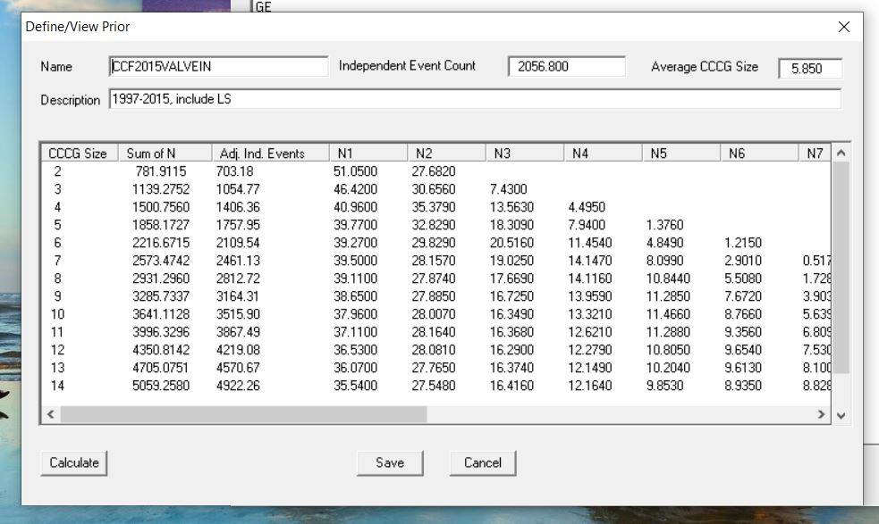
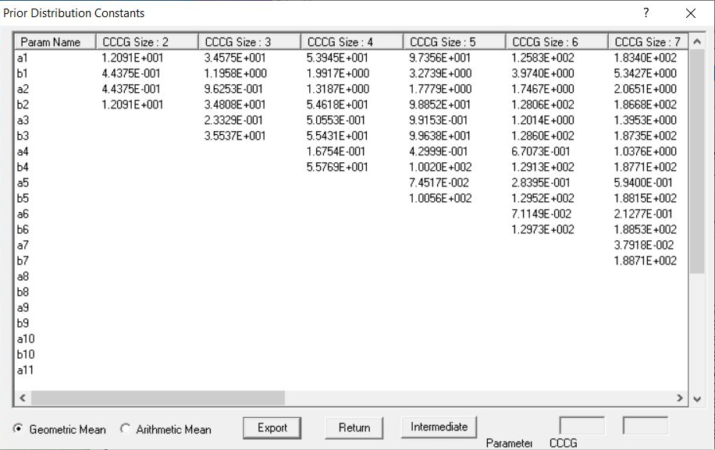
Pump Example – Estimating Prior Distributions
CalcPrior Input
CalcPrior Output
What CalcPrior.exe does:
  Calculate MLEs of alpha factors based on adjusted n_{k} values
  Assign MLEs as mean values of beta distributions, then estimate beta distribution parameters
  Based upon Dirichlet methodology to make sure all alpha factors in the same group add up to 1

Slide 12
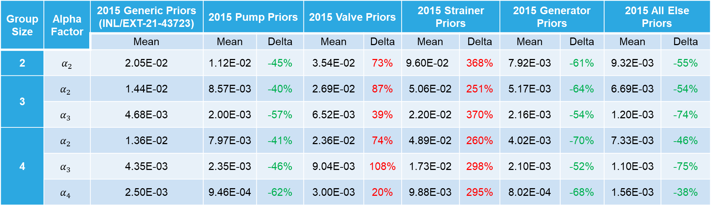
CCF Alpha Factor Prior Results
Group Size | Alpha Factor | 2015 Generic Priors (INL/EXT-21-43723) | 2015 Pump Priors |  | 2015 Valve Priors |  | 2015 Strainer Priors |  | 2015 Generator Priors |  | 2015 All Else Priors
 |  | Mean | Mean | Delta | Mean | Delta | Mean | Delta | Mean | Delta | Mean | Delta
2 | $$α_{2}$$ | 2.05E-02 | 1.12E-02 | -45% | 3.54E-02 | 73% | 9.60E-02 | 368% | 7.92E-03 | -61% | 9.32E-03 | -55%
3 | $$α_{2}$$ | 1.44E-02 | 8.57E-03 | -40% | 2.69E-02 | 87% | 5.06E-02 | 251% | 5.17E-03 | -64% | 6.69E-03 | -54%
 | $$α_{3}$$ | 4.68E-03 | 2.00E-03 | -57% | 6.52E-03 | 39% | 2.20E-02 | 370% | 2.16E-03 | -54% | 1.20E-03 | -74%
4 | $$α_{2}$$ | 1.36E-02 | 7.97E-03 | -41% | 2.36E-02 | 74% | 4.89E-02 | 260% | 4.02E-03 | -70% | 7.33E-03 | -46%
 | $$α_{3}$$ | 4.35E-03 | 2.35E-03 | -46% | 9.04E-03 | 108% | 1.73E-02 | 298% | 2.10E-03 | -52% | 1.10E-03 | -75%
 | $$α_{4}$$ | 2.50E-03 | 9.46E-04 | -62% | 3.00E-03 | 20% | 9.88E-03 | 295% | 8.02E-04 | -68% | 1.56E-03 | -38%
The alpha factor mean values are observed to vary significantly with component type
Those for pump, generator, all else are about 40% to 70% lower than generic priors.
Those for valve are about 20% higher, and for strainer about 2 to 3 times higher.
Understanding needs to be based upon physical meaning of alpha factors.

Slide 13
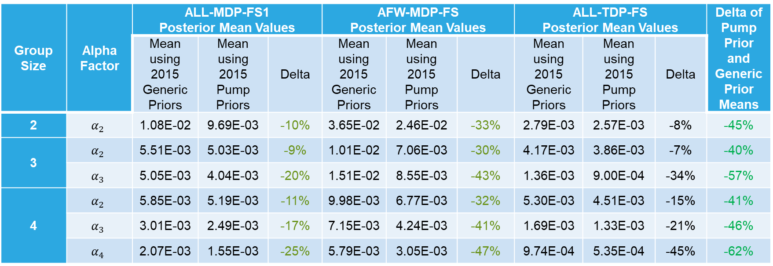
CCF Alpha Factor Posterior Results (Pump Example)
Group Size | Alpha Factor | ALL-MDP-FS1 Posterior Mean Values |  |  | AFW-MDP-FS Posterior Mean Values |  |  | ALL-TDP-FS Posterior Mean Values |  |  | Delta of Pump Prior and Generic Prior Means
 |  | Mean using 2015 Generic Priors | Mean using 2015 Pump Priors | Delta | Mean using 2015 Generic Priors | Mean using 2015 Pump Priors | Delta | Mean using 2015 Generic Priors | Mean using 2015 Pump Priors | Delta
2 | $$α_{2}$$ | 1.08E-02 | 9.69E-03 | -10% | 3.65E-02 | 2.46E-02 | -33% | 2.79E-03 | 2.57E-03 | -8% | -45%
3 | $$α_{2}$$ | 5.51E-03 | 5.03E-03 | -9% | 1.01E-02 | 7.06E-03 | -30% | 4.17E-03 | 3.86E-03 | -7% | -40%
 | $$α_{3}$$ | 5.05E-03 | 4.04E-03 | -20% | 1.51E-02 | 8.55E-03 | -43% | 1.36E-03 | 9.00E-04 | -34% | -57%
4 | $$α_{2}$$ | 5.85E-03 | 5.19E-03 | -11% | 9.98E-03 | 6.77E-03 | -32% | 5.30E-03 | 4.51E-03 | -15% | -41%
 | $$α_{3}$$ | 3.01E-03 | 2.49E-03 | -17% | 7.15E-03 | 4.24E-03 | -41% | 1.69E-03 | 1.33E-03 | -21% | -46%
 | $$α_{4}$$ | 2.07E-03 | 1.55E-03 | -25% | 5.79E-03 | 3.05E-03 | -47% | 9.74E-04 | 5.35E-04 | -45% | -62%
Overall trends (i.e., increase or decrease) of posterior are consistent with those of prior.
Posterior delta ranges are usually narrower than prior delta ranges.
The more evidences are, the less impact is prior delta on posterior delta.

Slide 14
Conclusions and Next Steps
Conclusions
  Categorized components as five types
  Developed alpha factor prior distributions for all five component types
  Examined impacts of using component-specific priors on alpha factor posterior distributions for representative failure modes
Next steps
  Improving and establishing better understanding of underlying statistical models, e.g.,
    Binomial regression suffers from lack of sufficient data points
    Needs to revisit the process of estimating beta distribution parameters based on Dirichlet distribution
  Developing a more integrated software tool for the whole process of developing CCF priors
    Currently done by querying from NRC CCF database, manual calculations, and running CalcPrior.exe

