Slide 1


Probabilistic Safety Assessment and Management (PSAM)
Study of Bridge Damage Prediction Leveraging Kinematic Contact Enforcement-based Moving Load and Deep Learning Techniques
Suyun Ham, Ph.D., Associate Professor
Shih-Ho Chao, Ph.D., Professor
Kyeong Rok Ryu, Ph.D., Assistant Professor
Ernie Yin Chao Wu
Dafnik David
Univ. of Texas at Arlington
s.ham@uta.edu
817 – 691 - 4397

Slide 2
Contents
Background / Motivation
Challenge and Research Gap
Objectives
Methodology
Results
Conclusion

Slide 3
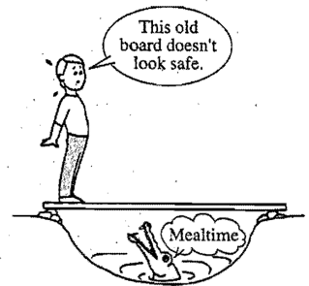
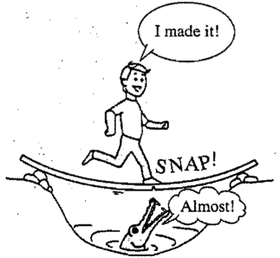
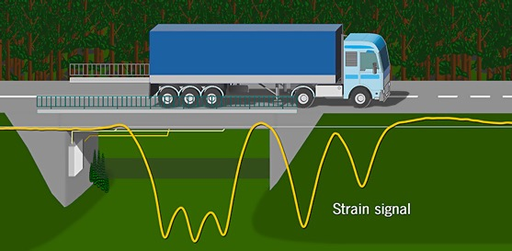
1. Background
Leet & Uang, 2006
Conceptual figure of Bridge-based weight-in-motion (BWIM)

Slide 4
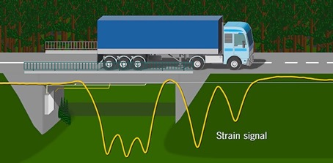
1. Background
BWIM to overcome the critical challenges of structural health monitoring (SHM) by monitoring the vehicle’s load distribution
Need a tool for performing accurate structural assessments in a real-time manner
Vehicle axle weight
Gross vehicle weight
Vehicle speed
Strain measurement
Influence line
Load distribution factor
Dynamic amplification
.
.
.
Structural
Health
Monitoring
Conceptual figure of Bridge-based weight-in-motion (BWIM)

Slide 5
2. Motivation
Still exist technical challenges :
Level 1: Is there damage present in the structure?
Level 2: What is the geometric location of the damage?
Level 3: What is the type of damage?
Level 4: What is the severity of the damage?
Level 5: What is the prediction of the remaining service life of the structure?
Current biggest challenge
It is hard to identify bridge damages and their damage severity due to many unknown factors (e.g., different type of bridge, different environment, limited current ML)
Notes:
Although BWIM for SHM has been studied, there

Slide 6
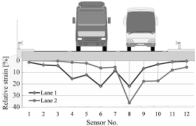
2. Challenge and Research gap
Main research gaps:
  Static-load based vs. moving-load based FE simulation, which likely simulates actual moving vehicle
  Healthy and unhealthy condition on the model by different severity (or damages level)
  Lack of superlearner study on advanced machine learning (ML) for SHM using BWIM: Comparison between several ML models for damage prediction
Superlearner as known as assemble learning which including different ML model to find which model provides the highest accuracy
Superlearner
ML model 1
ML model 2
.
.
.
ML model n
ML model 1 (96%)
ML model 2 (93%)
.
.
.
ML model n (86%)
ML model 1 is the best model
Use same input data for ML models
Assemble learning
Results (Accuracy)
Notes:
Although BWIM for SHM has been studied, there

Slide 7
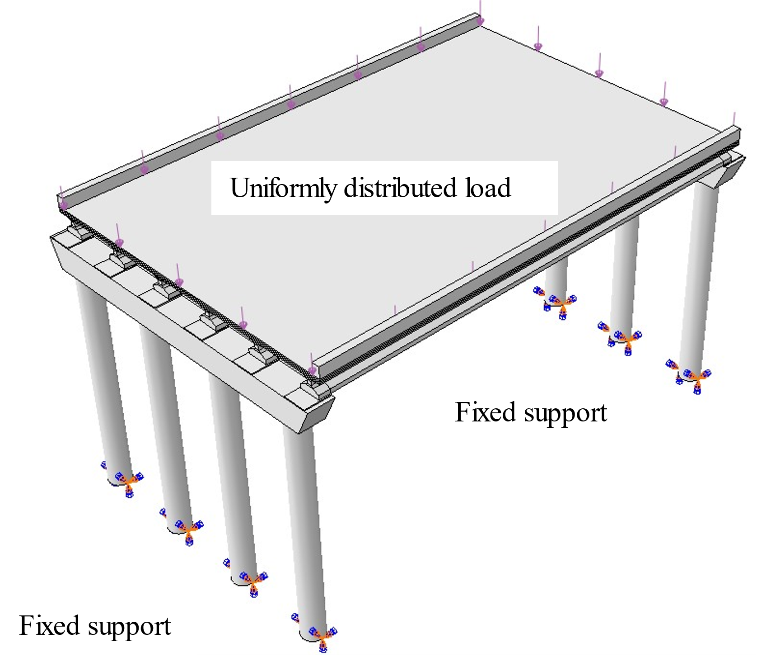
2. Challenge and Research gap
Gap 1
Gap 2
Gap 3
Lack of study of moving load-based FE model with
Lack of study with different structural damages
Lack of study of damage prediction model
Goal: Develop a damage prediction model using reliable damage classification approach leveraging FE model and machine learning(ML)
Objective 1
Objective 2
Objective 3
Fundamental study of
FE model with time-dependent moving load
Design a reliable FE model with moving load and several damages(verified with field data)
Develop reliable damage prediction model for high-accuracy
ML-BWIM system
Machine learning + BWIM
Goal and Objectives

Slide 8
3. Objectives
Objective 1. Study and develop reliable FE model applied with moving load and
several damages :
  Task 1) Design of FE model for moving load and verified with analytical solution:
    Use contact method to simulate actual motion of vehicle in FE model
    Use vehicle bridge interaction(VBI) theorem to verify results of FE model
    Apply four different severity crack on the bridge, which including healthy, mild damage, moderate damage, and sever damage.
    Set 30 different measuring points as sensor position to collect structural response data.
Objective 2. Collect BWIM data from low-cost sensors
  Task 2) Collect real data to verified FE model:
    Low-cost sensors and laboratory test data
    Collect field data with different vehicle speed and weight
    Verified FE model with field test data
Objective 3. Develop reliable damage prediction model with high-accuracy
  Task 3) Study and apply ML model:
    Use feature selection to delete unimportant data and reduce the uncertainty of damage prediction results.
    Apply different types of ML model to detect damage, which including backpropocation(BP), support vector machine(SVM), decision tree(DT) and XGBoost

Slide 9
4. Methodology and Procedure
  Task 1. Study of moving-load FE model

Slide 10
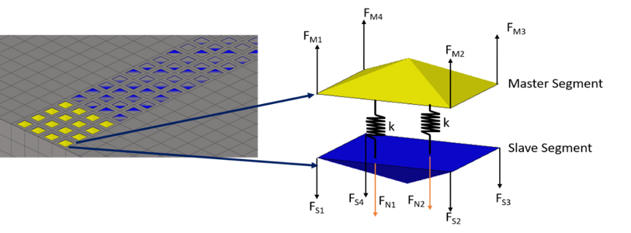


4. Methodology : Task 1. Study of moving-load FE model
In the “kinetic contact enforcement method” (or contact method ), the force is transmitting through the contacted surface of two contacted elements.
The contacted surface of elements with higher stiffness is named master surface, and the other is named slave surface.
Basic contact force equation:
$$F_{N}=\sum_{i=1}^{4}{F_{Mi}}$$
$F_{N}=k∙g_{N},$ if $g_{N}>0$
Total applied force
Gap between elements
Nodal force of master element
Stiffness
$$g_{N}$$
The simple concept of contact method
Hirmand (2015)
Notes:
Hirmand, M., Vahab, M., & Khoei, A. R. (2015). An augmented Lagrangian contact formulation for frictional discontinuities with the extended finite element method. Finite Elements in Analysis and Design, 107, 28–43. https://doi.org/10.1016/j.finel.2015.08.003

Slide 11
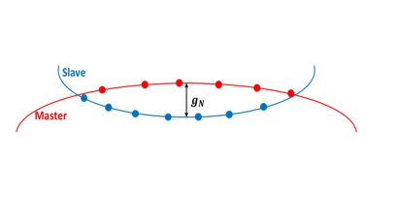
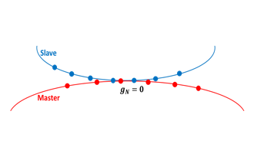


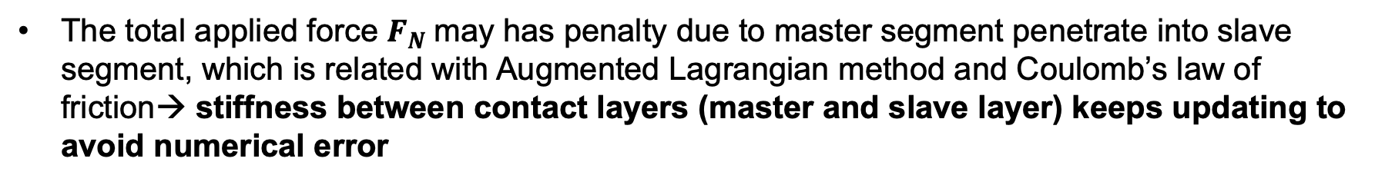





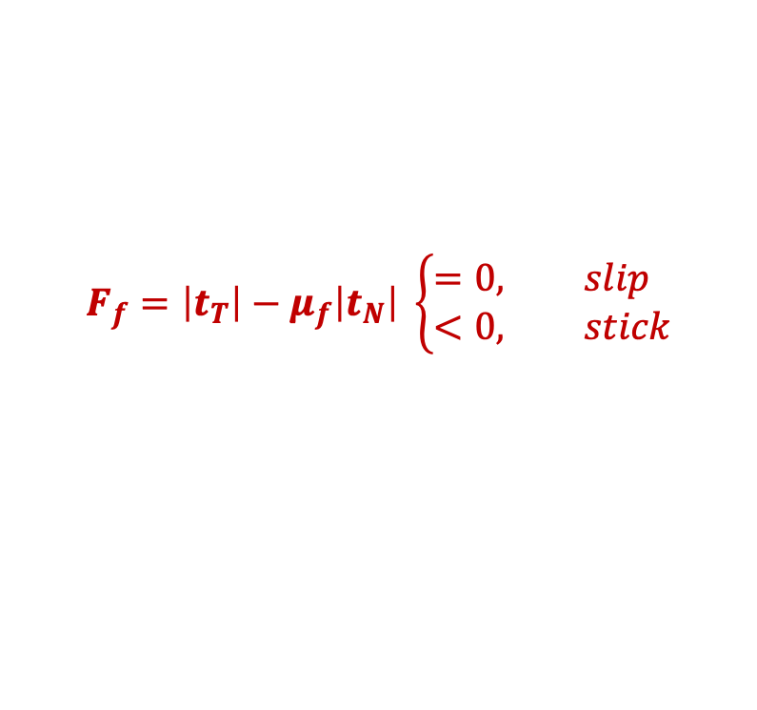
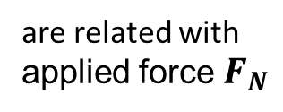
4. Methodology : Task 1. Study and apply for moving load (FE model)
The total applied force $F_{N}$may has penalty due to master segment penetrate into slave segment, which is related with Augmented Lagrangian method and Coulomb’s law of friction→ stiffness between contact layers (master and slave layer) keeps updating to avoid numerical error
$$numerial error$$
Master penetrates into slave ($g_{N}≠0)$
Master contact well with slave ($g_{N}=0)$
Friction force
$$F_{f}=\left|t_{T}\right|−μ_{f}\left|t_{N}\right| \left\{\begin{aligned}&=0, slip \\ &<0, stick\end{aligned}\right.$$
Coulomb’s friction coefficient
contact stress of tangential direction
contact stress of normal direction
penalization parameter(tangential direction)
$t_{T}={\overline{ε}}_{T}g_{T}+λ_{T}$
Lagrange multiplier(tangential direction)
$${\overline{ε}}_{T}$$
$$,$$
are related with
applied force $F_{N}$
where
$$ε_{N}$$
$$t_{N}=ε_{N}g_{N}+λ_{N}$$
Lagrange multiplier(normal direction)
penalization parameter(normal direction)
Simo(1992)
Notes:
Simo, J., & Lauren, T. (1992). AN AUGMENTED LAGRANGIAN TREATMENT OF CONTACT PROBLEMS INVOLVING FRICTION. In Computers & SWUCIW~S (Vol. 42, Issue I).

Slide 12
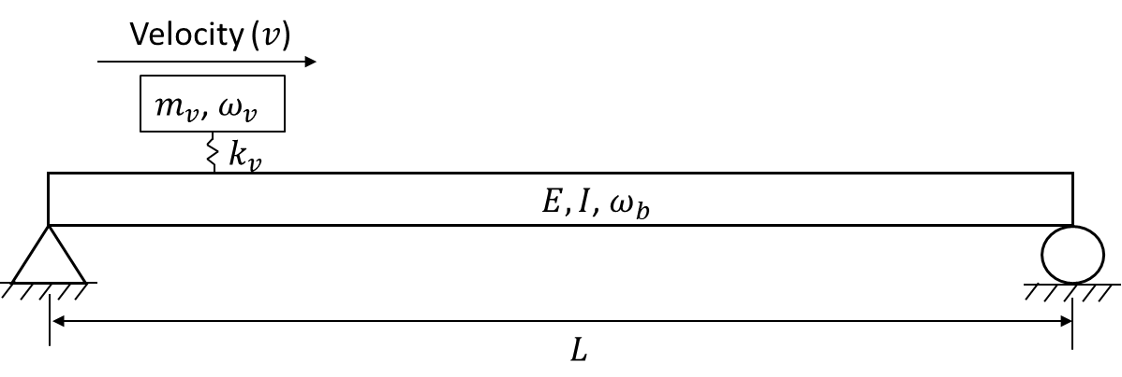
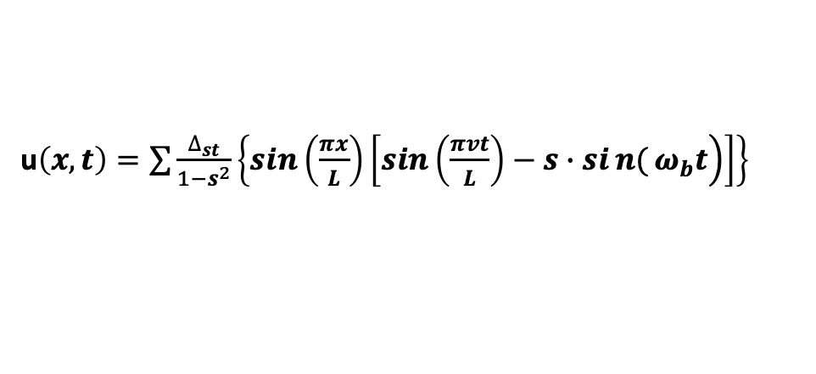
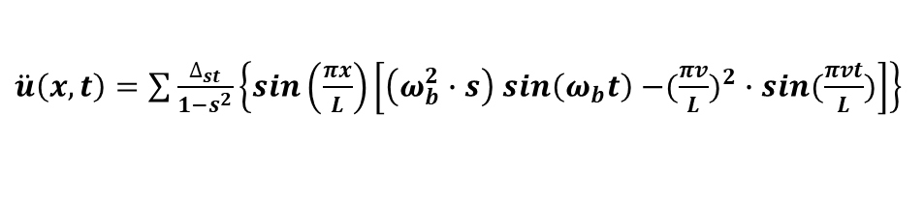
4. Methodology : Task 1B. Study and apply for moving load (analytical solutions)
The concept of vehicle-bridge interaction (VBI) is based on the interdependence between moving vehicles and bridge response.
Model and equation for a passing vehicle and simple bridge:
Bridge displacement under moving vehicle :
u$\left(x,t\right)=\sum{\frac{∆_{st}}{1−s^{2}}\left\{\sin\left(\frac{πx}{L}\right)\left[\left.\sin\left(\frac{πvt}{L}\right)−s∙sin{(}ω_{b}t\right)\right]\right\}}$
Bridge acceleration under moving vehicle:
$\ddot{u}\left(x,t\right)=\sum{\frac{∆_{st}}{1−s^{2}}\left\{\sin\left(\frac{πx}{L}\right)\left[\left(ω_{b}^{2}∙s\right) sin\left(ω_{b}t\right)−{({\frac{πv}{L})}^{2}}∙sin⁡(\frac{πvt}{L})\right]\right\}}$
where $∆_{st}=−\frac{2m_{v}gL^{3}}{π^{4}EI}$ , $s=\frac{πv}{Lω_{b}}$
Simple model for passing vehicle and bridge
Yang(2005)
Notes:
Yang, Y. B., & Lin, C. W. (2005). Vehicle-bridge interaction dynamics and potential applications. Journal of Sound and Vibration, 284(1–2), 205–226. https://doi.org/10.1016/j.jsv.2004.06.032

Slide 13
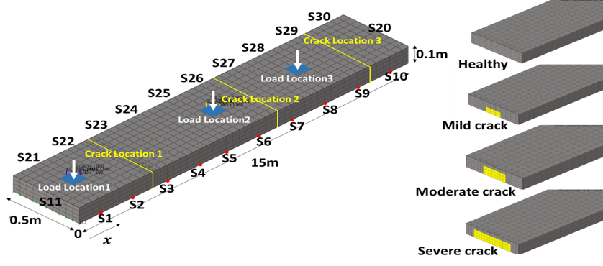
4. Methodology : Task 1C. Design of FE model (static load model):
Three different crack locations, three load locations, thirty sensing points(S1~30) with four types of bridge conditions
Bridge length is 15m, which is similar with actual length of one span
There are total 900 data set collected from static load model
The crack size is determined by 10%, 25% and 45%, with each missing element defined as a mild, moderate and severe crack, respectively
70% of dataset used for training model, and 30% used to test model
(10% missing)
(25% missing)
(45% missing)
The model of static load.

Slide 14
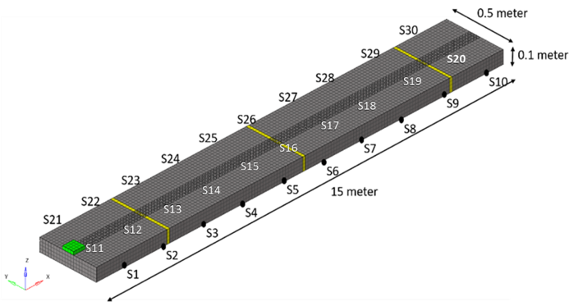
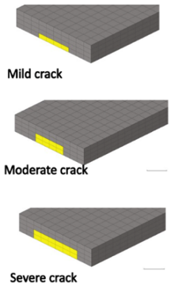
4. Methodology : Task 1C. Design of FE model (moving load model):
Apply contact method as vehicle moving path.
Contact parameters:
Mild crack
(10% missing)
Moderate crack
(25% missing)
The model of moving load
Sever crack
(45% missing)
The setting for one-way moving load detail and material properties
Velocity | Concrete Density | Concrete Poisson ratio | Concrete Elastic modulus | Tire Density | Tire Poisson ratio | Tire Elastic modulus | Load Applied
6 mph | 2400 kg/m³ | 0.2 | 30 GPa | 700 kg/m³ | 0.3 | 1 GPa | 1 Hz

Slide 15
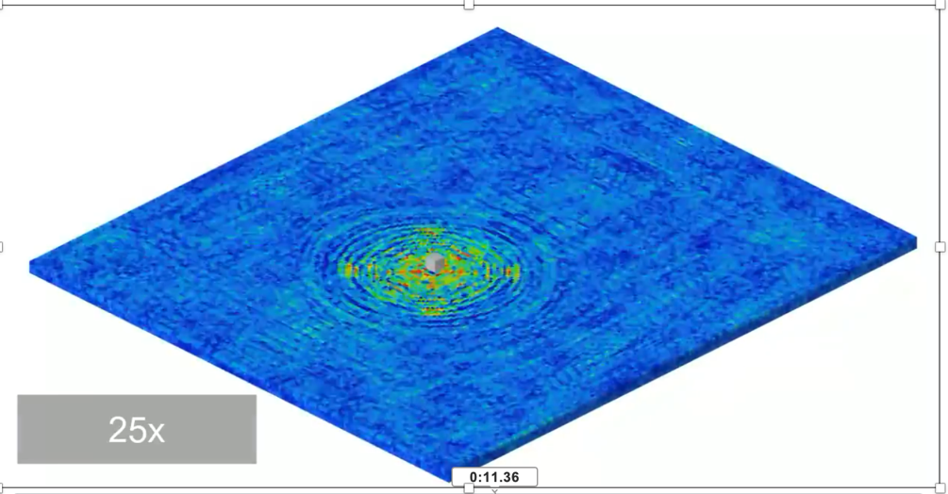
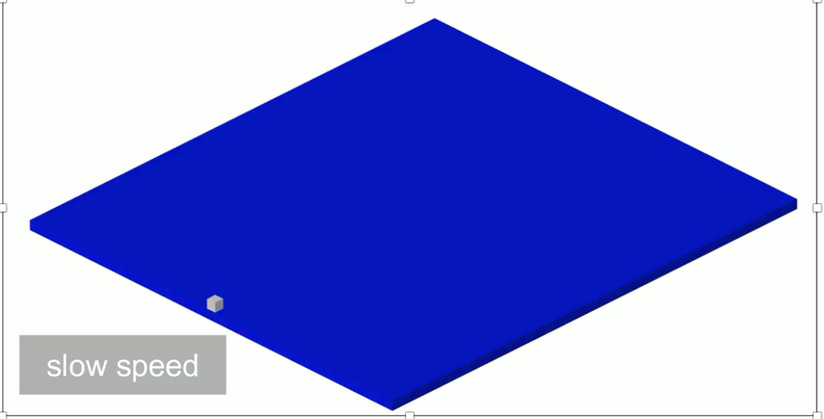
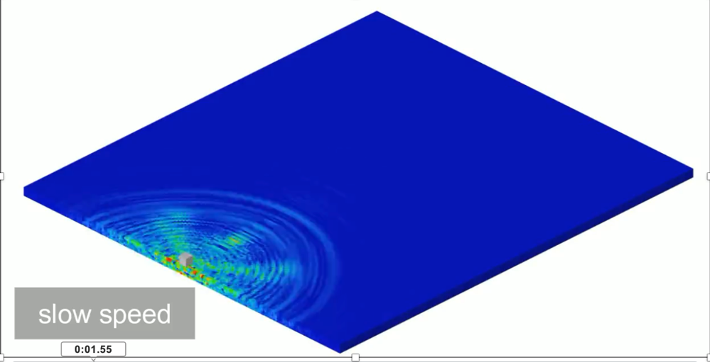
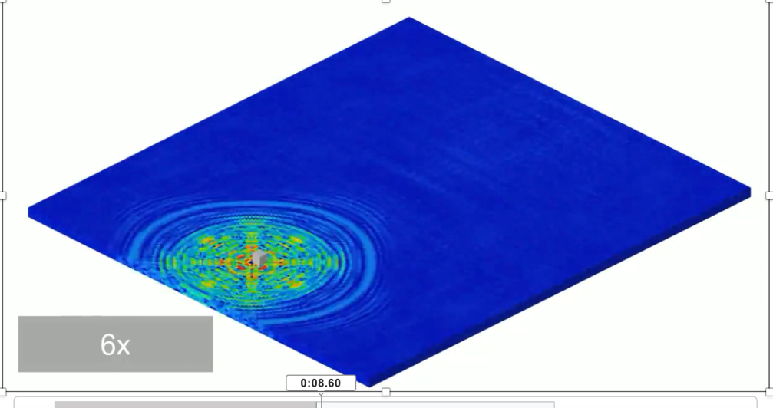
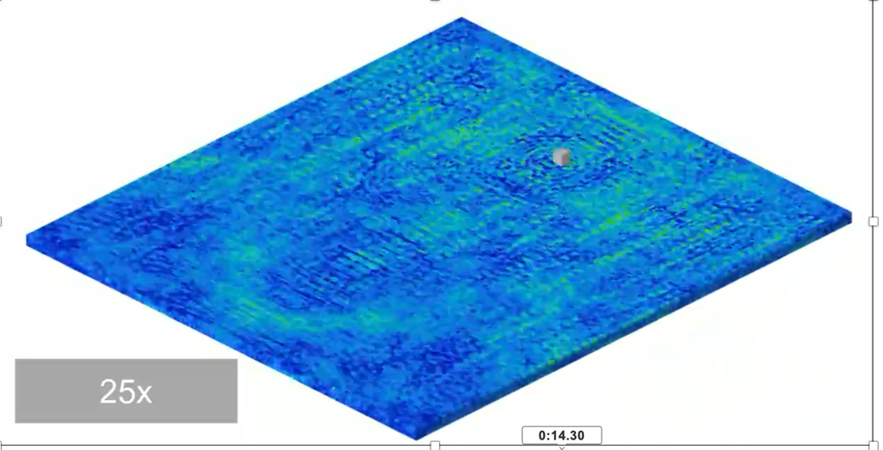
√

Slide 16
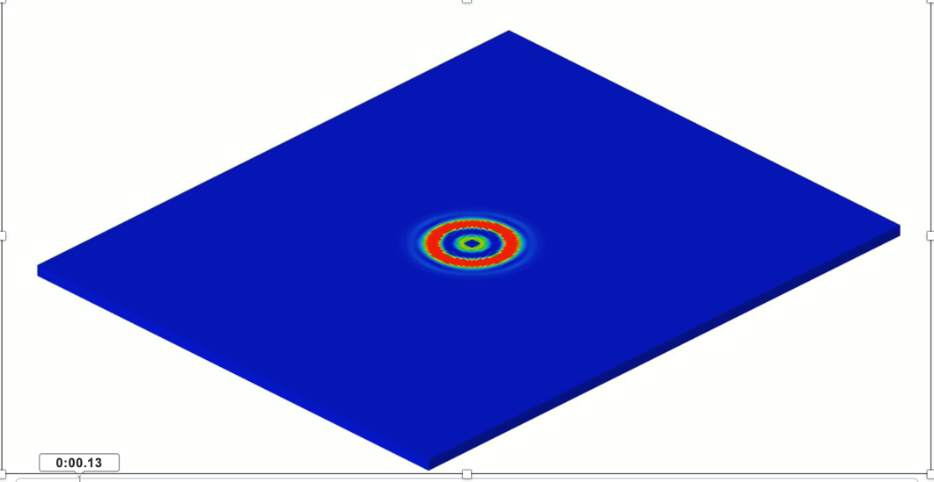
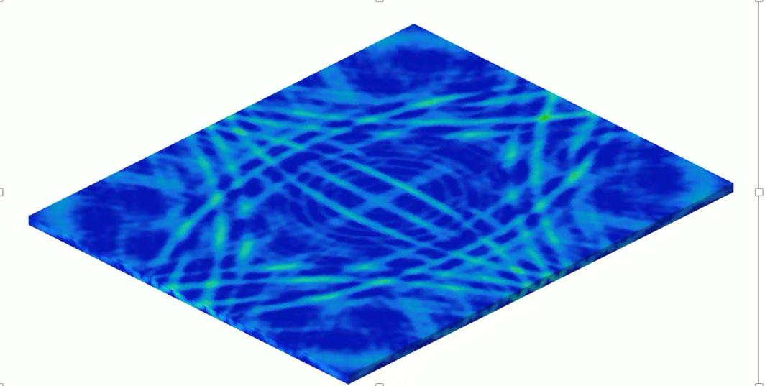

Slide 17
4. Methodology and Procedure
  Task 2. Low-cost sensor and data acquisition

Slide 18
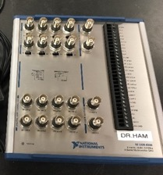
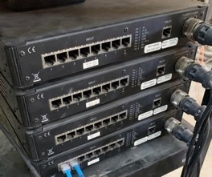
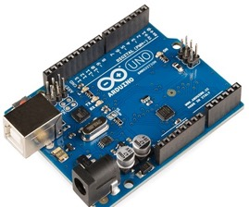
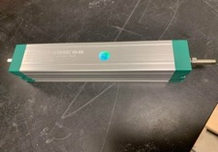
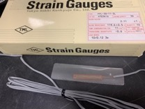
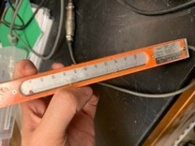
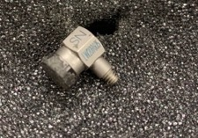
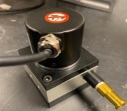
4.Methodology : Task 2A. Low-cost sensor and data acquisition(DAQ)
Different sensors use different DAQ system:
1) The accelerometer and low-cost linear potentiometer position sensor use National Instrument (NI) DAQ
2) Strain gauge and LVDT use VPG DAQ
3) Draw-wire displacement linear sensor use microcontroller
(a) NI DAQ ($5244)
(b) VPG DAQ ($2000)
(c) Microcontroller ($40)
($30)
($300)
($5)
($1000)
($76)
low-cost linear potentiometer position sensor
Accelerometer
Strain gauge
LVDT
Draw-wire displacement linear sensor
Test performance of low-cost sensors and DAQs in laboratory test

Slide 19
4.Methodology : Task 2A. Low-cost sensor candidate and laboratory test
 | Strain gauge | Linear variable differential transformer(LVDT) | PCB accelerometer | Linear potentiometer position sensor | Draw-wire displacement linear sensor
Company | Tokyo Sokki Kenkyujo Co.Ltd | Tokyo Sokki Kenkyujo Co.Ltd | PCB Piezotronics | Fafeicy | Calt
Model number | FFL-30-11-3L | SDP-1000 | 35B15 | KTC-100 | 5-24V-NPN
Resolution | 50000 (10⁶ strain) | 0.01mm | 10 mV/g | Unlimited | 0.2 mm /pulse resolution
Price | $5 | $1000 | $300 | $30 | $76
Data acquisition device (DAQ) used | VPG DAQ | NI DAQ | VPG DAQ | NI DAQ and amplifier | Micro-controller

Slide 20
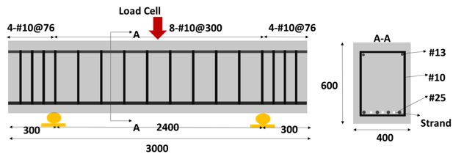
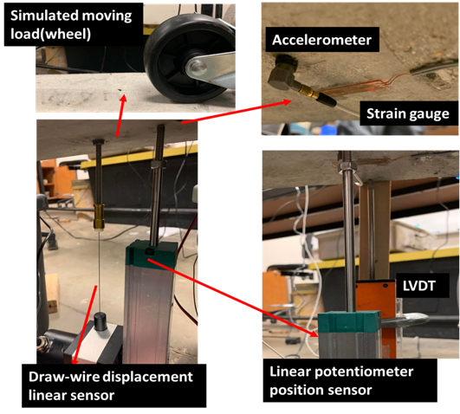
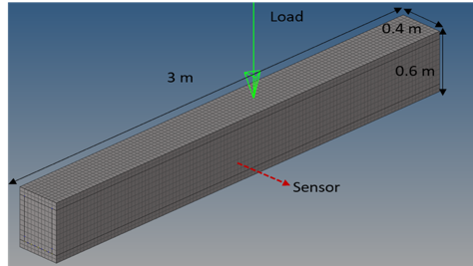
4.Methodology : Task 2B. Laboratory test setting
The sensors placed on mid span of specimen
The collected data are used to verified with moving-load FE model
Test low-cost sensors performance
Calibrate FE model with laboratory data
The concrete beam dimension
The setting of laboratory test
The FE model of specimen

Slide 21

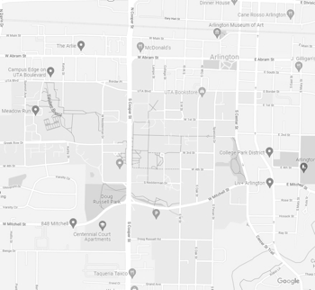
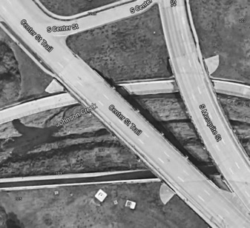


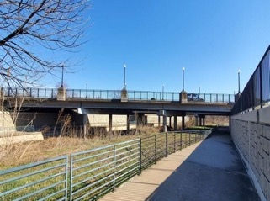
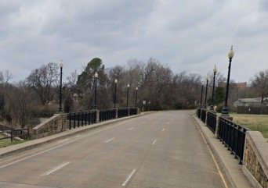
4.Methodology : Task 2C. Field test setting
Bridge location: 32.724363, -97.104853
Length: 64 m
Bridge deck: Concrete pavement
Three lane bridge
UTA
Campus
Bridge
Coordinate and view of bridge

Slide 22
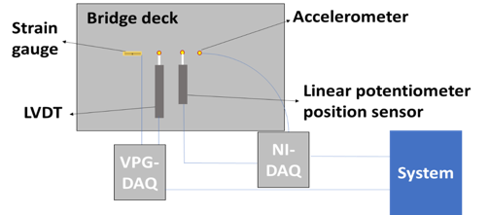
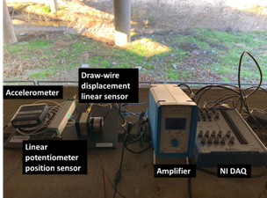
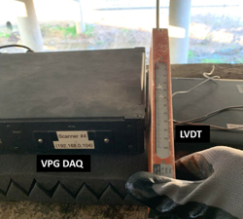
4.Methodology : Task 2C. Field test setting
The sensors are deployed on the middle lane under the bridge deck, 3m from the mid-span
Use three different weight vehicle with different speed
The research team skips traffic time to ensure that only one vehicle passes through the bridge to obtain correct sensing data
Vehicle used | Vehicle speed
Truck(9000lbs.) | 10 mph 25 mph 40 mph
Van(5950lbs.)
SUV(4455lbs.)
Sedan(4431lbs.)
Vehicle used and moving speed
Sensor configuration in field test

Slide 23
4. Methodology and Procedure
  Task 3. Develop damage prediction model

Slide 24
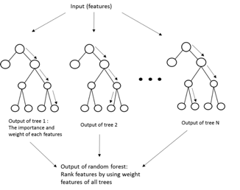
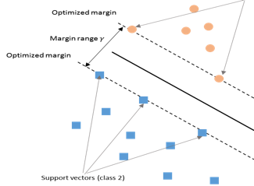
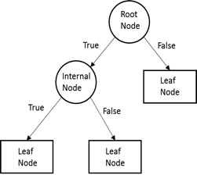
4. Methodology : Task 3B. Damage prediction model
ML algorithm applied in this project:
1) Decision tree (DT): By giving certain threshold(e.g., entropy), DT can classify data into different classification
2) Support vector machine (SVM): SVM is used to find the optimized hyperplane with the largest margin range to define the best classification of data
3) Backpropagation (BP): In BP, the error of each neuron is re-calculated in “back direction” to improve the accuracy of prediction results by updating the weight.
4) XGBoost: Also known as extreme gradient boosting, which is improved from random forest by using the first and second-order derivative of Taylor polynomial
SVM
DT
XGBoost
Notes:
Briggs, D. J., de Hoogh, C., Gulliver, J., Wills, J., Elliott, P., Kingham, S., & Smallbone, K. (2000). A regression-based method for mapping traffic-related air pollution: application and testing in four contrasting urban environments.

Slide 25
4. Methodology: Step 3A. Develop damage prediction model (Data feature)
The input of ML model is called feature, which displays the importance of variables is known as structural response from FE simulation
Feature could be variables(e.g., structural response) or statistical indicators
Statistical indicator

Slide 26
5. Results:

Slide 27
5. Results: Laboratory results and FE results
Draw-wire displacement linear sensor resolution is not good enough for field test
FE model results is verified with laboratory test
Low Resolution
Acceleration
Strain
(Mid-span)
Deflection results between FE simulation and laboratory test
Laboratory signal

Slide 28
5. Results: Field results
Find patterns between vehicle s and speed in BWIM data:
  lower speed has more displacement variations (bottom figure a)
  Vehicle weight affect peak displacement, while speed does not affect displacement (bottom figure b)
Vehicle first contact
End of displacement
Time period of Displacement
Peak of displacement
The displacement data from field test
1) truck, 2) van, 3) SUV and 4) sedan,
9002(lbs.), 5952(lbs.), 4452(lbs.), 4431(lbs.)
of GVW
Time period of Displacement
Figure (a)
Figure (b)
Data analysis with all field test data with three different speed and four different vehicle weight)

Slide 29
5. Results: Field test and FE simulation results
Verified moving-load FE model with field test data: FE model can simulate actual BWIM data collected from field test
Displacement
Displacement
Data samples
Data samples
The displacement data from field test (sedan vs van)

Slide 30
5. Results: In-depth FE study and analytical results
After comparison FE result with field test results, the FE model is used to create database for ML.
The parameter study of FE and VBI results, which are Elastic modulus, density, depth, and width. The detail value used for FE model as shown below.
Contact parameters

Slide 31
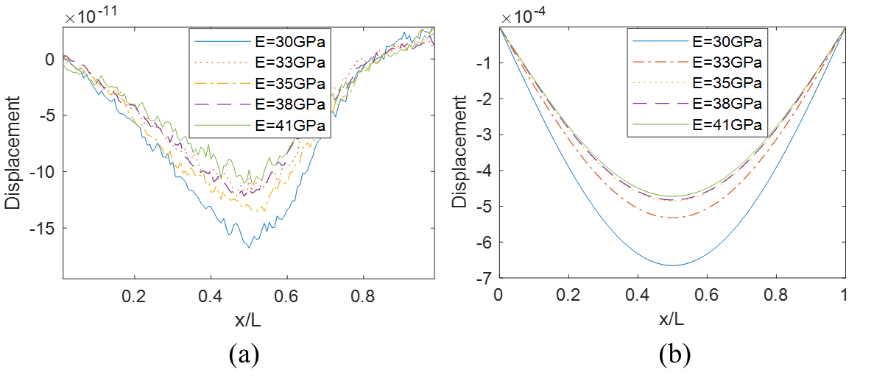
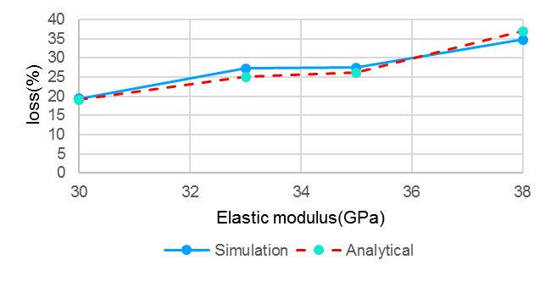
5. Results: FE and analytical results (Elastic modulus)
The trend of structural response is similar between FE and analytical solution.
The Energy loss also demonstrates good similarity between two approaches.
(a) FE simulation
(b) Analytical solution
(c) The loss(%) of maximum displacement calculated from different Elastic modulus cases
The bridge displacement with different Elastic modulus

Slide 32
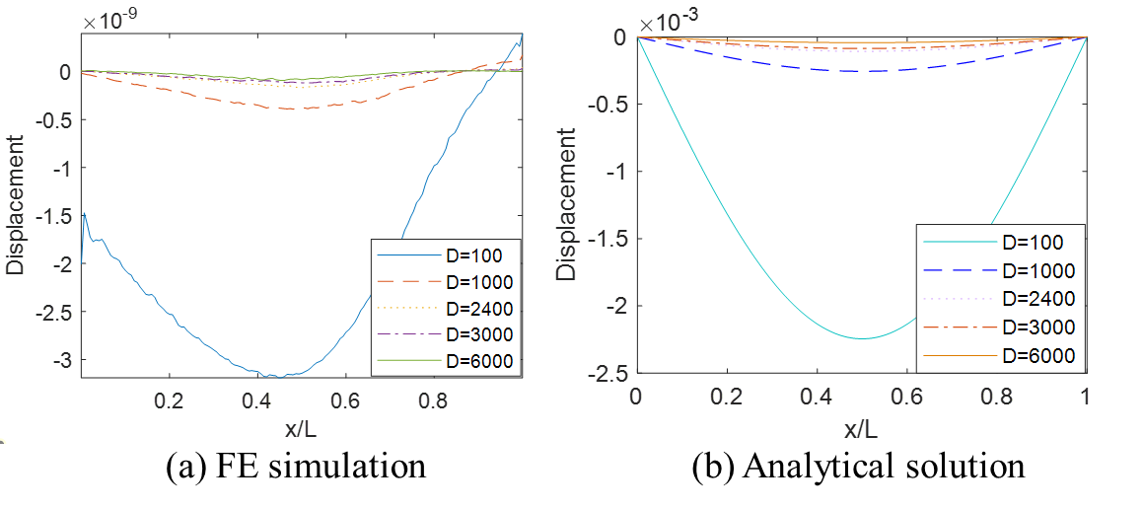
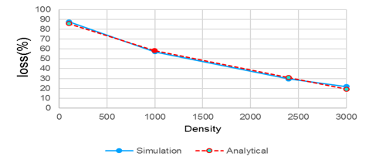

5. Results: FE and analytical results (Density)
In figure(a), the negative displacement happened when $x/L=0$, because the moving element density is 700$\frac{kg}{m^{3}}$ which more than bridge density 100$\frac{kg}{m^{3}}$.
(a) FE simulation
(b) Analytical solution
(c) The loss(%) of maximum displacement

Slide 33



5. Results: FE and analytical results (Depth)
H
(c) The loss(%) of maximum displacement
between different depth cases

Slide 34

5. Results: FE and analytical results (Width)
b
(a) FE simulation
(b) Analytical solution
(c) The loss(%) of maximum displacement
calculated from different width cases

Slide 35

5. Results: Feature selection
The relative importance over 0.3 are used as input to train damage prediction model.
The rank of relative importance for all features
Features
Relative importance(Normalized)

Slide 36

5. Results: Damage prediction
Total test data: 270
Real class number(30% randomly choose from database):
Healthy(75+1+2)=78
Mild(4+39+5+6)=54
Moderate(4+61)=65
Severe(4+69)=73
(From FE model)
75/79=94.9%, which means ML provides “healthy” class with 94.9% accuracy.
How many data set
(e.g., peak freq. )
75/270=27.7%
75/78 = 96%
Model accuracy:
27.7%+14.4%+22.6%+25.6%
= 90.3%
(From ML result)
(a) BP
These data(2 data) should be “healthy”
but ML give wrong classification to “Severe”
69/73=94.5%, which means for “severe”, ML has 94.5% accuracy of prediction

Slide 37




5. Results: Damage prediction (static load case)
XGBoost shows the highest accuracy, which about 92.6% of the correct rate of damage prediction.
(a) BP
(b) SVM
(c) DT
(d) XGBoost
Damage prediction results (static load case)

Slide 38




5. Results: Damage prediction (moving load case)
XGBoost shows the highest accuracy, which about 83.3% of the correct rate of damage prediction.
(a) BP
(b) SVM
(c) DT
(d) XGBoost
Damage prediction results (moving load case)

Slide 39
6. Conclusion
Developed a moving load FE model to simulate vehicle motion with contact method and finished the comprehensive parameter study of the FE model, which verified with VBI analytical solutions, and comparatively studied ML methods for damage prediction
Major Findings:
Among four different ML models, XGBoost brings the highest damage prediction accuracy, with 92.6% accuracy for the static load model and 83.3% accuracy for the moving load model
The contact method used to simulate moving load is feasible, which the structural responses are verified with VBI analytical solution with comprehensive parameter studies. The energy loss (%) of maximum displacement between FE simulation results and VBI analytical solution shows a similar value
Feature selection is required for ML to avoid overfitting and minimize the situation where the ML prediction model is not well trained to increase the accuracy of damage prediction
The prediction accuracy of moving load is lower than static load accuracy because the structural response with moving load is much more complicated than the response in static load model

Slide 40
Thank You
Suyun Ham, Ph.D.
Director of the Smart Infrastructure and Testing Laboratory (SITL)
Associate Professor of Structural Engineering and Applied Mechanics
Department of Civil Engineering
The University of Texas at Arlington
Tel: 817-272-5217
Email: s.ham@uta.edu

