Slide 1
PANEL CO-SPONSORED BY HRA SOCIETY: The Diamond Anniversary of HRA
THERP at 60 Years
Ronald Boring (INL)
Katrina Groth (UMD)
Andreas Bye (IFE)
Jeff Julius (JensenHughes)

Slide 2
Format for Panel
Each individual panelist will make opening remarks (ca. 10 minutes)
Ron Boring
Katrina Groth
Andreas Bye
Jeff Julius
We will then open it up for audience comments, questions, and discussion

Slide 3
Opening Remarks Ron Boring, PhD, FHFES Manager, Human Factors and Reliability Department Idaho National Laboratory

Slide 4
Wasn’t It Just Yesterday?
The HRA Society celebrated the Golden (50th) Anniversary of THERP at PSAM in Seattle in 2012
Let’s revisit some of the thoughts from that time
Chance for me to reuse ten-year-old slides! ☺
Let’s see if anything has changed in those ten years

Slide 5
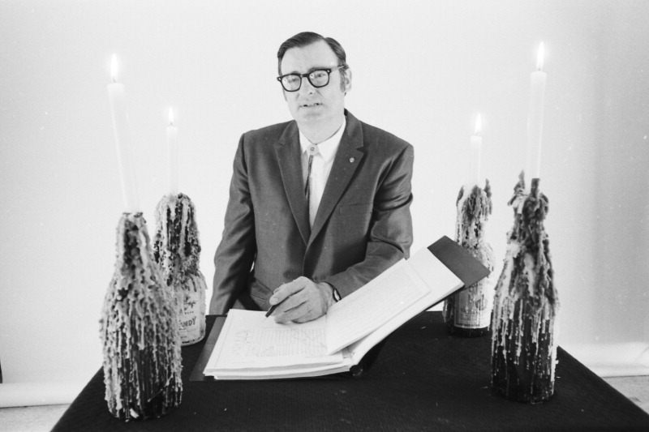
In Memoriam
Dr. Alan D. Swain, III
November 21, 1923 – November 2, 2021
Served as radioman-navigator for U.S. Navy in World War II
MA in 1948 and PhD in 1953 in Psychology from the Ohio State University under Paul Fitts
Worked for American Institute of Research before joining Sandia National Laboratories in 1961
Considered to be the founder of human reliability analysis

Slide 6
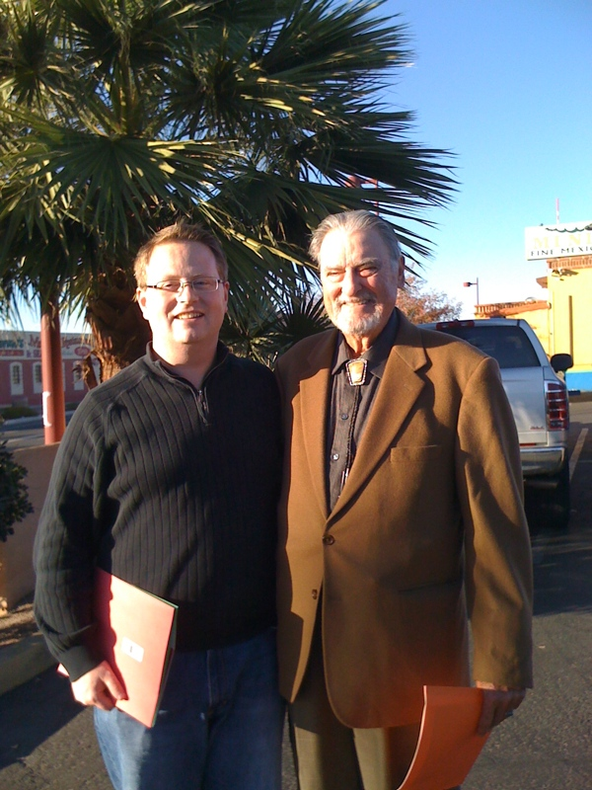
A Personal Dedication
At the 2008 Human Factors and Ergonomics Society Conference, I gave a talk on HRA and referred to him as the ”late” Alan Swain
His son in law, Michael Rodriquez, was in attendance and told me he certainly hoped Alan was still alive, because he was at home watching the grandkids
I began correspondence and met him once in Tucson in December, 2009
Alan would want nothing to do with deifying him at his passing, but I—like many of you—thank him for paving the way for my own career in HRA

Slide 7
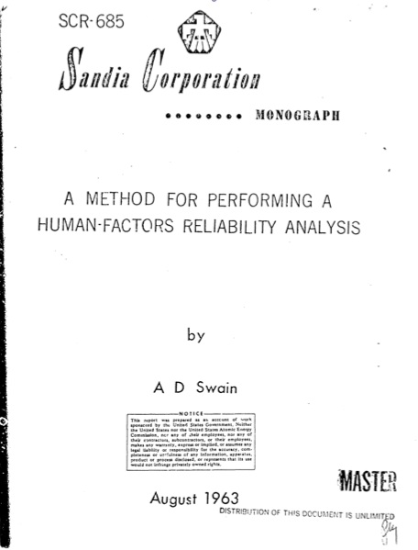
The Birth of HRA
1962: Human Factors Conference symposium of human error quantification
First published mention of a Technique for Human Error Rate Prediction (THERP)
1963: Sandia monograph outlining basic THERP quantification
1964: Human Factors journal, Volume 6, Issue 6, “Special Issue on Quantification of Human Performance”
Included contributors from across weapons and military aviation industry

Slide 8
Context
Early HRA and THERP work was focused on ensuring safety of assembling and handling nuclear weapons
U.S. Nuclear Regulatory Commission and U.S. Department of Energy were not split off for several decades from U.S. Atomic Energy Commission
Interest in using HRA for nuclear power applications did not come until 1970s

Slide 9
Alan Swain’s Own Observations on THERP’s History
1960s: main emphasis was on collecting data
Sandia Human Error Rate Bank (SHERB, with Rigby) database
Equally interested in predicting human success and human error
c. 1970: Jens Rasmussen invited Alan Swain to Risø National Laboratory to discuss use of HRA for nuclear power
Rasmussen very impressed with Swain’s insights into nuclear power operations
Two years later, Swain finally was able to take a course on nuclear engineering
1975: WASH-1400 articulated THERP approach for nuclear power
1983: NUREG/CR-1278 formalized approach for nuclear power

Slide 10
1983 Was Not the End!
1983: NUREG/CR-2254, A Procedure for Conducting a Human Reliability Analysis for Nuclear Power Plants
1987: NUREG/CR-4772, Accident Sequence Evaluation Program (ASEP)
Refinements to THERP procedure for weapons work at Sandia
1992: Swain retires, but continues consulting with industry and making minor revisions on THERP in courses he teaches until 2005

Slide 11
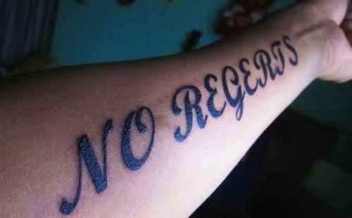
“There should have been many more changes had the research been done to develop more hard data on HEPs for human tasks. That failure has been a disappointment to me.…I always said that the data tables in [THERP] were not written in stone, and I was not Moses coming down from a mountain with these tables so inscribed.”

Slide 12
Foundations of HRA are in THERP
Human Error Identification (Qualitative HRA)
Task analysis approach
Human failure events
Performance shaping factors
Human Error Quantification (HEP)
Nominal HEP and error factor
Basic HEP: Adjustment for PSFs
Conditional HEP: Adjustment for dependence
PRA Integration
HRA event tree designed for integration into PRA
Recovery
Pre- and post-initiating events

Slide 13
Acknowledged Limitations of THERP
It’s showing its age
Predates modern plant technologies like digital HMIs or automation
Psychologically, mostly behaviorist, and doesn’t thoroughly address cognition
It’s very centered on nuclear power
Lookup tables make it hard to generalize THERP to new domains
It’s pretty focused on control room operations
Doesn’t cover balance of plant nor severe accidents
It has a very constrained list of PSFs and doesn’t address context very well
It has limited treatment of errors of commission
The quality of its underlying data for quantification is questionable
Documentation gaps for data sources
Its model of dependence is cumbersome and possibly inaccurate

Slide 14
Is THERP Still Relevant?
It’s still widely used
Integral part of execution calculation in EPRI HRA Calculator used by every plant in U.S.
It returns half a million hits on Google, and 59,200 with its full name spelled out
It is used in new plant licensing (e.g., Nuscale Power)
It’s still the benchmark for new HRA
A new HRA method needs to compare its findings to THERP
It still sets the research agenda
Many hot topics like HRA data collection are based on what THERP started
Many definitional items are unresolved since THERP
It may be more adaptable than people admit
New THERP tables might be easier than new HRA methods

Slide 15
A Modest Proposal
There are no specific awards in HRA for innovation
Wouldn’t the rightful legacy of THERP be continued innovation?
Working to set up Alan D. Swain Memorial Award for Innovation in Human Error Research
No current endowment for award (typical path) but could be funded as a recurring line item for HRA Society or IAPSAM
Does not necessarily need to be a cash award
Important point is to help encourage HRA research and evolution of methods and basic research needed to understand and prevent human error
Additionally, raise awareness of need for HRA research across multiple disciplines

Slide 16
The Legacy of THERP
THERP left us an impressive legacy
Has any subsequent HRA method topped it or just improved on it?
Its longevity of 60 years in general and 39 years as a NUREG is a testament of its tremendous significance
THERP started a field in which most of us in this room are now employed
To honor our field, we must remember where we came from
Any epistemic uncertainty about HRA can be resolved through practitioner best practices and new research

