Slide 1
Assessment of Hydrogen Plant Risks for Siting near Nuclear Power Plants
Austin Glover, Dusty Brooks, Austin Baird
SAND2022-7915 C

Slide 2
Contents
Background
Leak Frequency
Approach to Consequence Modeling
Consequence Methodology
Scenario Selection
Results at Fixed Distance
Set-back Distance
Conclusion

Slide 3
Background
Nuclear power plants (NPPs) may use flexible plant operations and generation to take advantage of excess thermal and electrical energy.
Hydrogen production through high temperature electrolysis is a feasible option for NPPs because the excess thermal and electrical energy produced through normal operation can be used to produce a carbon-free, storable energy source.
NPPs must show that the operation of such a system is safe and does not pose a significant threat to the high consequence NPP facilities and structures.

Slide 4
Background (cont’d)
Investigated the risk of a high temperature steam electrolysis hydrogen production facility (HTEF) in close proximity to an NPP for input into the plant probabilistic risk assessment (PRA)
List of components in HTEF
HAZOP for accident impact scenarios
Leak Frequency
Target Fragility
Consequence modeling
Two scenarios:
Detonation of high pressure jet
Detonation of accumulated hydrogen cloud
Two proximity evaluations
Consequence at 1 km from NPP
Minimum Separation Distance calculations

Slide 5
Leak Frequency
A Bayesian model was developed to predict the probability of a leak in various components used in an HTEF due to the limited industry data on hydrogen-specific component leakage events
The model was selected based on analysis of actual leakage data from the offshore oil industry.
Utilized published data on leakage events from non-hydrogen sources that are representative of hydrogen components to update model
The hydrogen data was used to update a second time
The Bayesian approach has several major advantages for cases in which large amounts of data are not available.
It allows for the generation of leakage rates for different amounts of leakage
It generates uncertainty distributions for the leakage rates that can be propagated through the risk assessment models to establish the uncertainty in the risk results
It provides a means for incorporating limited hydrogen-specific leakage data with leakage frequencies from other sources to establish estimates for leakage rates for hydrogen components.

Slide 6
Approach to Consequence Modeling
Purpose
Refine initial evaluation done by INL to determine at what distance a hydrogen generation plant can be located in relation to a NPP without damaging critical infrastructure
Approach
Define realistic inputs based on preliminary design of HTEF
Evaluate detonation as the consequence of leak event
Overpressure is metric for which proximity was evaluated
The other results of a leak that were not investigated include
Leak can be isolated
Escaped hydrogen can disperse
Leak can immediately ignite
Use Bauwens and Dorofeev methodology to calculate overpressure rather than TNT methodology
Only evaluated full bore leaks

Slide 7
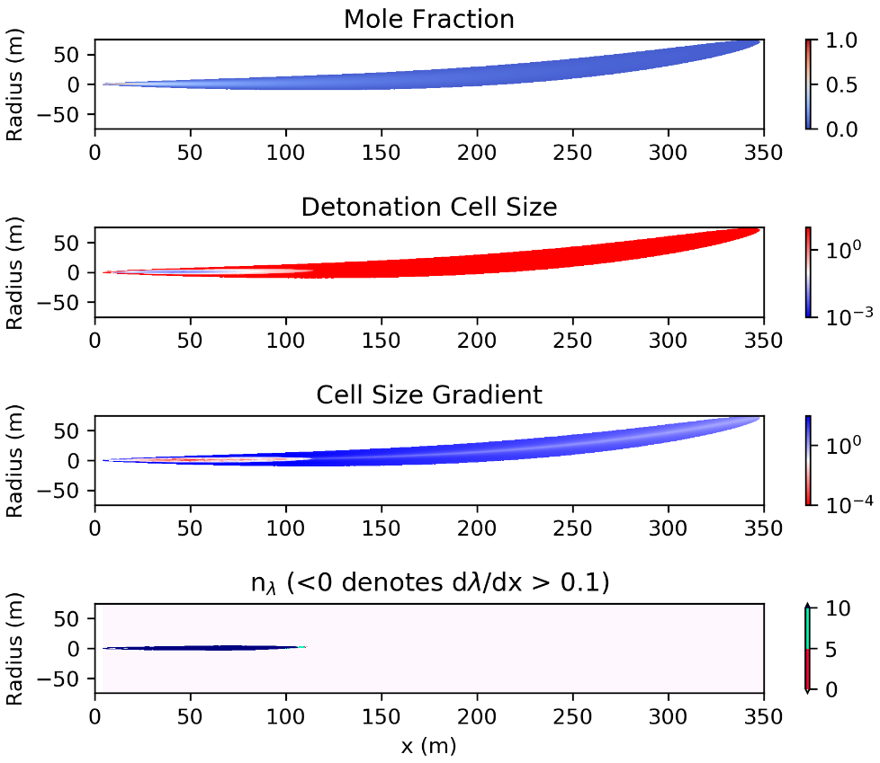
Consequence Methodology: High Pressure Jet
Detonation of high pressure jet (Bauwens and Dorofeev)
A flammable jet released from a leak could result in a detonation, which would expose nearby targets to damaging overpressure.
The cell size and concentration gradient in the jet reduce the portion of the flammable plume that is available as fuel for detonation (detonable region)
The overpressure released through detonation of the large plume can be calculated from the detonable region
The overpressure is compared to the target fragility criteria to determine if critical damage occurs

Slide 8
Consequence Calculation: High Pressure Jet
The HyRAM+ software toolkit was used to calculate the concentration of hydrogen in the high-pressure jet
HyRAM+ incorporates computationally and experimentally validated models of various aspects of hydrogen release and flame physics.
Experimental values of detonation cell size for a range of hydrogen-air mixture compositions were taken from the CALTECH Detonation Database
With the concentration and cell size define, the cell size gradient was evaluated to define the detonable region
Detonation propagation was only considered for regions in which the cell size increases by more than ~10% across a single cell length
The overpressure was estimated with a model informed by experimental studies of large-scale hydrogen jet releases that were ignited.

Slide 9
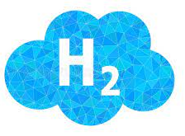
Consequence Methodology: Hydrogen Accumulation
An alternate consequence of a hydrogen leak in the HTEF system is ignition of an accumulated cloud of a hydrogen/air mixture.
If ignition/detonation of the high-pressure hydrogen jet does not occur, the hydrogen can accumulate and mix with ambient air before being ignited.
The total quantity of hydrogen released in this case was assumed to contribute to the overpressure experienced by the critical NPP structures.
The amount of hydrogen released is a function of the system flowrate at the leak location as well as the time to leak isolation.

Slide 10
Scenario Selection: High Pressure Jet
Scenario identification focused on variation of relevant variables in system
Pipe size
Pressure
Temperature
Full bore leak for each scenario was evaluated
Sections of the system carrying hydrogen were identified and evaluated
Scenario | System Section | Temperature (°C) | Pressure (MPa) | Line Sizes (mm)
1 | Mix-100 thru HX-KO1 | 735 | 0.52 | 203.2
2 |  |  |  | 254.0
3 |  |  |  | 300.0
4 | HX-KO1 thru HX-KO2 | 75 | 0.48 | 152.4
5 |  |  |  | 203.2
6 |  |  |  | 254.0
7 |  |  |  | 300.0
8 | HX-KO2 thru HX-KO3 | 75 | 1.01 | 88.9
9 |  |  |  | 101.6
10 |  |  |  | 200.0
11 |  |  |  | 254.0
12 | HX-KO3 thru K-301 | 25 | 2.23 | 88.9
13 |  |  |  | 200.0
14 |  |  |  | 254.0
15 | K-301 thru System Output | 50 | 7.00 | 200.0

Slide 11
Scenario Selection: Hydrogen Accumulation
Quantity of hydrogen released is a function of system flowrate and time to leak isolation
Identified the two systems with the largest hydrogen flowrates
Assumed a range of isolation times
Assumed 100% of the released quantity is hydrogen
Assumed hydrogen is well mixed in air
System | Flowrate (nlpm) | Isolation Time (min) | Total Hydrogen Quantity (kg)
Hydrogen Product, 93% H₂ | 750 | 5 | 0.3
 |  | 10 | 0.7
 |  | 20 | 1.3
 |  | 30 | 2.0
 |  | 60 | 4.0
 |  | 120 | 8.1
Hydrogen Product Manifold to Condenser, 62% H₂ | 1,223 | 5 | 0.5
 |  | 10 | 1.1
 |  | 20 | 2.2
 |  | 30 | 3.3
 |  | 60 | 6.6
 |  | 120 | 13.2

Slide 12
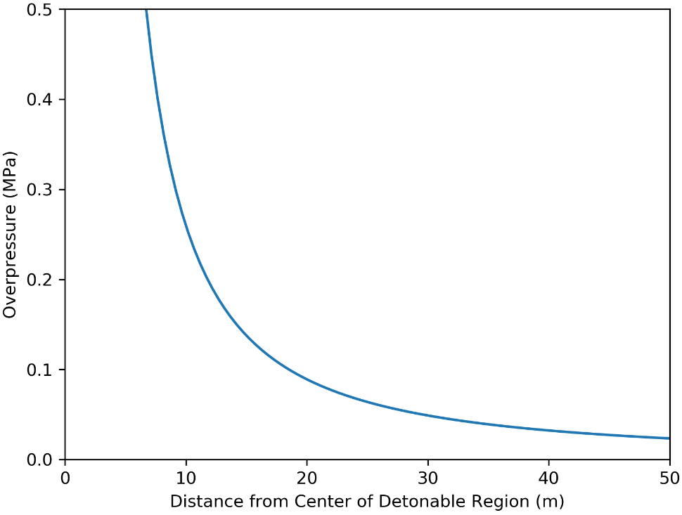
Results at Fixed Distance: High Pressure Jet
High Pressure Jet: the largest impulse overpressure at a distance of 1 km away is ~400 Pa (0.06 psi), which is well below the 1 psi fragility failure criterion.
Scenario | Overpressure at 1 km
 | (MPa) | (psi)
1 | 3.03E-05 | 0.00440
2 | 4.37E-05 | 0.00633
3 | 5.69E-05 | 0.00826
4 | 2.90E-05 | 0.00420
5 | 4.68E-05 | 0.00679
6 | 6.70E-05 | 0.00972
7 | 8.76E-05 | 0.0127
8 | 2.16E-05 | 0.00313
9 | 2.70E-05 | 0.00392
10 | 8.13E-05 | 0.0118
11 | 11.9E-05 | 0.0173
12 | 4.52E-05 | 0.00656
13 | 16.4E-05 | 0.0238
14 | 24.0E-05 | 0.0349
15 | 38.4E-05 | 0.0557
Scenario 15 is a 200.0 mm break with a temperature of 50°C and pressure of 7.0 MPa

Slide 13
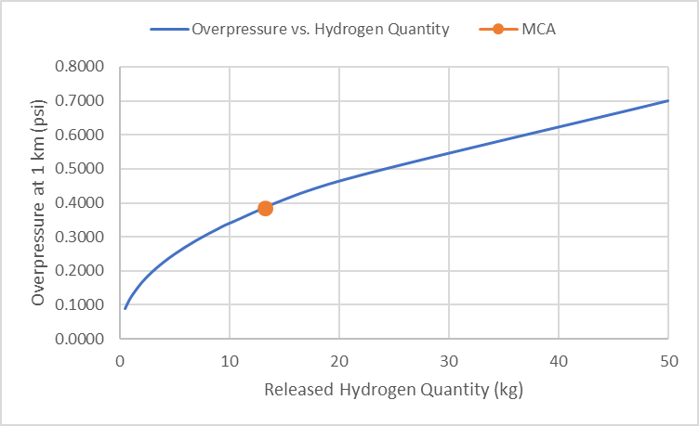
Results at Fixed Distance: Hydrogen Accumulation
Hydrogen Accumulation: the overpressure experienced at 1 km is ~ 0.7 psi for the case that estimates 50 kg of hydrogen released. When compared to the fragility criterion of 1 psi for the fragility criterion, there is more than a 40% margin.
System | Flowrate (nlpm) | Isolation Time (min) | Total Hydrogen Quantity (kg)
Hydrogen Product, 93% H₂ | 750 | 5 | 0.3
 |  | 10 | 0.7
 |  | 20 | 1.3
 |  | 30 | 2.0
 |  | 60 | 4.0
 |  | 120 | 8.1
Hydrogen Product Manifold to Condenser, 62% H₂ | 1,223 | 5 | 0.5
 |  | 10 | 1.1
 |  | 20 | 2.2
 |  | 30 | 3.3
 |  | 60 | 6.6
 |  | 120 | 13.2

Slide 14
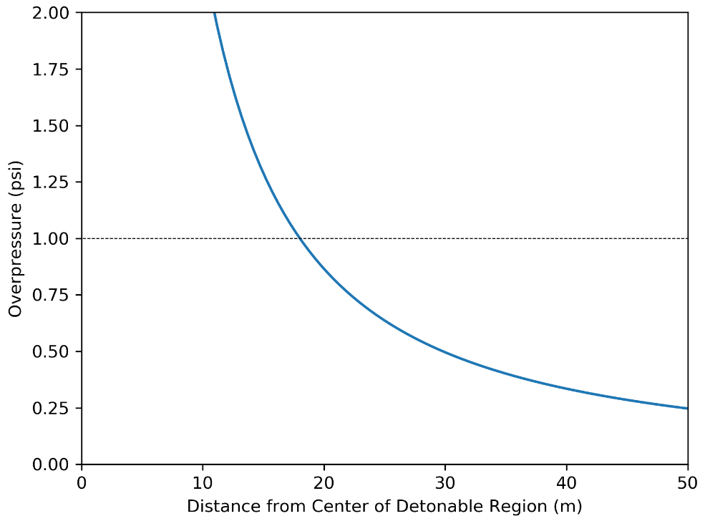
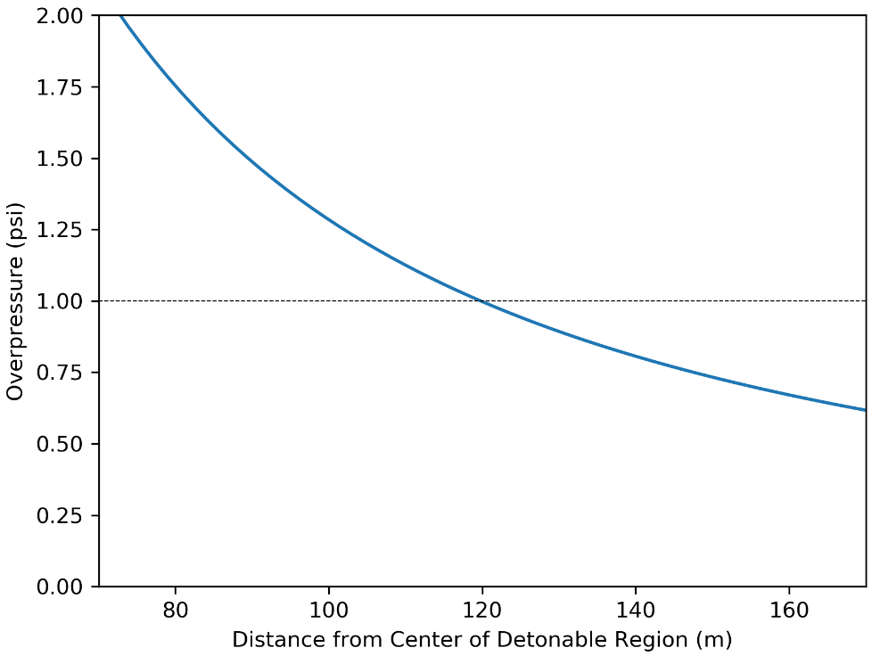
Set-back Distance: High Pressure Jet
The largest separation distance is ~120 meters away from the NPP.
Scenario 1 is a 203.2 mm break with a
temperature of 735°C and pressure of 0.52 MPa
Scenario 15 is a 200.0 mm break with a
temperature of 50°C and pressure of 7.0 MPa
Scenario | Separation Distance (m)
1 | 18.0
2 | 23.7
3 | 28.9
4 | 17.4
5 | 24.9
6 | 32.6
7 | 39.8
8 | 14.0
9 | 16.5
10 | 37.7
11 | 50.1
12 | 24.3
13 | 63.6
14 | 84.5
15 | 119.8

Slide 15
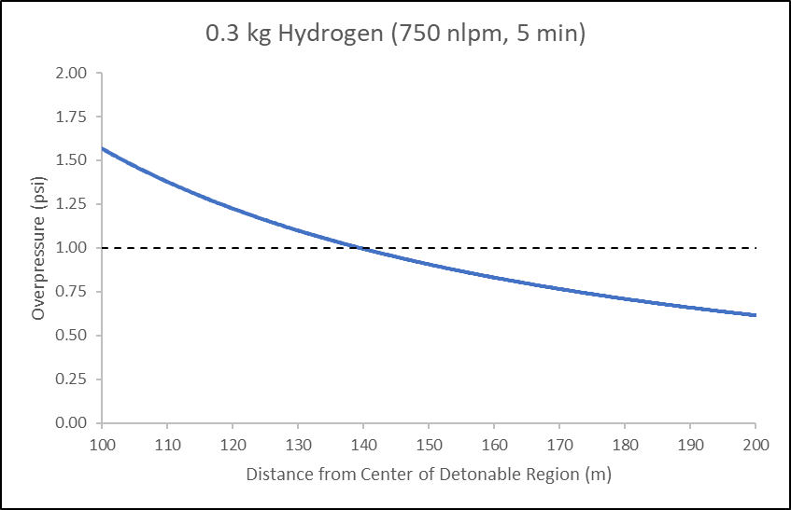
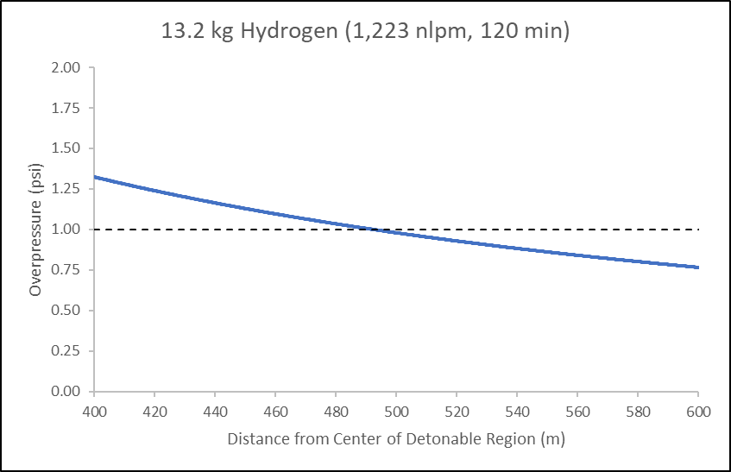
Set-back Distance: Hydrogen Accumulation
The largest separation distance is ~492.1 meters away from the NPP.
System | Flowrate (nlpm) | Isolation Time (min) | Total Hydrogen Quantity (kg) | Separation Distance (m)
Hydrogen Product, 93% H2 | 750 | 5 | 0.3 | 139.4
 |  | 10 | 0.7 | 184.9
 |  | 20 | 1.3 | 227.2
 |  | 30 | 2.0 | 262.3
 |  | 60 | 4.0 | 330.5
 |  | 120 | 8.1 | 418.2
Hydrogen Product Manifold to Condenser, 62% H2 | 1,223 | 5 | 0.5 | 165.2
 |  | 10 | 1.1 | 214.9
 |  | 20 | 2.2 | 270.8
 |  | 30 | 3.3 | 310.0
 |  | 60 | 6.6 | 390.6
 |  | 120 | 13.2 | 492.1

Slide 16
Conclusion
The consequence of a detonation does not detrimentally affect critical targets at the NPP at a distance of 1 km.
A full rupture leak was evaluated at different locations in the HTEF system with varying line sizes and system pressures.
Also, the consequence of detonation of the high-pressure jet release of hydrogen and the detonation of accumulated hydrogen were evaluated as worst-case scenarios.
The largest overpressure seen at a distance of 1 km away from the accident location was ~0.06 psi for detonation of the high-pressure hydrogen jet and ~0.4 psi for detonation of the accumulated hydrogen cloud.
The maximum set-back distance for the high pressure jet and hydrogen accumulation scenarios were 120 m and 492 m, respectively
This does not challenge the fragility criteria of the critical targets.

Slide 17
Questions

