Slide 1
RI309
Thermal and Electrical Coupling to Electrolysis Plants
Tyler Westover
Richard Boardman
Stephen Hancock
Kurt Vedros
  July 2022

Slide 2
Flexible Plant Operation and Generation Pathway

Slide 3
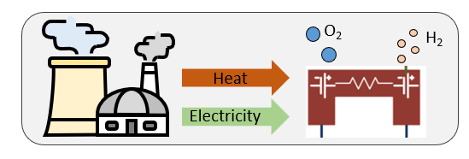
Why Couple a Light Water Reactor to a Solid Oxide Cell (SOC) Hydrogen Plant?
Hydrogen is useful to decarbonize industries that cannot be decarbonized with electricity alone:
  Heavy transportation, aviation, fertilizer, steal, cement, synthetic fuels, heating, etc.
SOC systems are advantageous because they use low-pressure steam at approximately 250 °F to increase efficiency and reduce hydrogen production costs (system efficiency >85% on a lower heating value basis)
  Full benefit of SOC technology requires electrical and thermal coupling between LWR and H₂ plant (ratio of thermal/electric power is ~1/4)
SOC systems are dispatchable, so that they provide an offtake for energy when the price of electricity is lower than the production cost.
Notes:
Compared to steam methane reforming (SMR), it is more efficient. Roughly, ~30% more efficient, but the comparison is difficult because they are very different processes. SMR has larger thermal losses associated with processing natural gas to hydrogen.

Slide 4
SOC TECHNOLOGY OVERVIEW
Steam flows through fuel electrode (anode) side where O⁻ is stripped and pulled through electrolyte to air stream
Air flows through air electrode (cathode) side and removes excess O₂
Electrodes operate at 700-800 ºC
  Steam & air flow through separate heat exchangers to cool products and preheat reactants
A small amount of H₂ is recycled to protect catalysts in electrodes
Reaction in the electrode cells is >98% efficient
  Largest losses are H₂ compression, AC/DC power rectification, blowers, and thermal losses.
LWR can provide both electricity and steam for H₂ production
Simplified process flow diagram for high temperature streams in a SOC system

Slide 5
Coupling Design Options
Design Option #A: Extract steam from main steam line
For high levels of thermal power extraction or for applications in which high temperature steam is required (>400 ºF)
Design Option #B: Extract steam downstream from high pressure (HP) turbine
  For lower levels of thermal power extraction or for applications in which low temperature steam is sufficient (<360 ºF)
Both options send steam to a reboiler that condenses secondary steam and generates tertiary steam to send to hydrogen plant
Secondary condensate is returned to main condenser
Option B
Option A
Pump
Reboiler
Simplified diagram of PWR/SOEC plant thermal power coupling options
Notes:
S&L preconceptual design indicates 100 MW thermal is reasonable for Option B but would require some modification, especially to account for pressure drop in the heat drain tank (see slide 11).

Slide 6
Approach: 3 Methods
Method #1: Full-scope, high fidelity generic PWR simulators (GSE Systems®)
  Support probabilistic risk assessments (PRAs), design-basis accident scenarios investigation, and technoeconomic assessments (TEA);
  Can capture realistic coupling between NPP and industry power user but are difficult to integrate with physical experiments & hardware
Method #2: Reduced-order (RO) generic PWR simulators
  Can be readily scaled and modified to match experimental systems for hardware-in-the-loop studies that probe vital system-system & human-system interactions that can be missed in purely digital simulations;
  Easier to share with partners for collaborations and stakeholder engagement
Method #3: Preconceptual engineering design (Sargent & Lundy, Westinghouse, etc.)
  PEPSE (Performance Evaluation of Power System Efficiencies) heat balance model of an existing four-loop Westinghouse PWR;
  ETAP (Electrical Transient Analyzer Program) electrical power system model was prepared to evaluate the power flow and short-circuit impacts of the H2 plant electrical tie-in;
  First project focuses 100 MW nominal SOC plant (25 MW_{t})
Full-scope simulators have 1,000+ parameters
Reduced-order simulators have ~50 parameters
Preconceptual design is based on engineering analysis
Notes:
RO built in both python with some Matlab. Current RO model is steady-state, but we are adapting it to be transient.
Next slides discuss results from each of these methods.

Slide 7
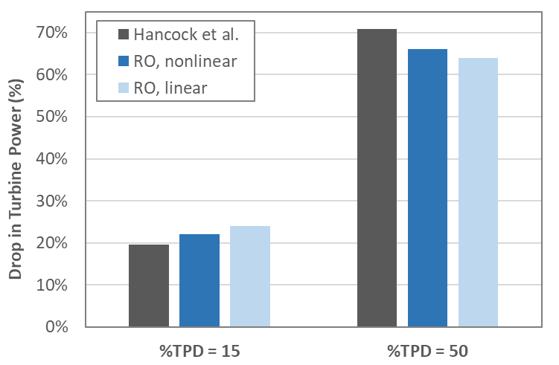
Methods #1 & 2: Full-scope & Reduced-Order (RO) PWR Simulators (Design Option A)
Drop in turbine power
As expected, power output from the turbine system decreases as steam flow to the hydrogen plant increases
Discrepancies between all simulations are less than 7% of the full turbine power output
  “RO-linear”: Reduced-order model that assumes pressure drops in components are linear
  “RO-nonlinear”: non-linearities added to pressure drops to better match full-scope simulator
Extracting 50% of the steam from the main steam line causes the turbine power to decrease more than 65%.
Traditional HSSL Control Room Modernization
Predicted decreases in turbine power output for extracting approximately 15% and 50% of the steam from the main steam line (Option A) as predicted by full-scope simulator (Hancock et al.) and linear and non-linear reduced-order (R-O) simulators.
Notes:
This slide shows the predicted decreases in turbine power output for extracting approximately 15% and 50% of the steam from the main steam line (Option 1) as predicted by the two models.
Two different versions of the reduced order (RO) model were employed.
In one version, all of the pressure drops in the plant lines and components were assumed to be linear (RO-linear) and in the other (RO-nonlinear), non-linearities were introduced into the pressure drops to better replicate the mass flows that were predicted by the high-fidelity, full-scope simulator (Hancock, et. al).

Slide 8
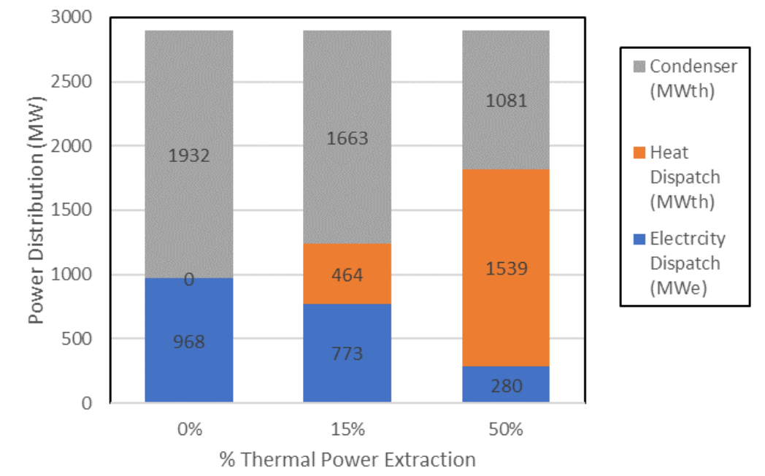
Methods #1 & 2: Full-scope & Reduced-Order PWR Simulators: (Design Option A)
Thermal power destination
15% thermal power extraction:
  Total power output increased from 968 MWe to 773 MW_{e} plus 464 MW_{t} (1241 MW_{e+t}), resulting in an overall thermal efficiency of 41.9%
50% thermal power extraction:
  Electrical output decreased from 968 MWE to 280 MWe (70% reduction)
  Overall thermal efficiency increased 60.1%
  Power dissipated by condenser decreased from 1,932 MW_{t} to 1,081 MW_{t} (nearly 50% reduction).
Traditional HSSL Control Room Modernization
Summary of thermal power destination for pure electric power dispatch (0%) thermal power dispatch, and mixed-mode operations with 15% and 50% thermal power dispatch
Notes:
Assuming the steam sent to the hydrogen plant can be used with 95% efficiency, the efficiency of the integrated PWR/SOEC system can be estimated as shown here.
For 15% thermal power extraction, the total power output of the PWR increased from 968 MWe to 773 MWe plus 468 MWth (1241 MWe+th), resulting in an overall thermal efficiency of 41.9%
Similarly, the combined power output of the nuclear plant during 50% thermal power extraction also increased, yielding an overall thermal efficiency of 60.1%, even though the net electrical output decreased to 30% of the full power output when 50% of the steam was extracted.
For 50% thermal power dispatch, the power dissipated by the condenser decreased from 1,932 MWth to 1,081 MWth, indicating that the amount of heat that is rejected to the environment decreased by nearly 50%.

Slide 9
Method #3: Preconceptual Design (Sargent & Lundy / Westinghouse) (Option B)
Steam from secondary plant is diverted to a steam reboiler, where its thermal energy is used to boil demin. water into steam. The steam generated within the reboiler is sent to the H₂ production facility. Steam condensed within the reboiler is sent to the main condenser.
Electricity is dispatched thru a new connection on high side of generator step-up (GSU) transformers. A motor-operated disconnect switch, a circuit breaker, and new high-V transmission line carry diverted electricity to the H₂ production facility.
Control of the electrical and mechanical equipment is predominantly accomplished within an H₂ Interface Enclosure, while operators in the main control room (MCR) have direct control of the steam extraction and electrical dispatch.
Thermal power destination
Traditional HSSL Control Room Modernization
Option B
Option A
Simplified diagram of Option B

Slide 10
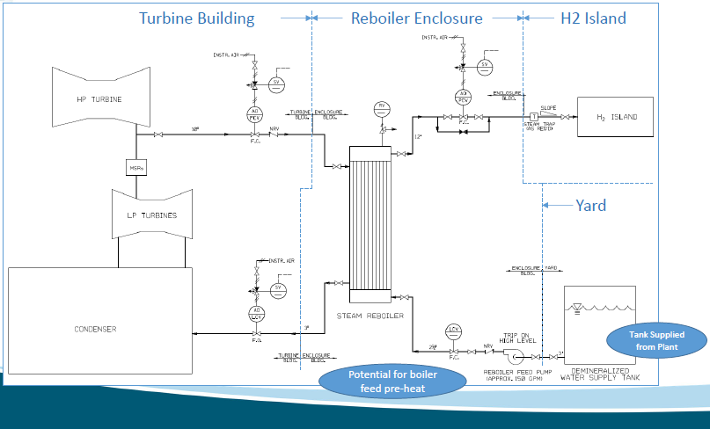
Method #3:
Continued…
Westinghouse 4‐loop pressurized water reactor rated at 1200 MW_{e} nominal
Traditional HSSL Control Room Modernization
Notes:
Layout of design

Slide 11
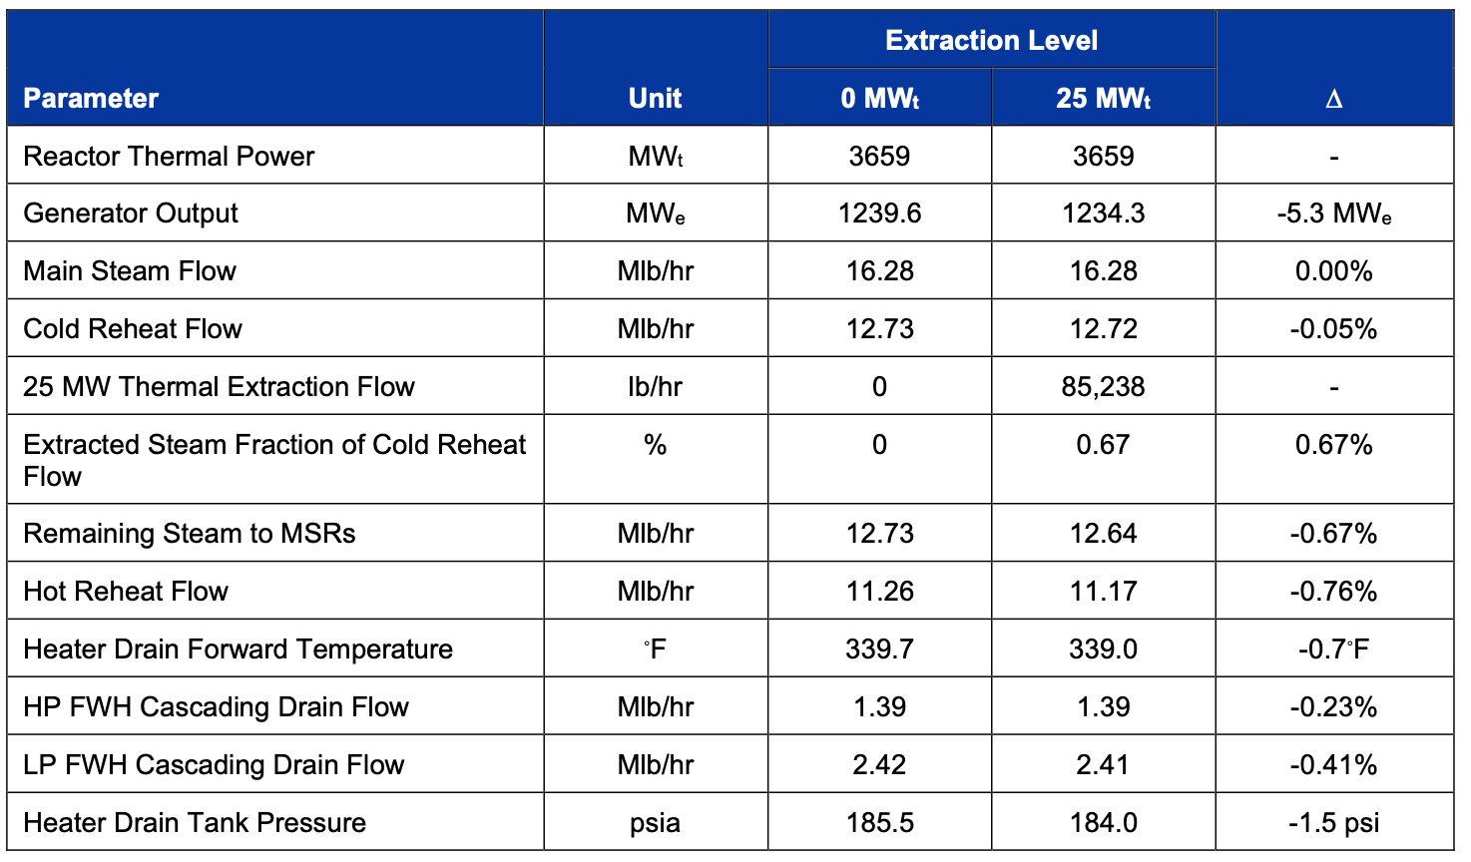
Method #3:
Continued…
Table 4-1. Summary of Important System Parameters for 25-MWt extraction.
Source: SL-106181, Rev0A 0 DRAFT)
Operation diverts 0.67% of the total cold reheat flow and reduces the hot reheat flow to the low-P turbines by approximately 0.76%.
Heater drain tank pressure decreases 1.5 psia
These changes are not expected to cause any significant burden on the existing plant operation.
Traditional HSSL Control Room Modernization
Notes:
Note: Cascading drain conditions are averaged. Individual FWDH drain lines may have higher variations in conditions.

Slide 12
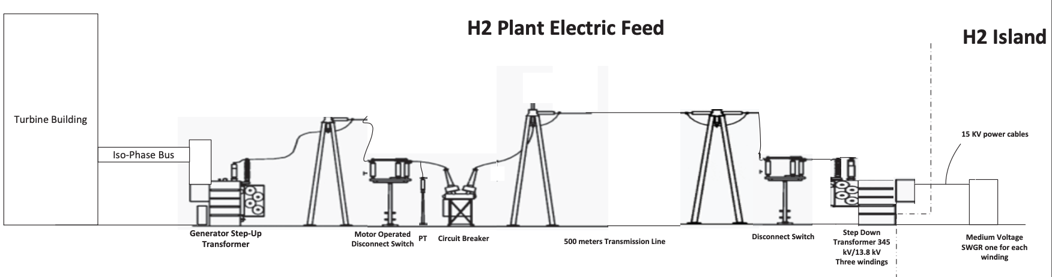
Method #3: Continued
Electrical Design. The preferred electrical system tie-in point is high-voltage side of the main GSU transformer. The electrical feed consists of a motor-operated disconnect switch, high-voltage circuit breaker, and high-voltage transmission line. For a total apparent power rating of 140 MVA transmitted to the H₂ plant, the current rating of the high-voltage equipment must be in the range of approximately 162 A-350 A, considering a nominal transmission system voltage in the range of 230 kV to 500 kV.
  Well within typical rating of available high-voltage electrical equipment.
Traditional HSSL Control Room Modernization
Notes:
Assumin

Slide 13
Future Directions
Full-scope & Reduced-order Simulators (Methods #1 & #2; Option A)
  Update simulators with automatic control system design
  Update simulators to match Sargent & Lundy Preconceptual Design (Option B)
  Add high fidelity simulation of H₂ plant for realistic electrical and thermal power coupling
Sargent & Lundy / Westinghouse Preconceptual Design (Method #3)
  Complete preconceptual design for 25 MW_{t} and perform sensitivity studies for 100-500 MW_{t}
  Estimate installation costs
  Perform 10 CFR 50.59 evaluation
Work with Partners to Develop Site-Specific Conceptual Designs
  Prepares for coupling of light water reactors with SOC hydrogen plants, potentially in a future Regional Hydrogen Hub.

Slide 15
Thermal Dispatch Modifications
Thermal-hydraulic two-phase models are generated using a GSE Systems software (JADE, Jtopmeret) which creates the FORTRAN source code from the designed system geometries
In each case, the model interfaces with the main steam header of the nuclear power plant, to extract high pressure steam prior to the high pressure turbine
The targeted extraction rate is 15% of the main steam flow
The extracted steam is used to generate process steam for the process plant on-site at the nuclear plant, with a transport pipeline to the process plant

Slide 16
Extraction Steam Line (XSL)
Source: Hancock, S.; Westover, T.; Luo, Y. Evaluation of Different Levels of Electric and Thermal Power Dispatch Using a Full-Scope PWR Simulator; Idaho National Laboratory INL/EXT-21-63226: Idaho Falls, ID 2021.
Notes:
Image on the left shows where the extraction occurs in the turbine loop. Extraction from the steam generator (PWR)/reactor vessel (BWR) outlet conditions, with reinsertion at the main condenser. The process steam generation is a once through design with the DI water source pumping through the TPE system and used directly as process steam in the H2 plant in this scenario.
The image on the right shows the P&ID for the steam-to-steam TPE system. This is a representation of the system that was added to each of the simulators (highlighted in the next slide).

Slide 17
GPWR Performance for Thermal Dispatch
For the PWR, the steam turbine power must be decreased by closing the turbine governor valves, otherwise steam extraction will result in a reactor overpower scenario
To maintain reactor power at near 100% during the transition, the XSL flow control valve is manually opened in a controlled manner during the turbine power decrease to maintain a minimal difference between the Tavg and Tref values
Hancock, S.; Westover, T. Simulation of 15% and 50% Thermal Power Dispatch to an Industrial Facility Using a Flexible Generic Full‐Scope Pressurized Water Reactor Plant Simulator. Energies 2022, 15, 1151. https://doi.org/ 10.3390/en15031151
Notes:
The top image shows the three steam flows of concern, main steam generator flow, steam flow to turbine, and steam flow to the TPE (XSL) system. The steam is simply maneuvered between the two systems while maintaining a balance around the steam generator.
Scale on the y-axes of the bottom image is important. It is enhanced to show the detail in the fluctuations in reactor power. These are results from the manual operation. This shows that the reactor power is maintained near 100% and it also shows the dependence of the reactor power on the cold leg temperature of the primary loop, which is directly affected by the changes in the steam flow of the secondary loop. (These results are technically from the oil-based simulator not the steam-to-steam simulator, but they are for 15% extraction and my other figures have 15% and 50% in the same figure, which may be confusing in this context. The results are very similar since the effect on the reactor system is essentially the same).

Slide 18
GBWR Performance for Thermal Dispatch
In BWR operation, the reactor vessel pressure (steam pressure) is controlled by the turbine governor valves. Steam extraction is therefore controlled by a pressure controller instead of a flow controller as in the PWR case
Since this control was automatic, using the same pressure control as in the unmodified BWR, results for steam flow are smoother
Reactor power could be maintained below 100% by adjusting the flow rate of the coolant through the reactor core since the pressure controller alone was not sufficient to maintain the desired reactor level
Source: Hancock, S.; Westover, T.; Rhodes, J.; Yeh, H.; Smola, T.; Watson, J. Incorporation of Thermal Hydraulic Models for Thermal Power Dispatch into a BWR Power Plant Simulator; Idaho National Laboratory INL/EXT-21-64479: Idaho Falls, ID 2021.
Notes:
The top image shows the steam flows as in the PWR version.
The bottom image is included to highlight the reactor power which goes above 100% in this case. I included the recommendation of how the reactor power could be maintained below 100%, this is based on my tests with he GBWR provided to us by GSE. (The results in the figures come from the results from GSE in their report to us. They were not as concerned about reactor power as we are.)

