Slide 1
Combining BERT with Numerical Features to Classify Injury Leave Based on Accident Description
Plínio Ramos, July Macedo, Caio Souto Maior, Márcio Moura and Isis Lins
CEERMA - Center for Risk Analysis, Reliability Engineering and Environmental Modeling
Federal University of Pernambuco - Brazil

Slide 2
Introduction
Occupational accidents can lead to:
injuries to employees
financial losses
Details of event and the injured employee are usually registered as documents
Accident reports also give details about the consequences of the accidents
A complete human review of large accident database is almost impossible
NLP involves any manipulation of human language allowing to train intelligent models

Slide 3
Motivation
Investigation of injury leaves provide insights about employee unavailability and worktime loss
Injury leaves can lead to financial loss:
The company must pay the salary of the injured employee within 15 days of leave
The company may need to hire a new employee
The goal is to determine if an accident may lead to an injury leave

Slide 4
Methodology
Accident narrative
Use or not of PPE
Years of work
Figure 1. Overview of the proposed methodology.

Slide 5
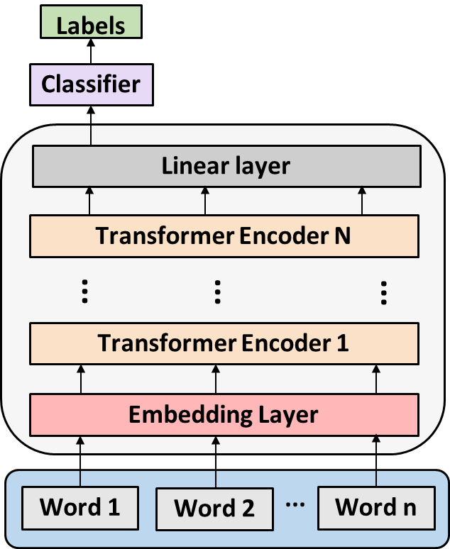
BERT
Bidirectional Encoder Representations from Transformers
12 transformer encoder layers
BERT training
Pre-training
Fine tuning
Figure 2. Overview of the BERT
Notes:
BERT is a new method of pre-training language representations proposed by Google and its architecture builds on top of 12 Transformer encoders
So, BERT training involves two phases the pretraining where the model understands language and context and the second phase is fine tuning where the model learns how to solve a specific task.

Slide 6
Case study
626 accident reports from a Brazilian hydroelectrical company
Reports are structured based on ABNT NBR 14280 - Workplace accident record
Accidents grouped into nine ‘accident agent’ classes
Table 1: ‘Accident agent’ categories.
Label | Category | Nº of documents
0 | Scaffolding | 17
1 | Duct, ditches, pipes, tunnels, pressure vessels | 17
2 | Building, structure, pole, tower, rope, cable, electrical cable, chair, drums, pulleys, tanks, cylinders, tank protection | 45
3 | Manual and automatic tools, drilling machines, sander, polisher, grinder, drill, lathe, electrical discharge machine, electrical equipment, electric arc, hydraulic or pneumatic | 126
4 | Engine, pump, turbine | 10
5 | Trip or slip | 196
6 | Chemical substance and industrialized metal, lead, mercury, zinc, cadmium, chromium, rebar, ferrous alloy | 12
7 | Commuting accidents | 149
8 | Motor vehicle, motorcycle, tractor scooter, on track, hoisting equipment | 54

Slide 7
Preprocessing dataset
Accident narrative
After parking the truck and getting out of it he did not realize that there was a gap in the ground slipping hurting his right knee
Preprocessing operation
after parking the truck and getting out of it he did not realize that there was a gap in the ground slipping hurting his right knee
Lowercasing
after parking car getting out of he did not realize that there was gap ground slipping hurting his right knee
[CLS] [after] [parking] [truck] [getting] [out] [of] [he] [did] [not] [realize] [that] [there] [was] [gap] [ground] [slipping] [hurting] [his] [right] [knee] [SEP]
DA 1
Tokenization
after parking truck getting out of he did not realize that there was gap ground slipping hurting his right knee
after parking truck getting out of he did not realize that there was gap ground slipping harming his right knee
Stopwords filtering
DA 2

Slide 8
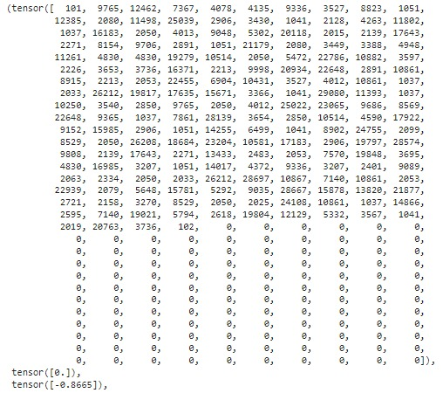
BERT and MLP applied
Figure 4. Example of tokenization and encoding concatenated vector.

Slide 9
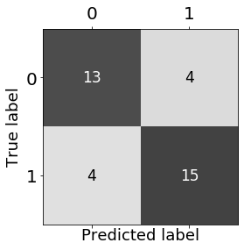
Results and discussion
Table 6. Median and standard deviation for the accuracy test set.
Measures | Median | Standard deviation
Accuracy | 73.50 % | 3.18
Table 7. Median of test data classification results for each consequence
Consequence/ Mensure | Precision | Recall | F₁-score
0 | 71.5% | 76% | 71.5%
1 | 76.5% | 74% | 74.5%
Figure 3. Confusion matrix for classification of test data with the best result.

Slide 10
Results and discussion
Table 8. Adapted reports with the higher and lower hit rates
Model input |  |  | Ground truth | Models output | Summary
Description | PPE | Years | True label | Majority predicted label | Hit rate
when the employee was executing a maneuver to remove the mechanical lock there was a sudden displacement taking the right hand with it and causing injury to the distal phalanx of the little finger | True | 45 | 0 | 0 | 10/10
the employee was storing the material for removing the ladder this one got its hooks stuck in the structure the employee went up to release it one of the hooks came loose and the ladder descended hitting the 4th finger of the left hand causing dislocation | True | 39 | 1 | 0 | 1/10

Slide 11
Conclusion
Most of the models (rounds) showed accuracy above 70%, with the best performance of 78%
The correct prediction of injury leaves can support managers to effectively deal with the costs and work replanning related to worker's absence
The reports that had a low hit rate did not have elements characterize the accidents in order to justify or not the injury leave
Limitation: Only ‘trip or slip’ accidents were analyzed. After cleaning the dataset summed up 181 reports
Future: Consider a other problems, such as predicting the number of days of injury leave and accident costs associated with injury leaves.

Slide 12
Thank you! Any questions?
Caio Souto Maior
caio.maior@ceerma.org/caio.maior@ufpe.br

