Slide 1
Quantum Fault Trees
Gabriel San Martín Silva (gsanmartin@ucla.edu)
Tarannom Parhizkar (tparhizkar@ucla.edu)
Enrique López Droguett (eald@ucla.edu)
Department of Civil & Environmental Engineering,
The B. John Garrick Institute for the Risk Sciences,
University of California, Los Angeles

Slide 2
Introduction
Engineering systems have been growing in both size and complexity for decades
New challenge in PRA: scalability and efficiency when trying to solve increasingly challenging problems
A promising field to achieve speed up and memory efficiency is quantum computing
Early exploration of quantum computing applied to Fault Trees
We propose an encoding method to represent systems as quantum circuits

Slide 3
Quantum Computing Basics

Slide 4
Quantum Information
Basic unit of classical information: on-off
$$bit=\{0, 1\}$$
Same concept, but for a quantum system:
$$qubit=\left|ψ\right\rangle =c_{0}\left|0\right\rangle +c_{1}|1⟩$$
$s.t. {\left|c_{0}\right|}^{2}+{\left|c_{1}\right|}^{2}=1$, with${ c}_{0},c_{1}∈ ℂ$
The basis states are obtained when $c_{0}=0$ or $c_{1}=0$
The qubit allow us to represent quantum mechanics phenomena such as superposition, entanglement or interference

Slide 5
Quantum Information Processing: Gates
Operations between one or more qubits are known as gates (similar to logic gates)
Mathematically, gates $u$ are represented by unitary matrices:
Its conjugate transpose $u^{†}$is also its inverse
$$u^{†}u=uu^{†}=I$$
$u$ is a complex square matrix
$u^{†}$is the conjugate transpose referred to the Hermitian adjoint
$I$ is the identity matrix
Thus, quantum gates are reversible

Slide 6
Quantum Gates
Negation: NOT gate (or Pauli-X)
$$X=\left[\begin{matrix}0 & 1 \\ 1 & 0\end{matrix}\right]$$
$X\left|0\right\rangle =\left({1 \atop 0}\right)$ $\left[\begin{matrix}0 & 1 \\ 1 & 0\end{matrix}\right]=$ $\left({0 \atop 1}\right)=\left|1\right\rangle$

Slide 7
Quantum Gates
Superposition: Hadamard gate
$$H=\frac{1}{\sqrt{2}}\left[\begin{matrix}1 & 1 \\ 1 & −1\end{matrix}\right]$$
$$H\left|0\right\rangle =\frac{1}{\sqrt{2}}\left(\left|0\right\rangle +\left|1\right\rangle \right)$$

Slide 8
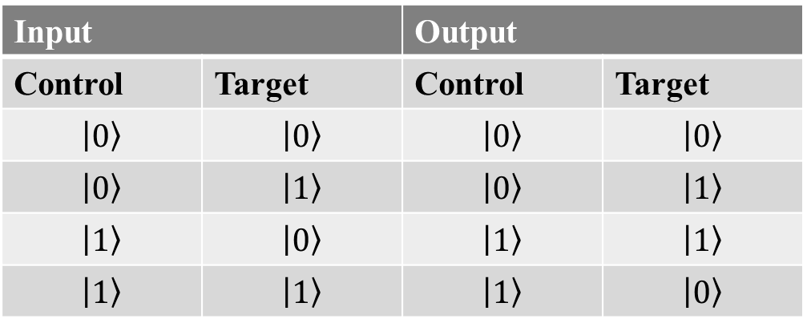
Quantum Gates
Entanglement: C-NOT gate.
The C-NOT gate acts on a two-qubit system, generating a dependency relationship
$$C−NOT=\left[\begin{matrix}1 & 0 & 0 & 0 \\ 0 & 1 & 0 & 0 \\ 0 & 0 & 0 & 1 \\ 0 & 0 & 1 & 0\end{matrix} \right]$$

Slide 9
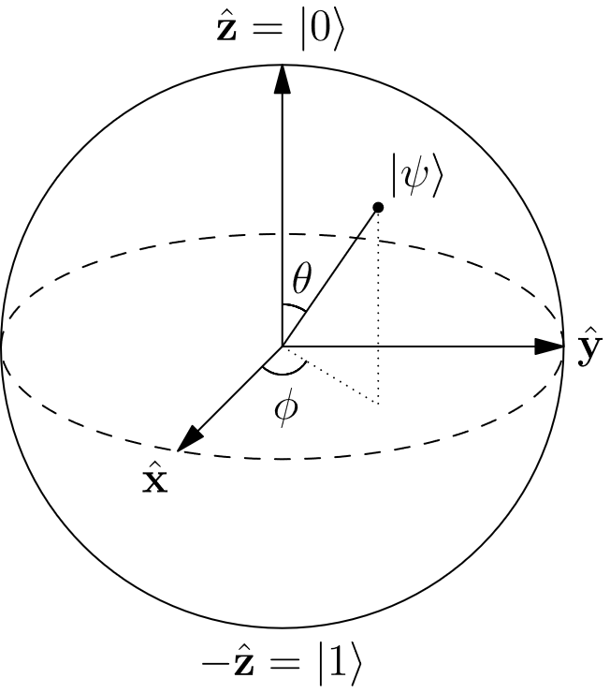
Rotation Gates: The Bloch Sphere
It is useful to represent a single qubit as a point in a unitary sphere (Bloch Sphere).
Naive representation: 4 parameters
$$c_{0}=a+bj; c_{1}=x+yj$$
It can be shown that these 4 parameters can be reduced to 2 free parameters [1]
This is useful for a fundamental set of gates: the rotation gates.

Slide 10
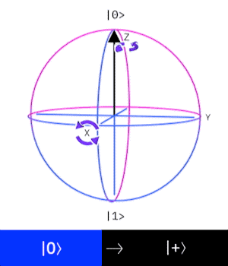
Rotation Gates
The rotation gates generate a shift of angle $ξ$ in any of the three axis of the Bloch sphere:
$$R_{x}\left(ξ\right)= \left[\begin{matrix}\cos{\frac{ξ}{2}} & −i\sin{\frac{ξ}{2}} \\ −i\sin{\frac{ξ}{2}} & \cos{\frac{ξ}{2}}\end{matrix}\right]$$
$$R_{y}\left(ξ\right)= \left[\begin{matrix}\cos{\frac{ξ}{2}} & −\sin{\frac{ξ}{2}} \\ \sin{\frac{ξ}{2}} & \cos{\frac{ξ}{2}}\end{matrix}\right]$$
$$R_{z}\left(ξ\right)= \left[\begin{matrix}e^{−i\frac{ξ}{2}} & 0 \\ 0 & e^{i\frac{ξ}{2}}\end{matrix}\right]$$

Slide 11
Quantum Representation of Logic Gates

Slide 12
Quantum Circuits
A measurement operation is performed, collapsing the qubit towards one of the states
Start with a qubit in state 0 (deterministic)
$$ψ=\left|0\right\rangle$$
$$H$$
$$X$$
$$R_{y}(ξ)$$
$$P\left(0\right)={\left|α\right|}^{2}$$
$$P\left(1\right)={\left|β\right|}^{2}$$
A series of gates are applied, modifying the quantum state to $ψ=α\left|0\right\rangle +β\left|1\right\rangle$

Slide 13
Quantum Circuits
$$P\left(00\right)=γ_{1}$$
$$ψ_{1}=\left|0\right\rangle$$
$$H$$
$$R_{y}(ξ)$$
This notion can be extended to a 2-qubit system, capable of encoding 4 different states.
$$P\left(01\right)=γ_{2}$$
$$ψ_{2}=\left|0\right\rangle$$
$$H$$
$$CN$$
$$R_{X}(ξ)$$
$$P\left(10\right)=γ_{3}$$
$$P\left(11\right)=γ_{4}$$
$$ψ_{1}=\left|0\right\rangle$$
$$H$$
$$R_{y}(ξ)$$
$$P\left(s_{1}\right)=γ_{1}$$
$$P\left(s_{2}\right)=γ_{2}$$
In the general case, quantum circuits are formed by $N$ qubits, encoding $2^{N}$ possible states → Exponential representation!
$$ψ_{2}=\left|0\right\rangle$$
$$H$$
$$CN$$
$$R_{Z}(ξ)$$
$$P\left(s_{3}\right)=γ_{3}$$
$$P\left(s_{4}\right)=γ_{4}$$
$$ψ_{N}=\left|0\right\rangle$$
$$H$$
$$R_{X}(ξ)$$
$$P\left(s_{2^{N}}\right)=γ_{2^{N}}$$

Slide 14
Quantum Logical Gates: AND Gate
Rotation gates are used to impose superposition in the qubits.
$$ψ_{1}=\left|0\right\rangle$$
$$R_{y}(ξ_{1})$$
$$ψ_{1}=\left|0\right\rangle$$
$$R_{y}(ξ_{1})$$
Qubit $ψ_{3}$ will shift its state only if $ψ_{1}$and $ψ_{2}$ are $\left|1\right\rangle$ after measurement.
$$ψ_{2}=\left|0\right\rangle$$
$$R_{y}(ξ_{2})$$
$$ψ_{2}=\left|0\right\rangle$$
$$R_{y}(ξ_{2})$$
$$ψ_{3}=\left|0\right\rangle$$
$$R_{y}(ξ_{3})$$
$$ψ_{3}=\left|0\right\rangle$$
$$CN$$
$$ψ_{4}=\left|0\right\rangle$$
$$CN$$
A double C-NOT (Toffoli) gate is used to entangle qubits $ψ_{1},ψ_{2}$ and $ψ_{3}$.
The scheme can be expanded to multiple qubits, generating AND gates will more than two basic events.

Slide 15
Quantum Logical Gates: OR Gate
The double negation gate assures that at measurement, $ψ_{1}$ and $ψ_{2}$ are not modified.
$$ψ_{1}=\left|0\right\rangle$$
$$R_{y}(ξ_{1})$$
$$X$$
$$X$$
$$ψ_{1}=\left|0\right\rangle$$
$$R_{y}(ξ_{1})$$
$$X$$
$$X$$
$$ψ_{2}=\left|0\right\rangle$$
$$R_{y}(ξ_{2})$$
$$X$$
$$X$$
$$ψ_{2}=\left|0\right\rangle$$
$$R_{y}(ξ_{2})$$
$$X$$
$$X$$
$$ψ_{3}=\left|0\right\rangle$$
$$R_{y}(ξ_{3})$$
$$X$$
$$X$$
$$ψ_{3}=\left|0\right\rangle$$
$$X$$
$$CN$$
$$ψ_{4}=\left|0\right\rangle$$
$$X$$
$$CN$$
The state of $ψ_{3}$ will not be modified if prior to the negation gate, $ψ_{1}$ and $ψ_{2}$ were in state $\left|0\right\rangle$
Extension to multiple qubits is also possible.

Slide 16
Quantum Encoding of Fault Trees

Slide 17
Framework to Encode Fault Trees in Quantum Circuits
Blank quantum circuit with $N+M$ qubits, where $N$ is number of basic events and $M$ number of gates in fault tree
Identify each basic event with a qubit
Apply $R_{y}\left(ξ\right)$ gates to each basic event, using the following formula to encode the failure probability $p_{i}$ :
$$ξ=2 \tan^{−1}\left(\sqrt{\frac{p_{i}}{1−p_{i}}}\right)$$
Using quantum gates, replicate the fault tree structure in the quantum circuit
As the process advances towards the TOP event, the inputs for the gates will be the results from previous gates
Execute the circuit $K$ times. Each execution represents one simulation of the fault tree
TOP
$$N=4$$
$$M=3$$
$$AND$$
$$AND$$
$$OR$$
A
B
C
D
$$ψ_{A}=\left|0\right\rangle$$
$$R_{y}(ξ_{A})$$
$$ψ_{B}=\left|0\right\rangle$$
$$R_{y}(ξ_{B})$$
$$ψ_{1}=\left|0\right\rangle$$
$$CN$$
$$ψ_{C}=\left|0\right\rangle$$
$$R_{y}(ξ_{C})$$
$$X$$
$$X$$
$$ψ_{D}=\left|0\right\rangle$$
$$R_{y}(ξ_{D})$$
$$X$$
$$X$$
$$ψ_{2}=\left|0\right\rangle$$
$$X$$
$$CN$$
$$ψ_{TOP}=\left|0\right\rangle$$
$$CN$$

Slide 18
Case Study: Dynamic Positioning System

Slide 19
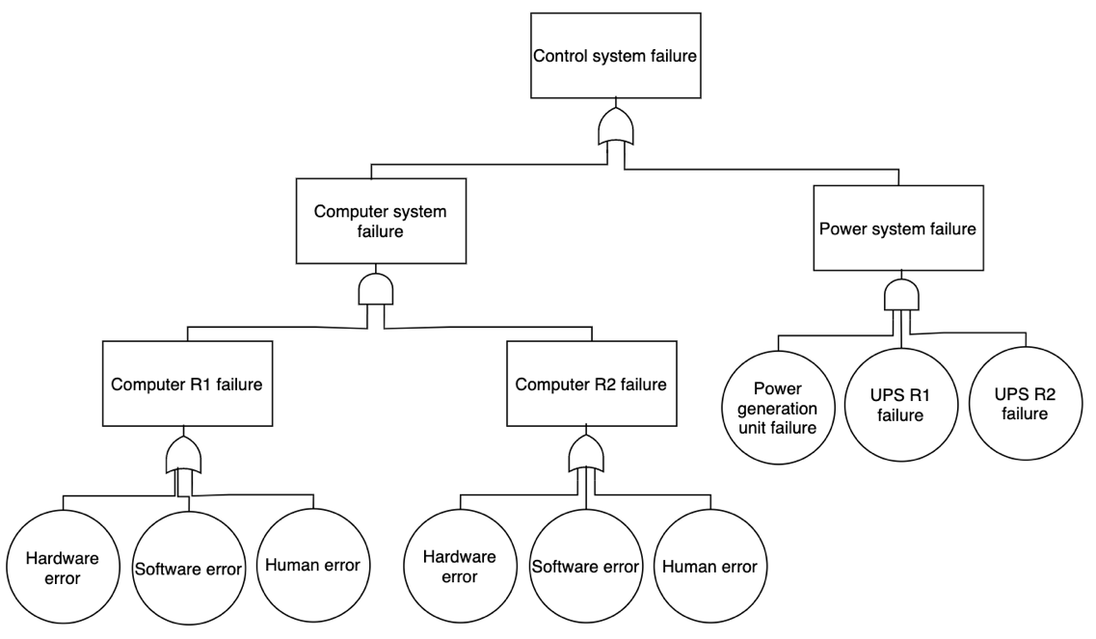
Dynamic Positioning System (DPS)
DPS can fail due to a power system failure or a computer system failure
Only the computer system has redundancy
As the fault tree is composed by 9 basic events and 5 AND/OR gates, a circuit with 14 qubits will be generated
$$N=9$$
$$M=5$$
Basic Event | Annual Failure Probability
Hardware Error | $$2.44×{10}^{−5}$$
Software Error | $$8.54×{10}^{−5}$$
Human Error | $$5.68×{10}^{−1}$$
Power Generation Unit Failure | $$3.41×{10}^{−4}$$
UPS Failure | $$3.66×{10}^{−5}$$

Slide 20
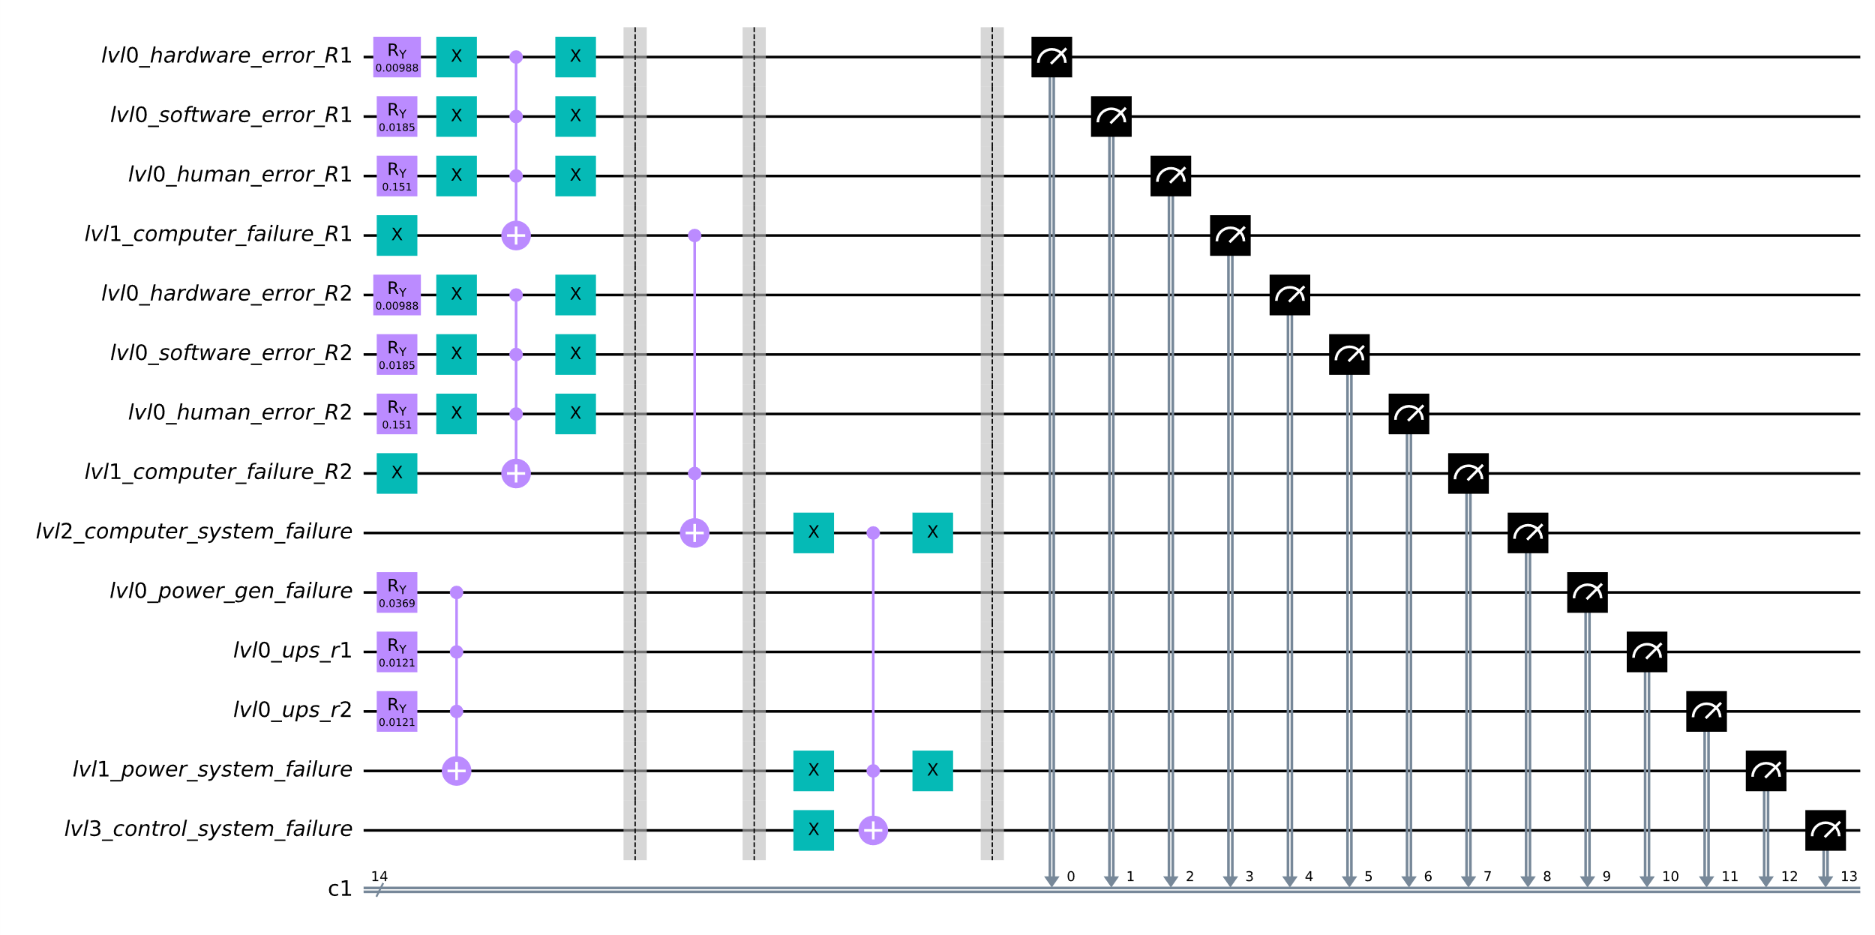
DPS Quantum Circuit

Slide 21
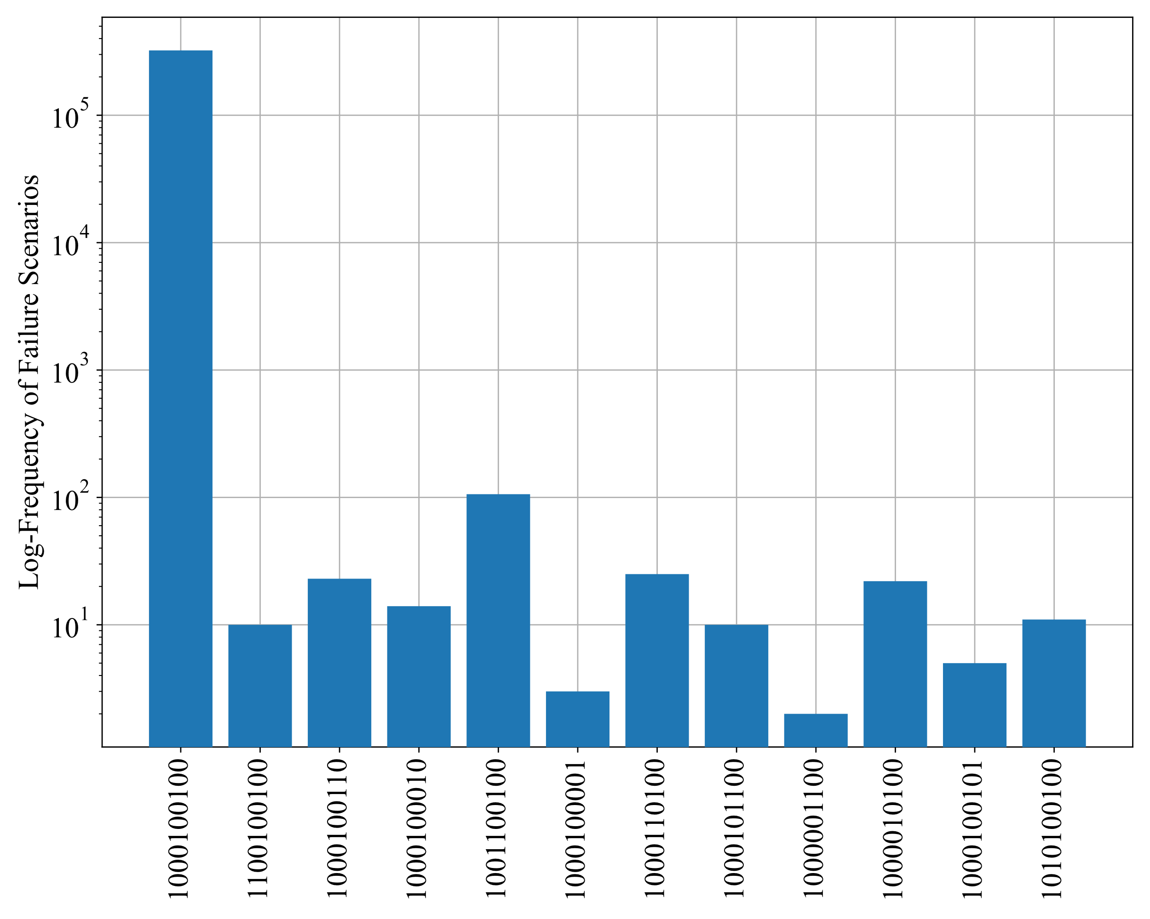
Results
Histogram of Failure Scenarios
The circuit is executed 1,000,000 times, obtaining 323,120 failure scenarios
This is in line with the expected failure probability of the system, computed as $P\left(TOP\right)=0.3231$
From the histogram, those bit-strings corresponding to human errors in the computer system are the most common ones:
This agrees with the failure probability for human errors being orders of magnitude higher than other basic events
Bit-strings represent system failure

Slide 22
Concluding Remarks
The proposed Quantum Fault Tree successfully encodes the original Fault Tree, mapping the failure probability distribution
Collection of scenarios simulated using the Quantum Fault Tree can provide insights into the weak points of the system, allowing practitioners to take preventive action and allocate resources where they would be more efficient
As the availability and capacity of Quantum hardware grows, it will be possible to encode bigger and more complex trees
Potential speedups and improved assessment of very low probability scenarios

