Slide 1
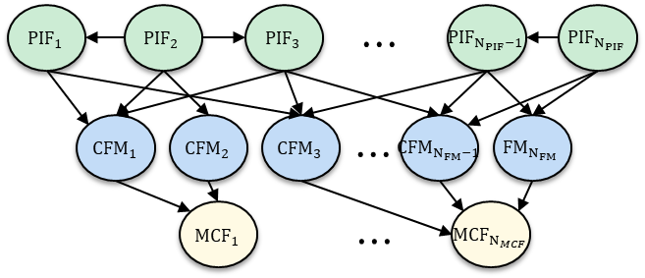
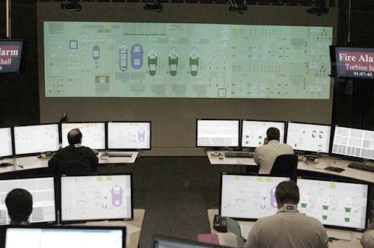
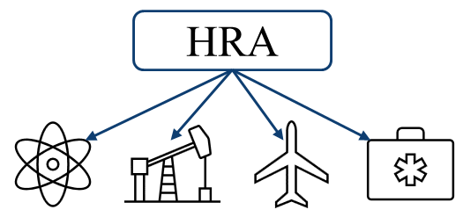
The Human Failure Event: What is it and what should it be?
Vincent Philip Paglioniª, Torrey Mortenson^{b}, Katrina M. Grothª
ªCenter for Risk and Reliability, University of Maryland
Mechanical Engineering Department
Reliability Engineering Program
Systems Risk and Reliability Analysis (SyRRA) Lab
^{b}Research Scientist
Human Factors & Reliability Department
Idaho National Laboratory
PSAM16, Honolulu, HI June 27, 2022

Slide 2
Our work: A two-pronged approach to investigating fundamental concepts in HRA
Computational cognitive modeling
Causal modeling for dependency
Computational methods
Cognitive modeling for HRA
PIF modules model causal factors
Agent archetypes simulate individuals
Causal HRA dependency
Definitional basis for dependency
BN structures to model dependency
Dependency quantification scheme
Intersection:
Identifying fundamental concepts and techniques in HRA that can be improved to further our capabilities to model human operation of complex engineering systems.

Slide 3
Motivation: HRA is critical to engineering system safety
HRA models human actions & decisions to produce:
Understanding of how & why “human error” occurs
Human error probabilities (HEPs) for use in PRA
Design/procedure recommendations to improve human reliability
System reliability is human reliability:
60% of IAEA-reported incidents from 2008-2017 human-influenced¹
THERP
SPAR-H
Human reliability is not improving relative to system reliability.
¹IAEA (International Atomic Energy Agency). 2020. “Nuclear Power Plant Operating Experience from the IAEA/NEA International Reporting System for Operating Experience 2015-2017.” NEA No. 7482. Vol. 7. Vienna.
Nuclear power plant data: https://www.statista.com/statistics/263945/number-of-nuclear-power-plants-worldwide/
Notes:
Below figures: system reliability increasing, human reliability not.
Nuclear: 60%
Aviation: 80% (Boeing)
Process Industries: 60-80% (HFACS)

Slide 4
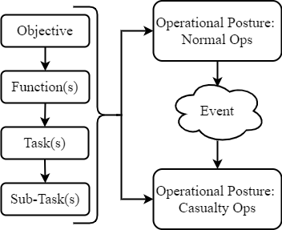
Foundational concepts in HRA remain poorly-defined and lack standardization
HRA has improved in many ways:
Increased accounting of cognition and causality
Better methods of eliciting expert values
Greater usability of end-user methods (EPRI Calculator, SPAR-H)
Critical aspects of HRA have not similarly improved
Definition and use of common terms and concepts including:
HFE
Task analysis levels (Objective, Function, Task, etc.)
Dependency
High-level terms can be standardized without losing flexibility
V. P. Paglioni and K. M. Groth, “Dependency definitions for quantitative human reliability analysis,” Reliab. Eng. Syst. Saf., vol. 220, 2022.
Notes:
A lot of the variability is by design – but it’s starting to be a detriment wherein methods cannot “communicate” – need to have some level of standardization, which is possible without sacrificing flexibility

Slide 5
The HFE needs to be a well-defined HRA construct
HFE is now a foundational concept in HRA
HRA began with “human error”
HFE introduced with ATHEANA
HFE is not robustly defined
Large variation in qualitative and quantitative results
Variation between methods and teams
Recent cross-sectional study required pre-defined HFEs
Predicted mean HEPs
1.0 x 10⁰
1.0 x 10⁻¹
1.0 x 10⁻²
1.0 x 10⁻³
1.0 x 10⁻⁴
1.0 x 10⁻⁵
Cross-comparison of HRA methods and teams assessing HEPs on four HFEs.
Figure adapted from:
H. Liao, et al., “Assessment of HRA method predictions against operating crew performance: Part II: Overall simulator data, HRA method predictions, and intra-method comparisons,” Reliab. Eng. Syst. Saf., vol. 191, 2019.

Slide 6
Methodology: Identifying the various HFE definitions and uses in HRA methods
Some use the HFE as a distinct entity, performed by the crew
Leads to the paradox of “successful” HFEs
Some conflate HFE with HEP, the probability of the HFE
ATHEANA
Introduces HFE, implies high level of abstraction
Phoenix
Objective-level HFEs defined by parent PRA
Our Work
Redefining the HFE to improve standardization and applicability
1970s
2000s
2020
THERP
“Human error” as failure of any task
SPAR-H
Task-level HFEs defined by analyst
IDHEAS
Objective and task-level HFEs defined by parent PRA
1990s
2010s
2022

Slide 7
How can we more effectively define HFE? Factors to consider
Use a system-oriented perspective to align HRA and PRA with common goal of system safety
Conceptualize HFE at a high level to connect lower-level task errors to observable system impacts
Recognize that the HFE is a failure, not a performable task/objective
E.g., crews perform an objective, the failure of which is the HFE
T1
T2
T3
HFE
Objective 1
HFE 1
Notes:
Make this active voice – answer the question in the slide title

Slide 8
Defining the HFE for HRA
The HFE is the failed state of an overarching objective, defined in accordance with scenario requirements. The HFE is the culmination of the failure process composed of at least one failed function-level element (e.g., MCF). The HFE is initiated by an erroneous, unintentional action by a human agent which, when not recovered, leads to a higher-order impact.
Notes:
Reposition – move up and center on slide

Slide 9
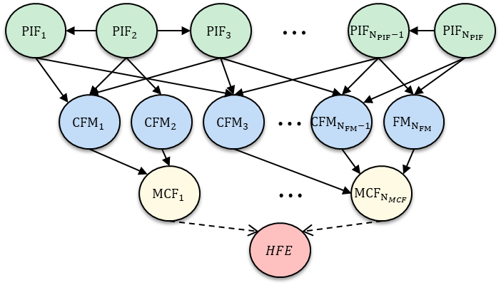
Relating the HFE to other HRA variables
Objective-level HFEs connected to causal constructs in HRA
Defining the HFE anchors the hierarchical structure
Image: K. M. Groth, R. Smith, and R. Moradi, “A hybrid algorithm for developing third generation HRA methods using simulator data, causal models, and cognitive science,” Reliab. Eng. Syst. Saf., vol. 191, 2019.

Slide 10
Systems-oriented definition of HFE does not discount importance of cognitive factors
Connecting the HFE to system impacts allows us to observe the HFE
Still need to understand cognitive and causal mechanisms
The definition of HFE does not discount cognition, but does provide a basis for assigning appropriate modeling levels

Slide 11
Future Work
My future dissertation work uses this definition of HFE to anchor task analyses and explore dependencies between human executables and their causal factors
Causal models of human performance need to be consistently anchored to a known definition, i.e. an objective-level HFE
Future work for the HRA community should be working to implement this definition in methods and ensuring that the foundations of the field are strong
Notes:
HUNTER…. @INL

Slide 12
Conclusions
The HFE as currently implemented in HRA is poorly-defined and used inconsistently
We presented a robust definition for HFE that clarifies what HFEs should mean in an HRA context while maintaining flexibility to multiple applications
We mapped the HFE to a hierarchical structure of HRA variables
The HRA community needs to continue to improve the foundations of the field and provide sound, usable analyses

Slide 13
Thank you!
Vincent Philip Paglioni
Torrey Mortenson
Katrina M. Groth
Paglioni@umd.edu
Torrey.Mortenson@inl.gov
kgroth@umd.edu

