Slide 1
Conditional Quantification PSAM 16
Ola Bäckström Pavel Krcal Pengbo Wang

Slide 2
Outline of this presentation
Problem statement
Conditional quantification basics
The implementation in RiskSpectrum
Future
Conclusions

Slide 3
Problem statement
There is a need for conditional quantification in PSA
Current methods include:
CCF approaches
Post processing
Explicit modelling
Drawbacks:
Cut off issues
Use of separate events (e.g. CCF, HFE dependency) distorts importance and potentially uncertainty.

Slide 4
Conditional quantification, basics
P(A) = P(A|B)·P(B) + P(A|-B)·(1-P(B))
P(A|-B) = [P(A) – P(A|B)·P(B)]/(1-P(B))
Hence, success of B should decrease the probability of A
How is this considered in our PSAs today? Compare:
CCF calculation approaches – in which the independent failure (not conditional failure of “B”) is reduced [Considered]
HFE dependency – in which success is not considered [Disregarded]

Slide 5
Conditional quantification, basics
P(A) = P(A|B)·P(B) + P(A|-B)·(1-P(B))
P(A|-B) = [P(A) – P(A|B)·P(B)]/(1-P(B))
Hence, success of B should decrease the probability of A
HFE dependency estimates
A conservative approach – the aim is to avoid an undeserved credit
Accounting for success could lead to overly optimistic results
Example: complete dependency – does success mean the dependent failure is impossible?

Slide 6
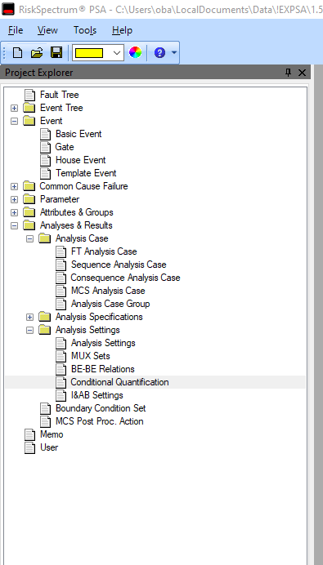
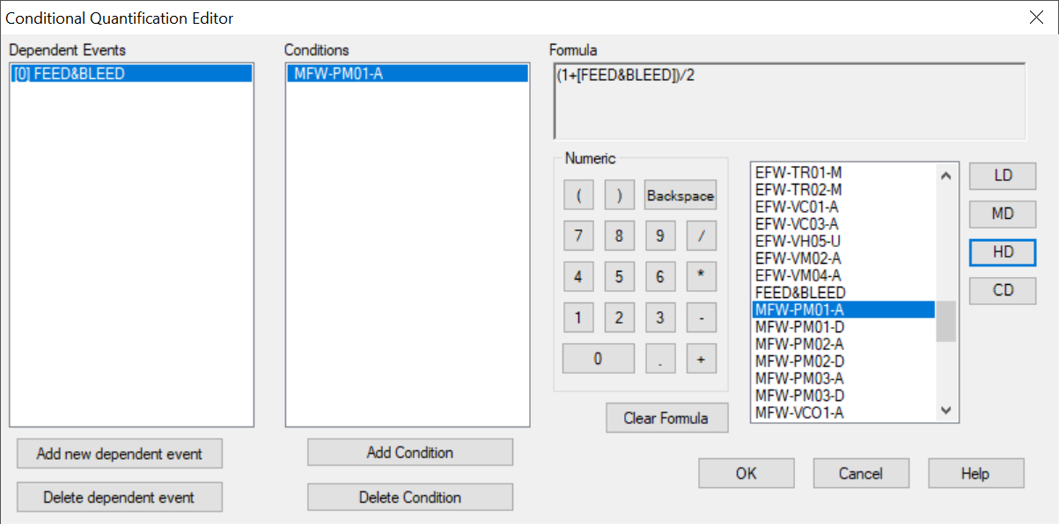
RiskSpectrum PSA implementation
Conditional Quantification
Calculate probabilities based on rules
Rules are applied during MCS generation

Slide 7
RiskSpectrum PSA implementation
Conditional Quantification
When the Dependent Event is found in a MCS …
…together with the conditional event(s)…
The dependent event is calculated as…
Calculate probabilities based on rules
Rules are applied during MCS generation
Application areas:
HRA (focus area)
No decrease at success
Ex. HRA dependency levels:
High P’(A) = ( 1+P(A) ) / 2
Medium P’(A) = ( 1+6P(A) ) / 7
Low P’(A) = ( 1+19P(A) ) / 20

Slide 8
RiskSpectrum PSA implementation
Conditional Quantification
Calculate probabilities based on rules
Rules are applied during MCS generation
Application areas:
HRA (focus area)
CCF
Any calculations including
conditions

Slide 9
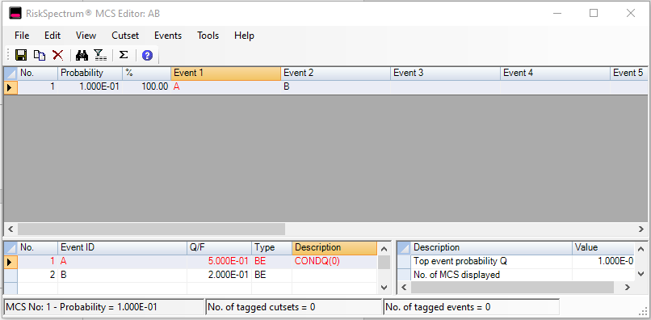
Results and importance
MCS list contains “same” event, but of different value (shadow events A’ )
Traceability:
Right-click in the result grid – a jump to the conditional probability used in quantification
MCS Editor – conditional probability number displayed

Slide 10
Results and importance
MCS list contains “same” event, but of different value (shadow events A’ )
Importance is improved as it considers all event “A” and its shadow events (A’)
FV(A) = Q(cutset contains A or any A’) / Q(all),
RIF(A) = Q(A = 1, and all A’ = 1) / Q(all),
RDF(A) = Q(all) / Q(A=0, and all A’=0).

Slide 11
RiskSpectrum PSA future
Include possibility to select success management
More flexible definition of CCF models
Will be a generic framework for management of conditional quantification in PSA

Slide 12
Conclusion
Existing methods for inclusion of conditional probabilities have drawbacks (e.g. post processing and CCF)
A generic framework for conditional probabilities has been developed and implemented
Currently with focus to manage HFE dependency (to not consider success)
Further development is to manage also success

Slide 13
Thank you - Questions
Please contact:
Ola Backstrom or Pavel Krcal
Ola.backstrom@lr.org

