Slide 1
Improving Measurement Reliability using Data Reconciliation and Digital Twin
PSAM 16
Probabilistic Safety Assessment and Management 16
2022.06.30.
Kyusik Oh, Department of Nuclear Engineering, Kyung Hee University
Sangjun Park, iSMR System Development Division, Korea Atomic Energy Research Institute
Gyunyoung Heo, Department of Nuclear Engineering, Kyung Hee University
Notes:
Hello, my name is Kyusik Oh, from Khung Hee University in South Korea.
I will present
‘Improving Measurement Reliability using Data Reconciliation and Digital Twin’.

Slide 2
This work was supported by the National Research Foundation of Korea(NRF) grant funded by the Korean government(MSIP:Ministry of Science, ICT and Future Planning) (No. 2017M2B2B1072806).
Notes:
First of all, I would like to say that,
This work was supported by the National Research Foundation of Korea(NRF) grant funded by the Korean government.
Then I’ll start the presentation.

Slide 3
contents
Introduction
Background
Objective
Methodology
Data Reconciliation
Gross Error Detection
Code Algorithm
Case Study
Result
Conclusion
Appendix
Notes:
The presentation order is as follows.

Slide 4
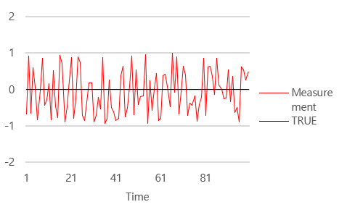
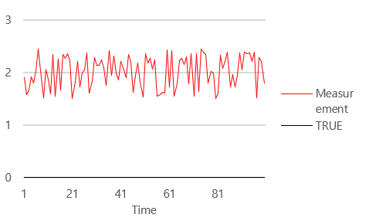
Background
Collecting accurate measurement data is important
for operation, monitoring instruments, calculation of power or efficiency, etc.
Errors in the data should be reduced or eliminated
Random Error
Gross Error
Neither the magnitude nor the sign of the error
Different values under same condition
Probability distribution
e.g. power fluctuation, network transmission, background noise, etc.
Fig. 1. Random Error
A certain magnitude and sign which may be unknown
Same contribution under same condition
Bias
e.g. miscalibration, corrosion, solid deposit, etc.
Fig. 2. Gross Error
Notes:
Collecting accurate measurement data is important.
It is a major concern to estimate the true conditions of process states
with the information provided by the raw measurements,
in order to achieve optimal process monitoring, control, and optimization.
However, there are errors in the data that inevitably occur
during measurement, processing, and transmission. There are two main types of errors. First, random error, which is defined as
'an error in which the magnitude or sign of the error is not predictable’. It is always present, even when repeatedly measured
with the same instrument in the same process, such as background noise,
and since different values are measured each time,
it oscillates around the true value as shown in Figure 1.
So, it is usually expressed as a probability distribution. Gross Error, on the other hand, is defined as
'error that can characterize the magnitude and sign of the error'. Because it has the same contribution
to repeated measurements under the same conditions,
certain biases are observed as shown in Figure 2,
and can be removed by calibration or repair.

Slide 5
background
Data Reconciliation(DR)
True values are estimated using physical model constraints.
Data are corrected differentially for their own accuracy.
Random error is reduced and precise is increased.
Gross Error Detection(GED)
Variables with suspected gross errors are identified.
The accuracy of the results of DR is improved.
It is an indicator for updating the physical model.
$y$ is Measured Value
$\hat{y}$ is Estimated True Value from Model
$Σ$ is Covariance of Measurement.
Data Reconciliation
Least squared Function
Minimize the Random Errors
Measured
Value
$$min\left(\hat{y},\hat{u}\right)={{\left(y−\hat{y}\right)}^{T}}Σ\left(y−\hat{y}\right)$$
Detect the Gross Error
$f\left(y,\hat{u}\right)=0$ $g\left(\hat{y},\hat{u}\right)>0$
Principle Principle
Estimate the Unmeasured Value
Notes:
Data reconciliation is one of the great techniques to correct these errors. As shown in the picture below,
DR is a technique that corrects values to satisfy the physical models
such as constraints in plants.
Constraints refer to primary principles such as material balance or energy balance
that data must satisfy.
It has the meaning of ‘Reconciliation’,
since the relationships existing in variables are used,
and the degree of correction varies according to the accuracy of the measurements.
As a result, accuracy is improved by obtaining data that satisfies the constraints,
and precise is also improved by reducing random errors.
However, there are also gross errors in the data,
typically due to instrument miscalibration or leaks present in the system.
So, gross error detection technique also should be considered with DR.
It is not only improves the accuracy of DR by itself, but also updates the physical model by identifying the location of gross error.

Slide 6
background
Limitation
Reconciled values cannot be reliable unless the physical model is accurate.
However, with digital twin, the accuracy of model has increased.
Studies and Commercial Software
Alireza Behroozsarand, Shabnam Afshari, Data Reconciliation of an Industrial Petrochemical Plant Case Study: Olefin Plant (Hot Section), Computers and Chemical Engineering, Vol. 137, No. 106803, June 2020.
Maurício M. Câmara et al., Numerical Aspects of Data Reconciliation in Industrial Applications, MDPI, Vol. 5, No. 4, October 2017.
Eduardo Damianik Valdetaro, Roberto Schirru, Simultaneous Model Selection, Robust Data Reconciliation and Outlier Detection with Swarm Intelligence in a Thermal Reactor Power Calculation, Annals of Nuclear Energy, Vol. 38, No. 9, pp. 1820-1832, September 2011.
Verein Deutscher Ingenieure, Control and quality improvement of process data and their uncertainties by means of correction calculation for operation and acceptance tests, 2018.
RECON, BTB JANSKY, OpenRefine, TIBCO Clarity, Winpure
It seems rare that the method of updating the physical model and the strategy of maintaining the actual measurement system are explained together.
No General Software with Opened Source Code, also Not in South Korea
Notes:
DR has a limitation in that
the reconciled values cannot be reliable if the physical model is unaccurate. However, with digital twin, the accuracy of the model has increased,
and thus, many studies applying DR and GED have been conducted,
and many commercial software have been developed.
Moreover, it was introduced as a process monitoring method
in German Technical Standard, VDI-2048, recently. I've also heard that it may be introduced into ASME code soon.
However, It seems rare that the method of updating the physical model and the strategy of maintaining the actual measurement system are explained together.
Also, no general-purpose software was found with opened source code.

Slide 7
objective
In-house Code is Developed and Validated
Reactor Temperature Reconciliation
Kyusik Oh, Sangjun Park, Gyunyoung Heo, Application of Reactor PHM using Data Reconciliation Algorithm, Korean Society for Prognostic and Health Management, 2021.
Uranium Materials(²³⁵U, ²³⁸U) Reconciliation
Kyusik Oh, Sangjun Park, SeungMin Woo, Gyunyoung Heo, Application of Data Reconciliation Algorithms to Improve Nuclear Process Monitoring, International Symposium on Future I&C for Nuclear Power Plants, 2021.
Objective
To introduce a strategy to update the physical model using code, taking the heat exchanger system
Notes:
So, I developed an In-house code using R, an open source.
And using this, I will introduce how to keep the physical model up to date
while distinguishing between random errors and gross errors.
The code has been verified through several cases, and some have been presented.
Two studies have been published to reconcile the temperature of the reactor
and the amount of Uranium 235 and 238 in the nuclear fuel process.
It was confirmed that the reconciled data were adjusted to satisfy the process constraints.
In this study, I will introduce a strategy to update the physical model using code, taking the heat exchanger system as an example.

Slide 8
Data reconciliation
If the constraint equation $f$ is nonlinear, it is linearized with the Taylor series
Formulation of Data Reconciliation
“Least Squares Method”
$$f\left(\hat{y},\hat{u}\right)=J_{y}\hat{y}+J_{u}\hat{u}−b$$
$$b=J_{y}y+J_{u}u−f(y,u)$$
$$\min_{\hat{y}, \hat{u}}{\sum_{i}{\frac{{(y_{i}−{\hat{y}}_{i})}^{2}}{σ_{i}^{2}}}}=\min_{\hat{y}, \hat{u}}{{\left(y−\hat{y}\right)}^{T}Σ^{−1}(y−\hat{y})}$$
where $J_{y}=\frac{∂f}{∂\hat{y}}$ $J_{u}=\frac{∂f}{∂\hat{u}}$ are Jacobian matrices containing partial derivatives of the constraint equations$f$ for $\hat{y}$ and $\hat{u}$, respectively.
Subject to
$$f\left(\hat{y},\hat{u}\right)=0$$
$y$ is an $m×1$ vector of raw measurements for M process variables
$\hat{y}$ is an $m×1$ vector of estimates (reconciled values) for the $M$ process variables
$\hat{u}$ is an $n×1$ vector of estimates for unmeasured process variables, $u$
$Σ$ is an $m×m$ covariance matrix of the measurements
$f$ is a $c×1$ vector describing the functional form of model equality constraints.
$J_{u}$ must be removed for reconciliation. It can be removed through the QR decomposition.
$$J_{u}=QR=\left[\begin{matrix}Q_{1} & Q_{2}\end{matrix}\right]\left[\begin{matrix}R_{1} & R_{2} \\ 0 & 0\end{matrix}\right]$$
$$Q^{T}Q=I$$
$f\left(\hat{y},\hat{u}\right)=0$
→ ${Q_{2}^{T}J}_{y}\hat{y}+Q_{2}^{T}J_{u}\hat{u}−Q_{2}^{T}b=0$
→ ${Q_{2}^{T}J}_{y}\left(\hat{y}−b\right)=0$
Solution of DR Problem
$Q$ is a $m×m$ orthogonal matrix
$Q_{1}$ is the first p basis vector for matrix $Q$
$Q_{2}$ is the second $m−p$ basis vector for matrix $Q$
$R_{1}$ is a nonsingular $p×p$ upper triangular matrix
“Lagrange Multipliers”
$𝓛\left(\hat{y},\hat{u},λ\right)={\left(y−\hat{y}\right)}^{T}Σ^{−1}\left(y−\hat{y}\right)−2λ^{T}f(\hat{y},\hat{u})$
Notes:
I will briefly explain the mathematical principles of DR and GED.
According to the process state, DR is divided into steady-state reconciliation problem and dynamic reconciliation problem.
I studied about steady-state DR solution,
because the operating conditions of power plants such as nuclear power plants are generally steady-state.
The steady-state DR problem is formulated
by finding [yhat], an estimate that satisfies the constraints,
making the random error of the measured value [y] the smallest,
and calculating the unmeasured value, [uhat].
In other words, solving the least squares optimization problem.
Its solution is obtained using Lagrange multiplier method.
Linear approximation or linear transformation should be performed depending on the state of the system.

Slide 9
Data reconciliation
Premultiplying by matrix $Q^{T}$
$$\left[\begin{matrix}Q_{1}^{T}J_{y} & R_{1} & R_{2} \\ Q_{2}^{T}J_{y} & 0 & 0\end{matrix}\right]\left[\begin{matrix}\hat{y} \\ {\hat{u}}_{r} \\ {\hat{u}}_{N−r}\end{matrix}\right]=\left[\begin{matrix}Q_{1}^{T}b \\ Q_{2}^{T}b\end{matrix}\right]$$
$r$ is the rank of $J_{u}$
$N$ is total number of unmeasured values
${\hat{u}}_{r}$ is estimates of unmeasured points that can be estimated (observable)
${\hat{u}}_{N−r}$ is estimates of unmeasured points that cannot be estimated (unobservable)
New Estimates for $\hat{y}$ and $\hat{u}$
$$\hat{y}=y−V{\left(Q_{2}^{T}J_{y}\right)}^{T}{\left[\left(Q_{2}^{T}J_{y}\right)V{\left(Q_{2}^{T}J_{y}\right)}^{T}\right]}^{−1}Q_{2}^{T}(J_{y}y−b)$$
$${\hat{u}}_{r}=−R_{1}^{−1}Q_{1}^{T}\left(b−J_{y}\hat{y}\right)−R_{1}^{−1}R_{2}{\hat{u}}_{N−r}$$
${\hat{u}}_{r}$ can be estimated when $R_{1}^{−1}R_{2}=0$
If $f$ is nonlinear, the solution process is repeated until $|\frac{{\hat{y}}_{k}−{\hat{y}}_{k−1}}{{\hat{y}}_{k}}|<ε$
Notes:
The resulting adjusted estimates and unmeasured estimates are as follows.
If the constraint f is non-linear,
there is a difference through linear approximation,
so the solution process is repeated,
until [yhat] is less than the specified tolerance.

Slide 10
Gross error detection
Method for GED - Global Test
Where Gross Error is - Serial Elimination
$$J_{y}=\left[\begin{matrix}J_{g} & J_{c}\end{matrix}\right]$$
$y=\hat{y}+ε$
g : number of measurements without suspected gross errors
c : number of measurements assumed to have gross errors
$E\left(ε\right)=0, cov\left(ε\right)=Σ$
$$V_{n}=\left[\begin{matrix}V_{g} & 0 \\ 0 & V_{c}+∆V\end{matrix}\right]$$
$$0=Q_{2}^{T}(J_{y}\hat{y}−b)$$
$$r=Q_{2}^{T}(J_{y}y−b)$$
$∆V$ : the increase due to gross error
$$V=cov(r)=\left(Q_{2}^{T}J_{y}\right)Σ{\left(Q_{2}^{T}J_{y}\right)}^{T}$$
$Φ_{n}=J_{y}V_{n}{J_{y}}^{T}$
$=J_{g}V_{g}{J_{g}}^{T}+J_{c}\left(V_{c}+∆V\right){J_{c}}^{T}$
$=Φ+J_{c}\left(∆V\right){J_{c}}^{T}$
$γ=r^{T}V^{−1}r$
$Φ_{n}^{−1}=Φ^{−1}\{I−A_{c}{\left[{\left(∆V\right)}^{−1}+A_{c}^{T}Φ^{−1}A_{c}\right]}^{−1}A_{c}^{T}Φ^{−1}\}$
$=Φ^{−1}\{I−A_{c}{\left[A_{c}^{T}Φ^{−1}A_{c}\right]}^{−1}A_{c}^{T}Φ^{−1}\}$
$γ≥χ_{1−α}^{2}\left(m\right)$
m : degrees of freedom (rank of $Q_{2}^{T}J_{y}$)
$$δ=r^{T}{Φ_{n}}^{−1}r$$
→ There is a ($1−α$)*100 % chance that the data set
contains gross errors in one or more of the measurements.
$δ_{i}<χ_{1−α}^{2}\left(m\right)$
→ $y_{i}$ may contain gross error
Notes:
Now, I’ll explain how to detect gross error. There are various detection methods, but I applied Global Test, a fast and universal. The global test is based on the fact that statistics, gamma, follows a Chi-square distribution, assuming that only random errors exist in the data. Under a given significance level alpha,
if the threshold of the chi-square distribution with rank of the constraints, m, as degree of freedom is exceeded,
it is determined that there is at least one gross error. As the name suggests, global test can only determine if there is a gross error in the system,
So it is required additional procedures to identify where it exists. It uses serial elimination method. The delta, which is the reduced gamma, is calculated by assuming the measured value
as the unmeasured value one by one and removing it. When delta_i from which the i-th value was removed,
is lower than the chi-square threshold,
it is judged that it is the result of removing data having gross error. After processing the i-th value as an unmeasured value, DR is performed again to derive a reliable correction values.

Slide 11
Code algorithm
The sequence of DR and GED
Reduce Random Errors in Measurements through data Reconciliation
Correct Measurements and Calculate Estimates of Unmeasured Points
Detect and Identify Variable Suspected to Have a Gross Error in Reconciled Data
Output Corrected Values and Estimates of Unmeasured Points where Gross error is Eliminated.
Process Models
Yes
Material Balance
Energy Balancee
2
Reconciled Data
3
Gross Error
1
Data Reconciliation
measurements
Variance of Reconciled Data
No
4
Steady-State
Dynamic
Estimates of unmeasured points
Corrected & Estimated values
All measured
Not all measured
All measured
Not all measured
Notes:
The sequence of DR and GED is summarized as follows. First, numbers 1 and 2 are about DR
DR reduces random errors and calculates data that are more likely to be true. Although the solution method varies depending on the state of the process model,
in this study, steady-state DR method is considered only. Through the process of GED, 3 and 4,
Corrected values from which gross error has been removed are finally obtained,
and data from unmeasured points obtained through calculation of the system error and the model are derived.
An indicator of model modification can be proposed
by examining the instrument for which the gross error has been detected,
or by examining where that value is involved in the model.

Slide 12
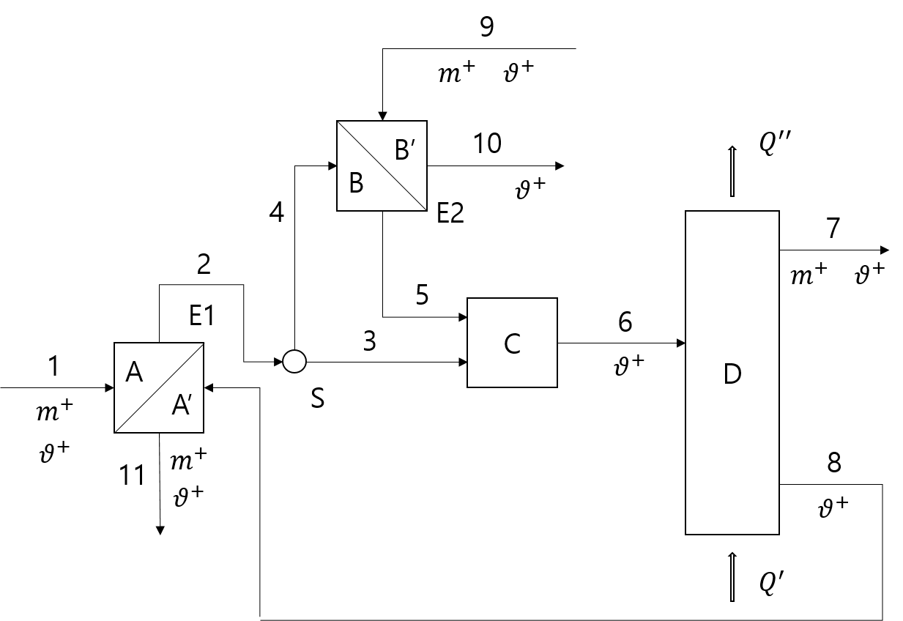
Case study
Problem Description
E1, E2 : heat exchanger
C : mixer
D : splitter
$c_{p}=2.2 kJ{kg}^{−1}K^{−1}$
Notes:
Stream 1 is preheated in heat exchanger E1 and as stream 2 is split in node S into by-pass 3 and stream 4, further preheated in heat exchanger E2.
The outgoing stream 5 is re-mixed in node C with stream 3 and as stream 6 enters the distillation column D with the interpretation.
Stream 7 is distillate.
The hot bottom product (stream 8) preheats stream 1 in exchanger E1 and leaves it as stream 11.
The hot stream 9, of the same nature, comes from another subsystem of the plant into exchanger E2 and leaves it as stream 10.
In the mass balance, the exchangers E1 and E2 are divided into cool and hot sides (A,A') and (B,B'), respectively.
The heat (enthalpy) balances are written for the whole E1 and E2 respectively.
We further assume that the heat of mixing can be neglected.
In addition, we approximate the specific heats by constant values.
It is assumed that the specific heat of the system is all the same.

Slide 13
Case study
Constraints
E1 | Mass balance | ${\overline{m}}_{1}−{\overline{m}}_{2}=0$ | ①
 |  | ${\overline{m}}_{8}−{\overline{m}}_{11}=0$ | ②
 | Enthalpy balance | ${\overline{m}}_{1}c_{p}{\overline{T}}_{1}+{\overline{m}}_{8}c_{p}{\overline{T}}_{8}−{\overline{m}}_{2}c_{p}{\overline{T}}_{2}−{\overline{m}}_{11}c_{p}{\overline{T}}_{11}=0$ | ③
S | Mass balance | ${\overline{m}}_{2}−{\overline{m}}_{3}−{\overline{m}}_{4}=0$ | ④
 | Enthalpy balance | ${\overline{T}}_{3}−{\overline{T}}_{2}=0$ | ⑤
 |  | ${\overline{T}}_{4}−{\overline{T}}_{2}=0$ | ⑥
E2 | Mass balance | ${\overline{m}}_{4}−{\overline{m}}_{6}=0$ | ⑦
 |  | ${\overline{m}}_{9}−{\overline{m}}_{10}=0$ | ⑧
 | Enthalpy balance | ${\overline{m}}_{4}c_{p}{\overline{T}}_{4}+{\overline{m}}_{9}c_{p}{\overline{T}}_{9}−{\overline{m}}_{5}c_{p}{\overline{T}}_{5}−{\overline{m}}_{10}c_{p}{\overline{T}}_{10}=0$ | ⑨
C | Mass balance | ${\overline{m}}_{3}+{\overline{m}}_{5}−{\overline{m}}_{6}=0$ | ⑩
 | Enthalpy balance | ${\overline{m}}_{3}c_{p}{\overline{T}}_{3}+{\overline{m}}_{5}c_{p}{\overline{T}}_{5}−{\overline{m}}_{6}c_{p}{\overline{T}}_{6}=0$ | ⑪
D | Mass balance | ${\overline{m}}_{6}−{\overline{m}}_{7}−{\overline{m}}_{8}=0$ | ⑫
 | Enthalpy balance | ${\overline{m}}_{6}c_{p}{\overline{T}}_{6}−{\overline{m}}_{7}c_{p}{\overline{T}}_{7}−{\overline{m}}_{8}c_{p}{\overline{T}}_{8}+Q^{′}−Q^{′′}=0$ | ⑬

Slide 14
Case study
Measured and Estimates of Unmeasured Values are substituted for vector $y$
Constraints
${\overline{m}}_{1}−{\overline{m}}_{2}=0$ | $y[1]−y[2]=0$
${\overline{m}}_{8}−{\overline{m}}_{11}=0$ | $y[17]−y[4]=0$
${\overline{m}}_{1}c_{p}{\overline{T}}_{1}+{\overline{m}}_{8}c_{p}{\overline{T}}_{8}−{\overline{m}}_{2}c_{p}{\overline{T}}_{2}−{\overline{m}}_{11}c_{p}{\overline{T}}_{11}=0$ | $y\left[1\right] c_{p} y\left[5\right]+y\left[17\right] c_{p} y\left[8\right]−y\left[12\right] c_{p} y\left[19\right]−y\left[4\right] c_{p} y[11]=0$
${\overline{m}}_{2}−{\overline{m}}_{3}−{\overline{m}}_{4}=0$ | $y[12]−y[13]−y[14]=0$
${\overline{T}}_{3}−{\overline{T}}_{2}=0$ | $y[20]−y[19]=0$
${\overline{T}}_{4}−{\overline{T}}_{2}=0$ | $y[21]−y[19]=0$
${\overline{m}}_{4}−{\overline{m}}_{6}=0$ | $y[14]−y[15]=0$
${\overline{m}}_{9}−{\overline{m}}_{10}=0$ | $y[3]−y[8]=0$
${\overline{m}}_{4}c_{p}{\overline{T}}_{4}+{\overline{m}}_{9}c_{p}{\overline{T}}_{9}−{\overline{m}}_{5}c_{p}{\overline{T}}_{5}−{\overline{m}}_{10}c_{p}{\overline{T}}_{10}=0$ | $y\left[14\right] c_{p} y\left[21\right]+y\left[3\right] c_{p} y\left[9\right]−y\left[15\right] c_{p} y\left[22\right]−y\left[18\right] c_{p} y[10]=0$
${\overline{m}}_{3}+{\overline{m}}_{5}−{\overline{m}}_{6}=0$ | $y[13]+y[15]−y[16]=0$
${\overline{m}}_{3}c_{p}{\overline{T}}_{3}+{\overline{m}}_{5}c_{p}{\overline{T}}_{5}−{\overline{m}}_{6}c_{p}{\overline{T}}_{6}=0$ | $y\left[13\right] c_{p} y\left[20\right]+y\left[5\right]{ c}_{p} y\left[22\right]−y\left[16\right] c_{p} y[6]=0$
${\overline{m}}_{6}−{\overline{m}}_{7}−{\overline{m}}_{8}=0$ | $y[16]−y[2]−y[17]=0$
${\overline{m}}_{6}c_{p}{\overline{T}}_{6}−{\overline{m}}_{7}c_{p}{\overline{T}}_{7}−{\overline{m}}_{8}c_{p}{\overline{T}}_{8}+Q^{′}−Q^{′′}=0$ | $y\left[16\right] c_{p} y\left[6\right]−y\left[2\right] c_{p} y\left[7\right]−y\left[17\right] c_{p} y[8]+y[23]−y[24]=0$
Values | Variables in code | Values | Variables in code
$$m_{1}$$ | y[1] | $$m_{2}$$ | y[12]
$$m_{7}$$ | y[2] | $$m_{3}$$ | y[13]
$$m_{9}$$ | y[3] | $$m_{4}$$ | y[14]
$$m_{11}$$ | y[4] | $$m_{5}$$ | y[15]
$$T_{1}$$ | y[5] | $$m_{6}$$ | y[16]
$$T_{6}$$ | y[6] | $$m_{8}$$ | y[17]
$$T_{7}$$ | y[7] | $$m_{10}$$ | y[18]
$$T_{8}$$ | y[8] | $$T_{2}$$ | y[19]
$$T_{9}$$ | y[9] | $$T_{3}$$ | y[20]
$$T_{10}$$ | y[10] | $$T_{4}$$ | y[21]
$$T_{11}$$ | y[11] | $$T_{5}$$ | y[22]
 |  | $$Q^{′}$$ | y[23]
 |  | $$Q^{′′}$$ | y[24]

Slide 15
Result
Variables | Measurements | Variance | Reconciled Values | Corrected Variance
$$m_{1}$$ | 1.01 (t/h) | 0.01 (t/h) | 1.0068 (t/h) | 0.0056 (t/h)
$$m_{2}$$ | - | - | 1.0068 (t/h)
$$m_{3}$$ | - | - | -
$$m_{4}$$ | - | - | -
$$m_{5}$$ | - | - | -
$$m_{6}$$ | - | - | 1.0068 (t/h)
$$m_{7}$$ | 0.32 (t/h) | 0.01 (t/h) | 0.3236 (t/h) | 0.0056 (t/h)
$$m_{8}$$ | - | - | 0.6832 (t/h)
$$m_{9}$$ | 0.79 (t/h) | 0.01 (t/h) | 0.7898 (t/h) | 0.0056 (t/h)
$$m_{10}$$ | - | - | 0.7898 (t/h)
$$m_{11}$$ | 0.68 (t/h) | 0.01 (t/h) | 0.6832 (t/h) | 0.0056 (t/h)
$$T_{1}$$ | 21 (K) | 0.5 (K) | 20.99 (K) | 0.273 (K)
$$T_{2}$$ | - | - | 74.92 (K)
$$T_{3}$$ | - | - | 74.92 (K)
$$T_{4}$$ | - | - | 74.92 (K)
$$T_{5}$$ | - | - | -
$$T_{6}$$ | 100 (K) | 0.5 (k) | 100.01 (K) | 0.273 (K)
$$T_{7}$$ | 81 (K) | 0.5 (K) | 81 (K) | 0.273 (K)
$$T_{8}$$ | 119 (K) | 0.5 (k) | 118.99 (K) | 0.273 (K)
$$T_{9}$$ | 137 (K) | 0.5 (K) | 136.99 (K) | 0.273 (K)
$$T_{10}$$ | 105 (K) | 0.5 (k) | 105.01 (K) | 0.273 (K)
$$T_{11}$$ | 39.5 (K) | 0.5 (K) | 39.51 (K) | 0.273 (K)
$$Q^{′}$$ | - | - | -
$$Q^{′′}$$ | - | - | -
The raw measurements do not satisfy the flow balance and heat balance, but the reconciled estimates satisfy.
$$γ=19.87$$
$$χ_{0.95}^{2}\left(13\right)=22.36$$
Test statistic is lower than critical value, Therefore there are no gross error in the system.
It can be concluded that there is no problem with the process model.
Notes:
The raw measurements do not satisfy the flow balance and heat balance, but the reconciled estimates satisfy.

Slide 16
conclusion
This study is try to improve the reliability of the data using in-house DR and GED algorithm code.
According to result,
Corrected data improved accuracy by satisfying the constraints.
Precision also improved by reducing the variance of the corrected data.
By confirming that there is no gross error, the model of the process is reliable.
If there is a system error, it can be instructed to identify defects in the instrument or system at the location where the system error is found.

Slide 17
Thank You
Kyusik Oh, ohsik95@gmail.com
Sangjun Park, sangjun@kaeri.re.kr
Gyunyoung Heo, gheo@khu.ac.kr
Notes:
Thank you for listening.
If you have any questions,
I would appreciate it if you could speak slowly.

