Slide 1

Design of Reliability Test Specification for a New Product with Unknown Failure Modes
Neda Shafiei ¹, Jeffrey W. Herrmann ¹, Aaron Krive ², Maxim P. Nikiforov ², Guneet Sethi ², and Mohammad Modarres ¹
University of Maryland, College Park, MD, U.S.
Amazon Lab 126, CA, U.S.

Slide 2
Reliability Test Specification
A reliability test follows specifications including
  sample size
  test conditions (i.e., stress levels and their frequencies of occurrence)
  the analytical procedures for assessing reliability and the acceptance criteria (e.g., numerical limits)
that are used to evaluate the reliability of a product.
1. N. Shafiei, J. W. Herrmann, A. Krive and M. Modarres, "Estimating Reliability Model of Consumer Electronics Using User Survey Data and Reliability Test Data," in Reliability & Maintainability Symposium (RAMS), Tuscon, Arizona, 2022.

Slide 3
Problem
The reliability test plans that are not designed based on the actual use conditions may address wrong failure modes (i.e., the failure modes that are never observed by users) or may not capture some of the most common failure modes.

Slide 4
Objective
The objective of this study is to design a reliability test for the new product based on the actual use conditions of a similar product that is collected through a user survey.
The test plan provides the chance to reveal the most probable failure modes of the new product and save time and money by disregarding the failure modes that will not happen at the actual use conditions.

Slide 5
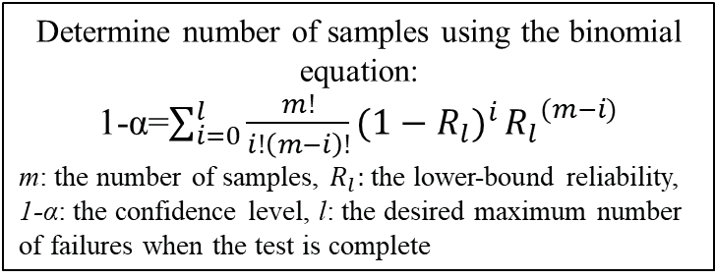
Research Approach
Determine the stress levels and the number of cycles:
Determine the sample size or the allowable number of failures:
Quantify the subjective stress adjustors and combine them though a stress-index (SI) model
Frequency-accelerated test
Collect the actual use conditions (i.e., stresses, stress adjustors* and usage cycles) of a similar product in use through the user survey
Apply the clustered use conditions to the devices.
Cluster the quantitative use conditions
Adjust the use conditions through a stress-life model.
Apply the adjusted use conditions to the devices.
Stress-accelerated test
Collect the manufacture’s requirements including:
The desired warranty time
The desired reliability with some confidence at the warranty time.
Maximum number of failures at the end of the test.
Determine number of samples using the binomial equation:
1-α=$\sum_{i=0}^{l}{\frac{m!}{i!\left(m−i\right)!}{(1−R_{l})}^{i}}{R_{l}}^{(m−i)}$
m: the number of samples, $R_{l}:$the lower-bound reliability, 1-α: the confidence level, l: the desired maximum number of failures when the test is complete
* Stress adjustors is a variable that increases or decreases the stress magnitude or stress absorption.

Slide 6

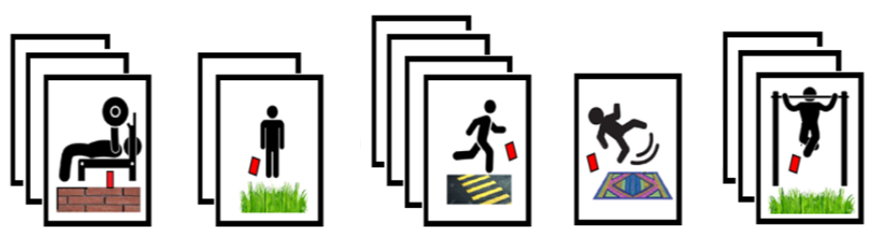
Case Study: A Drop Test
The case study designs a frequency-accelerated and a stress-accelerated drop test for a handheld electronic device.
A user survey dataset was simulated that contained the users’ responses to the number of times their devices dropped in a typical month and the applicable stress adjustors (i.e., the drop height, the surface type that hits the device, and the user activity) during the drops. For instance, a user had:
  10 drops from knee heigh on a semi-hard surface when he was seating.
  4 drops from waist height on a hard surface when he was running.
The dataset assumed 1000 users.
No. of Drops
Activity
Height
Surface
* Stress adjustors is a variable that increases or decreases the stress magnitude or stress absorption.

Slide 7
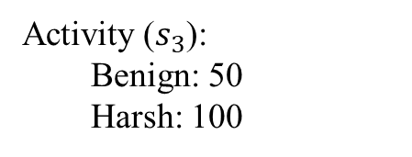
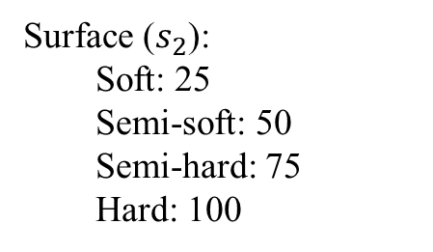
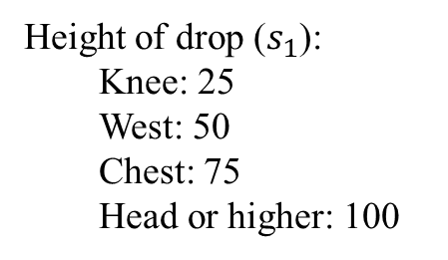
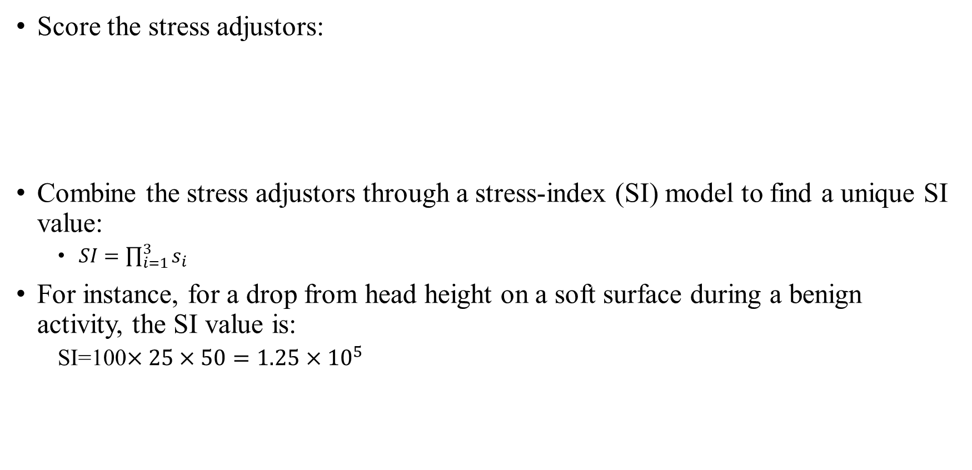
Quantifying the Stress Adjustors
Score the stress adjustors:
Combine the stress adjustors through a stress-index (SI) model to find a unique SI value:
  $SI=\prod_{i=1}^{3}{s_{i}}$
For instance, for a drop from head height on a soft surface during a benign activity, the SI value is:
  SI=100$×25×50={1.25×10}^{5}$
Height of drop ($s_{1}$):
  Knee: 25
  West: 50
  Chest: 75
  Head or higher: 100
Surface ($s_{2}$):
  Soft: 25
  Semi-soft: 50
  Semi-hard: 75
  Hard: 100
Activity ($s_{3}$):
  Benign: 50
  Harsh: 100
1. N. Shafiei, J. W. Herrmann, A. Krive and M. Modarres, "Estimating Reliability Model of Consumer Electronics Using User Survey Data and Reliability Test Data," in Reliability & Maintainability Symposium (RAMS), Tuscon, Arizona, 2022.

Slide 8
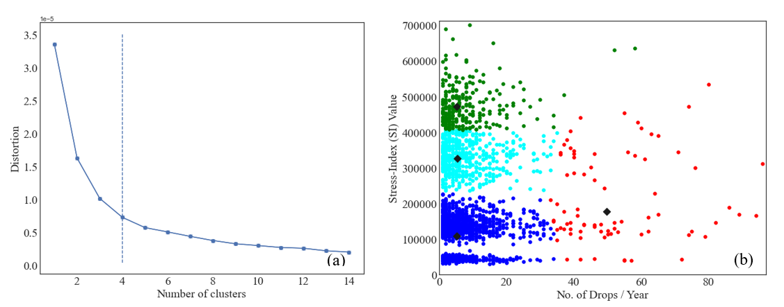
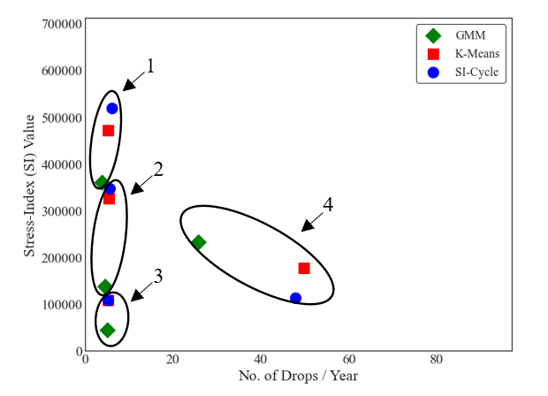
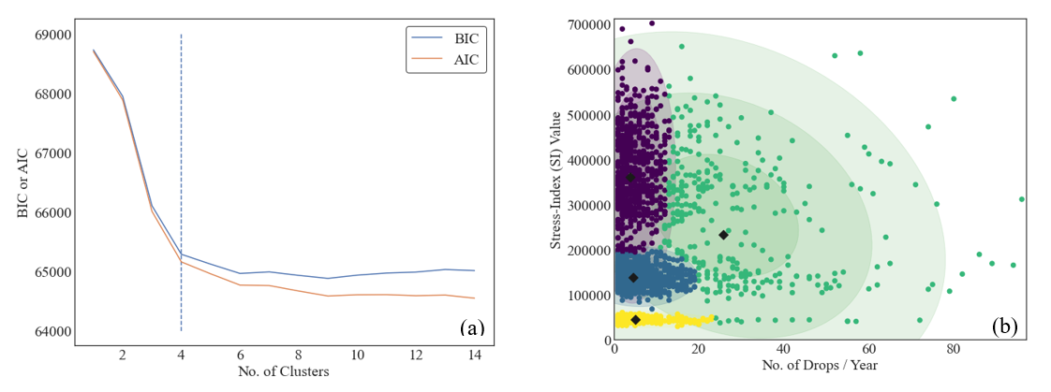
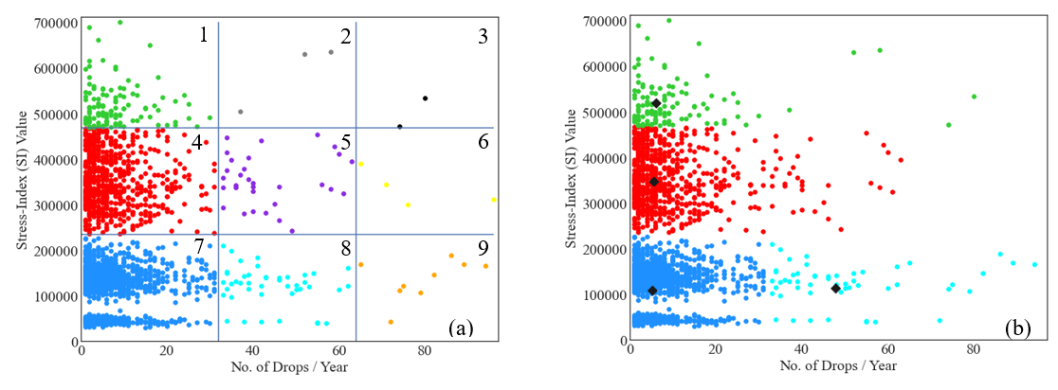
Clustering
K-Means Clustering:
Gaussian Mixture Model:
SI-Cycle Graph:

Slide 9
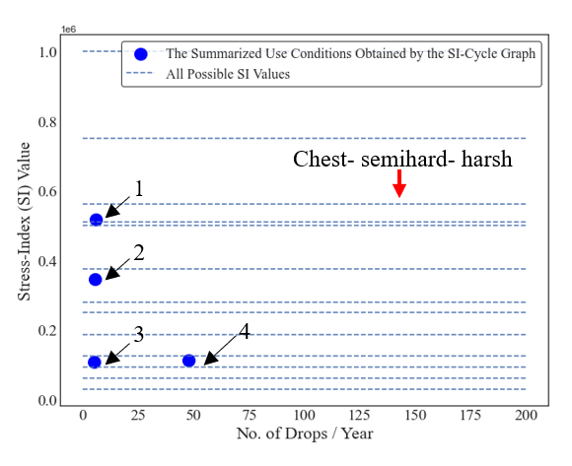
Determining the Stress Profiles for the Frequency-Accelerated Test
Stress Profile | S.I. Value | Stress Profile | S.I. Value
Knee- soft- benign | 31,250 | Waist- hard- benign | 250,000
Knee- semisoft- benign | 62,500 | Waist- semisoft- harsh | 250,000
Knee- soft- harsh | 62,500 | Head- semisoft- benign | 250,000
Waist- soft- benign | 62,500 | Head- soft- harsh | 250,000
Knee- semihard- benign | 93,750 | Chest- semihard- benign | 281,250
Chest- soft- benign | 93,750 | Chest- hard- benign | 375,000
Knee- hard- benign | 125,000 | Chest- semisoft- harsh | 375,000
Knee- semisoft- harsh | 125,000 | Head- semihard- benign | 375,000
Waist- semisoft- benign | 125,000 | Waist- semihard- harsh | 375,500
Waist- soft- harsh | 125,000 | Head- hard- benign | 500,000
Head- soft- benign | 125,000 | Head- semisoft- harsh | 500,000
Knee- semihard- harsh | 187,500 | Waist- hard- harsh | 510,000
Waist- semihard- benign | 187,500 | Chest- semihard- harsh | 562,500
Chest- semisoft- benign | 187,500 | Chest- hard- harsh | 750,000
Chest- soft- harsh | 187,500 | Head (or higher)- semihard- harsh | 750,000
Knee- hard- harsh | 250,000 | Head (or higher)- hard- harsh | 1,000,000
Stress profile is a combination of stress and stress adjustors.

Slide 10
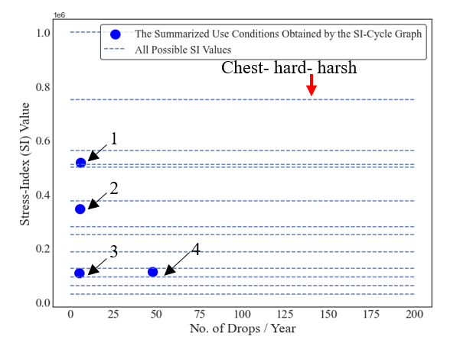
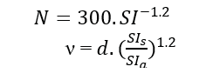
Determining the Stress Profiles for the Stress-Accelerated Test
Stress Profile | S.I. Value | Stress Profile | S.I. Value
Knee- soft- benign | 31,250 | Waist- hard- benign | 250,000
Knee- semisoft- benign | 62,500 | Waist- semisoft- harsh | 250,000
Knee- soft- harsh | 62,500 | Head- semisoft- benign | 250,000
Waist- soft- benign | 62,500 | Head- soft- harsh | 250,000
Knee- semihard- benign | 93,750 | Chest- semihard- benign | 281,250
Chest- soft- benign | 93,750 | Chest- hard- benign | 375,000
Knee- hard- benign | 125,000 | Chest- semisoft- harsh | 375,000
Knee- semisoft- harsh | 125,000 | Head- semihard- benign | 375,000
Waist- semisoft- benign | 125,000 | Waist- semihard- harsh | 375,500
Waist- soft- harsh | 125,000 | Head- hard- benign | 500,000
Head- soft- benign | 125,000 | Head- semisoft- harsh | 500,000
Knee- semihard- harsh | 187,500 | Waist- hard- harsh | 510,000
Waist- semihard- benign | 187,500 | Chest- semihard- harsh | 562,500
Chest- semisoft- benign | 187,500 | Chest- hard- harsh | 750,000
Chest- soft- harsh | 187,500 | Head (or higher)- semihard- harsh | 750,000
Knee- hard- harsh | 250,000 | Head (or higher)- hard- harsh | 1,000,000
Stress profile is a combination of stress and stress adjustors.

Slide 11

Determining the Sample Size
Manufacturer’s requirement:
  At least 95% reliability with 90% confidence after 1 year of warranty.
  Maximum number of test samples was 100.
1-α=$\sum_{i=0}^{l}{\frac{m!}{i!\left(m−i\right)!}{(1−R_{l})}^{i}}{R_{l}}^{(m−i)}$
1-0.95=$\sum_{i=0}^{l}{\frac{100!}{i!\left(100−i\right)!}{(1−0.9)}^{i}}×{0.95}^{(100−i)}⇒i=2$

Slide 12
Summary and Conclusions
A frequency-accelerated and a stress-accelerated test were proposed.
The various use conditions collected by the user survey data were grouped through the K-means clustering, GMM, and SI-cycle graph and were used to determine the test frequencies and the test stress profiles.
The process of designing test specifications was illustrated using a simulated dataset for an electronic device that was accidentally dropped by users in the field.
This study showed that the reliability test specification of a new product with unknown failure modes can be designed based on the usage conditions of similar products collected using a reliability-informed user survey.
The user survey is a cost-effective and quick way to collect the use conditions.
A test specification that is based on the user data allows revealing the failure modes observed in the field.

Slide 13
Thank You
Email: nshafiei@umd.edu

