Slide 1
Dependency Analysis within Human Failure Events for Nuclear Power Plant:
Comparison between Phoenix and SPAR-H
Kanoko Nishiono¹, Marilia A. Ramos², Yoshikane Hamaguchi¹, Ali Mosleh²
1: Regulatory Standard and Research Department, Secretariat of Nuclear Regulation Authority (S/NRA/R)
2: The B. John Garrick Institute for the Risk Sciences, University of California Los Angeles (UCLA). Los Angeles, United States of America

Slide 2





What is Dependency?
When you perform a task・・・
If the previous task was successful, you may also be successful on the subsequent action!
If the previous task fails, you may have a higher likelihood of making a mistake on a subsequent action:(

Slide 3
Dependencies between tasks and between operations
Operation 1
Cue of Operation 1
Task A
Success
Task B
Success
Linking between tasks
Cue of Operation 2
Task C
Success
Linking between operations
Task D
Success
Linking between tasks
Failure
Operation 2

Slide 4
All actions are affected by environmental factors, and some of them may exist as common factors.
Confidence
Adequate tools
Nice-coworker
Nice co-worker
Adequate procedure
Bias
Inadequate tools
Lack of knowledge
Lack of knowledge
Stress
Common factors can generate a causal dependency

Slide 5
Dependency analysis leads to robust and realistic HEP estimation
PRAs for NPP estimate HEP through HRA methods
NUREG-1792, “Good Practices for Implementing HRA”, emphasizes considering commonalities, similarities, and links among actions
These links are at the root of dependencies between actions and those between HFEs

Slide 6

Dependency assessment and dependency impact on the HEP are still a challenge
Subjective determination of dependency can lead to a difference in HRA and PRA results [Cepin, M (2008)]
THERP –style dependency model
Bayesian Belief Networks (BBNs), and graphical methods
  the quantitative HEP foundations are debatable
  Foundation for many methods’ dependency model
  Visualize the relationship
  ⇒can help identify
  the quantitative impact of dependency on the HEP is traceable using Bayesian updating

Slide 7

Aim of the research
to discuss approaches to dependency assessment in HRA
Compare two HRA methods: SPAR-H and Phoenix
Both can consider dependency, but foundations for dependency assessment are different in qualitative frameworks and in quantitative frameworks
This study is the first step of a large study comparing Phoenix and other methods from the following two points:
HEPs generated by different methods
the impact of the different approaches for dependency assessment

Slide 8
How to compare two HRA methods?
Study subjects: SPAR-H by INL and Phoenix by UCLA
Comparison view:
  HRA variables, Performance Influencing Factors, and causal modeling
  Assessing dependency and dependency impact on the HEP
References:
2 papers for Phoenix;
      Ekanem, N. J. et al. (2016) “Phoenix —A model–based Human Reliability Analysis methodology: Qualitative Analysis Overview.”
      Ramos, M et al. (2021) “Phoenix Human Reliability Analysis Method: Application to a Feed and Bleed Operation”
  NUREG for SPAR-H;
      Gertman, D.I. et al. (2004) “The SPAR-H Human Reliability Analysis Method”

Slide 9
Overview of HRA methods
SPAR-H
Phoenix
Developed by NRC and INL
Work-sheet based method
THERP-dependency model
The evaluation can be performed on-site and on-time
Developed by University of California, Los Angeles
Software-based method
BBNs and Bayesian Updating

Slide 10
Overview of HRA methods:
Main HEP estimation procedures are the same, but some steps are different
Phase 1:
Human Error Identification
Phase 2:
Context Characterization and
Causal Modeling
Phase 3:
Quantification
SPAR-H
Phoenix
SPAR-H
Phoenix
SPAR-H
Phoenix
Step 5:
Calculate HEP using the multiplicative method
Step 6:
Calculate HEP through the complete models with BBNs, FTs, and ESDs
Step 1:
Determine HFE
Step 1:
Determine HFE
Step 3:
Identify PIFs
Step 3:
Identify CFMs and Develop FTs
Step 4:
Identify Relevant PIFs
Step 6:
Assess Dependency
Step 7:
Assess Dependency
Step 2:
Categorize HFE as Action and/or Decision
Step 2:
Develop Crew Response Tree
Step 4:
Assess PIFs’ States
Step 5:
Assess PIFs’ States
Step 7:
Calculate HEP with Dependency
Step 8:
Calculate HEP with Dependency

Slide 11
HFE definition
SPAR-H
Phoenix
Arrange the sequence of events in timeline order and determine HFE
Determine HFEs by work-sheet questionnaire
Step 1:
Determine HFE
Step 1:
Determine HFE
Step 2:
Categorize HFE as Action and/or Decision
Step 2:
Develop Crew Response Tree
Model the Crew–Plant interactions
➜Phoenix provides a visual model of the crew tasks. The CRT can also include equipment failure.

Slide 12
Assessment of PIFs and causal modeling
SPAR-H
Phoenix
Assesses the performance drivers through the eight PIFs modelled by SPAR-H
Step 3:
Identify PIFs
Step 3:
Identify CFMs and Develop FTs
Model human performance through FTs and determine CFMs
Step 4:
Identify Relevant PIFs
Select relevant PIFs modelled by Phoenix for each CFMs, and connect PIFs–CFMs through BBNs
Select relevant PIF’s status on a worksheet and determine the PIF’s impact
Step 4:
Assess PIFs’ States
Step 5:
Assess PIFs’ States
Assess PIF’s status on application questionnaire
➜Phoenix has a middle layer modeling(FTs) human response based on IDA

Slide 13
HEP estimation and dependency assessment
SPAR-H
Phoenix
Step 5:
Calculate HEP using the multiplicative method
Step 6:
Calculate HEP through the complete models with BBNs, FTs, and ESDs
Calculate CFM’s probabilities from PIF status with BBN
Calculate HEP of CRT end state and ESD end state with BBN updating
Calculate the PIF-Modified HEP using nominal HEP for action/decision
Determine dependency level using dependency decision tree
Step 6:
Assess Dependency
Step 7:
Assess Dependency
Merge common PIFs within CFMs and modify BBN linking
Calculate HEP with dependency using PIF-Modified HEP and dependency level
Step 7:
Calculate HEP with Dependency
Step 8:
Calculate HEP with Dependency
➜Phoenix estimates HEPs considering PIFs states, conditional probabilities, and BBN updating.

Slide 14
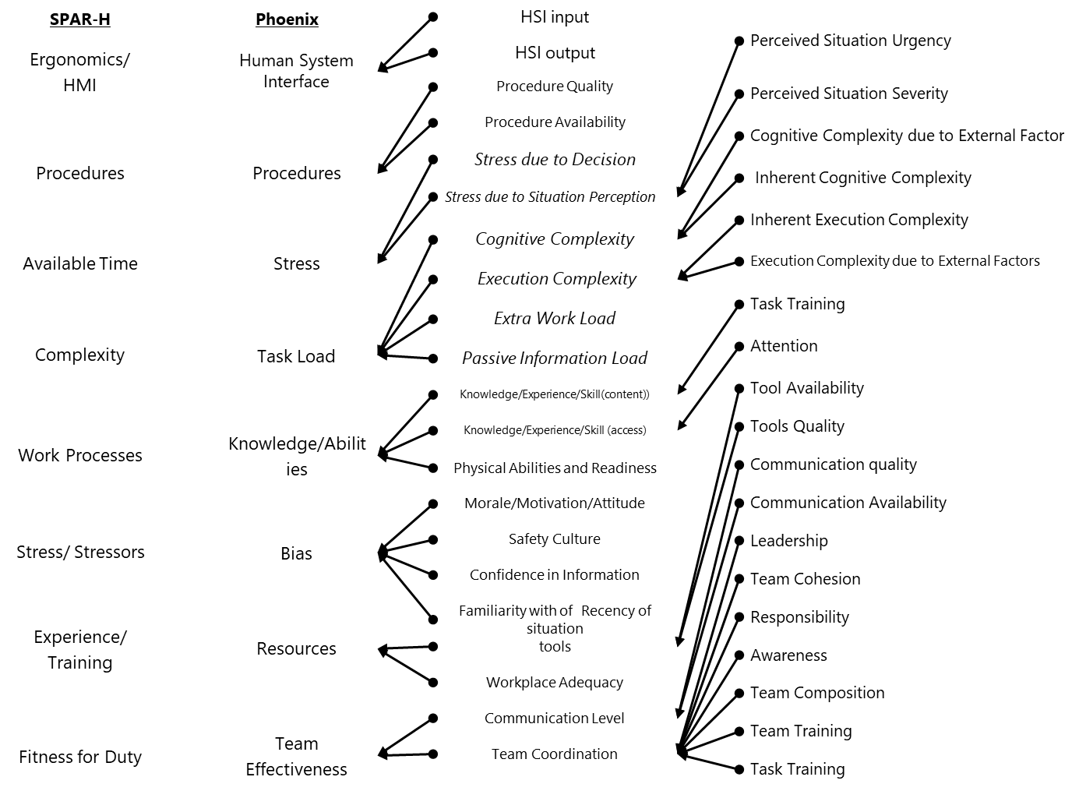
PIF models
Correspondences between PIFs in Phoenix’s and those in SPAR-H can be found as follows:
SPAR-H contains 8 PIFs impacting the HEP directly
and models the impact of these PIFs at different levels, which is different for action or diagnosis tasks.
Phoenix models PIFs in three layers
The impact of the PIFs is then estimated by considering both their marginal probability and the conditional probability of the CFM

Slide 15
Comparing items in dependency analysis procedures
1. Determine the dependency factors
2. Assess the dependency impact
3. Quantify the HEP
        the PIF modeled
a causal model
Quantify the impact of dependency in HEP

Slide 16
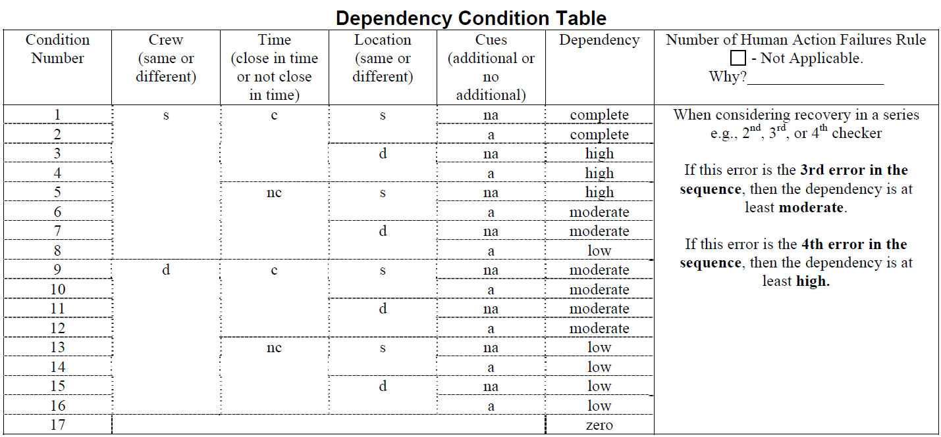
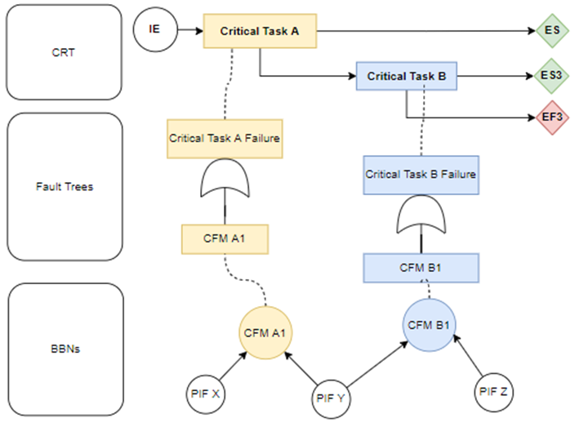
Determine the dependency factors (causal)
SPAR-H
Phoenix
Source: Gertman, D.I et al. "The SPAR H human reliability analysis method.; Human Factors, Robotic, and Remote Systems," Idaho National Engineering and Environmental Laboratory, Idaho Falls, United States, pp. 17–24 (2004).

Slide 17
PIFs considered in dependency analysis
Common factors related to PIFs
SPAR-H
Phoenix
Assess through direct use of PIFs
Human System Interface
Time
close in time or not close in time
Procedures
Stress
Cues
additional or no additional
Task Load
Knowledge/
Abilities
Crew
same or additional
Location
same or difference
Bias
Team Effectiveness
Resources

Slide 18
Assess the dependency impact
SPAR-H
Phoenix
Source: Gertman, D.I et al. "The SPAR H human reliability analysis method.; Human Factors, Robotic, and Remote Systems," Idaho National Engineering and Environmental Laboratory, Idaho Falls, United States, pp. 17–24 (2004).
➜Phoenix does not categorize dependency as SPAR-H. Multiple combinations can exist, resulting in different impacts on the HEP

Slide 19
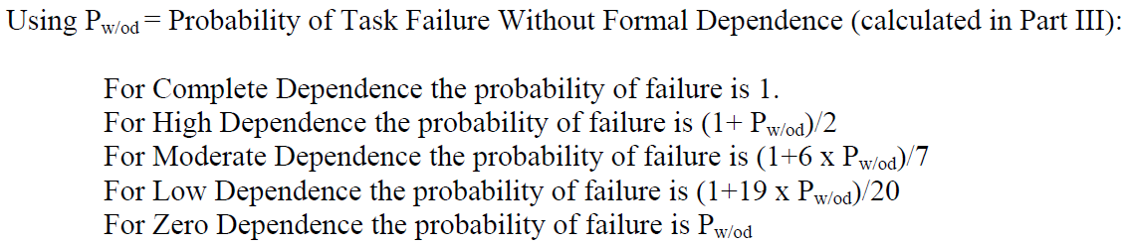
Quantify impact of dependency in HEP
Phoenix
SPAR-H
BBN updating
Time Step 1
Time Step 2
Multiplicative method
Causal Model
Source: Gertman, D.I et al. "The SPAR H human reliability analysis method.; Human Factors, Robotic, and Remote Systems," Idaho National Engineering and Environmental Laboratory, Idaho Falls, United States, pp. 17–24 (2004).

Slide 20
BBN modeling and Bayesian updating lead to estimate HEP considering PIF state changing by time step
First timestep |  | Second timestep
An initiating event occurs and critical task A1 is performed to prevent the event from progressing. | Situation | Critical task A1 fails and recovery is attempted by critical task B1
PIF X and PIF Y | PIF considered | PIF Y and PIF Z
P(CFM A1) | Calculation | P(CFM B1|CFM A1=1)

Slide 21
Conclusion and future work
Phoenix processes are different from SPAR-H are as below, which may contribute to possibly different HEPs
However, it is possible to “translate” elements of one method to the other (e.g., the PIFs) for a solid comparison study
We will continue this comparison between Phoenix and other methods
to discuss the HEP variation and the impact of the different approaches for dependency assessment.
 | Phoenix | SPAR-H
Causal Model (CFMs rooted in the IDA model) | Identify and classifies errors in information gathering, decision-making and situation assessment, action taking phases combination of those | Classify errors as Action Decision
PIFs modeled | Three layers Lead to Crew Failure Modes probabilities | One layer Impact the HEP directly
Quantitative framework | Estimate Human Failure Probabilities through modified Crew Failure Mode probabilities | PIFs and dependency impact are multiplicated to nominal HEP

Slide 22


Question?
Kanoko Nishiono¹, Marilia A. Ramos², Yoshikane Hamaguchi¹, Ali Mosleh²
1: Regulatory Standard and Research Department, Secretariat of Nuclear Regulation Authority (S/NRA/R)
2: The B. John Garrick Institute for the Risk Sciences, University of California Los Angeles (UCLA). Los Angeles, United States of America
^{nishiono_kanoko_yg4@nra.go.jp}
Note :
The views expressed in this paper are those of the authors and do not reflect the views of the Nuclear Regulation Authority, Japan.

