Slide 1
Are we going towards "no-brainer" risk management?
A case study on climate hazards
Nicola Tamascelli^{a,b}, Antonio Javier Nakhal Akel^{c}, Riccardo Patriarca^{c}, Nicola Paltrinieri^{a,d} and Ana Maria Cruz^{d}
ª Department of Mechanical and Industrial Engineering, Norwegian University of Science and Technology, Trondheim, Norway
^{b} Department of Civil, Chemical, Environmental, and Materials Engineering, University of Bologna, Bologna Italy
^{c} Department of Mechanical and Aerospace Engineering, Sapienza University of Rome, Rome, Italy
^{d} Disaster Prevention Research Institute, Kyoto University, Kyoto, Japan

Slide 2
Outline
Risk management in the digital era
Machine Learning: opportunities and limitations
The human role
Clustering of climate-driven disasters
Results and discussion
Conclusions
Notes:
Key aspects and enabling technologies of RM in the digital era
Opp and limitations of ML in the field of safety and risk management
Discuss if and to what extend humans can capture opportunities and overcome limitations
Show an example of
Present and discuss the results
Draw final conclusions

Slide 3
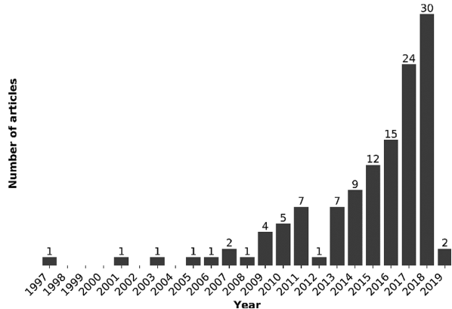
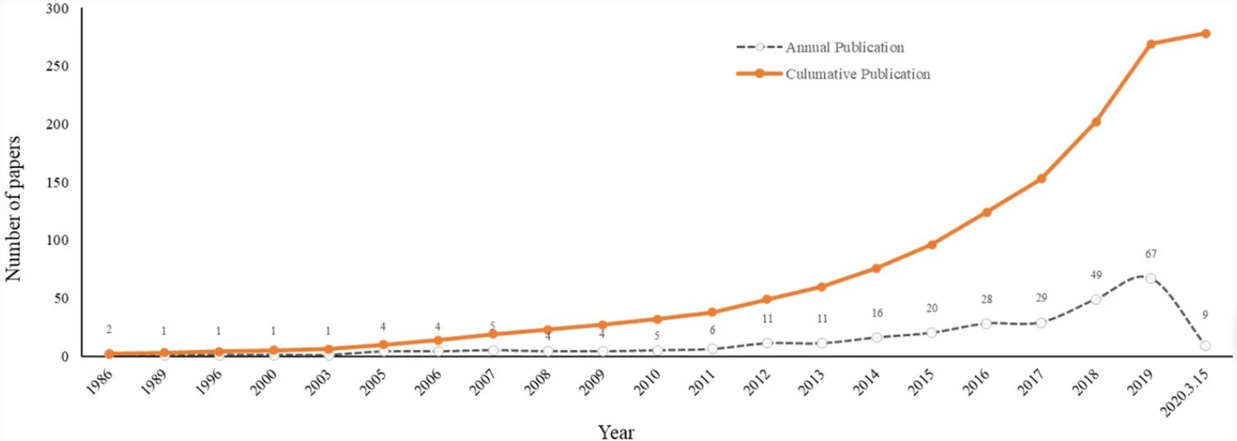
1. Risk management in the digital era (I)
Risk analysis will “rely more on the advances being made in Artificial Intelligence (AI) and cognitive sciences” (Diekmann, 1991)
ML and AI for risk management is an emerging field of study
Engineering risk assessment
Natural Disasters Management
Notes:
Expectations on the future role of AI were high.
How much of these expectations have been satisfied so far?
From the perspective of academic research, Diekmann’s prediction has revealed true.

Slide 4
1. Risk management in the digital era (II)
Computing
AI
Safety 4.0
IoT
Databases
How close are we to digital risk management?
What is the role of humans?
Notes:
Recent advancements in IoT and smart sensors → increased quantity of data → stored in easily accessible databases
Combination of advanced data mining algorithms and improved computation power → take advantage of heterogeneous data
Advancements has affected Safety as well → theorization of the so-called Safety 4.0 or digital safety.
We are far away from the point where the responsibility for human and system safety is entirely moved to the machine
approach the problem from the perspective of the human user and answer

Slide 5
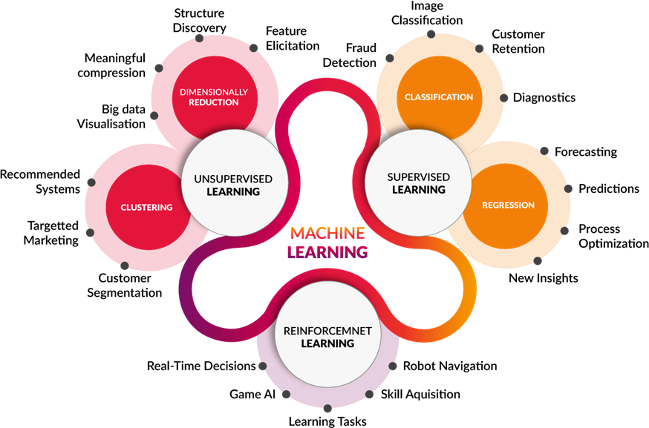
2. Machine Learning: opportunities and limitations (I)
“Methods that can automatically detect pattern in data . . . and perform decision making under uncertainty” (Murphy, 2012)
Risk is uncertainty about events and their consequences
Notes:
Define ML → definition interesting because risk is, in fact, Risk is …
So, a number of studies have proposed to take advantage. . . .
Is it really that simple?

Slide 6
2. Machine Learning: opportunities and limitations (II)
Uncertainty does not disappear!
Model
Which model?
Hyperparameters
Quantity
Quality
Significance
Interpretability
Confidence
Data
Results
Notes:
The answer is NO. Because. . . .
It can be found behind modelling choices and parameters setting
We must be aware of three “additional” sources of uncertainty
Significance → data is enough to describe the phenomena?
→ do I need a different set of features? Am I even aware that
ML algorithms cannot be aware or manage this additional sources of uncertainty.
Then who is responsible to acknowledge and manage the uncertainty hidden in ML?

Slide 7
3. The human role
Humans must acknowledge the “extra” uncertainty
ML addresses the uncertainty in the phenomena . . .
. . . but humans must manage the uncertainty in ML
Designer
User
Domain knowledge
Choose and preprocess data
Model selection
Hyperparameters tuning
Understand the model architecture
Acknowledge limitations and uncertainty
Notes:
Typically, at least two humans are involved in the development and deployment of ML algorithms.
Describe designer and user
The thread that links these two figures is domain knowledge.
Designer → knowledge of the application domain
User → knowledge of the model strengths and limitations (weaknesses)
→ circumstances in which the model is more likely to fail
We need to move from “how much are we sure that a certain event will occur in this situation” to “how much are we confident that the machine performs as intended in this situation”.

Slide 8
4. Clustering of climate-driven disasters (I)
Cluster countries based on their similarity with respect to climate-driven disasters
Bangladesh
Bangladesh
Madagascar
Japan
. . .
Vietnam
Learning opportunities
Cross-country learning
Japan
. . .
Jamaica
Madagascar
Vietnam
. . .
Jamaica
. . .
Climate-driven → storms, floods, drought, heatwaves
How to define and quantify similarity?
Notes:
In the next few slides → practical example. Focus on the sources of uncertainty and role of humans
In this example, we want to use ML methods to
A small clarification: Climate-driven =
The first question we need to answer is……

Slide 9
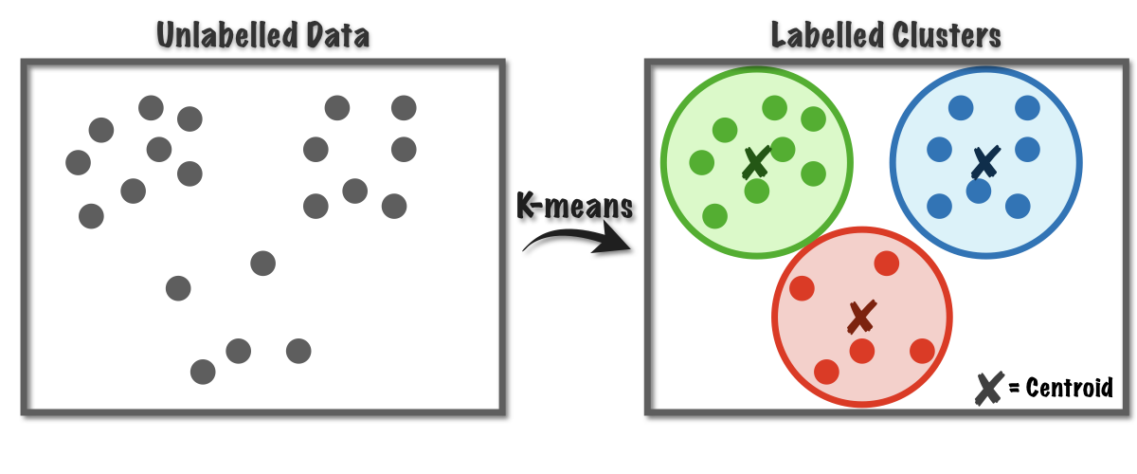
4. Clustering of climate-driven disasters (II)
Six numerical features are used to describe each country
Similarity $↔$ Euclidean distance
Clustering algorithm → k-Means
Country | Location | Disaster count | Deaths | Missing | GDP PPP | Pop. density | Disaster Type
Afganistan | 10 | 136 | 8940 | 0.125 | 80.9 | 46.63 | [-1.32, -0.619]
Argentina | 3 | 85 | 529 | 0.4 | 942.5 | 15.17 | [-0.48, -0.098]
. . . | . . . | . . . | . . . | . . . | . . . | . . . | . . .
EM-DAT
The world bank
Select most relevant features
Data-preprocessing
(k = 3)
Notes:
First of all, we need to decide how to describe a country
Each country described by six numerical features
Here we can see the first source of uncertainty we mentioned before → uncertainty in data; and how humans play an active role in managing this uncertainty
Now that we decided how to describe a country we must define what is similarity
In this context → distance in the 6-dimensional feature space

Slide 10
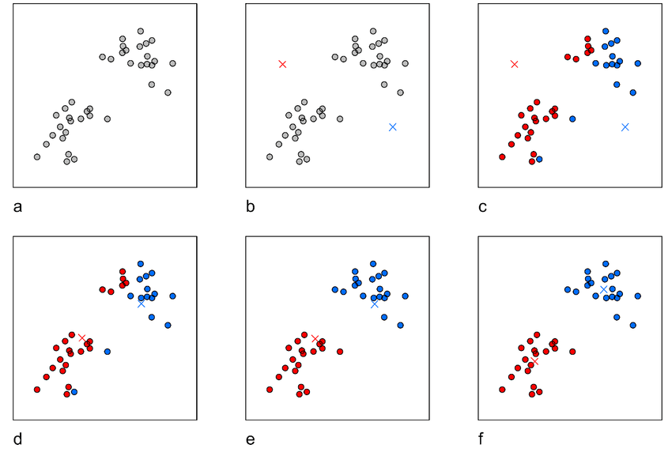
4. Clustering of climate-driven disasters (III)
K-Means algorithm (k = 2, iterations = 2)
Original data
Centroids initialization
Samples assignment
1
2
3
Select the number k of clusters
Compute new centroids
Samples assignment
Compute new centroids
4
5
6
Silhouette index
Domain knowledge
Context and objective
Adapted from Piech (2013)
Notes:
K-means is an iterative process
Again, here we can see the second source of uncertainty, that is, the uncertainty linked to modelling choices.
Silhouette = measure of how similar an object is to its own cluster (cohesion) compared to other clusters (separation)
Domain knowledge = maybe we already know the right number of clusters
Context and objective = maybe we are interested in small clusters
Human user must consider all of these aspects to effectively select the best algorithm and hyperparameters

Slide 11
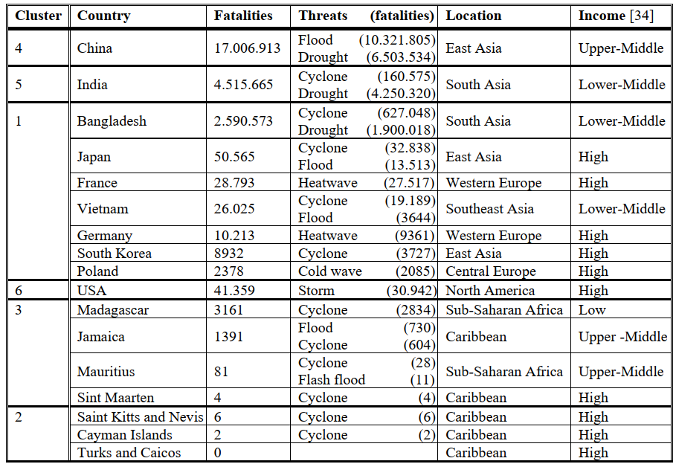
5. Results and discussion (I)
Countries were grouped into 40 clusters (k = 40)
Stand-alone countries
Largest number of fatalities
Smallest silhouette index
Largest silhouette index
Notes:
k-means was applied to the 189 countries that formed the dataset
40 clusters were formed
Only the most interesting clusters are displayed in this figure, which shows. . .
3 stand alone clusters → ok because of the unique characteristics of these countries in terms of location, area, exposure to natural threats, and economy
The green cluster → islands, low fatalities, cyclone Caribbean, high income
Orange → largest cumulative number of fatalities → heterogeneous

Slide 12
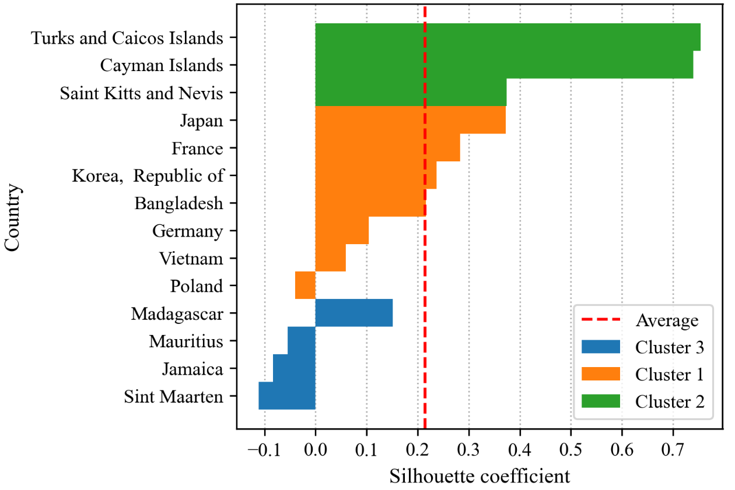
5. Results and discussion (II)
Some clusters appear heterogeneous
Interesting for cross-country learning
Interpret clusters
Extract lessons
Spot learning opportunities
Acknowledge limitations
France
Vietnam
Japan
Heat waves
Floods, storms
Germany
Korea
Bangladesh
Notes:
Describe figure
The fact that some clusters appear heterogeneous
here we can see the third and last source of uncertainty, that is, the uncertainty linked to the results
ML may provide clusters, but domain knowledge is needed to extract lessons from clusters.
Focus on orange cluster: → Poland may be considered an outlier
→ Manual analysis of disaster trends permitted to identify the learning opportunities in fig
CLUSTERING MAY SPEED UP THE ANALYSIS (highlighting similar countries that may be worth to compare), BUT KNOWLEDGE EXTRACTION IS UP TO HUMANS.

Slide 13
6. Conclusions (I)
We are not close to "no-brainer" risk management
Machine Learning has huge potential to improve safety
Additional sources of uncertainty
Human intervention and domain knowledge is essential
Manage uncertainty
Understand how the model operates
Understand limitations
Reliability
Effectiveness
Adoption
Notes:
Improve safety → enable real time monitoring, dynamic risk assessment, improve learning from past disasters and promote knowledge transfer
Humans must be aware that uncertainty does not disappear once we apply ML.
Example of clustering and role of humans to address uncertainty in data, model, and results.
In conclusion, in order to ensure improve reliability, effectiveness, and adoption of ML for safety application, humans must

Slide 14
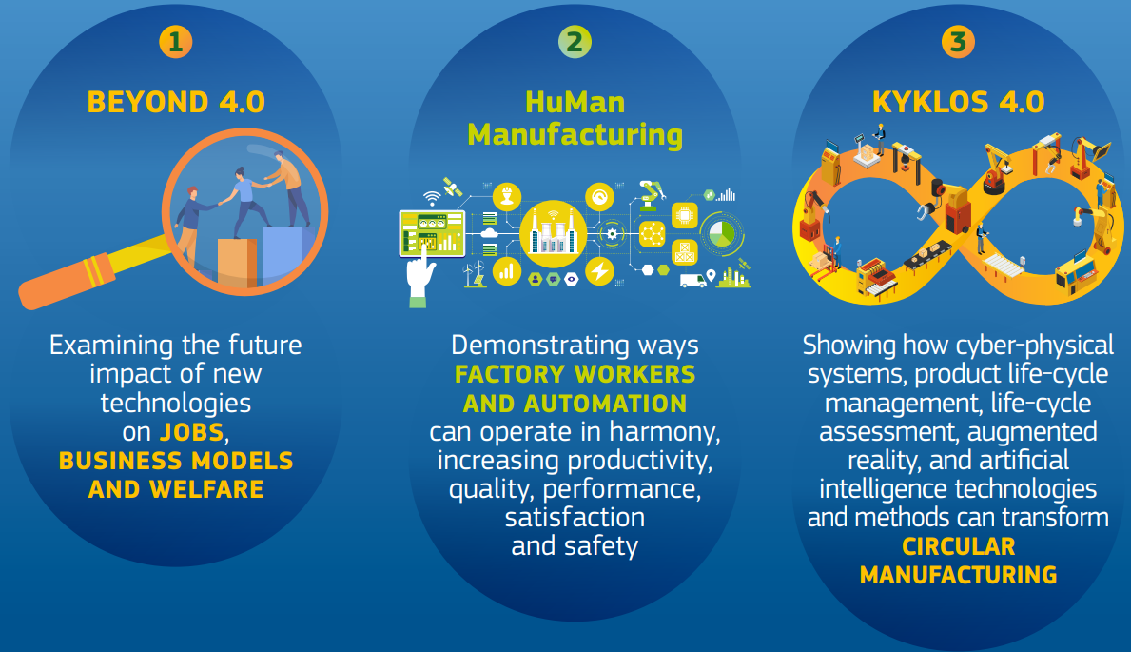
6. Conclusions (II)
Human-machine cooperation
Ensure sustainable adoption of ML algorithms for Safety applications
Industry 5.0
Industry 5.0 - Publications Office of the EU (europa.eu)
Notes:
The considerations made so far clarifies that the future of safety will focus on human-machine cooperation rather than competition to ensure. . .
This perfectly aligns to the idea of industry 5.0, which aims to go beyond industry 4.0 toward a more human-centric framework, where humans and machines cooperate to improve productivity, performance, and safety.

Slide 15
Thank you
Nicola Tamascelli:
nicola.tamascelli@ntnu.no
nicola.tamascelli2@unibo.it

Slide 16
References
J. E Diekmann, Risk analysis: lessons from artificial intelligence, Int. J. Proj. Manag., vol. 10, no. 2, pp. 75–80, 1992, doi: http://dx.doi.org/10.1016/0263-7863(92)90059-I.
K. P. Murphy, Machine Learning: A Probabilistic Perspective. Cambridge, Massachusetts, United States: MIT Press, 2012.
C. Piech, K Means Stanford CS221, 2013. Accessed June 09, 2022, from http://stanford.edu/~cpiech/cs221/handouts/kmeans.html

