Slide 1



OSMA Digital Evolution: R&M
Physics of Failure (PoF) Handbook
Anthony DiVenti, Reliability & Maintainability Technical Fellow NASA HQ
Nancy J. Lindsey, Reliability & Maintainability Deputy Technical Fellow NASA HQ/GSFC
For the PoF Handbook Development Team: Jeff Dawson (GSFC), Nobel Sindjui (GSFC), Doug Sheldon (JPL), Nancy Lindsey (HQ/GSFC), Anthony DiVenti (NASA R&M Technical Fellow), and many NASA contributing authors

Slide 2
Outline
National Aeronautics and Space Administration
www.nasa.gov
  Evolutionary Vision
  Why Physics of Failure ?
  Physics of Failure (PoF) Handbook
  How can the Community be engaged?
  Questions
Mission Assurance Standards and Capabilities Division
OSMA HQ-GD000

Slide 3
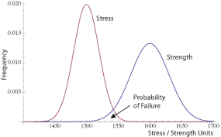
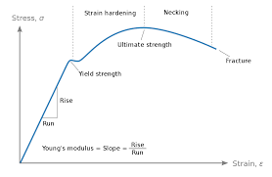
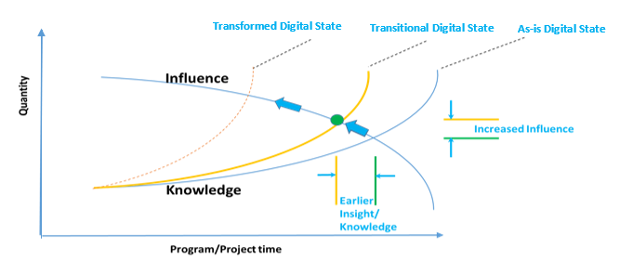
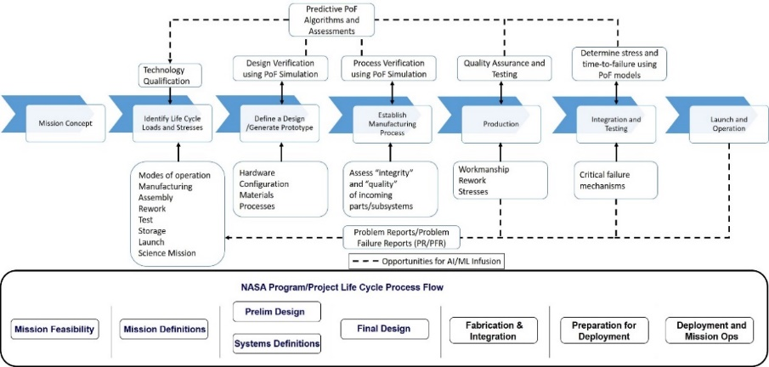
Evolutionary Vision
National Aeronautics and Space Administration
www.nasa.gov
Past
Data Access
AI/ML Infusion
Advanced Multi-Physics
QMU
Computing Power (HEC)
Full Digital Utilization
Future
Adhoc
Digital Enabled Analysis/Performance Interoperable Environments/Models
Digital Handbooks/
Guidance
SMA Requirements and Plans
QA Inspection Criteria
Hazard
Analyses
R&M Analyses (FTA, FMECA, PRA & CILs)
Today
Application Framework(s)
Integrated Body of Knowledge
Mission Assurance Standards and Capabilities Division
OSMA HQ-GD000
Notes:
Emphasize the importance of reliability engineering's role in developing the likelihood of success/failure in assessing risk. with that, the focus our PoF efforts has been bridge the interconnective between Probability estimates and PoF analysis.
In the past, much of our reliability and PoF activities have been adhoc in nature, whether doing empirical Strength vs Stress statistical analysis, deterministic fatigue analysis, or doing PoF related simulations through an engineering tool/platform.
Today, from a Reliability perspective, we are moving the ball forward with developing an integrated body of knowledge and application frameworks to support advanced and consistent Reliability support of mission throughout their life cycle. For example, we have developed an RMA knowledge portal and we are continually expanding our training and method advancement knowledge sharing via frameworks (PMD, PoF. Maintainability). This is allowing Reliability to raise the knowledge curve and push it to the left .
Tomorrow, our evolutionary vision is that of Full Digital Utilization!!! Many of you have probably heard about the evolving DT principles and applications being applied across associated with making our DATA/Knowledge F.A.I.R and linking necessary requirements, processes, data, and products together using Model-Based tools and methods, it is with these DT activities that we can begin building digital threads between PoF analysis describing and predicting how items can fail and corresponding analysis products such as FTA or FMEA/FMECA/CILs, which provide decision makers with necessary information when decided whether to accept or continue mitigating failure risks to Mission Success or Safety. Furthermore, with FULL digital utilization, whether it is access to Orders of Magnitude more data than ever before through use of sensor or other means, or Order of Magnitude improvements to our computing power and speed (including High End Computing (HEC)), we have real opportunities to utilize Model-based engineering and AI/ML and other advancements as part of our day-to-day applications. This will allow Reliability and SMA to raise the knowledge curve and further to the left .
Reliability is not waiting for full digital transformation begin transforming. We are already creating and providing Digital Handbooks and Guidance (emboldened text) to practitioners and stakeholders. One of these efforts has been the conversion of the PoF body of knowledge into a NASA handbook, which is available digitally and provides a potential common window/portal to access needed information for particular PoF applications. It is this Digital window that provides the basis for a new NASA framework to continually build our PoF body of knowledge complete with actual use-case examples across the NASA life cycle. At this time, I just want to emphasize how excited we are share this work with both the SMA and Engineering communities as part of today’s meeting. Collectively, we have a tremendous opportunity to bring both best practices and evolving PoF tools/applications/methods together to match Needs across all of NASA’s lifecycle applications. I know myself, Nancy, and her team are very excited to work with you and others on this effort.
Keeping these opportunities in mind, I am excited to turn the mic over to Nancy who will share the work done by there team in developing the PoF Handbook and basis for our evolving NASA PoF application framework……
References:
[1] Infusing Big Data as part of a NEW Physics of Failure (PoF) Framework, Anthony DiVenti, Bhanu Sood PhD, & Prince Kalia, NASA, Doug Sheldon PhD, NASA JPL, California Institute of Technology

Slide 4
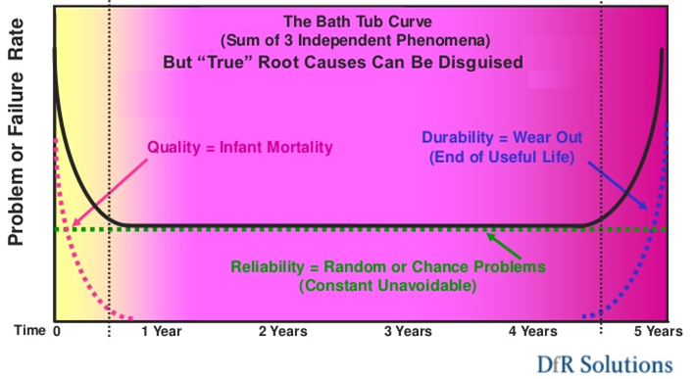
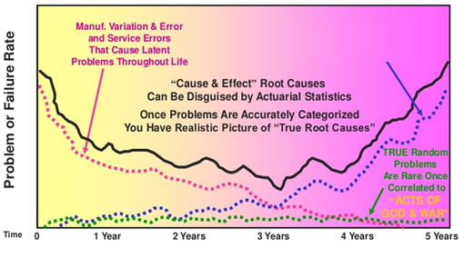



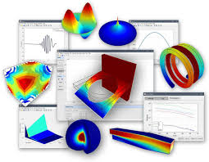
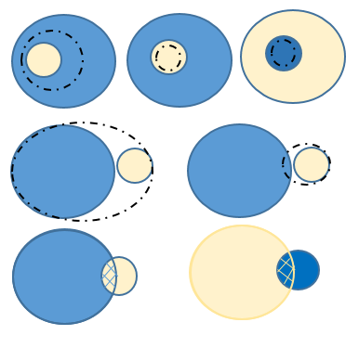
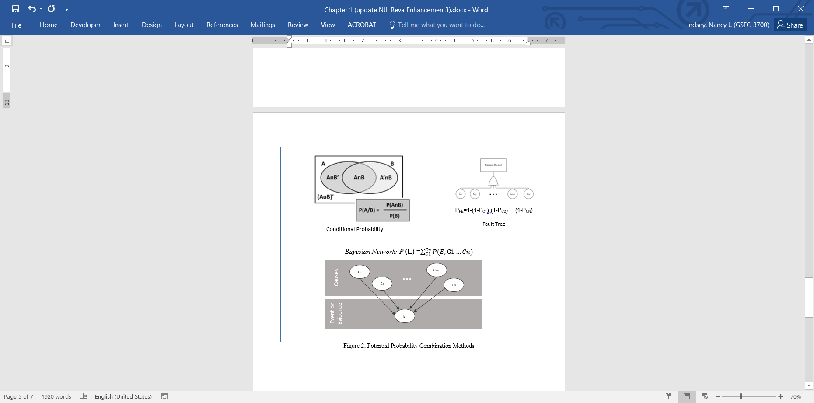



National Aeronautics and Space Administration
www.nasa.gov
  Why Physics of Failure (PoF)?
  Transition from bathtub curve assumptions
  to Root Cause Models for more realistic risk assessments.
Hypothetical Experimental Physics Result
Wear Out
Failure “Cause & Effect” Characteristics can be estimated using Physics
Image Courtesy of DfR Solutions [1]
Image Courtesy of DfR Solutions [1]
Hypothetical Radiation
Theory Result
All
L=1
$$\sum{ … }$$
[2] [3] [4] [5]
(……………………………………………………..……. Data/Models………………………..………………………..………)
(…………. Likelihood Relationships and Statistical Fusion Processes……….……)
Mission Assurance Standards and Capabilities Division
OSMA HQ-GD000
Notes:
Bathtub or constant failure rates assumption have issues. Excess redundancy costs or failure risk assessment. For example one NASA mission was predicted to have 13-14% chance of making its 6 year design-life, and its now 20 years into its mission and still on the primary side of redundant systems; Another had a probability of success value of 0.96 for the minimum mission duration of 2 years and 0.44 for the full mission duration of 5 years and is now 12 years into successful science mission.
<click>
PoF is a scientific discipline that determines the root causes of failure for systems, electrical, electronic or electromechanical (EEE) items, or mechanical systems. Using the postulate root causes or the systenm’s repsonses to the laws of physics that when they are mathematically modeled they can identify how likely a failure is to occur.
Physics of failure methodologies generally contribute to:
Defining the environmental conditions that components or assemblies will experience, by simulating the actual hardware operation in its assumed stress states.
Predicting hardware life by simulating stress conditions and utilizing failure models.
Enabling better design trade and sensitivity studies, where design parameters such as materials, geometries, configurations, and stresses may be easily manipulated in computational models.
Enhancing reliability and risk assessment activities.
Reliability estimation
Helps assess new versus obsolete parts in lieu of or based testing.
Note one cause or the combination of causes needs to be verified as capturing the entirity of the system’s volunarablities before the overall failure risk can be known.
This doesn’t eliminate testing (custom or legacy, such as handbook sources or previous/simliar systems/items - If testing is possible/pratical.) or performance data use. But modeling (third graphic) … could eliminate "overtest as you don't fly“ which may not be the optimal or subsititute testing. …leading to tailored/justified testing.
<click>
In terms of Reliability and this handbook PoF is the development of all root cause likelihoods/models that can be combined using sound reasoning and statistics. Conditional probability, baysiean networks (relational probabilistic models that represents a set of variables (failure likelihoods) and their conditional dependencies that can be solved for overall hypothesis=Failure likelihood), Fault Trees/Bolean logic. In its basic form, it is used to combine the results from several independence tests/Failure cause liklihoods bearing upon the same overall hypothesis/failure likelihood.
Graphics References:
[1] DFR Graphics - Introduction to Physics of Failure Reliability Methods, James McLeish, 2011 ASQ Presentation, ”https://www.slideshare.net/ASQwebinars/introdution-to-pof-reliability-methods.
[2] Handbook - https://blog.richmond.edu/heroes/files/2014/10/handbooks.jpg
[3] Monitoring - https://www.eginnovations.com/blog/how-can-i-use-microsoft-scom-for-end-to-end-performance-monitoring/
[4] Simulation - https://www.featool.com/multiphysics/
[5] Statistical images – From Draft PoF Handbook not publish but authored by PoF Team.
Fischer’s Method, Bayesian Nets, Conditional Probability, Fault Trees.
See Backup Image from paper if needed.

Slide 5
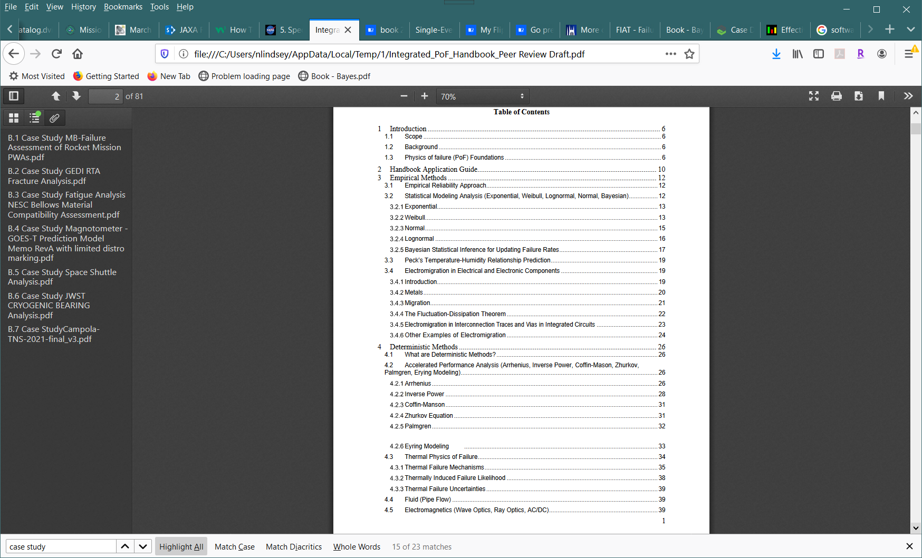



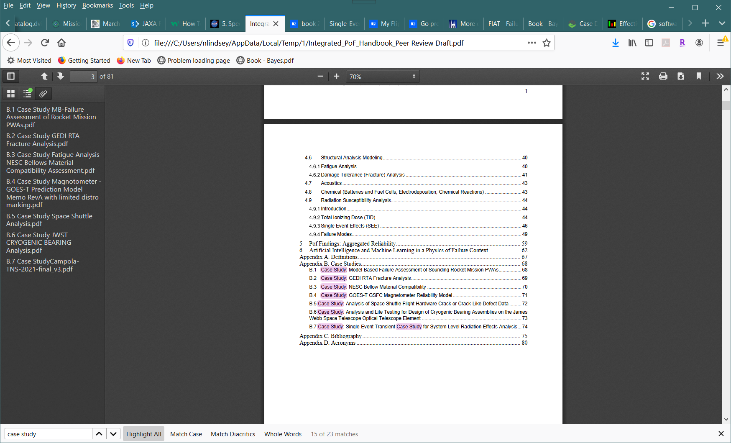
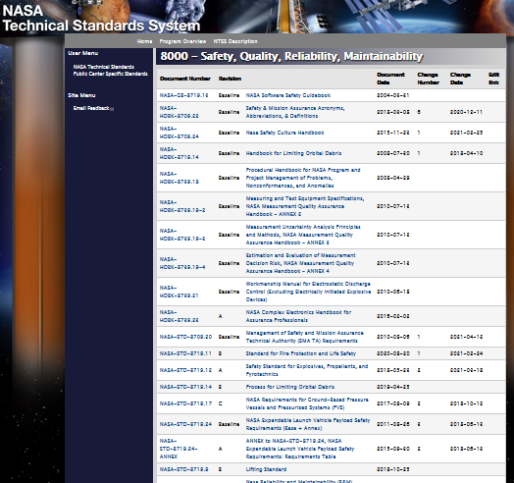
  R&M Physics of Failure (PoF) Handbook
National Aeronautics and Space Administration
www.nasa.gov
Empirical: Analysis methods that study the failure history of parts under given conditions, then fits the failure data to a probability distribution. Responsive to new concepts.
Deterministic: Analysis methods that involve the study of the predicted underlying physical processes/causes that could cause failure and results in a mathematical relationship describing the failure potential. Responsive to new concepts.
NASA
Aggregation: Using a single method or multiple methods concurrently with or in lieu of reference rates (e.g., handbook data) to develop system failure likelihood using statistical techniques and considering dependencies of individual findings. . Responsive to capability/concept advancement uncertainties, model-based, etc.
Future: Technology advancement infusion of Multiphysics tools, Artificial Intelligence, and Machine Learning.
Share and
Advance!
Case Studies: NASA examples of application (separate and controllable); Ever increasing set – Community sourcing!
Mission Assurance Standards and Capabilities Division
OSMA HQ-GD000
Notes:
The handbook is intended to be an overview of PoF methods and techniques as well as including examples and pointers for further information on each topic (see Table of Contents (TOC) on the left).
Aggregation: The objective is to calculate the actual probability of a space asset’s planned or current components and to more closely predict actual performance. This may mean that a single method or multiple methods would be utilized or should be used concurrently with or in lieu of reference rates (e.g., handbook data). Considering this, it is important for the analyst to evaluate the magnitude, independence, and dependence of each likelihood given by each physics of failure methodology on a case-by-case basis.
Empirical: Failure rate empirical estimation methods used in science and engineering are often based on past data. Using component failure data from field studies, warranty claims, and lab tests, reliability engineers have developed techniques to predict the reliability of systems. Or in PoF terms based on past physical mechanisms esperienced (or Physics experienced).
Deterministic: Deterministic Models analyze the dominate failure mechanisms behind a failure and how they limit the functional capability of the component (Varde, 2010). Failure mechanisms described by Deterministic Models include degradation (due to accumulated damage from stress), erosion, diffusion, and corrosion phenomenon leading to sudden or eventual failure (Schenkelberg, 2020). The model incorporates the component load profiles, material specifications, and environmental stresses to recreate the life condition a component or system experiences as a means to predict the reliability. Often this approach is based on the utilization of software applications which has advantages such a predefined or tailorable load profile and the ability to define geometric and electrical properties of the component under analysis. Over the years modeling precision and accuracy has increased, which has led to a deeper understanding of failure mechanisms and more realistic predictions (Zoran and Vlado, 2008).
SHARE To Advance > Enable virtual access to solicit addition content and case studies. Living Document!!

Slide 6
  R&M Physics of Failure (PoF) Handbook
National Aeronautics and Space Administration
www.nasa.gov
Empirical analysis uses and experimentation that exposes a system to multiple branches of physics (e.g., Thermodynamics, Kinematic/Static Mechanics, Acoustics, Fluids, Optics, Electrical) and the exhibited performance can be used to formulate the likelihood of failure of like systems under similar exposures using statistical approximations (e.g., Normal, Lognormal, Weibull, Thermal, Bayesian, Electromigration).
Empirical: Analysis methods that study the failure history of parts under given conditions, then fits the failure data to a probability distribution. Responsive to new concepts.
Lognormal
Weibull
Thermal/Electrical
Bayesian
Case Studies: NASA examples of application (separate and controllable); Ever increasing set – Community sourcing!
Mission Assurance Standards and Capabilities Division
OSMA HQ-GD000
Notes:
Empirical: Failure rate empirical estimation methods used in science and engineering are often based on past data. Using component failure data from field studies, warranty claims, and lab tests, reliability engineers have developed techniques to predict the reliability of systems. Or in PoF terms based on past physical mechanisms esperienced (or Physics experienced or experimental physics).
Methods is this part of the handbook focus on using statistical models to describe the physical behavior of components and systems. Such as The exponential distribution has a constant failure rate over time; as time increases, the probability of failure during a given time interval increases.; A Weibull analysis distribution estimate (when there is sufficient relevant failure data available) for an item that might have an increasing failure rate (wear out) or a decreasing failure rate (infant mortality); the lognormal distribution is used for components whose failure is due to stresses over time;
Bayesian inference which is a method of continual statistical inference in which Bayes' Theorem where experience is used to update the original probability a hypothesis or failure rate estimate, as more evidence or information about the system’s responses to operational physical stresses become available. This process can be considered an applied physics method that takes a prior distribution and evidence to statistically infer a new probability distribution, known as the posterior distribution.
Thermal/Electrical characteristics demonstrated in test and using Peck’s temperature-humidity model, based on test data, can be used to predict electronic semiconductor life or the potential for electromigration (metal ions movement observed) induced failure potentials
SHARE To Advance > Enable virtual access to solicit addition content and case studies. Living Document!!

Slide 7

  R&M Physics of Failure (PoF) Handbook
National Aeronautics and Space Administration
www.nasa.gov
Deterministic analysis uses the theories of physics (e.g., Thermodynamics, Kinematic/Static Mechanics, Acoustics, Fluids, Optics, Electrical) to formulate the likelihood of failure based on hypothetical or non-use-case (accelerated performance) exposures. These analysis depend on detailed system models and an understanding of the phenomenon that contribute to eventual or sudden failure of a system to formulate a prediction.
Deterministic: Analysis methods that involve the study of the predicted underlying physical processes/causes that could cause failure and results in a mathematical relationship describing the failure potential. Responsive to new concepts.
Inverse Power
Palmgren
Case Studies: NASA examples of application (separate and controllable); Ever increasing set – Community sourcing!
Mission Assurance Standards and Capabilities Division
OSMA HQ-GD000
Notes:
Deterministic: Deterministic Models analyze the dominate failure mechanisms behind a failure and how they limit the functional capability of the component (Varde, 2010). Failure mechanisms described by Deterministic Models include degradation (due to accumulated damage from stress), erosion, diffusion, and corrosion phenomenon leading to sudden or eventual failure (Schenkelberg, 2020). The model incorporates the component load profiles, material specifications, and environmental stresses to recreate the life condition a component or system experiences as a means to predict the reliability. Often this approach is based on the utilization of software applications which has advantages such a predefined or tailorable load profile and the ability to define geometric and electrical properties of the component under analysis. Over the years modeling precision and accuracy has increased, which has led to a deeper understanding of failure mechanisms and more realistic predictions (Zoran and Vlado, 2008).
Thermodynamics– Arrhenius, Inverse Power, and Coffin-Mason Analysis
Thermofluctuation – Zhurkov Analysis
Mechanics - Palmgren Modeling
Multiphysics (voltage, humidity, or mechanical stress) – Eyring Modeling,
Thermal Physics– Temperature and Heat Transfer Analysis
Fluids Modeling – Fluid Flow/Forces Analyses
Electromagnetics – Performance Interference/Disruptions, Failure, and Aging Analyses
Mechanics/Dynamics – Fatigue and Fracture Analysis
Acoustics - Harmonics and Vibration Modeling
Chemical Physics (atomic, molecular, and thermodynamics) – Chemical/Material Life/Decomposition Analysis
Radiation - Susceptibility Analysis (single event and cumulative)
True fully inclusive models of theoretical stresses of all kinds are still TBD.
SHARE To Advance > Enable virtual access to solicit addition content and case studies. Living Document!!

Slide 8
  R&M Physics of Failure (PoF) Handbook
National Aeronautics and Space Administration
www.nasa.gov
Empirical and Deterministic analyses are not necessarily mutually exclusive and can either independently or in combination inform the final likelihood of failure assumed for a system. Considering this, it is important for the analyst to evaluate the magnitude, independence, and dependence of each likelihood given by each physics of failure methodology on a case-by-case basis, so that statistical techniques, such as Fault Trees, Bayesian Networks, or Conditional Probability can be applied once or multiple times until all likelihoods are combined or considered.
Encompassed States
B. Complimentary States
C. Interrelated States
Aggregation: Using a single method or multiple methods concurrently with or in lieu of reference rates (e.g., handbook data) to develop system failure likelihood using statistical techniques and considering dependencies of individual findings. Responsive to capability/concept advancement uncertainties, model-based, etc.
Case Studies: NASA examples of application (separate and controllable); Ever increasing set – Community sourcing!
Mission Assurance Standards and Capabilities Division
OSMA HQ-GD000
Notes:
Aggregation: The objective is to calculate the actual probability of a space asset’s planned or current components and to more closely predict actual performance. This may mean that a single method or multiple methods would be utilized or should be used concurrently with or in lieu of reference rates (e.g., handbook data). Considering this, it is important for the analyst to evaluate the magnitude, independence, and dependence of each likelihood given by each physics of failure methodology on a case-by-case basis. (1)encompassed (when any likelihood covers the same failure scenarios or is part of another likelihood or the working aggregated likelihood (see .A)), (2) complementary (when two or more likelihoods (individual or aggregated) do not cover the same failure scenarios (see B)), or (3) interrelated (when any of the likelihoods to be combined have intersecting failure scenarios (see C)).
Fault trees are used to combine independent probabilities AND and OR gates would be used, while conditional probability finds the probability of successive pairs of cause probabilities;
Conditional probability finds the probability of successive pairs of cause probabilities (probability of event A occurring given the occurrence of event B (P(A|B) by dividing the probability of two events (A & B) occurring by the probability of the given event (B)) or evaluating the likelihood of all events occurring simultaneously (e.g., P(A and B and C) = P(A)P(B|A)P(C|A and B) for three probabilities);
Bayesian network of independent cause probabilities would be evaluated by multiplying the probabilities of each independent cause initiating the failure event (P(A|B)) with the probability of the cause in existence (P(B)) and the probability of the non-existence causes (1-P_{c,d,e,f} …) and summing the results of each permutation.
SHARE To Advance > Enable virtual access to solicit addition content and case studies. Living Document!!

Slide 9
  R&M Physics of Failure (PoF) Handbook
National Aeronautics and Space Administration
www.nasa.gov
Case Studies are included for clarity and as part of the living nature of the document :
Model-Based Failure Assessment of Sounding Rocket Mission Printed
Wiring Assemblies
GEDI RTA Fracture Analysis
NESC Bellow Material Compatibility
GOES-T GSFC Magnetometer Reliability Model
Analysis of Space Shuttle Flight Hardware Crack or Crack-Like Defect Data
Analysis and Life Testing for Design of Cryogenic Bearing Assemblies on the James Webb Space Telescope Optical Telescope Element
Single-Event Transient Case Study for System Level Radiation Effects Analysis
A General Reliability Model for Ni-BaTiO3-Based Multilayer Ceramic Capacitors
EOS Aqua Extended Mission Reliability Study Report, Revision C
New Approach to Total Dose Specification for Spacecraft Electronics
"Improving Reliability of High-Power Quasi-CW Laser Diode Arrays Operating in Long Pulse Mode"
Damage Propagation Modeling for Aircraft Engine
Degradation of Leakage Currents and Reliability Prediction for Tantalum Capacitors
Evaporative Heat Transfer Mechanisms within a Heat Melt Compactor
X-43A Rudder Spindle Fatigue Life Estimate and Testing
A Thermal Runaway Failure Model for Low Voltage BME Ceramic Capacitors with Defects
Analysis of Thermomechanical Fatigue of Unidirectional Titanium Metal Matrix Composites
Comparison of Experimental and Theoretical Thermal Fatigue Lives for Five Nickel Base Alloys
And More
Additional case studies are need, please shared what you may have or may produce in the future.
Today we have Multiphysics tools (e.g., COMSOL, MATLAB, Windchill, Ansys Sherlock, Cadence, Altair, etc.) to assist in the assessment of failure likelihood but these have limitations.
Based on the ongoing research, in the future PoF modeling will likely Include Artificial Intelligence and Machine Learning to enable a more complete evaluation with the application of predictive and statistical learning techniques.
For this to be possible research and data are needed from the community and must be share with the community.
Future: Technology advancement infusion of Multiphysics tools, Artificial Intelligence, and Machine Learning.
Case Studies: NASA examples of application (separate and controllable); Ever increasing set – Community sourcing!
Mission Assurance Standards and Capabilities Division
OSMA HQ-GD000
Notes:
The handbook is intended to be an overview of PoF methods and techniques as well as including examples (case Studies) and pointers for further information on each topic (see Table of Contents (TOC) on the left) and be a living resource so it must be informed by and inspire research into failures, physics, and modeling (AI/ML). This is why we have enabled virtual sharing (links on the next page ).
Currently, PoF modeling tools are Multiphysics modeling tools: COMSOL, MATLAB, Windchill, Ansys Sherlock, Cadence, Altair, etc. (more programmed than AI/ML and may only provide insight or prediction of specific or multiple (fatigue, thermal, RF , Fluids, etc.) contributions not all) and are based on combinations of solving systems of differential equations, that are first principals based, along with a mixture of well-established empirically driven relationships.
Since the underlying physical theories and related law expressions are in many cases mathematical approximations for the ease of computation, therefore AI/ML approaches are now being introduced into PoF in both the academia and industry at the conceptual level to mitigate reliance on approximations.
Artificial Intelligence (AI) is the overarching concept of trying to create intelligent machines that can mimic human thinking processes and behaviors or exhibit intelligence unique to computers.
Machine learning (ML) on the other hand is usually defined as a subset of AI focusing on training machines to learn from various data sources without specific and explicit software instructions. ML systems that learn and predict outcomes without manually programming a computer are also known as predictive analytics or statistical learning can further the efforts of PoF assessment.
These predictive and statistical learning techniques can be based on pattern recognition concepts and include supervised and unsupervised learning methods or for Physics of Failure - prognostics and fault detection and modeling (OR – “Physics-Based Modeling with Machine Learning“). Continued ML modeling advancement will provide a new direction in modeling both physical processes that are not completely described by current mathematics or understood, as well as exploring areas of incomplete knowledge very effectively to ensure design are as robust (failure detection and recovery, failure avoidance, improved architectures, etc.) as possible.
Since PoF not just for components, but for assemblies and eventually systems as well, as intractable as that may seem now; and current tools and methods have limitations; and AI/ML offers promise for future developments, a near-term approach might be to hybridize current prediction techniques with PoF is possible to use to capture the causal relationships between inter-dependent and interacting failure mechanisms as the system evolves over time. And this handbook is ready to assist with those efforts (and future ones).
For AI/ML and full PoF solutions to be possible research and data are needed from the community.
Research/Testing of AI/ML, materials, systems, life expectancies, environments, effects, physics, etc.
Example: AI/ML tools like distributed artificial intelligence based agent autonomy have been developed.
Lessons learned (data, patterns, susceptibilities) from observations, testing
We have Enable virtual access to the handbook to solicit addition content, research, and case studies. This is a Living Document that needs your involvement!!

Slide 10
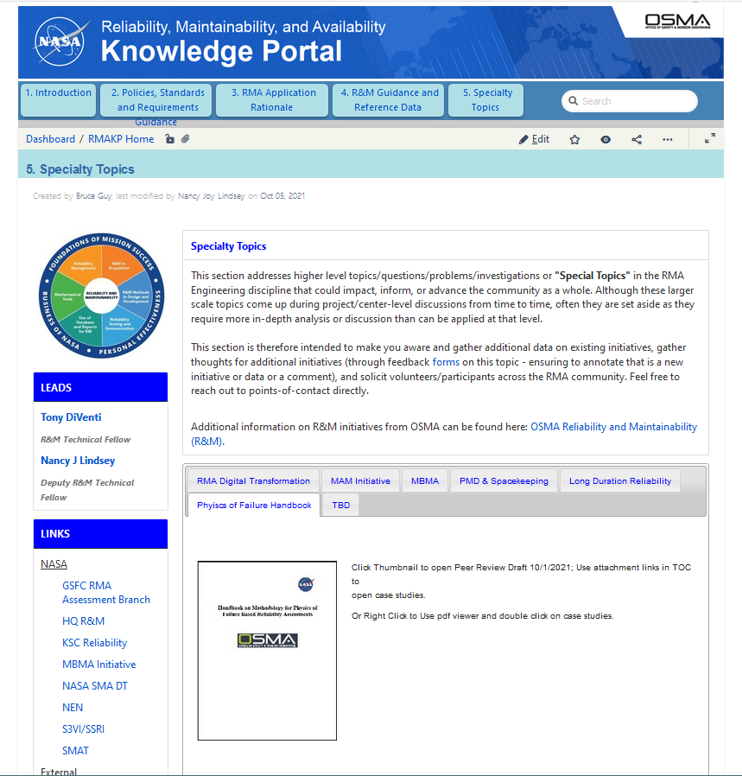
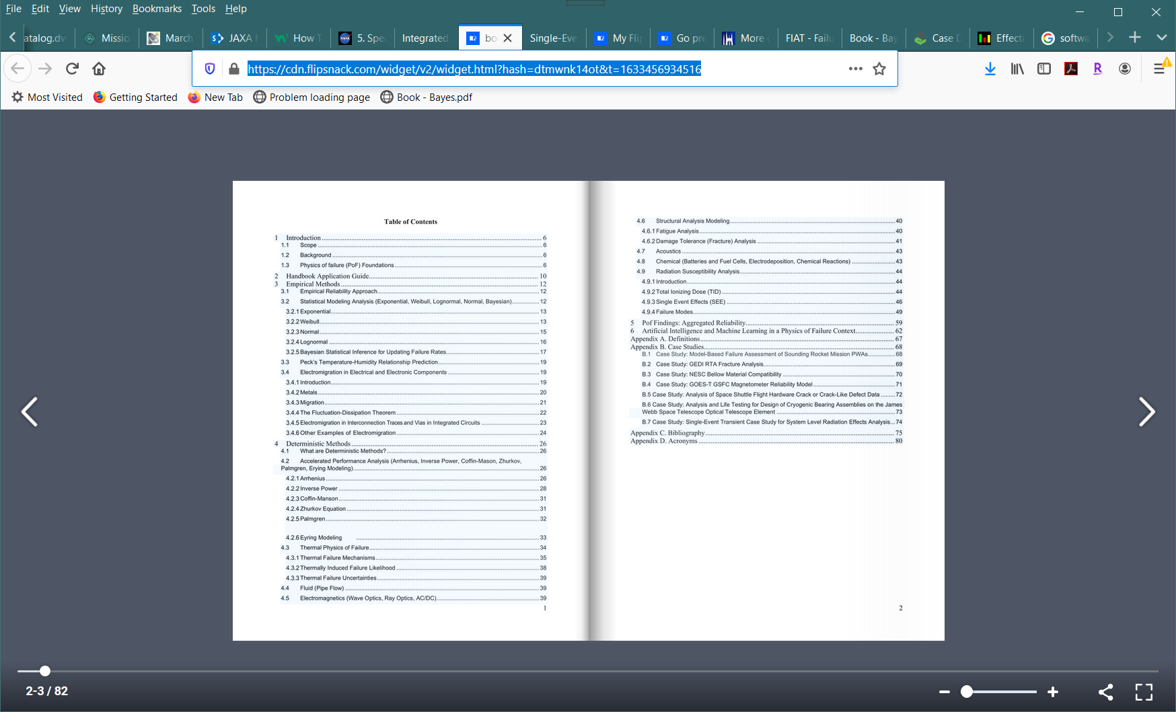
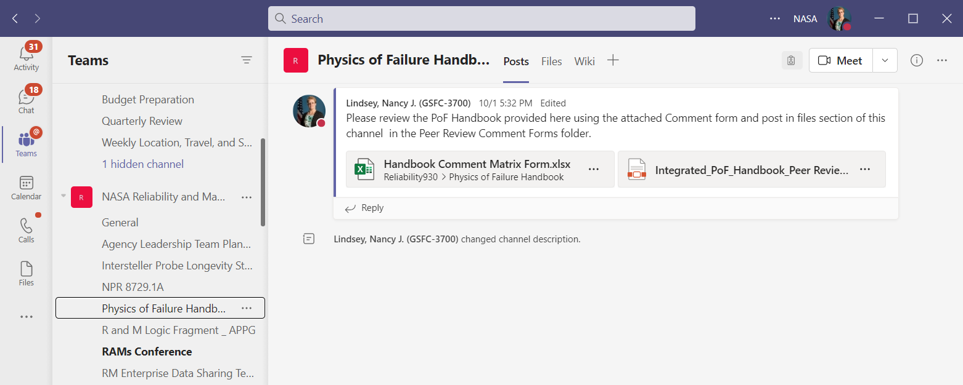
National Aeronautics
and Space Administration
www.nasa.gov
Community Engagement for R&M Physics of Failure (PoF) Handbook Advancement/Continued Evolution
RMA: PoF Handbook on NASA RMA Knowledge Portal (https://swehb-staging-pri.msfc.nasa.gov/display/RMAKP/5.+Specialty+Topics) and TEAMS (https://teams.microsoft.com/l/channel/19%3a9eb98aa16e7b45229a46e81dfb830af3%40thread.skype/Physics%2520of%2520Failure%2520Handbook?groupId=19fe22f8-e5cf-42f4-bf07-cb948663b19c&tenantId=7005d458-45be-48ae-8140-d43da96dd17b
NASA
SMA: Continue to share existence and solicit feedback/participation in the community of practice via conferences and discipline peers. Gather data/Case Studies
Engineering: Use roadshows to share existence and solicit feedback/participation in a community of practice. Establish a formal Community of Practice or become a branch from another one like NSET? Or NESC? Gather data/Case Studies
NASA: Share on other virtual/collaboration platforms. Release handbook as a formal NASA handbook. Add to STEP/SATERN. Gather data/Case Studies
Industry/Academia/Partners: Share with and gather data/Case Studies at Conferences.
We are counting on All of NASA and beyond to participate/support in the current peer review and in the future with continued research and data sharing!
Mission Assurance Standards and Capabilities Division
OSMA HQ-GD000
Notes:
Go to LINKS!!! If NASA or ask for a peer review copy (Peer review to close 7/15/2022 – but contributions can continue indefinitely)
SHARE To Advance - Therefore we have - Enable virtual access to solicit addition content and case studies. Living Document!!
Community of Practice? Community Sourcing?
Research opportunities?

Slide 11
National Aeronautics and Space Administration
www.nasa.gov
Questions
Mission Assurance Standards and Capabilities Division
OSMA HQ-GD000

Slide 12
National Aeronautics and Space Administration
www.nasa.gov
Backup Transition Motivation
Mission Assurance Standards and Capabilities Division
OSMA HQ-GD000
Notes:
As of January 2021

Slide 13
National Aeronautics and Space Administration
www.nasa.gov
https://swehb-staging-pri.msfc.nasa.gov/display/RMAKP/5.+Specialty+Topics
https://demo.nsc.nasa.gov/pof-handbook/
Mission Assurance Standards and Capabilities Division
OSMA HQ-GD000

