Slide 1
Development and Primary Application of a Level 2 PSA
Methodology in a Small Nuclear Plant design
Analysis, Evaluation and Risk Management Laboratory (LabRisco)
University of São Paulo - Brazil
Nathália N. Araújo, nathalia.nunes@labrisco.usp.br
Maritza R. Gual, maritza.gual@labrisco.usp.br
Ulisses A. M. Neto, ulisses.neto@labrisco.usp.br
Marcos C. Maturana, marcos@labrisco.usp.br
Marcelo R. Martins, mrmartin@usp.br

Slide 2
Summary
Introduction and objetive
Methodology
Identification of severe accident scenario
Nuclear systems
Results - event tree and fault tree
Final remarks

Slide 3
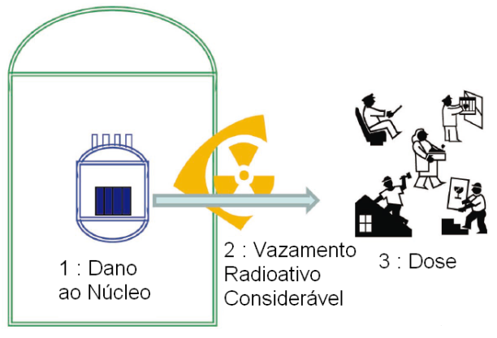
Introduction
The Probabilistic Safety Assessment (PSA) consist of a comprehensive and structured method of quantitative safety and risk assessment.
In nuclear industry, the PSA are performed for three different levels, from fuel damage to possible radiological release.
PSA Levels
At each level, the risk associated with the indicated event is analyzed
1 : Core
Damage
2 : Radioative
Leak
3 : Dose

Slide 4
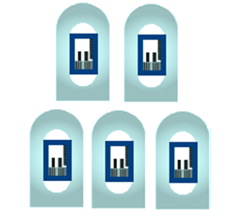
Introduction
Small and medium-sized reactors (SMR) are smaller than conventional reactors and are designed to produce up to 300 MWe.
A nuclear plant has two main operating states: full power and low power and shutdown (LPSD).
In Brazil, the Nuclear Regulatory Commission does not have specific PSA standards or recommendations for SMR.
Typical Reactor
SMRs

Slide 5
Objective
The main objective of the work is to define the scope of the modelling of a Level 2 PSA in the study of a loss of coolant circulation accident in the LPSD in an SMR.
The reference SMR is a two-loop pressurized water reactor (PWR) with an electrical capacity of 10 MWe.

Slide 6
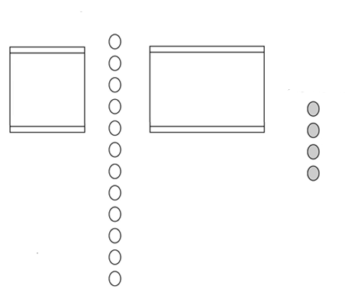
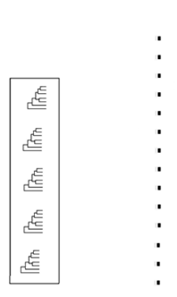
Methodology –Level 2 PSA
STEP 1
STEP 2
STEP 3
STEP 4
STEP 5
STEP 6
Final states of accident sequences and related occurrence frequences
Accidents
Sequence
Sub-PDS
(Plant Damage States)
Accident progression-
Containment
event trees
Source Terms
analyses
Calculation of the LERF
(Large Early Release Frequency)
Accident
grouping
process
Filtering of low
Frequency PDSs
Selected PDSs
Release category identification

Slide 7
Severe Accident scenario
Group number | Event | Main characteristics | Frequency of CDF(/yr) | Percentage of CDF in the LPSD
1 | Loss of coolant circulation in the SFP | Fuel transfer, part of the fuel in the SFP | 2.54E-06 | 5.60%
2 | Loss of coolant circulation in the SFP | All fuel in SFP | 2.54E-05 | 55.98%
3 | Loss of coolant circulation in the reactor core | All fuel in the reactor core. Reactor vessel head closed | 1.46E-05 | 32.14%
4 | Loss of coolant circulation in the reactor core | Fuel transfer, part of the fuel in the reactor core. Reactor vessel head open | 2.85E-06 | 6.28%

Slide 8
Severe Accident scenario
Group number | Event | Main characteristics | Frequency of CDF(/yr) | Percentage of CDF in the LPSD
1 | Loss of coolant circulation in the SFP | Fuel transfer, part of the fuel in the SFP | 2.54E-06 | 5.60%
2 | Loss of coolant circulation in the SFP | All fuel in SFP | 2.54E-05 | 55.98%
3 | Loss of coolant circulation in the reactor core | All fuel in the reactor core. Reactor vessel head closed | 1.46E-05 | 32.14%
4 | Loss of coolant circulation in the reactor core | Fuel transfer, part of the fuel in the reactor core. Reactor vessel head open | 2.85E-06 | 6.28%

Slide 9
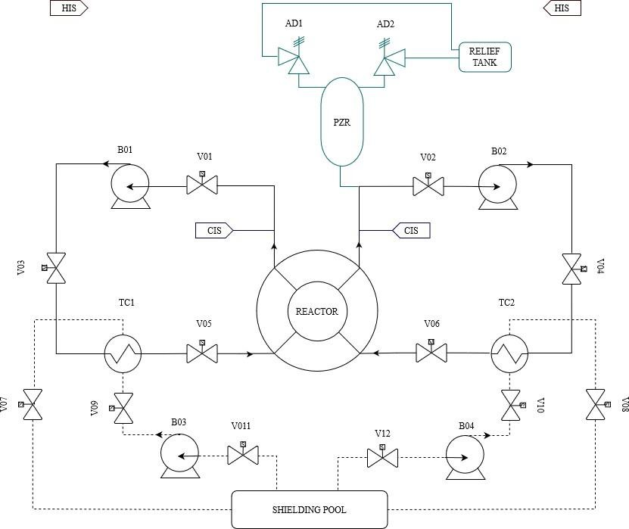
Nuclear systems
ADS – Automatic Depressurization System
B – Pump
CIS – Coolant Injection Subsystem
HIS – H2 Inertization System
V – Valve
PZR – Pressurizer
TC – Heat Exchanger

Slide 10
Nuclear systems
AD – Automatic Depressurization System
B – Pump
CIS – Coolant Injection Subsystem
HIS – H2 Inertization System
V – Valve
PZR – Pressurizer
TC – Heat Exchanger

Slide 11
Assumptions
Due to a lack of operational experience, some data used for failure rates were obtained from generic industry data, published probabilistic risk assessment data from similar nuclear power plants, and NUREG/CR-6928.
All component failures are considered repairable.
Steam generators are not available for emergency cooling.
The RHRS is identified as the second-highest contributor with respect to core damage from the system in the LPSD (for the reference design). The top common cause of failure (CCF) is the RHRS pumps B01 and B02 failing to run.

Slide 12
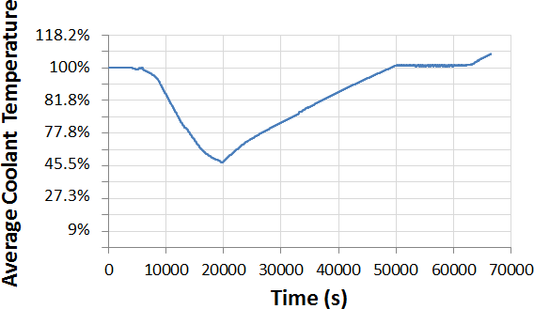
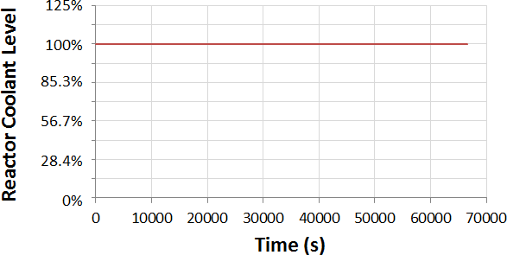
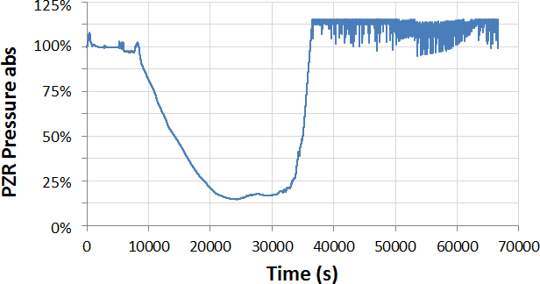
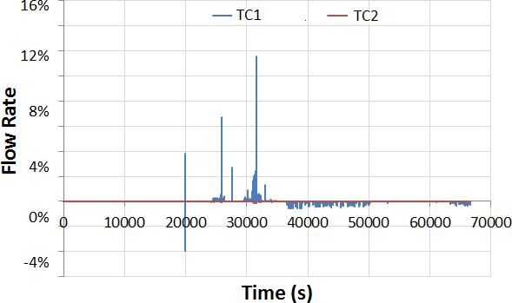
Initial event progression

Slide 13
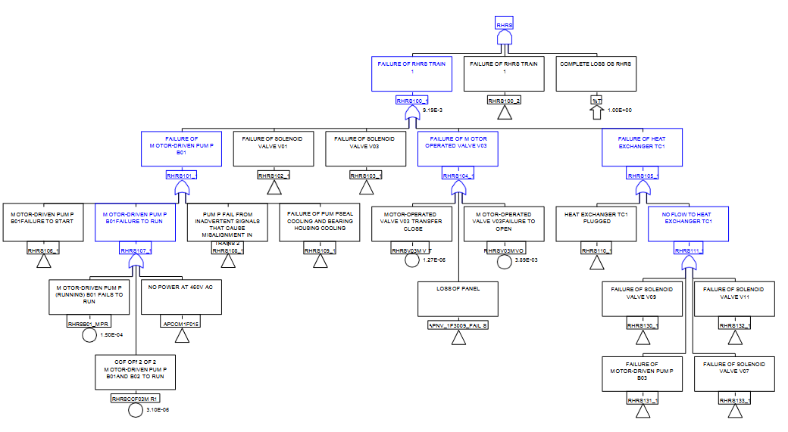
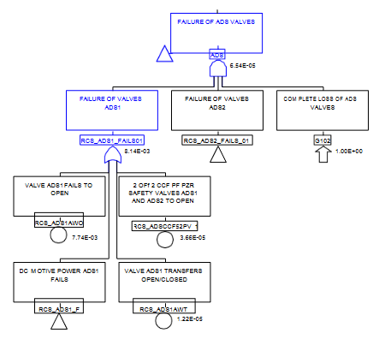
Fault Tree

Slide 14
Event tree
Loss of Coolant Circulation in the reactor
Reactor Cooling System – AD Valves
Recovery of RHRS
H2 control and mitigation
Contaiment
Integrity
Sequence 1
Sequence 2
Sequence 3
Sequence 4
Sequence 5
Computer Aided Fault Tree Analysis (CAFTA)

Slide 15
Event tree
1.46E-05
6.54E-05
8.27E-04
To be defined
To be defined
Loss of Coolant Circulation in the reactor
Reactor Cooling System – AD Valves
Recovery of RHRS
H2 control and mitigation
Contaiment
Integrity
Sequence 1
OK
Sequence 2
No release of FP to enviroment
Sequence 3
No release of FP to enviroment
Sequence 4
Release of FP to enviroment
Sequence 5
Release of FP to enviroment
Computer Aided Fault Tree Analysis (CAFTA)

Slide 16
Final remarks
The data obtained in this paper allowed the preliminary calculation of the frequency of sequence 1, 1.30E-05 /yr. From this data, it is possible to determine that the sum of the frequency of the other sequences is less than 1.56E-06/yr, which represents important information to the large early frequency release (LERF).
These results are preliminary, considering the methodology is under development, and for future studies, the event and fault trees will be improved to generate more results and expand the research.
The analysis of the loss of coolant circulation in the reactor core due to the failure of the RHRS with all the fuel in the reactor core and in the closed reactor vessel head in an SMR project demonstrated the need for further investigation in the study of safety and emergency systems

Slide 17
THANK YOU!

