Slide 1
Methodology & Demonstration of Git-Based Configuration Control in PRA
PSAM16
June 29th, 2022
Mostafa Hamza
mmhamza@ncsu.edu

Slide 2
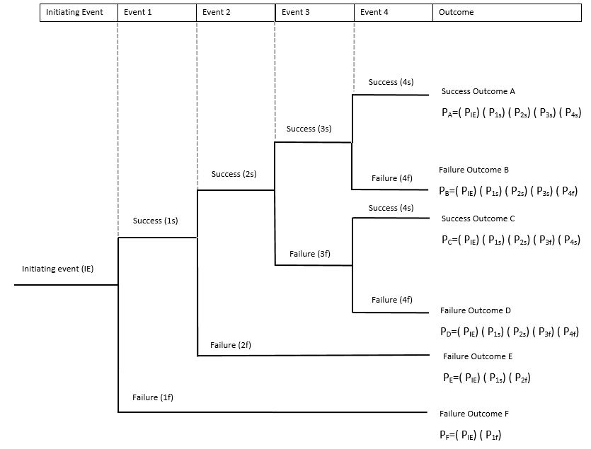
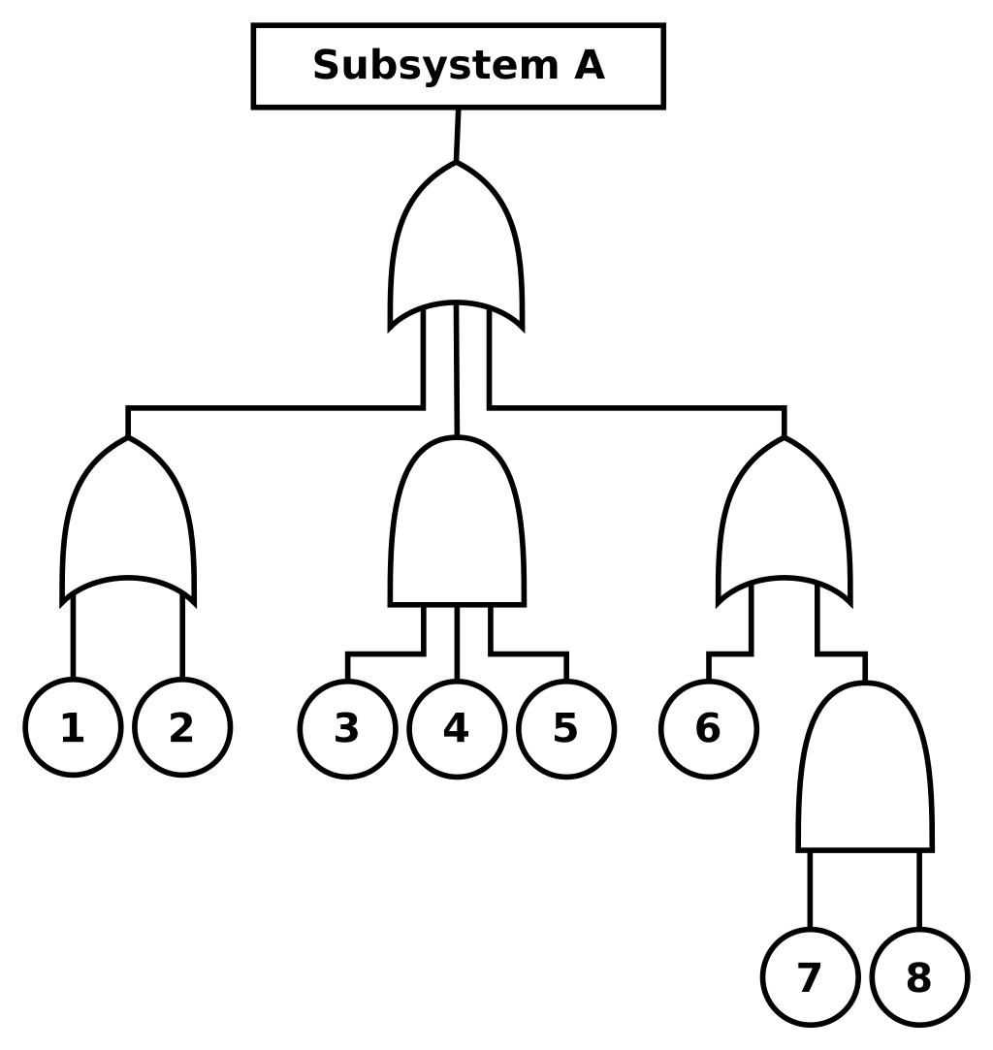
Background
Probabilistic Risk Assessment (PRA) quantify the risk associated with any large-scale project by answering three questions (Kaplan & Garrick)
What could go wrong?
How likely is it?
What are the consequences?
Fault Trees (FTs) and Event Trees (ETs) help answer the first two questions.
For small systems, building FTs are ETs are a straightforward task, however, as the system grows larger, FTs and ETs gets more and more complicated.
https://en.wikipedia.org/wiki/Event_tree_analysis
https://en.wikipedia.org/wiki/Fault_tree_analysis
6/28/2022

Slide 3
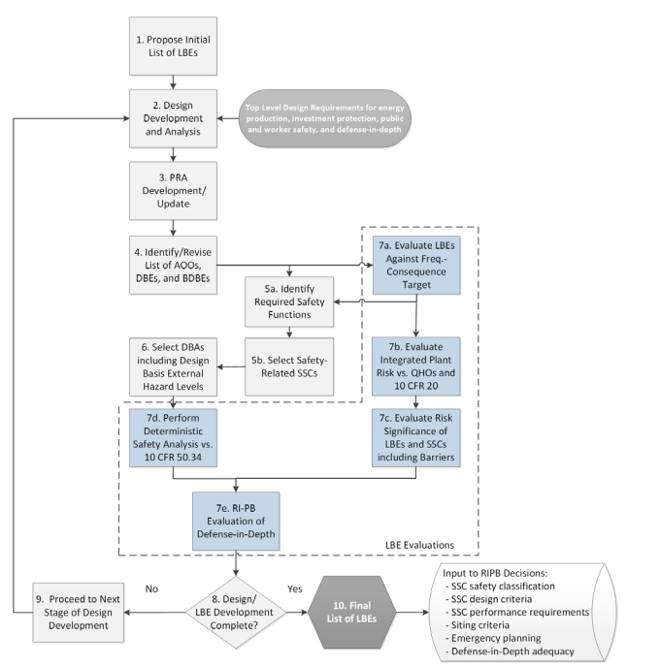
Motivation (1/2)
According to the ASME/ANS standard for advanced non-LWR, a configuration control program is required from PRA to track changes to the plant design and their impact on the risk profile of the design.
According to the Licensing Modernization Project (LMP), PRA can be used to support the design and licensing of non-LWRs.
This requires iterative PRA models that model different stages of the design and inform design updates in later stages of design.
Even though, the configuration control requirements does not require tracking changes to the PRA model, to facilitate the iterative process, tracking changes in the PRA model becomes a necessity.
Moe, W. L. (2019). NEI 18-04 Risk-Informed Performance-Based Technology Inclusive Guidance for Advanced Reactor Licensing Basis Development (INL/EXT-19-55375-Rev000). Idaho National Lab. (INL), Idaho Falls, ID (United States). https://doi.org/10.2172/1557649
Probabilistic Safety Assessment & Management 16
Notes:
PRA is used to risk-inform the design
After updating the design, informed by the PRA model, the PRA model is then modified/updated to reflect the new design
Before reaching the final design, the design along with the PRA model go through multiple iterations
Each iteration of the design is tracked through the configuration control requirement of the standard, however, no requirements for tracking the PRA model itself

Slide 4
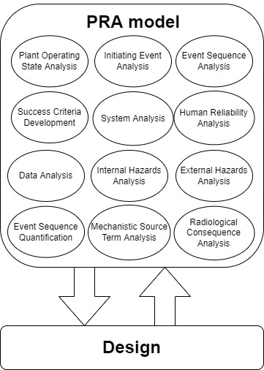
Motivation (2/2)
Different iterations of the PRA model consists of multiple elements including system analyses, event sequence analyses, and event sequence quantification.
These elements are supported by multiple FTs and ETs which are constantly changed and updated to reflect any changes to the design.
Even though, collaboration in small models is not required, for larger models, collaboration on different elements or different component of the same element present a way of speeding up the modeling process.
PRA tools (SAPHIRE, CAFTA, RISKMAN) provides limited configuration control, however, none of them provide any collaboration capability.
Probabilistic Safety Assessment & Management 16

Slide 5
Version Control Systems and git
VCS: Tool that manages and tracks different versions of software or other content
Goes back to 1970s, developed for UNIX distributions
Distributed VCS is the standard today, and thought alongside coding languages
git is one of the most widely used tools, released in 2005
Multi-user development
Speed
Scalability
Immutability
Accountability
VCS and git can be used for version controlling of PRA models, track changes, shorten development in a transparent environment
Probabilistic Safety Assessment & Management 16
Notes:
Distributed VCS: Multiple team members can reach a repository from different locations
Multi-user development → Branching
Scalability → Branching, Hashing, Continuous integration
Immutability, accountability → Commits and commit history

Slide 6
Methodology Overview
To fully utilize git, text-based model files must be adopted
Version history of auxiliary files are still recorded and can be reverted when needed
Fast tracking other’s changes and importing them are effortless
Vedros, K., Boring PhD, R., Knudsen, J., Lawrence, S., Mandelli, D., Park, J., Prescott, S., & Smith, C. (2021). Enhancement of Industry Legacy Probabilistic Risk Assessment Methods and Tools (INL/EXT-21-64448-Rev000, 1822882; p. INL/EXT-21-64448-Rev000, 1822882). https://doi.org/10.2172/1822882
Notes:
If the software exports binary files, they must be converted to text-based to track changes in each model
Changes can be examined within the browser using online and/or command line tools and modifications can be made easily
5-10 seconds for each step in the figure:
Issue recognition – issue can be a needed development/improvement
Branching for distributed multi-user development
Commits for tracking, immutability, speed and accountability
Verification for precision in model
Approval from peer-review and automated processes
Merge to use updated model

Slide 7
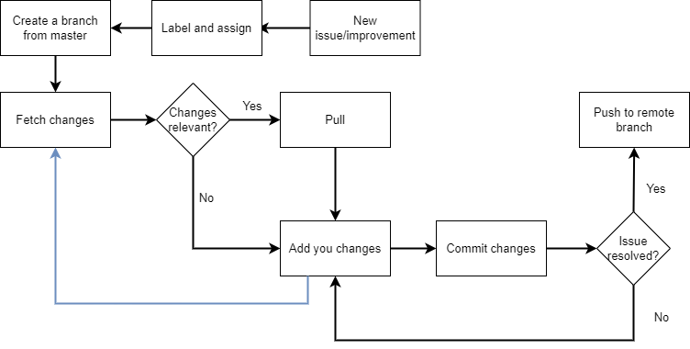
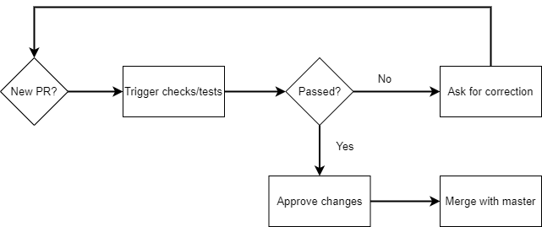
Methodology for model developer
Model developer
Repo maintainer
Probabilistic Safety Assessment & Management 16

Slide 8
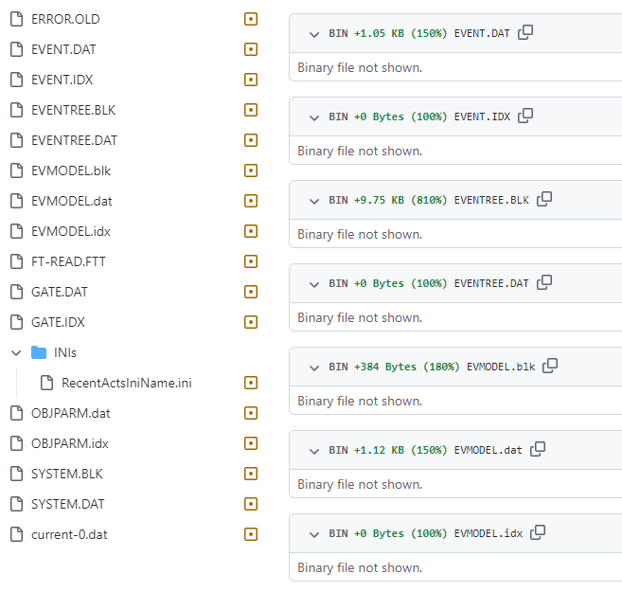
Version Control for PRA Models
This methodology mimics the one introduced by Vedros et al. in INL’s “Enhancement of Industry Legacy Probabilistic Risk Assessment Methods and Tools”.
INL’s methodology utilizes git to store and track different revisions of the design documents.
PRA tools, like SAPHIRE, exports binary files, hence, the application of this methodology is very limited for PRA models.
So, a text-based mediator is needed.
Probabilistic Safety Assessment & Management 16

Slide 9
Models and Results Database (MAR-D)
The NRC funded the development of a way to convert PRA models into manageable text-based format.
Being text-based, MAR-D gives the ability to store, modify, update, compare, and collaborate in PRA models using Git.
Most PRA tools, like SAPHIRE and CAFTA, read and export in MAR-D format.
Even though MAR-D is used in this demonstration, any text-based format, like json, is compatible with the same approach.
Probabilistic Safety Assessment & Management 16

Slide 10
Demonstration
Repo: https://github.com/mostafa-hamza/PSAM16
Probabilistic Safety Assessment & Management 16

Slide 11
Final Remarks
The methodology presented is a patch to provide version control and collaboration capabilities for PRA tools.
Version control maintains the traceability and credibility of the PRA model, allowing for easier peer review and quicker assessment of the impact of model changes.
Collaboration facilitates parallel development of different model branches; this reduces the time required to build the PRA model.
Better implementation of the proposed approach can be incorporated directly into the PRA tools which will provide the user with the capability to directly pull, modify, push, and merge any changes directly from the PRA tool.
Notes:
However, until implementing such a feature into the PRA tools, the proposed methodology provides a user-driven solution to both version control and collaboration capabilities.

Slide 12
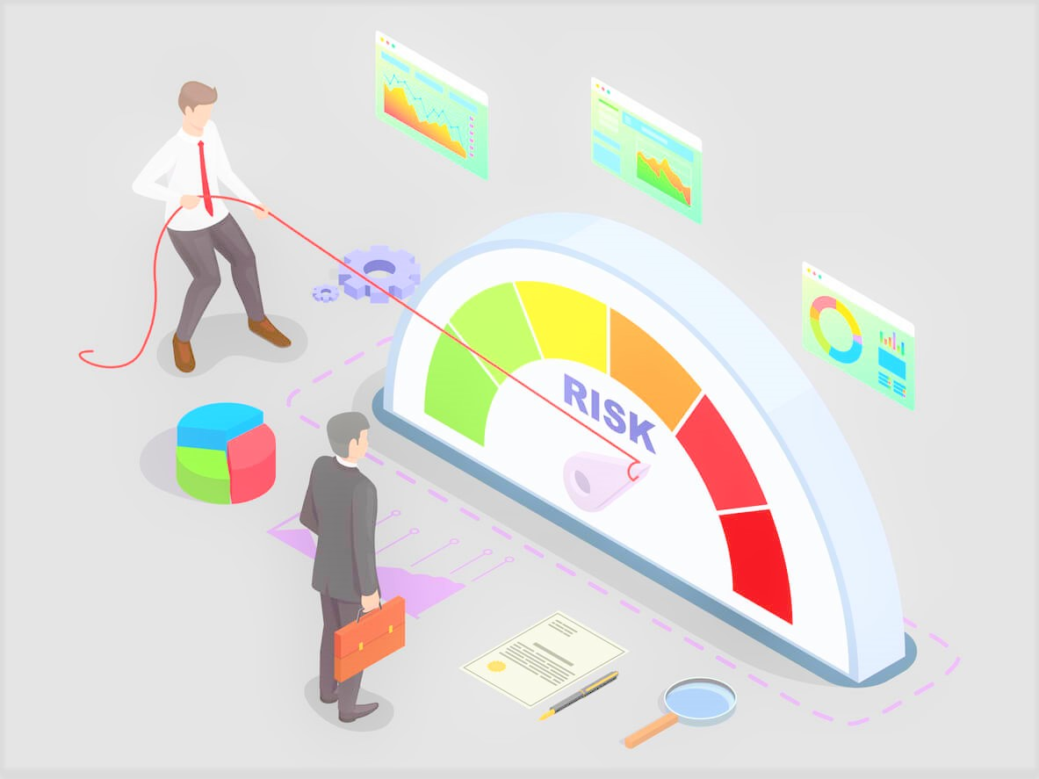
Thank you
Questions?

