Slide 1
Simulators and Operating Concepts for Hydrogen Production
Thomas A. Ulrich, Stephen Hancock, Roger Lew, Ronald L. Boring, Tyler Westover, Richard Boardman
Thomas A. Ulrich
  July 2022

Slide 2

Future Nuclear Power Plant Operations
Challenging electricity market
  Nuclear power plants were designed to produce steady baseload power
  Increased grid dynamics with increase in renewables
  Inexpensive natural gas competitors
Plant operational options to address challenges
  Required to diversify and increase economic competitiveness
    Flexible power operations
    Dedicated energy supplier to an industrial process (steam and electric)
    Hybrid operations
      Dispatch electricity between grid and industry user
      Dispatch electricity and steam to industry user
      Provide grid services
          supply and demand response
          grid regulation
O₂
H₂
Heat
Electricity
Thermal Dispatch - The purpose of this activity is to develop efficient electricity and thermal energy delivery systems and conduct reactor operator human factors and control systems research that is needed to dynamically extract and deliver thermal energy from a nuclear power plant for use by an industrial process.

Slide 3
Primary Thermal Dispatch Operator Task (normal operations)
Expediently divert steam from turbine through TD while maintaining 100% reactor power
  Place turbine in a decreasing ramp program, manually open TD control valves in tandem while monitoring reactivity Tref Tavg mismatch
Main
Turbine
Thermal Dispatch

Slide 4
Potential Operational Impacts
The thermal and electrical coupling of the nuclear power plant may require modified existing and additional operations.
Detecting, diagnosing, and mitigating new types of adverse conditions due to the thermal dispatch system
Inter-organization coordination that must be performed with the grid and the industrial user
Additional operations specific to monitoring and controlling the thermal dispatch system, which must be performed in tandem with existing operations
Used a simulator-based human-in-the-loop testing approach to perform a study evaluating an initial concept of operations for Thermal Dispatch in our HSSL

Slide 5
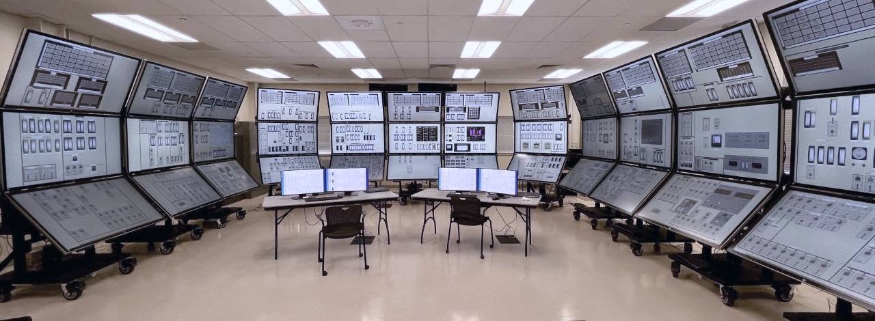
u
Human System Simulation Laboratory
a reconfigurable (4k motorized Vpanels)
full-scale,
full-scope,
research simulator

Slide 6
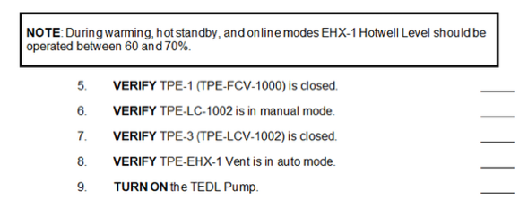
Simulator-based Research Approach
A human-in-the-loop simulator approach entails running representative scenarios with operators to develop and evaluate new concept of operations, identify operational impacts, and ensure the new concept of operations is safe, efficient, and reliable.
our team builds prototypes of control room concepts and existing control room upgrades that we then evaluate through operator-in-the-loop studies
~14 studies to date
Human-System Interface
[simulator model modifications]
Procedures
Use human and system performance data to evaluate the effectiveness of the engineered system design, HSI, and procedures (empirical evidence for licensing under NUREG-0711 Human Factors Engineering Program Review Model)

Slide 7
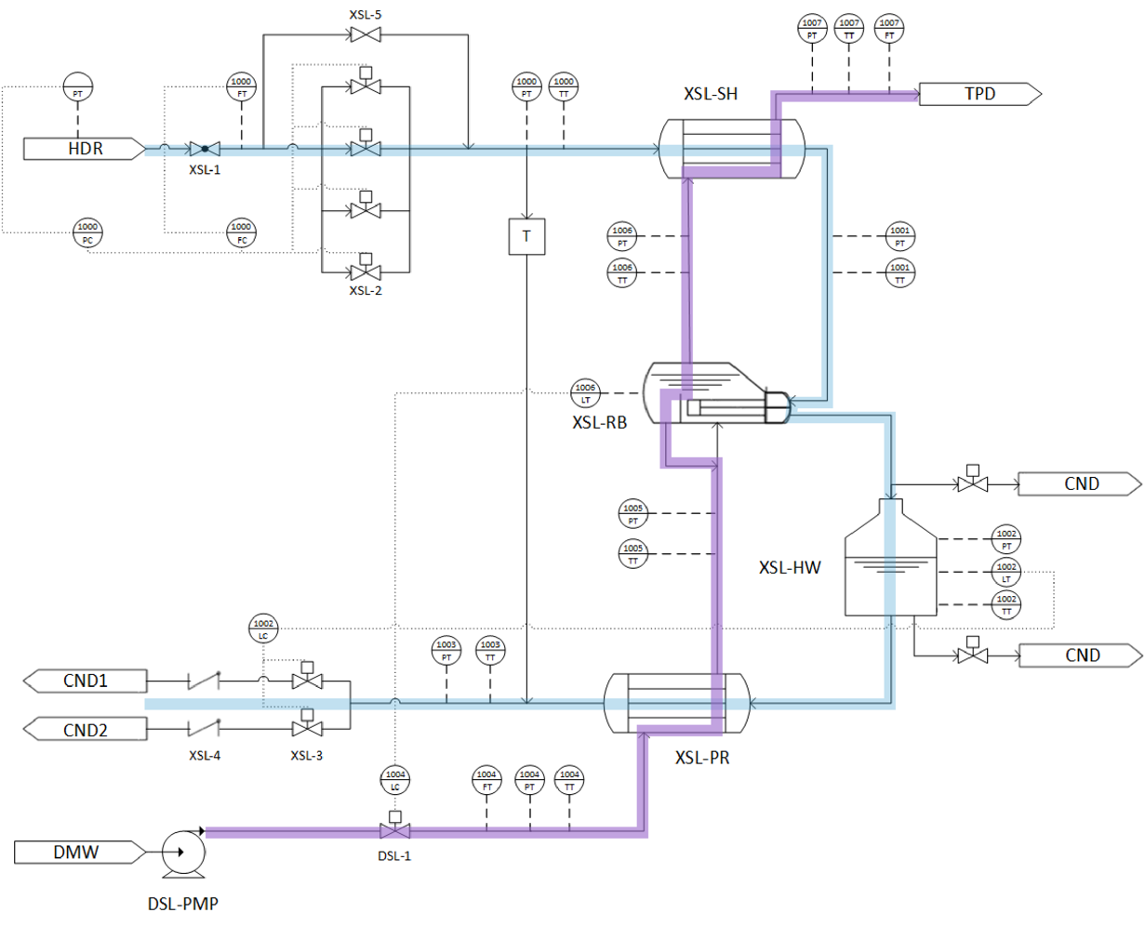
Full-scope Simulator Thermal Dispatch Modifications
GSE Systems GPWR BWR and PWR simulators avoid propriety plant design issues
15% main steam flow targeted extraction rate ~ 145 Mw_{e}
Thermal-hydraulic two-phase models are generated using a GSE Systems software (JADE, Jtopmeret) which creates the FORTRAN source code from the designed system geometries
Interfaces with the main steam header of the nuclear power plant, to extract high pressure steam prior to the high pressure turbine
The extracted steam is used to generate process steam for the process plant on-site at the nuclear plant, with a transport pipeline to the process plant
Source: Hancock, S.; Westover, T.; Luo, Y. Evaluation of Different Levels of Electric and Thermal Power Dispatch Using a Full-Scope PWR Simulator; Idaho National Laboratory INL/EXT-21-63226: Idaho Falls, ID 2021.

Slide 8
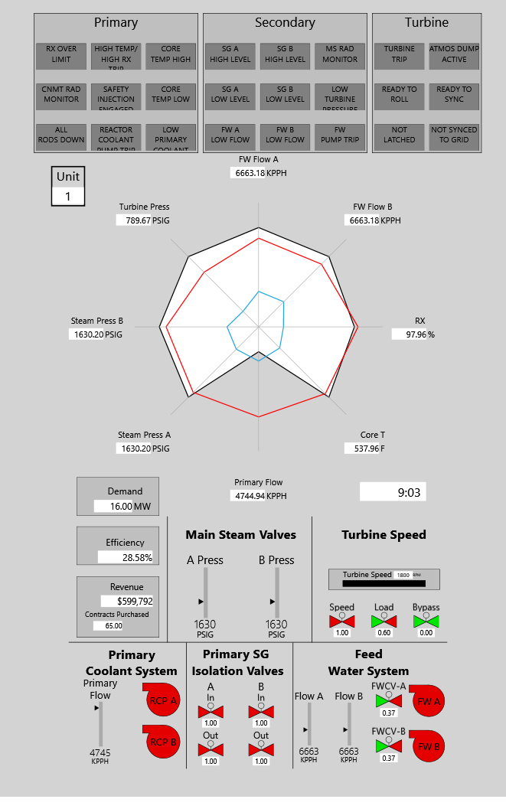
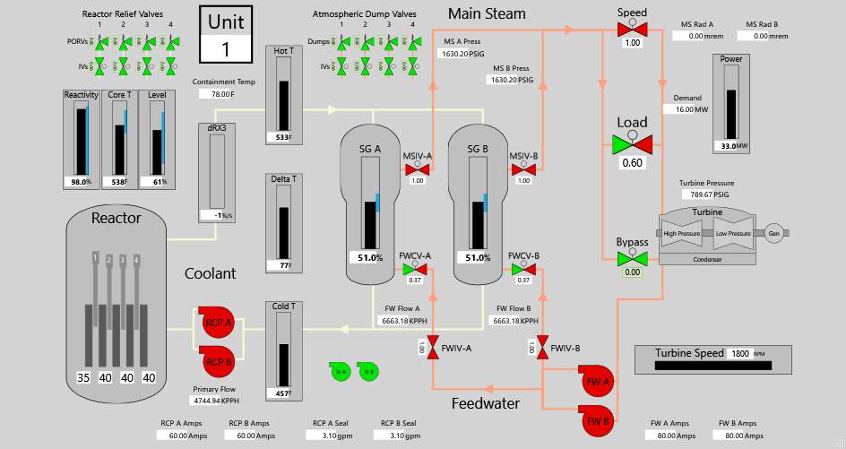
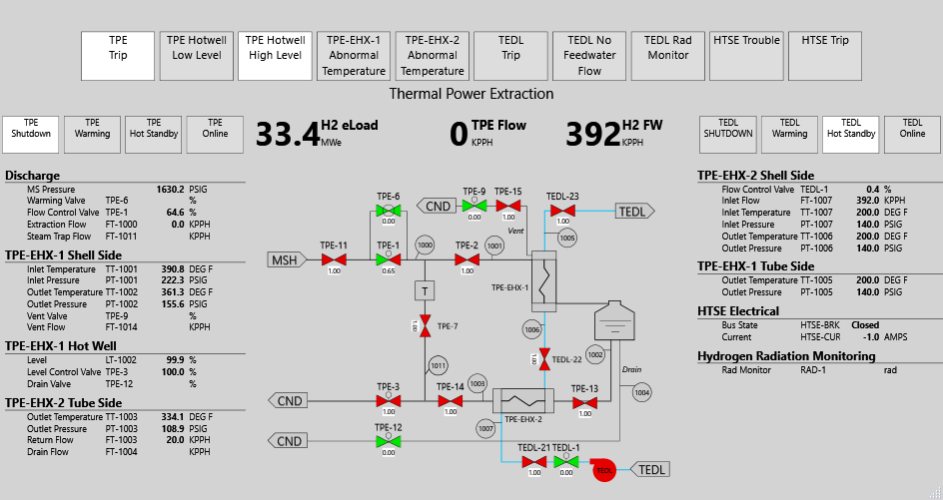
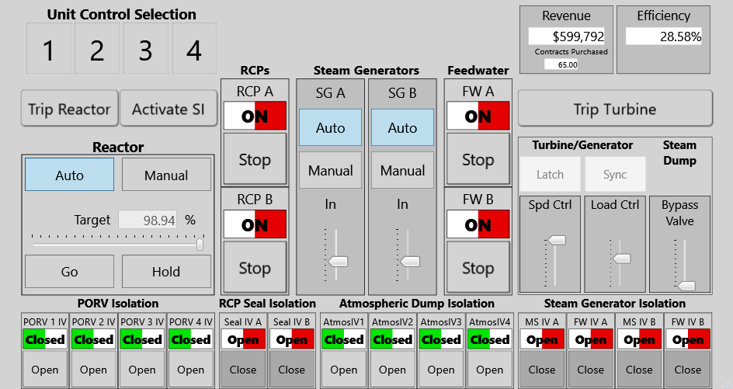
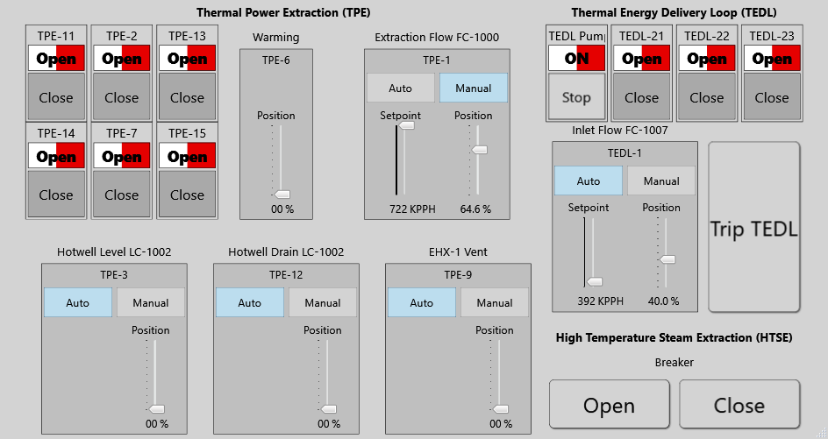
Reduced-Scope iterative design and evaluation
Rancor served as a testbed tool to drive performance based design refinements to the prototype TD HMI
Nuclear Power Plant
Thermal Dispatch System
*Reduced-scope required simplifications, but the the same tasks were present

Slide 9
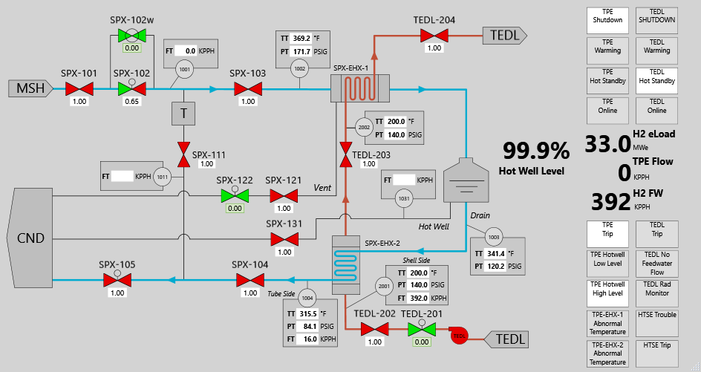
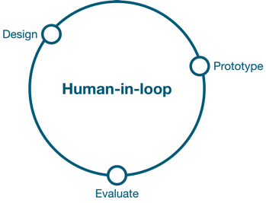
Reduced-Scope iterative design and evaluation
HMI underwent several design/evaluation iterations to address basic human factors issues
Indication details integrated into P&ID
Revised numbering system (valves 100s, instruments 1000s)
Valve value box highlights added to aid discerning “cracked” positions
Subsystem renaming SXL and DSL (visually distinct)

Slide 10
Full-scope Prototype Thermal Power Dispatch HMI
Operational issues could then be evaluated with a refined HMI to leverage operator expertise efficiently
System Display (adapted from microworld design)
System Controls
Sparklines (Trend) and digital values for key parameters
Dynamic System piping and instrumentation diagram graphic
  Instrument clusters aggregating parameters for key components
XSL and DSL Mode indicators
Alarms
Controllers with embedded task-based displays to keep operators aware of key parameters
Trip buttons for critical system functions

Slide 11
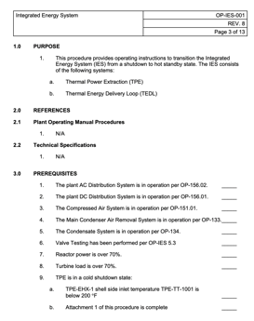
Procedures
Mock Procedures developed matching existing procedure format
  Procedures drafted specifically for the thermal power dispatch system operation
  Existing procedures modified to accommodate responses account for the thermal power dispatch operation
Types
  Normal Operations
    Shutdown to Hot Standby
    Hot Standby to Online
    Online to Hot Standby
    Hot Standby to Shutdown
  Abnormal
    Post-trip response rapid shutdown (isolate TDS)
Thank you Tyler!

Slide 12
Study Overview – General Protocol
Four Day Study (completed in FY21)
  Training
    Thermal Power Dispatch System Overview
    System Operation – Procedures
  Simulator Orientation and Familiarization
    Walk the digital boards
    Human-system interface discoverability
Data driven observation approach
  Track plant parameters within the
  context of operator actions
  Operator behaviors recorded via
    Paper surveys post-trial
    Eye Tracking
    Expert observer
    TomLogs

Slide 13
Study scenarios to identify and evaluate operational impacts
15 Scenarios
  Steam generator tube rupture (evaluate TD impacts on operator response)
    Failed, manual, automatic isolation
  Load rejection (evaluate TD impacts on operator response)
  Basic operating scenarios (evaluate workload for manual turbine ramp rates)
    5, 10, 15, 20 rpm/min ramp rates used for manually controlled evolution
    Hot Standby to Online, Online to Hot Standby (critical evolutions for operations and system adoption economics)
  Misc fault scenarios (evaluate operator response to most challenging plausible failure scenarios)
    TD line leak
    Hot Standby to Online TD evolution interrupted by load rejection
    Failed open CV in TD

Slide 14
Human Factors Conclusions
Operators were able to maintain the plant in a safe and known envelope across all scenarios
    A comprehensive, but non-exhaustive, set of 15 scenarios were tested to elicit potentially undesired plant impacts from thermal dispatch operations
    Operators reported they could not envision any more challenging fault scenarios to test the system, though additional work is underway to create a fully comprehensive suite of of scenarios to test against possible harmful impacts
The prototype human-machine interface was effective to support the operators in understanding the plant throughout the scenarios
    Operators used the prototype extensively and expressed positive opinions towards it
    Refinements were identified
      Additional key parameters were identified to support fault responses
    Integration with a digital turbine control system was suggested
      Automatic control capabilities and integration with digital turbine control intended to reduce workload

Slide 15
Thermal Dispatch Concept of Operations Conclusions
Automatic isolation linked with turbine trip signal required to minimize any thermal dispatch impacts
  Some unacceptable excursions occurred due to the lack of automatic thermal dispatch system isolation valve actuation
    Scenario with failed manual isolation control trip command resulted in main steam isolation valves shutting and rod insertions
    Automatic thermal dispatch trip scenarios were approximate to normal existing operations in terms of MSIVs behavior, pressurizer pressure, and Tavg
Manual transfer of steam via turbine load and thermal dispatch load adjustments deemed too workload intensive and time consuming
  Automatic load transfer
  Integrate with digital turbine control such that the thermal dispatch becomes another mode of turbine operations
    Eliminate the need for additional operator during thermal dispatch evolutions
An isolate upon transient philosophy was observed for the thermal dispatch system (non-safety system)
  There are some situations in which the system could act as a buffer to mitigate issues, such as load rejections
  Additional analysis must be performed to identify when to use the thermal dispatch as an additional asset

Slide 16
Future Directions
Develop two-year plan describing thermal dispatch implementation issues and the graded simulation-based approach required to provide solutions for these issues to accelerate industry adoption and mitigate implementation risk
Perform an integrated human- and hardware-in-the-loop test to evaluate thermal dispatch operations with pertinent scenarios
  Using the INL and vendor provided NPP simulators with modified thermal dispatch control system
  Develop automatic control systems
  Evaluate impacts of increased magnitudes for thermal dispatch
Continue to support university led research on thermal dispatch concepts, configurations, and control schemes
Begin working with potential industry first of a kind implementer

Slide 18
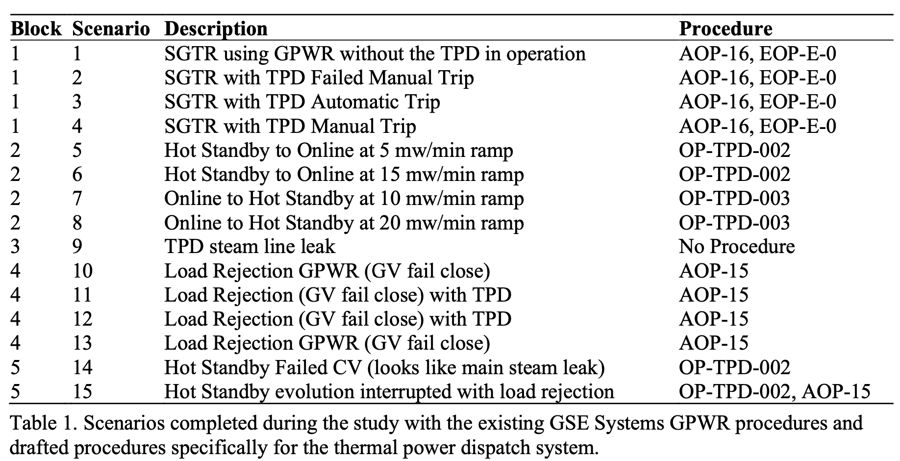
Operator Study Scenarios

