Slide 1
Uncertainty in Predicted Tropical Cyclone Path and Landfall Characteristics for Landfalling Storms to Support External Hazard Probabilistic Risk Assessments for Critical Infrastructure – A Preliminary Analysis
Somayeh Mohammadi (UMD)
Michelle Bensi (UMD)
Zhegang Ma (INL)
Kaveh Faraji Najarkolaie (UMD)
PSAM 2022
Honoulu, Hawaii

Slide 2
Identifying and Prioritizing Sources of Uncertainty in External Hazard Probabilistic Risk Assessment

Slide 3

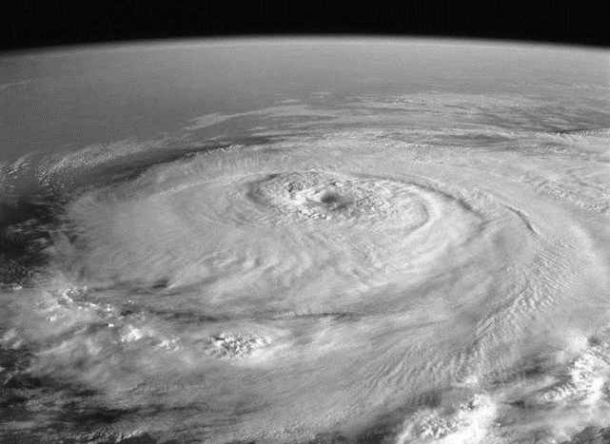
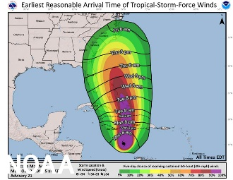
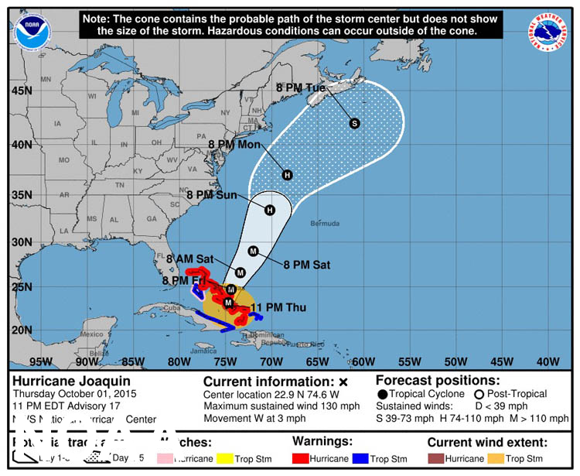
Source: https://www.noaa.gov/news/what-s-new-in-hurricane-forecasting

Slide 4
Storm Forecast
Uncertainty associated with the time available to implement actions
Decisions to Implement Actions
Execution of Actions
Source: https://www.noaa.gov/news/what-s-new-in-hurricane-forecasting

Slide 5
Storm Forecast
Uncertainty associated with the time available to implement actions
Decisions to Implement Actions
Execution of Actions
Seek to understand difference between assumed time available and actual time available
Source: https://www.noaa.gov/news/what-s-new-in-hurricane-forecasting

Slide 6
Storm Forecast
Uncertainty associated with the time available to implement actions
Decisions to Implement Actions
Execution of Actions
Seek to understand difference between assumed time available and actual time available
There have not been systematic assessments of uncertainties associated with TC forecasts in a manner amenable to characterizing uncertainties required for an XHPRA for NPPs.
Source: https://www.noaa.gov/news/what-s-new-in-hurricane-forecasting

Slide 7
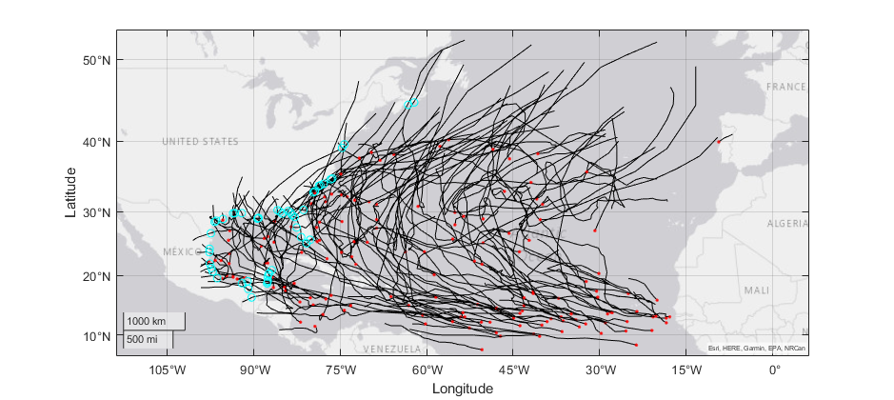
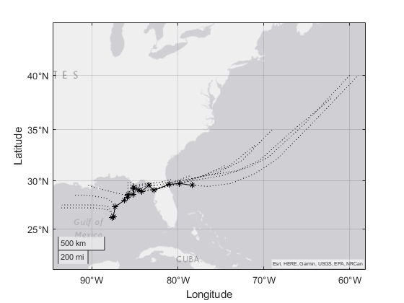

Slide 8

For each landfalling storm $i$ and each associated storm advisory
$t_{i,j}^{[a]}=$the time elapsed between the issuance of advisory $j$ for storm $i$ and the interpolated observed landfall time of storm $i$ (hours)
$t_{i,j}^{\left[p\right]}=$the time elapsed between the issuance of advisory $j$ for storm $i$ and the interpolated time of landfall (based on the predicted storm track) for storm $i$ and advisory $j$ (hours)
$w_{i}^{[a]}=$ interpolated observed wind speed at landfall for storm $i$ (mph)
$w_{i,j}^{[p]}=$ interpolated predicted wind speed at landfall from advisory $j$ for storm $i$ (mph)
$d_{i,j}=$ distance between the interpolated observed landfall location of storm $i$ and the interpolated predicted landfall location of storm $i$ from advisory $j$ for storm $i$ (miles)
Time to landfall prediction error: $ε_{ij}^{[t]}=t_{i,j}^{\left[p\right]}−t_{i,j}^{[a]}$
Landfall wind speed prediction error: $ε_{ij}^{[w]}=w_{i,j}^{[p]}−w_{i}^{[a]}$

Slide 9
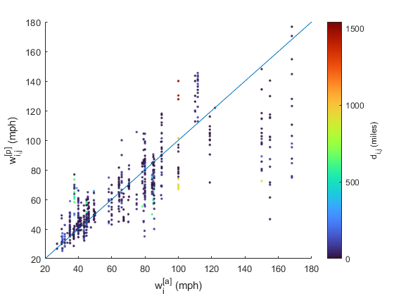


Time to landfall prediction error:
$ε_{ij}^{[t]}=t_{i,j}^{\left[p\right]}−t_{i,j}^{[a]}$
Landfall wind speed prediction error:
$ε_{ij}^{[w]}=w_{i,j}^{[p]}−w_{i}^{[a]}$

Slide 10
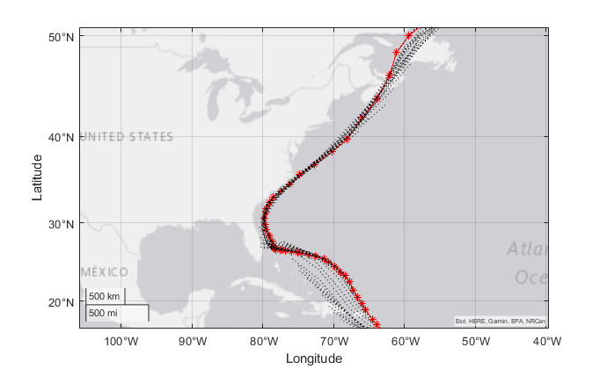
Time to landfall prediction error:
$ε_{ij}^{[t]}=t_{i,j}^{\left[p\right]}−t_{i,j}^{[a]}$
Landfall wind speed prediction error:
$ε_{ij}^{[w]}=w_{i,j}^{[p]}−w_{i}^{[a]}$

Slide 11
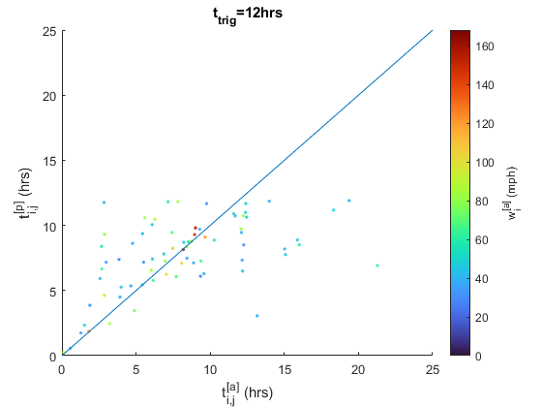
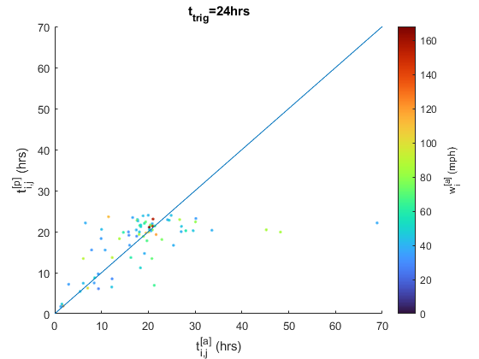
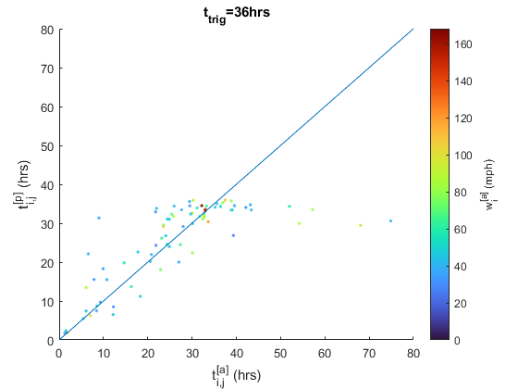
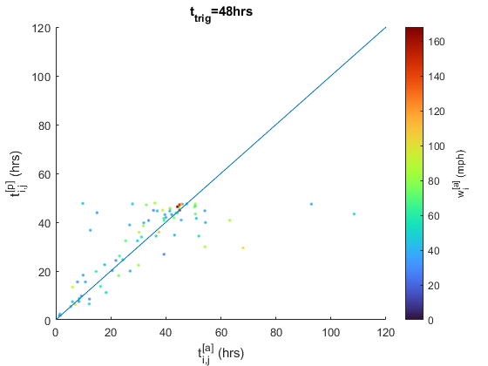

Slide 13
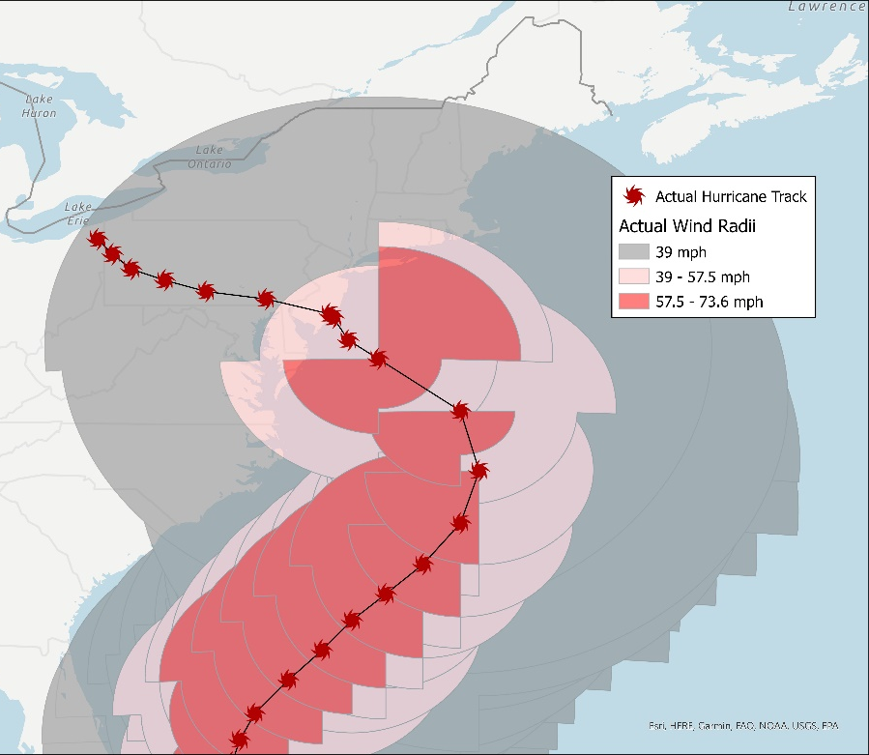
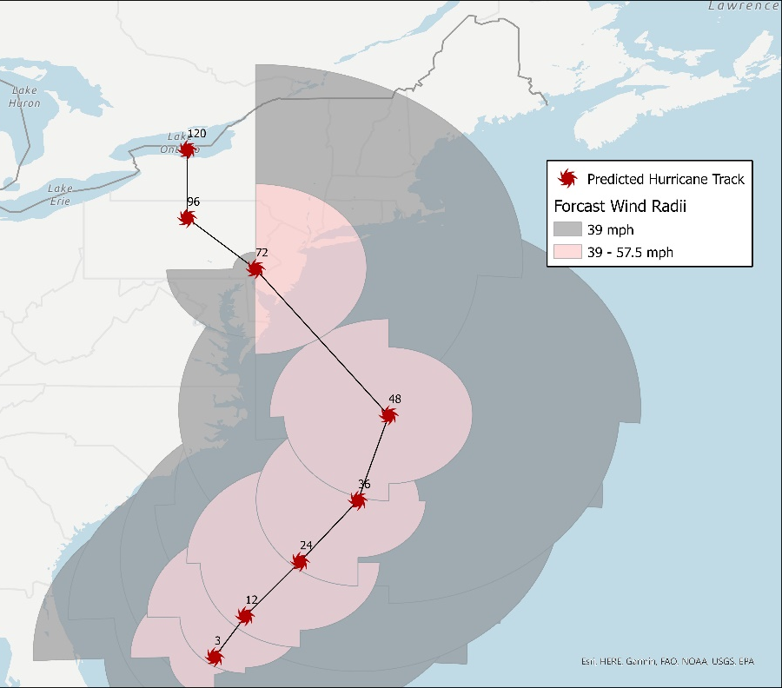
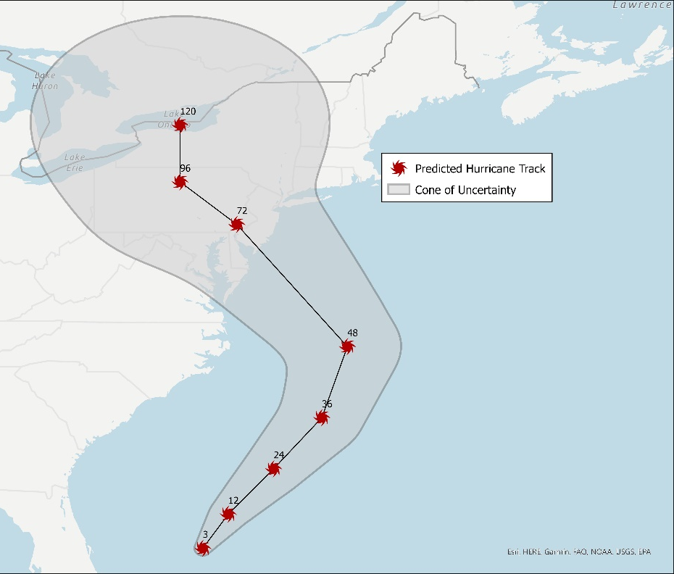
Next Steps

Slide 14
Contributors:
Somayeh Mohammadi (UMD)
Michelle Bensi (UMD)
Zhegang Ma (INL)
Kaveh Faraji Najarkolaie (UMD)
Questions?
This research is supported by a research grant from the Department of Energy's Nuclear Energy University Program (NEUP) under grant/cooperative agreement DE-NE0008974.
Any opinions, findings, and conclusions expressed in this paper/presentation are those of the authors and do not necessarily reflect the views of the funding agency or any other organization.

