Slide 1
Identifying and Prioritizing Sources of Uncertainty in External Hazard Probabilistic Risk Assessment:
Project Activities and Progress
Project funded by:
U.S. Department of Energy, Nuclear Energy University Program
Michelle Bensi (UMD) ● Katrina Groth (UMD) ● Zeyun Wu (VCU)
Ray Schneider (WEC) ● Zhegang Ma (INL) ● Ahmad Al-Douri (UMD)
Somayeh Mohammadi (UMD) ● Tao Liu (VCU) ● Camille Levine (UMD)
PSAM 2022
Honoulu, Hawaii

Slide 2
Motivation & Research Needs
Motivation:
Significant sources of uncertainties in XHPRA are associated with the frequency, severity, and temporal evolution of external hazard events and event impacts on plant response.
Research Needs:
Develop a technically sound, risk-informed strategy to:
  Identify and characterize drivers of hazard uncertainty
  Enable uncertainty reduction activities to be prioritized based on risk significance, risk reduction benefit, and value
Risk-informed strategy must account for:
  Impacts of hazard events on SSCs and event progressions
  Close coupling of the physical aspects of hazard events with plant response and human performance

Slide 3
Project Outcomes
Develop a structured process for identifying, evaluating, categorizing, and assessing the impact of uncertainties on XHPRA modeling elements and create a common taxonomy for communicating these uncertainties across hazard groups
Investigate the spectrum of uncertainties involved in the physical processes that underlie external hazards and assess the uncertainties associated with estimation of hazard frequencies and parsing of hazard information into the XHPRA
Investigate how uncertainties in the physical hazard characteristics and associated hazard timing interfaces with plant processes to prepare for, mitigate, cope, and recover from the external challenge
  Connect the uncertainties in the hazard severity/evolution with human response
Integrate insights and develop strategies for prioritization of uncertainty reduction efforts

Slide 4
Project Outcomes
Develop a structured process for identifying, evaluating, categorizing, and assessing the impact of uncertainties on XHPRA modeling elements and create a common taxonomy for communicating these uncertainties across hazard groups
Investigate the spectrum of uncertainties involved in the physical processes that underlie external hazards and assess the uncertainties associated with estimation of hazard frequencies and parsing of hazard information into the XHPRA
Investigate how uncertainties in the physical hazard characteristics and associated hazard timing interfaces with plant processes to prepare for, mitigate, cope, and recover from the external challenge
  Connect the uncertainties in the hazard severity/evolution with human response
Integrate insights and develop strategies for prioritization of uncertainty reduction efforts
Hazards
Plant
Humans

Slide 5
Project Goals and Structure

Slide 6
Task 1: Stakeholder Outreach and Development of Uncertainty Taxonomy
Stakeholder Outreach
Workshop
Survey of Existing Uncertainty Taxonomies
Development of XHPRA (for NPPs) Uncertainty Taxonomy

Slide 7
Task 1: Stakeholder Outreach and Development of Uncertainty Taxonomy
Stakeholder Outreach
Workshop
Virtual Discussions
Survey of Existing Uncertainty Taxonomies
Development of XHPRA (for NPPs) Uncertainty Taxonomy

Slide 8


Task 1: Stakeholder Outreach and Development of Uncertainty Taxonomy
Stakeholder Outreach
Workshop
Insights regarding the "most pressing" sources of uncertainty
The strategies used to address drivers of uncertainty
Identification of uncertainties w/ potential to change risk metrics
Sources of "compounding conservatisms" and "blindspots"
Inconsistencies in practices, conventions, etc. between hazard groups, technical elements, and other aspects of PRAs
Virtual Discussions
Survey of Existing Uncertainty Taxonomies
$←$ Scan now to share your insights
Development of XHPRA (for NPPs) Uncertainty Taxonomy
https://bit.ly/3xRhLHC

Slide 9
Task 1: Stakeholder Outreach and Development of Uncertainty Taxonomy
Stakeholder Outreach
Workshop
Virtual Discussions
Survey of Existing Uncertainty Taxonomies
https://bit.ly/3xRhLHC
Development of XHPRA (for NPPs) Uncertainty Taxonomy
Additional information in companion paper: MB157

Slide 10

Task 2: Hazard Uncertainty Characterization and Data Analysis
Focus on external flooding hazards
Identify key sources of uncertainty related to the probabilistic characterization of:
  External hazard occurrence
  Severity (e.g., flood depth, elevation)
  Timing (e.g., warning time, duration)
Develop event scenarios for consideration under Tasks 3 and 4
Understanding the potential "value of information" associated with uncertainty reduction

Slide 11
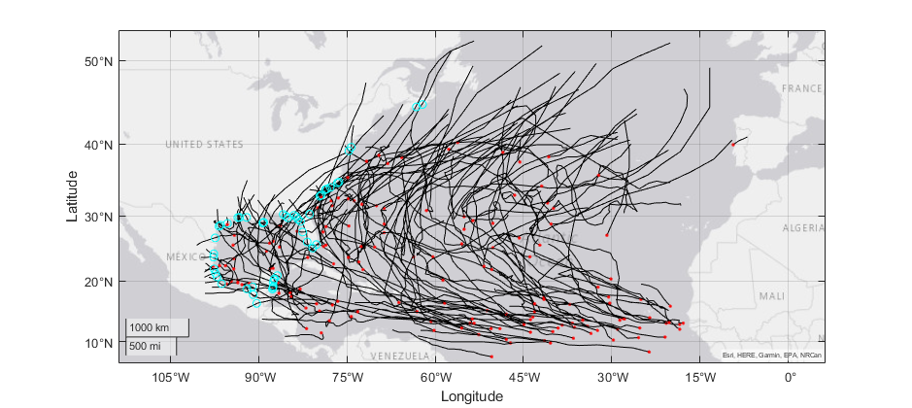
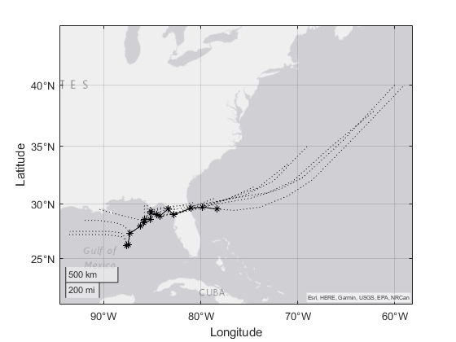
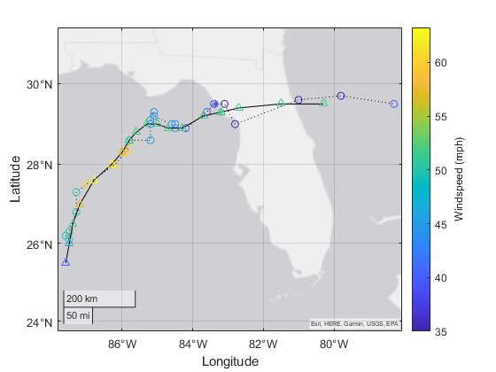
Task 2: Hazard Uncertainty Characterization and Data Analysis
Focus on external flooding hazards
Identify key sources of uncertainty related to the probabilistic characterization of:
  External hazard occurrence
  Severity (e.g., flood depth, elevation)
  Timing (e.g., warning time, duration)
Develop event scenarios for consideration under Tasks 3 and 4
Understanding the potential "value of information" associated with uncertainty reduction
Additional information in companion paper: MB290

Slide 12

Task 3: Assessment of Uncertainty in Scenario Development
Integrated Risk Assessment Framework

Slide 13
Task 3: Assessment of Uncertainty in Scenario Development
Generic PWR Model Modification and Improvement

Slide 14
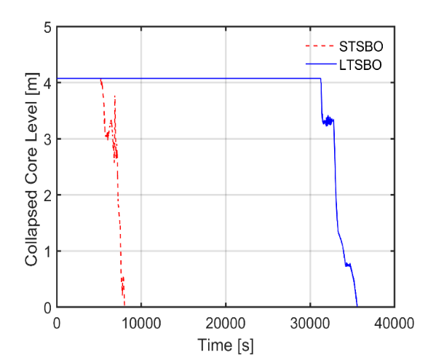
Task 3: Assessment of Uncertainty in Scenario Development
Station Blackout (SBO) Accident Simulation Using RELAP5-3D
Long term (LT) SBO and Short term (ST) SBO event sequence assumptions were developed
Thermal-hydraulic simulations for LTSBO and STSBO scenarios for the generic PWR were performed
The response of various key parameters of interest were analyzed
  Reactor cooling system (RCS) pressure & temperature, steam generator water level & pressure, core temperature & collapsed level…
The timing of key event sequences parameters of interest were analyzed
  the occurrence of steam generator dryout, initiation of core uncovery, and possible core damage, time available for operator to perform mitigation action.
Reactor core level during SBO

Slide 15
Task 3: Assessment of Uncertainty in Scenario Development
Simulation of Scenarios with Different Event Timing
Event timing constraints are being incorporated and addressed during loss of offsite power and SBO scenarios that happen in an external flooding event at various points including:
  Warning time ahead of the event
  Reactor operation time before shutdown
  The time at which the external flooding event begins to affect the plant
  The failure time of the diesel generators and batteries
  The recovery time of the diesel generators, batteries, and offsite power grid
  And more ……

Slide 16


Task 4: Characterization of Uncertainty in Human Response Under Physical Effects
Objective & Approach
Additional information in companion paper: AA176

Slide 17
Task 4: Characterization of Uncertainty in Human Response Under Physical Effects
Additional information in companion paper: AA176

Slide 18
Task 4: Characterization of Uncertainty in Human Response Under Physical Effects
Development of CRTs from Hierarchical Task Decomposition
Additional information in companion paper: AA176

Slide 19
Task 4: Characterization of Uncertainty in Human Response Under Physical Effects
Contributions & Next Steps
Demonstrated applicability of Phoenix method to ex-CR actions
  Cognitive-based methods (third-generation HRA) are better suited than older methods (first- and second-generation HRA)
CFMs provided in method are mostly relevant
  Further refinement needed for Action phase CFMs, but Information and Decision CFMs sufficient to describe scenarios
Future work:
  Validation on two more ex-CR tasks and seeking expert feedback
  Mapping of PIF causal chains to identified CFMs (Task 4.2)
  Quantification through resultant Bayesian Network (Task 4.3)
This work sets the stage for a systematic treatment of human actions in external environments, allowing for the future development of the causal basis of HRA.
Additional information in companion paper: AA176

Slide 20
Project Goals and Structure

Slide 21
Contributors:
Michelle Bensi (UMD) ● Katrina Groth (UMD) ● Zeyun Wu (VCU)
Ray Schneider (WEC) ● Zhegang Ma (INL) ● Ahmad Al-Douri (UMD)
Somayeh Mohammadi (UMD) ● Tao Liu (VCU) ● Camille Levine (UMD)
Questions?
https://bit.ly/3xRhLHC
This research is supported by a research grant from the Department of Energy's Nuclear Energy University Program (NEUP) under grant/cooperative agreement DE-NE0008974.
Any opinions, findings, and conclusions expressed in this paper/presentation are those of the authors and do not necessarily reflect the views of the funding agency or any other organization.
The authors acknowledge and appreciate the valuable insights provided by subject matter experts who have engaged with the project team over the course of the project to date.

