Slide 1
Uncertainty in External Hazard Probabilistic Risk Assessment (PRA): A Structured Taxonomy
Michelle Bensi (UMD) ● Somayeh Mohammadi (UMD) ● Nilanjana Ghosh (UMD)
Tao Liu (VCU) ● Camille Levine (UMD) ● Ahmad Al-Douri (UMD) ●
Ray Schneider (WEC) ● Zeyun Wu (VCU) ● Katrina Groth (UMD) ● Zhegang Ma (INL)
PSAM 2022
Honoulu, Hawaii

Slide 2
Identifying and Prioritizing Sources of Uncertainty in External Hazard Probabilistic Risk Assessment

Slide 3

Context and Motivation
Systematic process used to estimate the risks posed to or by a complex system
PRA
[PSA]
Provides insights that enable risk-informed decision-making
Enables focus on risk-significant aspects of facility operation
Uncertainty exists in all aspects of the operations of complex systems
Understanding and categorizing the sources contributing to that uncertainty enables the characterization, quantification, and (potential) reduction of uncertainty

Slide 4




Taxonomies of Uncertainty
Epistemic
Uncertainty
Linguistic
Uncertainty
Uncertainty
Epistemic
Completeness
Parameter
Aleatory
Model
Dequech [15]
Regan, et al [9]
Ontological
Uncertainty
Epistemic
Uncertainty
Inherent
Uncertainty
Model Error
NASA [20]
Physical Variability
Knowledge
Uncertainty
Probability
Vesely and Rasmuson [10]
Ambiguity
Complexity
Han, et al [17]

Slide 5
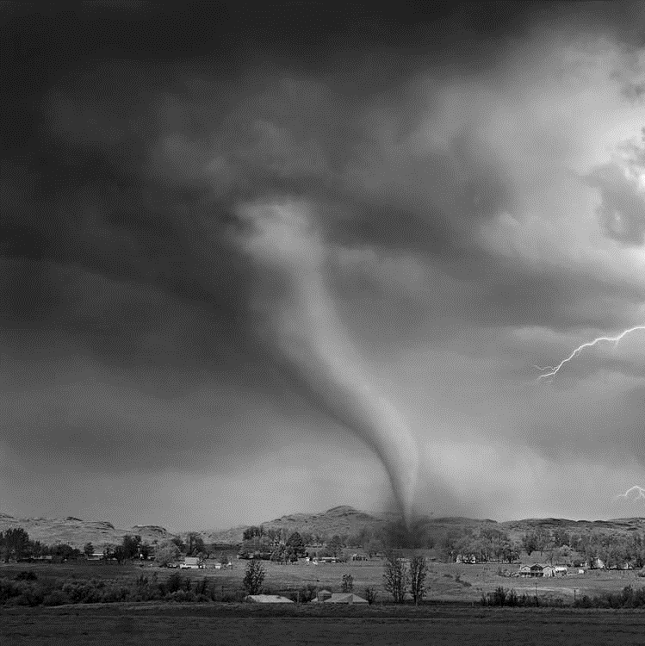

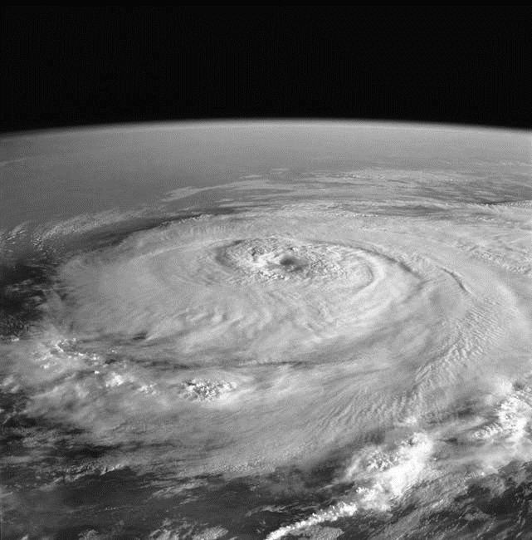

External Hazard PRA (XHPRA)
Hazard Analysis
Fragility Analysis
Plant Response (Systems) Analysis

Slide 7


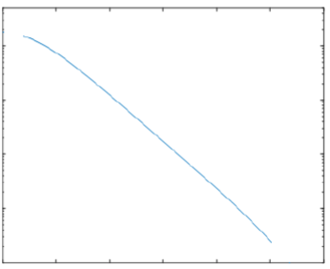


Hazard Occurrence
(Phenomena/Mechanisms)
Severity
External Hazard Assessment (Hazard Frequency)
Timing/Temporal Progression
External Hazard(s)
Site-specific Hazard Impacts Analysis
Spatial Distribution
Hazard Scenarios
Concurrent Conditions
Annual Exceedance Frequency
Hazard Severity

Slide 8
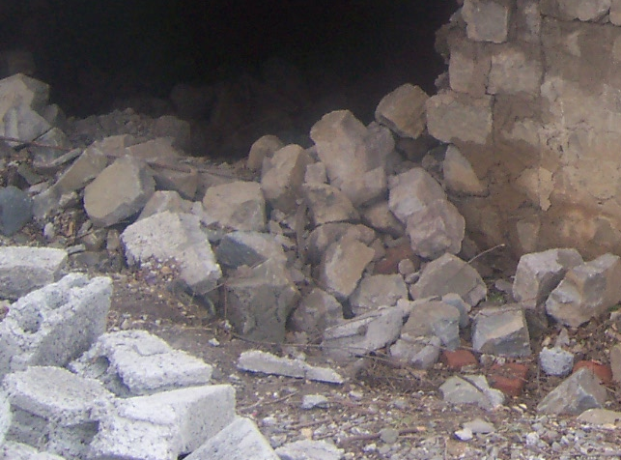

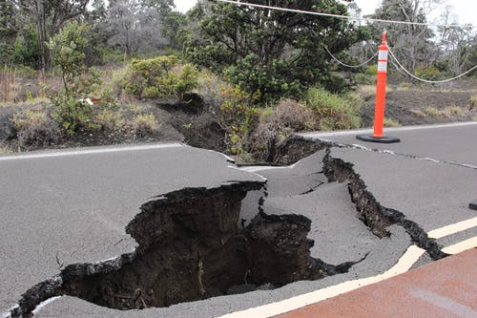
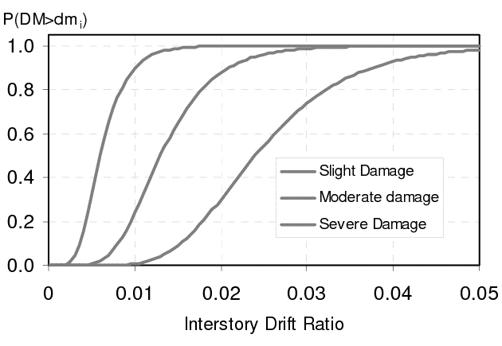





Hazard-Induced Failure Mechanisms
Identification of failure modes/mechanisms/effects
Failure Modes
Structural/Component Performance
Fragility Representation
Failure Effects
$$P(DS_{i}|S)$$
$$≥DS_{1}$$
$$≥DS_{2}$$
$$≥DS_{s}$$
Hazard Severity ($S$)

Slide 9

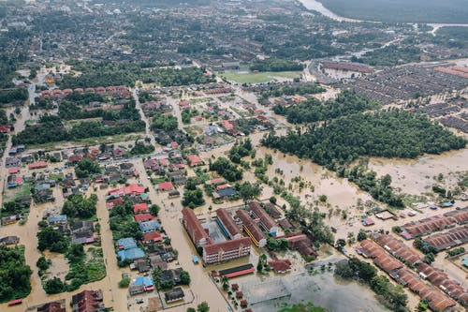


Offsite Power
Status & Timing
Offsite Factors
Conditional Probability Assessment
Regional Effects

Slide 10
Hazard-Induced Initiating Event Occurrence
Initiating Events
Frequency or Conditional Probability Assessment
Type/Characteristics/Timing

Slide 11





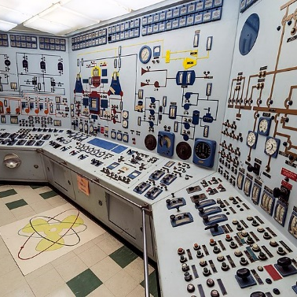

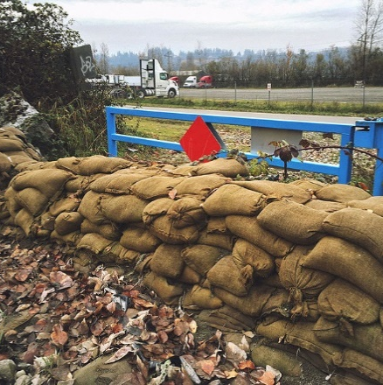
Organizational Response
Scenario Definition and Modeling
Equipment Response
Plant response
Human and Equipment Failure Event Identification
Human and Human-Equipment Response
Human Error & Equipment Failure Probability Assessment

Slide 12
Assessment of Taxonomy
Useful Taxonomy
Robust
Comprehensive
Concise
Extendible
Explanatory
Leveraging work of Nickerson, et al (2013) and Reilly, et al (2021)

Slide 13
Contributors:
Michelle Bensi (UMD) ● Somayeh Mohammadi (UMD) ● Nilanjana Ghosh (UMD)
Tao Liu (VCU) ● Camille Levine (UMD) ● Ahmad Al-Douri (UMD) ●
Ray Schneider (WEC) ● Zeyun Wu (VCU) ● Katrina Groth (UMD) ● Zhegang Ma (INL)
Questions?
This research is supported by a research grant from the Department of Energy's Nuclear Energy University Program (NEUP) under grant/cooperative agreement DE-NE0008974.
Any opinions, findings, and conclusions expressed in this paper/presentation are those of the authors and do not necessarily reflect the views of the funding agency or any other organization.
The authors acknowledge and appreciate the valuable insights provided by subject matter experts who have engaged with the project team over the course of the project to date.

