Slide 1
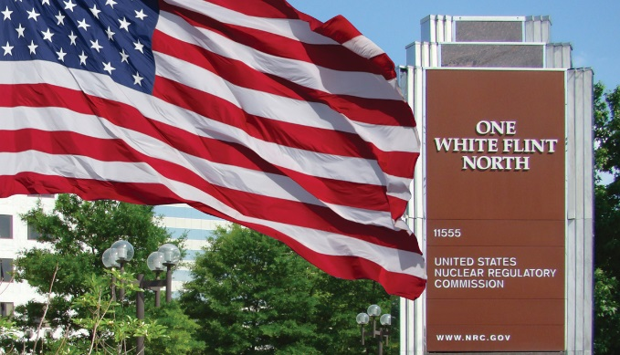
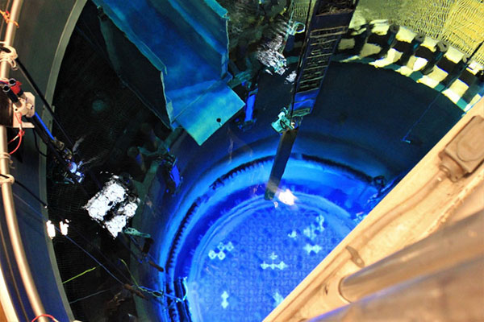
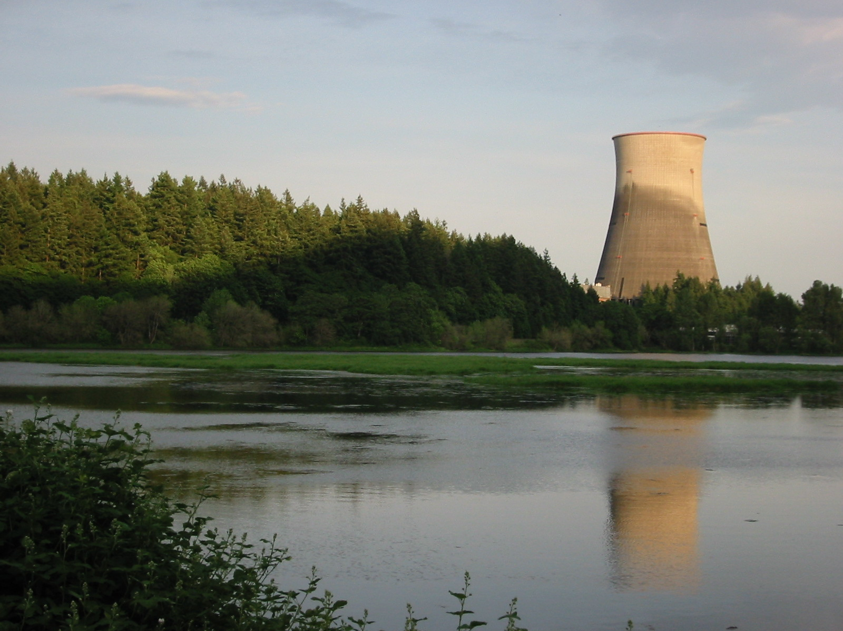
The Impact of External hazards and FLEX Credit in the Application of LMP for Operating Reactors
Matthew Humberstone, PhD
US NRC

Slide 2
Project Overview
The Licensing Modernization Project (LMP) for operating reactors leverages the NRC’s Level 3 probabilistic risk assessment (PRA) (L3PRA) model to test the feasibility of the LMP methodology for use beyond the original intent.
LMP methodology
Licensing approach for nonlight-water reactors
Described in Nuclear Energy Institute (NEI) 18-04 and endorsed by the NRC in Regulatory Guide 1.233
Uses L3PRA results
NRC L3PRA model
Pressurized-water reactors
Initially had only internal events results available
Has expanded to include external hazards and other enhancements

Slide 3
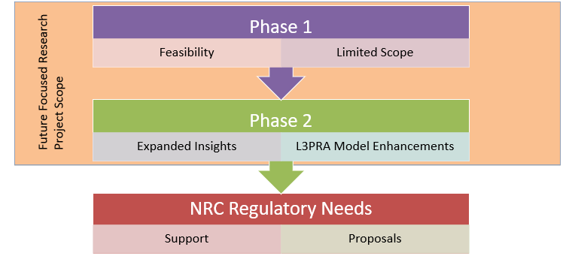

Slide 4
Objectives
Study LMP Feasibility
The LMP methodology is feasible for light-water reactors (LWRs)
Pilot LMP
Used the L3PRA model results to pilot the LMP
Communication
Shared progress/results
Identify Issues/Challenges
Use L3PRA Results
Glean LWR Risk Insights
Identified insights on implementation of the LMP
Used L3PRA results for Phase 1 and Phase 2
LWR “safety profile” consistent with NRC expectations

Slide 5
Technical Approach
LMP Methodology
- Risk-Informed, Performance-Based
- Non-LWR licensing
NRC L3PRA Model
- Severe Accident Research
- LWR Experience

Slide 6
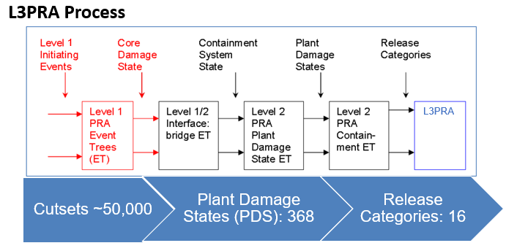

Slide 8
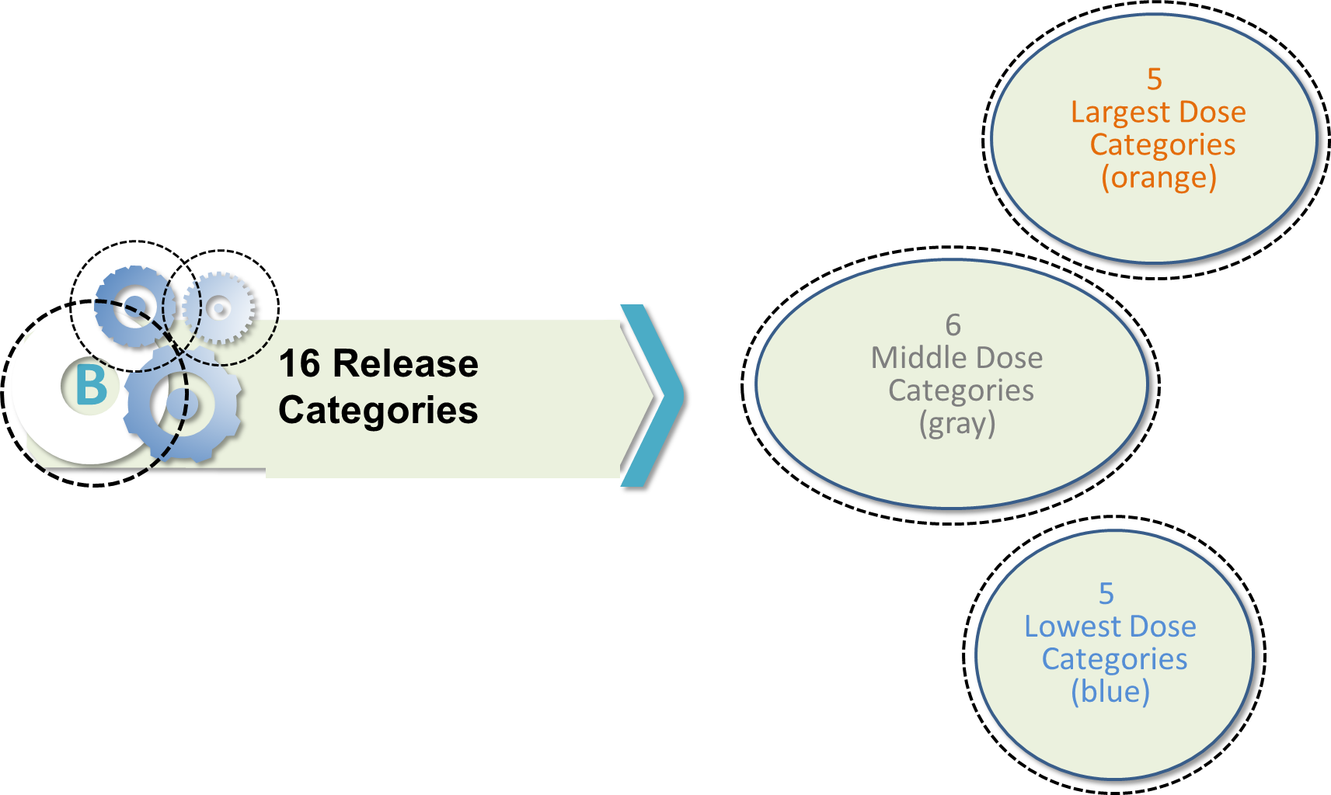
Release Category

Slide 9
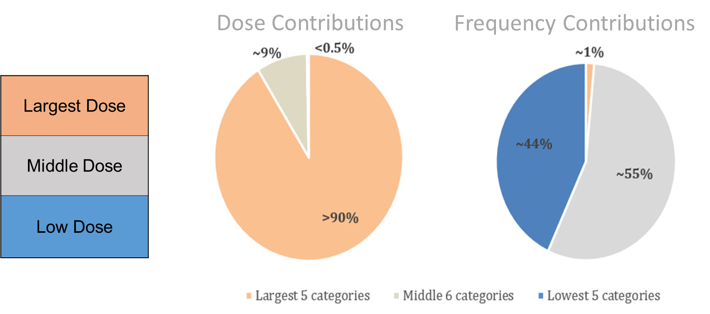
Release Category Contributions

Slide 10
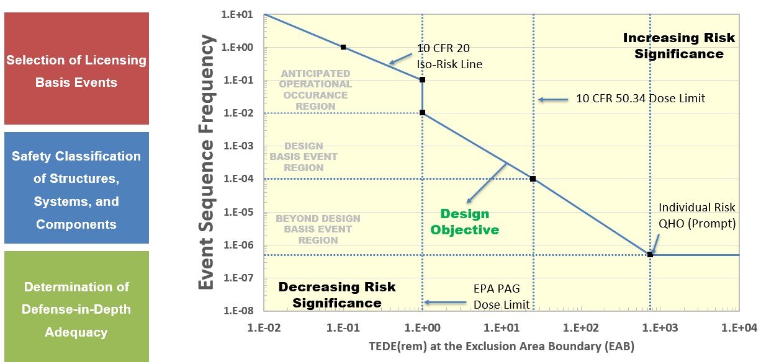
LMP Frequency-Consequence Curve

Slide 11
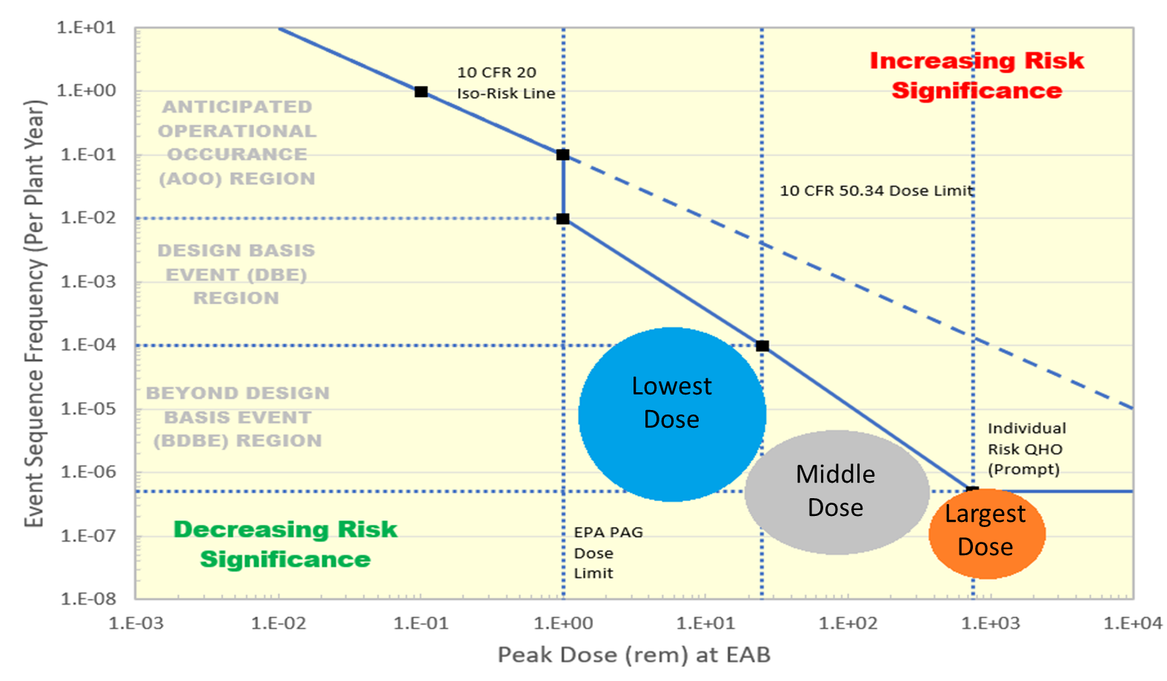
Phase 1 Results

Slide 12
Initial Phase 2 Insights
Changes to the NRC’s L3PRA model results vary
External events
FLEX credit, etc.
No impact
Different impacts on release categories/accidents
Loss-of-coolant accidents
Loss of offsite power
Station blackout
8
6
2

Slide 13
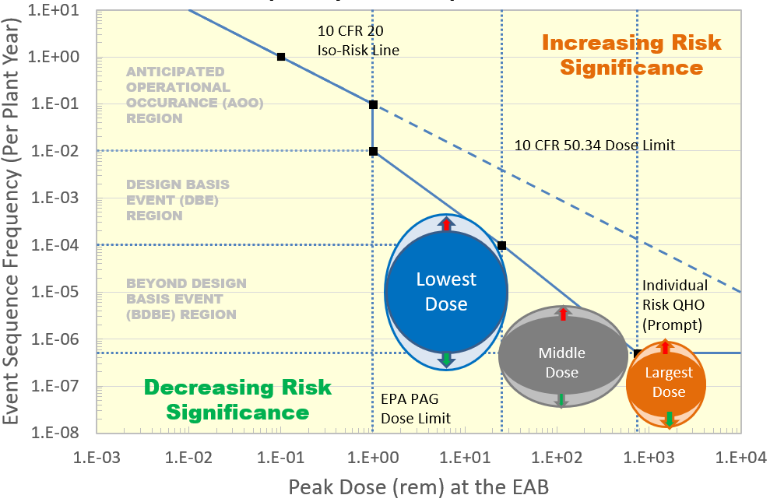
Phase 2 Results

Slide 14
Conclusions
LMP methodology is useful beyond the original intent
Insights gained to support future non-LWR licensing
Operating reactors safety profile is consistent with current NRC expectations
Several opportunities are being explored to leverage LMP methods and tools

Slide 15
Next Steps
Continue Phase 2 research
Enhanced model results
Accident sequence evaluations
Uncertainty impacts
Engagement with NRC technical staff on future needs
Supporting future regulatory work
Continue communication effort

