Slide 1
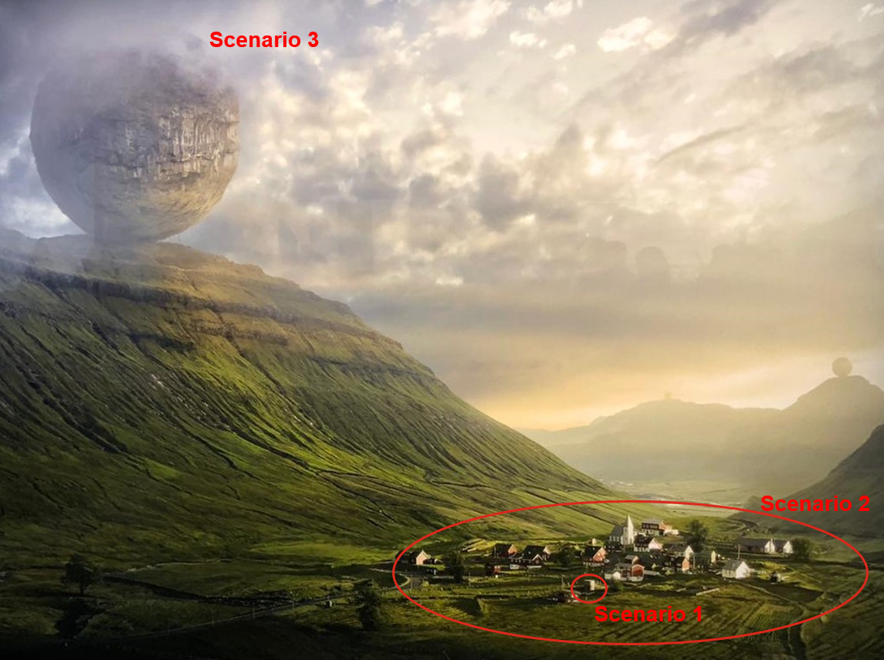
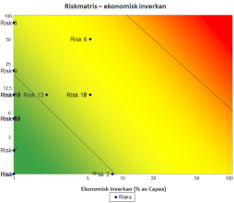
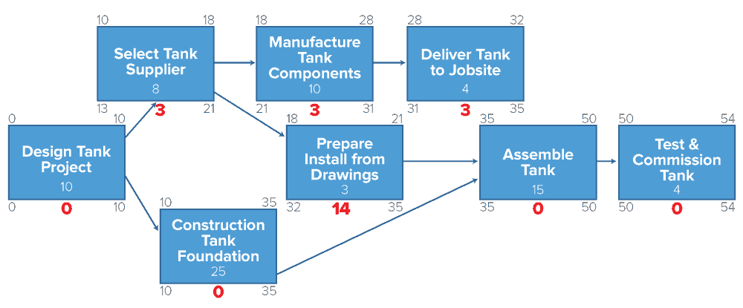
Identification of Input Errors in Schedule Risk Assessment (SRA) of Multidisciplinary Projects
Lukasz Sokolowski, Kiwa Sweden AB, Solna, Sweden
Probabilistic Safety Assessment and Management (PSAM) 16
Honolulu, HI, USA, June 26 - July 1, 2022
Cumulative Probability (%)
Predicted Construction (Date)

Slide 2
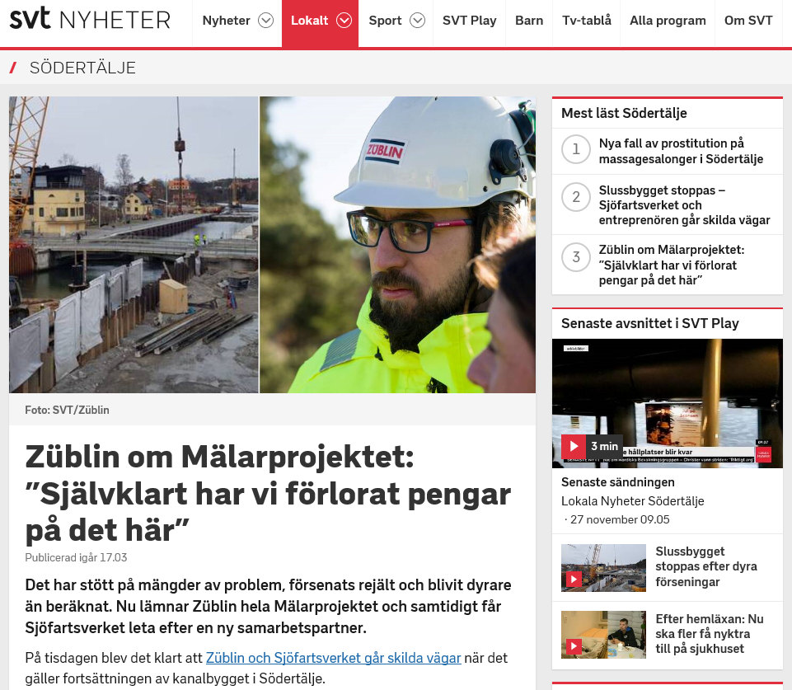

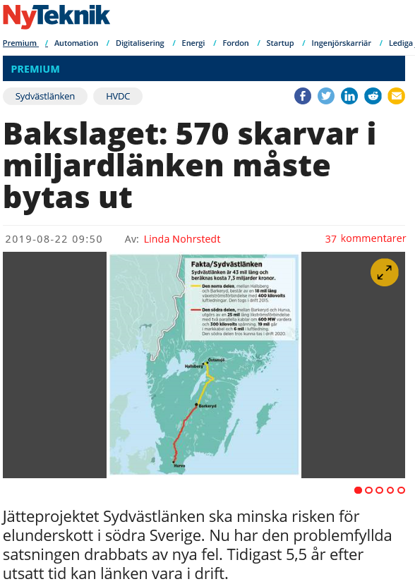
Who needs it?
1) SRA employs (usually) a statistical technique Monte Carlo.
2) It can be performed by a main company or contructor.
Schedule Risk Assesment (SRA)
SRA is a useful methodology that can support a decision-making process in complex interdisciplinary projects. One of the main results of the SRA is a Cumulative Distribution Function (CDF). Rearranged CDF, S-curve, provides information about a project outcome as a function of time and probability. Based on the SRA results tasks and subtasks of the project can be rearranged, replanned, in order to avoid among other things suboptimization.
The main concept is fairly straightforward and universal. Suitable data needs to be collected on a project status. This part is usually denoted as a qualitative risk analysis. The second part of the SRA process used to be a quantitative risk analysis (QRA), i.e. an assessment on how it is probable that certain tasks will be delayed. This part includes preparation of input data, creating a model, computations and analysis of the results.
Input data to Probabilistic Safety Assessment (PSA) can be collected in the literature – in SRA mainly from project members (human factor).
Cumulative Probability (%)
Predicted Construction (Date)

Slide 3
Requirements of risk assessment (RA)
Integrated
Structured and Comprehensive
Customized
Inclusive
Best Available Information
Human and Cultural Factors
Continual Improvement
Principles, process and framework according to SS-ISO 31000 – Risk management – Guidelines
The purpose of the risk management framework is to help organizations integrate risk management into all activities and functions.
The effect of risk management depends on how it is integrated into the organization's management structures and all activities, including decision - making.
This requires the support of stakeholders, in particular top management.
Scope, Context, Criteria
Integration
Design
Implementation
Evaluation
Improvement
Risk Assessment
Risk Identification
1) In order to understand roots of errors it is good to take a look at requirements according to ISO standard.
2) Many “soft” requirements.
3) Results of risk analysis can be depicted on the risk matrix (probability x consequence). More subtle diagrams includes how certain risks can influence projects’ capital expenditure (CaPex), statistics regarding risk cathegories or Schedule Risk Analysis (SRA).
Communication & Consultation
Monitoring & Review
Leadership and Commitment
Risk Analysis
Risk Evaluation
Risk Treatment
Recording & Reporting
Notes:
Integrated - Risk management is an integral part of all organizational activities.
Structured and comprehensive - A structured and comprehensive approach to risk management contributes to consistent and comparable results.
Customized - The risk management framework and process are customized and proportionate to the
organization’s external and internal context related to its objectives.
Inclusive - Appropriate and timely involvement of stakeholders enables their knowledge, views and
perceptions to be considered. This results in improved awareness and informed risk management.
Dynamic - Risks can emerge, change or disappear as an organization’s external and internal context changes. Risk management anticipates, detects, acknowledges and responds to those changes and events in an appropriate and timely manner.
Best available information - The inputs to risk management are based on historical and current information, as well as on future expectations. Risk management explicitly takes into account any limitations and uncertainties associated with such information and expectations. Information should be timely, clear and available to relevant stakeholders.
Human and cultural factors - Human behaviour and culture significantly influence all aspects of risk management at each level
and stage.
Continual improvement - Risk management is continually improved through learning and experience.

Slide 4



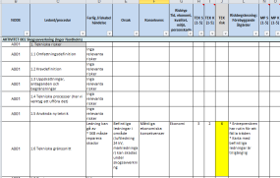

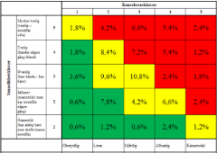
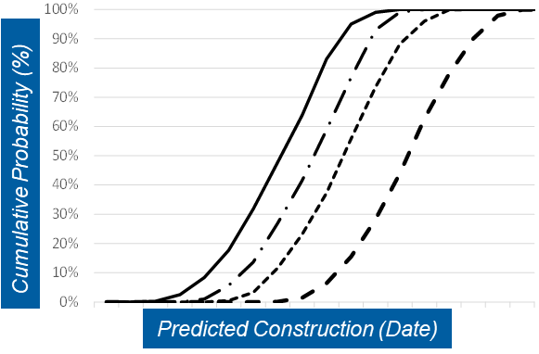
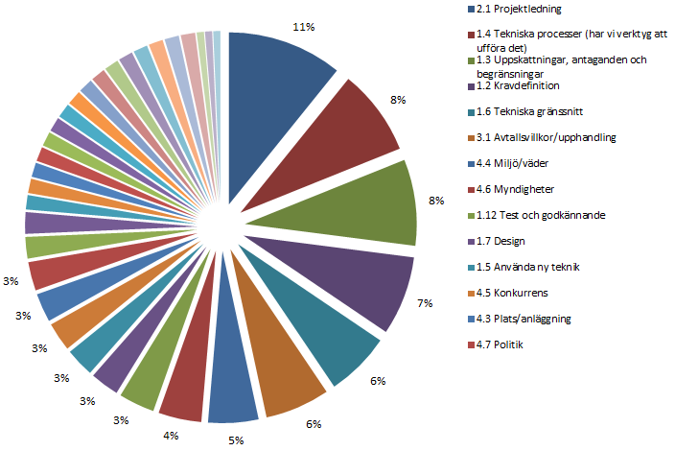
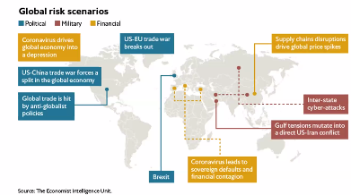
Organizational background and practices
Integrated
Structured and Comprehensive
Customized
Inclusive
Best Available Information
Human and Cultural Factors
Continual Improvement
Most of the large companies running large projects has its own “risk culture”. It might be expressed in the form of own internal steering documents on risk assessment
It can happen that these rules and praxis are not adjusted to the given project (risk appetite, probability scales, consequence calibration).
It can also happen that available tools within the company are not suitable for the project (Project, Portfolio and Resource Management Software).
Riskworkshops (co-workers)
(1) TOP-10 risks, Q1-4, (management, program leader)
(3) Status of risk assessment, Q1-4 (risk manager)
1) Focus on deliveries not on software.
2) Compile a plan for risk assessment within the project.
RAW DATA
Risk register
(2) Client’s internal management system
(4) Trends & Statistics, e.g. presentations, summary reports, Risk Review Meetings, and SRA.
Global risks (risk manager)

Slide 5
Perception and understanding of a risk
Integrated
Structured and Comprehensive
Customized
Inclusive
Best Available Information
Human and Cultural Factors
Continual Improvement
Black Swans and other vocabulary
There are known knowns. These are things we know that we know.
There are known unknowns. That is to say, there are things that we know we don't know.
But there are also unknown unknowns. There are things we don't know we don't know.
Dick Chenney, Secretary of Defense from 1975 to 1977 under Gerald Ford, and again from January 2001 to December 2006 under George W. Bush
SS-EN 31000: Risk = effect of uncertainty on objectives
But risk can be even an ”opportunity”
Risk can also be defined as the intentional interaction with uncertainty. Uncertainty is a potential, unpredictable, and uncontrollable outcome; risk is an aspect of action taken in spite of uncertainty.
The National Encyclopedia: ”Risk = possibility that something undesirable can occur”
Unknown unknowns are so called Black Swans. Some say that Corona pandemic fulfil criteria of it.
1) Define basic concepts and important terms at the beginning of the project.
2) Standardize input in the risk register (description, language, consequences).
3) Decide how detailed a risk assessment is going to be (sensitivity to a risk).
4) Be aware about internal and organizational risks.
”It ain’t what you don’t know that gets you into trouble. It’s what you know for sure that just ain’t so”. Mark Twain, a writer.
“The attack on Pearl Harbour was a surprise military strike”. Pearl Historic Sites.
“If war eventuates with Japan, it is believed easily possible that hostilities would be initiated by a surprise attack upon the Fleet or the Naval Base at Pearl Harbor”. Frank Knox, Secretary of the Navy, February 5, 1941.
Fotografiska, 2019

Slide 6
Personal background
Integrated
Structured and Comprehensive
Customized
Inclusive
Best Available Information
Human and Cultural Factors
Continual Improvement
Challenges to get reliable input
There are different personalities. As might be expected some people are much more than comfortable to share their thoughts and opinions in front of a bigger group of people than others. Those others sometimes might need some help. Arrange risk assessment so that everyone has space and are not dominated by bosses or managers. The same is valid for new and old project members, technical and managerial stuff, etc.
This is the role of risk manager to cerate a suitable and friendly environment during risk workshops so that project members are willing to contribute.
Input is usually is collected during risk workshops.
Risk workshop can be conducted in-live or digitally. Digital meetings via Zoom or MS Teams might restrain creativity. People visual focus narrows on the screen.

Slide 7


Bottom-Up and Top-Down
Integrated
Structured and Comprehensive
Customized
Inclusive
Best Available Information
Human and Cultural Factors
Continual Improvement
Necessary to get a good picture of the risk level
Results of risk assessment and SRA are reviewed by the customer. One of the key aspects during input gathering in QRA is to balance information in a proper way that comes from specialists and management staff in the project.
These two might be referred as bottom-up and top-down approaches. Both inputs are crucial and necessary in order to achieve the most accurate and precise status of the project in terms of its risk level. Bottom-up assessment tend to focus on mostly technical issues of the project. Top-down assessment put usually more emphasis on commercial environment and external risks.
A convenient way is to organize meetings on a regular basis where top risks are chosen.
Exchange of information

Slide 8
Risk manager (champion)
1) Define clear roles in risk assessment process.
2) Role of the risk manager is to create a suitable environment during risk workshops to gather a reliable input.
3) PL might have incentives at certain circumstances to suboptimize the project.
Wrong role
SME is a person which is an expert withing its expertise and field
Risk owner (project leader, project member, sponsor)
Responsible for risk analysis
General requirements and expectations
Decide about risk measures
Informs and reports risks
Subject-Matter Experts (SME) (project members)
Detailed knowledge and experience in the field
Even external experts
New people should be introduced to the process of risk analysis
Risk Manager (Champion)
Organize risk workshops
Prepares reports, report and communicate
Is responsible for quality assurance of risk analysis process as a whole
Action owner
Conduct agreed measures
Follow the schedule

Slide 9
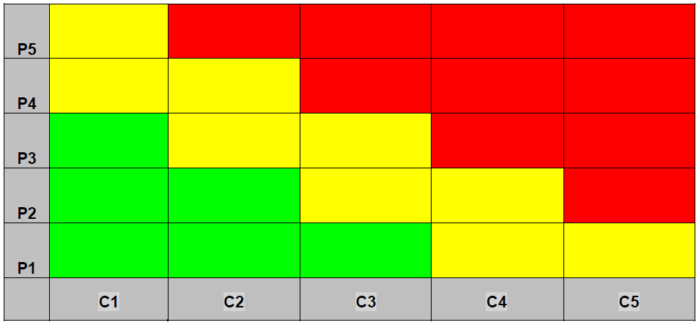
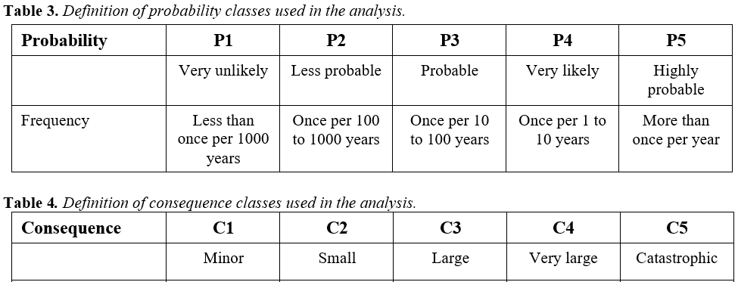
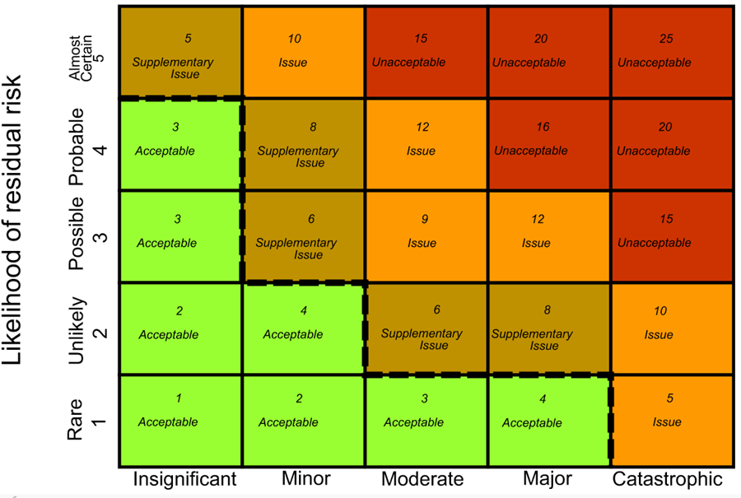
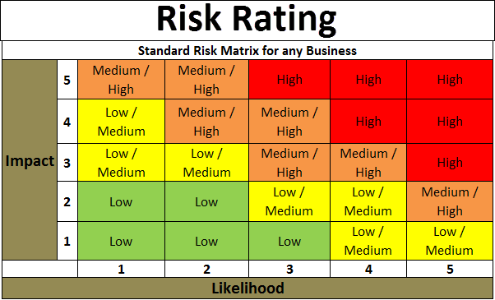
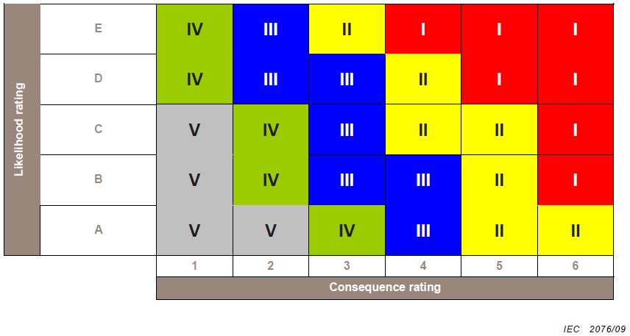
Risk matrix
Calibration and consequence classes
The main issue related to risk matrices is that they are not well defined and adapted for the given project. In medical industry the matrices where focus in on a process, it might of relevance to focus on frequencies 1 event a week or year. In construction industry this lifespan might be higher. Using a standardized matrix calibration is thus counterproductive. It will not function its purpose since it will be difficult to analyze the results.
In large projects it is a common praxis that a subcontractor prepares its own analyses. This leads to a situation where matrices are non-compatible. The recommendations here is to set up a standardize risk matrix for the whole project. This is because matrices are not usually not compatible.
Incompatible risk matrices (subcontractors)
Lack of understanding of probability scales
Unsuitable risk calibration
1) It is fundamental to agree on risk calibration and consequence classes.
2) Few risk matrices can be valid.
3) Introduce no more strict rules than those you can fulfil.

Slide 10
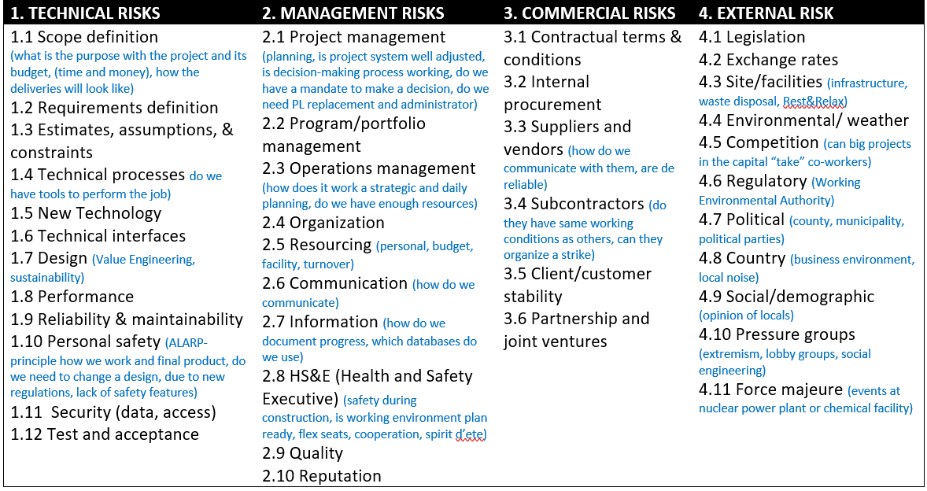
Risk Breakdown Structure (RBS)
We should strive to get as detailed input as possible. It is better to have more data than less.
RBS should be adjusted to a certain project (size, budget, number of co-workers, technology, etc.)
Choose a proper level of details
Risk analysis should preferably be of “full record” (better for statistical purposes)
RBS for a construction project (Hillson 2012)

Slide 11
Master Schedule/base line
The master schedule (or preliminary schedule) should be prepared at the beginning of the project.
Important with action (AKA urgency) and impact windows. This two constitute so called the Critical Path of the project. In many cases these information are hardly available (uncertainties).
There should be a responsible person to keep the schedule updated. This information should be available at any time.
Action and impact windows in the project
Project ”Critical Path”

Slide 12
From Qualitative to Quantitative (Hillston 2004)
Risk Identification
Project Schedule
Risk mapping, transfer of information
Risk model
Qualitative Assessment
Input Data
Measures
Quantitative Assessment
1) Detail level of the model is not suitable
2) Lack of detailed information about the risks
Risk Register
Risk Reports
Cumulative Probability (%)
Predicted Construction (Date)
Actions

Slide 13
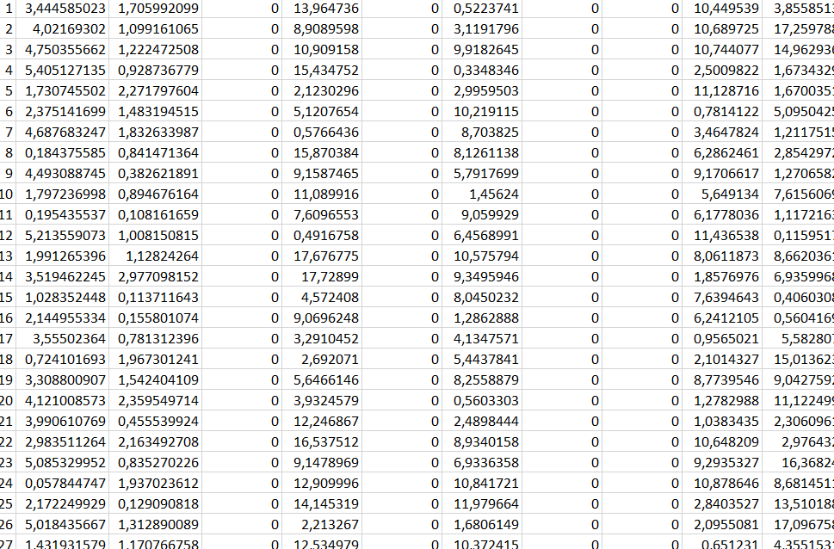
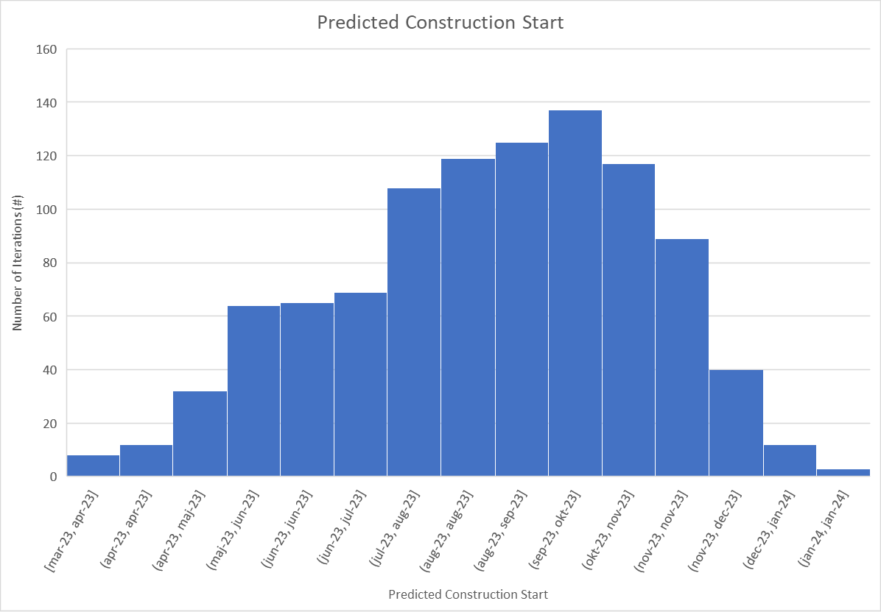
SRA model and results (DoE)
1) Complicated software
2) Wrong distributions
3) Iteration errors (too little iterations)
4) Interpretation of results
Input
Method
Results
Monte Carlo
Risk information
Distributions used in Monte Carlo
Modified triangular distribution or trigem
Uniform Distribution
Normal distribution
Beta Distribution
Lognormal distribution
Discrete or Spike Dis
Overlapping S-Curves (with onion ring)
No need for complex tools regarding simplex project. Excel, Matlab, Python should do the job.
Monte Carlo Histogram

Slide 14
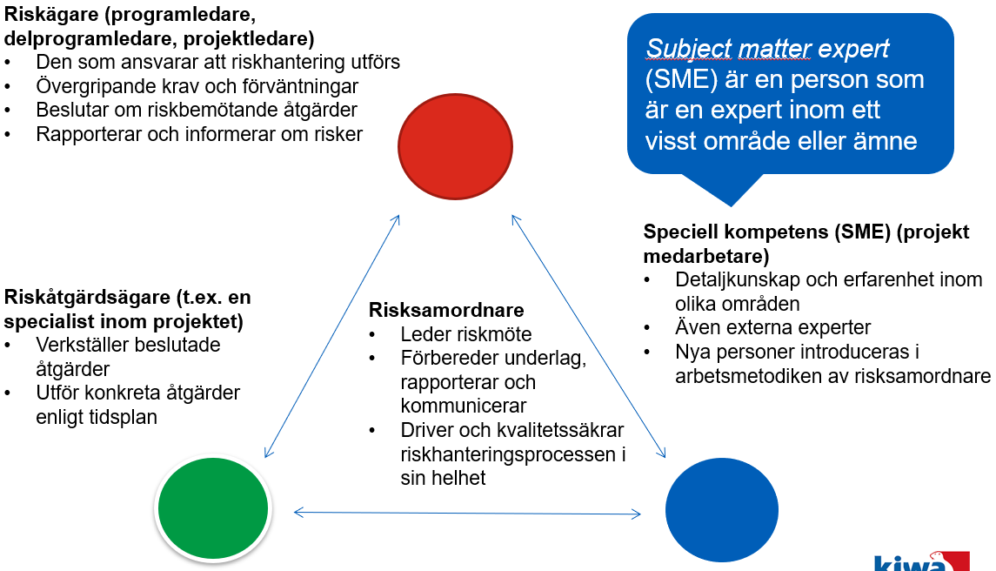
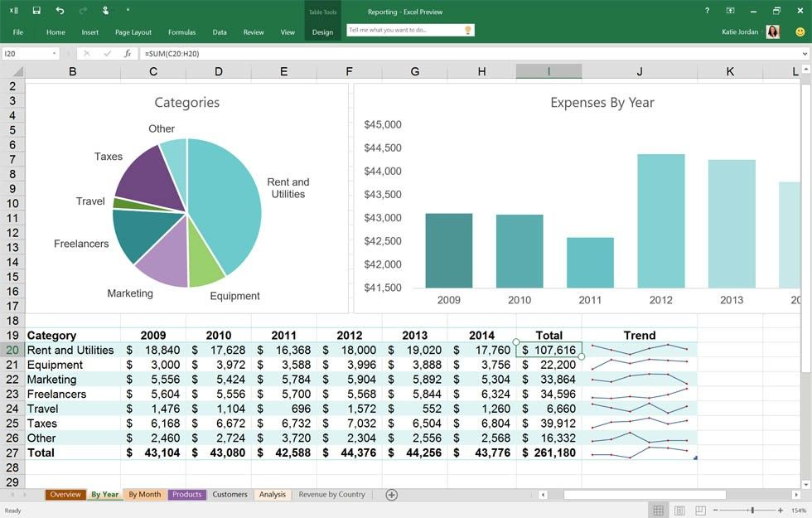
Conclusions
Schedule Risk Assessment (SRA) is a suitable quantitative assessment that can be used for identification and managing of high-risk areas of the complex projects in many industries
It is important to focus on general principles of the risk assessment to avoid input errors of the SRA
SRA uses Monte Carlo method for computations. This requires projects’ resources -> the project organization must be quite mature
There are many commercial software that can be employed in the SRA analysis. For simpler schedules a script in Excel, Matlab or Python can be used to create a computational model and conduct computations
Meetings without risk manager
Introduction of SME
Double reporting
Quarterly reports

Slide 15
References
SS-ISO 31000:2018, Risk Management – Risk management – Guidelines, 2010-08-23.
IEC/ISO 31010, Risk management – Risk assessment techniques, Edition 1.0 2009-11.
B. Weibull, “SIL i praktiken. Introduktion och SIL-bestämning,” (In Swedish), IPS, 2016.
D. Hillson, P. Simon, ”Practical Project Risk Management. The ATOM Methodology”, Second Edition, 2012.
D. Hillson, ”Effective Opportunity Management for Projects. Exploiting Positive Risk”, 2004.
DoE, recommendations.
W.L. Winston, ”Microsoft Office 2013. Data Anlaysis and Business Modeling”, Microsoft Press, 2014.

