Slide 1
Review of Quantum(-Inspired) Optimization Methods for System Reliability Problems
Lavínia M. Araújo¹, Isis D. Lins¹, Diego A. Figueroa¹, Caio B. Souto Maior¹, Márcio C. Moura¹ and Enrique L. Droguett²
¹CEERMA - Center for Risk Analysis, Reliability Engineering and Environmental Modeling
UFPE - Federal University of Pernambuco – Brazil
²GIRS - The B. John Garrick Institute for the Risk Sciences
UCLA - University of Califormia – Los Angeles – USA

Slide 2
Introduction
Demand of high levels of reliability leads to optimization problems:
The redundancy allocation (RAP);
The reliability allocation;
The reliability-redundancy allocation (RRAP)
NP-hard problems:
Exact methods – small instances;
Metaheuristics:
Genetic Algorithms (GA);
Ant Colony Optimization (ACO);
Particle Swarm Optimization (PSO).
Quantum algorithms:
- Quantum annealing;
- Q-Aprox.Opt.Alg. (QAOA)
Quantum-inspired models:
- Q-Evolutionary Alg.;
- Q-GA.
GOAL: review on quantum(-inspired) methods applied to system reliability problems, specifically, RAP, RRAP and reliability-allocation problems.

Slide 3
Introduction
Quantum Computing
Figure 1: (a) Bloch Sphere as a graphical representation of a single qubit [21];
(b) A Quantum Circuit example [22]
Quantum-inspired algorithms
Quantum classical algorithms processed by quantum computers.
Quantum-inspired metaheuristics emerge enable running models with better performance on classical computers.
Quantum physics phenomena (e.g., superposition, entanglement) are simulated to explore quantum programming and predict future behavior and results (Han and Kim)[13].

Slide 4
Introduction
System Reliability Optimization Problems
Redundancy Allocation Problem
$$Maximize R\left(x\right)=\prod_{j=1}^{s}{\left[1−\prod_{k=1}^{ct_{j}}{{\left(1−R_{jk}\right)}^{x_{jk}}}\right]}$$ s.t. | (1)
$$\sum_{j=1}^{s}{\sum_{k=1}^{ct_{j}}{x_{jk}∙c_{jk}≤c}}$$ | (2)
$$n_{j,min}≤\sum_{k=1}^{ct_{j}}{x_{jk}≤n_{j,max}}$$ | (3)
$$x_{jk}∈\left\{0,1,…,n_{j,max}\right\}$$ | (4)
2. Reliability Allocation Problem
$$Minimize C= \sum_{i=1}^{n}{c_{i}(R_{i})}$$ s.t. | (5)
$$R_{s}≥R_{G}$$ | (6)
$$R_{i,min}≤R_{i}≤R_{i,max} , i=1, 2,…,n.$$ | (7)
3. Reliability-redundancy Allocation Problem
The goal is to maximize overall system reliability by allocating redundancy and reliability to the components of each subsystem in the most efficient way possible.

Slide 5
Research materials and methods
Planning the review:
Web of Science database.
Gathering and selecting papers:
Reporting:
Final paper.
Keywords combination | Phase 1 | Phase 2 | Phase 3
“Reliability Problem” AND “Quantum” | 11 | 4 | 1
"Redundancy allocation" AND "Quantum" | 4 | 4 | 4
"System reliability" AND "quantum" AND "optimization" | 9 | 6 | 2
“Reliability problem” AND “Quantum” AND "Optimization" | 1 | 0 | 0
Total | 25 | 14 | 7
Notes:
A Systematic Literature Review is a useful technique for determining the current state of knowledge in relation to a specific subject. It differs from a traditional review in that it is achieved through a repeatable, scientific, and transparent method, which eliminates the potential of bias and lack of critical examination. Furthermore, determining what might be recognized and unknowable about the specified research question necessitates a methodological approach [20]. Different approaches are used for performing systematic reviews of the literature [26]. They are organized around three primary stages: (1) planning the review, (2) gathering and selecting papers, and (3) reporting.
In the first stage, Web of Science (WoS) was the database chosen to be used in this research. It aggregates a variety of databases into a single searching tool [27]. In the second stage, one criterion used for filtering the articles was the language of publication. Only copies published in English were selected. The search interval was 1945 to 2022 (WoS default). But publications do not occur until 2004. Quantum optimization is already known to be relatively new [21]. The maximum number of articles per year is 2, in 2021. No article type filtering was used, i.e., journal and conference copies are included. The conference papers can point out this novelty since the quantum approach is new in this reliability context.
Also, in stage (2), the main keywords were also thought to conduct the study. First, keywords were combined, referring to the system reliability problems mentioned in this paper. No papers were found directly related to the keywords “Reliability allocation”, “Reliability-redundancy allocation” or “Reliability-redundancy” with “Quantum”. The only combinations that returned articles were the ones shown in Table 1. In this regard, three phases of article selection were conducted. Phase 1 consists of the general collection of articles; phase 2 deals with filtering from the reading of titles and abstracts; finally, in phase 3 the selection was made from the complete reading of the articles.

Slide 6
Discussions and Gaps
Only seven studies address the approaches
Table 2: Quantum(-inspired) methods in the literature review
Source | Method | Method Category
Leon and Cascal [14] (2019) | Simulated Annealing | Classic Quantum
Li and Zio [7] (2014) | QEA | Quantum-inspired
Du and Li [1] (2019) | QEA | Quantum-inspired
Bhattacharyee [35] (2021) | BWQPSO | Quantum-inspired
Zhang, Zhou and Yang [36] (2014) | QPSO | Quantum-inspired
Alvarez-Alvarado and Jayaweera [37] (2018) | AQPSO | Quantum-inspired
Dueñas-Osorio, Vardi and Rojo [38] (2018) | Quantum-inspired Boolean states | Quantum-inspired
Only mono-objective and series-parallel systems.
Notes:
Based on the survey of what has been studied in the literature regarding quantum applied to system reliability optimization problems, some interesting aspects can be highlighted. First, it is an area with little exploration so far. Only seven studies address these types of approaches to handle those problems to the best of our knowledge. One is for quantum algorithms run on quantum computers, and six are related to quantum-inspired analysis. Table 2 below summarizes the methods encountered.
Besides being few, the applications are made only in the mono-objective context. With reliability optimization and cost constraint, or vice-versa. Thus, there is a gap concerning multi-objective applications. Furthermore, all analyses concerns only series-parallel systems.
Broadening the horizon of applications, we observe that there are different possible methodologies to be used in the context, besides the ones that have been applied specifically for the RAP. For example, quantum-inspired, as seen, can be used in different metaheuristics, such as ACO, GA, and tabu search. Nevertheless, among the methodologies that were applied in the RAP, in QEA, different local search techniques can be inserted to refine the solution, signaling that this method can also be further explored.

Slide 7
Results
Quantum Approaches
In the area of RAP only one study was found that applies a quantum algorithm to optimize the problem (LEON; CASCAL, 2019)[14].
The problem was modeled to be in the format of quadratic unconstrained binary optimization (QUBO);
Series-parallel reliability model;
The D-Wave quantum computer;
Quantum annealing for the optimization process. Analogous to classical simulated annealing approach, but with superior performance;
The quantum version of the method can be eight times faster than the classical one (computational speed).
Notes:
Regarding traditional quantum computing, only one study was found related to RAP of a series-parallel system that applies a quantum algorithm for optimization [14]. The problem was modeled as QUBO. The D-Wave quantum hardware has brought focus to this method [29]. This approach uses quantum annealing for the optimization process, analogous to the classical simulated annealing, but with superior performance. From the computational speed point of view, the quantum version of the method can be eight times faster than the classical one [14].

Slide 8
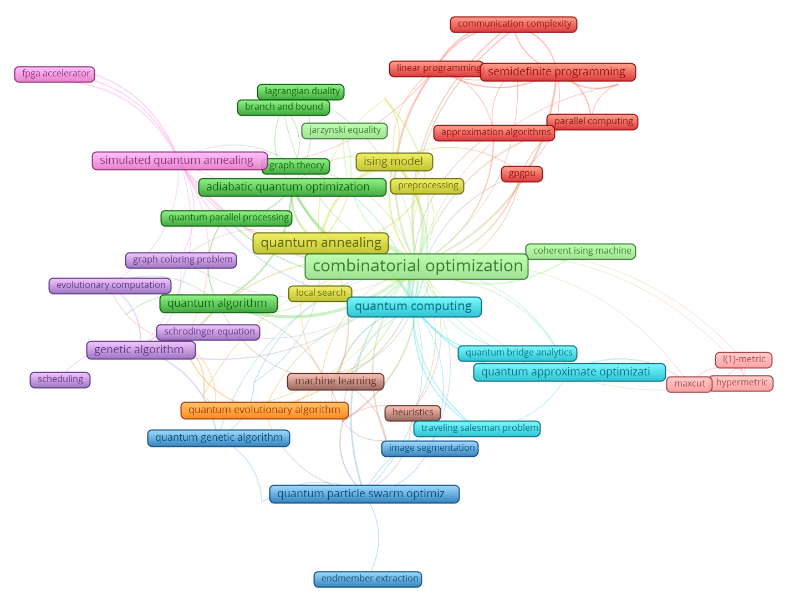
Results
Quantum Approaches
313 papers
Keywords: "quantum algorithms" and "combinatorial optimization"
excluding the words "quantum-inspired", "quantum inspired".
Notes:
Since the classic quantum basis is scarce in the reliability optimization context, we extended our search to identify other such methods that are applied in other combinatorial optimization problems. For analysis purposes, a Web of Science® search was performed with keywords such as “quantum algorithms” and “combinatorial optimization”, excluding the words “quantum-inspired”, “quantum inspired”. A sample of 313 articles was found. Based on it we plotted a network of the main terms of the articles with the help of the VOSviewer® software, as shown in Figure 5. In the literature, in general, applications of different algorithms in different problems have been found. For example, quantum genetic algorithm for the MaxCut problem [30], quantum annealing [31], quantum approximative optimization - QAOA [23] quantum particle swarm optimizer applied to the backpack problem [32]. We can also detect applications in classical problems such as Travelings Salesman Problem [33]. It is worth noting that there are also multi-objective applications in the routing problem [34].

Slide 9
Results
Quantum-inspired Approaches
Li and Zio (2014): RAP - QEA
series-parallel systems with multi-states;
performing numerical analyses, QEA showed better results in the number of fitness evaluations and faster than the others; tests were compared with results from GA, ACO, among others.
Du and Li (2020): RAP - QEA
QEA with two different local search methods. One for cost reduction and the other for availability improvement.
The results are better than those proposed by Li and Zio (2014).
Bhattacharyee et al. (2021): RAP - BWQPSO
an incorporation of the Big-M penalty in the Weighted Quantum behaved Particle Swarm Optimization;
reliability components that are time-dependent;
aims to optimize reliability.

Slide 10
Results
Quantum-inspired Approaches
Zhang, Zhou and Yang (2014):
System Reliability-aware Energy Optimization Problem;
QPSO.
Alvarez-Alvarado and Jayaweera (2018):
Maximize reliability for electronic devices
Accelerated Quantum Particle Swarm Optimization (AQPSO).
Dueñas-Osorio, Vardi and Rojo (2018):
Boolean analysis translated from qubits
quantum-inspired computing perspective for system reliability bounds as a precursor to more complex applications;

Slide 11
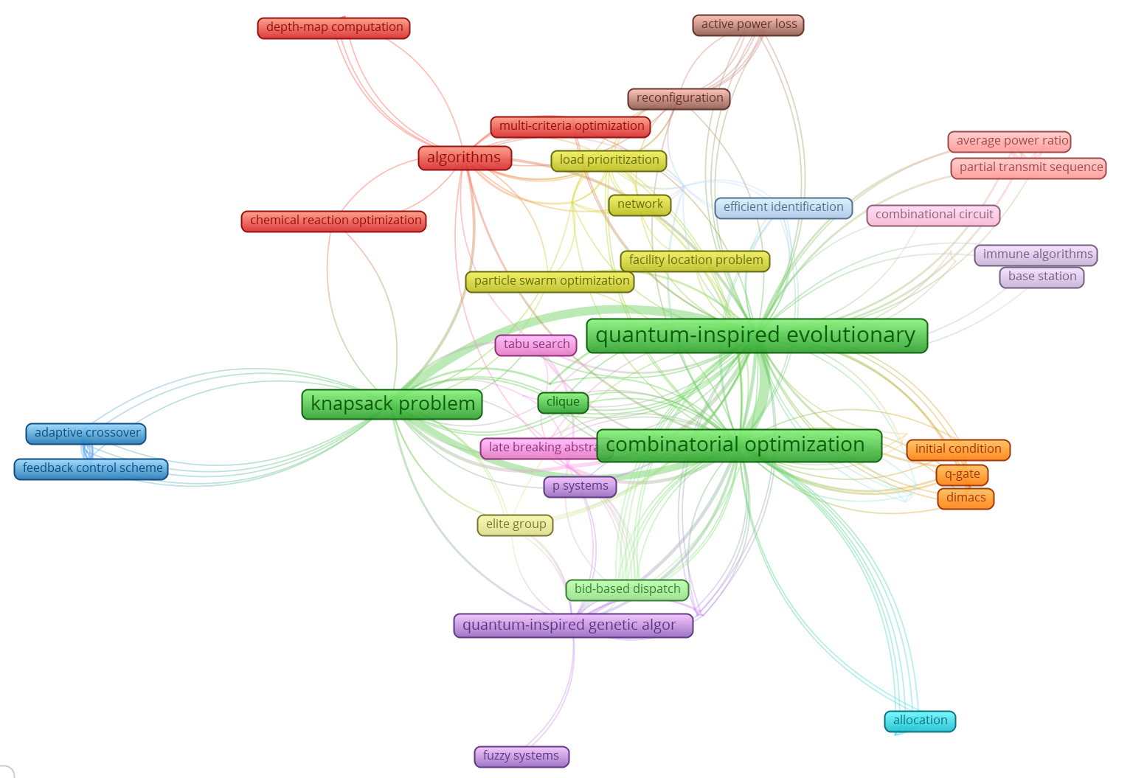
Results
Quantum-inspired Approaches
42 papers
Keywords:
"Quantum-Inspired Algorithms" and "Combinatorial Optimization"
Notes:
Similar to what was done with quantum algorithms, we expanded our search to a general context of combinatorial optimization problems. In the WoS database, 42 studies addressed the theme “Quantum-Inspired Algorithms” and “Combinatorial Optimization”. With the help of the VOSviewer® software, we created a network that relates the main terms of these articles (Figure 6). We observe a strong relationship between combinatorial optimization, QEA, and the knapsack problem. The literature has shown developments in this methodology for different variations of the problem [20, 21]. We can also find other methods for the same problem, such as quantum-inspired differential evolution and quantum-inspired tabu search [25]. In other problems, we can see quantum-inspired ant colony [41] and quantum-inspired genetic algorithm [42].

Slide 12
Conclusions
Future Works -> applications of quantum(-inspired) algorithms:
for experimentation, evaluation, and creation of a benchmarking. There are libraries in Python, such as Qiskit, that can run the models for a limited number of qubits;
on RRAP problem;
in multi-objective contexts;
in Binary Syst. State and Multi-Syst. State;
with other local search engines.
Notes:
This paper aimed to perform a literature review to identify the applications of quantum and quantum-inspired optimization in systems reliability optimization problems. Given the discussions and gaps found, it is possible to identify a research agenda to be carried out in a practical way to expand the knowledge of the quantum-based methods on the specific problems. Some of the possibilities of studies seen are the applications of quantum(-inspired) algorithms:
for experimentation, evaluation, and creation of a benchmarking. Given the difficulty of obtaining quantum computers, there are libraries in Python, such as Qiskit, that can run the models for a limited number of qubits;
on RRAP problem;
in multi-objective contexts;
in systems with different reliability models beyond series-parallel,
in BSS and MSS;
with other local search engines, like the Hill Climbing [43] and the Iterative Local Search (ILS) [44] techniques.
In summary, there are many possibilities for research. Notably, expanding this research field will enable managers, reliability engineers, maintenance professionals, and other decision-makers to use more computationally efficient methods to solve these problems. This is especially true for complex systems involving many subsystems and multiple redundancy possibilities. Applying fundamental models to support the decision-making process in more classical methodologies becomes onerous.
As a limitation of this study, we emphasize that not all methods found in the literature were detailed. So, to understand more about them, it is necessary to access the references. Furthermore, it is crucial to expand the search to other databases, such as Scopus. Despite these points mentioned above, this study can provide relevant information about the problem, generate insights for new reviews and empirical studies, and fill the previously identified gaps.

Slide 13
Thank you!
Do you have any questions?
Caio Souto Maior
caio.maior@ceerma.org
Acknowledgements

