Slide 1
PSAM 16
Probabilistic Risk Assessment of a Light Water Reactor Coupled with a High-Temperature Electrolysis Hydrogen Production Plant – Part 2: Hazards Assessment and PRA
Flexible Power Operation and Generation
June 29, 2022
Kurt Vedros, Idaho National Laboratory

Slide 2
INL Flexible Power Operations and Generation (FPOG) PRA Team
Kurt G. Vedros, kurt.vedros@inl.gov
  PRA project lead for FPOG PRA
  Active member of team as well
Robby Christian, robby.christian@inl.gov
  Worked on the current PRA
  Will work on the improvements proposed for the PRA in FY22 and FY23
Austin Glover, amglove@sandia.gov
  Led team that performed hydrogen safety analysis
  Will continue hydrogen safety analysis improvements for the PRA in FY22 and FY23

Slide 3
INL Flexible Power Operations and Generation (FPOG) PRA Purpose
The goal of the project is to provide support for potential flexible power options for existing light water reactor nuclear power plants (NPPs) to support hydrogen production
Questions for utilities are:
  Will flexible power operations increase profitability (the financial case)?
  Will the safety case be proven for the modifications necessary?
    To what extent will the safety case impact the financial case?
PRA is meant to assess the safety case and help determine the extent of modifications necessary to license a modification to an existing NPP

Slide 4
Evaluation of Safety Hazards and Licensing Considerations
Licensing pathways
  10 CFR 50.59
    Support of RG 1.174
Probabilistic Risk Assessment (PRA)
  Hazard analysis of generic PWR and BWR
    Addition of Heat Extraction System (HES)
    H₂ High Temperature Electrolysis Facility (HTEF)
  Identification of affected Licensing Basis Events (LBEs)
    Design Basis Accident initiating events
  Quantification of the effects on LBE initiators
  Quantification of the effects on Core Damage Frequency (CDF) and Large Early Release Frequency (LERF)
Notes:
10 CFR 50.59 based on LBE increase not greater than 10% (minimal increase accepted 10%)
RG 1.174 cdf and LERF increase less than …. Table

Slide 5
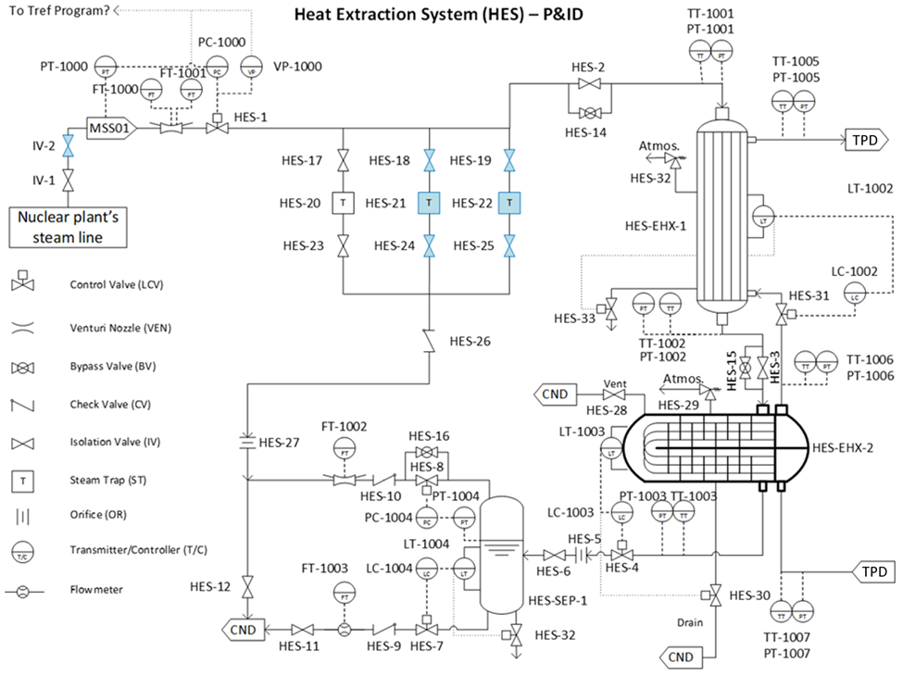
Representative PWR and BWR LWRs
Hazards Analysis of Heat Extraction
  Evaluated a 4-Loop Westinghouse PWR and a Mark I containment BWR servicing a hydrogen production HTEF
    Specific risks identified and quantified for heat extraction from each reactor type
  Heat extraction system (HES)
    Dedicated HES using steam extracted downstream from MSIVs
  Identified external targets for potential industrial accident in close proximity to the NPPs
    Hydrogen detonation overpressure effects on switchyard components, tanks, critical and non-critical structures
Notes:
Heat extraction was limit to 5% in nominal condition

Slide 6
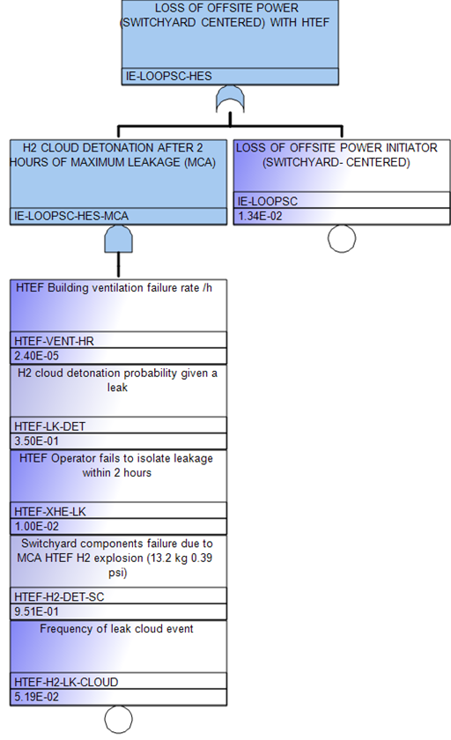
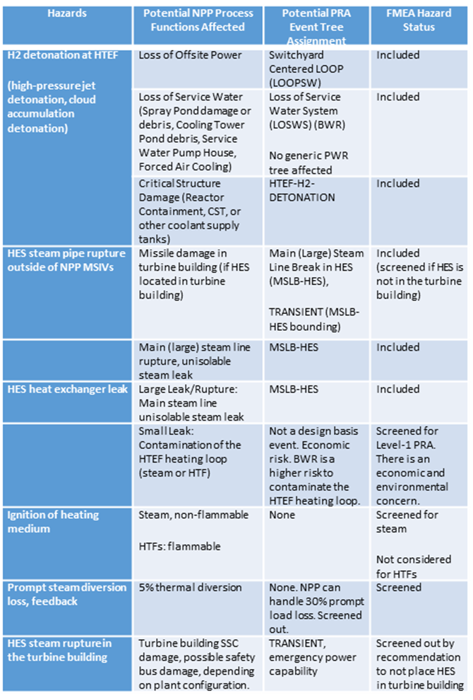
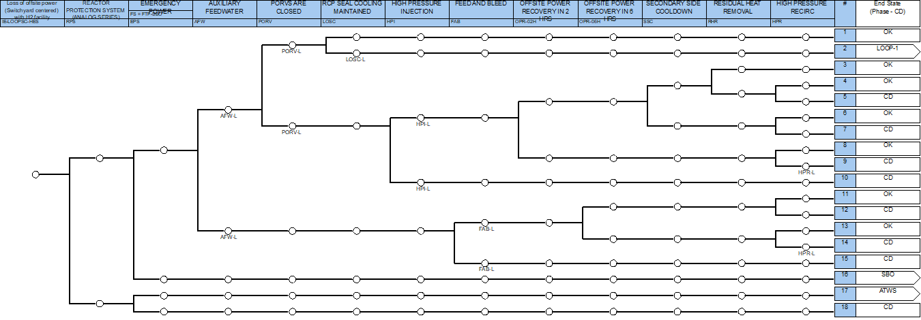
Tools Used in the PRA Project
SAPHIRE – PRA tools suite developed by INL for the US NRC
Hazards analyses
  FMEA, What-If?, etc…
  Hydrogen leak, detonation, and overpressure
  Overpressure sensitivity analysis
PRA Models
  Generic models for BWR and PWR
  Addition of the HES and external hazards

Slide 7
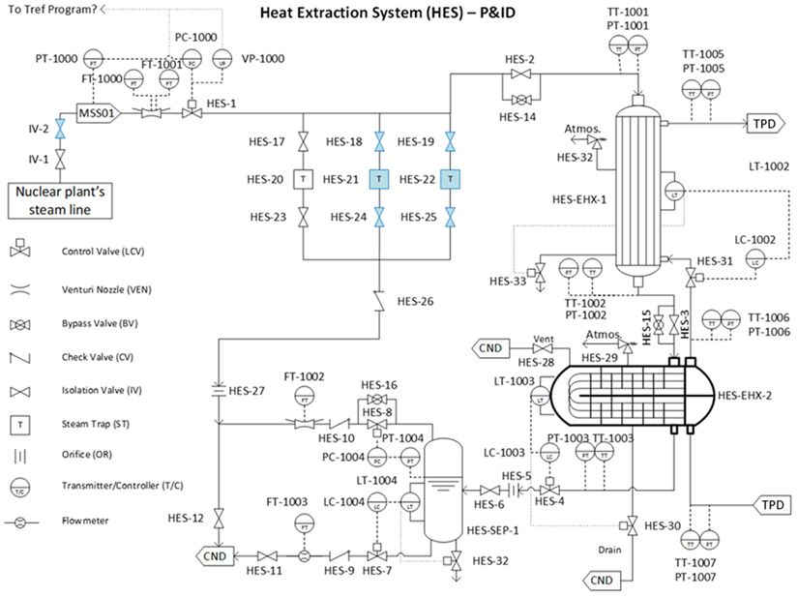
Tools Used in the PRA Project
RELAP5-3D – Transient analysis in water cooled reactors developed by INL
  Stephen Hancock, INL
  Thermo-hydraulic model of the heat extraction loop to the H₂ production facility

Slide 8
Assumptions Made in the Models
HES
  Number of isolation valves use the accepted MSIV configuration
Heating medium
  Steam
HES placement
  Dedicated building
Hydrogen storage and transfer facility
  Production H₂ piped to storage and transfer facility 5 km distant from NPP
Electrical power linkage
  NPP is connected to the grid to buffer upsets from the HTEF
HTEF design is from
HTEF ventilation
  A dedicated industrial building ceiling ventilation is not considered as a base case
Loss of offsite power (LOOP) frequency
  Same frequency used for both the PWR and BWR, assuming same geographical region
Multiple detonations at HTEF
  Bounding accident is assumed for the first detonation overpressure
Temperature of the thermal delivery loop
  ≤ 600ᵒF
No natural or manmade barriers are in place between the HTEF and the NPP critical structures
Notes:
Cloud detonation is more severe than flame jet detonation. Could can happen only once. So one cloud detonation is the bounding

Slide 9
PRA Steps
Evaluate the hazards identified for inclusion in the PRA
Apply the included hazards in the BWR and PWR PRAs
  Add to the event trees and fault trees for existing initiating events
  Add new event trees for any new initiators identified

Slide 10
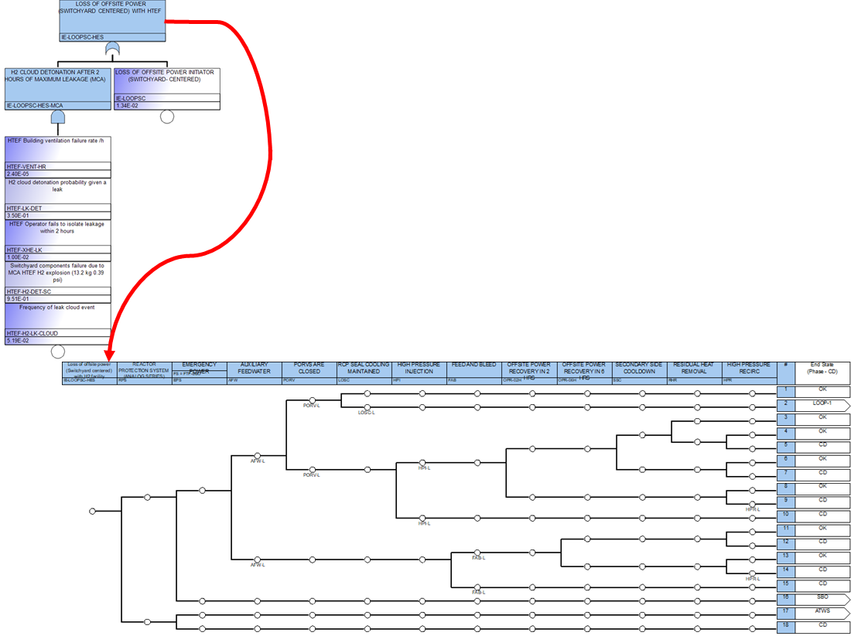
Evaluation of Safety Hazards
Internal to NPP
  Steam line break in the Heat Extraction System
    Included in an initiating event fault tree to modify the initiating event
    Included modifications to existing mitigating system fault trees based on the initiator
  Loss of steam load on HTEF loop
    Screened out at 5% extraction (<30% loss is tolerable)
  Heat transfer fluid leak and flammability
    Pressure differential will prevent contamination of NPP steam
  Potential for contamination from leaking heat exchanger
    Safety of NPP not in question, but monitoring will be required to prevent contamination at HTEF
Notes:
Transmission tower total fragility = Fragility of the electrical transmission tower to the effective pressure from a detonation event
High pressure jet MCA = Hydrogen pressure jet detonation maximum credible accident will cause an overpressure of 0.05 psi felt at the transmission tower. The chart shows the margin of safety.

Slide 11
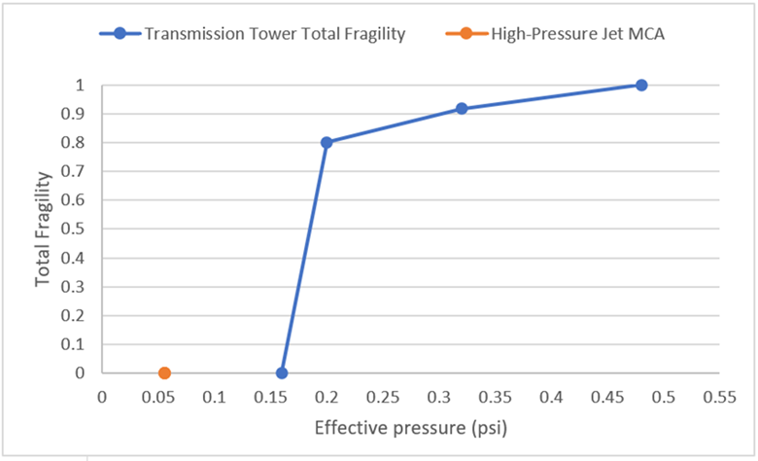
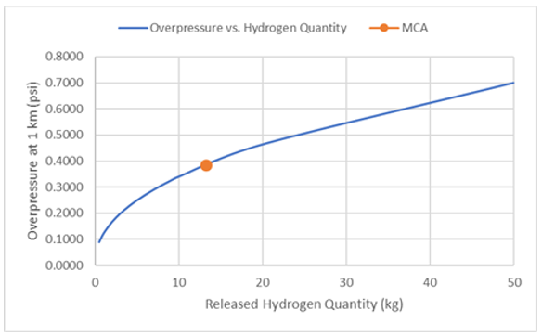
Evaluation of Safety Hazards
External to NPP
  H₂ detonation effects
    Critical structure fragility analysis
    Modeled HTEF initiating event frequency in fault tree format for high-pressure jet and cloud detonation
  LOOP frequency increase
    External initiator based on H₂ detonation frequency
Transmission Tower Fragility vs Overpressure
Cloud Detonation Analysis
MCA = Maximum Credible Accident
Notes:
Transmission tower total fragility = Fragility of the electrical transmission tower to the effective pressure from a detonation event
High pressure jet MCA = Hydrogen pressure jet detonation maximum credible accident will cause an overpressure of 0.05 psi felt at the transmission tower. The chart shows the margin of safety.

Slide 12
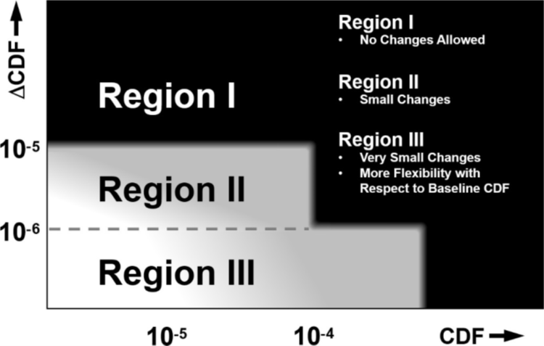
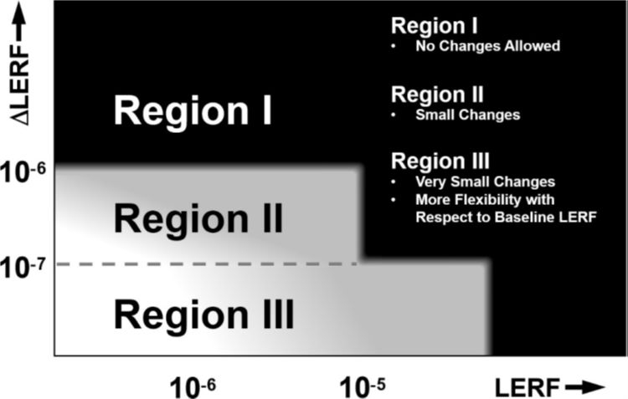
Evaluation of Safety Hazards and Using PRA for Licensing Considerations
Licensing basis events at 1 km separation distance
  10 CFR 50.59 criteria: Initiating event frequencies are within the range for minimal increase DBA initiating event frequency (≤ 10%)
    Largest initiator increase was 5.6% (Large steam line break) for PWR
  RG 1.174 criteria: CDF and LERF changes are within Region III of for both PWR and BWR

Slide 13
Improvements Proposed for the Generic PRA
Interaction with LWRS Hydrogen Research Regulatory Review Group (H3RG) has highlighted several research areas that can help industry to develop PRA assisted licensing pathways:
  The existing SAPHIRE-coded PRA model can be translated to a prominent industry code such as CAFTA,
  Modify the hazards analysis and model to match the current design of the HES and the HTEF as details become available,
  Analyze full or partial direct electrical coupling of the NPP and HTEF,
  Analyze seismic upsets to the NPP as a result of a hydrogen detonation,
  Analyze the effects of engineered blast barriers on the safe minimum separation between the NPP and HTEF.
  Evaluate effects of different levels of hydrogen storage on the HTEF site
  Sensitivity analysis of effects of prompt loss of load from diverted steam at increasing levels of diverted steam
H3RG PRA Subcommittee Lead: Linthicum, Roy R:(Constellation Nuclear) <roy.linthicum@constellation.com>
Notes:
Linthicum, Roy R:(Constellation Nuclear) <roy.linthicum@constellation.com>

Slide 14
Summary
The LWRS PRA investigation into risk-informed licensing considerations under 50.59 concluded that:
  The risk-based licensing criteria is met for a large-scale HTEF sited 1 km from a generic PWR and BWR
  The safety case for less than 1 km distance is achievable
Other insights:
  The individual site NPP and geographical features can affect the results of the generic PRA positively or negatively
    Wind missiles, blast berms or walls, etc…
  The generic PRAs presented in the study are examples for official site studies for use in licensing
In addition to the PSAM papers there is a Technical Report: INL/EXT‑20‑60104 Probabilistic Risk Assessment of a Light Water Reactor Coupled with a High-Temperature Electrolysis Hydrogen Production Plant
  https://www.osti.gov/biblio/1691486-probabilistic-risk-assessment-light-water-reactor-coupled-high-temperature-electrolysis-hydrogen-production-plant
Notes:
Large-Scale HTEF = 272,000 kg hydrogen, 300 US tons hydrogen produced per day, 13.2 kg of hydrogen leakage potential in an HTEF module 120 minutes.

