Slide 1
Lessons-learned of using
Monte Carlo Method with
Importance Sampling in Fault Tree Quantification
Probability Safety Assessment and Management 16
June 27 – July 1
Heejong Yoo (kreacher@khu.ac.kr)
Gyunyoung Heo (gheo@khu.ac.kr)
Notes:
Good afternoon everyone, my name is heejong yoo, a master’s candidate at kyung hee university in korea. Today I’m going to talk about the lessons learned of using monte carlo method with importance sampling in fault tree quantification. Although there are a lot of known methods in fault tree quantification, there were no previous researches that I found using monte carlo method with importance sampling. So the main focus was to try to apply monte carlo method with importance sampling to fault tree quantification and figure out the pros and cons of the method

Slide 2
Contents
00
Introduction
Methodology
Algorithm
Result
Conclusion
Notes:
These are the contents.

Slide 3
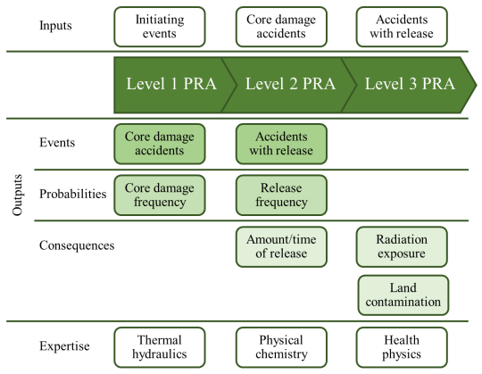
Introduction
01
Probabilistic Safety Assessment
  Level 1 PSA: Core damage frequency (CDF)
  Level 2 PSA: Release frequency
  Containment building response
  Level 3 PSA: Radiation exposure
  Consequence analysis
  Sequential process
Level 1 PSA
  Initial event declaration
  Accident scenario analysis
  Accident scenario quantification
  Result analysis
Kampanrat Silva, Shin-etsu Sugawara, Reconsideration of PRA Framework-Addressing Level 3 PRA Coverage and Multi-unit Issues, PSAM14, 2018
Chang Kyoo Park and Jae-Ju Ha, Probabilistic Safety Assessment,
Brain Korea, 2008
Notes:
This conference is a probabilistic safety assessment and management conference, and I’m sure that you will all be aware about PSA, and even know more than me. For those who
Probabilistic Safety Assessment, PSA in short, is a method to evaluate the risk of a system, which are mainly nuclear power plants in nuclear engineering. PSA has three levels, where each level calculates the core damage frequency, the release frequency, and the radiation exposure to the public, respectively. The results of the former level PSA are used as the input of the latter level PSA, making the levels to be sequential.
For level 1 PSA, there are four steps in order to gain the core damage frequency, which are initial event declaration, accident scenario analysis, accident scenario quantification, and result analysis.

Slide 4
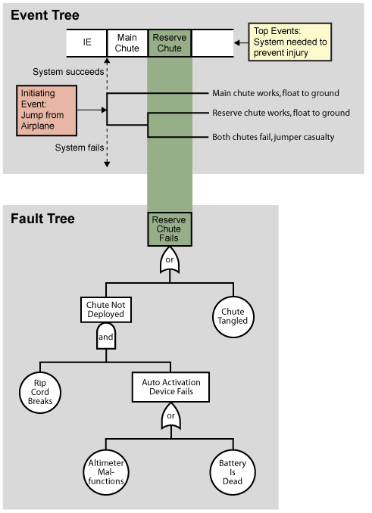
Introduction
01
Initial event declaration & accident scenario analysis
  Generation of event trees and fault trees
  Event trees
    Sequential analysis after initial event occurs
    Developed by whether the system succeeds or fails
  Fault trees
    Derivation of a system to succeed or fail
    Top-down analysis using Boolean logic
Accident scenario quantification
  Calculation of the generated event & fault trees
  Ends up to the final core damage frequency
  Event trees simply calculated by multiplication
  Fault trees needs additional process for quantification
Chang Kyoo Park and Jae-Ju Ha, Probabilistic Safety Assessment, Brain Korea, 2008
Notes:
For the results to be gained, the former three steps should be processed. In the initial event declaration initial events are first examined in the initial event declaration, and event trees and fault trees are generated based on the initial events in the accident scenario analysis step. Here, event tree is a sequential analysis after the initial event occurs, and eventually shows the progress whether the system would succeed or fail depending on the accident mitigation systems. The systems are determined to succeed or fail based on their fault trees, where the fault trees are used with top-down analysis using Boolean logic. The third step, accident scenario quantification, is the step where the event trees and fault trees are calculated to gain the results, the core damage frequency of the top event. Event trees are simply calculated by the product of each system to succeed or fail, since the system’s state should all occur simultaneously, while fault tree needs additional process for quantification due to logic gates.

Slide 5
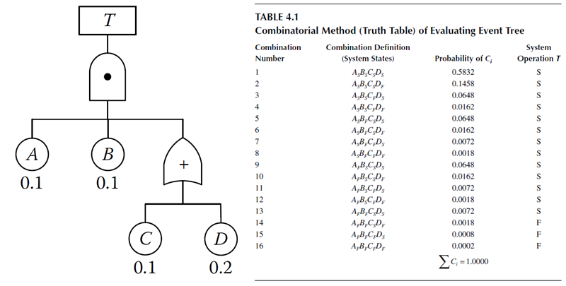
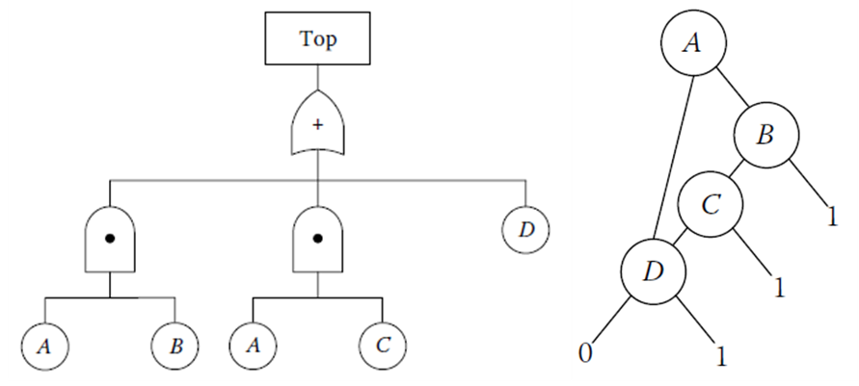
Introduction
01
Fault tree quantification methodologies
  Truth table, binary decision diagram (BDD) analysis
    Methods with exact solution
    Application for large fault trees unavailable due to the enormous number of calculations
    Adjustment and assumption for the methods available to reduce time, but accuracy decreases
Truth Table
Binary Decision Diagram
Reliability Engineering and Risk Analysis: A Practical Guide, Third Edition, Mohammad Modarres, Mark P. Kaminskiy, Vasiliy Krivtsov, CRC Press, 2016
Notes:
There are a number of known methods of how to quantify fault trees. The methods that could gain the exact solution are by using the truth table and binary decision diagram, BDD, analysis. The truth table shows every combination of basic events to succeed or fail, and sum up the combinations that leads to the system failure. The BDD method uses a different algorithm, but generally shows the combinations of basic events that leads to the system failure. Both methods becomes hard to use in large fault trees due to the time consumption, where the truth table needs to calculate 2 to the n number of calculations for a fault tree with n number of basic events, and the BDD method also needs a close enough number of calculations in order to determine the failure combinations of basic events. There are some work done to reduce the time and resource consumption for the methods, but it leads to a less precise result.

Slide 6
Introduction
01
Fault tree quantification methodologies
  Minimal cut set method
    Calculation of top event using minimal cut sets (minimal combination of component failures that causes system failure)
    General method of fault tree quantification
    Fast calculation available (few seconds)
    Rare event approximation (REA): Calculation of first-order term
    Minimal cut upper bound (MCUB): Calculation results near the third-order term
Inclusion-exclusion principle (Exact solution with minimal cut sets) Rare event approximation (REA)
$$p\left(S\right)=\sum_{i}{p(c_{i})}−\sum_{1≤i<j≤n}{p\left(c_{i}c_{j}\right)}+\sum_{1≤i<j<k≤n}{p\left(c_{i}c_{j}c_{k}\right)}−…$$
Minimal cut upper bound (MCUB)
$$p\left(S\right)≈p_{MCUB}=1−\prod_{i}{\left(1−p\left(c_{i}\right)\right)}=\sum_{i}{p(c_{i})}−\sum_{1≤i<j≤n}{p\left(c_{i}\right)p(c_{j})}+\sum_{1≤i<j<k≤n}{p\left(c_{i}\right)p(c_{j})p(c_{k})}−…$$
$$p\left(S\right)≈p_{REA}=\sum_{i}{p(c_{i})}$$
Mohammad Modarres, Mark P. Kaminskiy, Vasiliy Krivtsov, Reliability Engineering and Risk Analysis: A Practical Guide, Third Edition, CRC Press, 2016
Notes:
The most widely used methodology is by using the minimal cut sets. Here, minimal cut sets are the minimal combination of components, or basic events, failures that causes the system failure. The strong point of this method is in its consumption of time and resource by adjustments; it only takes a few seconds to gain the results even in large fault trees. The widely used adjustments to make this happen are rare event approximation and minimal cut upper bound. The exact solution using minimal cut sets uses the inclusion-exclusion principle, which considers all calculation processes for logical gates, while rare event approximation eliminates the terms under the first term, assuming that the product of rare events would be a value that could be considered zero. Minimal cut upper bound calculates the success probability and subtracts it from one to gain the failure probability, and the results are known to be approximately the result of the inclusion-exclusion principle over the fourth term.

Slide 7
Introduction
01
Fault tree quantification methodologies
  Limitations for minimal cut set method
    Minimal cut set dependency
      Large fault trees: Difficult to gain minimal cut sets (FTs in nuclear engineering considers large fault trees)
      Complex logics: Difficulties in gaining minimal cut sets (i.e. Conditioning events in multi-unit PSA)
    High probability events issue
      Rare event approximation, truncation error, delete term approximation
    Cross-checking issue
      All conventional methods uses minimal cut sets
      Methods without using minimal cut sets are needed for cross-checking
Sang Hoon Han, A top-down iteration algorithm for Monte Carlo method for probability estimation of a fault tree with circular logic, Nuclear Engineering & Technology, 50, 854-859, 2018
Notes:
Although the minimal cut set method is the most widely used method in fault tree quantification, there are known limitations for the method discussed in several papers and presentations, and the representative three are shown in the slides. The first one is the dependency to the minimal cut sets. Fault trees that are used in nuclear engineering uses large fault trees due to the complexity of the systems. This could be an issue, because as the fault tree gets bigger, gaining the minimal cut sets becomes difficult. Also, as PSA projects are recently aiming for multi-unit sites, complex logics such as conditioning gates are used, increasing the difficulty of gaining the minimal cut sets. Another point is from the point where minimal cut set methods use adjustments and assumptions to simplify the calculation process. Although the error of the simplified process is not a big issue for rare events, there are events that has a high probability, and calculations for high probability events results in a noticeable error, even having a probability over one. Finally, in the application to nuclear power plants, the conventional methods are all based on minimal cut sets, which could cause cross-checking issues, such as differences that could occur via other methods without minimal cut sets.
여기서 최소단절집합 방법의 한계라고 적은 것은… 아래 참고문헌의 의견인가요?
하나같이 누가 보면.. 다 틀린 말이네? 할 것도 같네요.
Unclear calculation process는… 모르는 사람이 모르는 상황같고. Cross checking이 안되는 것은 최소단절집합 잘못도 아니고.

Slide 8
Introduction
01
Fault tree quantification methodologies
  Monte Carlo method
    Random number generation for the failure of events, leading to the count of the final core damage frequency of the top event
    Time consumption is top priority
Count: 1
Iteration: 3
Prob.: 0.333
Trial 1
Trial 2
Trial 3
Sang Hoon Han, A top-down iteration algorithm for Monte Carlo method for probability estimation of a fault tree with circular logic, Nuclear Engineering & Technology, 50, 854-859, 2018
Notes:
Another promising method in fault tree quantification is the monte carlo method. Monte Carlo method is used in determining the success or failure for each basic events and finds out whether the top event fails or not. For example, in the bottom figure, the four basic events, which are the bottom four, are determined with Monte Carlo method whether to succeed or fail. In the three trials, B is failed for the first, A and D are failed in the second, and C and D are failed in the third. Based on these, following up the fault tree, the success or failure of the top event is determined. Here, the top event failed only in trial 2. For the three iterations, there was one failure, and the probability is calculated to be the count over the iterations, leading to the value of one thirds for the example. There could be uncertainties for generating random numbers, and a reasonable amount of iterations are needed for the monte carlo method, leading to the need to focus on reducing the time consumption.

Slide 9
Introduction
01
Fault tree quantification methodologies
  Monte Carlo method vs. conventional methods with minimal cut sets
    Minimal cut set dependency
      Monte Carlo method favors minimal cut sets, but calculations are available even without minimal cut sets
    High probability events issue
      Monte Carlo method are not affected by the probabilities of the events in FTs
    Cross-checking issue
      No use of minimal cut sets for Monte Carlo method → cross-checking available with the conventional methods
Sang Hoon Han, A top-down iteration algorithm for Monte Carlo method for probability estimation of a fault tree with circular logic, Nuclear Engineering & Technology, 50, 854-859, 2018
Jong Soo Choi, Nam Zin Cho, A practical method for accurate quantification of large fault trees, Reliability Engineering and System Safety, 92, 971-982, 2007
Notes:
The use of Monte Carlo simulation in fault tree quantification were able to deal with the limitations of conventional methods using minimal cut sets. Although minimal cut sets could give the monte carlo method some advantage, using the monte carlo simulation without the use of minimal cut sets, which generally reduces the need to gain the minimal cut sets. Also, the high probability events does not affect the results of the monte carlo method. Since the monte carlo simulation can be done without the use of minimal cut sets, an improved cross-checking would be possible for the results of fault tree quantification.

Slide 10
Introduction
01
Research Objectives
  Monte Carlo simulation method
    Has its potential of use in fault tree quantification (w/o minimal cut sets)
    Need to cope with time consumption
  Importance sampling
    Can reduce time consumption in Monte Carlo method
    Need to cope with the setting of distributions
Fault Tree Quantification
Monte Carlo Simulation
Importance Sampling
Jong Soo Choi, Nam Zin Cho, A practical method for accurate quantification of large fault trees, Reliability Engineering and System Safety, 92, 971-982, 2007
Notes:
The research objectives are the following. The process of proving the advantages monte carlo method could have over minimal cut set methods should be clarified. With the process, a additional adjustment for the monte carlo method in order to reduce the time and resource consumption is done by applying importance sampling. In short, the objective of this research would be showing the potential monte carlo simulation with importance sampling has for fault tree quantification.
이 부분이 연구 목적이고 목표라면, 이를 명시해 주면 좋겠네요.
제목이 lessons-learne인데.. 이것이 목표일까요?

Slide 11
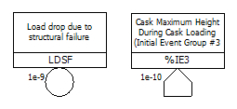
methodology
02
Gate
  Logic symbols that represent events that can be defined by one or more lower level events
  AND, OR, NOT, NAND, NOR, etc.
Event
  Lowest level items in a fault tree diagram
  Represents the events that occur leading up to higher level gates, ultimately to the TOP gate
  Have a probability of occurrence associated with
  Basic, House, Undefined, etc.
Notes:
Before we move further on, I would like to briefly go through some basic stuff, though most people would be familiar with the terms. Gates are logic symbols that represent events that can be defined by one or more lower level events. The combination of the states for each lower level events are progressed through the gate with some logic, for instance, the upper level would fail if all the lower level events fail. In that case, the logic gate would be an AND gate.The figure on the left side are frequently used gates in fault trees for nuclear engineering, which are AND, OR, NOT, NAND, NOR, and so on.
Events are the lowest level items in a fault tree diagram, which represents the events that occur leading up to the higher level gates, ultimately to the TOP gate. Each event have a probability of occurrence associated with. There are basic events and house events, where house events are for the ones that are likely to occur in any circumstances, normally with the probability of one. Undefined is introduced as a gate in the left figure, but it could also be used in events where the probability of the event is “undefined”

Slide 12
Methodology
02
Monte Carlo simulation method
  Methodology for obtaining estimates of the solution of mathematical problems by means of random numbers
  Powerful modelling tool for the analysis of complex systems
  Basic procedure
    Set equation for calculation
    Set distribution for random number generation
    Random number generation from distribution
    Calculate by the equation
    Repeat steps 3 & 4 n times
    Deliberate the results by the iterations
Monte Carlo simulation
  Increase of number of iteration causes:
    Increased accuracy of the numerical result
    Smaller variance of the result
  In the simulation model:
    Determination of the state of events for each iteration
    Random number distribution set as uniform distribution
    Probability of event < Random Number
      Event judged to have not occurred
    Probability of event > Random Number
      Event judged to have occurred
A.H.Ang and W.H.Tang, Probability Concepts in Engineering Planning and Design Volume II: Decision, Risk, and Reliability, John Wiley & Sons Inc, 1984
Notes:
In the research, Monte Carlo method was introduced to be the key, and the explanation would be the followings. Monte Carlo Simulation is a methodology for obtaining estimates of the solution of mathematical, or engineering problems by means of random numbers. This method especially has its strong point where analysis of complex systems is required. The basic procedure of Monte Carlo simulation could be shown with six steps. The equation that needs calculation is clarified first, and based on the situation or condition given in the equation, the random number generation distribution is set. The random number is to replace the parameters inside the equation, and with the repeated random number generated, the matching of the equation is done, and when the situation meets the criteria of the equation, counts increase. With the total iterations and counts, the results are derived.
The key point of Monte Carlo method is for the number of iterations. Increased number of iterations causes increased accuracy of the numerical result and a smaller variance of the result. In the simulation model, Monte Carlo method is used for the determination of the state of events for each iteration. The random number distribution is set as uniform distribution, and the random numbers are compared with the probability of each event. If the generated number is bigger than the probability of the event, the event is judged to be in normal state, while the opposite situation is determined to have the event to fail.

Slide 13
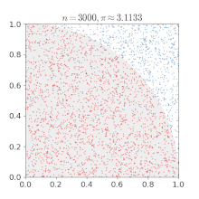


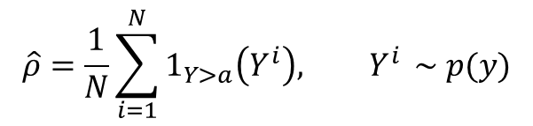
methodology
02
Monte Carlo simulation method
  $\hat{ρ}$: probability by using Monte Carlo method
  p(y): distribution of the random number generation
  N: number of iterations
  $Y^{i}$: ith random number
  a: number in comparison with the random number
  $1_{Y>a}\left(Y^{i}\right)$: function indicating that when the random number meets the condition in question, the output is zero, and the output is one when the random number does not fit in the condition
Variance of Monte Carlo Method
  Shooman
  $p$: Estimated probability of Monte Carlo Method
  $n$: Sample size (Number of iterations used)
$$\hat{ρ}=\frac{1}{N}\sum_{i=1}^{N}{1_{Y>a}\left(Y^{i}\right),{ Y}^{i}} \sim p(y)$$
$$\% error=200\sqrt{\frac{1−p}{np}}$$
A.H.Ang and W.H.Tang, Probability Concepts in Engineering Planning and Design Volume II: Decision, Risk, and Reliability, John Wiley & Sons Inc, 1984
Notes:
The left part of this slide contains a equation to express Monte Carlo simulation. Here, the function one Y bigger than a Y i is the number of counts that satisfies the criteria, while N is the number of iterations, leading to the final value to be counts over iterations. For the variance of the Monte Carlo method, there are some equations given, while Shooman’s equation is used in this study. The increase in the number of iterations generally leads to a smaller percent error, or the variance, in the Monte Carlo method. The figure on the bottom right is given for a method of calculating pi, using the distance between a random point and zero to gain the area of a one-fourth circle.

Slide 14
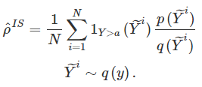
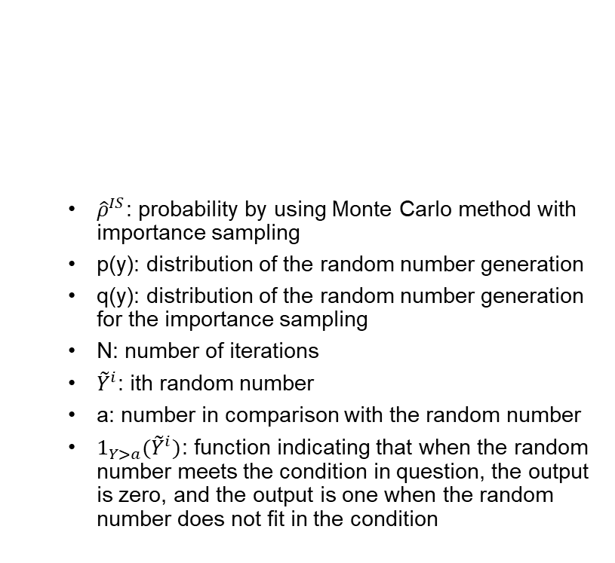
Methodology
02
Importance sampling
  Mechanism reducing overload and high variance caused by Monte Carlo simulation
  Adjustment of random number generation interval to the interval in interest
  Weighting factor to be multiplied on the result
  Strong point when the target number is small (E-2 ~ E-10 for here)
  ${\hat{ρ}}^{IS}$: probability by using Monte Carlo method with importance sampling
  p(y): distribution of the random number generation
  q(y): distribution of the random number generation for the importance sampling
  N: number of iterations
  ${\tilde{Y}}^{i}$: ith random number
  a: number in comparison with the random number
  $1_{Y>a}({\tilde{Y}}^{i})$: function indicating that when the random number meets the condition in question, the output is zero, and the output is one when the random number does not fit in the condition
A.H.Ang and W.H.Tang, Probability Concepts in Engineering Planning and Design Volume II: Decision, Risk, and Reliability, John Wiley & Sons Inc, 1984
Notes:
For the number of iterations required in Monte Carlo simulation in order to gain reasonable results, gaining it with less effort, here time and resource consumption, is always considered, and in this study, importance sampling is introduced. Importance sampling reduces both the required number of iterations for a reasonable result and the variance of the results by adjusting the random number generation distribution to have more counts. Compared to the raw Monte Carlo method results, the number of counts increase, and weighting is needed to gain the final result. Importance sampling has a strong point when the target number, or target interval, is small, usually under ten to the minus two. The right part of the slid is a equation of Monte Carlo method with importance sampling, where the difference is in the weighting, expressed as py over qy.

Slide 15
Methodology
02
Importance sampling
  Suppose a known event probability 0.0036 (3.6E-3) in uniform distribution:
  Monte Carlo simulation
    Random number distribution
      p(x)
      Uniform distribution [0, 1]
    Counting interval: [0, 0.0036]
  Importance sampling
    Random number distribution
      q(x)
      Uniform distribution [0, 0.01]
    Counting interval: [0, 0.0036]
  Increased counts weighted with the distributions p(x) and q(x)
Target number
0
$${10}^{−n}$$
Probability
1
Target number
0
Probability
$${10}^{−n}$$
A.H.Ang and W.H.Tang, Probability Concepts in Engineering Planning and Design Volume II: Decision, Risk, and Reliability, John Wiley & Sons Inc, 1984
Notes:
In the simulation model, importance sampling is applied to reduce the interval of the random number generation distribution, which is uniform distribution, to the region of interest. This slide contains an example, where a known event probability of a event is 3.6 times ten to the minus three. In a typical Monte Carlo simulation, the random number would be generated in the interval of zero and one, while with importance sampling, the interval could be reduced, here in the interval of zero and zero point zero one. The random number for both are compared to the probability, 3.6 times ten to the minus three, and the interval with importance sampling would have a lot more counts. With the example of the figure, there was only one count for the Monte Carlo simulation, but with importance sampling, there were increased counts of nine.

Slide 16
Methodology
02
Importance sampling
  Weighting of p(x) and q(x)
    Uniform distribution
    Weighting factor: $w=\frac{q(x)}{p(x)}$
    Probability of A and B: a, b
    AND gate
      $w=w\left(A\right)×w(B)$
    OR gate
      $w=\frac{a×w\left(A\right)+b×w\left(B\right)−a×b×w(A)×w(B)}{a+b−a×b}$
Target number
0
$${10}^{−n}$$
Probability
1
Target number
0
Probability
$${10}^{−n}$$
A.H.Ang and W.H.Tang, Probability Concepts in Engineering Planning and Design Volume II: Decision, Risk, and Reliability, John Wiley & Sons Inc, 1984
Notes:
** This slide does not contain valuable context for the weighting. Change!
The weighting of the increased counts are required, while in this case, the calculation for the weighting factor in upper level gates should be done.

Slide 17
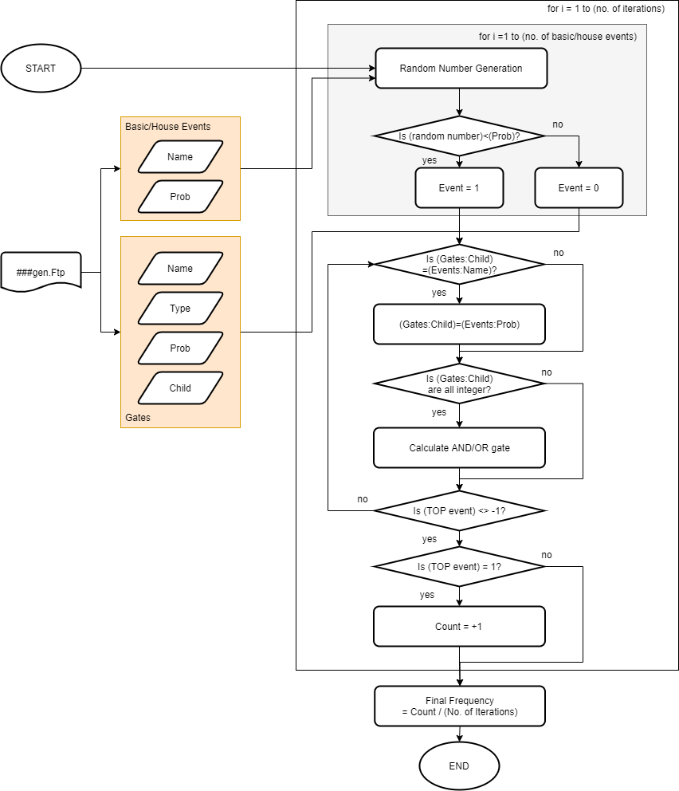
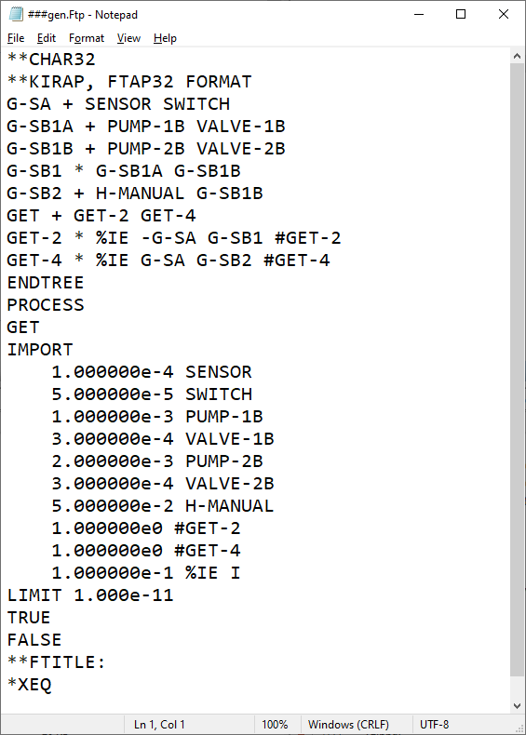
Algorithm
03
Ftp file
Gates
(Name, Type, Child)
Top Event
Events
(Name, Probability)
Notes:
In the simulation, a Ftp file is used. With most tools to express fault trees, a Ftp file is generated to contain the information of the fault tree. The Ftp file contains the information of gates, the name, type, and the lower level events or gates for each gate, the information of the top event, and the name and probability for each event. For the gates, the information does not need to be sequential, which means that the data are all mixed up. In the algorithm, The data of events and gates are collected and saved, while random numbers are generated for each events. The random numbers and events are compared to determine the state of each event to succeed or fail: zero for success and one for failure. The gates are then determined to success or fail based on their logic, with an bottom-up approach. The top event probability is initially set as minus one, while as the process is complete, it will get a value of zero for success or one for failure. If the value is one, the count is added. The process from the random number generation to the end is repeated for the designated iteration

Slide 18
Case study
04
Verification sets
  Truth table
  Rare event approximation (REA)
  Minimal cut upper boundary (MCUB)
FT quantification methods comparison vs. Monte Carlo method
  Case 1: Rare events
  Case 2: High probabilities
FT quantification methods comparison with and without importance sampling
  Case 3: Probabilities of 2E-2 & 2E-2 for basic events A and B
  Case 4: Probabilities of 2E-2 & 2E-3 for basic events A and B
Notes:
It would be best to directly apply the quantification method to a actual or similarly large fault tree, but it was chosen to start from basic models in order to show the process of the method. For verification, known methods of fault tree quantification was chosen, which are truth table for the exact result, REA and MCUB for the methods using minimal cut sets. There are a total of four case studies, where the first two are to show the difference between the method introduced and the conventional methods, while the latter two cases are to show the difference that occurs when applying importance sampling to monte carlo simulation.

Slide 19
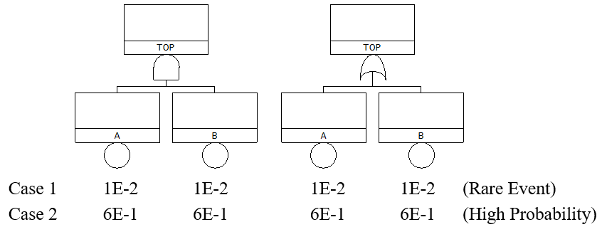
Case study
04
Case 1: FT quantification methods comparison vs. Monte Carlo method, rare events
Case 2: FT quantification methods comparison vs. Monte Carlo method, high prob.
Notes:
Here are the first two cases, while case 1 is for rare events and case 2 is for high probability events. For both cases, and gates and or gates are all considered

Slide 20
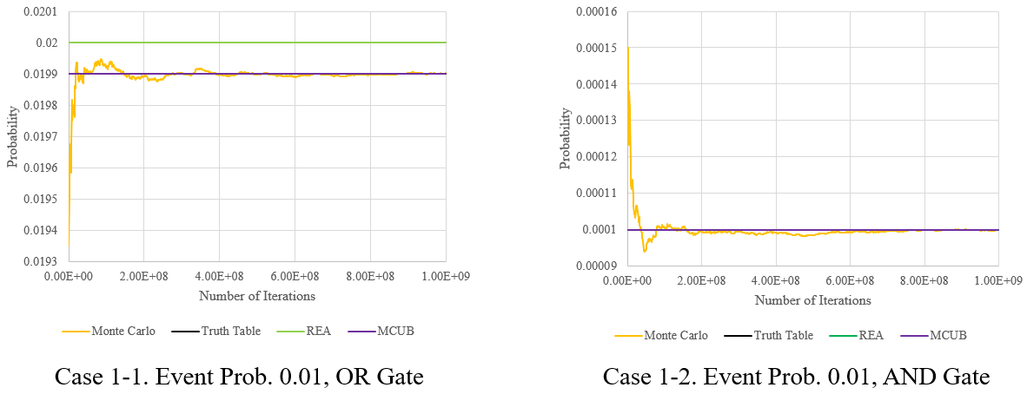
Case study
04
Case 1: FT quantification methods comparison vs. Monte Carlo method, rare events
  Converges to the exact value (Iteration more than 1E+8)
  REA has assumable difference

Slide 21
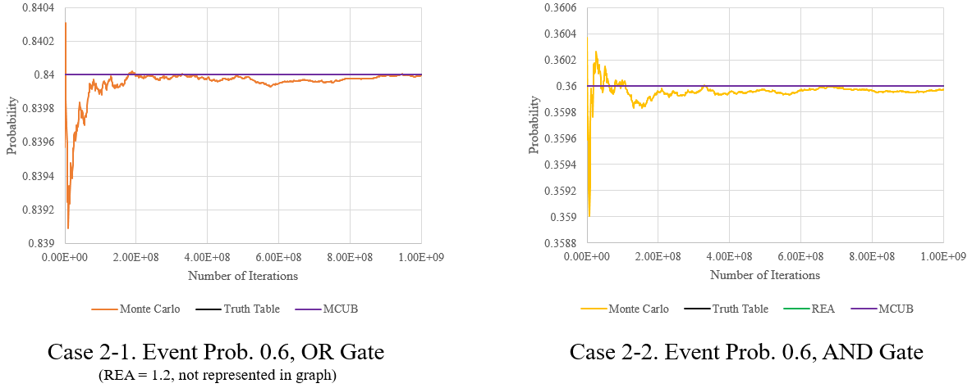
Case study
04
Case 2: FT quantification methods comparison vs. Monte Carlo method, high prob.
  Converges to the exact value (Iteration more than 1E+8)
  REA shows a noticeable error (Even over one!)

Slide 22
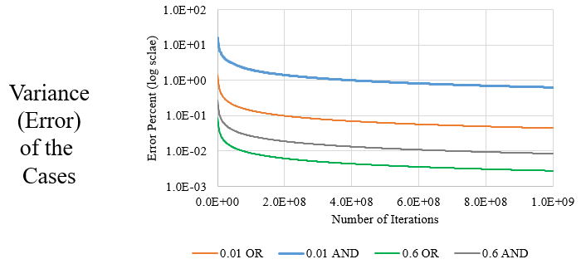

Case study
04
Variance reduction to number of iteration for Case Study 1 and 2
  Variance decreases as number of iteration increases
  Error: AND gates > OR gates
$$\% error=200\sqrt{\frac{1−p}{np}}$$
Notes:
우상단의 식이 설명이 되는 그래프인가요?

Slide 23
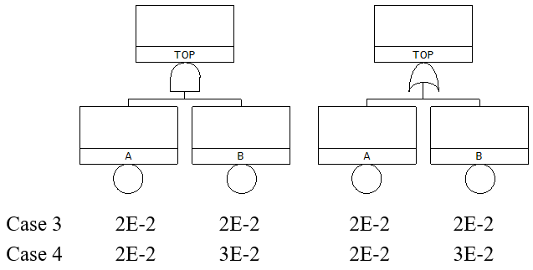
Case study
04
Case 3: FT quantification methods comparison with/without IS, 2E-2 & 2E-2
Case 4: FT quantification methods comparison with/without IS, 2E-2 & 2E-3

Slide 24
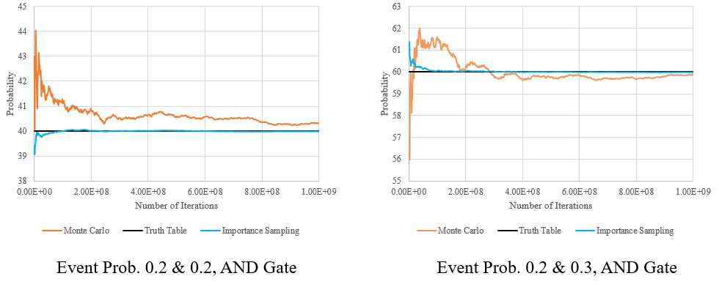
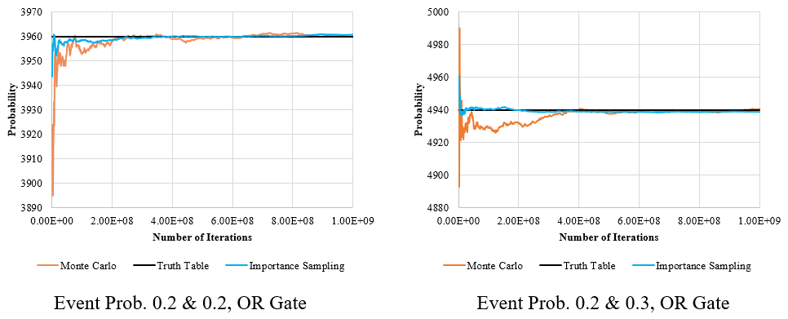
Case study
04
Case 3: FT quantification methods comparison with/without IS, 2E-2 & 2E-2
  Weighting factor: 0.01 (Case 3-1), 0.11 (Case 3-2)
  Importance sampling reaches to the true value with less iterations (AND gate is faster)
Case 3-1.
Case 3-2.

Slide 25
Case study
04
Case 4: FT quantification methods comparison with/without IS, 2E-2 & 3E-2
  Weighting factor: 0.01 (Case 4-1), 0.11227 (Case 4-2)
  Importance sampling reaches to the true value with less iterations (AND gate is faster)
Case 4-1.
Case 4-2.

Slide 26
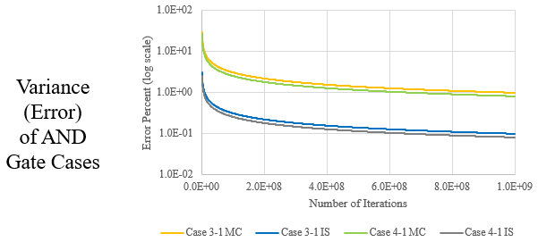
Case study
04
Variance reduction results for AND gates
  Importance sampling reduces variance to one-tenth for AND gates
$$\% error=200\sqrt{\frac{1−p}{np}}$$

Slide 27
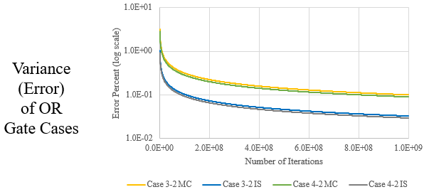
Case study
04
Variance reduction results for OR gates
  Importance sampling reduces variance to one-third for OR gates
$$\% error=200\sqrt{\frac{1−p}{np}}$$

Slide 28
Case study
04
Result analysis
  Case Study 1 and 2
    Monte Carlo method is applicable in high probability basic events
  Case Study 3 and 4
    Importance sampling is able to reduce the variance of the result
    Unidentified patterns for weighting factor for OR gates

Slide 29
Conclusion
05
Monte Carlo method
  Proved its potential for FT quantification
    No use of minimal cut sets
    Not affected by probabilities of basic events
  Number of iterations is the challenge (time and resource consumption)
Importance sampling
  Able to reduce variance
  Showed fast convergence to the true value
  Weighting factor issues
    AND gate: No problem, product of weighting factor for lower level gates/events
    OR gate: Undefined, weighting factor proportional to true value
  ➔ Has its strong points, but difficulties for application without clarifying calculation of
  OR gates (Lessons-learned)
Notes:
제목이 lessons-learned인데.. 여기가 그 부분인가요? 제목에 대한 답이 되면 좋겠고…
당연히 연구목적과 목표가 달성되었는지도 언급되어야 겠지요.

Slide 30
THANK YOU

