Slide 1
PSAM16, June 26th – July 1st, 2022, Sheraton Waikiki, Honolulu, O’ahu, Hawaii, USA
Seismic Re-evaluation of the Unit 1&2 of the Mochovce NPP
by
Zoltan Kovacs and Tibor Zöld

Slide 2
Contents
Introduction
Safety requirements
Engineering standards
SMA
SPSA
Synthesis of the SMA and SPSA results
Conclusion

Slide 3
Introduction
The Slovak Nuclear Regulatory Authority (UJD) requires the licensee (Slovenske Elektrarne) to keep the seismic capacity of the plant in operation on a level generally accepted by the international community.
The re-evaluation of the seismic capacity of an existing plant is generally due to evidence that the seismic hazard is greater than the design basis earthquake, arising from a new seismic hazard analysis.

Slide 4
Introduction
The original design basis earthquake of the plant with VVER440 type reactors was 0.06 g.
The first project of seismic re-evaluation in 1997 increased the RLE (Review Level Earthquake) to 0.10 g. Significant number of plant upgrading measures were implemented.
As a consequence of a new hazard evaluation carried out at the site, a new project was launched by the licensee, which further upgrades the seismic capacity of the plant to the RLE = 0.15 g (SL-2 value).
The seismic re-evaluation is being performed on the basis of the IAEA guideline “Evaluation of Seismic Safety for Existing Nuclear Installation (NS-G-2.13)”.

Slide 5
Safety requirements
Full power operation is the starting operating mode of the plant to be brought into the safe shutdown state.
The selected SSCs are needed for shutdown and cooling down the plant.
The range of time to be considered is 72 hours after the safe shutdown earthquake occurrence.
Offsite power is considered not available at least for 72 hours after the earthquake.
In addition, the occurrence of small break LOCA is considered.

Slide 6
Safety requirements
UJD Decree No. 430/2011 classifies the SSCs according to the following
categories:
Seismic category 1
    1a - active SSCs that must keep their functionality at or after earthquake.
    1b - SSCs that must have seismic robustness related to their strength and ability to stay hermetical and to keep integrity.
Seismic category 2
    2a - SSCs that due to seismic interactions directly or by means of side effects may cause loss of functionality, strength, integrity or stability of seismic category 1 SSCs or cause disconnection of necessary access routes,
    2b - other SSCs.

Slide 7
Safety requirements
The safety analyses identify a special subset of items able to guarantee the following three basic safety functions under the above specified conditions, namely:
  Plant cold shutdown
  Residual heat removal (for 72 hours)
  Containment integrity
SSCs in seismic category 1 are analyzed and the main success path and alternative success path are selected to perform the safety functions.
SSCs in category 2a are placed in proximity of the selected category 1 SSCs. They are also involved in a special section of the SSC list and are covered by dedicated methodologies during category 1 SSCs assessment.

Slide 8
Engineering standards

Slide 9
SMA
SMA is a deterministic approach to evaluate the seismic capacity of the plant.
Two success paths (the main success path and the alternative success path) are identified.
The seismic capacity of the SSCs involved in the success paths is assessed.
The seismic capacity of the weakest SSC of the stronger success path (path with higher seismic capacity) determines the seismic capacity of the plant (nuclear unit).

Slide 10
SMA
Finite element model (FEM) is used to represent SSCs and calculate their seismic capacity, except for simpler SSCs, that can be assessed by simpler calculations.
These models are carefully developed taking into account the complexity of the considered items, in order to represent with a sufficient level of detail their behavior.

Slide 11
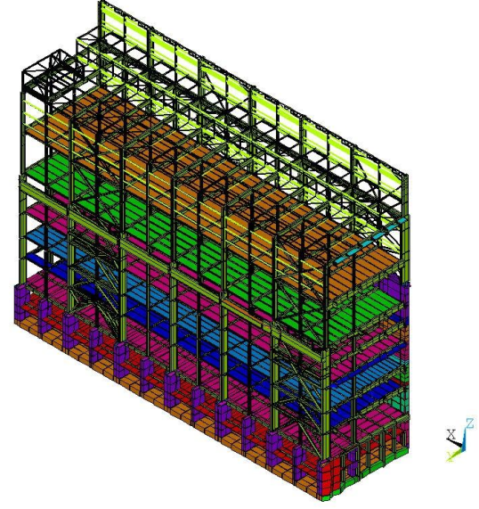
SMA – FEM (Longitudional building, ANSYS model)

Slide 12
SMA – FEM (proposed supports for piping)

Slide 13
SMA
The seismic capacity of SSCs is defined in the form of HCLPF (High Confidence of Low Probability of Failure).
The Conservative Deterministic Failure Margin (CDFM) approach is used.

Slide 14
SMA
For specific equipment, such as tanks and heat exchangers, distribution systems (including cold and small piping and HVAC ducts) and cable and conduit raceway, suitable simplified approach is used.
This is the GIP-VVER approach developed for VVER plants, compliant with the US-GIP approach.
The two approaches are formally different, but they rely on the same technical basis and only minor differences affect the qualification procedures.
The IAEA TECDOC-1333 summarizes the differences between the standard US-GIP data base and the GIP-VVER.

Slide 15
SMA - GIP VVER

Slide 16
SMA
Taking into account the outcomes of the HCLPF calculation, those SSCs that exhibit an HCLPF lower than RLE in terms of PGA are subjected to corrective measures in order to ensure that everywhere HCLPF > RLE.
These corrective measures are determined from case to case, according to the specific SSC affected, tailored on the considered object, and according to the applicable standards.

Slide 17
Seismic PSA
In addition to deterministic seismic analyses also probabilistic seismic analyses are required by the regulatory authority.
The seismic PSA (SPSA) is carried out to evaluate the risk associated with occurrence of a seismic event.
In probabilistic studies (Level 1 and 2 SPSA), the risk of core damage is generally referred as CDF and LERF and represents a bounding estimation of the annual frequency of occurrence of an accidental event leading to core damage which can possibly result into radiation releases.

Slide 18
Seismic PSA
The input data necessary for SPSA are listed below:
  The seismic hazard curves for the site
  The design documentation of the plant and seismic safety technological concept
  The fragility curves of SSCs
  The report assessing the results of observations during plant walkdown
  The existing internal event Level 1 and 2 PSA model for internal events

Slide 19
Seismic PSA
CDF and LERF are computed considering that all the basic events induced by an earthquake are independent.
This assumption is generally accepted due to the low probability of occurrence of major earthquakes, despite of the fact that the earthquake represents a common mode of failures for the plant. The interrelations generally considered in SPSA are:
  correlation of SSCs characterized by similar seismic resistance: multiple failures of components is likely if they have similar seismic fragilities and are subjected to comparable seismic floor spectra;
  correlation of SSCs due to spatial interactions: the failures of several components located in the same room can be associated with the collapse of the civil structure or the rupture of a component jeopardizing the functionality of several SCCs in the same room.

Slide 20
Synthesis of the SMA and SPSA results
The SMA process provides a set of SSCs to be upgraded, with reference at the main success path and alternative success path selected during the SSC list development (loss of off-site power and small break LOCA are considered) and to the initial plant design (already upgraded to 0.15 g).
The SPSA provides the list of SSCs which represent the major contributors to the risk for the “as-is” plant configuration and proposes safety measures to improve the plant safety given a seismic event.

Slide 21
Synthesis of the SMA and SPSA results
The results obtained from the two processes are analyzed and merged by means of the following rules:
  All SSCs resulted as to be upgraded in the SMA process will be considered for the upgrade.
  The SSCs recognized as major contributors to the risk in the SPSA process may or may not be present in the list of point 1 because the SPSA takes into account a wider range of scenarios:
    if the major contributors to the risk are already in the list of SSCs to be upgraded resulted from the SMA process, they will be considered for the upgrade;
    if some major contributors will not be in the list of components to be upgraded resulted from the SMA process, a deeper sensitivity analysis will be performed.

Slide 22
Synthesis of the SMA and SPSA results
From these two processes a final list of SCCs to be upgraded is determined.
This list undergoes a specific analysis to assess the compatibility with plant operation.
The final list undergoes a basic design and a time/cost analysis.

Slide 23
Conclusions
The seismic re-evaluation of the Unit 1&2 of the Mochovce NPP is an ongoing process.
The objectives of this project is to increase the design basis earthquake from 0.10 g to 0.15 g.
The safety requirements of the project, used engineering standards, application of SMA and SPSA within the project and synthesis of the SMA and SPSA results are presented.
The project contributes to the state of knowledge and deep understanding of the plant seismic risk.
It is important due to growing recognition of the safety significance of the seismic hazard.
In addition, further areas may be identified for improvement the existing methods and models.

Slide 24
Thank you for your attention !

