Slide 1
Insights for HRA Method Gained From Root Cause Analysis of Human Error Events Occurred in Korea
PSAM 16., June 26th ~July 1st. 2022
Dept. of Severe Accident and Risk Assessment
PSA Group
Seung woo Lee, Ph.D

Slide 2
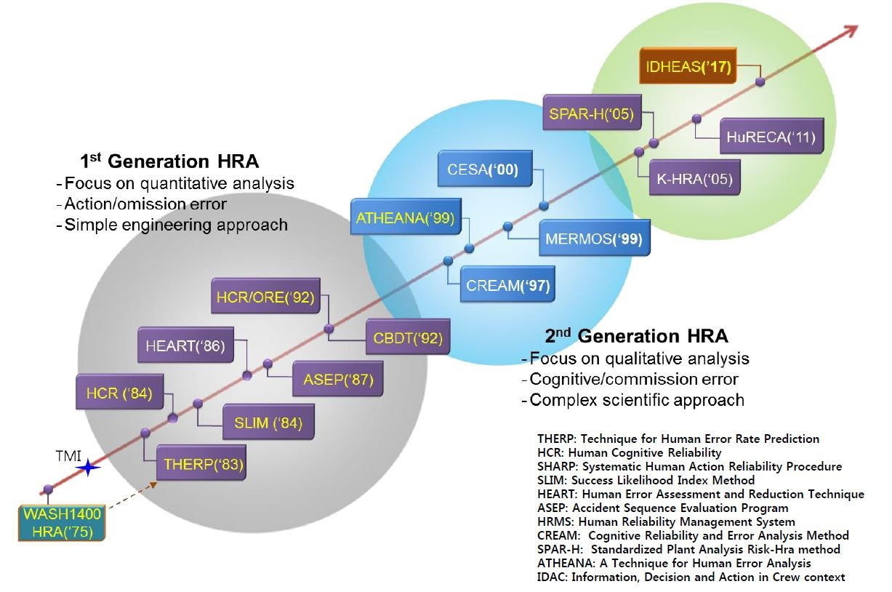
Background
Various human reliability analysis(HRA) approaches and methods have been suggested to assess human error in nuclear industry.
However, there is no single, comprehensive HRA method which has gained international consensus.
Fig. Lineage of HRA methods in nuclear industry

Slide 3
Background
Given the differences between the methods and their associated models, there is substantial interest in validating and improving HRA methods.
“The International HRA Empirical Study” – Lessons learned from comparing HRA methods
Predictions to HAMMLAB simulator data (NUREG-2127)
① Findings and insights from 13 HRA methods being empirically tested
② Comparisons between HRA methods and crew performance
A number of literature surveys have been conducted for existing HRA methods.
 | Examples of Recent Literature Surveys | Objective
1. | Issues in Benchmarking Human Reliability Analysis Methods(Boring et al., 2010, RESS) | Literature review of past benchmarking studies in the areas of psychology and risk assessment
2. | Evaluation of Human Reliability Analysis Methods Against Good Practices(NUREG-1842) | 10 HRA methods evaluation against NUREG-1792
3. | A comparison of the quantification aspects of human reliability analysis methods in nuclear power plant(Park et al., 2019, ANE) | 4 HRA methods were compared in aspect of quantification
4 | Human reliability analysis for risk assessment of nuclear power plant(Jung et al., 2011, Journal of the Ergonomics Society of Korea) | 8 HRA methods were compared to find strength and weakness of the methods.
5 | Human error identification in human reliability assessment. Part 2: Detailed comparison of techniques(Kirwan et al., 1992, Applied Ergonomics) | 12 human error identification approaches in HRA were compared.
Notes:
Halden Man Machine Laboratory simulators at the Halden Reactor Project in Norway

Slide 4
Background
However, most of the efforts were given to literature surveys with the exception of some simulator experiments.
- Measures can be different in comparing HRA methods.
- The number of simulator data sets are limited.
When the events occur in nuclear power plant, a restrospective approach such as identifying the root-causes of events is used in investigating the cause of the events.
- If the events are due to human error, analysis scheme is used to find out the detailed causes
of human error.
Although ‘Human Failure Events’ is a common target in the field of HRA and incident investigation, the information in these two fields are not exchanged so well since the purpose and their required expertise is different.
In this manner, this study aims to use a retrospective approach for human error events occurred in Korean nuclear industry to provide insights for HRA methods.

Slide 5
Methods for Analyzing Human Failure Events - ‘HuRAM+’
In this study, two frameworks were used for analyzing human failure events.
① Human Related Events Root Cause Analysis Method Plus(HuRAM+) was used.
Understanding & Analyzing Event
Analyzing Sequence of Event
Analyzing Causes of Event
Safety Assessment
Deriving Corrective Actions
HuRAM+
Information Gathering
Template
- Preparation of Task
- Task/System
- Supervision
- Safety Culture
Gathering Information
Event & HSE information
Outline of the event
SOE and HSE Basic information
Time of the event occurrence
Type of Error
Type I. Error of Omission , Error of Commission
Type II. Mistake, Slip/Lapse, Violation
Type III. Latent , Active
Types of Error
Cause of Error
Cause of Error
1. Task/System Factors
2. Organizational/Safety Culture Factors
3. Etc
SOE : Sequence Of Event
HSE : Human Failure Subevent

Slide 6
Methods for Analyzing Human Failure Events -Types of Human Error-
(Type I) Error of Omission(EOO) / Errors of Commission(EOC)
EOO is a failure to take a required action
EOC is well-intended but inappropriate, overt action.
(Type II) Slip and Lapses
Slip and lapses occur in very familiar tasks without much conscious attention
- Example of ‘Slip’ : A simple, frequently-performed physical action goes wrong(Commission).
- Example of ‘Lapses’ : Omit to perform a required action(Omission).
(Type II) Mistakes
Mistakes are decision-making failures(Fail to form adequate intention)
- Example of ‘Rule-Based Mistake’ : If behavior is based on remembered rules and procedures, mistakes occur due
to mis-application of a good rule or application of bad rule
- Example of ‘Knowledge-Based Mistake’ : Individual has no rules or routines available to handle an unusual
situation
(Type II) Violation
Violation is intentional failures-deliberately doing the wrong thing.
(Type III) Latent Errors / Active Errors
Latent errors are the ones inherent in the system(pre-initiator human failure events).
Active errors are the ones that occur at the point of operator’s action(post-initiator human failure events).

Slide 7
Methods for Analyzing Human Failure Events -Causes of Human Error-
Causes of human error are classified into 3 factors and each factor has hierarchy of categories and their related causes.
1. ‘Task/System Related Factors’ are consisted of 7 causes.
① Procedure/Instruction/Drawing(2 categories with 10 detailed causes)
② Workload(1 category with 4 detailed causes)
③ Training/Education(2 categories with 5 detailed causes)
④ HSI(3 categories with 10 detailed causes)
⑤ Communication(2 categories with 9 detailed causes)
⑥ Personnel/Team(2 categories with 15 detailed causes)
⑦ Supervision/Confirmation(2 categories with 8 detailed causes)
* Personnel/Team : Appropriateness of Personnel/Team’s task method or physical/mental fitness for work
2. ‘Organizational/Safety Culture Related Factors’ are consisted of 3 factors.
① Management/policy(6 categories with 9 detailed causes)
② Administration/Organization(8 categories with 25 detailed causes)
③ Safety Culture(1 category with 7 detailed causes)
3. ‘Etc’ (1 category with 1 detailed scause)

Slide 8
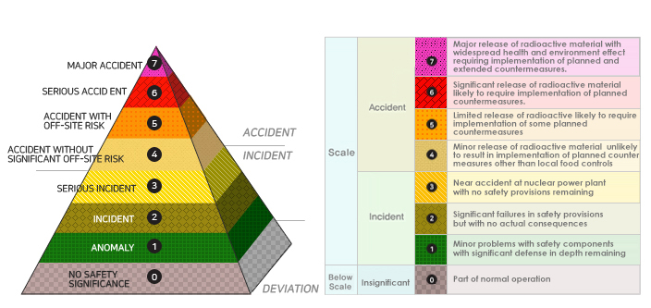
Methods for Analyzing Human Failure Events -’INES’
② International Nuclear Event Scale(INES) was used to consider the safety significance of the
human failure events.
- In march 1990, the IAEA and OECD/NEA introduced INES to help the public to understand easily
the safety significance of the events occurring at nuclear power plants.
- The event scale is divided into 7 levels to the safety significance in the INES.
- Korea announced regulations for nuclear event reporting on Dec. 1, 1992.
- Licensees report an event scale evaluation to the government and KINS, and KINS performs the
final evaluation through a Nuclear Event Evaluation Committee.

Slide 9
Analysis of Human Error Events Occurred in Korea
Among 489 events occurred in Korea nuclear power plants from 1993 to 2021, 96 human error events were analyzed in this study.
1) Results of Human error events using HuRAM+ are analyzed.
- Human Error : Type I, II, II
- Human Error : Workplace
- Human Error : Operation Mode
2) Results of root-cause of human error are analyzed.
3) Results of INES evaluation are analyzed for ‘1)’ and ‘2) to consider the safety
significance of the events.
- Results of all event scale
- Results of event scale above ‘1’ to consider the safety significance
- Results of event scale for each ‘1’ and ‘2’
Insights for HRA methods are suggested considering the current status of the Korean HRA methods.

Slide 10
Figure. Result of Type I Human Error to All Human Error Events
Figure. Result of Type I Human Error Related to Scale ‘1’ &’2’ Events
1. It was shown that the most of the human error occurred due to EOC.
Also, EOCs was the major contributor to the safety significant events.
☞ Not considering the EOCs in HRA methods will underestimate
human error probability leading to biased PSA results and insights.
Figure. Result of Type I Human Error Related to Scale ‘1’ Events
Figure. Result of Type I Human Error related to Scale ‘2’ Events

Slide 11
Figure. Result of Type II Human Error to All Human Error Events
Figure. Result of Type II Human Error Related to Scale ‘1’ &’2’ Events
It was shown that the ratio of the ‘mistake’ and ‘slip/lapse’ is similar.
When considering the safety significance of events, ‘mistake’ was the major contributor and it seems ‘violation’ is not negligible compared to ‘slip/lapse’.
☞ In aspect of HRA methods, we need to consider whether the weightings
should be given to the diagnosis error and the necessity of considering
‘violation’ into HRA methods.
Figure. Result of Type II Human Error Related to Scale ‘1’ Events
Figure. Result of Type II Human Error related to Scale ‘2’ Events

Slide 12
Figure. Result of Type III Human Error to All Human Error Events
Figure. Result of Type III Human Error Related to Scale ‘1’ &’2’ Events
It was shown that the ‘Active Error’ was the major contributor to all human error events and also to the events with safety significance.
However, ‘Latent’ is not negligible and the ratio of ‘Latent’ and ‘Active’ is same in Scale 2 Events
☞ In Korea, licensees attempt to exclude the evaluation of the possibility of
‘Latent Error’ considering periodic check performed in NPPs. However, it is
shown that ‘Latent Error’ still needs to be considered in HRA methods.
Figure. Result of Type III Human Error Related to Scale ‘1’ Events
Figure. Result of Type III Human Error related to Scale ‘2’ Events

Slide 13
Figure. Result of Human Error-Workplace to All Human Error Events
Figure. Result of Type Human Error-Workplace Related to Scale ‘1’ &’2’ Events
* All the Scale 2 events was occurred in the MCR.
It was shown that the most of the human error occurred in the MCR.
All scale 2 events happened in the MCR.
☞ MCR and local activities are both considered in the task analysis and we
need to think whether considering the same importance to both activities
are adequate.
Also licensees consider ‘workplace’ as one of the PSFs and they
consider the higher weightings to local activities which was shown
different compared to empirical events data.
Figure. Result of Type Human Error-Workplace Related to Scale ‘1’ Events

Slide 14
Figure. Result of Human Error-Operation mode to All Human Error Events
Figure. Result of Human Error-Operation mode Related to Scale ‘1’ &’2’ Events
It was shown that the most of the human error occurred during ‘Power Increase/Decrease’ operation.
When considering safety significance of the events, ratio of human error during ‘Full power’ is relatively small compared to other two operation modes.
☞ HRA method for full power operation and LPSD(Low power and
shutdown) operation is same in Korea. However, it is required to develop
or modify HRA methods which enables to consider the operational
characteristics of power increase/decrease operation.
Figure. Result of Human Error-Operation mode Related to Scale ‘1’ Events
Figure. Result of Human Error-Operation mode Related to Scale ’2’ Events

Slide 15
Figure. Result of HuRam + to All Human Error Events
Figure. Result of HuRam + Related to Scale ‘1’ &’2’ Events
It was shown that the ‘Task/System Factors’ are dominant contributor.
Considering safety significance of human error events, ‘Personnel/Team’,
‘Administration/Organization’ and ‘Procedure/Instruction/Drawing’ were
major contributor.
☞ Most of the ‘Task/System Factors’ were considered as PSFs in Korean HRA
methods. However, none of the ‘Org/Safety Culture Factors’ are considered.
‘Communication’, ‘Administration/Organization’ need to be considered in
HRA method.
Figure. Result of HuRam + Related to Scale ‘1’ Events
Figure. Result of HuRam + Related to Scale ‘2’ Events

Slide 16
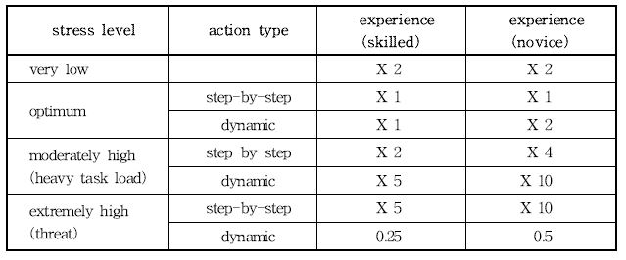
PSFs considered in Korean HRA method
Table. Stress Level
Table. Workplace
Table. Procedure
Table. Available Time
Table. Training

Slide 17
Conclusion and Discussion
Results of analyzing 96 human error events using HuRAM+ and INES were shown and
the insights for HRA methods were suggested considering the current status of Korean
HRA methods.
1) EOCs were dominant contributor to human error.
2) Mistakes were dominant contributor to human error.
3) Possibility of latent human error still exists.
4) Efforts should be made to consider the operational characteristics of power
increase/decrease operation mode.
5) None of the ‘Organizational/Safety Culture Factors’ were considered.
6) Although it was not in the presentation, almost 40% of the human error events
above event scale over ‘0’ had series of two or more human failure subevents.
Thsis is just a preliminary study and needs work so that the results from this study can be
theoretically generalized. However, it is expected that results of this work can be used as a
basis to better understand the characteristics of human errors.

Slide 18
Thank You for Listening. Any Comments or Questions?
E-mail : k727lsw@kins.re.kr

