Slide 1
Synthesis of Questionnaire Insights Regarding Current PRA and Additional Tools
Joy Shen, Michelle T Bensi, and Mohammad Modarres
University of Maryland, College Park, MD, USA
jshen132@umd.edu; mbensi@umd.edu; modarres@umd.edu
This research is supported by the U.S. Nuclear Regulatory Commission. Any opinions, findings, and conclusions expressed in this paper/presentation are those of the authors and do not necessarily reflect the views of the funding agency or any other organization. The authors acknowledge and appreciate the valuable insights provided by subject matter experts who responded to the anonymous questionnaire discussed in this paper.
Notes:
Joy Shen graduated with a B.S. in Mechanical engineering and an minor in Nuclear engineering from the University of Maryland at College Park. She stayed at Maryland and is currently a PhD candidate in the Reliability Engineering program, advised by Dr. Bensi and Dr. Modarres. Her research focuses on advanced PRA development, and PRA tool improvement, especially applied to external flooding hazards.

Slide 2
Introduction
Event Tree and Fault Tree Analyses (ETA/FTA) are the foundational tools of the conventional PRA framework
The needs of the PRA community have evolved
Available technologies and tools have improved
Need to reassess available PRA tools and how they address the community needs and contribute to the risk informed decision making (RIDM) process

Slide 3
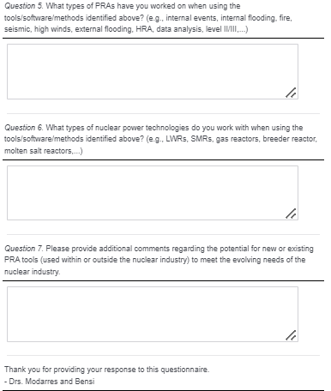
Questionnaire
What static PRA software do you have experience using? Select multiple if applicable.
SAPHIRE
Riskman
RiskSpectrum
CAFTA
WinNUPRA
FRANX
Other (Please Specify)
I do not use PRA tools

Slide 4
Questionnaire
2) What are the strengths of the PRA software/tools you are using/have used? If you discuss multiple tools, please connect each tool to its strengths.
3) What are the limitations of the PRA software/tools you are using/have used? If you discuss multiple tools, please connect each tool to its limitations.
4) What other tools or software have you used to supplement the PRA tools/software you identified above? Why have they been needed? If you discuss multiple tools, please connect each tool to its necessity.

Slide 5
Questionnaire
5) What types of PRAs have you worked on when using the tools/software/methods identified above? (e.g., internal events, internal flooding, fire, seismic, high winds, external flooding, human risk assessment (HRA), data analysis, level II/III,...)
6) What types of nuclear power technologies do you work with when using the tools/software/methods identified above? (e.g., LWRs, SMRs, gas reactors, breeder reactors, molten salt reactors,...)
7) Please provide additional comments regarding the potential for new or existing PRA tools (used within or outside the nuclear industry) to meet the evolving needs of the nuclear industry.

Slide 6
Questionnaire Characteristics
Sent to 431 members of the international PRA community
52 anonymous responses
Gathered insights on:
PRA tool experience
Advantages/limitations
PRA community needs
Work is ongoing and will continued to
be shared with the community
Scan above to share your insights

Slide 7
Questionnaire Characteristics
Survey supplemented questionnaire to create comprehensive analysis.
Responses subject to opinion and personal beliefs
Questionnaire Response to Conventional PRA Tool Experience

Slide 8
Questionnaire Responses on Conventional PRA Tools
Traditional PRA methods (Event Tree/Fault Tree analysis)
e.g. SAPHIRE, Riskman, Risk Spectrum, CAFTA, WinNUPRA
Advantages
Conflicting Insights
Limitations
Quantification efficiency /inefficiency
Comprehensive/
Limited external
hazard capabilities
Model
visualization/
navigation
Post-processing capabilities
Ease of use
Software compatibility

Slide 9
Questionnaire Responses on Dynamic PRA Tools
Dynamic PRA methods
e.g. EMRALD, RAVEN, ADS-IDAC, CFAST, FRI3D, Crystal Ball
Advantages
Limitations
Conflicting Insights
Ease of use
Software compatibility
Efficient quantification
High
computational
requirement
Complex model limitations
Comprehensive/
Limited risk
assessment
capabilities

Slide 10
Questionnaire Responses on Severe Accident/Thermohydraulic Tools
Accident progression or thermal-hydraulic behavior
e.g. RELAP, TRACE, SCDAP/RELAP5, MAAP, MELCOR, MACCS
Advantages
Limitations
Conflicting Insights
Large user base
Enhances accident modeling
Further informs PRAs
Modeling capabilities
High computational requirement

Slide 11
Questionnaire Responses on Supplemental and Miscellaneous Tools
Provides additional information to the PRA
e.g. FTREX, PRAQuant, UNCERT, XFTA, ACUBE, SYSIMP, MSCAL, EVNTRE, FRANX, GOFACS, PHOENIX, EPRI HRA Calculator
Advantages
Limitations
Conflicting Insights
Ease of use
Efficient quantification
Software compatibility
High computational requirement
User-interface
Model setup time
Risk assessment capabilities

Slide 12
Questionnaire Responses on Novel PRA tools
Expands traditional PRA scope
e.g. AIMS-PSA, Isograph, Phoenix Architect, PSAPACK, KANT, Andromeda, SCRAM, KB3
Advantages
Limitations
Conflicting Insights
Ease of use
Software compatibility
Risk assessment capabilities
Post-processing
User-interface

Slide 13
Questionnaire Responses on General-Purpose Tools
Pre/post processing data
e.g. Excel, general programming codes, Open Bugs/WinBugs, CCFWin
Advantages
Limitations
Conflicting Insights
Customizable data visualization
Organizes results
Integration into PRA software
Requires prior external knowledge

Slide 14
Questionnaire Responses on HRA Models:
Human behavior and reliability assessments
e.g. PANAME, HORAAM, SPAR-H Model
Advantages
Limitations
Conflicting Insights
Well-established
Expands the PRA scope
Task representation
Limited guidance

Slide 15
Summary of Current Tool Advantages
User experience improvements potentially make it easier for more practitioners to enter the community
User interface, training, user base
Improvements in algorithms, risk assessment functionalities, computational abilities to handle larger/complex models
Numerous tools expand the traditional PRA scope and methods

Slide 16
Summary of Current Tool Limitations
PRA community is looking for increased interfacing and integration of analyses

Slide 17
Summary of Inconsistencies about Current Tools
Inconsistencies in insights among respondents are subjected to the individual user’s opinion
Quantification speed
Model setup ease
XHPRA functionality comprehensiveness
Software integration

Slide 18
PRA Community Needs
Dynamic PRA
Post/Pre Processing Data
Traditional PRA Framework
Supplemental Information
HRA
Collaboration

Slide 19
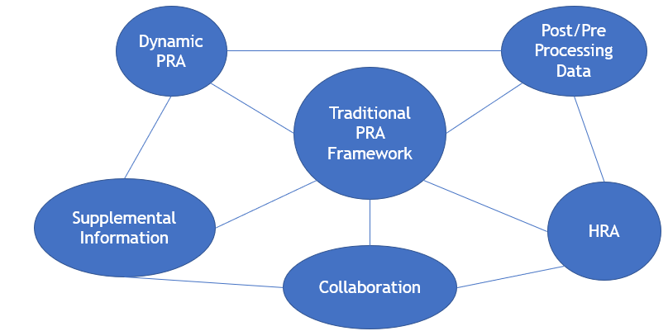
PRA community needs
Integration/interfacing/development of…
Dynamic PRA
Believed to be the PRA community’s next focus
Post/Pre-processing
Standardizing data
Information sharing to stakeholders or other practitioners
Result presentation

Slide 20
PRA community needs
Integration/interfacing/development of…
Supplemental Information
Physical models
CCF
Collaboration
Facilitate information sharing and integrating interdisciplinary skills
Model management
Version control

Slide 21
PRA community needs
Integration/interfacing/development of…
HRA
Expand PRA scope

Slide 22
Conclusion
Community favors a hybrid combination of conventional, novel and additional PRA tools
Tools have enhanced in computational capabilities and functionalities
Questionnaire highlights the trends the PRA community are moving towards
i.e., XHPRA, dynamic PRA, collaboration

Slide 23
Questions?
Have something to add?
Scan the QR code and share with us now!
This research is supported by the U.S. Nuclear Regulatory Commission. Any opinions, findings, and conclusions expressed in this paper/presentation are those of the authors and do not necessarily reflect the views of the funding agency or any other organization. The authors acknowledge and appreciate the valuable insights provided by subject matter experts who responded to the anonymous questionnaire discussed in this paper.

Slide 24
References
[1] S. Kaplan and B. J. Garrick, “On The Quantitative Definition of Risk,” Risk Analysis, vol. 1, no. 1, pp. 11–27, 1981, doi: 10.1111/j.1539-6924.1981.tb01350.x.
[2] "Systems Analysis Programs for Hands-on Integrated Reliability Evaluations (SAPHIRE): Summary Manual." Accessed: Sep. 23, 2021. [Online]. Available: https://www.nrc.gov/reading-rm/doc-collections/nuregs/contract/cr6952/v1/index.html
[3] D. Wakefield, S. Epstein, Y. Xiong, and K. Nouri, "RISKMAN®, celebrating 20+ years of excellence!," 10th Int. Conf. Probabilistic Saf. Assess. Manag. 2010 PSAM 2010, vol. 4, pp. 3488–3497, Jan. 2010.
[4] S. Prescott, C. Smith, and L. Vang, "EMRALD, Dynamic PRA for the Traditional Modeler," Los Angel., p. 12, 2018.
[5] A. Alfonsi, D. Mandelli, C. Parisi, and C. Rabiti, "Risk analysis virtual ENvironment for dynamic event tree-based analyses," Ann. Nucl. Energy, vol. 165, p. 108754, Jan. 2022, doi: 10.1016/j.anucene.2021.108754.
[6] A. Alfonsi, C. Rabiti, D. P. Maljovec, D. Mandelli, and C. L. Smith, "Enhancements to the RAVEN code in FY16," INL/EXT--16-40094, 1369372, Sep. 2016. doi: 10.2172/1369372.
[7] A. Alfonsi, C. Rabiti, D. Mandelli, J. Cogliati, S. Sen, and C. Smith, "Improving Limit Surface Search Algorithms in RAVEN using Acceleration Schemes."
[8] "ADS-IDAC," The B. John Garrick Institute for the Risk Sciences. https://www.risksciences.ucla.edu/adsidac (accessed Mar. 04, 2022).
[9] M. A. Diaconeasa and A. Mosleh, "Performing an Accident Sequence Precursor Analysis with the ADS-IDAC," in Los Angeles, 2018, p. 7.
[10] "COMPUTER CODES FOR LEVEL 1 PROBABILISTIC SAFETY ASSESSMENT," p. 103.
[11] A. Prošek and M. Matkovič, "RELAP5/MOD3.3 Analysis of the Loss of External Power Event with Safety Injection Actuation," Sci. Technol. Nucl. Install., vol. 2018, p. e6964946, Apr. 2018, doi: 10.1155/2018/6964946.
[12] "Computer Codes," NRC Web. https://www.nrc.gov/about-nrc/regulatory/research/safetycodes.html (accessed Sep. 24, 2021).
[13] W. Tietsch, “RELAP5/MOD3.3 Release Pre & Postprocessor.” International Agreement Report.
[14] "Modular Accident Analysis Program (MAAP5) Version 5.02 - Windows." https://www.epri.com/research/products/1021648 (accessed Mar. 04, 2022).
[15] "Containment Modeling using MAAP."

Slide 25
References
[16] J. L. LaChance et al., "Development and Application of a Dynamic Level 1 and 2 Probabilistic Safety Assessment Tool," p. 10.
[17] A. Hakobyan, "Severe Accident Analysis using Dynamic Accident Progression Event Trees," Ohio State University, 2006.
[18] K. Sunnevik, “Comparison of MAAP and MELCOR.” Uppsala Universitet.
[19] W. S. Jung, "FTREX Features for a Multi-Unit PSA," presented at the Transactions of the Korean Nuclear Society Spring Meeting, Jeju, Korea, May 2018. Accessed: Feb. 03, 2022. [Online]. Available: https://www.kns.org/files/pre_paper/39/18S-696%EC%A0%95%EC%9A%B0%EC%8B%9D.pdf
[20] M. Marcilhac, N. Rahni, E. Raimond, E. H. Moussi, K. Maccoco, and G. Blondet, "Gofacs: Generator Of Fragility Assessment For Coupled Systems, Structures And Components," Uncertain. Quantif., p. 8, 2021.
[21] S. H. Han, J.-E. Yang, and S.-C. Jang, "AIMS-PSA : A Software for Integrating Various Types of PSAs," p. 20.
[22] "Reliability Workbench," Isograph, Nov. 26, 2019. https://www.isograph.com/software/reliability-workbench/ (accessed Mar. 04, 2022).
[23] T. Friedlhuber, “Model Engineering in a Modular PSA,” p. 229.
[24] "WinBUGS," MRC Biostatistics Unit. https://www.mrc-bsu.cam.ac.uk/software/bugs/the-bugs-project-winbugs/ (accessed Mar. 07, 2022).
[25] E. Engineering, "NUREG-2127, 'The International HRA Empirical Study: Lessons Learned from Comparing HRA Methods Predictions to HAMMLAB Simulator Data'.," p. 157.
[26] V. Fauchille, "Application of the HORAAM method for the updating of the IRSN Level 2 PSA Model," presented at the PSAM 9.
[27] R. Boring and D. Gertman, "P-203: Human Reliability Analysis (HRA) Training Course," INL/EXT--17-40997-Rev000, 1467594, Mar. 2016. doi: 10.2172/1467594.
[28] D. I. Gertman, H. Blackman, J. Marble, J. Byers, and C. Smith, "The SPAR-H Human Reliability Analysis Method." USNRC, Aug. 2005

