Slide 1

External Flood Fragility Development and Integrating Novel Tools to the XFPRA framework
Joy Shen, Michelle Bensi, and Mohammad Modarres
University of Maryland, College Park
College Park, MD 20742
jshen132@umd.edu; mbensi@umd.edu; modarres@umd.edu
This research is supported by the U.S. Nuclear Regulatory Commission. Any opinions, findings, and conclusions expressed in this paper/presentation are those of the authors and do not necessarily reflect the views of the funding agency or any other organization.

Slide 2
Introduction
Event Tree and Fault Tree Analyses (ETA/FTA) are the traditional tools of the PRA framework
Challenges:
  Binary state assumption
  Limitations in dependency modeling
  Static treatment of time

Slide 3

PRA Questionnaire Insights [1]
PRA Community needs are trending towards hybrid tools for …
Dynamic PRAs
External hazard modeling
Collaboration
Supplemental tools
Scan above to share your insights

Slide 4
Conventional PRA Challenges in the External Flooding Context
Binary state assumption
  Component failures may have partial failures
Dependencies
  Flood events are spatially dependent
  Component dependencies due to location, manufacturing and maintenance
Static Treatment of Time
  No inclusion of duration uncertainties
  Temporally dynamic

Slide 5
Additional Challenges to XFPRA
Traditionally deterministic approach of design-basis guidance
No established XFPRA methodology

Slide 6
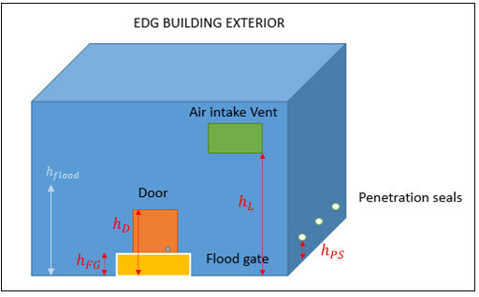
Overall Objectives of Research
Develop a flood fragility methodology for multiple components
Use Bayesian networks (BNs) to
  Integrate dependencies and uncertainties
  Probabilistically connect external flood height to internal component fragility
Integrate these tools to existing conventional PRA framework (ET and FT)

Slide 7
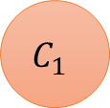
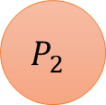
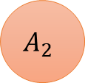
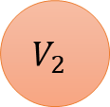

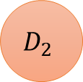

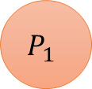



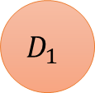

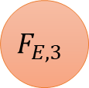
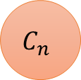


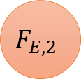
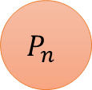

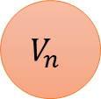


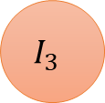
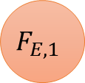
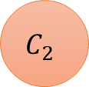
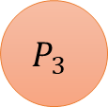

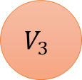
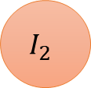
Problem Context: Bigger Picture
$$F_{E,s}$$
$$F_{E,1}$$
$$F_{E,2}$$
$$F_{E,3}$$
$$F_{E,n}$$
…
$$ε_{A}$$
$$P_{1}$$
$$C_{1}$$
$$P_{2}$$
$$C_{2}$$
$$P_{3}$$
$$C_{3}$$
$$P_{n}$$
$$C_{n}$$
…
$$D_{1}$$
$$A_{1}$$
$$D_{2}$$
$$A_{2}$$
$$D_{3}$$
$$A_{3}$$
$$D_{3}$$
$$A_{3}$$
…
$$V_{1}$$
$$V_{2}$$
$$V_{3}$$
…
$$V_{n}$$
$$I_{1}$$
$$I_{2}$$
$$I_{3}$$
…
$$I_{n}$$
7 |
Notes:
F_E: External flood height
P: Pre-existing degradation
C: Component fragility state
D: Flood duration
A: Area
V: Flow velocity
I: Internal flood height

Slide 8
Problem Context: Bigger Picture
$$F_{E,s}$$
$$F_{E,1}$$
$$F_{E,2}$$
$$F_{E,3}$$
$$F_{E,n}$$
…
$$ε_{A}$$
$$P_{1}$$
$$C_{1}$$
$$P_{2}$$
$$C_{2}$$
$$P_{3}$$
$$C_{3}$$
$$P_{n}$$
$$C_{n}$$
…
$$D_{1}$$
$$A_{1}$$
$$D_{2}$$
$$A_{2}$$
$$D_{3}$$
$$A_{3}$$
$$D_{3}$$
$$A_{3}$$
…
$$V_{1}$$
$$V_{2}$$
$$V_{3}$$
…
$$V_{n}$$
$$I_{1}$$
$$I_{2}$$
$$I_{3}$$
…
$$I_{n}$$
8 |

Slide 9
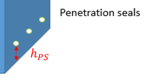
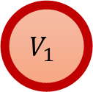

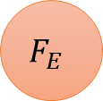
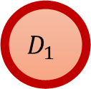


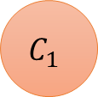
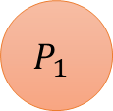



Problem Context: Focused Picture
$$F_{E}$$
$$F_{E}$$
$$P_{1}$$
$$C_{1}$$
$$P_{1}$$
$$C_{1}$$
$$D_{1}$$
$$A_{1}$$
$$I_{1}$$
$$V_{1}$$
$$I_{1}$$

Slide 10
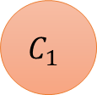


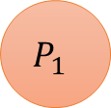
Near Term Objectives of Research
Develop a flood fragility methodology for a single penetration seal multi-state failure
Develop Bayesian network (BN) to probabilistically connecting external to internal flood height through a penetration seal performance
Monte Carlo simulation to stochastically model internal flood height
$$F_{E}$$
$$P_{1}$$
$$C_{1}$$
$$I_{1}$$

Slide 11
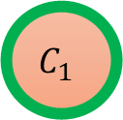
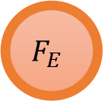
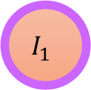
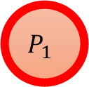
Bayesian Network Methodology
Previously accumulated damage, degradation and wear before a given flooding event
Probabilistic external flood hazard assessment
Flood fragility development
Internal flood Monte Carlo simulation
$$F_{E}$$
$$P_{1}$$
$$C_{1}$$
$$I_{1}$$

Slide 12


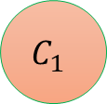
Pre-Existing Degradation
Describes accumulated damage, degradation and wear before a flooding event
Sourced from empirical or observational data
Ma et al. [2] surveyed a reference plant’s flood walkdown to find success, degradation, and failure probabilities seen in the table
$$F_{E}$$
$$P_{1}$$
$$C_{1}$$
Flood Barrier | Probability
 | Success | Degradation | Failure
Conduit Penetration Seal | 0.82 | 0.11 | 0.07
Rectangular Penetration Seal | 0.44 | 0.50 | 0.06
Pipe Penetration Seal | 0.79 | 0.18 | 0.03
$$I_{1}$$

Slide 13
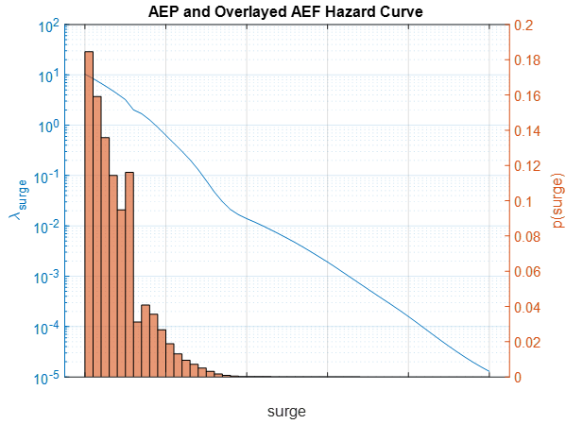
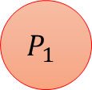
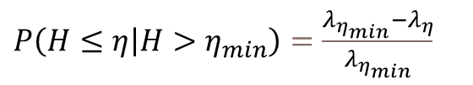
Probabilistic Flood Hazard Assessment
$P\left(H≤η | H>η_{min}\right)$ $=\frac{λ_{η_{min}}−λ_{η}}{λ_{η_{min}}}$
$$F_{E}$$
Adapted from Baker’s Introduction to Probabilistic Seismic Hazard Analysis [3]
$$P_{1}$$
$$C_{1}$$
$$I_{1}$$

Slide 14
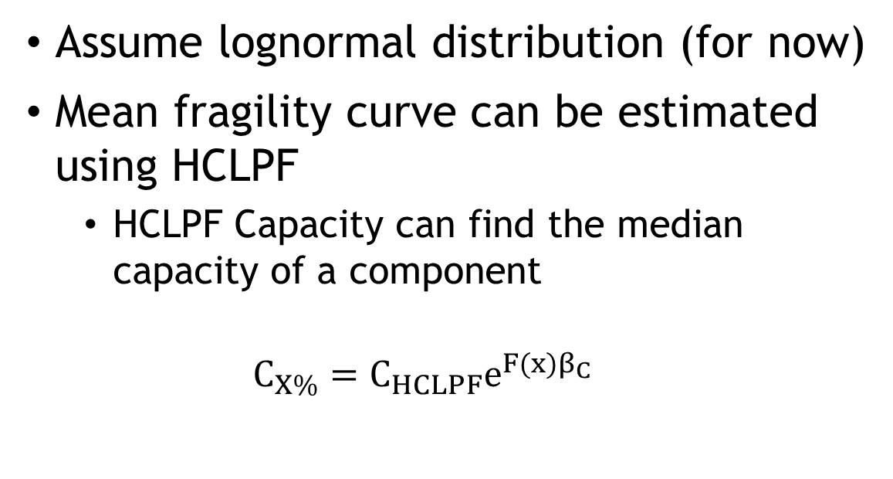
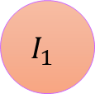
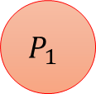
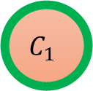

Leverage High-Confidence-Low-Probability-of-Failure (HCLPF) Concept for Fragility Function
Assume lognormal distribution (for now)
Mean fragility curve can be estimated using HCLPF
  HCLPF Capacity can find the median capacity of a component
  $$C_{X\%}=C_{HCLPF}e^{F(x)β_{C}}$$
$$F_{E}$$
$$P_{1}$$
$$C_{1}$$
$$I_{1}$$
Dasgupta’s Evolutions of Methods used to Calculate Seismic Fragility Curves [4]

Slide 15
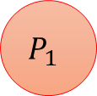




Fragility Function Methodology
$$F_{E}$$
$$P_{1}$$
$$C_{1}$$
$$I_{1}$$
$$Pr⁡[g_{k}\left(X,θ\right)≤0|S=s]$$

Slide 16
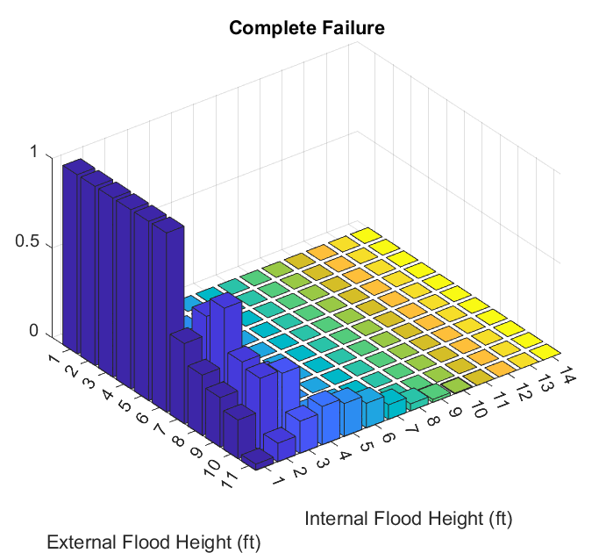
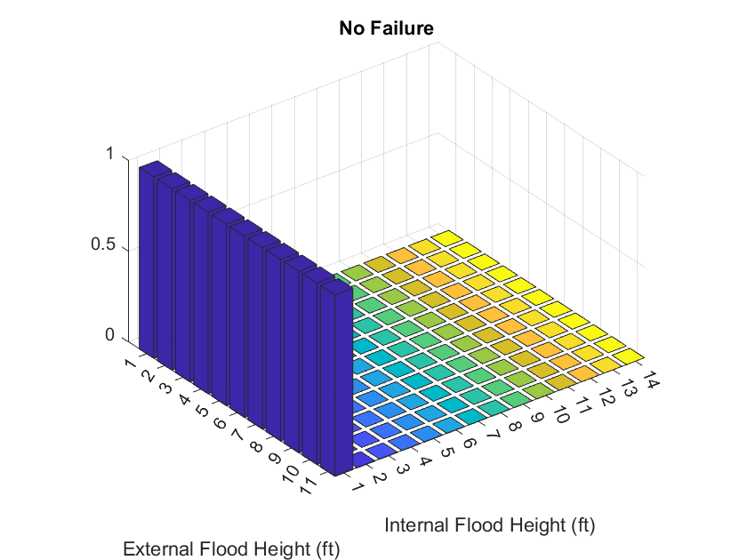
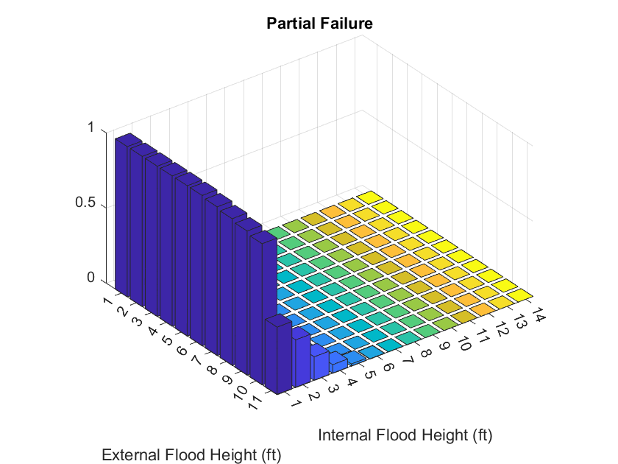
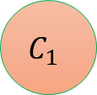


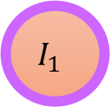
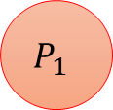
Internal Flood Height Node
$$F_{E}$$
External Flood Height
Internal Flood Height
Internal Flood Height
$$P_{1}$$
$$C_{1}$$
External Flood Height
$$I_{1}$$
External Flood Height
Internal Flood Height
Monte Carlo Simulation assuming given distributions
$$h_{int}=\frac{\sqrt{2g(∆h)}A_{f}∗T\left(h_{EF}>h_{ins}\right)}{l_{int}∗w_{int}}$$

Slide 17
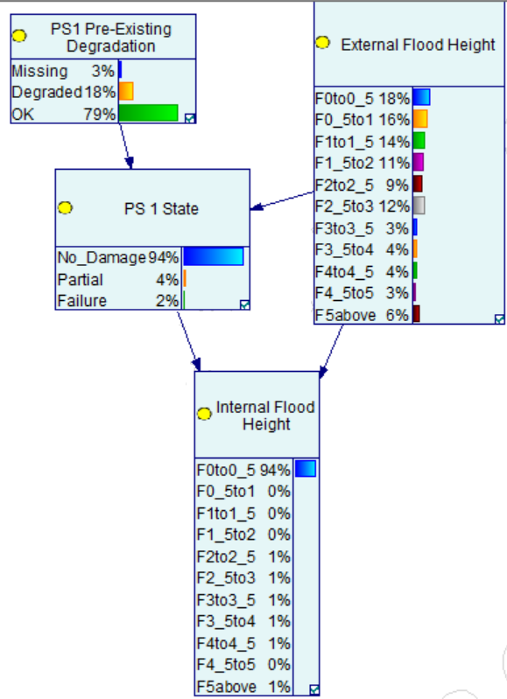
Conclusion
Established a methodology for XFPRA
The BN stochastically connects the external to internal flood height
Integrates dependencies and causal relationships
SSC multi state

Slide 18
Future Work
Include additional barrier types, and redundant barriers
Compare the BN to FT
  Quantification
  Correlation
Sensitivity analysis with other fragility distributions (normal, logistic…)
Expand the BN to include internal component failures

Slide 19
  Questions?

Slide 20
References
[1] J. Shen, M. T. Bensi, and M. Modarres, “External Flood Fragility Development and Integration of a Novel PRA Tool to the XFPRA framework,” 2022, p. 12
[2] S. Zhang and Z. Ma, “Literature Review and Previous Flood Barrier Tests,” p. 20.
[3] J. W. Baker, “Introduction to Probabilistic Seismic Hazard Analysis,” p. 80.
[4] B. Dasgupta, “Evaluation of Methods used to Calculate Seismic Fragility Curves,” Center for Nuclear Waste Regulatory Analyses, San Antonio, TX, NRC-HQ-12-C-02-0089, May 2017. Accessed: Apr. 22, 2021. [Online]. Available: https://www.nrc.gov/docs/ML1712/ML17122A268.pdf

