Slide 1
Significance Determination Process
Notes:
Right-click, select Format Background and change the Picture fill, File

Slide 2
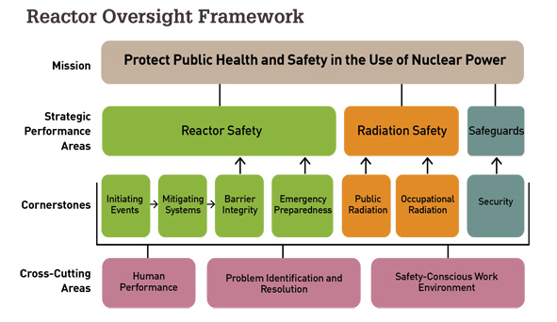
Significance Determination Process (SDP)
Part of the Reactor Oversight Framework
process for determining the safety or security significance of events or issues at nuclear power plants
Given a functional degradation over a period of time, the SDP can be used to determine the increase in risk (Core Damage Frequency or Large Early Release Frequency) for postulated initiating events

Slide 3
Significance Determination Process
Purpose and scope
The SDP assigns a colour to the events
Green: Very low safety significance ΔCDF < 1E-6
White: Low to moderate safety significance 1E-6 < ΔCDF < 1E-5
Yellow: Substantial safety significance 1E-5 < ΔCDF < 1E-4
Red: High safety significance 1E-4 < ΔCDF

Slide 4
Significance Determination Process
Overview of process
Phase 1 – Definition and Initial Screening of Findings (table)
Characterization of the event
Initial Screening Out of Low-Significant Issues
Phase 2 – quantify impact using (normally) simplified risk models
Performed by event analyst
Study:
Initiating events
Which systems/functions are affected – defining the sequence
Exposure time
A simplified result is generated
Phase 3 – if detailed justification needed
Detailed justification needed
Risk analyst performs justification

Slide 5
The process
Create/import Original Event
Filter the event with simple rules
Filtered out
No SDP
Create SDP Event
SDP event: Add information
SDP phase 1:
Identification and impact
No risk
Green
May imply risk
SDP phase 2: Easy evaluation of impact using PSA
Type of impact, system, duration
ΔCDF / ΔLERF
Colour
If further assessment deemed necessary
SDP phase 3: impact using standard PSA
ΔCDF / ΔLERF
Colour

Slide 6
RiskSpectrum SDP

Slide 7
RiskSpectrum SDP
Difference risk monitor & SDP tool
Risk Monitor
Tool for planning and monitoring risk in plant operations
SDP
Process for analysing and determining the significance of events that has occured
Notes:
40 min for Ola. Maybe 30 min for me?

Slide 8
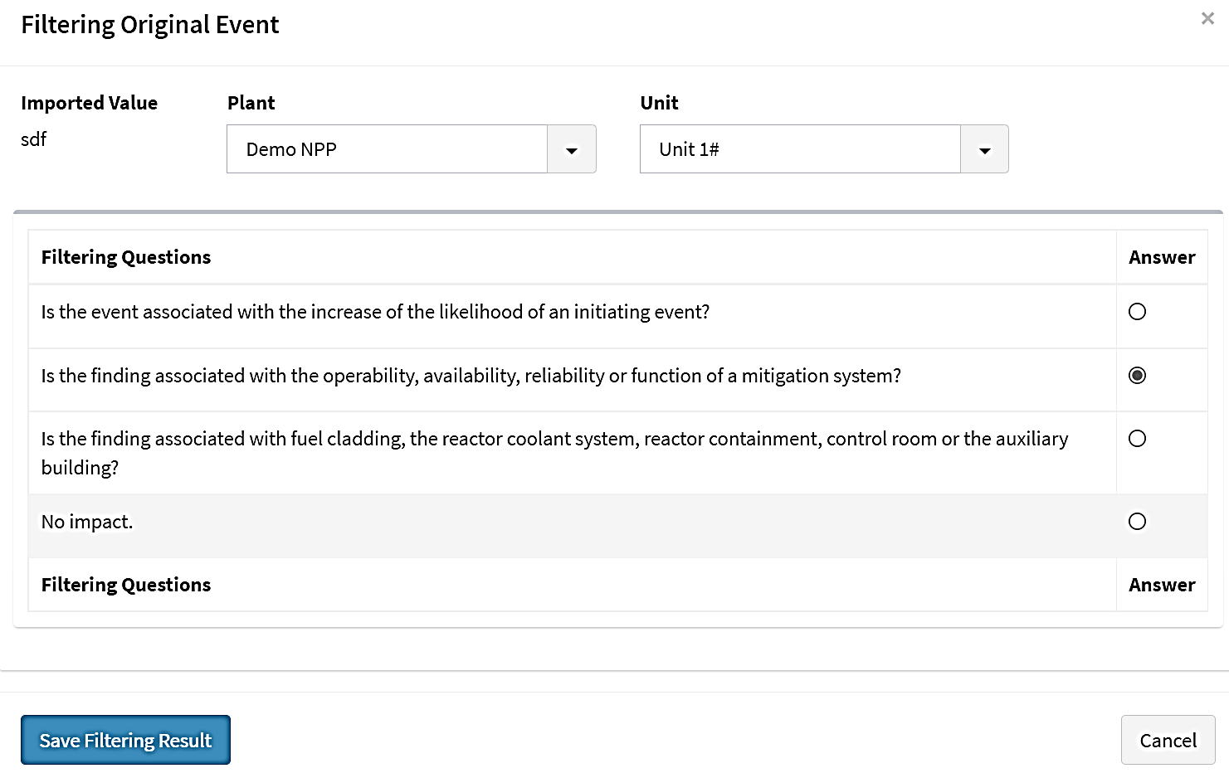
The process in RiskSpectrum SDP
Create and filter the original event
Filtering questions defined by you
Answers will either be screened out or create an SDP event

Slide 9
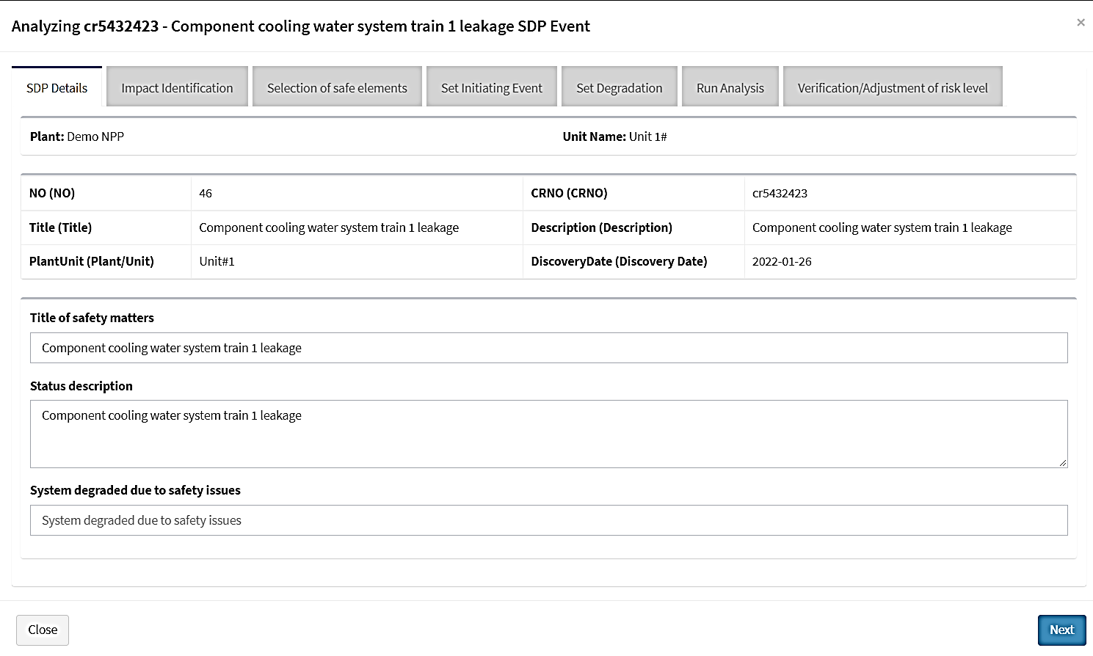
The process in RiskSpectrum SDP
If an SDP event – follow the guide
Add more information about the event

Slide 10
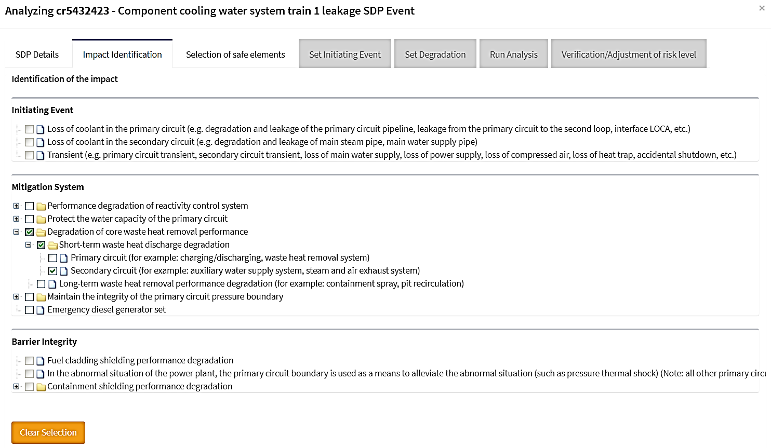
The process in RiskSpectrum SDP
SDP Phase 1 - select impact
Initiating Event
Mitigation System
Barrier Integrity

Slide 11
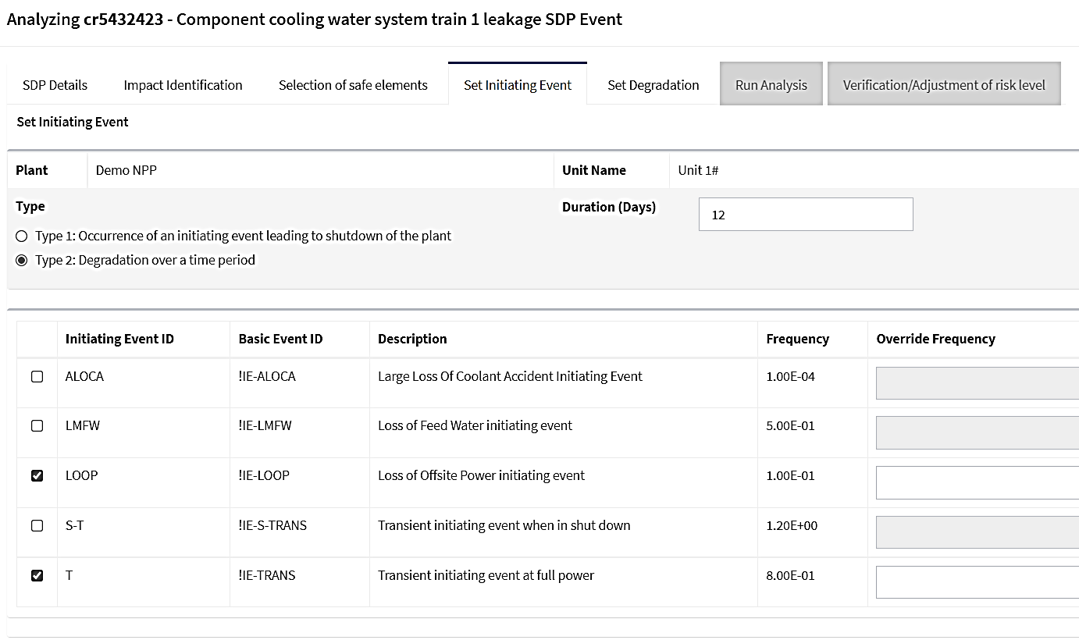
The process in RiskSpectrum SDP
SDP Phase 2 - Define type of impact
Initiating event
Unavailability over time period

Slide 12
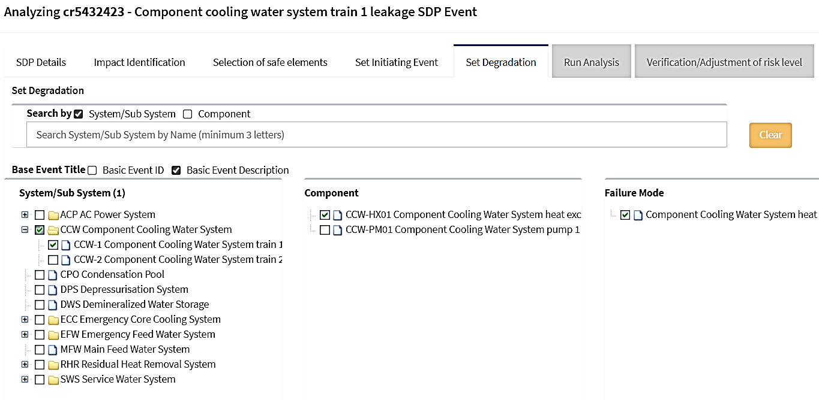
The process in RiskSpectrum SDP
SDP Phase 2 – Set degradation if selected
Select affected equipment

Slide 13
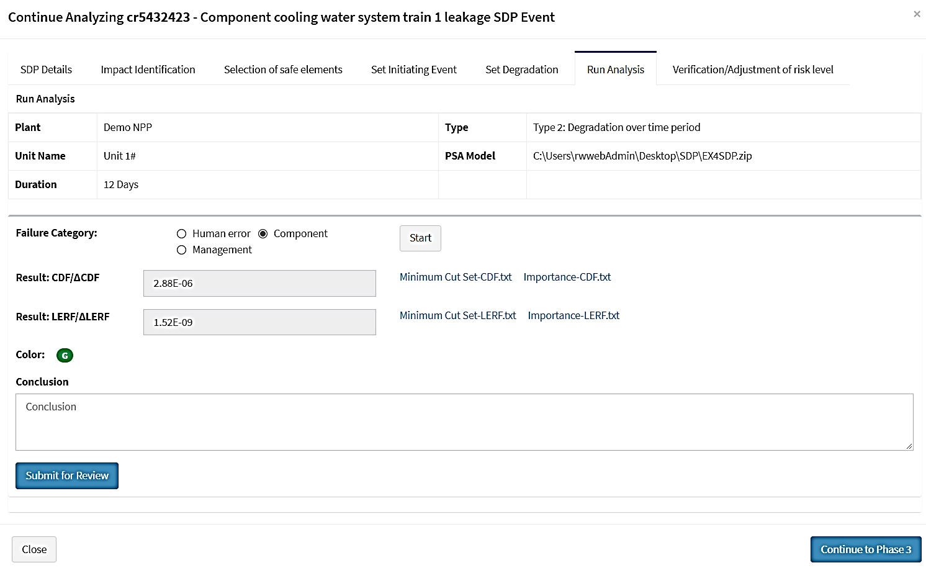
The process in RiskSpectrum SDP
SDP Phase 2 – Run analysis
Set the type of failure:
Human error
Component
Management

Slide 14
The process in RiskSpectrum SDP
SDP Phase 2 – Run analysis
The PSA model is run, with the conditions defined
Impact assessed – in this case Green

Slide 15
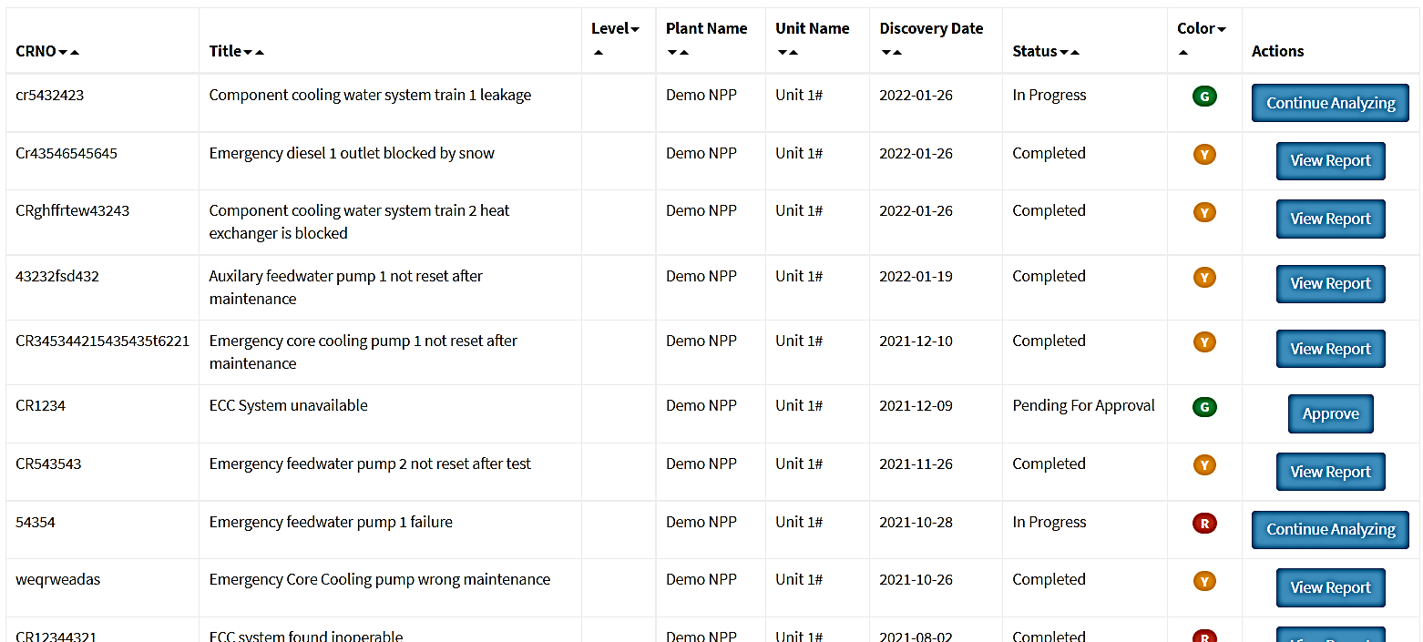
RiskSpectrum SDP
Submit report for review
When approved the events appears on the summary
You can drill down in the report to look into the analysis

Slide 16
RiskSpectrum SDP
Key features
Manage several stations/units
Using the PSA model
You can use any RiskSpectrum PSA model you would like - configurable
Reports and result overview (dashboards)

Slide 17
RiskSpectrum SDP
Key features
Manage several stations/units
Using the PSA model
You can use any RiskSpectrum PSA model you would like - configurable
Reports and result overview (dashboards)
User management system
Review and approve
Process control/overview
Browser based system

Slide 18
RiskSpectrum SDP
Conclusions
Dashboard for all events reported
Manage several plants and units
Provides tool assistance for the steps in the SDP process
Configurable for your needs, e.g., any language
Easy to use interface, based on real PSA model to estimate risk
User management system with different user rights

Slide 19
Thank you
Please contact:
Johan Sörman +46 70 773 0404
Johan.sorman@lr.org

