Slide 1

Analysis of Frequency of Aircraft Impact from Overflights
Presented at
Probabilistic Safety Assessment and Management PSAM 16, Honolulu, Hawaii, June 26 – July 1, 2022
James C. Lin

Slide 2
Introduction
Evaluation of frequency of aircraft impact from overflights during the in-flight phase has become more challenging in recent years
  Changes in flight paths (even for itinerary flights) & difficulty in collecting flight frequency data
Can now fly using GPS & not always have to follow airways.
  based on the shortest routes between the origin and destination navigated by GPS.
The frequency of enroute overflights in the airspace nearby a nuclear facility cannot be just estimated by the air traffic along the nearby airways as specified in NUREG-0800, Section 3.5.1.6.
  All overflights within certain distance from the target facility should be considered.
  Air traffic in the airspace nearby a US nuclear facility can be estimated using the FAA records on flights crossing specific latitude/longitude boundaries,
    Includes not only aircraft operations into and out of a nearby airport, but also overflights through the same airspace without landing at that airport.

Slide 3
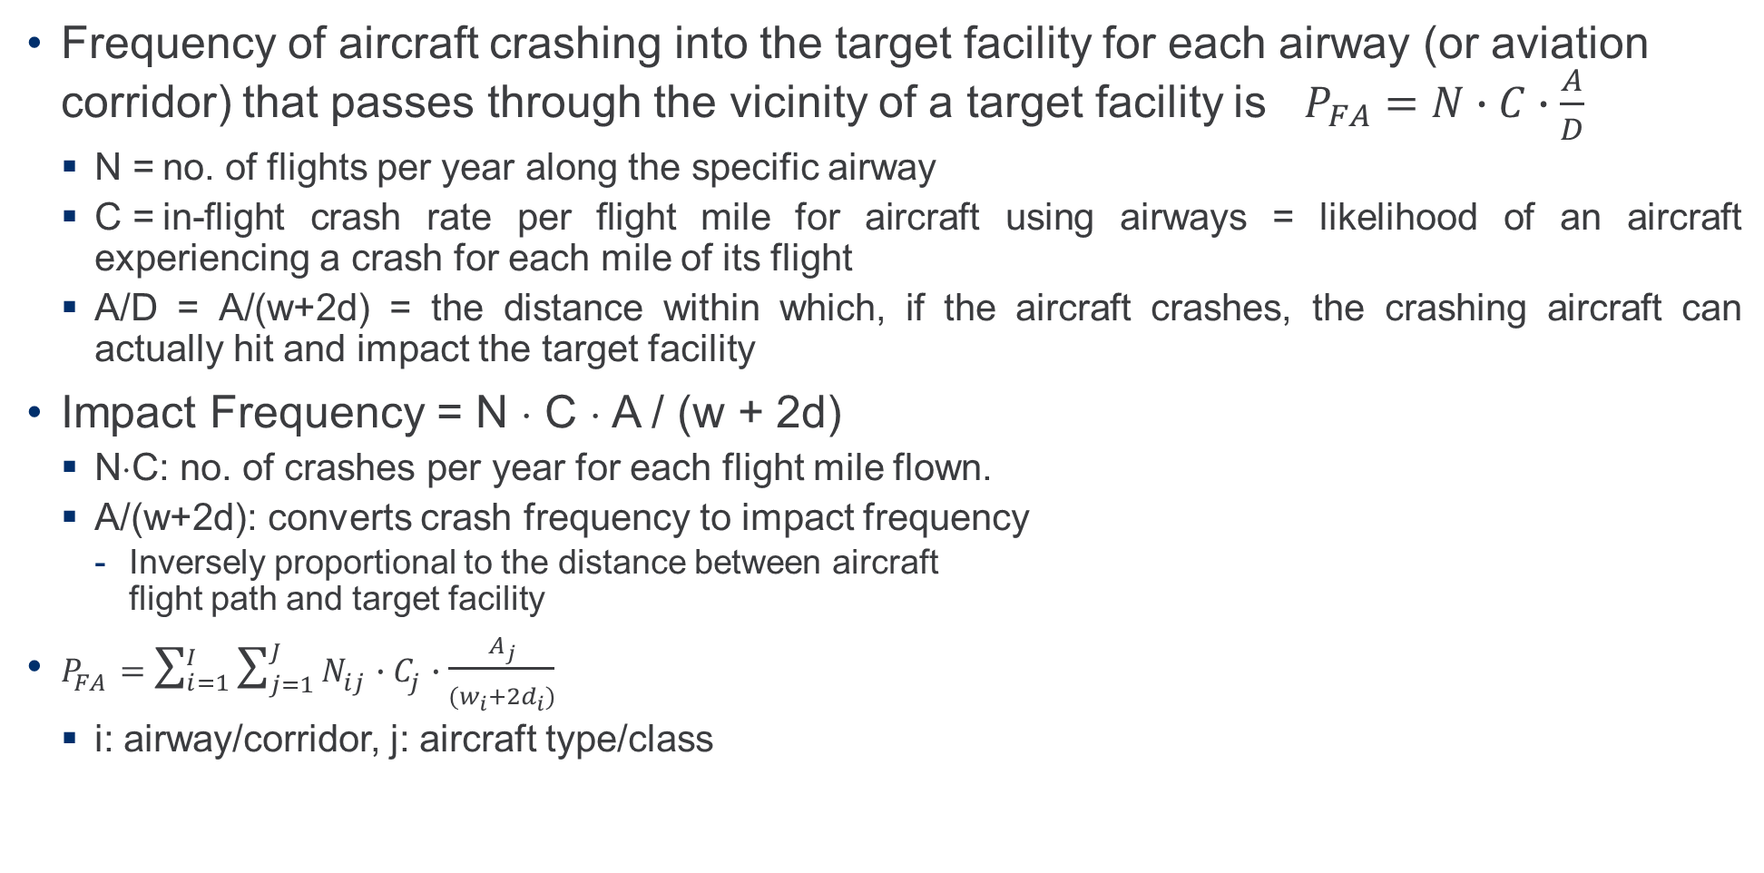
Current Methods: NUREG-0800, Section 3.5.1.6 - Airway Flight Frequency
Frequency of aircraft crashing into the target facility for each airway (or aviation corridor) that passes through the vicinity of a target facility is $P_{FA}=N∙C∙\frac{A}{D}$
  N = no. of flights per year along the specific airway
  C = in-flight crash rate per flight mile for aircraft using airways = likelihood of an aircraft experiencing a crash for each mile of its flight
  A/D = A/(w+2d) = the distance within which, if the aircraft crashes, the crashing aircraft can actually hit and impact the target facility
Impact Frequency = N ⋅ C ⋅ A / (w + 2d)
  N⋅C: no. of crashes per year for each flight mile flown.
  A/(w+2d): converts crash frequency to impact frequency
    Inversely proportional to the distance between aircraft
    flight path and target facility
$P_{FA}=\sum_{i=1}^{I}{\sum_{j=1}^{J}{N_{ij}}∙C_{j}∙\frac{A_{j}}{(w_{i}+{2d}_{i})}}$
  i: airway/corridor, j: aircraft type/class

Slide 4
Current Methods: NUREG-0800, Section 3.5.1.6 - Airway Flight Frequency (cont’d)
Risk of impact is characterized by the closest distance between the flight & target facility
The main issue: only considers flights along the airways & does not account for flights that are outside the airways, but in the vicinity of the target facility, which, if crash, can still impact the target facility.
N and C can be determined using the actual flight data and accident data, respectively.
  Uncertainty in these two parameters is limited to the statistical variations in the actual data.
The key source of uncertainty in the airway flight frequency method is the model used to convert from the crash frequency to the impact frequency
  Simply inversely proportional to the distance between the flight path and the target facility.

Slide 5
Current Methods: Location-Dependent Impact Density Method
Ideally, frequency of aircraft impact at a target facility can be estimated by using the actual aircraft crash data (including the crash events and the crash locations) to determine the location-dependent impact density first.
  Then, the aircraft impact frequency at the target location can be obtained by multiplying this location-dependent impact density at the target location by the effective target area.
  Since the aircraft impact frequency determined using this approach is intended to be derived directly from the aircraft crash data, uncertainty in the calculated result can be minimized.
Due to the scarcity of the aircraft crash data, the historical crash sites are too scattered and widely spread out to support a statistically meaningful determination of location-dependent impact density.
  A possible approach is to use the Bayesian method to estimate the distribution of the location-dependent impact density.
  A 2-dimensional, prior distribution of the aircraft impact density can be postulated first.
  Using the Bayes’ theorem, this distribution can then be updated with the actual crash site data.
  The main issue with this approach is the selection of the prior distribution of the aircraft impact density which is highly subjective and may not be fully supported by the key characteristics of the influencing factors for aircraft crashes.

Slide 6
Current Methods: Location-Dependent Crash Density Method (cont’d)
In principle, the crash/impact frequency at each location can be influenced significantly by many factors including weather pattern, topography, terrain-related weather conditions (e.g., frequently generated wind shear at location with steep mountain elevation drop), etc.
  Based on considerations of these influencing factors, one can subdivide the entire continental U.S. into many small areas, each of which entails relatively uniform characteristics of these factors that influence the impact density.
  Such detailed study has not been available to support the characterization of these influencing factors, classification of the geographical areas, and the specification of the prior distribution of the location-dependent impact density.
  Without substantiation by these in-depth evaluations, any assumed distribution for the prior distribution could essentially be arbitrary and not fully supported by the actual crash data.
  This kind of assumed prior distribution will no doubt contribute substantially to the inaccuracy and uncertainty in the calculated results for the aircraft impact frequency.

Slide 7
Current Methods: Average Impact Density Method
Some studies simply estimate the average impact density, which is then multiplied by the effective target area to derive the frequency of impact at the target location.
  Assumes uniform impact density throughout the entire area
    Total no. of crashes per year is divided by the total area to determine average impact density per year.
  Main drawback: neglects potentially significant variation in impact density from location to location.
    Assumption of equal impact density may not be realistic since some locations should be more likely than others because the impact density is likely location-dependent.
    The average impact density method is non-conservative for locations closer to the flight routes.
In one study, total no. of crashes per year in an entire country was divided by the total land area of the country to derive average impact density per year used for the calculation of the impact frequency per year.
  The average impact density was stated as conservative for the target facility because most of the crashes occurred in the mountainous areas far away from the target facility.
  While the terrain may be an important factor affecting the location-specific impact frequency, there may be other factors that also contribute to the variability in the location-specific impact frequency.
  Applying average impact density to a specific location without fully investigating any other possible influencing factors could potentially underestimate significantly the aircraft impact frequency.

Slide 8
Recently Proposed Method Based on Air Traffic Data –
Flight Density Method
An extension of the airway flight frequency method specified in NUREG‑0800.
  To account for all flights in the vicinity of the target facility, the in-flight aircraft impact frequencies can be estimated using the FAA air traffic data obtained from the radar environment.
  The flights navigated by GPS are similar to the flights along airways except that they may not follow the airways even though each flight could essentially follow a straight path.
  The FAA air traffic data must be processed by a computer program to derive the unique overflights nearby a target facility, the closest distance between the target facility and each unique flight, and the frequency of these flights.
  The closest distance between the target facility and each unique flight is used to determine the lateral aircraft impact range based on the model adopted by NUREG-0800.
  For each class of aircraft, its total frequency of crashing into a target facility can be estimated by summing the products of in-flight crash rate, effective target area, and the inverse of lateral aircraft impact range over all unique flights.
  Can be calculated for several cases of the maximum closest distance, which is used to determine the appropriate area around the target facility for characterizing the aircraft impact hazard.

Slide 9
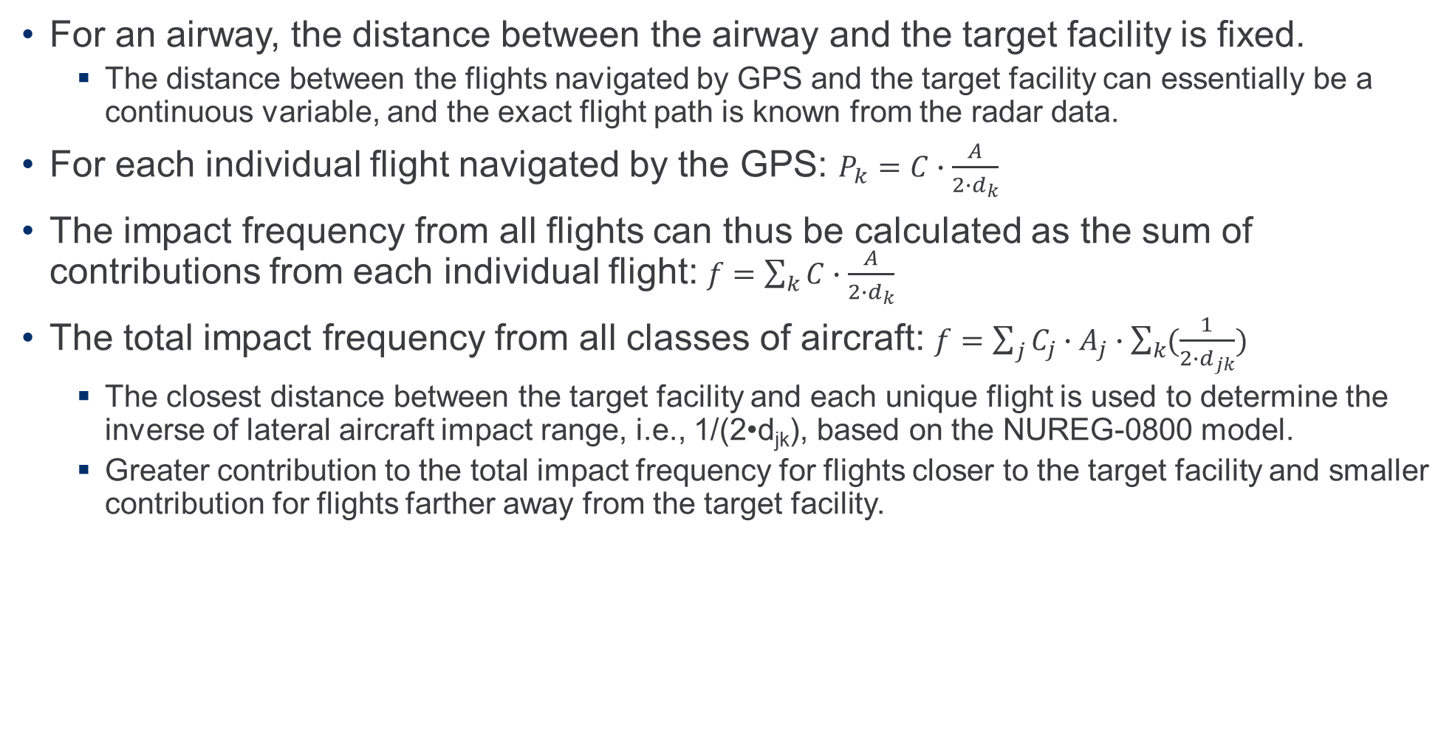
Closest Distance between Flights and Facility – Continuous Variable
For an airway, the distance between the airway and the target facility is fixed.
  The distance between the flights navigated by GPS and the target facility can essentially be a continuous variable, and the exact flight path is known from the radar data.
For each individual flight navigated by the GPS: $P_{k}=C∙\frac{A}{2∙d_{k}}$
The impact frequency from all flights can thus be calculated as the sum of contributions from each individual flight: $f=\sum_{k}{C∙\frac{A}{2∙d_{k}}}$
The total impact frequency from all classes of aircraft: $f=\sum_{j}{C_{j}∙A_{j}∙\sum_{k}{(\frac{1}{2∙d_{jk}})}}$
  The closest distance between the target facility and each unique flight is used to determine the inverse of lateral aircraft impact range, i.e., 1/(2•d_{jk}), based on the NUREG-0800 model.
  Greater contribution to the total impact frequency for flights closer to the target facility and smaller contribution for flights farther away from the target facility.

Slide 10
Closest Distance between Flights and Facility – Continuous Variable (cont’d)
The calculation can be performed for a number of different cases in terms of the maximum closest distance between the target facility and the unique flights.
  e.g., all flights with the closest distance within 5 miles from the target facility, within 10 miles, and within 15 miles, which can be used to determine the appropriate area around the target facility for representing the aircraft crash hazard.
  The range of, for example, 5 miles, 10 miles, and 15 miles are simply used to determine whether a flight will be included or excluded from the calculation of the aircraft impact frequency.
Another approach in determining the boundary for including flights in estimating the aircraft impact frequency is based on the NUREG-0800 proximity criteria.
  Per Section 3.5.1.6 of NUREG‑0800, the aircraft impact risks are considered negligibly low if the distances between the target facility and the military training routes, federal airways, and holding/approach patterns are beyond the following:
    5 statute miles from the nearest edge of military training routes
    2 statute miles from the nearest edge of a federal airway, holding pattern, or approach pattern
Assuming the airway width is ~ 9.2 miles, the above criteria imply that the distance between the target facility and the aircraft can possibly be as much as 14.2 miles and 11.2 miles, respectively.
  Therefore, for purpose of evaluating the risk of aircraft impact from enroute overflights in accordance with the NUREG-0800 proximity criteria, flights traversing the airspace within about at least 15 miles from the target facility should be collected and included in the evaluation.

Slide 11
Closest Distance between Flights and Facility – Discretized Bins
For ease of analysis, one can also group all flights by not only the aircraft type but also their closest distances from the target facility, d_{jk}.
  Variable, d_{jk} (closest distance to the target facility for each flight) can be discretized into a number of distance bins, each with a width and a distance to the target facility from the inner or nearest edge of the respective bin.
  “annular distance bins” around the target facility are simply bins for the locations of the closest point of each of flights.
  All of the flights can be grouped into distance bins according to the closest distance to the target facility each flight reaches.
Each flight traverses through a number of annuli around the target facility in essentially a straight line.
  Each annulus is a distance bin with a width.
  The inner most annulus that the flight traverses through is the closest point in its path from the target facility.
    This flight is counted as one flight for this inner most annulus (bin) and not counted in any other annuli (bins) that it traverses through.

Slide 12
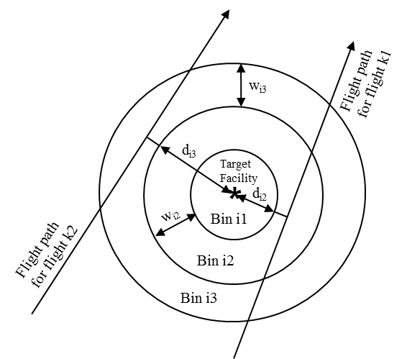
Closest Distance between Flights and Facility – Discretized Bins (cont’d)
Illustration of distance bins

Slide 13
Closest Distance between Flights and Facility – Discretized Bins (cont’d)
  Corresponding to each annulus (bin), there is a total no. of flights and the values of “w” (annulus or bin width) and “d” (distance from the inner edge of the annulus or bin to the target facility).
  Each annulus is simply the airspace within which the closest points (to the target facility) of the flights are located.
All flights sorted into the same bin/annulus are assumed to be at the same distance from the target facility even though they can be anywhere across the width of the bin/annulus.
  If these flights traverse through the centreline of the annulus, the distance to the target facility is (w/2)+d. The crash spread width is thus 2[(w/2)+d] = w+2d.
The binning process sorts all unique flights into the distance bins defined.
  Accounts for all unique flights with no overlapping in sorting into the various bins; i.e., the flights in each distance bin are not repeated in any other bins.
  The processing of FAA data is simply identifying the unique flights, as well as counting and sorting them into different distance bins, each with a different distance from the target facility.

Slide 14
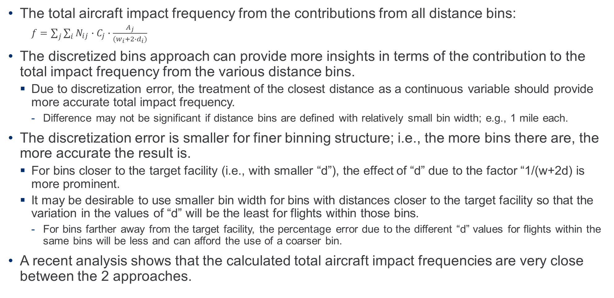
Closest Distance between Flights and Facility – Discretized Bins (cont’d)
The total aircraft impact frequency from the contributions from all distance bins:
  $f=\sum_{j}{\sum_{i}{N_{ij}∙C_{j}∙\frac{A_{j}}{(w_{i}+{2∙d}_{i})}}}$
The discretized bins approach can provide more insights in terms of the contribution to the total impact frequency from the various distance bins.
  Due to discretization error, the treatment of the closest distance as a continuous variable should provide more accurate total impact frequency.
    Difference may not be significant if distance bins are defined with relatively small bin width; e.g., 1 mile each.
The discretization error is smaller for finer binning structure; i.e., the more bins there are, the more accurate the result is.
  For bins closer to the target facility (i.e., with smaller “d”), the effect of “d” due to the factor “1/(w+2d) is more prominent.
  It may be desirable to use smaller bin width for bins with distances closer to the target facility so that the variation in the values of “d” will be the least for flights within those bins.
    For bins farther away from the target facility, the percentage error due to the different “d” values for flights within the same bins will be less and can afford the use of a coarser bin.
A recent analysis shows that the calculated total aircraft impact frequencies are very close between the 2 approaches.

Slide 15
Average Flight-Hour Density Method
Uses flight-hour data which can also be derived by processing the FAA radar data.
Average flight-hour density within a flight data collection area = (total annual flight-hours within a flight data collection area) / (total area within the flight-hour data collection area)
Aircraft impact frequency = average flight-hour density (flight-hours/mile²-year) * crash rate (crashes per flight-hour) * effective target area (miles²)
Assume uniform flight-hour density within a flight data collection area; i.e., the airplanes will show up anywhere in the area with same amount of time & equal likelihood.
  The flight frequency and annual flight hours could be highly location dependent; i.e., may be concentrated in specific locations & not uniformly distributed throughout a large area.
  Not considered realistic because, e.g., the flight-hour density should be much higher at locations near the flight routes.
    The flight-hour density could be diluted for large areas with variable air traffic within the airspace.

Slide 16
Average Flight-Hour Density Method (cont’d)
  This assumption is also combined with the assumption of equal crash likelihood anywhere the aircraft shows up; i.e., constant crash rate which is an assumption that is commonly used and is considered acceptable on a relatively basis.
    Combining these two assumptions leads to essentially the same assumption as the constant impact density assumption; i.e., equal impact likelihood anywhere within the area.
Although, given an aircraft crash, the likelihood of impacting the target may not be strongly location dependent, nevertheless, it is still heavily influenced by at least one characteristic; i.e., the distance of these flights or flight hours from the target location.
  To sum up the total flight hours within an area and equally distributes it throughout the entire area is essentially shifting the flight hours from concentrated locations to other areas with much less flight hours.
    The net effect is to significantly reduce the flight hours from specific locations by spreading the cumulative flight hours in those specific locations to a much larger areas, which essentially reduces artificially the impact likelihood from selected areas.
The average flight-hour density approach could be non-conservative and significantly underestimate the flight-hour density at specific locations and thus underestimate the frequency of aircraft impact at the target facility.
  e.g., the location-specific concentration of flight hours will be diluted by the average over the entire area and a diluted density could be used at locations closer to the flight routes.

Slide 17
Summary & Conclusions
Overflights during the in-flight phase:
  The airway flight frequency approach can no longer be used in present-day aviation because it does not account for flights outside the airways.
  Both the average impact density and average flight-hour density methods imply a constant impact density within the area regardless of the location of the target facility.
    Not realistic in some cases and can potentially be non-conservative for locations closer to flight routes or locations with greater influence by conditions affecting the impact likelihood.
Ideally, the location-dependent impact density method can use the aircraft crash data to directly determine the aircraft impact frequency at the target location.
  Main problem: unsubstantiated basis for the model adopted to extrapolate the impact frequency from the historical, actual crash sites to the target facility location.
The flight density method uses a model adopted in Section 3.5.1.6 of NUREG-0800, assuming that the aircraft impact is more likely to occur at locations closer to the flight routes and is less likely to occur at locations farther away from the flight routes.
  The model implementing this assumption (i.e., the impact likelihood is inversely proportional to the closest distance between the flight path and the target facility) represents a key source of uncertainty but may or may not contribute to any conservatism present in the calculated result for aircraft impact frequency.
  Considered most credible, realistic, and practical.

Slide 18
Questions and Answers

Slide 19
James C. Lin
jlin@absconsulting.com

