Slide 1



Challenges for Human Reliability Analysis in
New Nuclear Power Plant Designs
OECD NEA Halden HTO Project
PSAM 16
Andreas.Bye@ife.no
Andreas Bye, IFE, OECD NEA Halden HTO Project
Jeffrey A. Julius, Jensen Hughes
Ronald L. Boring, Idaho National Laboratory
PSAM 16, June 26th – July 1st, 2022
Honolulu, Hawaii

Slide 2
Background, new needs
New plants and upgrades to existing plants
  New control rooms with digital I&C
  Some operated similarly as in analog control rooms
  Changing the role of the operator?
  New technology impacts crew work and teamwork

Slide 3
Challenges associated with digital control rooms
Human-System Interfaces
  If poorly implemented, added secondary tasks
  Degradation of instrumentation (also for analog)
Computerized Procedures
  Relates to both HSI and automation
Automation
  Reduced situation awareness
  Overreliance, miscalibrated trust in automation
  Automation transparency
From execution role to monitoring role

Slide 4
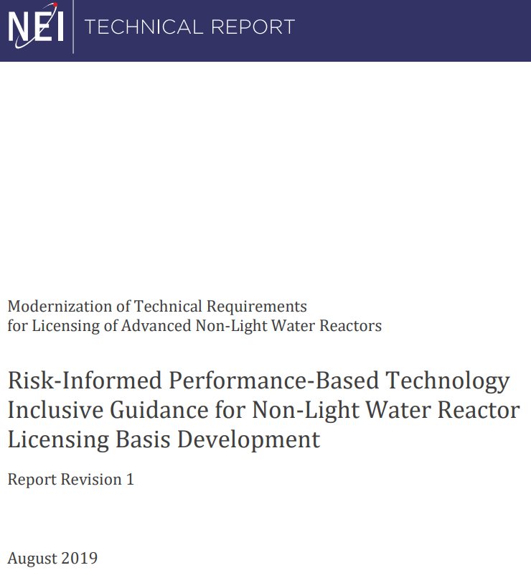
Challenges associated with safety analysis
Methods and scope may change for completely new designs of advanced reactors
Changes needed since the technology and the physics may have changed
  For example, many of the proposed non-LWR advanced reactor designs include “less radioactive inventory, more stable fuel forms, higher system thermal capacities, and longer thermal constants, as well as passive safety features that rely on natural phenomena.” (A Regulatory Review Roadmap for Non-Light Water Reactors, nrc.gov, ML17312B567, Dec 2017)
NEI 18-04 framework addresses changes in technology
  Providing “…a modern, technology-inclusive, risk-informed, and performance-based
  (TI-RIPB) process for selection of Licensing Basis Events (LBEs); safety classification of
  structures, systems, and components (SSCs) and associated risk-informed special
  treatments; and determination of defense-in-depth (DID) adequacy for non-LWRs”
Notes:
JAJ updated slide

Slide 5
HRA: Understanding the operating challenges
Traditionally, diving into detailed procedure steps is necessary for the HRA analyst
  Example: SGTR from the international study, next slide

Slide 6
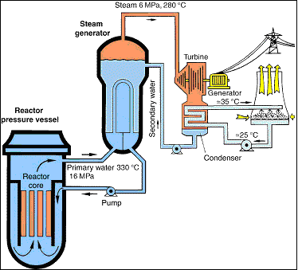
International HRA Empirical Study, SGTR scenarios
Base: SGTR, no further complications
Complex: SGTR,
  Concomitant steam line (SL) break causes SL isolation
  Failure in radiation measurement in sampling from ruptured SG
  No radiation alarms (HFE 1B)
Turbine
Sampling
14 crews of licensed NPP operators, PWR simulator in HAMMLAB

Slide 7
Typical conditions
SG Tube Rupture
E-0
E-0 Step 19
E-3
SG isolated
Non-typical conditions
E-0 Step 14
E-2
FR-H1
ES-1.1 foldout
ES-1.1
E-0 step 19
SG Tube Rupture
E-0
E-0 Step 19
E-0 Step 21
E-3
SG isolated
E-0 Step 24
E-0
E-0 Step 19

Slide 8
HRA: Understanding the operating challenges
It was not enough to evaluate procedures as “industry standard”, and evaluate them to be nominal for this case
The analyst needed to understand the operating challenge in the detailed procedure step, in this case step 21 in E-0, and see that this was actually a difficult task and evaluate the procedure support to be less than nominal and to increase the Human Error Probability (HEP)

Slide 9
HRA: Understanding the operating challenges
Task Analysis (TA) is central
TA, when to stop?
  Achieving the safety functions
  Given by the procedures (sometimes implicit)
What about TA for new designs?
  Similar to Beyond Design Basis Events (BDBE)
  Also lacking procedures covering all situations and combinations of events
Experiments from simulators, including rare combinations of initiating events
  Can study in EOP space
Too detailed TA?
  Summing up too many HEPs that creates unrealistically high HEP?

Slide 10
HRA: Understanding the operating challenges
Qualitative analysis
Expert elicitation
  Detailed walk-through/talk-through may be necessary
  Example from the U.S. Empirical HRA Study
    It was not enough to ask for expert opinion
    Detailed talk-through of the procedure with the expert was necessary to reveal that there was not enough time for a critical action
Granularity of the PSF evaluation
  Methods should have guidance that forces the analyst to dive into details
  Extensive examples, good descriptions of anchor points

Slide 11
HRA: Analyzing scenarios without procedures
Early design similar to BDBE
Model functions and actions implemented by safety systems
  Similar input as when designing and writing the procedures
  HSI design need similar input
Basic knowledge of physical properties necessary

Slide 12
HRA: Orthogonality in Performance Shaping Factors
Strive to define PSFs as orthogonal
  This is not possible
  A PSF such as training will always be able to cover up for bad design to a certain extent
  Complexity and HSI may often overlap
Avoid double counting in an HRA
  Can lead to too conservative HEP (or too optimistic, if a good phenomenon is accounted for twice)
  Solution for HRA: Analyst must be aware and document how a risk phenomenon is accounted for and document that it is accounted for only once
For new design
  Not a problem in qualitative analysis: If a problem is pointed to from two angles, ok
  A problem if quantified, and resources prioritized to wrong fix

Slide 13
HRA: Error taxonomies for Digital I&C in new control rooms
Do old methods address the new context in a digital control room?
  Automation, computerized procedures and new HSI
Some methods, No
  If the methods are detailed and analyze typical analog control room stuff as pushing buttons
  Some methods need update regarding higher degree of automation and computerized procedures
Some methods, Yes
  If the methods are based on cognitive mechanisms
Cyber attacks may create new modality of faults
  Need more knowledge for HRA

Slide 14
HRA: Crew roles and teamwork
New I&C leads to changes in crew roles and teamwork
  The technology and the use of the technology is entangled and must be analyzed together
Important for recovery and dependency in HRA
  Credit recovery if good work practices
  This depends on the designed HSIs and physical solutions in the control room
    The collaboration between the crew members
    The independence of the Shift Technical Advisor (STA)
These things can be trained
  The HRA analyst must be aware of the training on the roles and teamwork as well as how they are trained on the new systems

Slide 15
HRA: The need for data
Data on all these aspects are needed
  Effects of new digital I&C
  Effects of new crew roles
  Effects of teamwork
Data from full-scope simulators, such as HAMMLAB (HAlden huMan Machine-LABoratory) or the HSSL (Human System Simulation Laboratory) at INL
Data from HFE studies
Data from microworld simulators
Data from operating experience
Generalizability in use of students vs. use of licensed operators
  Which studies can be used for what

Slide 16
HRA: New challenges beyond post-initiating event actions
Post-initiating event (post-IE) scenarios well studied (Type C human actions in PRA)
Digital systems introduce opportunities for new types of Type A and Type B events
  Flexibility in configuration may introduce new challenges
  This is underexplored in current HRA

Slide 17
Integration of human factors engineering and HRA
Quantification of HRA to complement HFE
Human factors engineering provides insights:
  Tasks, procedures, training, human-system interface and allocation of functions
  Improves safety and reliability
Human reliability analysis (HRA) evaluates the effectiveness of these HFE improvement
  HRA as part of a risk assessment can provide insights into what is likely to go wrong and the consequences of errors
  Quantification forces analysts to dive into details

Slide 18
Integration of human factors engineering and HRA
Integrating HFE and HRA during design or plant modifications
HRA also helps determine & evaluate control measures to meet safety & reliability targets
Graded approach to human factors engineering based on PRA risk importance
  Integrates use of PRA
  Reliability targets for human actions
HAZCADS: Hazards and Consequence Analysis for Digital Systems; EPRI 30020166982; 2021
Human Factors Analysis Methodology (HFAM) for Digital Systems: A Risk-Informed Approach to Human Factors Engineering; EPRI 3002018392; 2021
Notes:
Integrating HFE and HRA during design or during plant modifications.
Human Factors Analysis Methodology for Digital Systems: A Risk-Informed Approach to Human Factors Engineering [EPRI 3002018392; 2021]
Part of the Risk Informed Digital Engineering Process [DEG + HAZCADS]

Slide 19
Conclusions, 1
Pinpointed a set of challenges for new designs with digital I&C and higher levels of automation
  Understanding the operating challenges, proper task analysis
  Analyzing scenarios without procedures
  Treating orthogonality in PSFs
  Error taxonomies for digital control rooms
  Crew roles and teamwork in new control rooms
Some HRA methods can be used for new digital control rooms and in design
  Some adaptions may be needed related to higher degrees of automation, computerized procedures and HSI

Slide 20

Conclusions, 2
Digital engineering can provide significant improvements to safety and reliability
  Instrumentation and Controls
  Automation
  Computer-based procedures
  Data collection
Digital engineering also presents a series of new challenges, and these challenges are being addressed by current research initiatives
Human factors engineering provides methods and techniques to improve plant design and plant modifications
Closely coupled with HFE, HRA provides a tool for measuring the effectiveness of HFE in addressing the challenges through programs such as EPRI HAZCADS
Sharing insights and data at meetings such as PSAM helps to improve the
technical basis in this rapidly changing field
Notes:
In this paper we have pinpointed a set of challenges for future HRA for new designs including digital I&C and possibly higher levels of automation. HRA may be a very important tool as input to HFE in order to avoid non-analyzed technical solutions and automation levels that will put the operators and crews in difficult situations when the automation is outside its defined scope of design. In addition, empirical testing of new solutions is important. HRA can be a first analysis tool before solutions are tested in simulator environments. Additionally, HRA can be used to complement HFE for changes to existing designs and also for new designs of advanced reactors. These analytical approaches can help ensure the operator actions in the safety case are reliable, and that operator actions for beyond design basis and to address uncertainty are also reliable.
The challenges of HRA are not completely solved by current HRA tools. As highlighted in this paper, there are still many gaps, but adaptations of current methods and introduction of new methods are helping to ensure HRA adequately addresses design issues and ensures safe operations with new control technologies. These new challenges are bringing about a stronger convergence of HFE and HRA than in the past [26], and it is clear that both qualitative aspects of HRA to inform design and quantitative aspects of HRA to prioritize risk are needed to support new nuclear power plants.

Slide 21
Author Information
Andreas Bye
  IFE, OECD NEA Halden HTO Project,
  Halden, Norway,
  Andreas.Bye@ife.no
Jeffrey A. Julius
  Senior Director for Risk and Safety, Jensen Hughes
  Seattle, Washington, USA
  jjulius@jensenhughes.com
  +1 (206) 276-8229
Dr. Ron Boring
  Distinguished Scientist and Manager, Human Factors and Reliability Department
  Idaho National Lab
  Idaho Falls, Idaho, USA
  Ronald.Boring@inl.gov
  +1 (208) 526-096

