Slide 1
A Risk Assessment and Reduction Approach for National Critical Infrastructure
DHS Color Palette Per OPA RGB Colors
Use Arial Font For All Text
Change Presenter’s Name
In Slide Master
Notes:
Change Presenter’s Name and Date in Slide Master view.

Slide 2
Who We Are
Department of Homeland Security
Protects the United States against threats. Its wide-ranging duties include aviation security, border control, emergency response and cybersecurity.
Cybersecurity & Infrastructure Security Agency
Leads the national effort to understand, manage, and reduce risk to our cyber and physical infrastructure.
National Risk Management Center
Leads strategic risk reduction efforts for the Nation, the planning, analysis, and collaboration center within CISA.
Analysis Division
Performs risk assessments, modeling, and data management and visualization to understand cross-cutting critical infrastructure risks to support ensuing policy making, process enhancements, and risk management decisions.

Slide 3
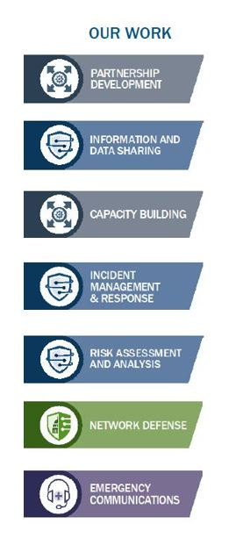
Cybersecurity & Infrastructure Security Agency
CISA leads the national effort to understand, manage, and reduce risk to our cyber and physical infrastructure.
CISA works with partners to defend against today’s threats and collaborate with industry to build more secure and resilient infrastructure for the future.
We connect our stakeholders in industry and government to each other and to resources, analyses, and tools to help them build their own cyber, communications, and physical security and resilience, in turn helping to ensure a secure and resilient infrastructure for the American people.

Slide 4
Critical Infrastructure Hazards
In today’s rapidly evolving threat environment, sources of strategic risk are widespread and include:

Slide 5
National Infrastructure Simulation & Analysis Center
Invests in research to build advanced analytic capabilities
Builds tools that inform risk mitigation and reduction nationwide
Empowers homeland security decision-makers with vital knowledge about the impacts and dependencies of systemic network risks
Works with expert performers to advance risk analysis and decision science around critical infrastructure and cybersecurity
The current NISAC performers are:
The NISAC is a statutorily defined program found in 6 USC 321
NISAC Investments
Subject Matter Expertise​
Data Maturation
Methodology Development​
Analytic Tools​
Capability Integration​
Threat and Consequence Modeling
Risk Architecture
MCTE
Sector Risk Modeling
Cyber Risk
Sectors
Decomposing National Critical Functions to the subfunctional/ system/ asset level
Water Modeling
Cyber Risk
PySCES
Squirrel
ERGO
Cyber Risk Framework
Cascading Consequences
Proximity Analysis

Slide 6
Research and Capability Development
National Infrastructure Simulation and Analysis Center (NISAC)
Invests in research to build advanced analytic capabilities
Builds tools that inform risk mitigation and reduction Nationwide
Empowers homeland security decision-makers with vital knowledge about the impacts and dependencies of systemic network risks
Works with expert performers to advance risk analysis and decision science around critical infrastructure and cybersecurity
Current NISAC Performers:
The NISAC is a statutorily defined program found in 6 USC 321

Slide 7
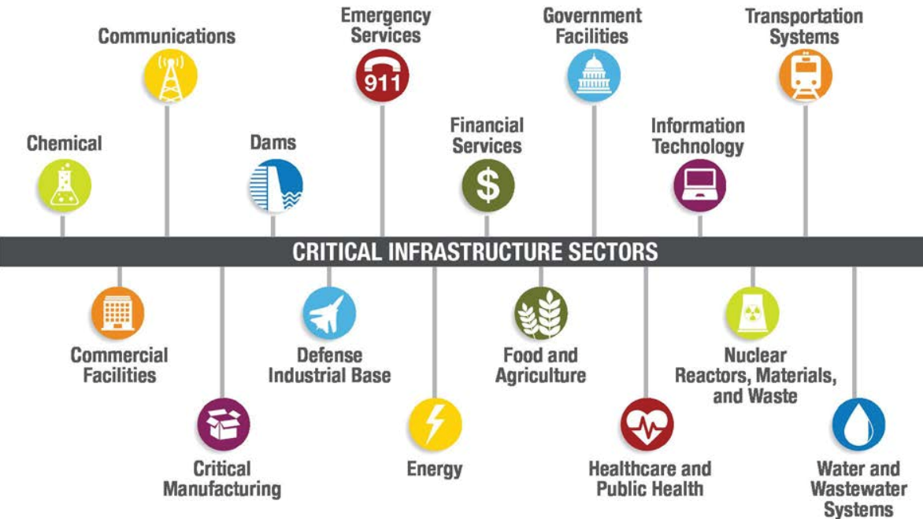
The Challenge of Risk Analysis at Scale
The cyber and physical infrastructure across the United States is a complex network of interdependent systems and assets that are categorized under the sixteen CI sectors.
An organization-centric view (the “who”) of CI provides insights into risk reduction and management activities and stakeholders but understanding cross-cutting and systemic risks to interdependent systems can be challenging.
An asset-centric view (the “how”) of CI highlights the hardware, software, and services that must be addressed to manage risk, but is likely too vast, dynamic, and distributed to fully enumerate and describe.
A third, functional view (the “what”) is required to assess risks to critical infrastructure at the national scale.

Slide 8
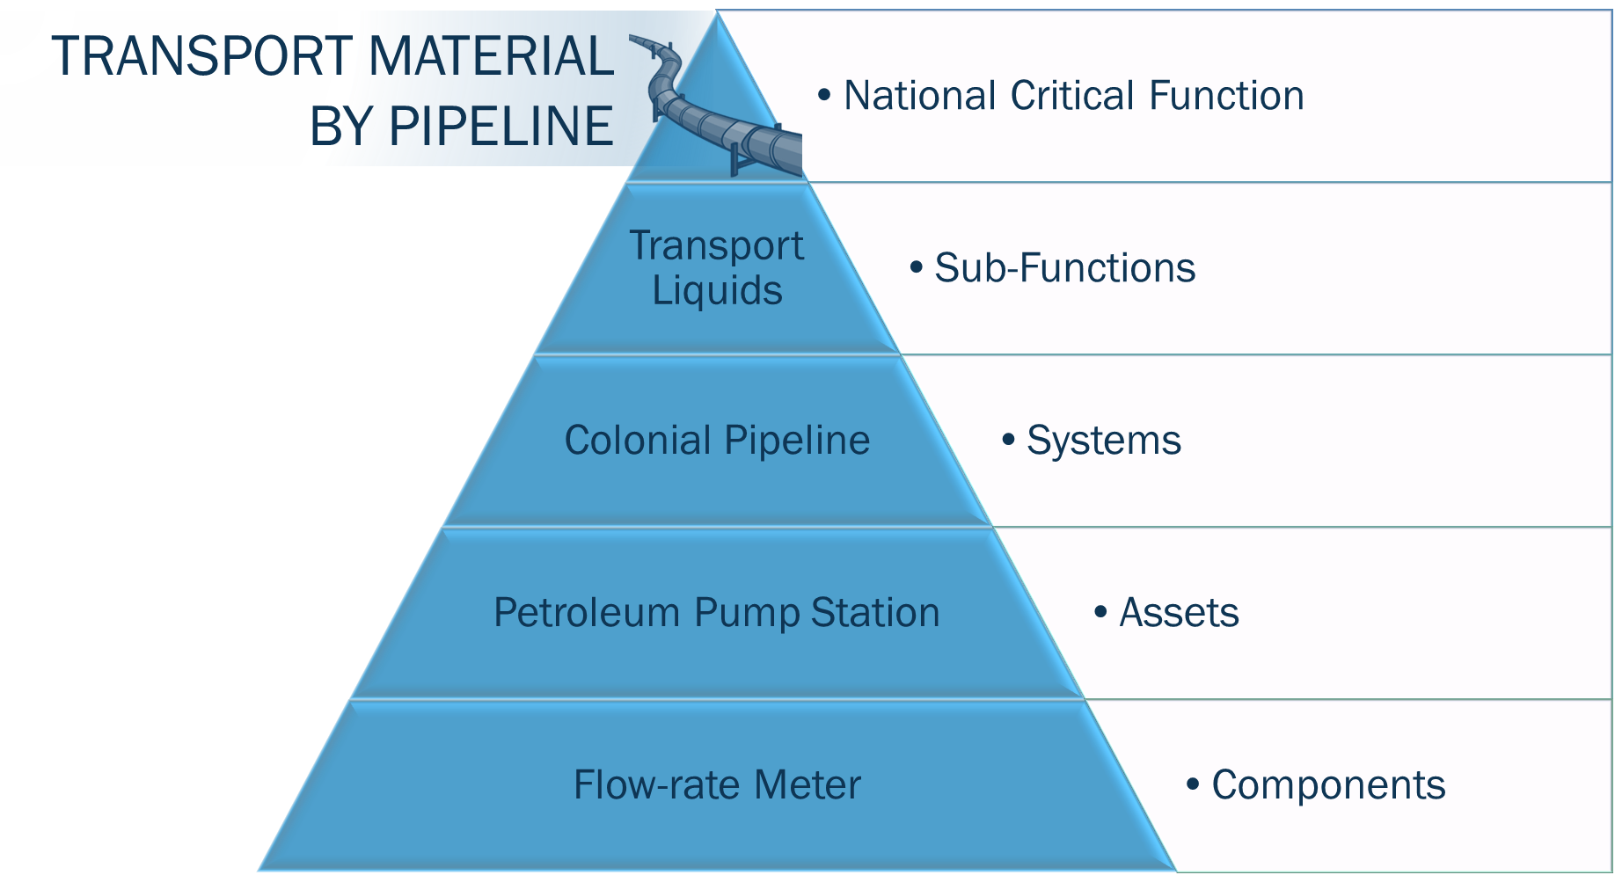
National Critical Functions Decomposition
NCFs are functions of government and the private sector so vital to the United States that their disruption, corruption, or dysfunction would have a debilitating effect on security, national economic security, national public health or safety
WHAT IS DECOMPOSITION?
Decomposition is an analytical approach to break down large, complex systems into smaller units of analysis
WHY DECOMPOSE THE NCFs?
Decomposition provides the ability to describe and analyze interdependencies to critical infrastructure
Decomposition reveals insight into the underlying infrastructure and dependencies that are key to functional resilience and helps identify potential vulnerabilities

Slide 9
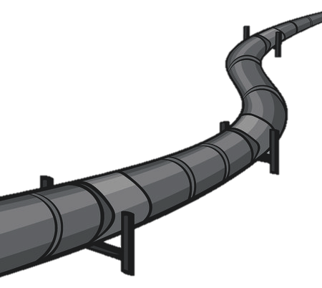
Functional Dependencies Cascading Across …
Transport Material by Pipeline
Transport Cargo and Passengers
by Road
Fuel Refining
and Processing
of Fuels
Store Fuel and Maintain Reserves
NCF Pathway
Generate
Electricity
Notes:
*these are all unique NCFs

Slide 10
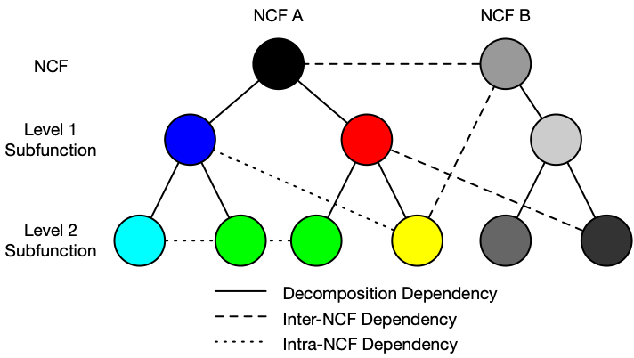
NCFs as a Functional Graph
The decomposition of NCFs identifies geographically, organizationally, and implementation agnostic functions and subfunctions that enable critical infrastructure.
Functions can be connected through dependencies that describe various types of relationships:
Transactions (how material, energy, info)
Logical Relationships
Constituency (is made up of)
The functions (nodes) and dependencies (edges) create a graph that can serve as a mathematical basis for performing key risk analytic functions:
Critical functions (e.g., node centrality)
Critical dependencies (e.g., highly connected sub-structures)
Cascading impacts (e.g., path analysis)

Slide 11
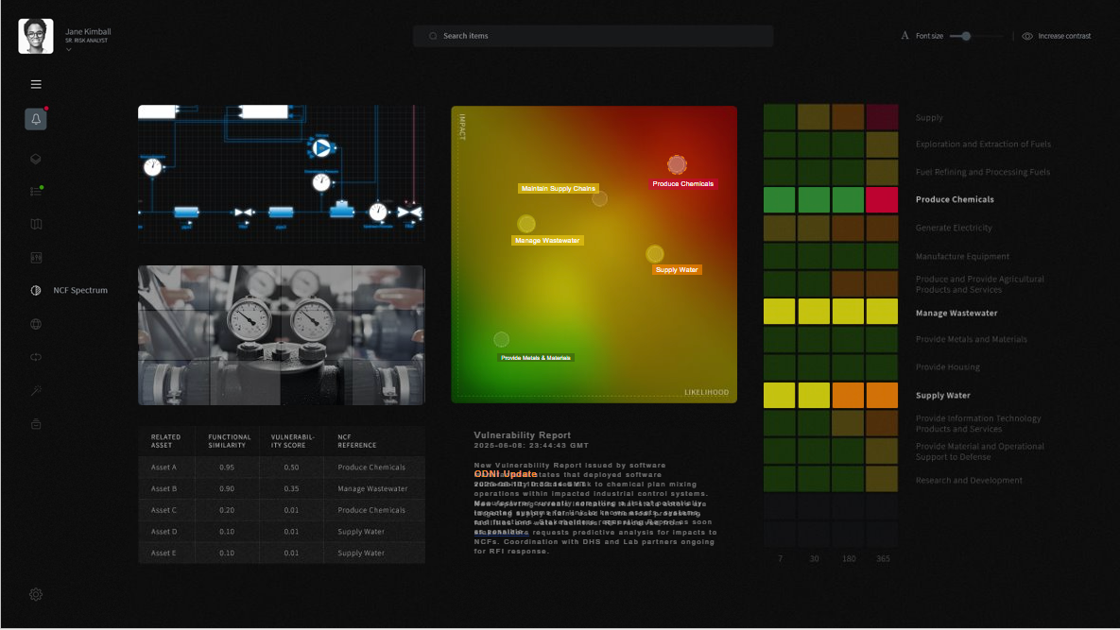
Suite of Tools for the Analysis of Risk (STAR)
Future: Fully
Integrated Risk
Analytic Engine for CISA
Next: Improved Risk Analytic Tools for NRMC
Now: Functional View of NCFs & Impacts
Original STAR Concept
The STAR is an engine of standard analytic tools, standards, and scenarios that leverage the NCF decomposition and dependency network to enable reproducible risk assessments, ensuring that analysis is forward-looking, defensible, compatible, and provides a basis for risk reduction.

Slide 12
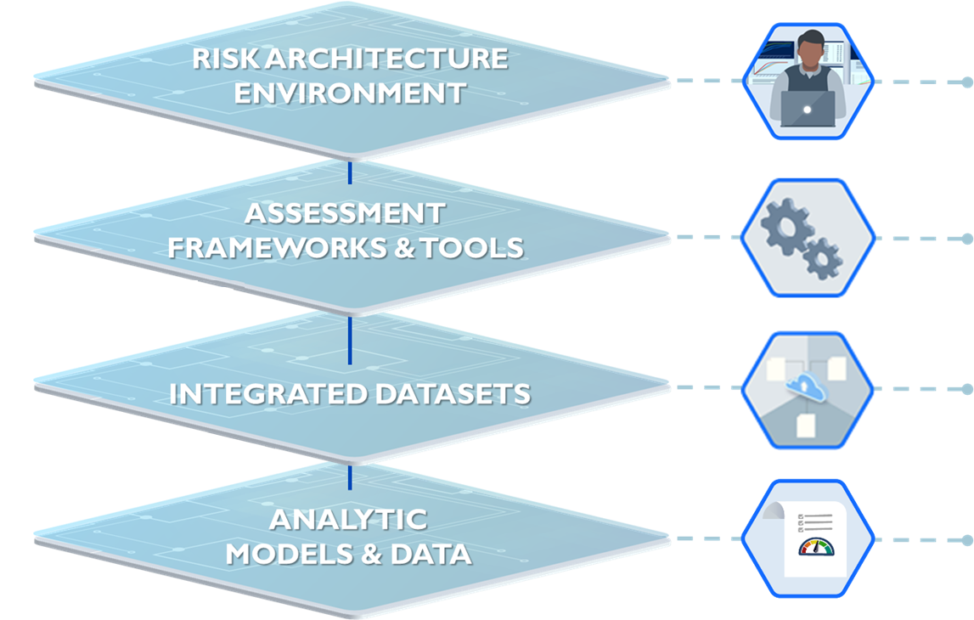
STAR Capability Layers
Environment: CISA/USG/CI communities interact with the Risk Architecture as a centralized, structured environment for assessing risk across critical infrastructure.
Assessment: Risk assessment frameworks, processes, and tools that enable analysts to generate results for internal and external stakeholders
Integration: Data generated from analysis efforts and previous assessments stored and curated according to a standard that assessments draw upon quickly.
Analysis: Detailed analytical efforts, methods, and models that create and use data in service assessments, responsively and in anticipation of needs.

Slide 13
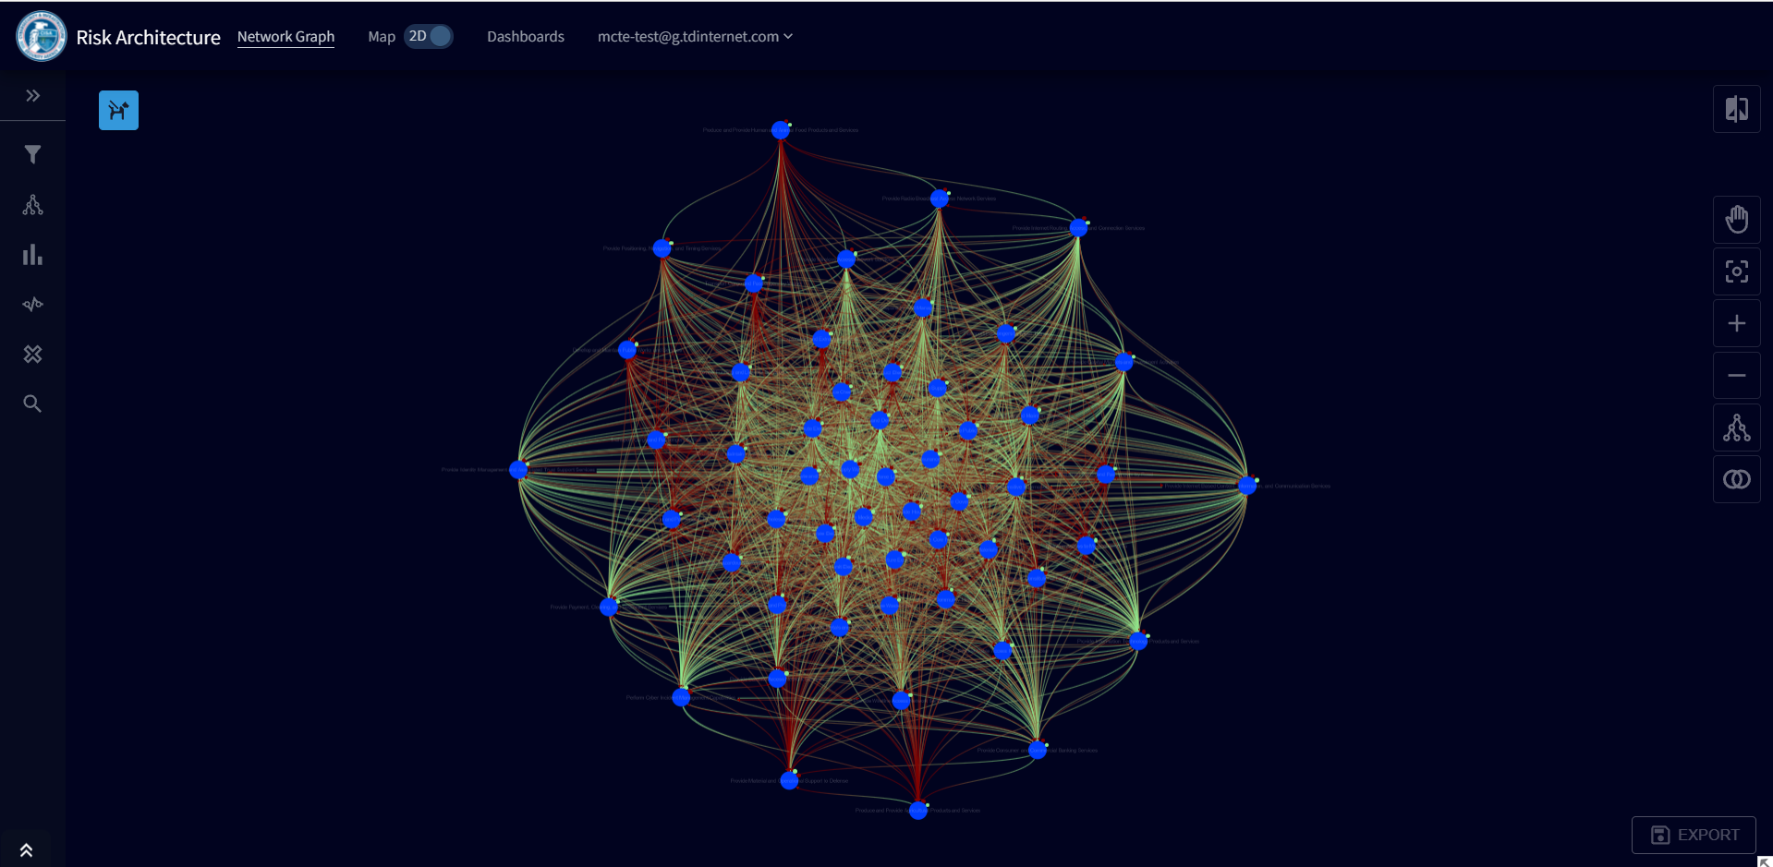
Proof of Concept (Year 1) Development
Y1 development focused on laying the foundation for advanced analytics through development of core RA capabilities:
Long term vision for STAR structure, content, and components
First User Story concepts and analyst workflow wireframes
First NCF Decomposition Database and FIRM tool build-out
Connections between NCF functions and assets
Requirements for STAR V1 tool and Use Case
STAR V1 Tool Proof-of-Concept and visualizations
Built upon existing capabilities for cataloguing and mapping assets and functions
Pipeline of future STAR capabilities (e.g., NCF pathways, hotspots, multigraph analysis, natural language processing for NCF ontologies, …)
Y1 accomplishments provide proofs-of-concept for several aspects of the STAR value proposition, including the use of NCF and subfunctions as a unit of analysis, inter-NCF dependencies, and NCF-to-asset connections.

Slide 14
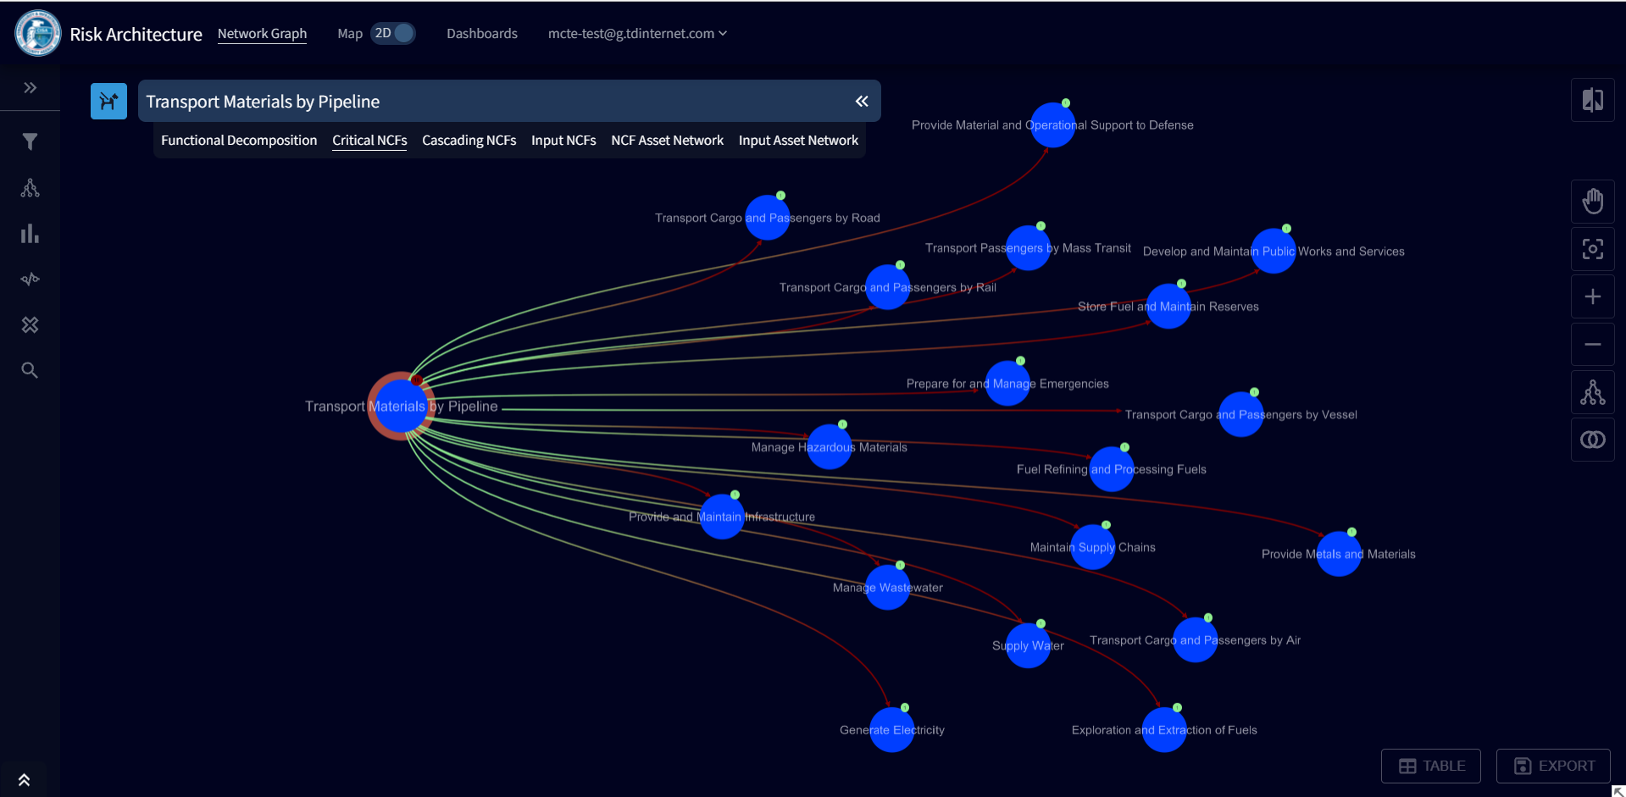
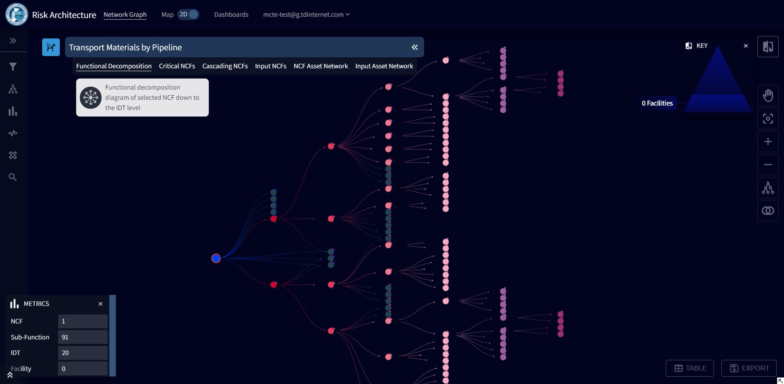
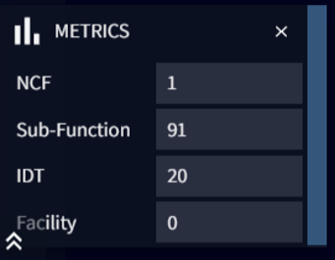
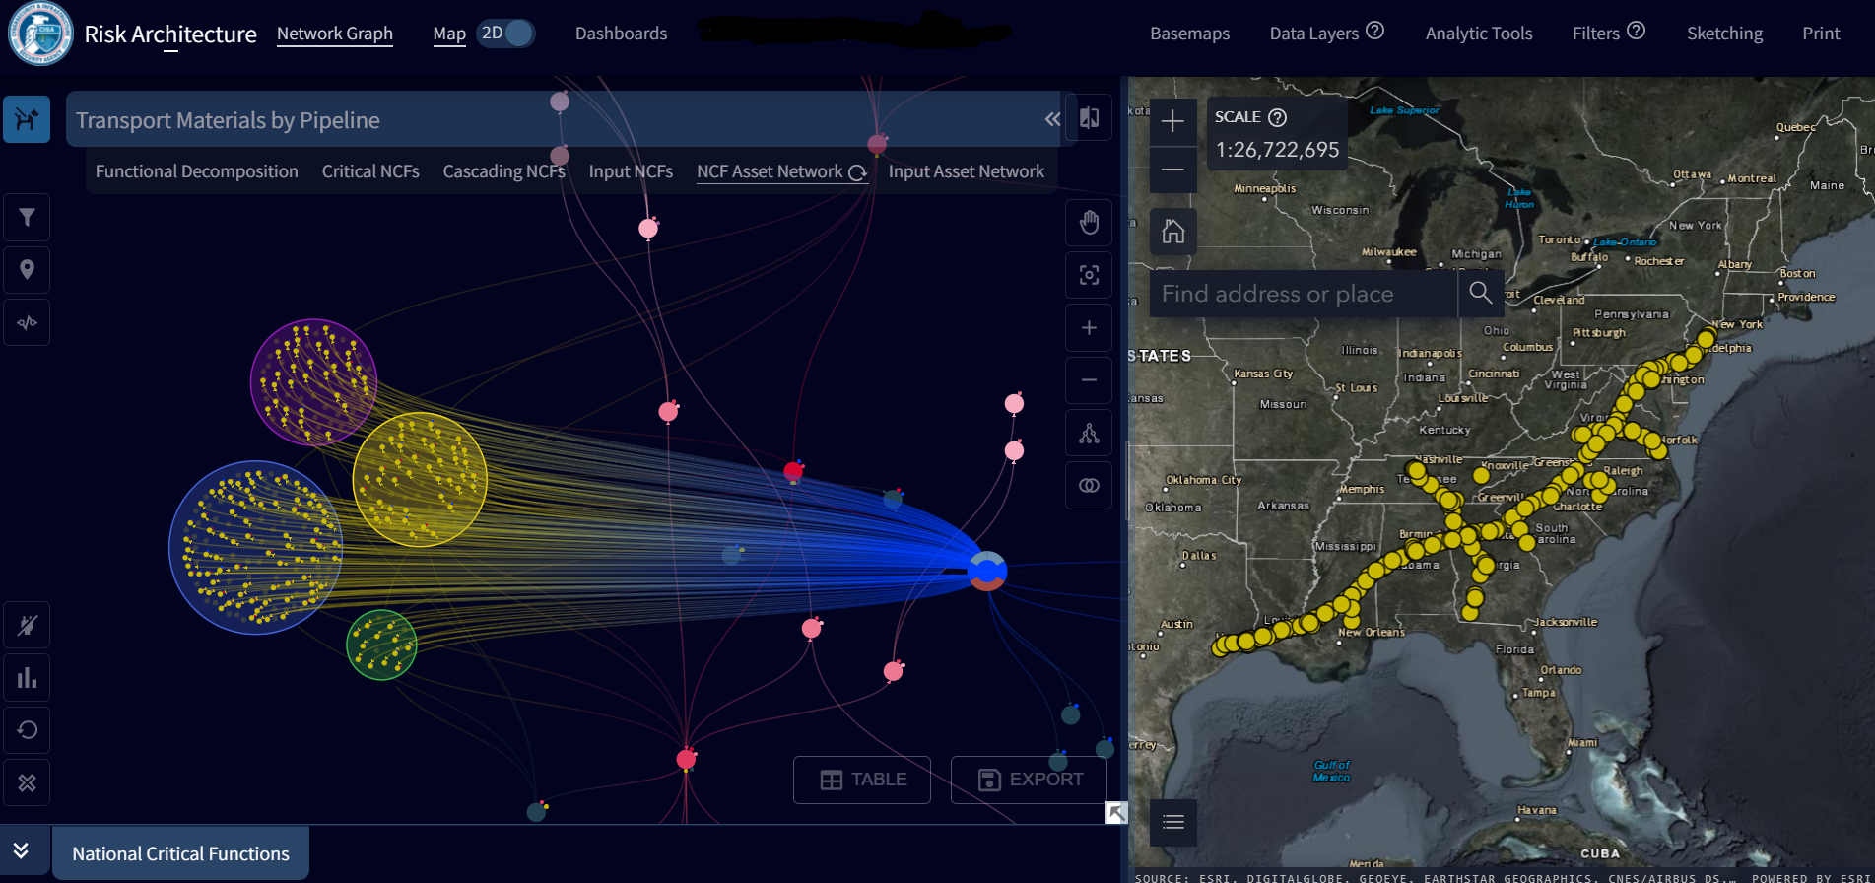
Proof of Concept (Year 1) Development
The STAR enables analysts to:
Have a consistent method to functionally describe critical infrastructure and disruption
Identify potential cascading impact pathways both upstream and downstream via the functional network of dependencies
Connect NCFs to real or virtual assets, and vice versa.

Slide 15
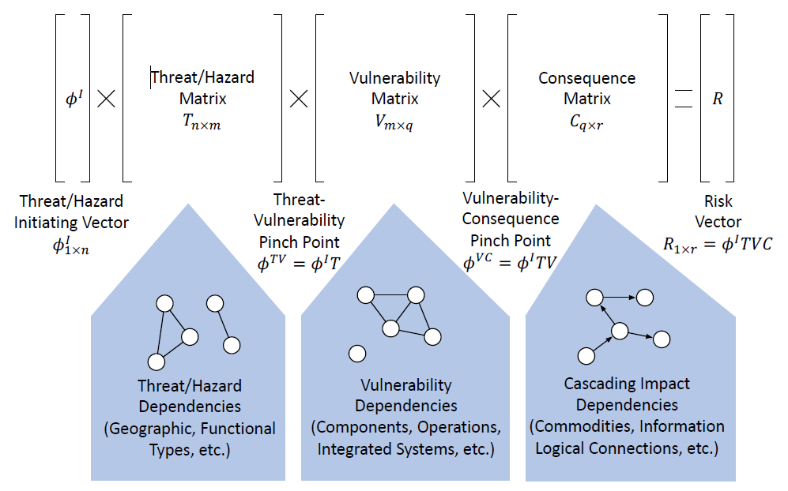
Matrix Formalizations of Risk
A rapidly calculatable approximate, aggregate risk profile over multiple hazard scenarios is enabled through matrix formalizations that induce separability (i.e., pinch points) in the state space of the event tree.
Creates a trade-off between pragmatism and conditionality or accuracy.
How accurate is ‘accurate enough’ to be fit for purpose?
What is the optimal pinch-point state space?
How can T, V, and C matrices be further decomposed?
How do mod/sim/data feed these matrices?
See: Kaplan, “Matrix Theory Formalism for Event Tree Analysis:
Application to Nuclear Risk Analysis,” 1982

Slide 16
The Way Ahead
The National Risk Management Center is developing the Suite of Tool for the Analysis of Risk (STAR) to enable better identification and analysis of CI risk through the functional lens of the NCFs.
Novel approaches and capabilities are needed to fully realize NRMCs vision of an end-to-end, all-hazards risk analysis that can inform risk reduction efforts across the nation’s critical infrastructure.
Scalability
Graph Analytics
Model/Data Integration
Matrix Formalizations
Approximation Methods
Frameworks & Standards
Scenario Standardization
Results Aggregation
Network Path Analysis
Critical Node Identification
Automated Graph Discovery (Data Analytics, ML & NLP Methods, etc.)
Improved Infrastructure & Hazard Models
Multi-mode and Cascading Impact Models
Asset-to-function Linking

Slide 17
Authors
Jason Reinhardt
Merideth Secor
Lauren Wind
Jeffrey Munns
Derek Koolman, II
Ray Ludwig
Ron Lafond
Lindsey Miles

Slide 18
For more information:
www.cisa.gov
Questions?
Email: jason.reinhardt @associates.cisa.dhs.gov
Senior Advisor for Risk Sciences
Analysis Division

