Slide 1
Probabilistic Evaluation of Critical Scenarios with Adaptive Monte Carlo Simulations Using the Software Tool SUSA
Dr. Jan Soedingrekso Dr. Tanja Eraerds, Martina Kloos, Jörg Peschke, Josef Scheuer
Gesellschaft für Anlagen- und Reaktorsicherheit (GRS) gGmbH, Garching, Germany
PSAM16 – Probabilistic Safety Assessment and Management Honolulu, HI, USA, June 26 to July 1, 2022

Slide 2
Motivation: Analysis of rare Events
BEPU (Best-Estimate Plus Uncertainty)
Variation of uncertain Simulation Parameters
Monte Carlo Sampling
SUSA (Software tool for Uncertainty and Sensitivity Analysis)
Problem for rare Events
Large amount of (unnecessary) Simulations
Adaptive Sampling

Slide 3
Adaptive Sampling - Idea
Create initial training dataset (parameter set + simulation)
Train metamodels on training dataset
Sample new parameter sets
Use metamodels to predict simulation result
Identify best candidates of parameter sets
Run simulation
Extending the training dataset
Check termination
Terminate or go back to Step 2

Slide 4
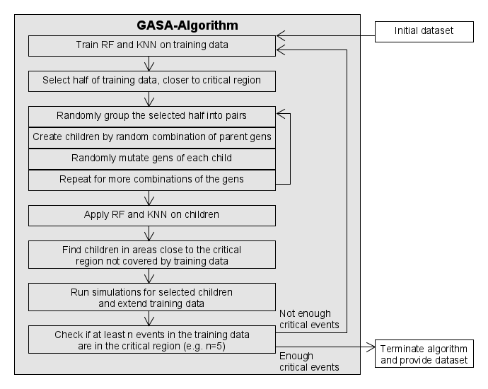
GASA-PRECLAS Algorithm (1)
Genetic Adaptive Sampling Algorithm
Generate training dataset with sufficient candidates in critical region

Slide 5
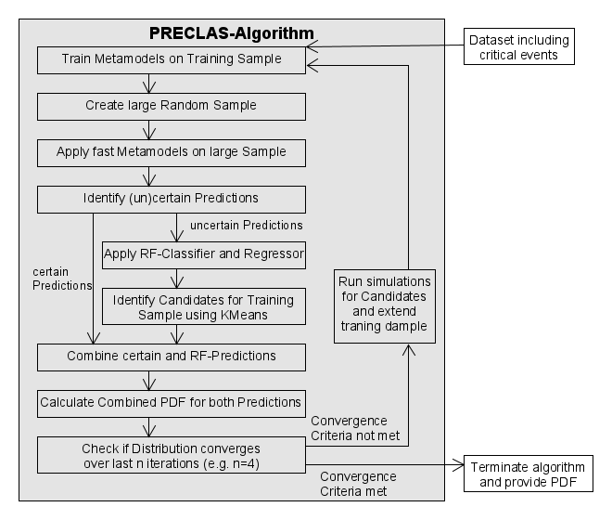
GASA-PRECLAS Algorithm (2)
Probability estimation using an Ensemble of Classification algorithms
Extend training dataset to improve metamodels for precise probability estimation

Slide 6
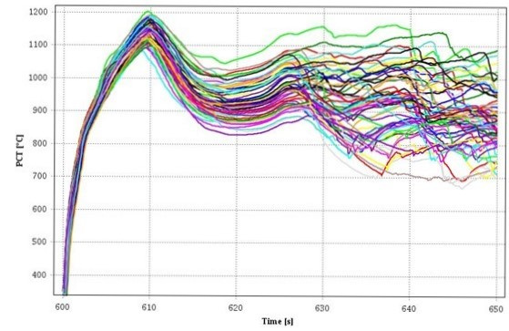
Loss Of Cooling Accident (LOCA)
Reference Model in ATHLET (version 3.2)
Pressurized Water Reactor of 1425 MW
Double ended guillotine break
Goal: Probability of Peak Cladding Temperature (PCT) above 1200 °C

Slide 7
Development of Iterations
GASA Algorithm
Generate 20 children / parent
Select 8 candidates per iteration
Termination after 2 Iterations with 5 critical events
PRECLAS Iterations
https://www.bundeswehr.de/de/ausruestung-technik-bundeswehr/luftsysteme-bundeswehr/sikorsky-ch-53
Iteration | PCT > 1200 | PCT < 1200 | Mean | Median | $$σ$$ | δ
0 | 5 | 60 | 4.35 E-03 | 3.65 E-03
… | … | … | … | … | … | …
6 | 16 | 108 | 1.24 E-02 | 1.23 E-02 | 0.27 | 1.08
7 | 18 | 116 | 1.51 E-02 | 1.50 E-02 | 0.19 | 0.62
8 | 20 | 124 | 1.83 E-02 | 1.82 E-02 | 0.20 | 0.63
9 | 22 | 131 | 1.54 E-02 | 1.54 E-02 | 0.14 | 0.48

Slide 8
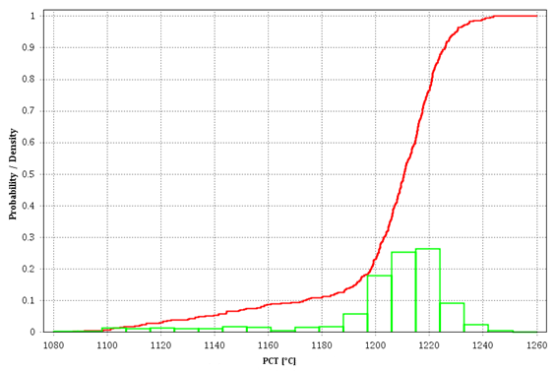
PCT Distribution using Adaptive Sampling
Most simulations lead to a PCT around the threshold of 1200 °C.

Slide 9
Conclusion
3 Adaptive Sampling Methods implemented in SUSA
GASA-PRECLAS, SuSSVR, Gaussian Process
Application inside LOCA Analysis
Classic MC Sampling: [4.22 E-04, 8.94 E-02]
Adaptive Sampling: [8.16 E-03, 9.36 E-03]
To obtain the same precision of Adaptive Sampling with classic MC Sampling, ~100.000 Simulations are required.

Slide 10
Thank you for your attention!
For further questions, please contact
Jan Soedingrekso jan.soedingrekso@grs.de

