Slide 1
Challenges and Opportunities to Implement Advanced Probabilistic Safety Assessment (PSA) Approaches and Applications for Nuclear Power Plants
Ruslan MINIBAEV & Jorge LUIS HERNANDEZ
Safety Assessment Section
Division of Nuclear Installation Safety
Department of Nuclear Safety and Security
International Atomic Energy Agency
Probabilistic Safety Assessment and Management PSAM 16
June 26 - July 1, 2022, Honolulu, Hawaii

Slide 2

IAEA TECDOC
“Advanced Probabilistic Safety Assessment (PSA) Approaches and Applications for Nuclear Power Plants”
Includes several PSA topics
Describes basic information for each topic
Current status and experience in IAEA Member States
Reflects main issues and challenges

Slide 3

Contents
Advanced methods and approaches in PSA
  Dynamic PSA
  Software Reliability and Modelling in PSA
  Incorporation of Ageing Aspects in PSA
Approaches in applications of PSA
  Use of Level 2 PSA in Development of SAMG
  Combination of Hazards
  Modelling of Portable Equipment
Level 3 PSA
Conclusions

Slide 4
Advanced Methods and Approaches in PSA: Dynamic PSA
Event types by their dynamic impact
Non-dynamic events: Some relevant condition is reached or the need for some action is identified
  Examples: an automatic action is demanded,
  a pressure limit is reached ...
Dynamic events: A change in the course of a transient,
i.e., a change of the dynamic laws (model equations)
  Examples: an initiating event, a protection actuation ...
Event types by their occurrence time
Non-stochastic events: Linked to dynamic conditions
Examples: automatic protection, alarm signal ...
Stochastic events: Occurring at uncertain times
  Examples: operator action, hydrogen burn-up ...

Slide 5
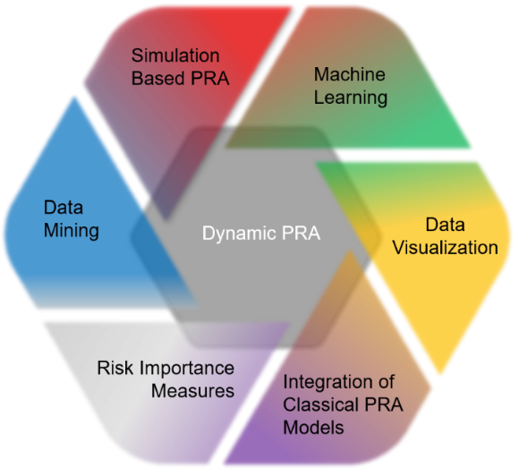
Advanced Methods and Approaches in PSA: Dynamic PSA - Challenges and Issues
  Dynamic PSA can require a higher degree of complexity than classical PSA
  Dynamic PSA is not yet considered in current practice for regulatory oversight
  Dynamic PSA codes development has increased in recent years supported by research programmes and computer improvements
  Application of Dynamic PSA methodology
  and codes has been used in the industry
  for selected accident analysis sequences
  to provide more realistic risk simulations
  Dynamic PSA methodology can be
  applied for Level 1, Level 2 and Level 3
  PSA

Slide 6
Software Reliability and Modelling in PSA
Failure rate
All NPPs (especially new designs) depend on digital I&C and the related software
Important for safety: software failure may lead to catastrophic consequences
Hardware
Failure rate
Software
It cannot be “inspected” visually
Software can be affected by “ageing” and at the same time
it does not wear out
Possible software updates can lead to an increase, or, conversely, to a decrease of reliability
Hierarchy structure of digital systems
6
Notes:
First bullet: I&C-Instrumentation and Control

Slide 7
Software Reliability and Modelling in PSA: Challenges and Open Issues
  Substantial complexity (depends on detail level)
  Reliability data for hardware & software (also CCF parameters)
  Consideration of reliability changes due to software updates
  Consideration of reliability changes due to “ageing”
  Significant uncertainty
  Human-machine interface
  Cyber security
  Lack of consensus between I&C designers and PSA specialists
Notes:
Second bullet: CCF-Common Cause Failures

Slide 8
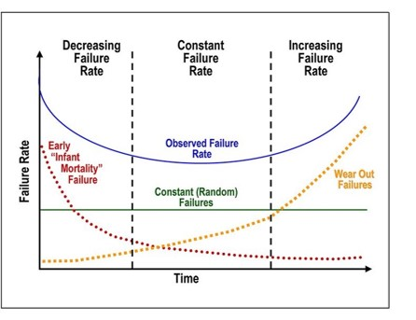
Incorporation of Ageing Aspects in PSA:
Why Consider Ageing Aspects in PSA?
  Assumption on a simplified component reliability model, where lambda is constant, it is not realistic
  for aged components
  Ageing aspects could induce additional dependencies
  Current PSA models generally neglect passive components (e.g. pipe supports, cables, civil structures), as they have a very low failure probability;
  however, they might have an increased
  importance due to ageing effects
  Contributes to IRIDM for modifications
  and maintenance activities as well as
  on PSR and AMP for LTO.
Notes:
Last bullet: IRIDM-Integrated Risk Informed Decision Making, PSR-Periodic safety Review, AMP-Ageing Management Programme, LTO-Long Term Operation

Slide 9
Incorporation of Ageing Aspects in PSA:
Challenges and Open Issues
  Incorporation of ageing aspects in PSA could lead to
  high complexity of models and will require more resources
  Appropriate data: A realistic APSA requires more information than a traditional PSA model, and data
  need to be available, sufficient, and of good quality
  Methodology for incorporating ageing aspects in PSA have been developed and demonstrated [ref. JRC
  APSA Project], but not widely used yet
  Selection and prioritization of SSCs to
  be modelled is needed
  Uncertainties related to long prediction
  periods
Notes:
Second Bullet: APSA-Ageing Probabilistic Safety Assessment
Third Bullet: JRC-Joint Research Centre
JRC

Slide 10
Combinations of Hazards
  Potential synergistic effects of the combinations of hazards might have a stronger impact on plant safety than each individual hazard by its own
  The affected area can cover a large area surrounding a nuclear site with a damage or destruction of the infrastructure (roads, electrical grid, etc.)
  Hazards
  Consequential (Subsequent) Hazards
  Unrelated (Independent) Hazards
  Corelated Hazards
  Combinations

Slide 11
Combinations of Hazards:
Challenges and Open Issues
  Resources and national legislative framework
  Scope of assessment depends on methodological approach applied
  Systematic and comprehensive screening criteria is
  a key issue
  Screening vs completeness
  Combination of hazards requires a careful PSA modelling since multiple failures might occur as part of the initiating event and opposite when modelling in PSA
  a single initiating event originating from
  a single hazard
Source:: OECD/NEA

Slide 12
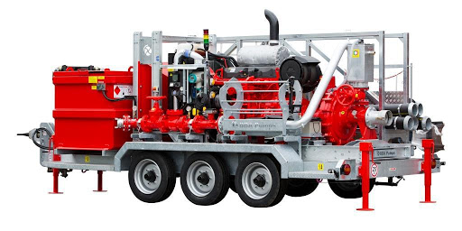
Modelling of Non-Permanent Equipment: Current Status
  Modelling of portable equipment in PSA has been identified as an important issue in many Member States
  Despite being outside design basis, modelling of portable equipment in PSA provides important risk reductions
  Member States (e.g., Belgium, Canada, France, Korea, Russia, USA) have introduced portable equipment in their PSA models
  Operators have developed documents to model portable equipment in PSA while regulators have modified their oversight process to consider the associated enhancement of safety
  However, additional guidance is needed to support the modelling of particularities of HRA in PSA
  related to portable equipment
Notes:
The Term “non-permanent equipment” is equivalent to portable equipment, Emergency Mitigating Equipment (EME) or Diverse and Flexible Mitigation Capability (FLEX) portable equipment.
Last bullet: HRA-Human Reliability Analysis

Slide 13
Modelling of Non-Permanent Equipment: Challenges and Open Issues
  Insufficient data for non-permanent equipment and HRA
  HRA for non-permanent equipment is more complicated than for permanent equipment
  Considerations of test vs real demands
  Impact of external hazards needs to be considered such as debris removal
  Minor failures might be assessed using sensitivity studies related to timing
  Number of various scenarios

Slide 14
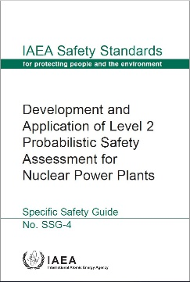
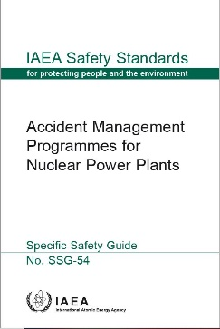
Level 2 PSA for Development of SAMGs: Challenges and Open Issues
  Modelling of severe accident phenomena.
  Modelling of severe accident management provisions and assessment of their impact on the progression of the accident
  Level of detail and accuracy of system modelling
  Human reliability analysis
  Modelling of the containment function
  Modelling of radioactive releases

Slide 15

Level 3 PSA: Current Status
  Methodology for conducting Level 3 PSA exists in some Member States
  Applicable to a multi sources PSA at a site level
  Important to consider trans boundary aspects
  Recent works and references have been issued in different Member States
  A specific IAEA Safety Guide on Level 3 is not yet available
  Full or partial Level 3 PSA is currently being developed and applied for different applications such as siting of nuclear installations, supporting IRIDM, EPR, EIA, etc.
Notes:
Last bullet: IRIDM-Integrated Risk Informed Decision Making, EPR-Emergency Preparedness and Response, EIA-Environmental Impact Assessment

Slide 16
Level 3 PSA: Challenges and Open Issues
  Misunderstanding of benefits in terms of safety improvements and absence of regulatory framework
  or enforcement
  Risk metrics and communication of results
  Extensive data required and codes capabilities
  Level 3 PSA feedback could be used for Level 1 and Level 2 PSA in terms of selection of more effective mitigation and prevention strategies
  Request resources and assessment of uncertainties, including propagation of uncertainties and conservatisms from Level 1 and Level 2 PSA
  Definition of geographical and temporal scope, and of
  a suitable representative person,
  including low dose issues modelling
  consideration

Slide 17
Conclusions
This project has explored seven advanced PSA topics (methods and approaches) that expand the scope of traditional (classical) nuclear power plant PSA as practiced in Member States
For all topics, the advanced methods and approaches are:
  likely to provide improved realism, improved characterization of uncertainties, and improved support for practical IRIDM (incl. the conduct of drill exercises and decision-making during accidents
  as well as changes in plant design and operation)
  expected to be used to complement deterministic safety analysis and safety assessment, in accordance with the IRIDM philosophy
  expected to be developed and implemented following a graded approach
For some topics, e.g. combined hazards and non-permanent equipment, the improvements and associated benefits are likely to be realized in the near term
For other topics, due to a variety of challenges, improvements and benefits are likely to be longer term, presuming of course that efforts continue

Slide 18
Acknowledgements
The authors acknowledge the outstanding support provided by experts from IAEA Member States involved in drafting a TECDOC on “Advanced Probabilistic Safety Assessment (PSA) Approaches and Applications for Nuclear Power Plants”:
Brinkman, J. L., NRG, Arnhem, The Netherlands, brinkman@nrg.eu
Jeon, H., Korea Hydro & Nuclear Power, Daejeon, Korea, jeonhojun@khnp.co.kr
Guigueno, Y., IRSN, Fontenay-aux-Roses, France, yves.guigueno@irsn.fr
Hortal, J., Consultant, Madrid, Spain, jav.hortal@gmail.com
Mandelli, D., Idaho National Laboratory, Idaho Falls, ID, USA, diego.mandelli@inl.gov
McLean R., Bruce Power, Toronto, ON, CANADA, rob.mclean@brucepower.com
Nitoi, M., RATEN ICN, Mioveni, Romania, mirela.nitoi@nuclear.ro
Röwekamp, M., Gesellschaft für Anlagen- und Reaktorsicherheit (GRS) gGmbH, Köln, Germany, Marina.Roewekamp@grs.de
Schneider, R., Westinghouse Electric Corporation, Windsor, CT, USA, schneire@westinghouse.com
Siu, N., Consultant, North Potomac, MD, USA, nosiubiz@gmail.com

Slide 19
Thank you for your attention.
Questions?
Ruslan MINIBAEV (r.minibaev@iaea.org)
Jorge LUIS HERNANDEZ (j.luis-hernandez@iaea.org)
Notes:
Thank you!

