Slide 1
Risk-Informed Approach for Regulatory Approval of Microreactor Transport
Garill Coles
Notes:
This presentation is about a proposed risk-informed approach for regulatory approval of microreactor transport with its irradiated fuel contents.
What makes this interesting and challenging is that it pertains to a nuclear concern that is neither fish or fowl.., right? We know how to regulate the safety of a cited stationary reactor and a uniformly shaped transportation package. But this is not quite neither.

Slide 2
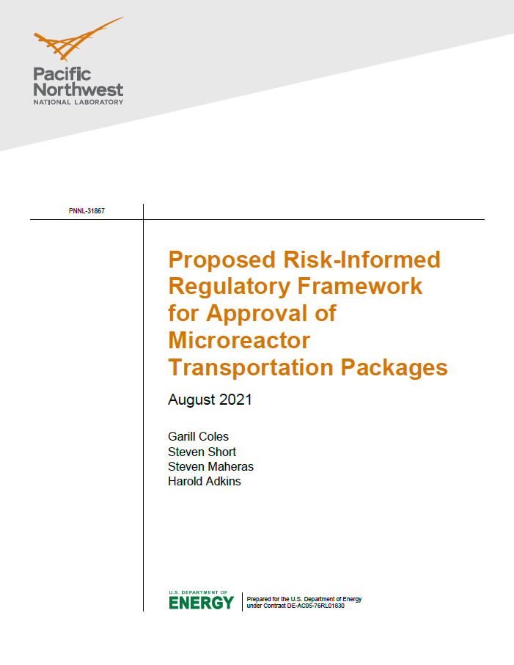
Overview
Last year PNNL developed a risk-informed regulatory framework for licensing the transportation of a microreactor with its fuel contents (PNNL-31867)
  Under Nuclear Regulatory Commission (NRC) review
PNNL is currently performing trial implementation of a major element of the framework for the DOD Strategic Capabilities Office (SCO) Project Pele which is a PRA of transportation of the TRISO fueled microreactor
Key elements discussed here today:
  Proposed regulatory approach for initial unit
  Proposed risk acceptance guidelines
  Proposed risk assessment approach
Notes:
Last year PNNL developed a risk-informed regulatory framework for licensing such transportation. See our PNNL report on the right-hand side with my co-authors.
This year PNNL is performing a trial implementation of a key element of the framework for Project Pele, the DoD project, which consist of a transportation PRA of a TRISO fueled < 5 mW microreactor. (Of course, TRISO fuel is high-assay low-enriched uranium fuel made of ceramic particles encased in a graphite compact that is highly resistant to temperature)
The key elements I’m going to discuss today are our:
Proposed regulatory approach – at least for the initial units
Our proposed risk acceptance guidelines
And our proposed risk assessment approach

Slide 3
Proposed Regulatory Approach
US transportation regulatory requirements contained in 10 CFR Part 71 largely focus on the definition for thick-wall steel vessel (transportation package)
A microreactor with its irradiated or unirradiated fuel contents is unlikely to meet the codified regulatory requirements in 10 CFR 71
If Fissile Material or Type B package requirements cannot be directly met, then other package approval options are possible:
  10 CFR 71.41(c) Alternative Environmental and Test Conditions (10-160B and 8-120B Transportation Casks)
  10 CFR 71.41(d) Special Package Authorization (West Valley Melter Package)
  10 CFR 71.12 Exemption (Trojan Reactor Vessel)
Preferred initial pathway identified by PNNL is the Exemption process that allows compensatory actions to protect basis of exemption if acceptable risk is demonstrated
  Can apply to multiple shipments unlike Special Package Authorization
  Flexibility in deviating from deterministic requirement compared to Alternative Environmental and Test Conditions
Regulatory change may be needed in the future for more frequent or multiple transports
Notes:
Concerning the regulatory approach, federal requirements for transport of radiological material largely focus on thick-walled steel transportation packages – like casks.
But a microreactor package with its contents is unlikely to meet the codified requirements of 10 CFR Part 71
However, if the test requirements cannot be met, then other regulatory pathways are possible which are listed along with examples of past use.
The Alternative Environmental and Test Conditions option
The Special Package Authorization option
And the Exemption Process – if acceptable risk can be demonstrated through compensatory actions
The Exemption process is viewed by PNNL as the preferred process for at least the initial units because:
It can be applied to multiple shipments unlike the Special Package Authorization option
And there is flexibility in deviating from deterministic requirements compared to Alternative Environmental and Test Conditions option

Slide 4
Proposed Risk Acceptance Guidelines
Demonstration of acceptable risk will require a quantitative risk assessment given the complexities and uncertainties about package performance and potential risk to public:
The benefit of risk acceptance guidelines is that they provide a key basis in support of risk-informed regulatory decisionmaking
However, regulatory risk evaluations guidelines do not exist for transportation packages like they do for nuclear power plants (NPPs)
NRC proposed guidance in a risk-informed decision making (RIDM) report for nuclear material and waste applications (ML08072038).
  These are based on quantitative health objectives and guidelines developed from the Safety Policy Statement (QHOs and QHGs)
  However, challenges remain in its implementation and the approach has not been endorsed for use by NRC as that would be a policy decision
Notes:
This slide introduces the topic of risk acceptance guidelines.
PNNL contends that demonstration of acceptable risk (if the exemption process is used) will require a quantitative risk assessment given the complexities and uncertainties about package performance and potential risk to public.
The benefit of risk acceptance guidelines is that they provide a key basis in support of risk-informed regulatory decisionmaking
However, regulatory risk evaluations guidelines do not exist for transportation packages like they do for nuclear power plants (rather requirements are deterministic)
That said, NRC has proposed guidance in a risk-informed decision making (RIDM) report for nuclear material and waste applications (easiest to find by its ML number in the slide)
This guidance includes quantitative health guidelines developed from the 1986 NRC Safety Policy Statement
However, challenges remain in implementing the guidance and the approach has not been endorsed for use by NRC (that would be a policy decision)

Slide 5
Proposed Risk Acceptance Guidelines
NRC Proposed QHGs Based on Interpretation of Safety Policy Statement
Receptor | Acute Fatality | Latent Cancer Fatality | Serious Injury (Cancer Illness)
Public | QHG-1 - Public individual risk of acute fatality is negligible if it is less than or equal to 5×10⁻⁷ fatality per year. | QHG-2 - Public individual risk of a LCF is negligible if it is less than or equal to 2×10⁻⁶ fatality per year or 4 mrem per year | QHC-3 - Public individual risk of serious injury is negligible if it is less than or equal to 1×10⁻⁶ injury per year.
Worker | QHG-4 - Worker individual risk of acute fatality is negligible if it is less than or equal to 1×10⁻⁶ fatality per year. | QHG-5 - Worker individual risk of LCF is negligible if it is less than or equal to 1×10⁻⁵ fatality per year or 25 mrem per year. | QHG-6 - Worker individual risk of serious injury is negligible if it is less than or equal to 5×10⁻⁶ injury per year.
The premise of the 1986 NRC Safety Goal Policy is that risk to people from a nuclear power pant should be very small compared to the sum other accident risk (e.g., 0.1% prompt fatality)
The Safety Goal does not specifically address workers, so the RIDM report proposes that worker risk be small compared to other risk but not as small as for the public who are not trained in radiation protection
Notes:
The premise of Safety Goal Policy on which the RIDM report proposal is based is that risk to people from nuclear power should be very small compared to the sum other accident risks (e.g., 0.1% of prompt fatality)
The Safety Goal does not specifically address workers, but the RIDM report proposes that worker risk be small compared to other risk but not as small as for the public who are not trained and equipped in radiation protection.
So, in the table shown I’ve organized the proposed Quantitative Health Guidelines into 3 levels of harm (Acute Fatality, Latent Cancer Fatality, and Cancer Illness) and the different criteria proposed for the Public and for the Worker. The basis for these criteria values are all worked out in the RDIM report.

Slide 6
Surrogate Measures for Proposed Risk Acceptance Guidelines
Levels of NPP PRA include Level I (CDF/LERF), II (release), and III (health effects)
However, NPP PRAs (which are mature and well used) are not typically taken to Level III, but rather use the surrogates of CDF and LERF for risk informed applications because they are more attainable (see Regulatory Guide 1.200)
PNNL proposes using surrogates for the QHGs suggested by the RIDM report by formulating goals in terms of radiological dose and likelihood:
  Reduction in calculational burden by eliminating conversion to health effects
  Dose limits can be compared to other federal/international dose limits used in related contexts
  Determining likelihood and consequence separately provides a greater level of information for decisionmaking
PNNL examined the use of dose consequence-likelihood pairs for other applications
  Nuclear Energy Institute (NEI) 18-04 guidance for risk informed licensing basis development for advanced nuclear reactors
  DOE-STD-3009 semi-quantitative risk ranking in support of nuclear safety basis for nonreactor facilities
  IAEA Q system that defines radionuclide quantities allowed in Type A packages (A₁ and A₂ quantities)
Notes:
In PRA of a nuclear power plant, there are levels of analysis. Level 1 - determination of core damage frequency (CDF) and large early release fraction LERF)), Level 2 quantification of release of radiological material, and Level 3 - determination of health effects from the potential releases.
However, nuclear power plant PRAs (which are now mature and used for risk informed applications) are not typically taken to Level III, but rather use the surrogates of CDF and LERF to support risk informed applications because these values are more attainable (The basis for the acceptance of these surrogates is spelled out in NRC Regulatory Guide 1.200)
In like vein, PNNL proposes use of surrogates for the QHGs suggested by the RIDM report by formulating goals in terms of radiological dose and likelihood. This provides some advantages such as:
Reduction in calculational burden
The dose limits can be compared to other federal/international dose limits used in related contexts for perspective
Determining likelihood and consequence separately provides a greater level of information for decisionmaking (rather than combining them into an expected value)
PNNL examined the use of dose consequence-likelihood pairs from other applications
Nuclear Energy Institute (NEI) 18-04 guidance for risk informed licensing of advanced nuclear reactors that uses this concept (which I am going to show in the next slide)
DOE-STD-3009 uses this concept in their semi-quantitative risk ranking approach in support of nuclear safety for nonreactor facilities
Guidance for the IAEA Q system that defines radionuclide quantities allowed in a Type A packages define the accident analyses methods (In Appendix I) and an allowed dose to come up with the A1 and A2 quantities.

Slide 7
Surrogate Measures for Proposed Risk Acceptance Guidelines
Frequency-Consequence Targets from NEI 18-04, Revision 1
Illustration of the concept of risk evaluation guidelines based on the combination of radiological dose and likelihood
Notes:
The most sophisticated example (of the three cited) of our proposed concept (which is based on the combination of dose and likelihood limits) is this figure from NEI 18-04 of the Frequency-Consequence Targets. Accidents whose consequences and likelihood fall above the blue line in the plot are considered risk significant (and not acceptable as is), and accidents whose consequences and likelihood fall below the blue line in the plot are considered less risk significant (and may not require further attention.) So, risk is controlled to below the blue line. NRC has endorsed this approach but provides the caveat that this figure does not represent risk acceptance criteria.
The bases for establishing the blue-line starting with the high-frequency, low consequence events in the upper-left hand corner to the low-frequency, high consequence events on the lower right-hand corner are provided in the NEI report and includes reference to related applicable federal requirements and guidance.

Slide 8
Example Surrogate Measures for Proposed Risk Acceptance Guidelines
Annual Accident Frequency (per year) | Radiological Dose Consequence to the MOI | Radiological Dose Consequence to the Worker | Risk Acceptability
≤5×10⁻⁷ | >750 rem TED | >750 rem TED | Acceptable
<1×10⁻⁶ and >5×10⁻⁷ | ≤750 and >25 rem TED | ≤750 and >100 rem TED | Unacceptable
≤1×10⁻⁶ and >5×10⁻⁷ | < 25 and >5 rem TED | ≤100 and >25 rem TED | Acceptable
<1×10⁻⁴ and >1×10⁻⁶ | < 25 and >5 rem TED | <100 and >25 rem TED | Unacceptable
≤1×10⁻⁴ and >1×10⁻⁶ | ≤ 5 and >1 rem TED | <25 and >1 rem TED | Acceptable
<1×10⁻³ and >1×10⁻⁴ | ≤ 5 and >1 rem TED | <25 and >1 rem TED | Unacceptable
≤1×10⁻³ and >1×10⁻⁴ | ≤1 and >100 mrem TED | ≤1 and >100 mrem TED | Acceptable
>1×10⁻³ | ≤1 and >100 mrem TED | ≤1 and >100 mrem TED | Unacceptable
≤1×10⁻³ | ≤100 mrem | NA | Acceptable
≤1×10⁻² | NA | ≤100 mrem TED | Acceptable
        Note: The radiological dose consequence as presented as TED, based on Integrated Committed Dose to
        all organs thereby accounting for direct exposure as well 50-Year Committed Effective Dose Equivalent.
This table is an aggregation of the limits from the cited sources but refined to ensure that no criterion is greater than proposed QHGs when converted to health effects
Notes:
So, the evaluation criteria from the three cited sources were merged together and the result is shown in this table for the maximum offsite individual (or closest member of the public) and a worker. The results were refined to ensure that no criterion when converted to health effects represents risk greater than the proposed QHGs in the RIDM report.
The table presents for each of the accident frequency ranges (see far left column), the radiological dose limits for the pubic and workers (see the middle columns) that are acceptable or unacceptable (see far right column)
So, in the very extremely unlikely frequency range of 1E-06 to 5E-07 per year, radiological doses less than or equal to 25 rem total dose are acceptable and those greater than 25 rem are unacceptable.

Slide 9
Proposed Risk Assessment Approach
The NRC RIDM report advocates use of PRA when quantitative benefits are needed
PRAs for NPPs typically involve event tree and fault tree analysis are not are proposed here
  The value of fault tree analysis of complex engineered systems or event tree analysis to map accident sequences is limited because most of initiating events lead directly to failure (release of radiological material or loss of shielding)
Rather PRA development will focus on:
  Identification of accident scenarios
  Development of the likelihood of those scenarios
  Development of the consequence of those scenarios
Like-kind accidents will be grouped be create representative bounding accidents.
  Grouped primarily by accident phenomena
  Bounding likelihood and consequence of accidents in the group used
Notes:
This slide begins the discussion of our proposed Risk Assessment approach:
The NRC RIDM report advocates use of PRA when quantitative benefits are needed
Though PRAs for nuclear power plants typically involve event tree and fault tree analysis – They are not are proposed here.
The value of fault tree is for analysis of complex engineered systems and system interaction. And the value of event trees is to map accident sequences. But these models have limited benefit here because most of transportation initiating events lead directly to an undesired outcome.
So, our PRA approach focuses on:
Identification of accident scenarios
Development of their likelihoods
And development of their consequences
And we propose that like-kind accidents will be grouped be create representative bounding accidents.
Grouped primarily by accident phenomena and defined by the highest consequence of accidents in the group and assigned the sum of accidents frequencies for that group.

Slide 10
PRA Trial Approach
Identification of Accident Scenarios
Hazard Analysis provides broad understanding of accident possibilities – which is important given lack of experience in transporting a microreactor
  (e.g., Hazard identification checklist and Hazardous condition evaluation)
Hazardous condition evaluation worksheets was used to postulate accident conditions in which likelihood and consequence bins are assigned:
  Fire hazard events, Explosion events (e.g., diesel fires)
  Kinetic energy, Potential energy (e.g., collisions, drops to a lower elevation)
  Loss of containment hazard events (e.g., human errors, road vibration)
  Direct radiological exposure events (e.g., loss of shielding, increased routine exposure),
  Criticality event (e.g., road accident that results in drop into body of water)
  Man-made events, (e.g., human error in errors in disassembly or packaging)
  Natural Phenomena events (e.g., high wind accidents, containment degradation due to extreme cold)
Accident may involve scenarios beyond accidents typically considered
Notes:
We used a Hazards Analysis for identification of accident scenarios because it provides a broad understanding of accident possibilities – which is important given lack of experience in transporting a microreactor.
I’ve listed the broad classes of Hazardous Conditions to give a senses of what they are: fires, explosions, kinetic and potential energy events, human errors, pressurized events, etc. Its worth pointing out that the microreactors are designed to be dismantled into pieces, loaded into transport containers, and reassembled,.. which you might imagine introduces hazards do not exist for a stationary reactor.

Slide 11
PRA Trial Approach – Identification of Accident Scenarios
Hazardous Condition Evaluation Worksheet – Fire Events
Event Class/ Initiator | Hazardous Event Summary | Initiating Event Likelihood | Consequences | Risk Characterization | Preventive and Mitigative SSCs
Diesel fuel fire General fire in the Transport | Release of rad material from microreactor package to environ caused by damage to package due to fire that originates inside the transport container | Anticipated F ≥ 10⁻² Unlikely 10-2 > F ≥ 10-4 Extremely Unlikely 10-4 > F ≥ 10-6 Beyond Extremely Unlikely F < 10⁻⁶ | Physical Consequence Material at Risk Potential damage to elements of the package and mechanism for release from…. | Low Medium High Involved MAR (e.g., Rad material plated out in Primary Cooling System or Rad material diffused in core structures) | Non-flame propagating rated cable Fire detection and suppression Emergency response
Accidents defined and grouped into bounding representative accident as appropriate (representative but not overly conservative)
Notes:
In this slide I present elements of a simplified Hazardous Condition Evaluation worksheet entry which includes the Event Class or Initiator, the Hazardous Event Summary, the Likelihood, Qualitative characterization of the Consequence and of the Risk, and identification of Preventive and Mitigative features.
In this case I have defined the Hazardous Event Summary as “Release of radiological material from microreactor package to the environment caused by damage to the package due to fire that originates inside the transport container”. Essentially, the Hazardous Event Summary statement is articulation of an accident sequence.

Slide 12
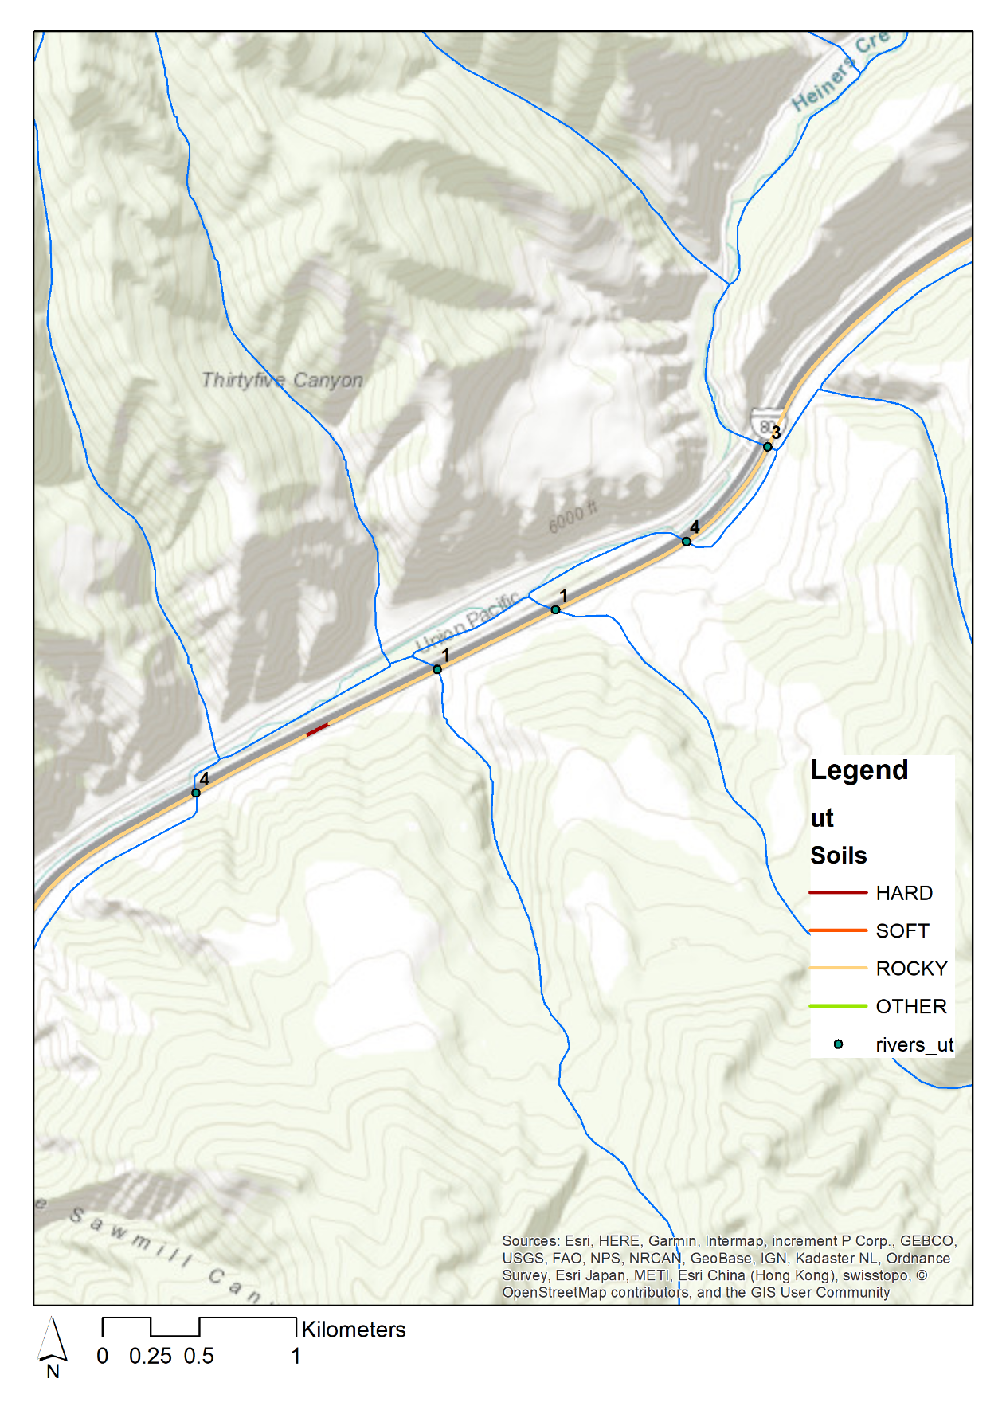
PRA Trial Approach
Determination of Accident Frequencies
Likelihood determination
  Truck accident data (failure frequency of impacts, rollover, drops) for specific route (augmented by national statistics from earlier transportation studies)
  Specific routing information (distances, key features such as bridges, bodies of water)
  Non-truck failure estimation (e.g., human error, containment failure)
Notes:
For determining accident likelihood, three general sources of data are applicable:
The most oblivious is the truck accident data (which can be route-specific and/or general)
Also, route information needs to be compiled about specific features of the route that could be important. Note for example in the figure on the right that the route follows and goes along a river - and the legend shows different hardness's of soils. These feature are important if the accident involves a wreck where the vehicle falls off the road into a body of water or runs into the embankment.
Data is also needed for the estimation of accident frequencies that involve non-road events. This might include loss of containment because the package was not correctly dismantled and loaded, or mechanical failure of a containment feature exasperated by road vibration.

Slide 13
PRA Trial Approach – Determination of Accident Consequences
Consequence analysis will be based on estimating the impact from two sources:
  Direct radiation dose to humans from material that becomes unshielded in a transportation accident
  Radiological dose to a human through possible dose pathways from radiological material that is released
Five Factor formula used to determine source term (e.g., MAR x DR x ARF x RF x LPF)
  Material at risk, Damage ratio, Airborne release fraction, Respirable fraction, Leak path factor
Estimation off these factors will be done for packaged reactor system elements, the TRISO fuel, and compacts holding the fuel particles (expected to be small for TRISO fuel)
  Fuel analysis and testing for transportation is currently limited, and system thermal and impact fragility and testing analysis have not been completed– so initially efforts will use a bounding approach
Estimation of radiological dose will be based on traditional methods for possible dose pathways (e.g., IAEA SSG-26 for transportation packaging, and DOE-STD-3009)
  Such as inhalation dose, direct external radiation dose (gamma and beta), skin contamination, direct gamma and direct beta radiation dose, etc.
Notes:
Determination of consequences can be performed using classical methods for applicable radiological dose pathways as indicated here.
The challenge at this point in time is that analysis and testing for TRISO fuel transportation is currently limited,. Also, analysis and testing (concerning both thermal and fragility limits) have not been completed–for the reactor package - so initial efforts will use bounding approaches

Slide 14
PRA Trial Approach – Modeling Uncertainty Challenges
Fragility of the package to the impacts associated with different road accidents
Mechanisms of release and characterization release fractions
Characterization of material at risk:
    Nongaseous fission products from TRISO fuel and heavy metal contamination damaged an accident,
    Gases from TRISO fuel and heavy metal contamination damaged an accident,
    Radioactive material that has diffused and is held up the compact and other core structures
    Radioactive material that has plated-out in the Primary Cooling system,
    Noble gases in the pressure boundary of cooling system assuming (it’s not evacuated),
    Clean-up system inventory (if applicable),
    Contamination outside the reactor.
    Contamination on and outside the microreactor transportation package
The PRA model provides a means to explore the sensitivity of the modeling uncertainties on the risk results to identify where to focus design, testing, or modelling refinement efforts.
Notes:
This slide introduces the need to address modelling uncertainties.
As described in the last slide, one source of modelling uncertainty that will likely be a challenge for some time is estimating the fragility of the package to the impacts associated with different road accidents. Along with understanding the associated mechanisms of release and determining the applicable release fractions.
To make the situation more complex yet, the material-at-risk exists in different forms as shown in the numbered list. For example: Gaseous and nongaseous fission products from the TRISO fuel itself, radioactive material that has diffused into the compact and other core structures, and radiological material that has plated out in the cooling system. All could become source term.
That said, the PRA model provides a means to explore the sensitivity of the modeling uncertainties on the risk results and can be used to identify where to focus design, testing, or modelling refinement efforts.

Slide 15
Credit or Identification of Compensatory Measures
Specific permitting requirements (e.g., for heavy haul or superloading) vary by state and in some cases may require specific measures that could be considered compensatory measures
Potential compensatory measures that may be credited in the PRA or identified as a defense-in-depth measure such as:
  Real time health/fitness onboard monitoring/diagnostics of reactor package
  Escort the reactor forward and aft for the entire route
  Choose a route that avoids bodies of water (balanced by quality of road)
  Controls for bridges over bodies of water (speed reduction, close bridge to other traffic)
  Avoid shipping during known times of high traffic volume such as at night
  Avoid shipping during severe weather
  Conduct training for emergency responders along the route
PRA provides a means to quantify the potential benefit of specific compensatory measures.
Notes:
Using the Exemption process, compensatory measures will be credited either as separate justification for the exemption or credited in the PRA itself to reduce risk. Compensatory actions could include:
An on-board safety monitoring system
An escort forward and aft
Avoidance of certain road features, or high traffic times, or severe weather.
Again, the PRA provides a way to estimate the risk reduction impact of these features.

Slide 16
Summary
In summary the approach:
  Layouts a feasible regulatory pathway for licensing a first-of-kind transportation of microreactor with irradiated fuel based on risk information
  Proposes a workable risk evaluation guidelines derived from QHGs proposed by NRC for these kinds of activities
  Describes an applicable PRA approach to support the regulatory pathway consistent with the measures used in the proposed risk evaluation guidance
We think the advantages of the approach are:
  Increases the likelihood of successfully obtaining regulatory transportation package approval,
  Can be used to inform the design on the relative risk significance of microreactor containment and shielding, and
  Can be used to inform the need for and identification of transportation compensatory measures
Notes:
So, in summary we have:
Laid out a feasible regulatory pathway for licensing transport a of a microreactor with irradiated fuel based on risk information
Proposed workable risk evaluation guidelines derived from NRC guidance
Described an applicable PRA approach to support the regulatory pathway
We think the advantages of the approach are:
It increases the likelihood of successfully obtaining regulatory package approval,
It can be used to inform the design on the relative risk significance of design features, and
the worth of transportation compensatory measures

