Slide 1
Challenges and Lessons Learned From a PSA on a Spent Fuel Pool Facility

Slide 2
What we do
We actively challenge convention to achieve great things. We believe in working hand in hand with clients to tackle complex and multi-layered challenges head-on. Our deep knowledge and earned expertise is driven by a profound passion for achieving engineering excellence. We improve your operational performance, mitigate risk, optimise cost and facilitate better decision making, in an ever-changing world.
Improve operational performance
Optimise costs
Reduce risk
Informed decision making
www.vysusgroup.com

Slide 3
Overview
Description of the facility
General overview of the PSA
Challenges
Challenges related to long time windows
Challenges related to fire analysis
Lessons learned
Conclusions
Notes:
Challenges: A selected number of challenges encountered during the work with developing the PSA will be discussed in this presentation.
Lessons learned: Example of insights from the PSA that has been of value to other parts of the organization
Conclusions: A short summary

Slide 4
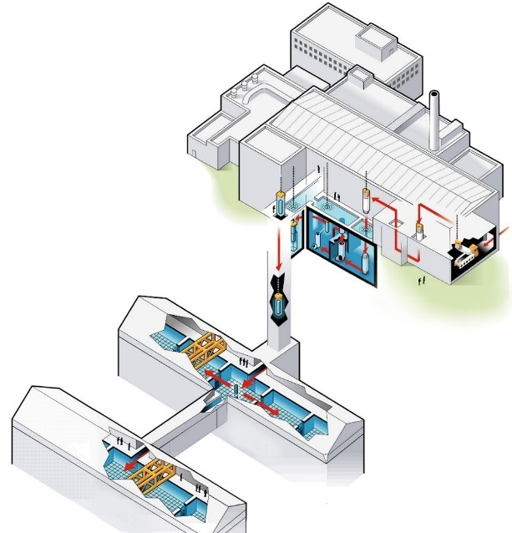
Description of the facility
The facility is a interim storage facility which has the purpose of keeping the spent fuel coming from different NPPs in storage pools before disposal in the final repository.
The fuel is handled mainly in two processes:
Firstly, the spent nuclear fuel arrives and is properly prepared to be placed in the interim storage pool.
Secondly, the interim storage pool itself where the spent fuel is kept cooled and under observation waiting for the final repository.
Notes:
When the transport container with the spent fuel arrives at the facility it must first be cooled down. The transport container is placed in a cooling cell where water cooling systems are connected to the container. Next the transport container is transported via a bridge crane into a pool in which the process of unloading the fuel elements and placing them in a storage canister takes place. The storage canister is transported underground to the long-term storage pools. The fuel is then kept in these pools about 30 meters below ground and covered with eight meters of water.

Slide 5
Overview of the PSA
The development of the PSA was initiated in 2015.
The PSA evaluates the risk both related to the process of the containers´ transport and fuel elements handling, as well as the long-term storage in spent fuel pools.
Relevant initiating events are dependent on where in the facility the fuel is situated.
All different fuel positions are evaluated. The analysis is divided into eight process steps following the fuel on its way through the process.
Internal events, area events and external events are covered.
The consequences studied in the model are
Mechanical damage to fuel
Overheating of fuel
Uncovering of fuel
Boiling
Due to the low grade of automatization and redundancies, the human actions are an important part of the PSA.

Slide 6
Differences SFP vs NPP
Some main differences between a SFP facility and a NPP are
Different initiating events
Different end-states
Division into Level 1 and Level 2 PSA is not applicable
Lower grade of automatization
Lower grade of redundancy/diversity
Longer available time
Repair plays a more important role
Notes:
Aspects are different due to differences in some key aspects of the different facilities. These differences does impact the PSA.

Slide 7
Challenges
Performing a PSA for a spent fuel pool facility provides several different aspects and challenges compared to a NPP PSA.
The representation of various aspects need to have an acceptable level of realism and detail in the PSA.
A few specific challenges encountered along the road developing the spent fuel pool PSA will be discussed. The main topics for these are challenges related to:
Long Time Windows
Fire Analysis

Slide 8
Challenges
Performing a PSA for a spent fuel pool facility provides several different aspects and challenges compared to a NPP PSA.
The representation of various aspects need to have an acceptable level of realism and detail in the PSA.
A few specific challenges encountered along the road developing the spent fuel pool PSA will be discussed:
Long Time Windows
Challenge 1: Mission time
Challenge 2: Modelling repair
Fire Analysis
Challenge 3: Fire ignition frequencies
Notes:
The two first challenges are related to the long time windows associated with sequences in a SPF facility.
The third challenge is on how to assign realistic fire ignition frequencies to the facility.

Slide 9
Challenge 1
What mission time should we assign to our systems in the PSA?
→ The mission time used for most system functions, 30 days, is derived from deterministic criteria. For certain system functions shorter mission times are assumed.
→ It is shown that with such a long mission time it becomes one of the main driving factors of the results.
Normal | Sensitivity Analysis | Difference in frequency for boiling
720 hours | 72 hours | -77 %
720 hours | 360 hours | -42 %
720 hours | 1440 hours | +85 %
Notes:
This question is not so straight forward to give an answer to when you start thinking about it.
First a reminder of what the mission time represents: The mission time is the time we require a component or system to function until we can reach a safe state.
24-48 hours are commonly used in NPP.

Slide 10
Challenge 1 – contd.
Different solutions are evaluated and results from the NPSAG (Nordic PSA Group) research projects PROSAFE (Prolonged Available Time and Safe States) and DIOR (Deeper Investigation of Repairability) are going to provide input to further model development.

Slide 11
Challenge 2 – Modelling of repair
In a facility where there is long available time to take actions and preventive measures it is reasonable to consider and credit repair of component and systems.
Sensitivity analysis indicates that crediting repair and calculated repair probabilities are of great importance to the result.
How can we represent repair and calculate failure probabilities in the PSA?

Slide 12
Challenge 2 – Modelling of repair contd.
Repairs are only considered in sequences leading to consequence boiling of the underground spent fuel pool. Repair is also considered for some initiating events.
Repairs are modelled explicitly in the fault trees and event trees with a probability of failure to repair. Calculations for repair probabilities are based on availability of spare parts and expert judgements on the repair time.
Notes:
These are the sequences where we have very long time windows, normally several days available for repairs.
The sequence is initiated by failure of the operating pump train. The function event MUX is basically a technicality used to exclude unwanted combinations of events as only one sub can be in operation at a time. If the failure is caused by failure of one component where repair is credited, the possibility to repair the initiating event, i.e. the component failure is modelled in function event REPAIR-IE. The function events INITIATING EVENT and REPAIR-IE do in principle have the same input fault tree. The possibility to allow repair in REPAIR-IE is controlled with house events in the fault tree that are set to TRUE in the function event. The input to function events SWITCH SUB and REPAIR are in an analogous manner using the same input fault tree. Crediting repair in the function event REPAIR is managed through activating house events.

Slide 13
Challenge 2 – Modelling of repair contd.
The estimated time to repair a component is compared to the available time. Almost double the required time is available. The probability to fail to perform such a repair is assumed to be 0.01.
Historical failure records for the components are studied as well as what spare parts are available on-site.
Example of estimation of repair failure probability for a pump:
One failure of the historical failure events meant that one particular spare part had to be sent away for repair. Also a few specific parts do not have spare parts on-site. Based on this information it is estimated that 0.05 of the failures are such that no spare parts are available or that the component has to be sent away for repair. The total probability of failure to repair the component can then be calculated:
$$0.05∗1+0.95∗0.01=0.06$$

Slide 14
Challenge 2 – Modelling of repair contd.
The current representation of repair in the PSA is still quite rough.
Different solutions are evaluated and results from the NPSAG (Nordic PSA Group) research projects PROSAFE (Prolonged Available Time and Safe States) and DIOR (Deeper Investigation of Repairability) are going to provide input to further model development.
Notes:
The issue with modelleing repair in this static representation is also connected to the mission time challenge.
For example in PROSAFE we showed that with a semi-dynamic representation of repair, the most contributing sequences will change compares to the static representation. I a semi-dynamic model representation also the mission time issue will be solved, as a mission time is not needed as a model parameter.

Slide 15
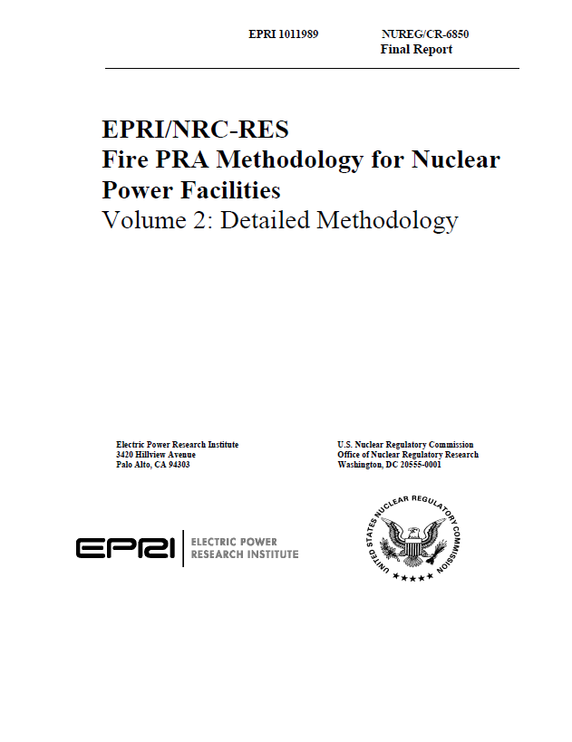
Challenge 3 – Fire ignition frequencies
The compilation of fire ignition frequencies is performed to a great degree in accordance to NUREG/CR-6850
The total fire ignition frequency for one plant is 2.1E-1 per year at full power and 2.8E-1 (BWR) or 2.7E-1 (PWR) per year at shutdown.
In total 37 bins are defined in NUREG/CR-6850. Only 10 out of these are applicable for the SFP facility:
Bin 1 – Batteries
Bin 9 – Air Compressors
Bin 12 – Cable Run
Bin 14 – Electric Motors
Bin 15 – Electrical Cabinets
Bin 18 – Junction Boxes
Bin 21 – Pumps
Bin 23 – Transformers
Bin 25 – Transients (Plant-Wide Components)
Bin 26 – Ventilation Subsystems
Using a methodology developed for NPPs?
Notes:
The challenge was to decide which data to use that was also applicable for a SFP facility, how to justify that not the total fire ignition frequency for NPP was used.

Slide 16
Challenge 3 – Fire ignition frequencies contd.
Excluding bins from the analysis thus means that the total fire ignition frequency for the whole facility will be lower than the generic fire ignition frequency for an NPP in NUREG/CR-6850.
The summed frequency used in the studied facility is 1.15E-1 per year.
This is considered reasonable and even quite conservative considering the differences to this facility compared to an NPP.

Slide 17
Lessons Learned – Insights from the PSA
Even though the spent fuel does not reside very long time in certain positions during its transport, operations in such locations can still contribute with a significant risk.
Improvement of procedures
Identifying sensitive rooms in area events analysis
Notes:
One such important example is when the transport container is transported using the bridge crane between the cooling cell and the fuel unloading pool. This phase does not take very long and the risk of the bridge crane failing and stopping for an extended time is not considered very high. However, in the event of a sudden stop in the bridge crane with the container hanging for several hours, the fuel needs cooling to prevent boiling inside the container. Previously, the only way to provide cooling for the container include moving it to another position with the bridge crane. The PSA showed that the risk from the event that the bridge crane cannot move indeed was significant compared to other risks. The solution was to install a new function which introduced a possibility for the operators to provide emergency cooling to the container while hanging in the bridge crane.
Example: In the case of an initiating event, the operators are meant to follow the appropriate procedure. However, in case repair of components is required, this is performed by maintenance personnel and is not part of the procedures. From HRA performed as part of the PSA for repair actions, how procedures link to necessary maintenance actions such as repair or replacing components after an initiating event has been discussed among the personnel and the procedures were also clarified.
In the flooding analysis, the PSA pointed out a certain room to be sensitive to flooding. Thanks to that insight specific measures were introduced in this room. Hatches near the floor level were installed which can open in case of a flooding incident and thus limit the water levels in the room.

Slide 18
Conclusions
“New” challenges with a SPF PSA to achieve the desired level of realism and detail, compared to a NPP PSA. Some specific challenges encountered during the work on this specific SFP PSA are discussed on the topics:
Long available time
Long mission times
Modelling repair
Using methodology for nuclear power plants
Fire analysis
For some of the identified challenges, tailor made modifications to commonly used methods that usually applies to NPP have been the resolution. For other challenges, reasonable and suitable solutions to further develop and improve the PSA study are still a work in progress.
The PSA has so far contributed with important insights about risk at the facility which have led to plant modifications and other significant improvements in equipment, procedures and training.

Slide 19
Anders Olsson
Principal Consultant / VP Nuclear
+46 (0)70 733 43 08
Anders.Olsson@vysusgroup.com
Frida Olofsson
Senior Consultant
+46 (0)72 019 18 81
Frida.Olofsson@vysusgroup.com

